Slide 1
Machine Learning Algorithms Using Scikit-learn
Model Validation and Hyperparameters

Slide 2
Model Validation
Model validation: process where a trained model is evaluated with a validation data set.
The validation data set is a separate portion of the same data set from which the training set is derived. The main purpose of using the testing data set is to test the generalization ability of a trained model¹.
Model validation is done after training the model.
¹ Alpaydin E (2010) Introduction to machine learning. MIT Press, Cambridge

Slide 3
Model Validation
Model validation: checking how well your model fits a given dataset.
Use a holdout set: hold back some subset of the data from the training of the model and then use it to check the model performance.
It is common to use 80% of the data for training and hold out 20% for testing.
Split the data into 2 sets: training set and test set.
Train your model using the training set, and test it using the test set.

Slide 4
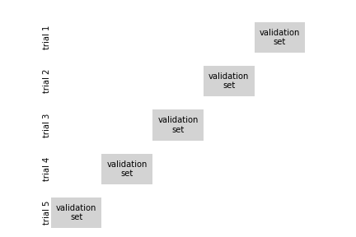
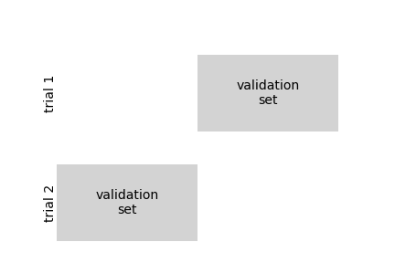
Model Validation
Validation set
- A second holdout set.
- Train multiple models with various hyperparameters using the training set, select the model and hyperparameters that perform best on validation set, perform a single final test set.
Cross-validation
- A common technique to avoid ‘wasting’ too much training data in validation sets.
- Split the training set into complementary subsets, and each model is trained against a different combination of these subsets and validated against the remaining parts.
2-fold cross-validation
5-fold cross-validation
From ‘Python Data Science Handbook’ by Jake Vander Plas.

Slide 5
Model Validation
Scikit-Learn
sklearn.model_selection.train_test_split utility
Parameters
test_size: float, int or None, optional, default=0.25
If float, should be between 0.0 and 1.0 and represent the proportion of the dataset to include in the test split.
If int, represents the absolute number of test samples.
If None, the value is set to the complement of the train size.
train_size: float, int or None, default=None
If float, should be between 0.0 and 1.0 and represent the proportion of the dataset to include in the train split.
If int, represents the absolute number of train samples.
If None, the value is automatically set to the complement of the test size.

Slide 6
Model Validation
Scikit-Learn
sklearn.model_selection.cross_val_score utility
In a utility function greater is better, it’s the opposite of a cost function where lower is better.
Parameters
estimator : estimator object implementing ‘fit’
The object to use to fit the data.
X : array-like
The data to fit. Can be for example a list, or an array.
y : array-like, optional, default: None
The target variable to try to predict in the case of supervised learning.
cv : int, cross-validation generator or an iterable, optional
Determines the cross-validation splitting strategy.
For integer/None inputs, if the estimator is a classifier and y is either binary or multiclass, StratifiedKFold is used. In all other cases, KFold is used.
Scikit-Learn in the cross_validation module implements a number of useful cross-validation schemes that are useful in particular situations.

Slide 7
Model Validation
K-fold cross-validation
It randomly splits the training set into k distinct subsets called folds, then it trains and evaluates the model k times, picking a different fold for evaluation every time and training on the other k-1 folds.
The result is an array containing the k evaluation scores.

Slide 8
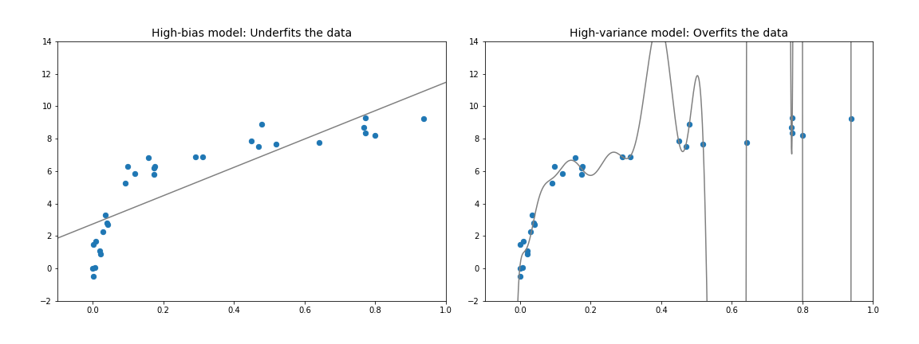
Model Validation
The Bias-Variance Trade-off
How can we find the best model?
These figures represent the same dataset.
- Underfits the data.
- It does not have enough model flexibility to account for all the features in the data.
- The model has high bias.
- Overfits the data.
- It has enough flexibility to account for the fine features in the data, but seems to be reflective of the noise the data.
- The model has high variance.
From ‘Python Data Science Handbook’ by Jake Vander Plas.

Slide 9
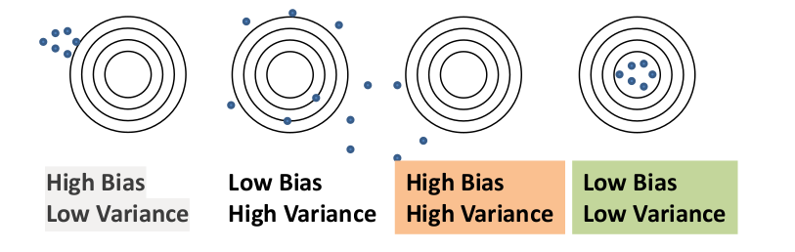
Model Validation
High-bias models: the performance of the model on the validation set is similar to the performance on the training set.
High-variance models: the performance of the model on the validation set is far worse than the performance on the training set.

Slide 10
Model Validation
If a model performs well on the training data but generalizes poorly according to the cross-validation metrics is overfitting.
If the model is overfitting the possible solutions are to simplify the model, constrain it (i.e. regularize it), or get more training data.
If the model performs poorly on both is undefitting.
If the model is underfitting the possible solutions are to use a more complex model, or come up with better features.

Slide 11
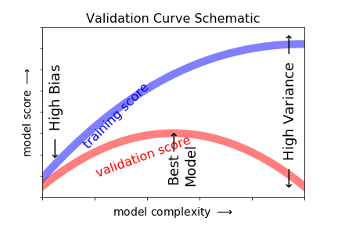
Model Validation
Validation Curves
- The training score is everywhere higher than the validation score. This is generally the case: the model will be a better fit to data it has seen than to data it has not seen.
- In a high-bias model (very low model complexity), the training data is under-fit: the model is a poor predictor both for the training data and for any previously unseen data.
- In a high-variance model (very high model complexity), the training data is over-fit: the model predicts the training data very well, but fails for any previously unseen data.
- For some intermediate value, the validation curve has a maximum. This level of complexity indicates a suitable trade-off between bias and variance.
From ‘Python Data Science Handbook’ by Jake Vander Plas.

Slide 12
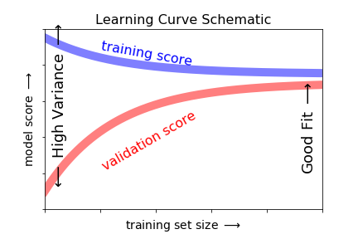
Model Validation
Learning Curves
The optimal model will generally depend on the size of your training data.
To explore the behavior of the model as a function of the number of training points, using increasingly larger subsets of the data to fit our model.
Learning curve: a plot of the training/validation score with respect to the size of the training set (or the training iteration).
To generate these plots train the model several times on different sized subsets of the training set.
From ‘Python Data Science Handbook’ by Jake Vander Plas.

Slide 13
Model Validation
- A model of a given complexity will overfit a small dataset: the training score will be relatively high, while the validation score will be relatively low.
- A model of a given complexity will underfit a large dataset: the training score will decrease, but the validation score will increase.
- A model will never, except by chance, give a better score to the validation set than the training set: this means the curves should keep getting closer together but never cross.
Once you have enough points that a particular model has converged, adding more training data will not help: the only way to increase model performance in this case is to use another (often more complex) model.

Slide 14
Model Validation
Regularization
- Constraining the model to make it simpler and reduce the risk of overfitting.
- i.e. in the linear model there are 2 parameters: θ₀ and θ₁: the learning algorithm has 2 degrees of freedom to adapt the model to the training data.
- The amount of regularization to apply during learning can be controlled by a hyperparameter.
Hyperparameters
- A parameter of the learning algorithm, not of the model so it’s not affected by the learning algorithm itself.
- It must be set prior to training and remains constant during training.
- In machine learning, a hyperparameter is a parameter whose value is set before the learning process begins. Given these hyperparameters, the training algorithm learns the parameters from the data.

Slide 15
Model Validation
Hyperparameter Optimization (or Tuning)
- It is the problem of choosing a set of optimal hyperparameters for a learning algorithm.
- The same kind of machine learning model can require different constraints, weights or learning rates (hyperparameters) to generalize different data patterns.
- Hyperparameter optimization finds a tuple of hyperparameters that yields an optimal model which minimizes a predefined loss function on given independent data.
- Cross-validation is often used to estimate this generalization performance.

