Slide 1
Machine Learning Algorithms Using Scikit-learn
Linear Models

Slide 2
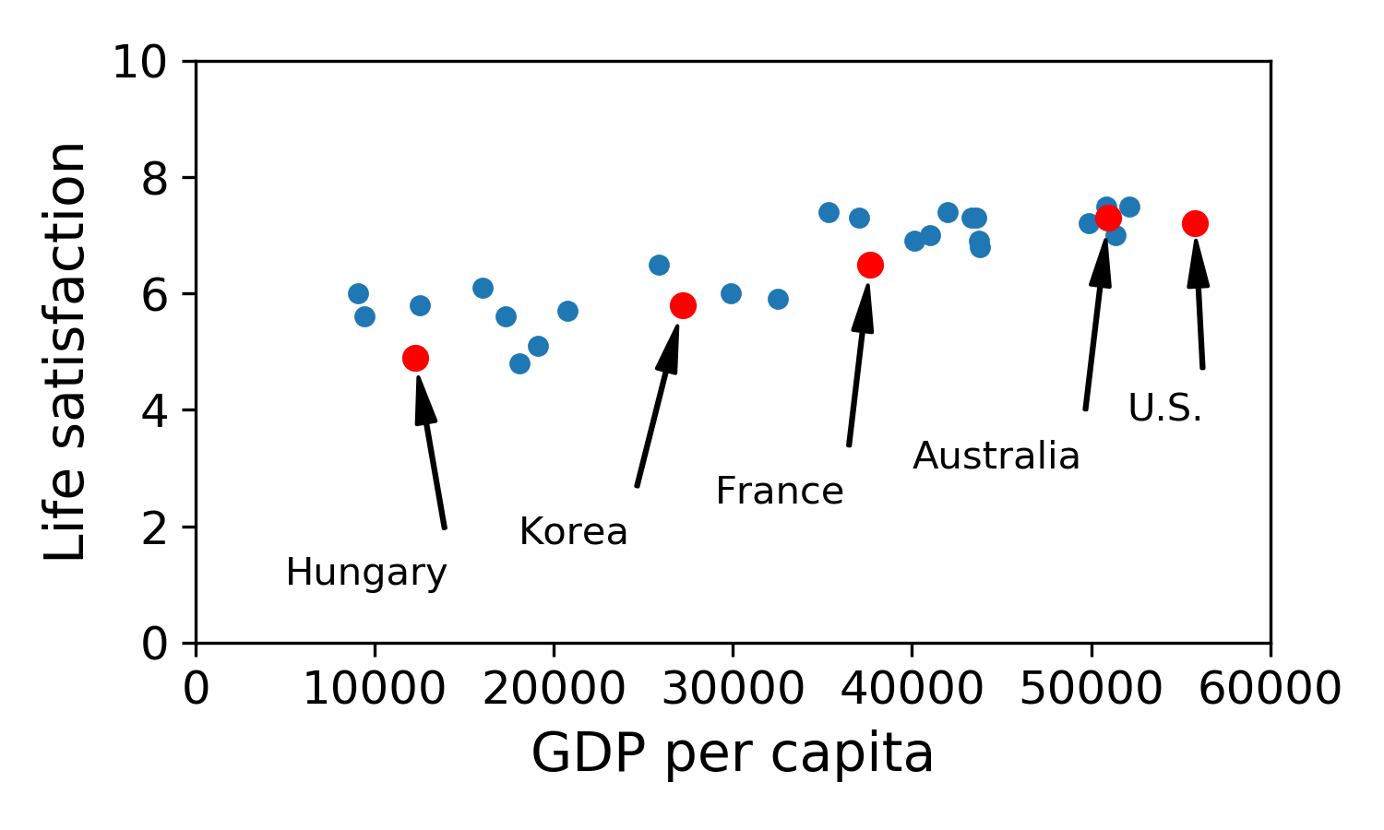
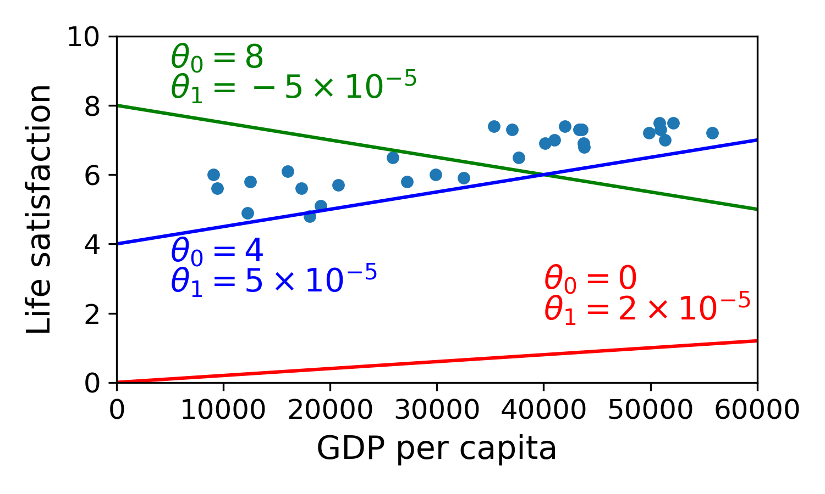
Linear Models
Linear Regression
- In supervised learning, the training data fed to the algorithm includes the desired solutions, called labels. In regression, the labels are continuous quantities.
A simple regression model:
$y=ax+b$
$y=θ_{0}+θ_{1}.GDPpercapita$
a and b are the model’s parameters
a: slope
b:intercept
Adapted from ‘Hands-On Machine Learning with Scikit-Learn and TensorFlow’ by Aurélien Géron.

Slide 3
Linear Models
Linear Regression
Generally, a linear model makes a prediction by simply computing a weight sum of input features, plus a constant called the bias term or intercept term.
Multidimensional linear models of the form:
$\hat{y}=θ_{0}+θ_{1}x_{1}+θ_{2}x_{2}+...+θ_{n}x_{n}$
ŷ: predicted value
n: number of features
i^{th} feature value
$x_{i}:$
j^{th} model parameter (including the bias term and the feature weights )
$θ_{j}:$
$θ_{0}$
$θ_{1},θ_{2},...,θ_{n}$
Geometrically, this is similar to fitting a plane to points in three dimensions, or fitting a hyper-plane to points in higher dimensions.

Slide 4
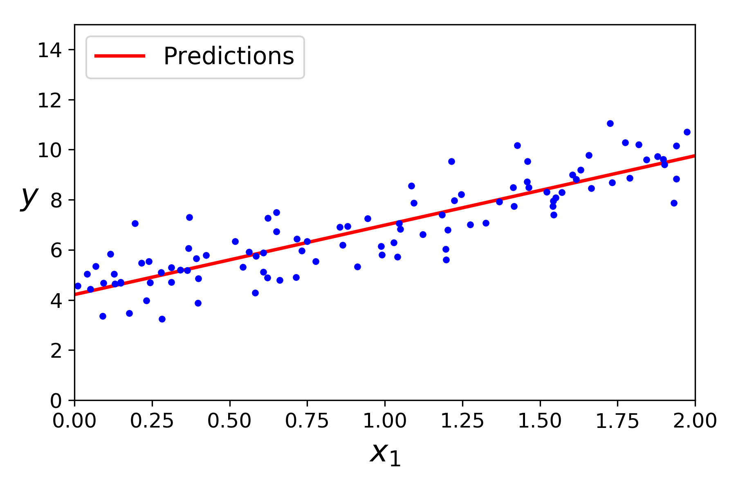
Linear Models
Linear Regression
Mean Square Error (MSE)
- The most common performance measure of a regression model is the Root Mean Square Error (RMSE).
- The square root of the average of squared differences between prediction and actual observation:
$RSME=\sqrt{\frac{\sum_{j=1}^{n}{{\left(y_{j}−\hat{y_{j}}\right)}^{2}}}{n}}$
- To train a Linear Regression Model you need to find the value of that minimizes the RMSE (the cost function).
- In practice, minimize the Mean Square Error (MSE).
$θ$
From ‘Python Data Science Handbook’ by Jake Vander Plas.

Slide 5
Linear Models
Polynomial Regression
- A linear model can be used to fit nonlinear data.
- A simple way to do it is to pass powers of each feature as new features and train the linear model on this set of features.
$y=a_{o}+a_{1}x_{1}+a_{2}x_{2}+a_{3}x_{3}+...$
Transformed to:
$y=a_{0}+a_{1}x+a_{2}x^{²}+a_{3}x^{3}+...$
This is still a linear model, the linearity refers to the fact that the coefficients never multiply or divide each other.
We took the one-dimensional x values and projected them into a higher dimension.

Slide 6
Linear Models
Linear Regression
Scikit-Learn
class sklearn.linear_model.LinearRegression
Parameters
fit_intercept: boolean, optional, default True
Whether to calculate the intercept for this model.
Attributes
coef_: array, shape (n_features, ) or (n_targets, n_features)
Estimated coefficients for the linear regression problem. If multiple targets are passed during the fit (y 2D), this is a 2D array of shape (n_targets, n_features), while if only one target is passed, this is a 1D array of length n_features.
intercept_: array
Independent term in the linear model.

Slide 7
Linear Models
Polynomial Regression
Scikit-Learn
class sklearn.preprocessing.PolynomialFeatures
Parameters
degree : integer
The degree of the polynomial features. Default = 2.
Attributes
degree : integer
The degree of the polynomial features. Default = 2.
PolynomialFeatures transforms the training data, e.g. adding 2nd-degree polynomial of each feature in the training set as new features.

Slide 8
Linear Models
Regularization
A way to reduce overfitting is to regularize the model (e.g. constrain it), having less degrees of freedom.
For example in a polynomial model: reduce the number of polynomial degrees.
Regularization of a linear model is usually achieved by constraining the weights of the model.

Slide 9
Linear Models
Lasso Regression or L₁ Regularization
- Regularized version of Linear Regression.
- A regularization term is added to the cost function (MSE).
- It uses the l₁ norm of the weight vector.
- It penalizes the sum of absolute values (1-norms) of regression coefficients.
- The hyperparameter α controls how much you want to regularize the model:
α = 0: just Linear Regression
α = ++: all weights close to zero, a flat line going through the data’s mean
- Lasso tends to eliminate the weights of the least important features (sets them to zero): automatically performs feature selection and outputs a model with few non-zero feature weights.
- It is important to scale the data before performing Lasso Regression.
$J\left(θ\right)=MSE\left(θ\right)+α\sum_{i=1}^{n}{\left|θ_{i}\right|}$

Slide 10
Linear Models
Ridge Regression or L₂ Regularization
- Regularized version of Linear Regression.
- A regularization term is added to the cost function (MSE).
- It forces the learning algorithm to fit the data and keep the model weights as small as possible.
- The regularization term should only be added to the cost function during training.
- Once the model is trained: evaluate the model’s performance using the unregularized performance measure.
- It penalizes the sum of squares (2-norms) of the model coefficients.
- The hyperparameter α controls how much you want to regularize the model:
α = 0: just Linear Regression
α = ++: all weights close to zero, a flat line going through the data’s mean
- It is important to scale the data before performing Ridge Regression.
$J\left(θ\right)=MSE\left(θ\right)+α\frac{1}{2}\sum_{i=1}^{n}{θ_{i}^{2}}$

Slide 11
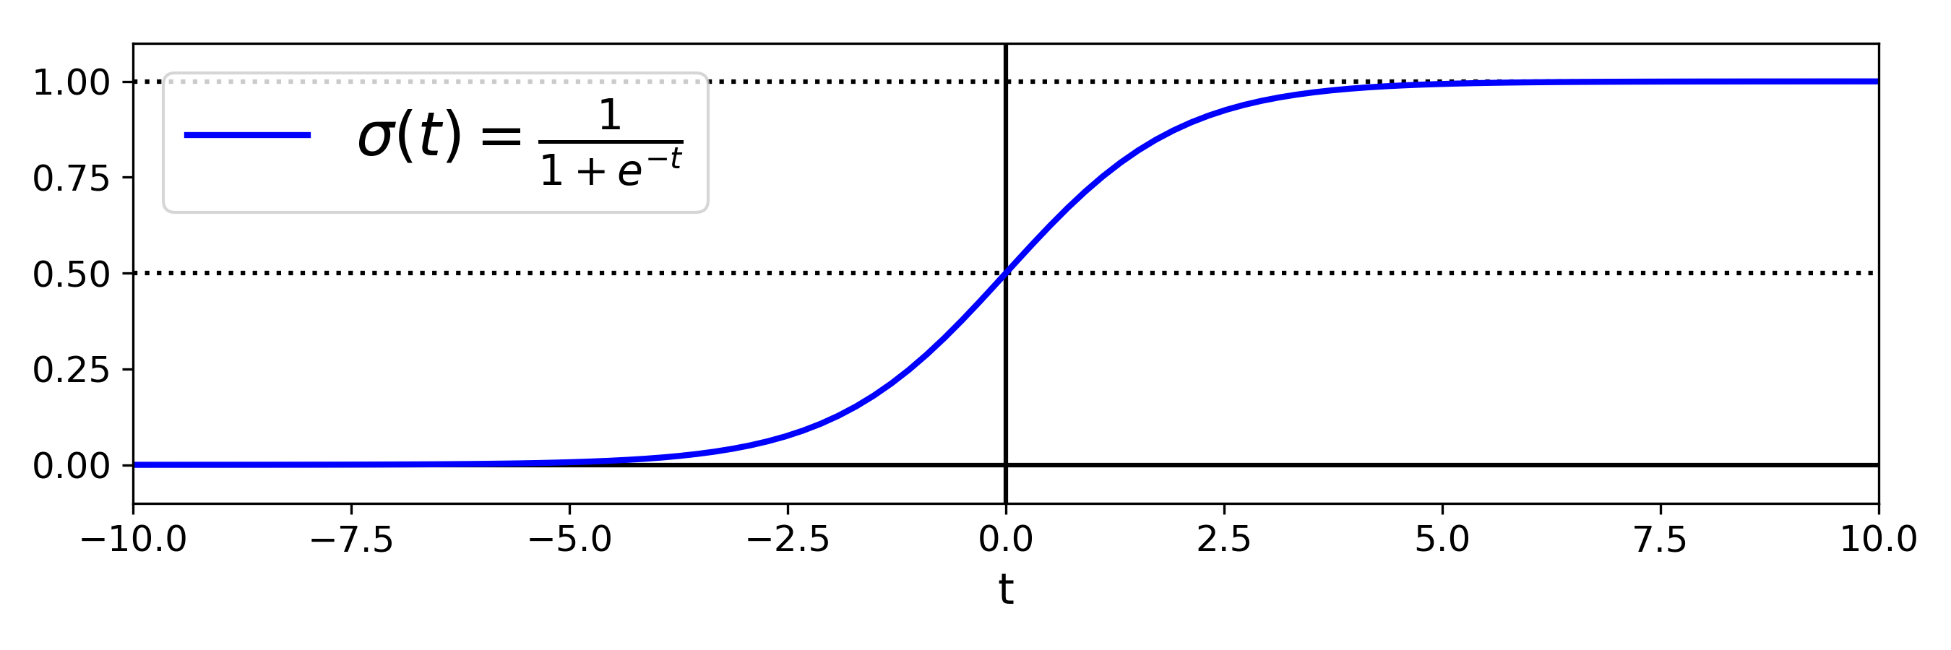
Linear Models
Logistic Regression
- Some regression algorithms can be used for classification as well.
- Estimates the probability that an instance belongs to a particular class (e.g. what is the probability that an email is spam?).
- If the probability is grater that 50% the model predicts the instance belongs to that class (positive class, labeled ‘1’), or else it predicts that not (negative class, labeled ‘0’).
- Computes a weight sum of the input features plus a bias term but instead of outputting the result directly like the Linear Regression does, it outputs the logistic of this result.
- It uses a logistic function to model a binary dependent variable.
Adapted from ‘Deep Learning with Python’ by Francois Chollet.

Slide 12
Linear Models
Logistic Regression
- Cost function for a single instance x:
$\begin{aligned}c\left(θ\right)=\left\{\begin{matrix}−log\left(\hat{p}\right) & ify=1 \\ −log\left(1−\hat{p}\right) & ify=0\end{matrix}\right. \\ where\hat{p}istheestimatedprobabilitythatx\text{belongs}\text{to}thepositiveclass\end{aligned}$
- Cost function over the whole training set is the average cost over all training instances:
$J\left(θ\right)=\frac{−1}{m}\sum_{i=1}^{m}{\left[y^{\left(i\right)}log\left(\hat{p^{\left(i\right)}}\right)+\left(1−y^{\left(i\right)}\right)log\left(1−\hat{p^{\left(i\right)}}\right)\right]}$
There is no known closed-form equation to compute the value of θ that minimizes the cost function.
Gradient Descent can find the global minimum.

Slide 13
Linear Models
Logistic Regression
Regularization
- It can be regularized using L₁ or L₂ penalties.
- The hyperparameter controlling the regularization strength in Scikit-Learn is C:
$C=\frac{1}{α}$
$C=++$
less regularization

Slide 14
Linear Models
Multinomial Logistic Regression or Softmax Regression
- Logistic Regression can be generalized to support multiple classes directly.
- It computes a score for each class and then estimates the probability of each class by applying the softmax function to the scores.
- This classifier predicts the class with the highest estimated probability.
- It predicts one class at a time so it should be used only with mutually exclusive classes.

