Slide 1
Machine Learning Algorithms Using Scikit-learn
Support Vector Machines

Slide 2
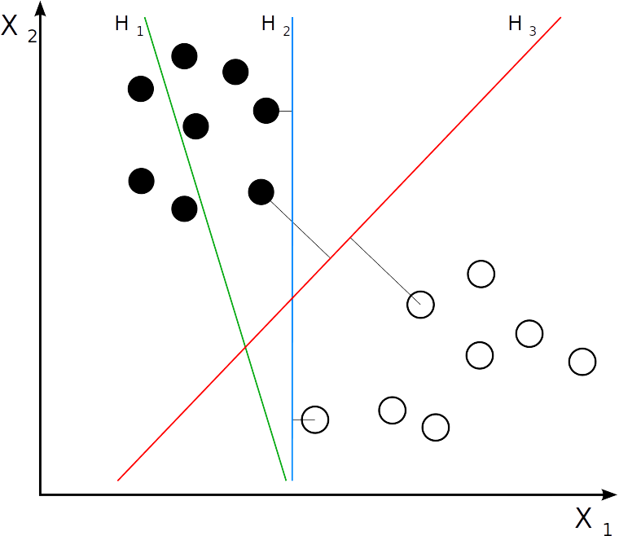
Support Vector Machines (SVM)
SVM
- Supervised learning models capable of performing linear and non-linear regression, classification, regression and outlier detection.
- Good for classification of complex, small- or medium-sized datasets.
- Unlike Logistic Regression classifiers, SVMs classifiers do not output probabilities for each class.
By User:ZackWeinberg, based on PNG version by User:Cyc - from: Svm separating hyperplanes.png, CC BY-SA 3.0, https://commons.wikimedia.org/w/index.php?curid=22877598

Slide 3
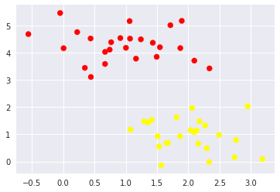
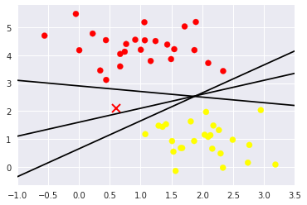
Support Vector Machines (SVM)
SVM
- An SVM model is a representation of the examples as points in space, mapped so that the examples of the separate categories are divided by a gap as wide as possible.
- New examples are then mapped into that space and predicted to belong to a category based on which side of the gap they fall.
- SVMs are sensitive to the feature scales.
- There is more than one line that can discriminate between the two classes.
- Depending on which you choose, a new data point (i.e., "X") will be assigned to a different class.
From ‘Python Data Science Handbook’ by Jake Vander Plas.

Slide 4
Support Vector Machines (SVM)
Linear SVM Classification - Maximizing the Margins
- A margin of some width can be drawn around each line, up to the nearest point.
- The line that maximizes this margin is the one we will choose as the optimal model.
- Maximize the margin: in general the larger the margin the lower the generalization error of the classifier.
- A few of the training points touch the margin: these points are known as the support vectors.
- For the fit, only the position of the support vectors matter; any points further from the margin which are on the correct side do not modify the fit.
- This insensitivity to the exact behavior of distant points is one of the strengths of the SVM model.

Slide 5
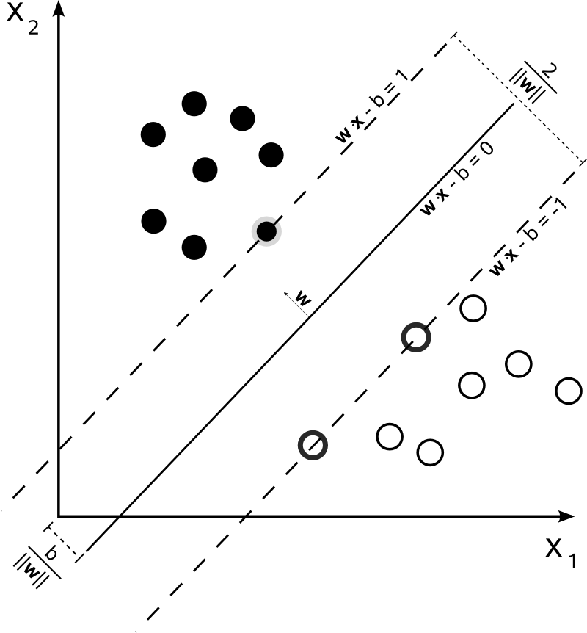
Support Vector Machines (SVM)
By Cyc - Own work, Public Domain, https://commons.wikimedia.org/w/index.php?curid=3566688

Slide 6
Support Vector Machines (SVM)
Linear SVM Classification
- A hyperplane is a line that separates the points in the variable space.
x₂
$\begin{aligned}a_{0}+a_{1}∗x_{1}+a_{2}∗x_{2}=0 \\ wherea_{0}is\text{the}\text{intercept},a_{1}\text{and}a_{2}\text{detrmine}theslope \\ \text{and}x_{1}\text{and}x_{2}aretheinputvariables\end{aligned}$
- Linear SVM can be rephrased as the inner product of two observations.
- The inner products of between two vectors is the sum of the multiplication of each pair of input values:
x₁
$\begin{aligned}f\left(x\right)=a_{0}+\sum{a_{0}}∗\left(x,x_{i}\right) \\ wherexistheinput\text{and}x_{i}thesupportvector\end{aligned}$

Slide 7
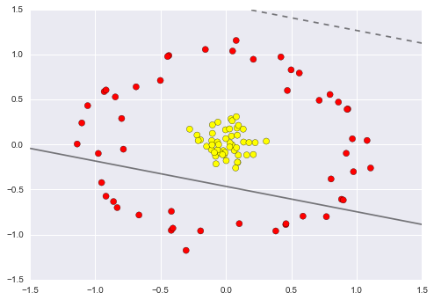
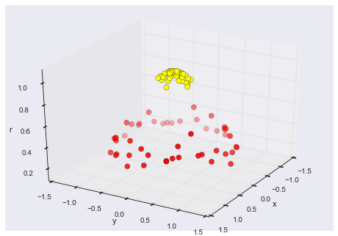
Support Vector Machines (SVM)
Kernel SVM
- Data non-linearly separable: we project the data into higher-dimensional space to fit for non-linear relationships with a linear classifier.
From ‘Python Data Science Handbook’ by Jake Vander Plas.

Slide 8
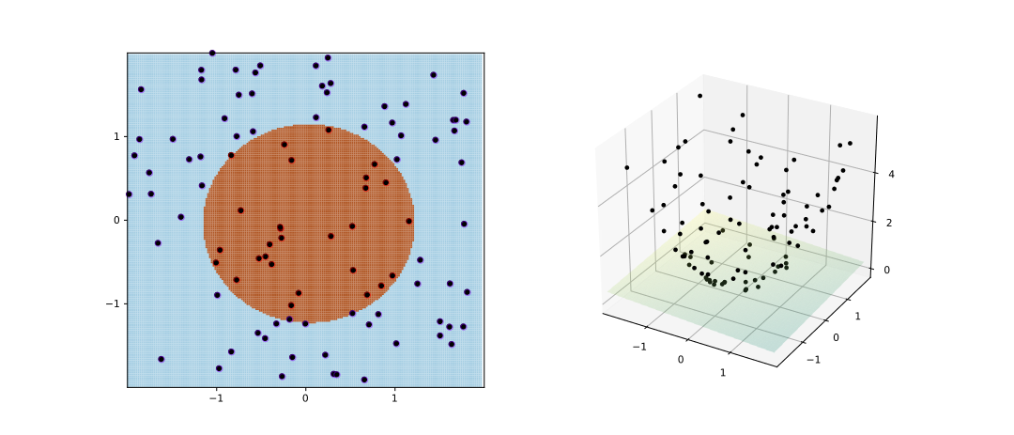
Support Vector Machines (SVM)
Kernel SVM
- Choose and carefully tune the projection to obtain linearly separable results.
- Kernel transformation: compute a basis function centered at every point in the dataset, and let the SVM algorithm go through the results.
- Kernel transformation: basis function transformation based on a similarity relationship (or kernel) between each pair of points.
i.e. Gaussian Radial Basis Function (RBF)
- Kernel trick: projecting N points into N dimensions might become very computationally expensive so a fit on kernel-transformed data can be done implicitly without ever building the full N-dimensional representation of the kernel projection.
$\begin{aligned}K\left(x,x_{i}\right)=\sum{\left(x∗x_{i}\right)} \\ wherethe\text{dot}productiscalledkernel \\ \text{and}definesthedistancebetweentheinputx \\ \text{and}thesupportvectorsx_{i}\end{aligned}$
By Shiyu Ji - Own work, CC BY-SA 4.0, https://commons.wikimedia.org/w/index.php?curid=60458994

Slide 9
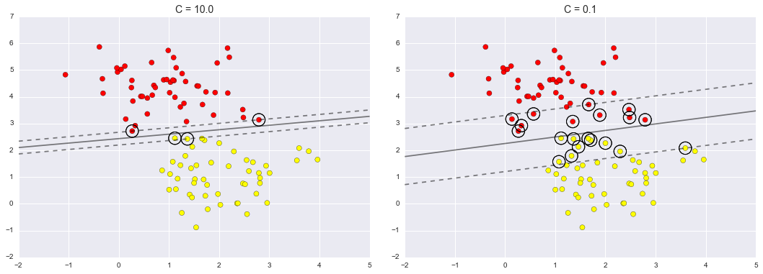
Support Vector Machines (SVM)
Softening Margins - Tuning the SVM
What if the data has some amount of overlap so there is no perfect decision boundary?
- Soften margins: it allows some of the points to creep into the margin if that allows a better fit.
- Parameter C: the hardness of the margin is controlled by the tuning parameter C.
C = ++ hard margin, all instances off the margins
C = --- soft margin
- C can be tuned using cross-validation.
C = 10.0
C = 0.1
From ‘Python Data Science Handbook’ by Jake Vander Plas.

Slide 10
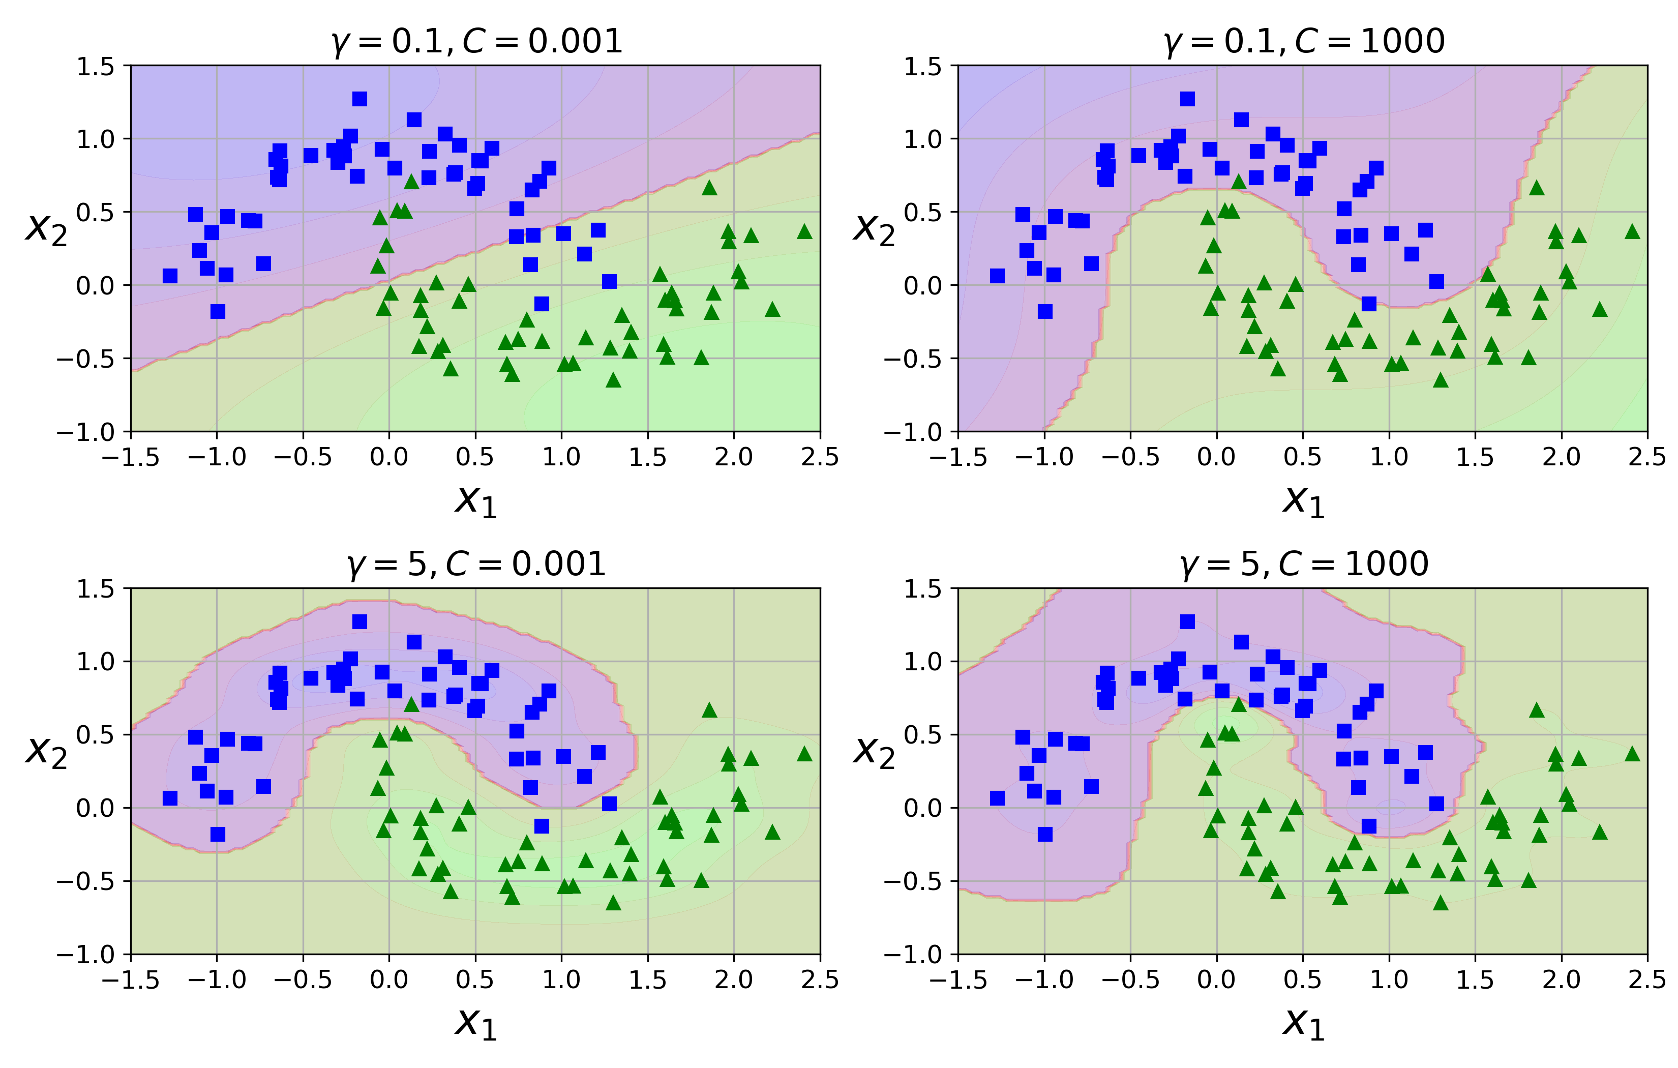
Support Vector Machines (SVM)
Gaussian RBF Kernel
- Hyperparameters C and gamma:
gamma = ++ each instance’s range of influence smaller, decision boundary more irregular
gamma = ---- each instance’s range of influence larger, decision boundary more regular
- C and gamma act like a regularization hyperparameter.
- Other kernels exist: string kernels (e.g. classification of text documents, DNA sequences).
$\begin{aligned}PolynomialKernelSVM \\ K\left(x,x_{i}\right)=1+\sum{{\left(x∗x_{i}\right)}^{C}} \\ whenC=1is\text{the}sameaslinearkernel\end{aligned}$
$\begin{aligned}RadialKernelSVM \\ K\left(x,x_{i}\right)=e^{−gamma∗\sum{\left(x−x_{i}^{2}\right)}}\end{aligned}$
From ‘Hands-On Machine Learning with Scikit-Learn and TensorFlow’ by Aurélien Géron.

Slide 11
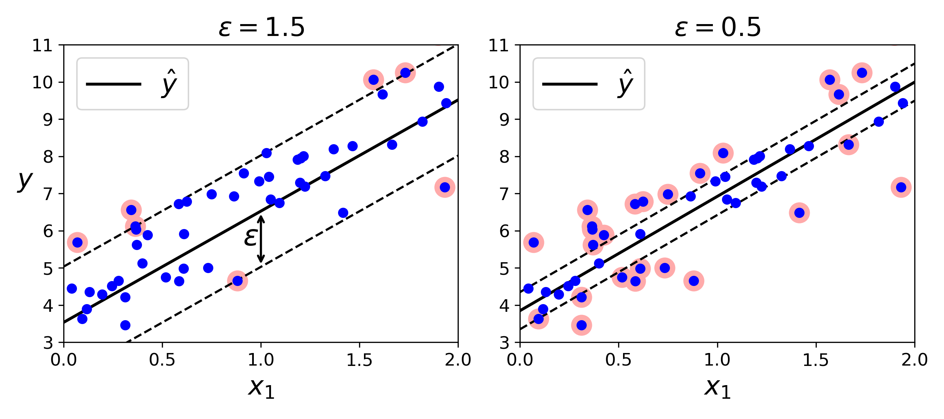
Support Vector Machines (SVM)
SVM Regression
- SVM algorithm supports linear and non-linear regressions.
- SVM regression tries to fit as many instances as possible on the street while limiting instances off the street.
- Hyperparameter ε controls the width of the street.
- Adding training instances within the margins does not affect model’s prediction: the model is ε-insensitive.
From ‘Hands-On Machine Learning with Scikit-Learn and TensorFlow’ by Aurélien Géron.

Slide 12
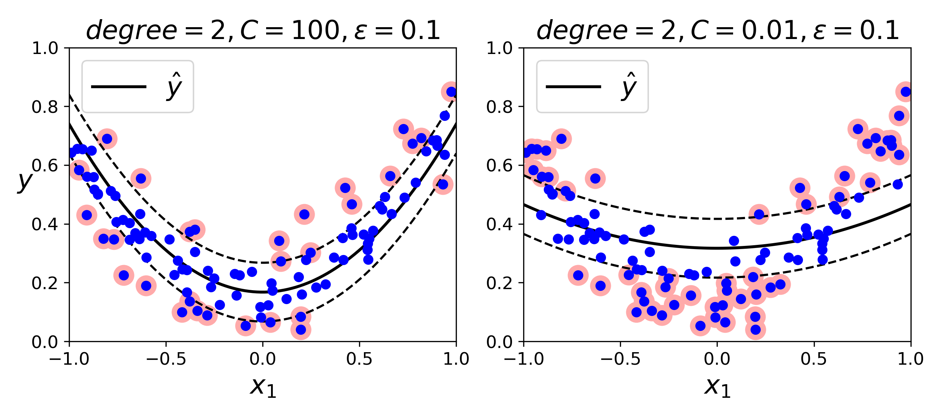
Support Vector Machines (SVM)
SVM Regression
- Non-linear regressions: kernelized SVM model.
- SVM regression tries to fit as many instances as possible on the street while limiting instances off the street.
From ‘Hands-On Machine Learning with Scikit-Learn and TensorFlow’ by Aurélien Géron.

Slide 13
Support Vector Machines (SVM)
Scikit-Learn
class sklearn.svm.LinearSVC
Parameters
loss: float, int or None, optional, default=0.25
Specifies the loss function. ‘hinge’ is the standard SVM loss (used e.g. by the SVC class) .
Set the loss hyperparameter to ‘hinge’.
dual : bool, (default=True)
Select the algorithm to either solve the dual or primal optimization problem. Prefer dual=False when n_samples > n_features.
C : float, optional (default=1.0)
Penalty parameter C of the error term.
multi_class : string, ‘ovr’ or ‘crammer_singer’ (default=’ovr’)
Determines the multi-class strategy if y contains more than two classes.
"ovr" trains n_classes one-vs-rest classifiers, while "crammer_singer" optimizes a joint objective over all classes.

Slide 14
Support Vector Machines (SVM)
Scikit-Learn
- LinearSVC class: center the training set first by subtracting the mean (class:sklearn.preprocessing.StandardScaler) and for better performance set the dual hyperparameter to false unless there are more features than training instances.
- SVC class, SVC(kernel=’linear’) is much slower than LinearSVC(loss=’hinge’).

Slide 15
Support Vector Machines (SVM)
Scikit-Learn
class sklearn.svm.SVC
Parameters
C: float, optional (default=1.0)
Penalty parameter C of the error term.
kernel : string, optional (default=’rbf’)
Specifies the kernel type to be used in the algorithm.
It must be one of ‘linear’, ‘poly’, ‘rbf’, ‘sigmoid’, ‘precomputed’ or a callable.
If none is given, ‘rbf’ will be used.
If a callable is given it is used to pre-compute the kernel matrix from data matrices; that matrix should be an array of shape (n_samples, n_samples).
gamma : float, optional (default=’auto’)
Kernel coefficient for ‘rbf’, ‘poly’ and ‘sigmoid’.

