Slide 1
Machine Learning Algorithms Using Scikit-learn
Decision Trees and Random Forest

Slide 2
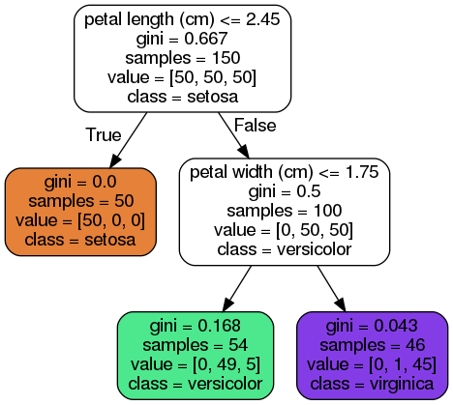
Decision Trees
- Decision Trees ask a series of questions and perform a sequence of branching operations based on comparisons of some quantities.
- They can perform classification and regression tasks and even multioutput tasks (with more than two classes).
- They are capable of fitting complex datasets.
- They don’t require feature scaling or centering, only very little data preparation.
From ‘Hands-On Machine Learning with Scikit-Learn and TensorFlow’ by Aurélien Géron.

Slide 3
Decision Trees
Decision Trees
Root node: depth 0, at the top.
Leaf node: does not have any children nodes, it doesn’t ask any questions.
Samples attribute: counts how many training instances it applies to.
Value attribute: how many training instances of each class the node applies to.
From ‘Hands-On Machine Learning with Scikit-Learn and TensorFlow’ by Aurélien Géron.

Slide 4
Decision Trees
Gini attribute: measures the impurity.
A node is pure (gini=0) if all the training instances it applies to belong to the same class. It is a measure of inequality between nodes.
Gini score in depth-2 left node:
1 – (0/54) ² - (49/54) ² - (5/54) ² ≈ 0.168
p_{i,k}: ration of class k instances among the training instances in the i^{th} node.
$G_{i}=1−\sum_{k=1}^{n}{p_{i,k}^{2}}$
From ‘Hands-On Machine Learning with Scikit-Learn and TensorFlow’ by Aurélien Géron.

Slide 5
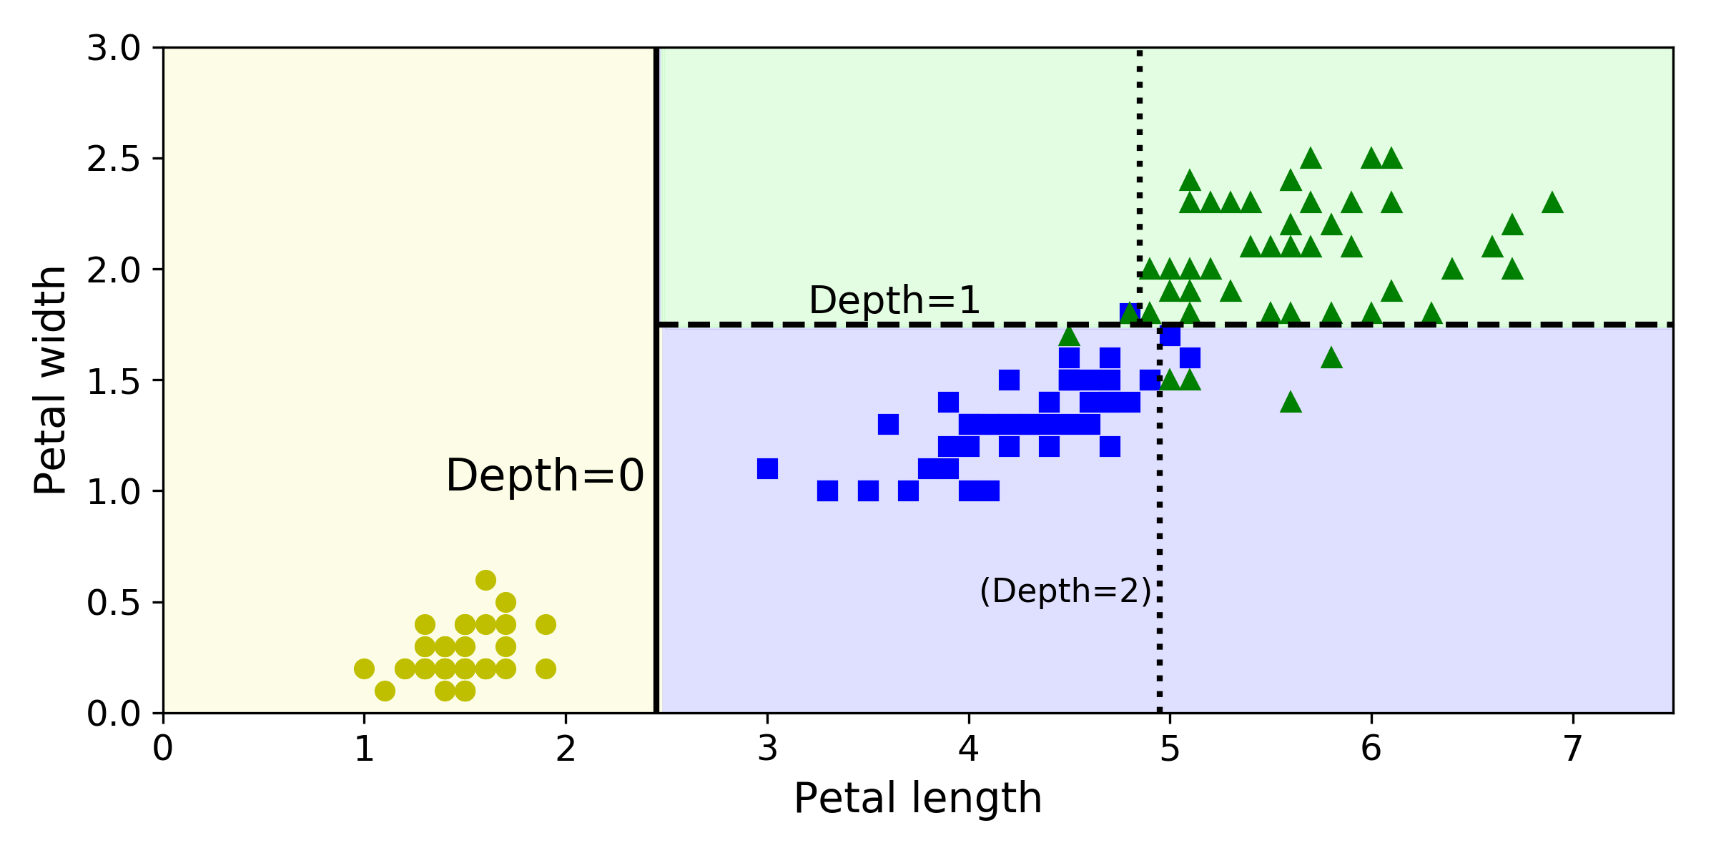
Decision Trees
- Decision Trees are white box models, their decisions are easy to interpret and easy to explain how the predictions were made.
- Decision Trees can also estimate the probability that an instance belongs to a particular class k.
From ‘Hands-On Machine Learning with Scikit-Learn and TensorFlow’ by Aurélien Géron.

Slide 6
Decision Trees
Decision Trees
Decision Trees
CART (Classification and Regression Trees) Algorithm
CART (Classification and Regression Trees) Algorithm
CART (Classification and Regression Trees) Algorithm
- CART algorithm produces only binary trees (the one used by Scikit Learn).
- For classification, while training the model on observations, at each step, pick a feature and split the dataset into two parts based on how best to reduce node impurities at the next lower level.
- As the number of features in each observation increases, it gets more difficult to find and select the right feature, and the right value to split on.
- For regression, the continuous value of the dependent variable can be computed to be the ‘average’ of the other nodes within that leaf node.
- Since the nodes are close in n-dimensional space among the features that matter the most, it is logically similar to perform piecewise linear regression of related or close data (graded by purity) vs performing a global regression.

Slide 7
Decision Trees
CART (Classification and Regression Trees) Algorithm
To reduce variance, a stopping criterion may be used:
1- stop growing the tree at a specific number of leaf nodes (pruning)
2- when leaves contain a certain minimum number of observations.
CART (Classification and Regression Trees) algorithm first splits the training set into two subsets using a single feature k and a threshold t_{k} (e.g. petal length < 2.45 cm ).
It searches for the pair (k, t_{k)} that produces the purest subsets (weighted by their size).
It tries to minimize a cost function:
where:
G_{left/right} measures the impurity of the left/right subset
m_{left/right} is the number of instances in the left/right subset
$J\left(k,t_{k}\right)=\frac{m_{lef}}{m}G_{lef}+\frac{m_{righ}}{m}G_{righ}$

Slide 8
Decision Trees
CART (Classification and Regression Trees) Algorithm
The CART algorithm is a greedy algorithm:
- it greedily searches for an optimum split at the top level, then repeats the process at each level
- it doesn’t check whether or not the split will lead to the lowest possible impurity several levels down
- it produces a good solution, but it’s not guaranteed that it’s the optimal one

Slide 9
Decision Trees
Gini Impurity and Entropy
- A set’s entropy is zero when it contains instances of only one class.
- Most of the time there is no big difference between Gini and entropy.
- Gini impurity is slightly faster to compute.
- When Gini and entropy differ, entropy tends to produce slightly more balanced trees while Gini tends to isolate the most frequent class in its own branch of the tree.
$H_{i}=−\sum_{\begin{aligned}k=1 \\ p_{i≠k}\end{aligned}}^{n}{p_{i,k}}log\left(p_{i,k}\right)$
p_{i,k}: ration of class k instances among the training instances in the i^{th} node.

Slide 10
Decision Trees
Regularization Hyperparameters
- Nonparametric model: Decision Trees make few assumptions about the training data, the number of paramters is not determined prior to training.
- Regularization: to avoid overfitting the training data, it is necessary to restrict the freedom during training.
- Regularization: restrict the maximum depth of the Decision Tree (e.g. Scikit Learn max_depth hyperparameter).

Slide 11
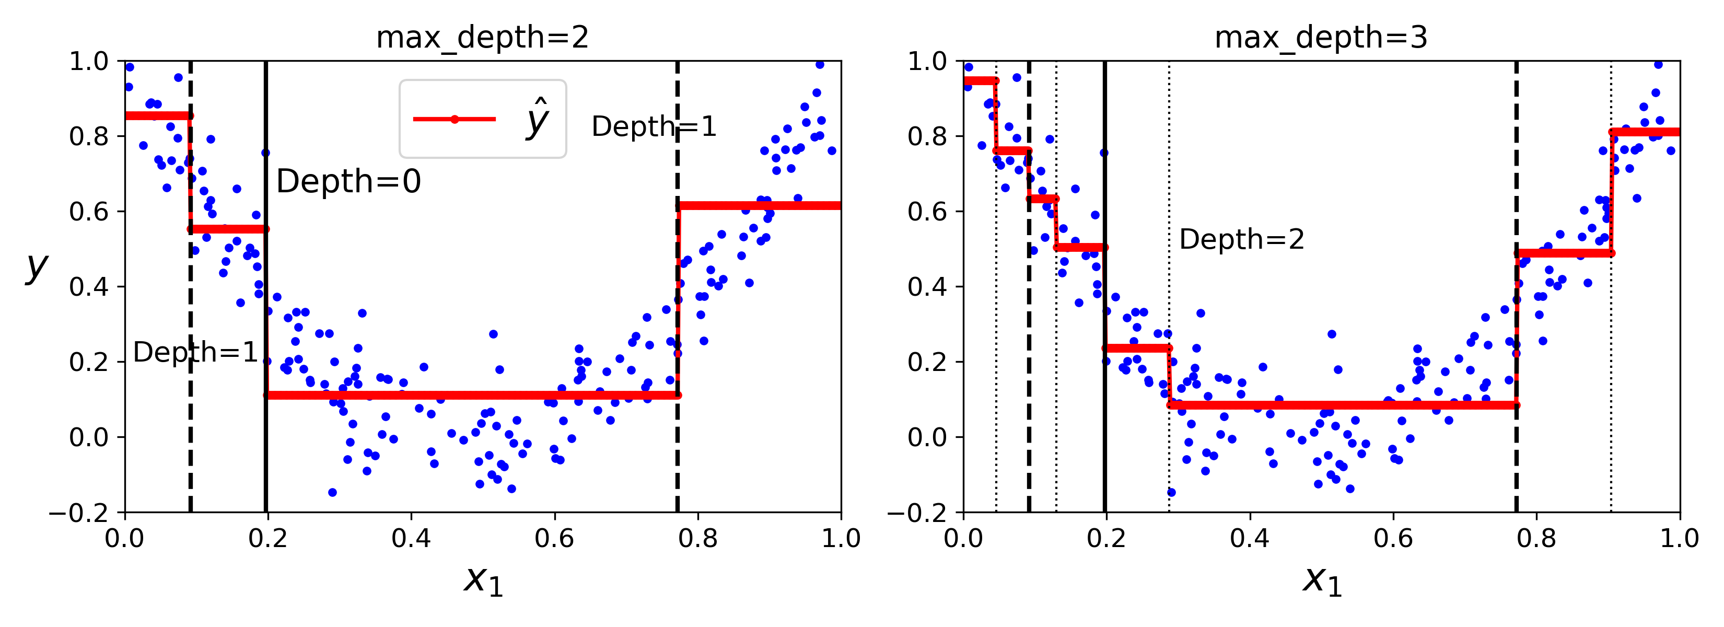
Decision Trees
Regression
- It predicts a value in each node instead of a class.
- The predicted value for each region is always the average target value of the instances in that region.
- The CART algorithm splits the training set in a way that minimizes the MSE.
The cost function is:
where:
$J\left(k,t_{k}\right)=\frac{m_{lef}}{m}{MSE}_{lef}+\frac{m_{righ}}{m}{MSE}_{righ}$
${MSE}_{node}=\sum_{i∈node}{{\left(\hat{y_{node}}−y^{\left(i\right)}\right)}^{2}}$
$\hat{y_{node}}=\frac{1}{m_{node}}\sum_{i∈node}{y^{\left(i\right)}}$
From ‘Hands-On Machine Learning with Scikit-Learn and TensorFlow’ by Aurélien Géron.

Slide 12
Decision Trees - Ensemble Learning and Random Forest
- If you aggregate the predictions of a group of predictors, better predictions than with the best individual predictor are often obtained.
- A group of predictors is called an ensemble.
- Random Forest: a group of Decision Trees classifiers (or regressors), each trained on a different random subset of the training set.
- For predictions you obtain the predictions of all individual trees and then predict the class that gets majority of votes (or the average for regression).
- Random Forest: each predictor will be trained on a random subset of the input features.
- Random Forest: instead of searching for the very best feature when splitting a node, it searches for the best feature among a random subset of features.

Slide 13
Decision Trees - Ensemble Learning and Random Forest
Random Forest
- At each node only a random subset of the features is considered for splitting.
- Each tree in the ensemble is built from a sample drawn with replacement (i.e., a bootstrap sample) from the training set.
- Feature importance: Random Forest measures the relative importance of each feature.
In Scikit Learn: how much the tree nodes that use that feature reduce impurity on average across all trees in the forest. It is a weight average, where each nodes weight is equal to the number of training samples that are associated with it (feature_importances_ variable).

Slide 14
Decision Trees - Ensemble Learning and Random Forest
Random Forest
Advantages
- Both training and prediction are very fast, because of the simplicity of the underlying decision trees.
- The multiple trees allow for a probabilistic classification: a majority vote among estimators gives an estimate of the probability (accessed in Scikit-Learn with the predict_proba() method).
- The nonparametric model is extremely flexible, and can thus perform well on tasks that are under-fit by other estimators.
Disadvantages
- The results are not easily interpretable.

Slide 15
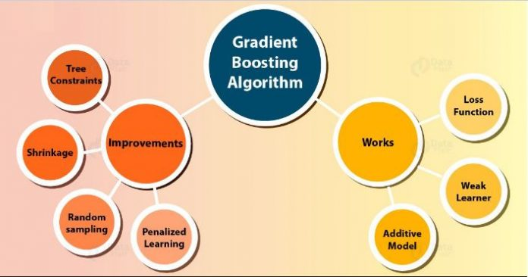
Decision Trees – Gradient Boosting
- It produces a prediction model in the form of an ensemble of weak prediction models i.e. decision trees, especially CART trees of a fixed size.
- Models are add sequentially until no further improvements can be made.
- It allows optimization of a diffentiable loss function with gradient descent.
https://www.fromthegenesis.com/exploring-xg-boost-extreme-gradient-boosting/

Slide 16
Decision Trees – XGBoost
- It allows optimization of a diffentiable loss function with gradient descent with a regularization term that penalizes the complexity of the model.
- Shrinkage as regularization method: adds a term with a learning rate.
- Stochastic gradient boosting: it uses row, feature (column), or column per split level subsampling (like Random Forest).
- It comes with built-in cross-validation method at each iteration.
- The algorithm is aware of sparcity.
- It is faster than other ensemble classifiers.
- It is parallelizable onto GPU’s.
http://arogozhnikov.github.io/2016/07/05/gradient_boosting_playground.html

