Slide 1
Machine Learning Algorithms Using Scikit-learn
Dimensionality Reduction

Slide 2
Dimensionality Reduction
- When there are many features (e.g. thousands or millions) for each training instance it makes training slow and it could be hard to find a good solution.
- Reducing dimensionality of the training set before training a model speeds up training.
- Reducing dimensionality does reduce information.
- It is useful for data visualization.

Slide 3
The Curse of Dimensionality
- High-dimensional datasets are risk of being very sparse: most training instances are far away from each other making predictions less reliable since they will be based on larger extrapolations.
- Sparsity is a problem for statistical significance, the amount of data needed to support the result often grows exponentially with the dimensionality.

Slide 4
Approaches for Dimensionality Reduction
1- Projection
2- Manifold Learning

Slide 5
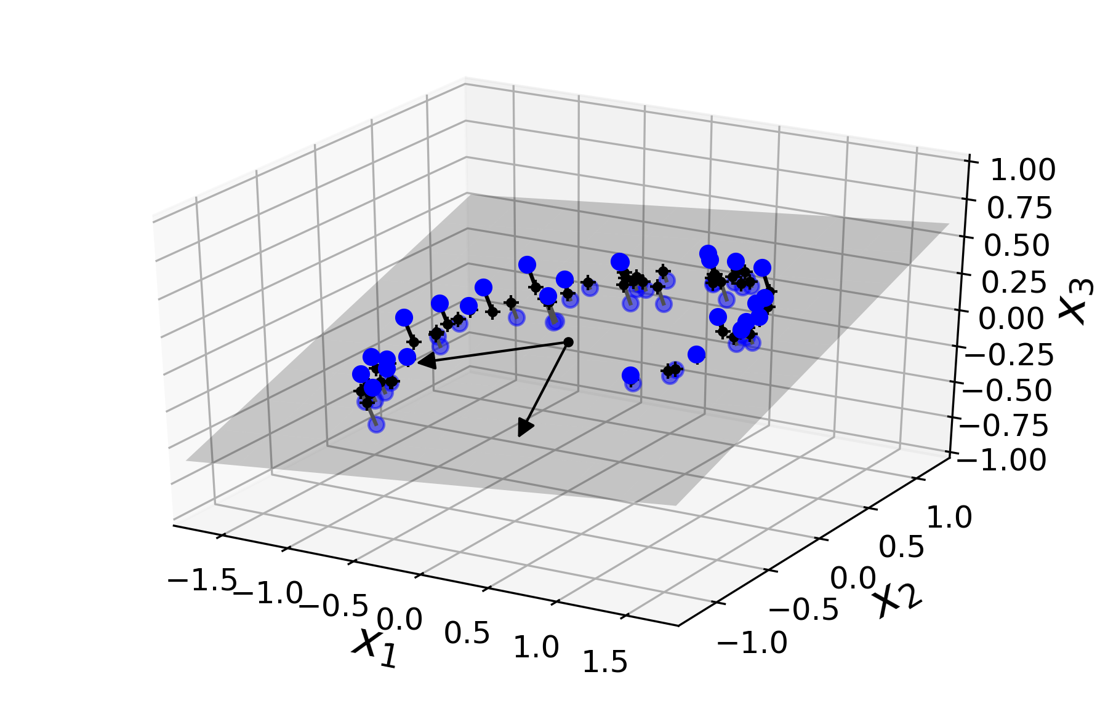
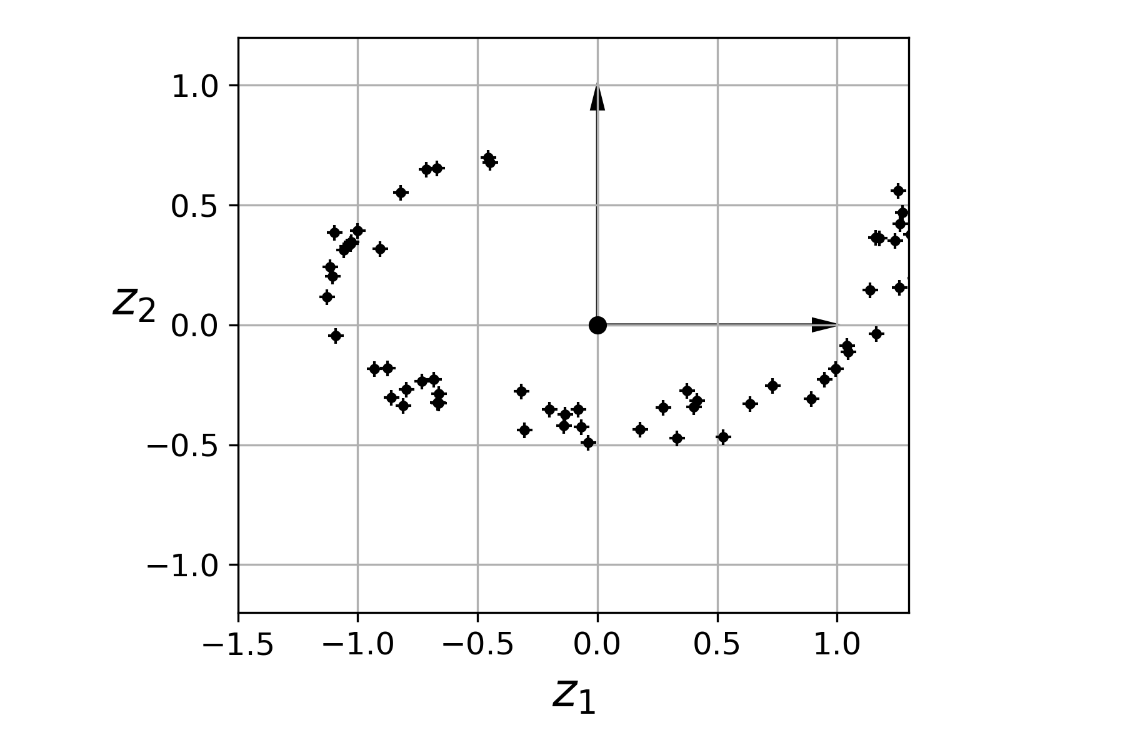
Approaches for Dimensionality Reduction
1- Projection
- In real world-problems, training instances are not spread out uniformly across all dimensions.
- Then, training instances lie within a lower-dimensional subspace of the high-dimensional space.
Before projection
After projection
From ‘Hands-On Machine Learning with Scikit-Learn and TensorFlow’ by Aurélien Géron.

Slide 6
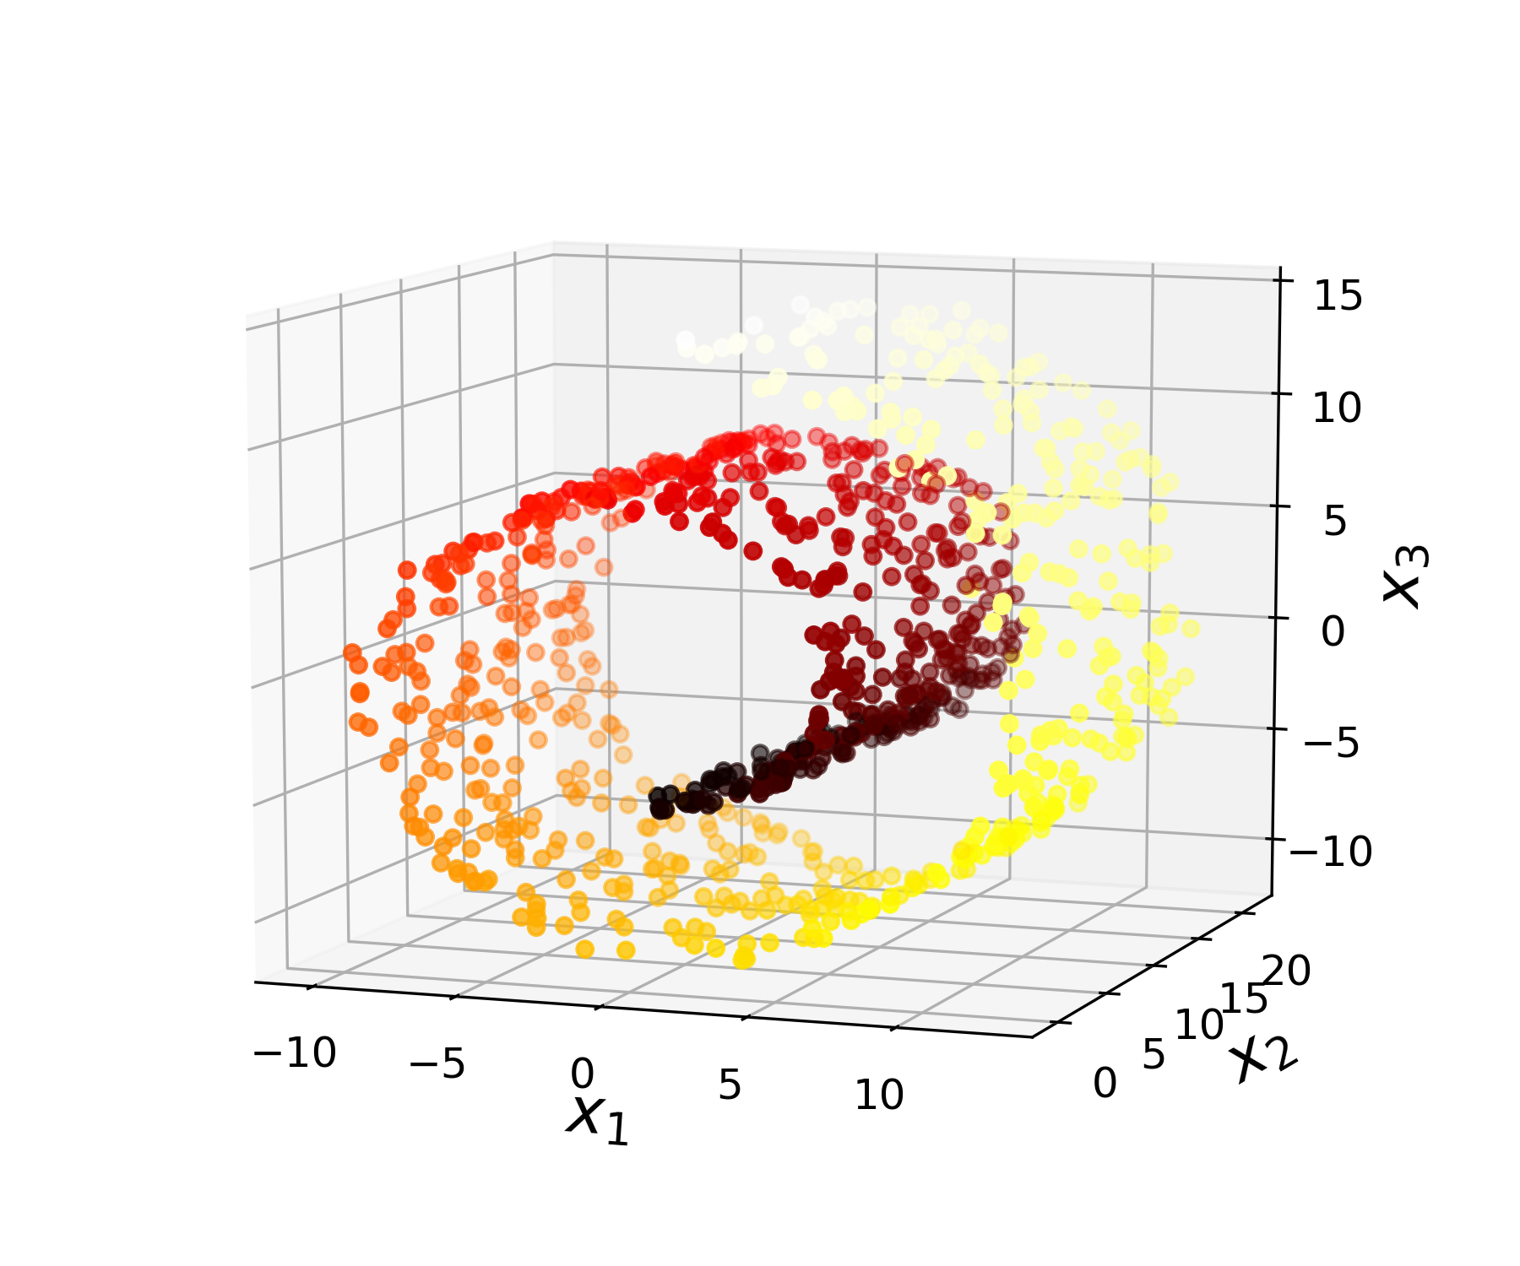
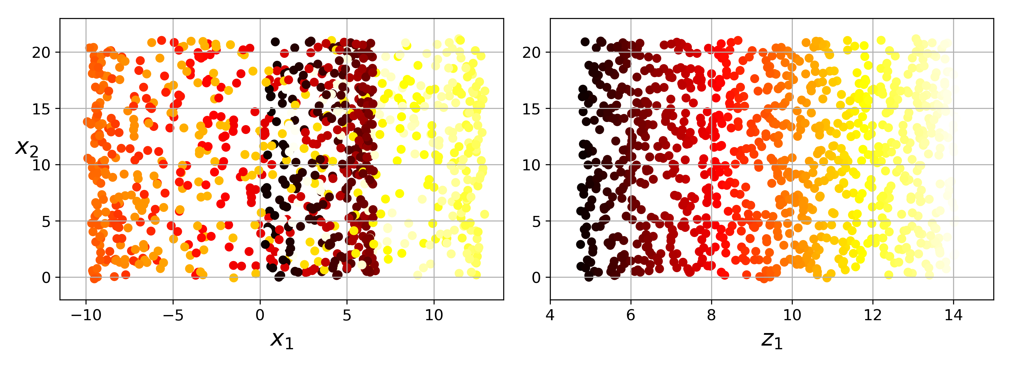
Approaches for Dimensionality Reduction
2- Manifold Learning
- In cases where the subspace twists or turns.
- A d-dimensional manifold is part of an n-dimensional space (where d < n) that locally resembles a d-dimensional hyperplane.
Projection
Unrolling
From ‘Hands-On Machine Learning with Scikit-Learn and TensorFlow’ by Aurélien Géron.

Slide 7
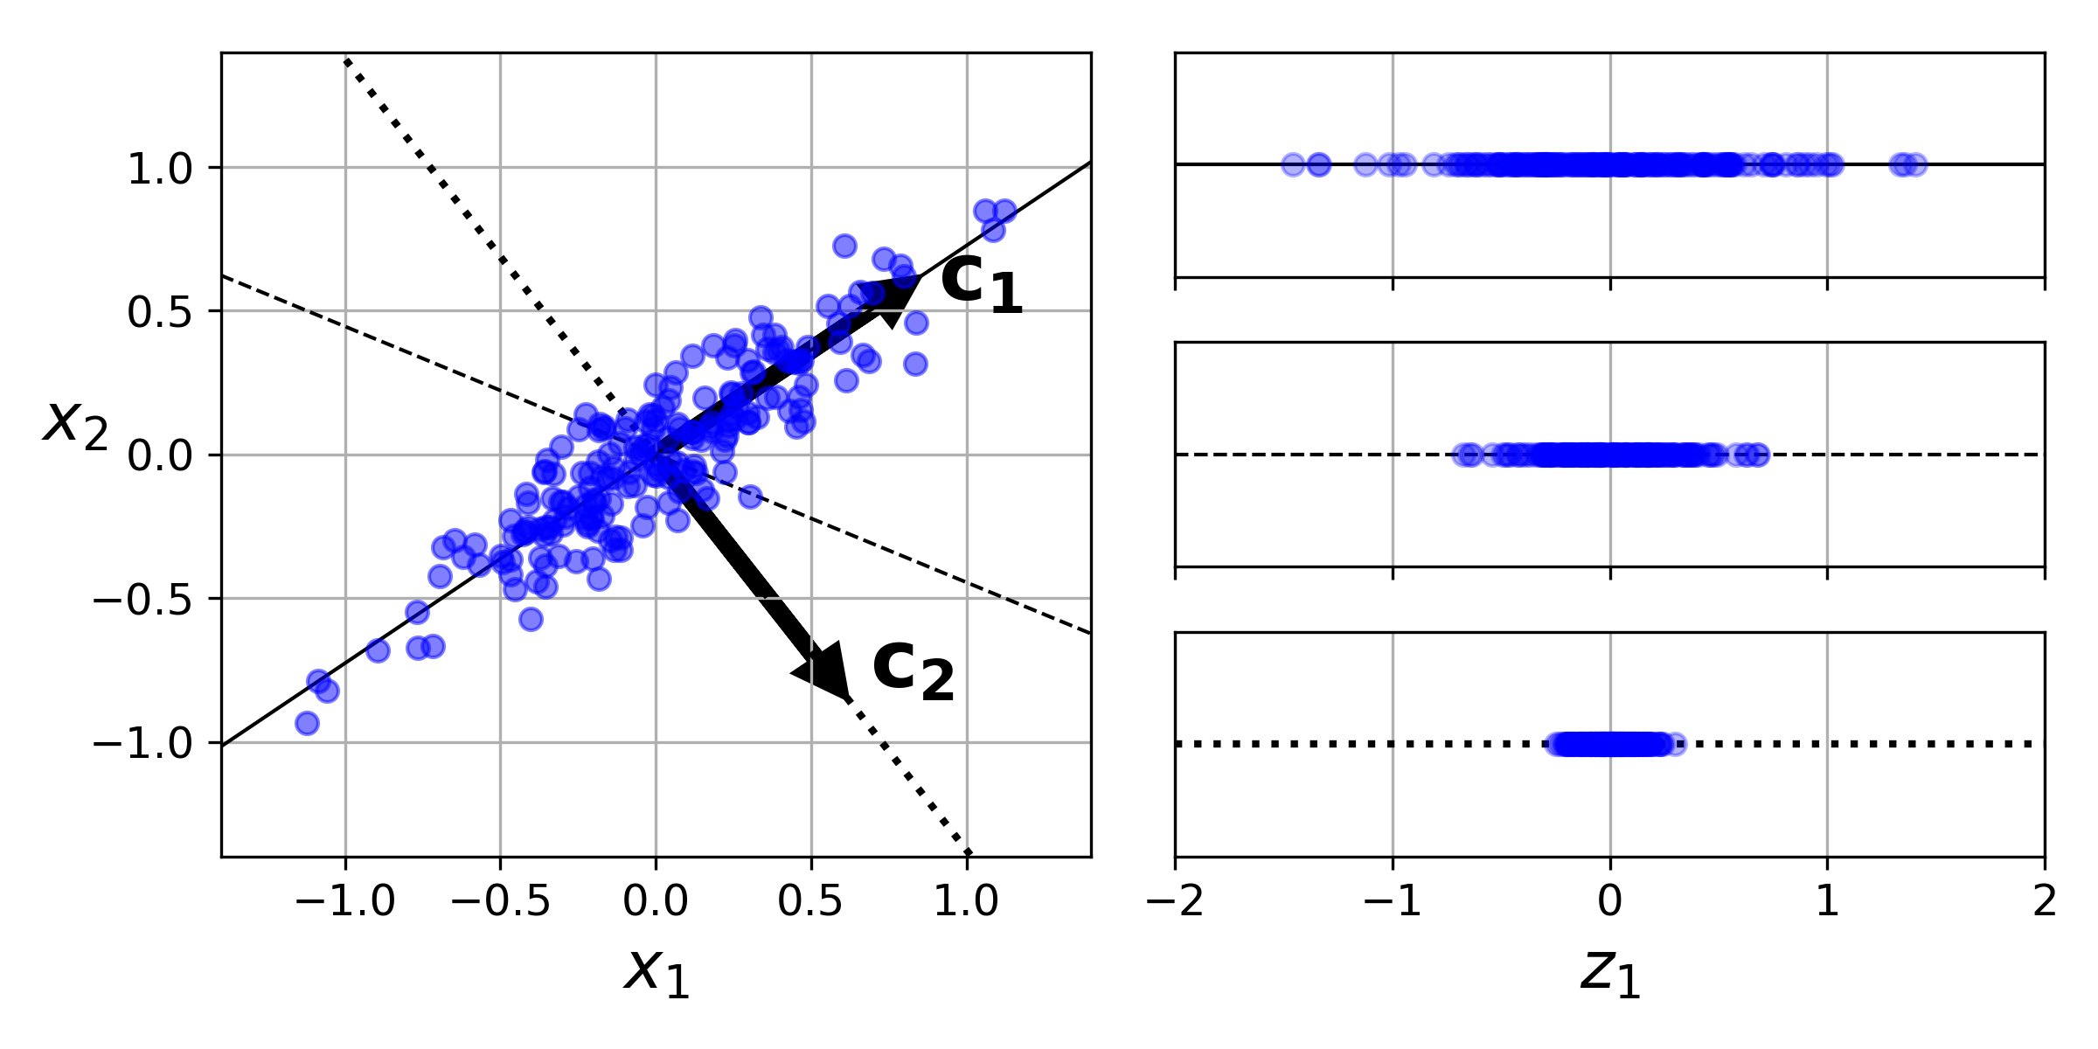
Principal Component Analysis(PCA)
- Unsupervised method for dimensionality reduction of the data
- Identifies the hyperplane that lies closest to the data.
- Then, it projects the data onto it.
- Selects the projection that preserves the maximum amount of variance (the axis that minimizes the mean squared distance between the original dataset and its projection onto that axis).
$X_{dproj}=X.W_{d}$
X: matrix training set
W_{d}: matrix containing the first d principal components
This projects the training set onto the space defined by the principal components.
From ‘Hands-On Machine Learning with Scikit-Learn and TensorFlow’ by Aurélien Géron.

Slide 8
Principal Component Analysis(PCA)
Principal Components
- PCA identifies the axis that accounts for the largest amount of variance in the training set.
- PCA finds a second axis, orthogonal to the first one, that accounts for the largest amount of remaining variance.
- PCA would also find a third axis, orthogonal to the both previous axis, etc.
- The unit vector that identifies the i^{th} axis is called principal component.
- PCA assumes that the dataset is centered around the origin. Scikit-Learn’s PCA classes centers the data.

Slide 9
Principal Component Analysis(PCA)
Scikit-Learn
- After fitting PCA transformer to the dataset, the principal components can be accessed using components_ variable (the first one: pca.components_T[:, 0]).
- Explained variance ratio of each principal component: the proportion of the dataset’s variance that lies along the axis of each principal component, explained_variance_ratio_ variable.

Slide 10
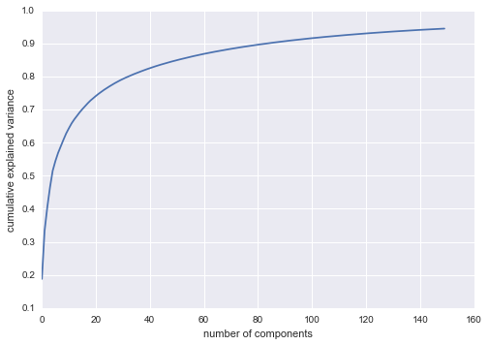
PCA (Principal Component Analysis)
Choosing the Right Number of Dimensions
- It is generally useful to choose the number of dimensions that add up to a large proportion of the variance (i.e. 95%).
- In case of data visualization the dimensionality is usually reduced to 2 or 3 dimensions.
- Scikit_Learn: set n_components to a float between 0.0 and 1.0, indicating the ratio of variance to preserve, PCA(n-components=0.95).
- Plot the explained variance as a function of the number of dimensions.
Explained variance
n° of components / dimensions
From ‘Python Data Science Handbook’ by Jake Vander Plas.

Slide 11
Principal Component Analysis(PCA)
PCA for Compression
- After dimensionality reduction, the training set takes up much less space.
- Speeds up an algorithm like SVM.
- It’s possible to decompress the reduced dataset by applying the inverse transformation of the PCA.

Slide 12
PCA (Principal Component Analysis)
Disadvantages
- PCA tends to be highly affected by outliers in the data.
- PCA assumes that the principle components are a linear combination of the original features.
- PCA assumes that the principle components are orthogonal.
- PCA uses variance as the measure of how important a particular dimension is. So, high variance axes are treated as principle components, while low variance axes are treated as noise.

Slide 13
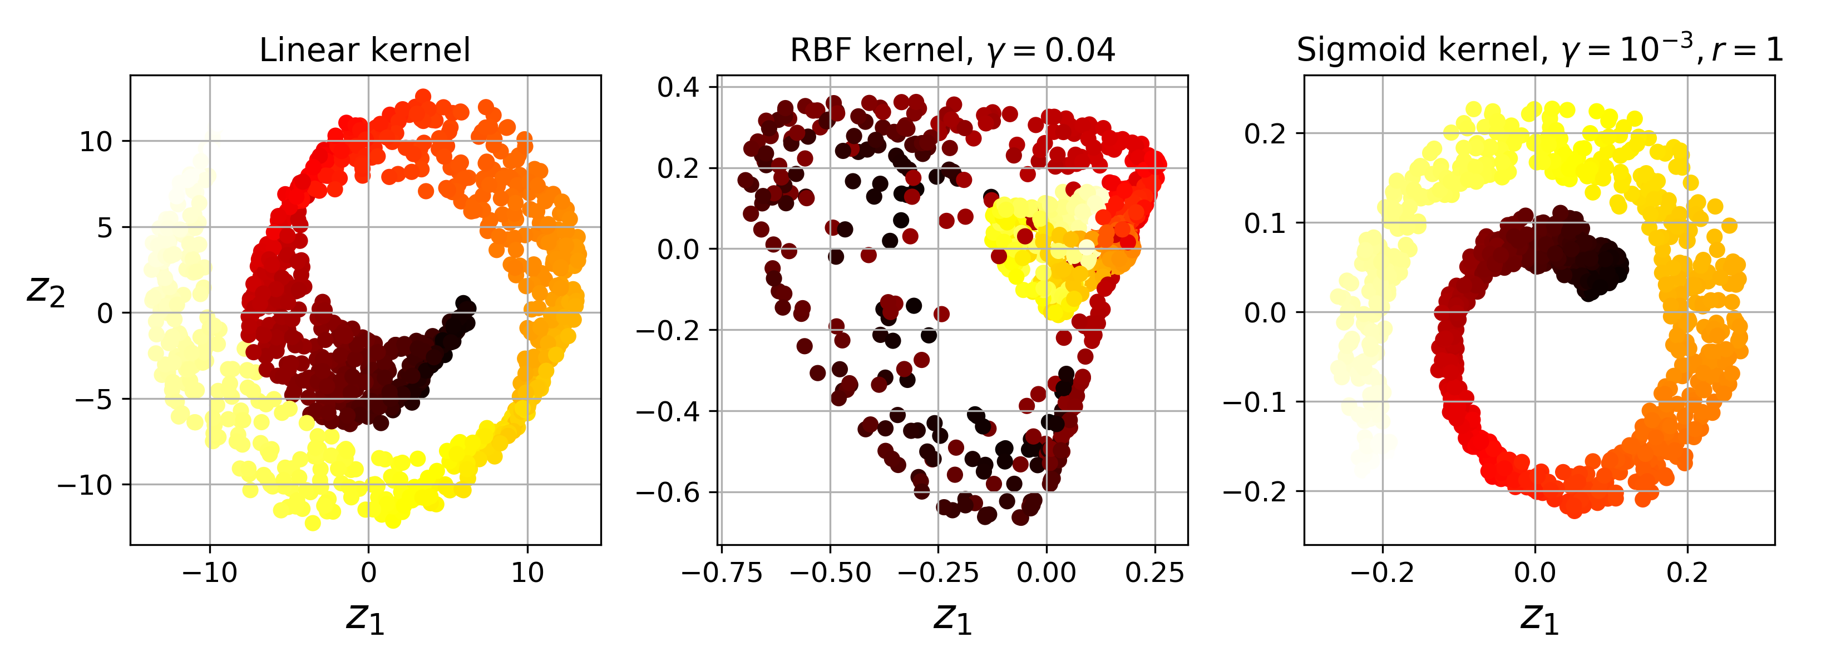
Kernel PCA
- To perform complex nonlinear projections for dimensionality reduction.
- Kernel trick: technique that implicitly maps instances into a very high-dimensional space to perform complex nonlinear projections for dimensionality reduction.
- Good at preserving clusters of instances after projection or even unrolling datasets.
PCA
From ‘Hands-On Machine Learning with Scikit-Learn and TensorFlow’ by Aurélien Géron.

Slide 14
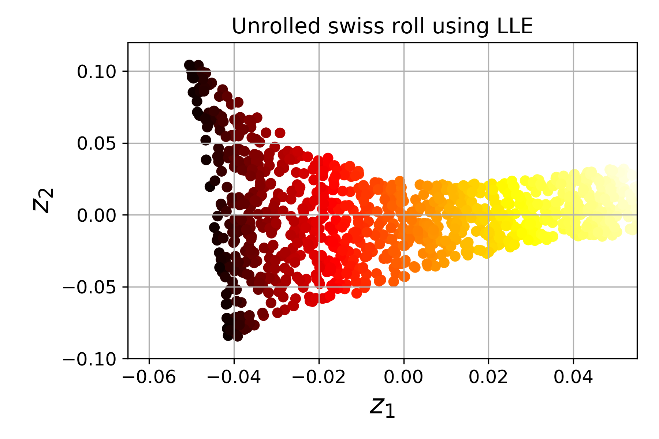
Locally Linear Embedding (LLE)
- Non-linear dimensionality reduction technique.
- Manifold Learning technique that does not rely on projections.
- LLE first measures how each training instance linearly relates to its closest neighbors, then looks for a low-dimensional representation of the training set where the local relationships are best preserved.
- Good at unrolling twisted manifolds.
From ‘Hands-On Machine Learning with Scikit-Learn and TensorFlow’ by Aurélien Géron.

Slide 15
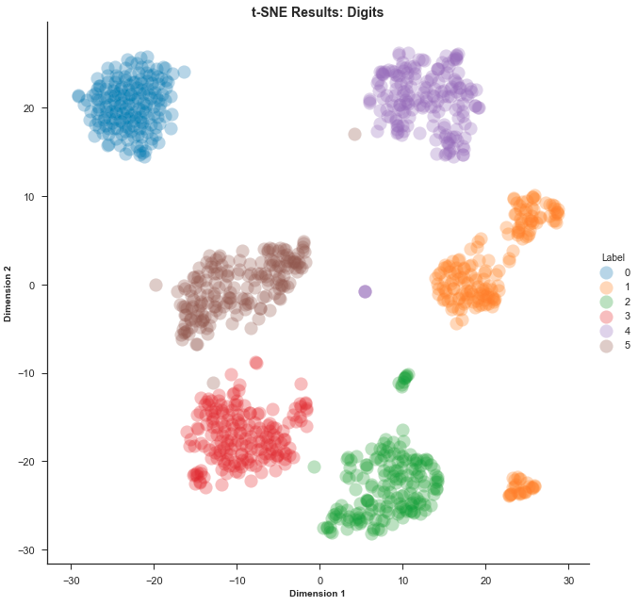
t-Distributed Stochastic Neighbor Embedding (t-SNE)
- It reduces dimensionality while keeping similar instances close and dissimilar instances apart.
- It is a non-linear technique.
- Mostly used for visualization i.e. clusters of instances of high-dimensional space.
https://towardsdatascience.com/an-introduction-to-t-sne-with-python-example-5a3a293108d1

Slide 16
Manifold Methods
Advantages Compared to PCA
Manifold learning preserves nonlinear relationships in the data.

Slide 17
Manifold Methods
Disadvantages Compared to PCA
PCA | Manifold
Iterative approaches to handle missing data | No good frameworks to handle missing data.
Filters noise from the most important components. | Sensible to noise.
No choice of number of neighbors involved. | Result highly dependent on number of neighbors chosen.
Optimal number of dimensions based on explained variance. | Optimal number of dimensions difficult to determine.
Principal components have clear meaning. | Meaning of embedded dimensions not always clear.
Faster randomize approaches. | Computationally expensive.

