Slide 1
Machine Learning Algorithms Using Scikit-learn
Clustering

Slide 2
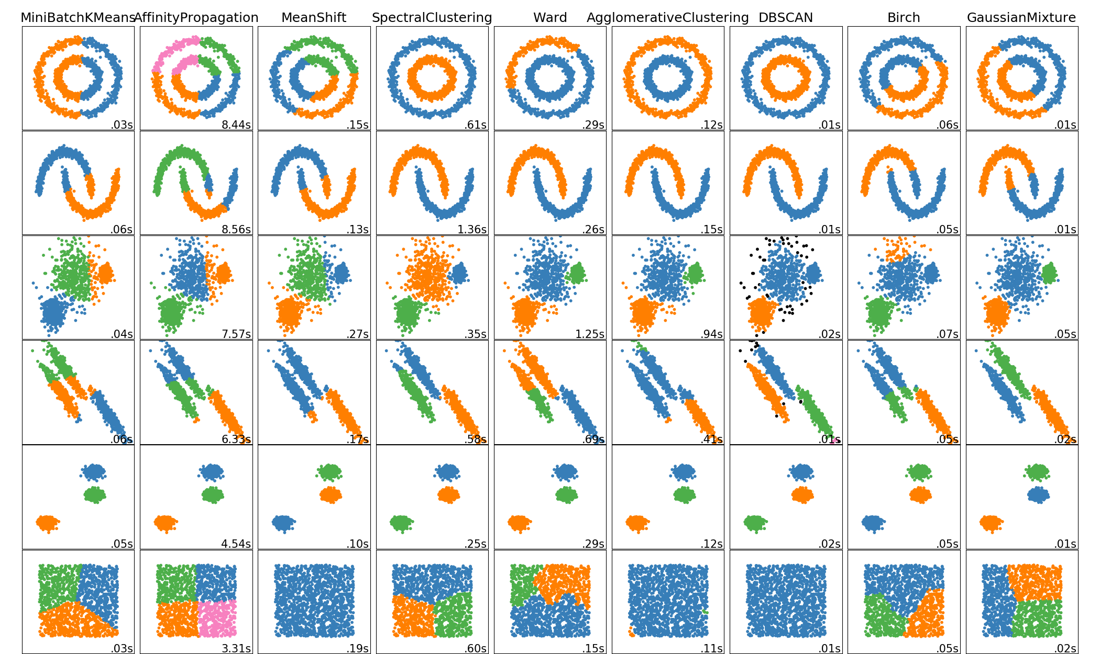
Clustering
- Unsupervised learning.
- Cluster analysis or clustering is the task of grouping a set of objects in such a way that objects in the same group (called a cluster) are more similar (in some sense) to each other than to those in other groups (clusters).
- Clustering algorithms seek to learn, from the properties of the data, an optimal division or discrete labeling of groups of points.
http://scikit-learn.org/stable/modules/clustering.html

Slide 3
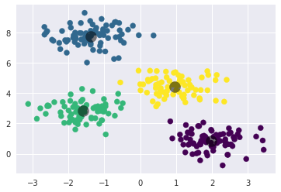
Clustering - k-Means
- k-means algorithm searches for a pre-determined number of clusters within an unlabeled multidimensional dataset.
- The cluster center is the arithmetic mean of all the points belonging to the cluster.
- Each point is closer to its own cluster center than to other cluster centers.
- It has an expectation–maximization approach:
- Guess some cluster centers
- Repeat until converged:
- Expectation-step: assign points to the nearest cluster centered
- Maximization-step: set the cluster centers to the mean
- Each repetition of the Expectation-step and Maximization-step will always result in a better estimate of the cluster characteristics.
From ‘Python Data Science Handbook’ by Jake Vander Plas.

Slide 4
Clustering - k-Means
- First initialize k centroids randomly: k distinct instances are chosen randomly from the dataset and the centroids are placed at their locations.
- Repeat until convergence (i.e., until the centroids stop moving):
- Assign each instance to the closest centroid.
- Update the centroids to be the mean of the instances that are assigned to them.
From ‘Python Data Science Handbook’ by Jake Vander Plas.

Slide 5
Clustering - k-Means
- Inertia: To select the best model in unsupervised learning can measure the distance between each instance and its centroid.
- A measure of how internally coherent clusters are.
- Inertia: sum of squared distances between each training instance and it’s closest centroid.
$\sum_{i=0}^{n}{\min_{μ_{j}}}\left({\left\|x_{i}−μ_{j}\right\|}^{2}\right)$
- Inertia assumes that clusters are convex and isotropic so it responds poorly to elongated clusters, or manifolds with irregular shapes.
- Inertia is not a normalized metric: we just know that lower values are better and zero is optimal.

Slide 6
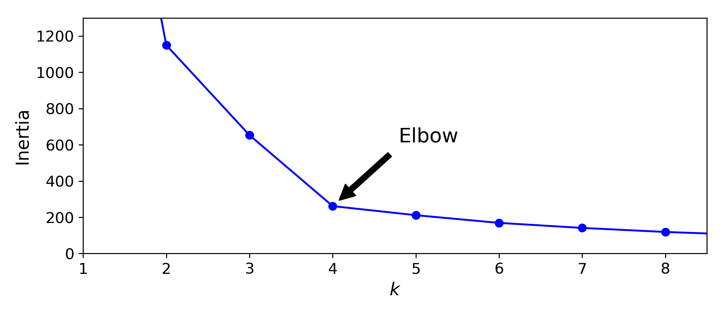
Clustering - k-Means
Finding the Optimal Number of Clusters
- Plot the inertia as a function of k: the elbow means that less clusters than that would be bad, and more clusters would not help much.
From ‘Hands-On Machine Learning with Scikit-Learn and TensorFlow’ by Aurélien Géron.

Slide 7
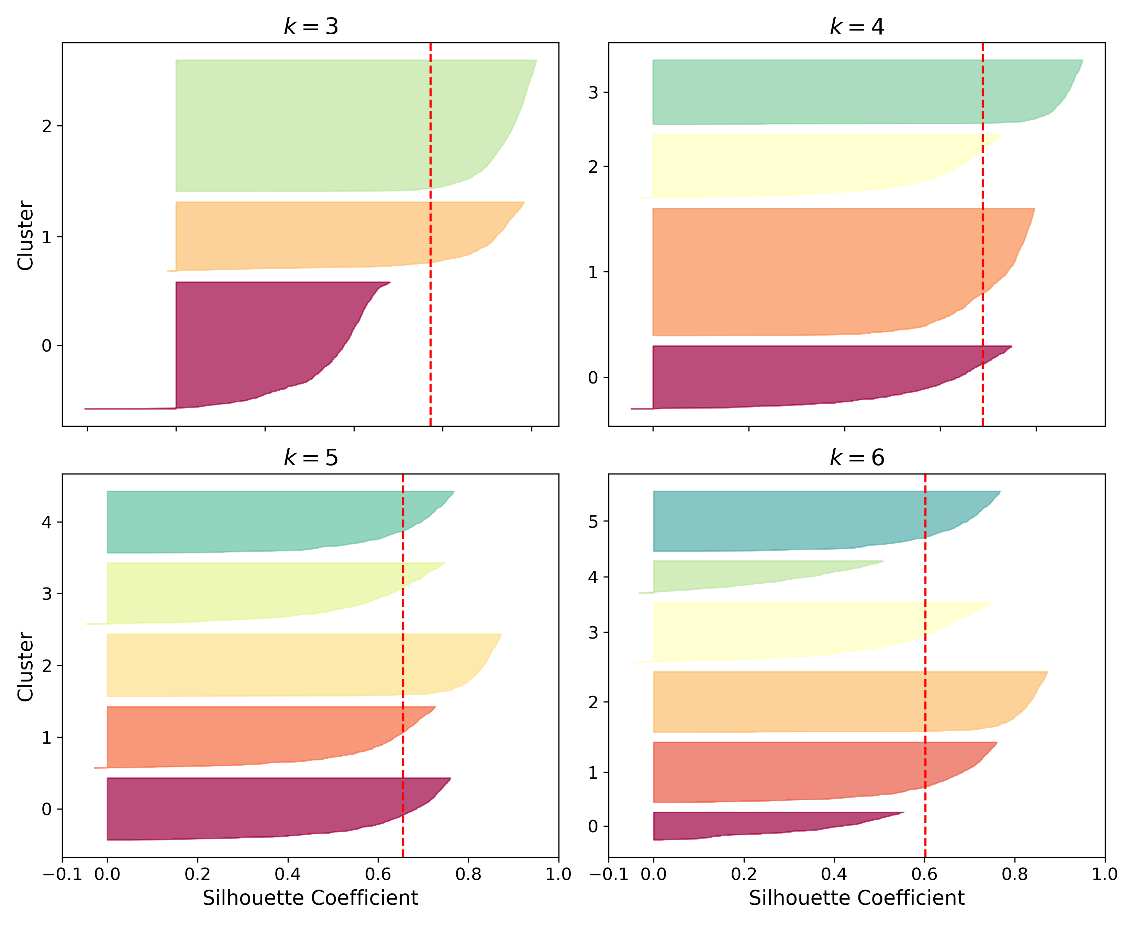
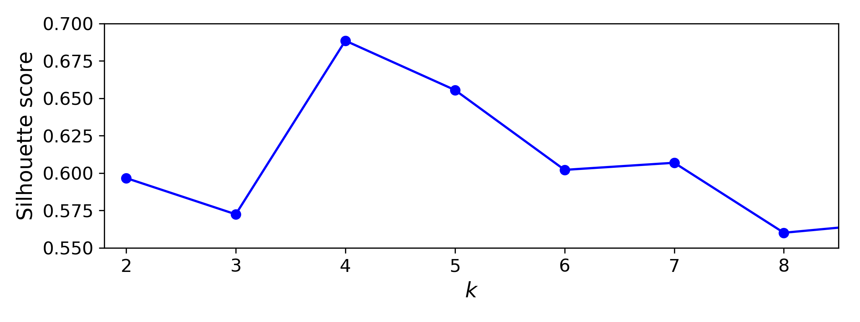
Clustering - k-Means
Finding the Optimal Number of Clusters
- Silhouette score: the mean silhouette coefficient over all the instances.
Silhouette coefficient = (b – a)
max(a,b)
a: mean distance to the other instances in the same cluster (mean intra-cluster distance)
b: mean nearest-cluster distance (mean distance to the instances of the next closest cluster)
From ‘Hands-On Machine Learning with Scikit-Learn and TensorFlow’ by Aurélien Géron.

Slide 8
Clustering - k-Means
Problems
- The globally optimal result may not be achieved.
- The expectation–maximization procedure is guaranteed to improve the result in each step, there is no assurance that it will lead to the global best solution i.e., if we use a different random seed in our simple procedure, the result may be poor.
- The number of clusters must be selected beforehand.
- k-Means is limited to linear cluster boundaries, and can be ineffective if the clusters have complicated geometries.
- k-Means can be slow for large numbers of samples: each iteration of k-means must access every point in the dataset, the algorithm can be relatively slow as the number of samples grows.

Slide 9
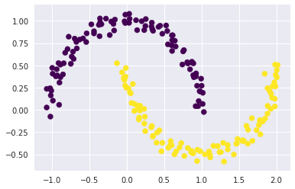
Clustering - Spectral Clustering
- k-Means is often ineffective if the clusters have complicated geometries.
- Spectral Clustering does a low-dimension embedding of the affinity matrix between samples, followed by a k-Means in the low dimensional space.
- Spectral Clustering requires the number of clusters to be specified.
- Spectral Clustering works well for a small number of clusters but is not advised when using many clusters.
- Spectral Clustering uses the graph of nearest neighbors to compute a higher-dimensional representation of the data, and then assigns labels using a k-Means algorithm.
From ‘Python Data Science Handbook’ by Jake Vander Plas.

Slide 10
Clustering - Gaussian Mixtures
- A Gaussian mixture model attempts to find a mixture of multi-dimensional Gaussian probability distributions that best model any input dataset.
- It measures the probability that any point belongs to the given cluster.
- It uses an expectation–maximization approach:
Choose starting guesses for the location and shape.
Repeat until converged:
E-step: for each point, find weights encoding the probability of membership in each cluster.
M-step: for each cluster, update its location, normalization, and shape based on all data points, making use of the weights.
- Each cluster is associated not with a hard-edged sphere, but with a smooth Gaussian model.
- The expectation–maximization approach can miss the globally optimal solution: in practice multiple random initializations are used.

Slide 11
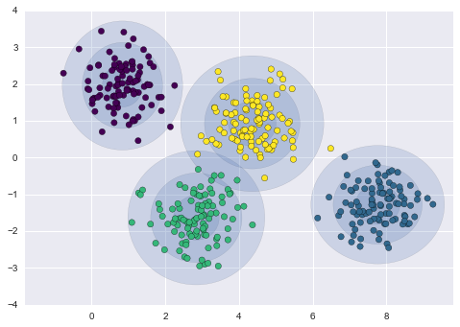
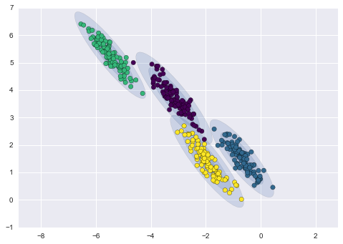
Clustering - Gaussian Mixtures
- The GMM approach to fit the stretched dataset fitting even very oblong, stretched-out clusters.
- Use the model to predict which cluster each instance belongs to (hard clustering) or the probabilities that it came from each cluster.
From ‘Python Data Science Handbook’ by Jake Vander Plas.

Slide 12
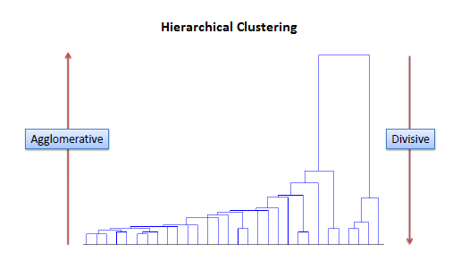
Clustering – Hierarchical Clustering
- Objects are more related to nearby objects than to objects farther away.
- 2 types: agglomerative and divisive.
- Agglomerative: data points are clustered using a bottom-up approach starting with individual data points.
- Divisive: data points are clustered using a top-down approach starting with all points treated as one cluster then divided into small clusters.
Clusters are represented with a dendrogram
http://saedsayad.com/clustering_hierarchical.htm

Slide 13
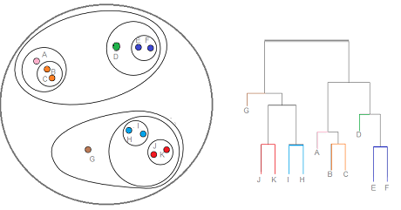
Clustering – Hierarchical Clustering
- The distance between clusters can be Euclidean or Manhattan (L1 norm).
- The distance can be measure as :
- the distance between the closest points of 2 clusters
- the distance between the farthest points of 2 clusters
- the distance between the centroids of 2 clusters
- the distance between all possible combination of points between 2 clusters
https://www.statisticshowto.datasciencecentral.com/hierarchical-clustering/

Slide 14
Clustering – DBSCAN
Density-Based Spatial Clustering of Applications with Noise
- DBSCAN views clusters as areas of high density separated by areas of low density.
- It can find clusters of any shape.
- Core samples: samples that are in areas of high density.
- A cluster is a set of core samples, each close to each other (measured by some distance measure) and a set of non-core samples that are close to a core sample (but are not themselves core samples).
- A cluster is a set of core samples that can be built by recursively taking a core sample, finding all of its neighbors that are core samples, finding all of their neighbors that are core samples, etc.
- It does not require the user to set the number of clusters a priori.
https://scikit-learn.org/stable/modules/clustering.html

Slide 15
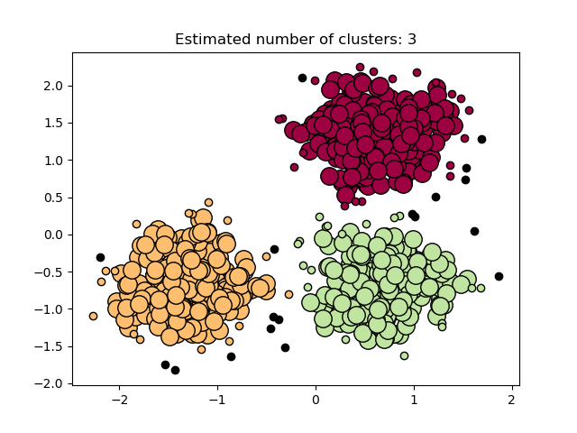
Clustering – DBSCAN
Core samples
Non core samples
Outliers
https://scikit-learn.org/stable/modules/clustering.html

