Slide 1
Ethics and Risks in ML and AI

Slide 2
Table of Contents
- Definition of ethics.
- Data ethics.
- Human bias in machine learning.
- Ethics of algorithms.
- Algorithmic biases in data and models.
- Cognitive bias.
- How AI bias happens.
- Why AI bias is hard to fix.
- How to reduce algorithmic bias?
- Face recognition, detection, and analysis technology.
- Gender shades paper.
- Ethics into AI.
- Ethical challenges of AI in health care.
- Ethics in autonomous weapons systems.
- Ethics in recommender systems.
- Risks of AI.
- General Data Protection Regulation (GDPR).
- IBM AI Fairness 360.
- Discussion.

Slide 3
Ethics
Ethics or moral philosophy is a branch of philosophy that involves systematizing, defending, and recommending concepts of right and wrong conduct.
Ethics seeks to resolve questions of human morality by defining concepts such as good and evil, right and wrong, virtue and vice, justice and crime.
https://en.wikipedia.org/wiki/Ethics

Slide 4
Data Ethics
The branch of ethics that studies and evaluates moral problems related to:
1- data
- generation
- recording
- curation
- processing
- dissemination
- sharing
- use
2- algorithms
- AI
- ML
- artificial agents
- robots
3- practices
- innovation
- programming
- hacking
- professional ethics
Floridi L, Taddeo M. 2016.What is data ethics? Phil. Trans. R. Soc. A 374:20160360.
http://dx.doi.org/10.1098/rsta.2016.0360

Slide 5
Data Ethics
Ethics of data - collection and analysis of large datasets
- use of big data in biomedical sciences
- profiling
- advertising
- data philantropy
- open data
- possible re-identification of individuals
- group privacy (group discrimination: ageism, sexism, racism, etc)
- trust and transparency
Floridi L, Taddeo M. 2016.What is data ethics? Phil. Trans. R. Soc. A 374:20160360.
http://dx.doi.org/10.1098/rsta.2016.0360

Slide 6
Data Ethics
Ethics of algorithms - moral responsibility of data scientists
- accountability of data scientists
- auditing of algorithms
- assessment of potential outcomes
Floridi L, Taddeo M. 2016.What is data ethics? Phil. Trans. R. Soc. A 374:20160360.
http://dx.doi.org/10.1098/rsta.2016.0360

Slide 7
Data Ethics
Ethics of practices - professional ethics
- liabilities of people and organizations
- definition of ethical frameworks
- consent, user privacy and secondary use
Floridi L, Taddeo M. 2016.What is data ethics? Phil. Trans. R. Soc. A 374:20160360.
http://dx.doi.org/10.1098/rsta.2016.0360

Slide 8
Human Bias in Machine Learning
Influence
People trust outputs of AI.
Automation
Sometimes AI models are plugged into a programmatic function, which could lead to the automation of bias.
https://techcrunch.com/2018/11/06/3-ways-to-avoid-bias-in-machine-learning/

Slide 9
Ethics of Algorithms
Ethical Concerns Raised by Algorithms
1- Inconclusive evidence: conclusion of algorithms produce probable but uncertain knowledge.
2- Inscrutable evidence: the connection between data and conclusion is not accessible.
3- Misguided evidence: conclusions are as reliable as the data they are based on.
4- Unfair outcomes: actions driven by algorithms can be found discriminatory.
5- Transformative effects: algorithms can affect how we conceptualize the world and modify its social and political organization.
6- Traceability: it’s hard to debug harm caused by algorithms and to find who should be responsible for that harm.
BD Mittelstadt, P Allo, M Taddeo, S Wachter, L Floridi, Big Data & Society, July–December 2016: 1–21.

Slide 10
Algorithmic Biases in Data and Models
1. Training Data Algorithmic Bias
If biased data are used, the resulting model reflects that bias.
Underrepresentation of data perpetuates societal bias.
2. Algorithmic Focus Bias
Selection or rejection of certain types of input data to avoid.
e.g. it is illegal to discriminate against someone based on their race.
3. Transfer Context Bias
How an algorithm is deployed by those who wish to use it.
https://www.ictworks.org/algorithmic-bias-machine-learning/#.XLXdCHUzbiZ

Slide 11
Cognitive Bias
- A limitation in objective thinking caused by the tendency for the human brain to perceive information through a filter of personal experience and preferences.
- A coping mechanism that allows the brain to prioritize and process the vast amount of input it receives each second.
https://searchenterpriseai.techtarget.com/definition/cognitive-bias

Slide 12
Cognitive Bias
Anchoring effect: the tendency for the brain to rely too much on the first instance of information it received when making decisions later on.
Availability bias: the tendency for the brain to conclude that a known instance is more representative of the whole than is actually the case.
Bandwagon effect: the tendency for the brain to conclude that something must be desirable because other people desire it.
Bias blind spot: the tendency for the brain to recognize another’s bias but not its own.
Clustering illusion: the tendency for the brain to want to see a pattern in what is actually a random sequence of numbers or events.
Confirmation bias: the tendency for the brain to value new information that supports existing ideas.
https://searchenterpriseai.techtarget.com/definition/cognitive-bias

Slide 13
Cognitive Bias
Framing effect: the tendency of the brain to arrive at different conclusions when reviewing the same information depending upon how the information is presented.
Group think: the tendency for the brain to place value on consensus.
Negativity bias: the tendency for the brain to subconsciously place more significance on negative events than positive ones.
Recency bias: the tendency for the brain to subconsciously place more value on the last information it received about a topic.
Sunk cost effect: the tendency for the brain to continue investing in something that isn’t working in order to avoid failure.
Survivorship bias: the tendency for the brain to focus on positive outcomes in favor of negative ones.
https://searchenterpriseai.techtarget.com/definition/cognitive-bias

Slide 14
How AI Bias Happens
1. Framing the problem
Decide what you actually want it to achieve, those decisions are made for various business. Reasons other than fairness or discrimination.
2. Collecting the data
Either the data you collect is unrepresentative of reality, or it reflects existing prejudices.
3. Preparing the data
Introduce bias during the data preparation stage, which involves selecting which attributes you want the algorithm to consider.
https://www.technologyreview.com/s/612876/this-is-how-ai-bias-really-happensand-why-its-so-hard-to-fix/

Slide 15
Why AI Bias is Hard to Fix
1. Unknown unknowns
The introduction of bias isn’t always obvious during a model’s construction and realize about the impact much later.
2. Imperfect processes
Scientists randomly split their data in training, validation and test sets so the data you use to test the performance of your model has the same biases as the data you used to train it.
3. Lack of social context
Usually systems are designed to be used for different tasks in different contexts.
4. The definitions of fairness
The concept of fairness has to be defined in mathematical terms, like balancing the false positive and false negative rates of a prediction system. But there are many different mathematical definitions of fairness that are also mutually exclusive.
https://www.technologyreview.com/s/612876/this-is-how-ai-bias-really-happensand-why-its-so-hard-to-fix/

Slide 16
Human Bias in Machine Learning
Example - Examining Data
e.g. AI for approving loans
- equality of outcome: people from all cities get loans at the same rates
- equality of opportunity: people who would have returned the loan if given the chance are given the same rates regardless of city
https://techcrunch.com/2018/11/06/3-ways-to-avoid-bias-in-machine-learning/

Slide 17
How to Reduce Algorithmic Bias?
1. Choose the right learning model for the problem
No single model will avoid bias.
Excluding sensitive information from the model not always a solution to bias problem.
2. Choose a representative training data set
Training data should be diverse and segmented like the real data.
3. Monitor performance using real data
Do not use test groups on algorithms already in production.
Run the statistical methods against real data whenever possible
https://techcrunch.com/2018/11/06/3-ways-to-avoid-bias-in-machine-learning/

Slide 18
How to Reduce Algorithmic Bias?
A. Hiring external firms as data and model auditors
B. Making algorithms publicly accessible for scrutiny
C. Making data sets available to the public
https://www.ictworks.org/algorithmic-bias-machine-learning/#.XLXdCHUzbiZ

Slide 19
Face Recognition, Detection, and Analysis Technology
Recognition systems (Facebook’s photo-tagging recommender and Apple’s FaceID): identify specific individuals.
Detection systems: determine whether a face is present at all.
Analysis systems: try to identify aspects like gender and race.
All of these systems are now being used for a variety of purposes, from hiring and retail to security and surveillance.
https://www.technologyreview.com/s/612846/making-face-recognition-less-biased-doesnt-make-it-less-scary/

Slide 20
Face Recognition, Detection, and Analysis Technology
Gender Shades
A study led by MIT Media Lab researcher Joy Buolamwini.
Found that gender classification systems sold by IBM, Microsoft, and Face++ had an error rate of 34.4% higher for darker-skinned females than lighter-skinned males.
The problem: face recognition and analysis systems are often trained on skewed data sets, they’re fed far fewer images of women and people with dark skin than they are images of men and people with light skin.
http://gendershades.org/
https://www.technologyreview.com/s/612846/making-face-recognition-less-biased-doesnt-make-it-less-scary/

Slide 21
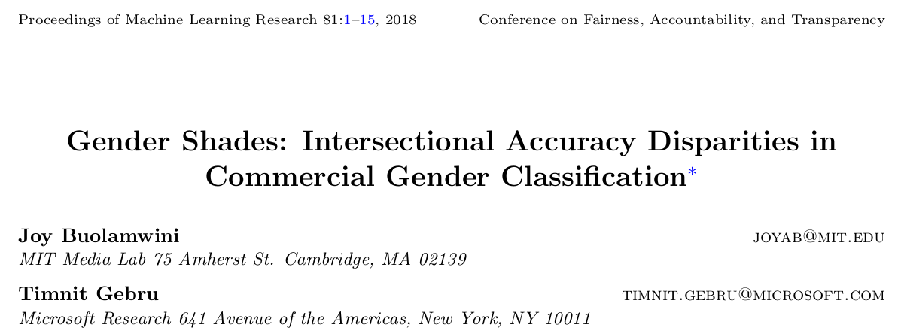

Slide 22
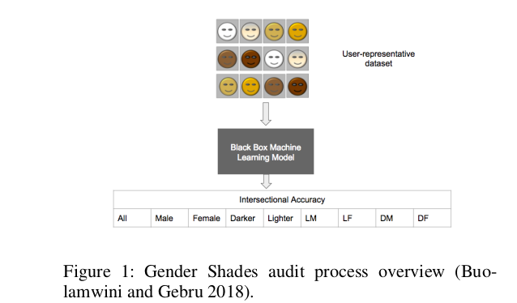
Gender Shades
Algorithmic audit: the collection and analysis of outcomes from a fixed algorithm or defined model within a system (ID Raji, J Buolamwini, ACM Conf. on AI Ethics and Society, 2019).
Is audit independent of target corporations or its competitors?
https://www.media.mit.edu/projects/actionable-auditing-coordinated-bias-disclosure-study/publications/

Slide 23
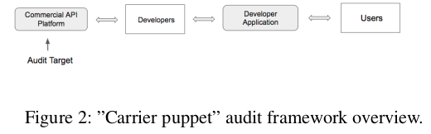
Gender Shades
Algorithmic Audit
A puppet user of the API that interacts with the API the way a developer would.
It influences the end user experience.
It audits the bias detected in an intermediary step that can carry bias to end users.
https://www.media.mit.edu/projects/actionable-auditing-coordinated-bias-disclosure-study/publications/

Slide 24
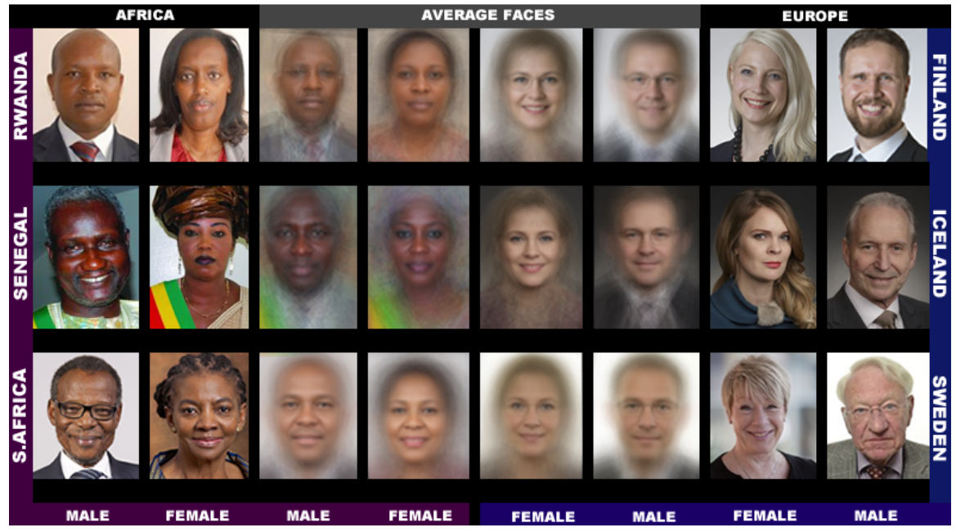
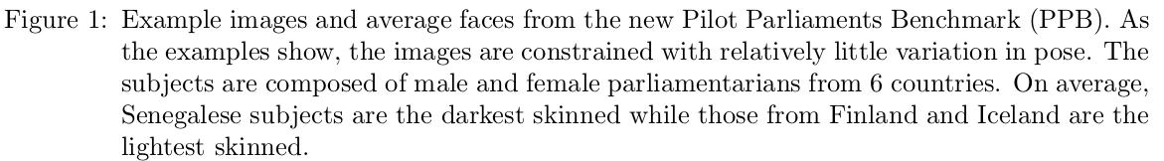
Intersectional demographic and phenotypic evaluation of face-based gender classification in commercial APIs (ID Raji, J Buolamwini, ACM Conf. on AI Ethics and Society, 2019).
Evaluate the performance of gender classification by skin type.
Creation of Pilot Parliaments Benchmarks (PPB) using:
IJB-A: US government benchmark
Audience: gender classification benchmark

Slide 25
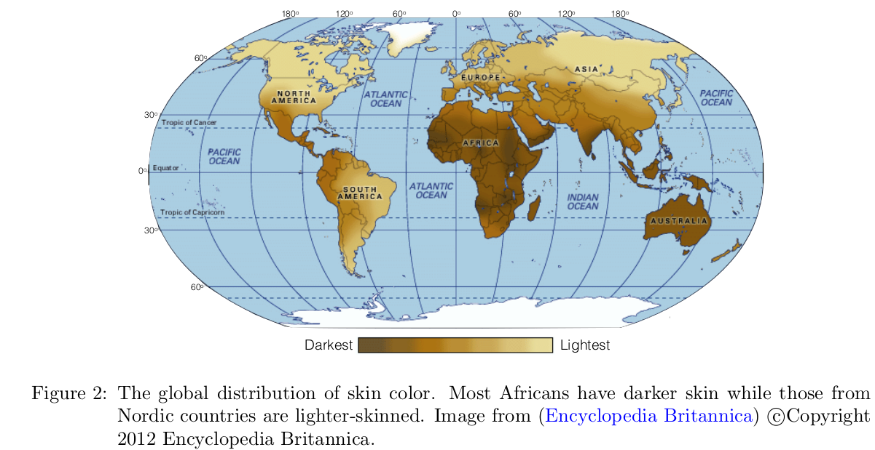
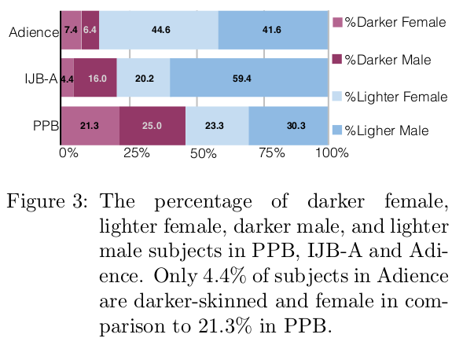
Gender Shades
IJB-A and Audience: overrepresentation of lighter males; underrepresentation of darker women.
PPB: photos of parliament member from Rwanda, Senegal, South Africa, Iceland, Finland, and Sweden.

Slide 26
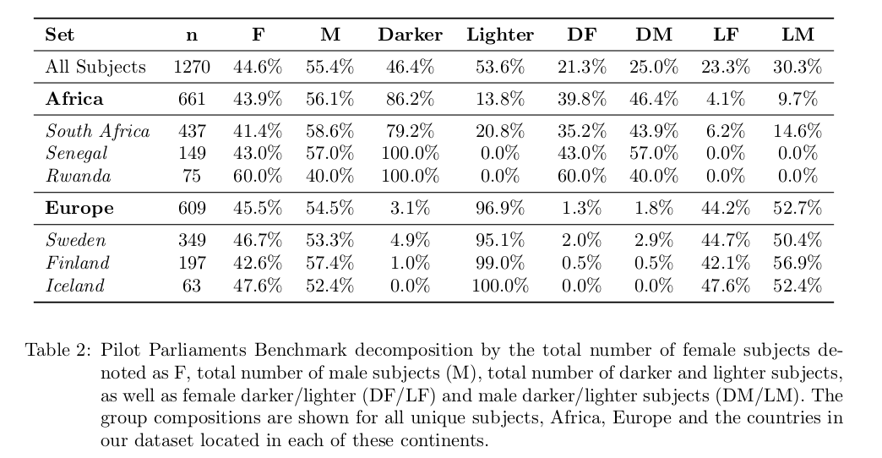
Gender Shades
Skin Type Label: Fitzpatrick six-point labeling system (Types I to VI; Types I, II and III light; Types IV, V and VI dark).
Gender Labels: male and female.

Slide 27
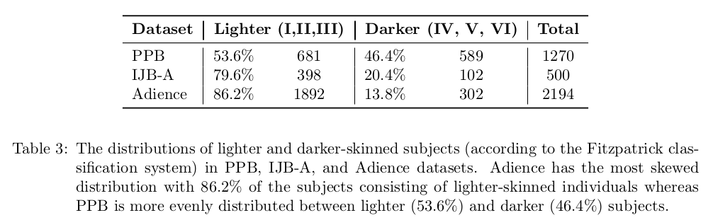
Gender Shades

Slide 28
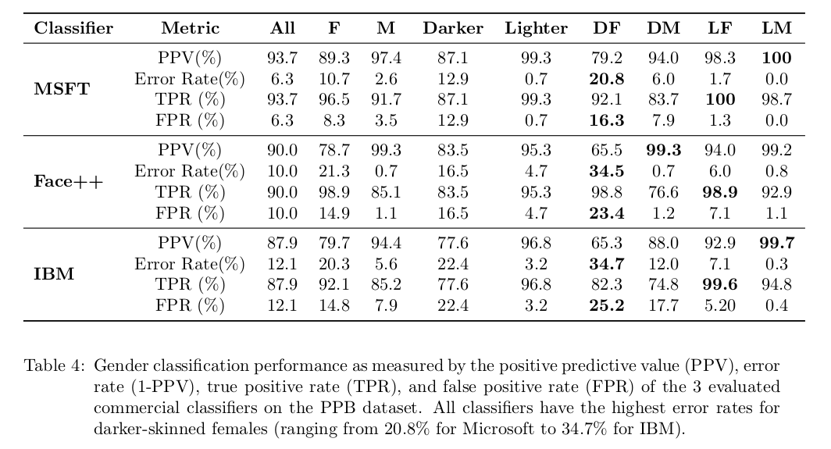
Gender Shades
Evaluation of 3 commercial gender classifiers in aggregate: Microsoft, Face++ and IBM.

Slide 29
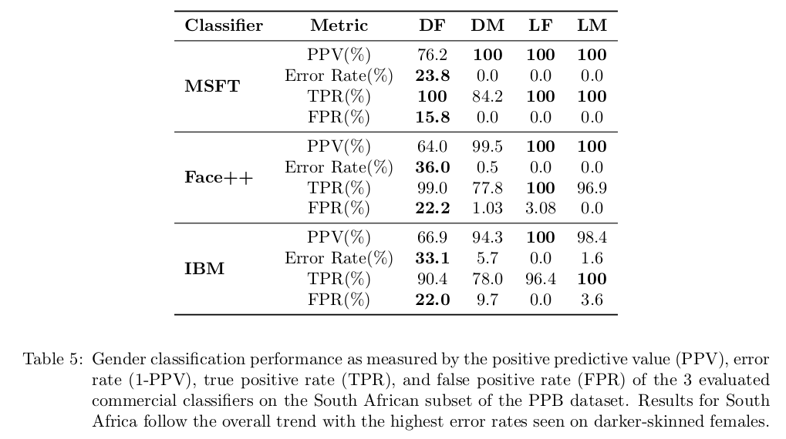
Gender Shades
Evaluation of 3 commercial gender classifiers on South Africa.

Slide 30
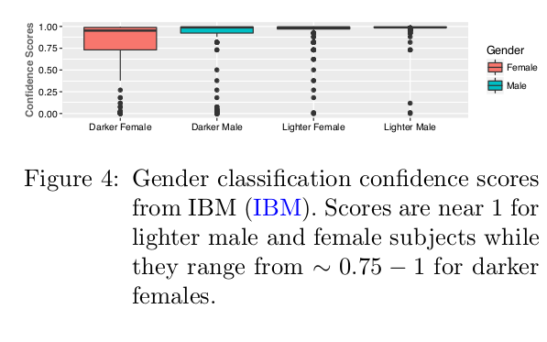
Gender Shades
IBM’s API outputs the confidence with which the classification was made.

Slide 31
Gender Shades
Conclusions
All classifiers perform better on male faces than female faces.
All classifiers perform better on lighter faces than darker faces.
All classifiers perform worst on darker female faces.

Slide 32
Ethics into AI
1- AI minds: software seeking to reason and make decisions like humans do so it aspires to replace humans.
2- AI partners: provide assistance to humans within parameters set by humans or under human supervision.
A Etzioni, O Etzioni, J Ethics (2017) 21:403–41, DOI 10.1007/s10892-017-9252-28

Slide 33
Ethics into AI - Levels of Automation in Cars
Level 0: no automation, human driver full-time for all aspects of driving.
Level 1: driver assistance, system sometimes assists with specific tasks.
Level 2: partial automation, system performs tasks and human monitors.
Level 3: conditional automation, system manages all driving tasks and monitors the driving environment, human intervenes only when the system requires assistance.
Level 4: high automation, system drives and monitors in certain environments without human response and sometimes is fully autonomous.
Level 5: full automation, system does everything a human could do under all conditions.
Fleetwood J. AJPH, April 2017, Vol 107, No. 4

Slide 34
Ethics into AI
In May 2016 a Tesla car traveling in autopilot mode crashed and the passenger was killed.
Choices made by legal dictates: ethical decision made collectively, e.g. stop the car at stop sign.
Choices open to each individual: e.g. stop to give a ride to a hitchhiker.
- top-down approach: ethical principles programmed into car’s guidance system e.g. ten commandments
- bottom up approach: machines learn ethical decisions through observation of humans
A Etzioni, O Etzioni, J Ethics (2017) 21:403–41, DOI 10.1007/s10892-017-9252-28
https://www.theguardian.com/technology/2016/jul/01/tesla-driver-killed-autopilot-self-driving-car-harry-potter

Slide 35
Ethics into AI
Ethic bot
- AI program that reads the owner’s moral preferences and instructs the machines to follow them.
- The ethical decisions left to the individual are the ones the society ruled are not harmful and are not constrained by legislation.
A Etzioni, O Etzioni, J Ethics (2017) 21:403–41, DOI 10.1007/s10892-017-9252-28

Slide 36
Ethical Challenges of AI in Health Care
Robots that provide child, elder and health care.
Patient’s data privacy and anonymization.
Robotic surgeons.
Racial / gender biases built in health care algorithms.
Clinical decision-support systems could be programmed to increase profits.
Premature incorporation of a diagnosis or practice into an algorithm may imply legitimacy.
AI for diagnosis and advice about treatments
Educate physicians about the limitations of AI, datasets etc.
Confidentiality of medical records.
Apps giving health advice or ‘diagnosis’.
Ownership and property of health data and/or biological material.
Obtainment of patient consent for studies.
S Danton et al. N Engl J Med. 2018 March 15; 378(11): 981–983

Slide 37
Ethics in Autonomous Weapons Systems
Autonomous weapon system: once activated, can select and engage targets without further intervention by a human operator (2012 U.S. Department of Defense).
Some such systems exist in limited defensive contexts.
Genuine autonomy in weapons will probably remain rare.
Unmanned aerial vehicles (UAVs) are piloted from afar, autonomous for flying but not for some systems will be designed to be used only for “machine-on-machine” encounters,
(e.g. missile defense).
The communication between human and weapon system could be jammed or hacked.
K Anderson, MC Waxman. American University Washington College of Law Research Paper No. 2013-11, 2013.
https://papers.ssrn.com/sol3/papers.cfm?abstract_id=2250126

Slide 38
Ethics in Recommender Systems
A study showed lower paying job being recommended to women candidates.
A news article mentioned, the possibility of expensive flight recommendations were made to MacBook owners.
Google’s search results are affected by your previous search history and your user profile.
https://cds.nyu.edu/recommendation-systems-go-bad-%E2%80%A8/

Slide 39
Ethics in Recommender Systems
YouTube algorithms transmit content and filter it making the content more relevant to its potential customers (D O’Callahan et al, Social Science Computer Review, 2015, Volume: 33 issue: 459-478).
Extremism: a desire to radically, and if necessary, forcefully and violently impose a political and/or religiously motivated ideology that has a claim to totality in the sense of true interpretation (U Kemmesies, 2006, p. 11, München: Luchterhand;J Scmitt et al, 2018, Journal of Communication 00: 1–29).
Recommendations can result in users being excluded from information that is not aligned with their existing perspective leading to immersion within an extremist ideological bubble (D O’Callahan et al, Social Science Computer Review, 2015, Volume: 33 issue: 459-478).

Slide 40
Ethics in Recommender Systems
‘Increasing filtering mechanisms makes it more likely for people to only get news on subjects they are interested in, and with the perspective they identify with.
Such developments undoubtedly have a potentially negative impact on democracy’ (EU High Level Group on Media Freedom and Pluralism, 2013, p. 27)

Slide 41
Risks of AI
Creation of Malevolent AI
Hacks as many computers as possible to gain more calculating power.
Creates its own robotic infrastructure (bioengineering).
Prevents other AI projects from finishing by hacking or diversions.
Has goals which include causing suffering.
Interprets commands literally.
Overvalues marginal probability events.
https://arxiv.org/pdf/1605.02817.pdf

Slide 42
Risks of AI
Malicious AI would run on closed-source code (less secure than open-source).
It can create non-cyclical, structural unemployment.
Take over global servers and operations controling food markets, power stations, transportations, financial markets, etc.
Disseminate false information and other operations leading to coups d’état.
Take over political control of local and federal governments, international corporations.
Overvalues marginal probability events.
Set up a total surveillance state.
Destroy or irreversibly change the planet.
https://arxiv.org/pdf/1605.02817.pdf

Slide 43
Risks of AI
Vulnerabilities of AI
Data poisoning attacks (introducing training data that causes a learning system to make mistakes).
Adversarial examples (inputs designed to be misclassified by machine learning systems).
Exploitation of flaws in the design of autonomous systems’ goals.
https://arxiv.org/pdf/1802.07228.pdf

Slide 44
Risks of AI
Risks in Digital Security
Automation of social engineering attacks: victims’ online information used to automatically generate custom malicious websites/emails/links they would be likely to click on.
Automation of vulnerability discovery.
More sophisticated automation of hacking.
Human-like denial-of-service: imitating human-like behavior(e.g. through human-speed click patterns and website navigation), a massive crowd of autonomous agents overwhelms an online service.
Automation of service tasks in criminal cyber-offense.
https://arxiv.org/pdf/1802.07228.pdf

Slide 45
Risks of AI
Risks in Physical Security
Terrorist repurposing of commercial AI systems: using drones or autonomous vehicles to deliver explosives.
Endowing low-skill individuals with previously high-skill attack capabilities: reduce the expertise required to execute certain kinds of attack.
Attacks further removed in time and space.
https://arxiv.org/pdf/1802.07228.pdf

Slide 46
Risks of AI
Risks in Political Security
State use of automated surveillance platforms to suppress dissent.
Fake news reports with realistic fabricated video and audio.
Automated, hyper-personalised disinformation campaigns.
Automating influence campaign.
Denial-of-information attacks: Bot-driven, large-scale information generation attacks to swamp information channels with noise (false or merely distracting information).
Manipulation of information availability.
https://arxiv.org/pdf/1802.07228.pdf

Slide 47
General Data Protection Regulation (GDPR)
GDPR (Regulation EU 2016/6791) regulates the processing by an individual, a company or an organization of personal data relating to individuals in the EU.
It doesn’t apply to the processing of personal data of deceased persons or of legal entities.
The rules don’t apply to data processed by an individual for purely personal reasons or for activities carried out in one's home, provided there is no connection to a professional or commercial activity.
When an individual uses personal data outside the personal sphere, for socio-cultural or financial activities, for example, then the data protection law has to be respected.
https://ec.europa.eu/info/law/law-topic/data-protection/reform/what-does-general-data-protection-regulation-gdpr-govern_en

Slide 48
General Data Protection Regulation (GDPR)
Examples
When the regulation applies
A company with an establishment in the EU provides travel services to customers based in the Baltic countries and in that context processes personal data of natural persons.
When the regulation doesn’t apply
An individual uses their own private address book to invite friends via email to a party that they are organizing (household exception).
https://ec.europa.eu/info/law/law-topic/data-protection/reform/what-does-general-data-protection-regulation-gdpr-govern_en

Slide 49
General Data Protection Regulation (GDPR)
Personal data: any information that relates to an identified or identifiable living individual. Different pieces of information, which collected together can lead to the identification of a particular person, also constitute personal data.
For data to be truly anonymised, the anonymisation must be irreversible.
The law protects personal data regardless of the technology used for processing that data provided the data is organized in accordance with pre-defined criteria (for example alphabetical order).
It also doesn’t matter how the data is stored.
https://ec.europa.eu/info/law/law-topic/data-protection/reform/what-does-general-data-protection-regulation-gdpr-govern_en

Slide 50
General Data Protection Regulation (GDPR)
Examples of Personal Data
a name and surname
a home address
an email address such as name.surname@company.com
an identification card number
location data (for example the location data function on a mobile phone)
an Internet Protocol (IP) address
a cookie ID
the advertising identifier of your phone
data held by a hospital or doctor, which could be a symbol that uniquely identifies a person
https://ec.europa.eu/info/law/law-topic/data-protection/reform/what-does-general-data-protection-regulation-gdpr-govern_en

Slide 51
General Data Protection Regulation (GDPR)
Examples of Data Not Considered Personal
a company registration number
an email address such as info@company.com
anonymised data
https://ec.europa.eu/info/law/law-topic/data-protection/reform/what-does-general-data-protection-regulation-gdpr-govern_en

Slide 52
General Data Protection Regulation (GDPR)
Data Processing
Operations performed on personal data, including by manual or automated means.
It includes the collection, recording, organization, structuring, storage, adaptation or alteration, retrieval, consultation, use, disclosure by transmission, dissemination or otherwise making available, alignment or combination, restriction, erasure or destruction of personal data.
It applies to the processing of personal data wholly or partly by automated and non-automated processing, if it is part of a structured filing system.
https://ec.europa.eu/info/law/law-topic/data-protection/reform/what-does-general-data-protection-regulation-gdpr-govern_en

Slide 53
General Data Protection Regulation (GDPR)
Examples of Data Processing
staff management and payroll administration
access to/consultation of a contacts database containing personal data
sending promotional emails
shredding documents containing personal data
posting/putting a photo of a person on a website
storing IP addresses or MAC addresses
video recording (CCTV)
https://ec.europa.eu/info/law/law-topic/data-protection/reform/what-does-general-data-protection-regulation-gdpr-govern_en

Slide 54
IBM AI Fairness 360
Open-source Python package of metrics to check for bias in datasets and ML, and algorithms to mitigate such bias.
Similar to scikit-learn’s fit/predict paradigm.
Contains tutorials on credit scoring, predicting medical expenditures, and classifying face images by gender.
To be used only for allocation or risk assessment problems with well-defined protected attributes in which one would like to have some sort of statistical or mathematical notion of sameness.
Bias mitigation algorithms improve the fairness metrics by modifying the training data, the learning algorithm, or the predictions.
https://www.ibm.com/blogs/research/2018/09/ai-fairness-360/

Slide 55
IBM AI Fairness 360
Examples of Metrics
Individual vs. Group Fairness, or Both
Group fairness partitions a population into groups defined by protected attributes and seeks for a statistical measure to be equal across groups; metrics in the DatasetMetric and ClassificationMetric class. Individual fairness use metrics in the SampleDistortionMetric class.
Group Fairness: Data vs. Model
For metrics on training data, use DatasetMetric class. For metrics on models, use the ClassificationMetric.
Group Fairness: We’re All Equal vs. What You See Is What You Get
If the application follows the WAE, then use the metrics disparate_impact and statistical_parity_difference. For the WYSIWYG, use average_odds_difference and average_abs_odds_difference.
https://www.ibm.com/blogs/research/2018/09/ai-fairness-360/

Slide 56
Discussion
Physiognomy’s New Clothes
by Blaise Agüera y Arcas, Margaret Mitchell and Alexander Todorov
https://medium.com/@blaisea/physiognomys-new-clothes-f2d4b59fdd6a

Slide 57
Discussion
Facebook’s Role in Brexit – and the Threat to Democracy
TED2019, by Carole Cadwalladr
http://www.ted.com/talks/carole_cadwalladr_facebook_s_role_in_brexit_and_the_threat_to_democracy?language=en

