Slide 1
Car price prediction based on model algorithms using the real data from the website auto.ria.com

Slide 2

Input Data:
NEW cars data from the Ukrainian website Auto.ria.com (parsing of 352 pages with new cars, 6393 objects in total):

Slide 3
Input Data
Only new cars were selected for analysis in order to equalize the criterion of the condition of cars, which affects the price (for example, in used cars, in addition to mileage, the price is also affected by the general condition of the car, which cannot be described in specific parameters)

Slide 4
Selected parameters for evaluation:
Brand
Country of production
Production year
Engine_power
Fuel & tank_volume
Gear_shift_box
Drive_train
Price

Slide 5
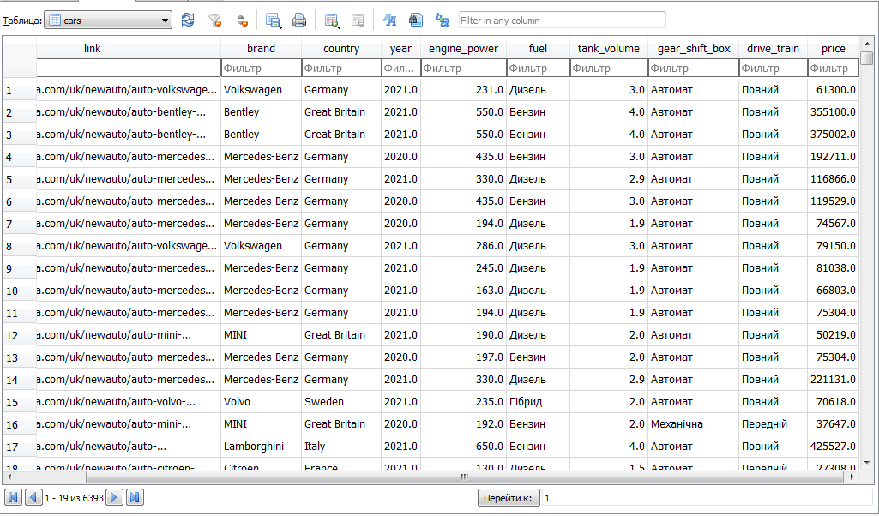
Database
Database with 6393 rows:

Slide 6
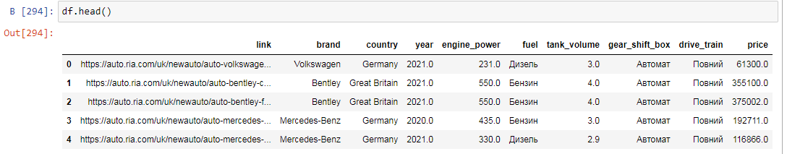
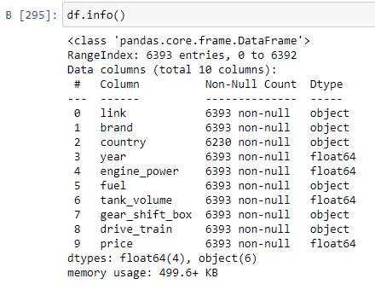
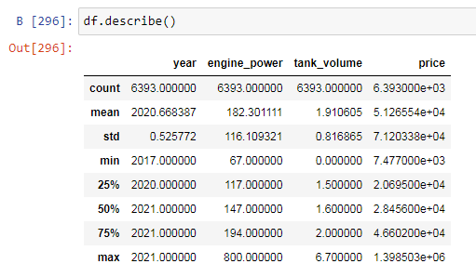
Working with a DataFrame
My DataFrame:

Slide 7
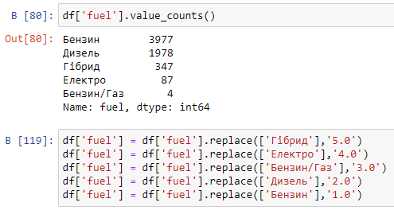
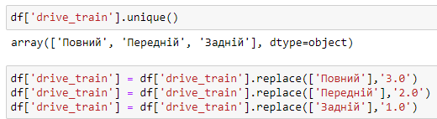
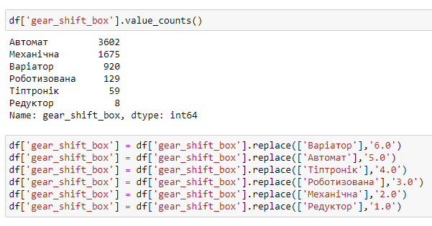
Working with a DataFrame
Correcting zero values, converting object parameters to numeric ones (fuel, drive_train, gear_shift_box):
I got a table with 6342 rows;
I left the car brand and country
of production in the object type for
the convenience of graphical data
analysis;
set the price up to $800,000

Slide 8
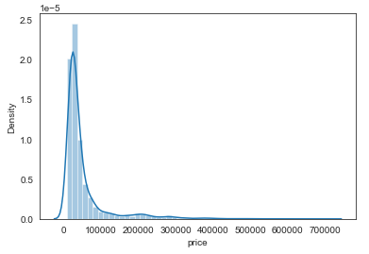
Data analysis Price distribution

Slide 9
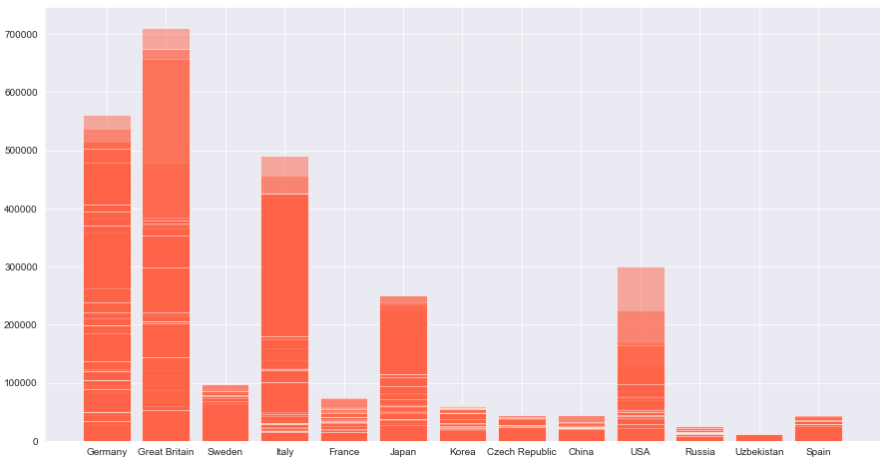
Car pricing by country of production

Slide 10
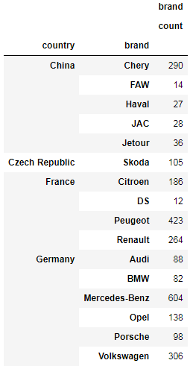
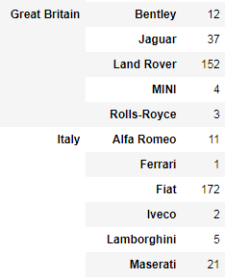
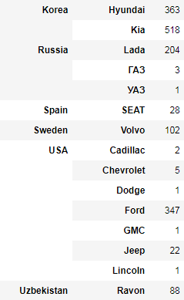
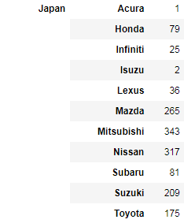
*Groups of countries and car brands included in their group:

Slide 11
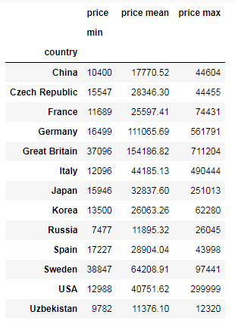
Car pricing by country of production

Slide 12
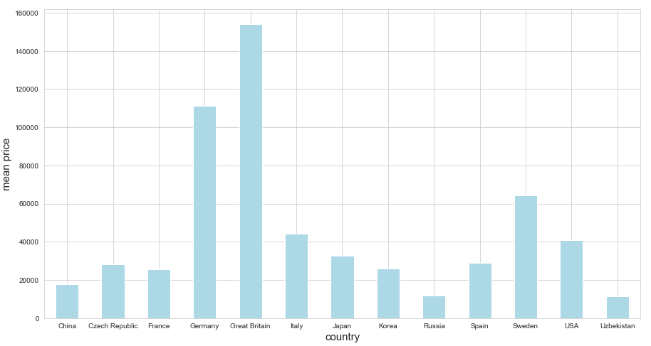
Average car price by country of production

Slide 13
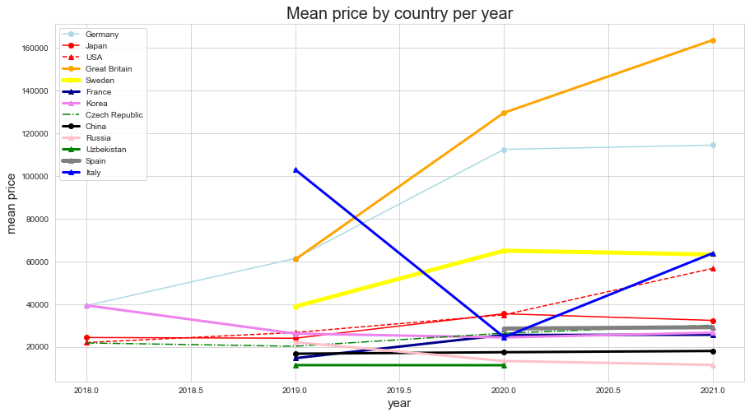
Average car price by country and year of production

Slide 14
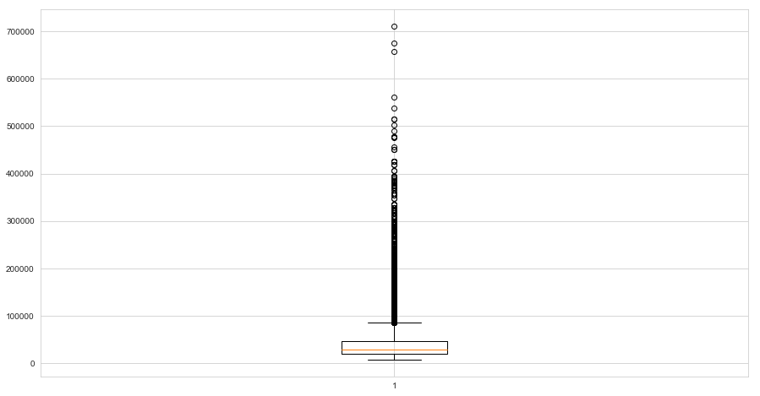
Price analysis with boxplot

Slide 15
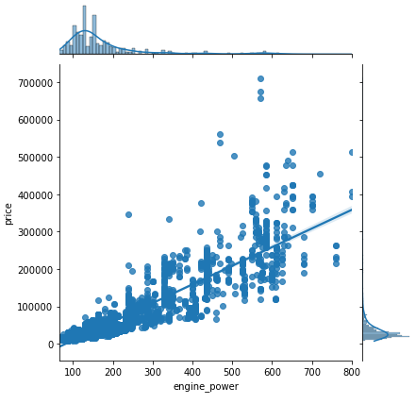
Dependence of price on engine power

Slide 16
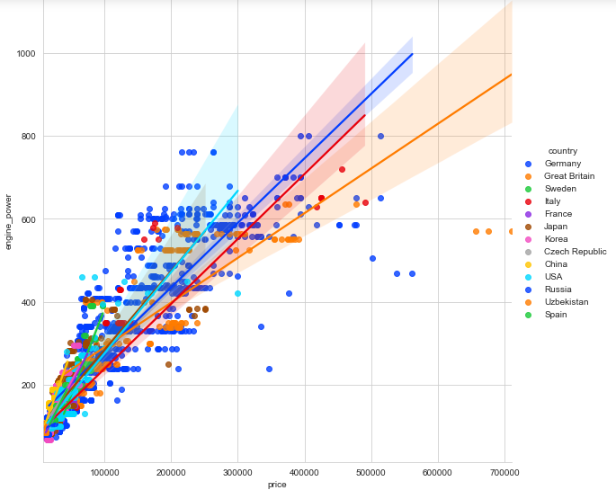
The dependence of the price on the engine power, broken down by country of production

Slide 17
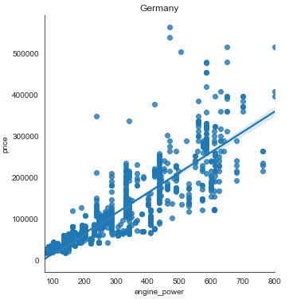
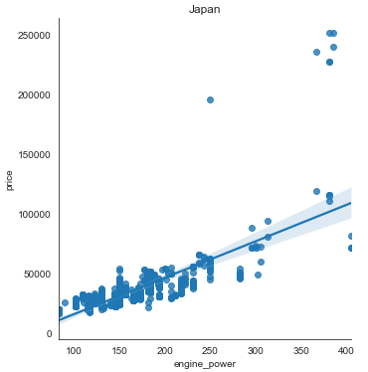
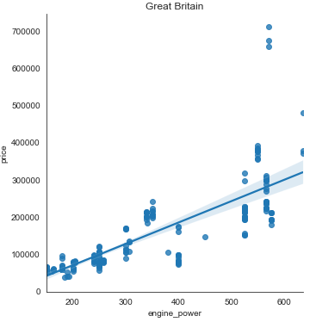
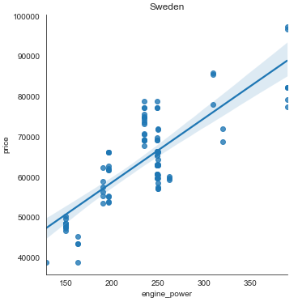
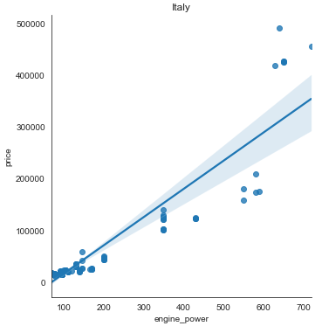
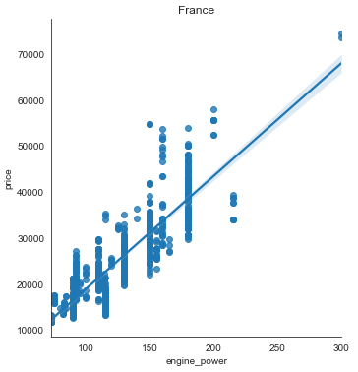

Slide 18
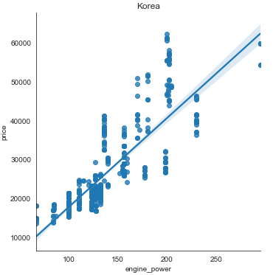
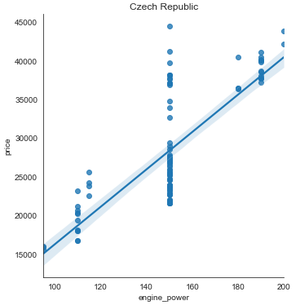
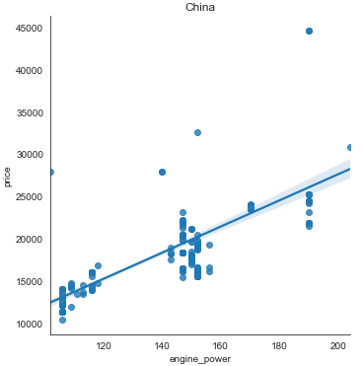
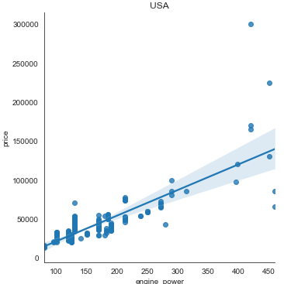
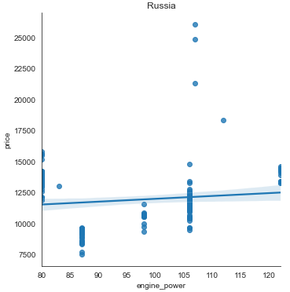
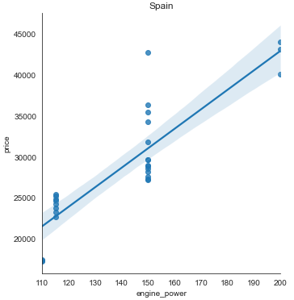

Slide 19
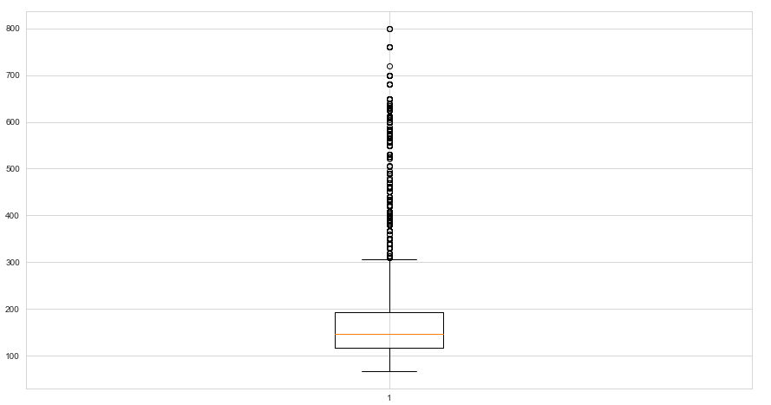
Engine power analysis with boxplot

Slide 20
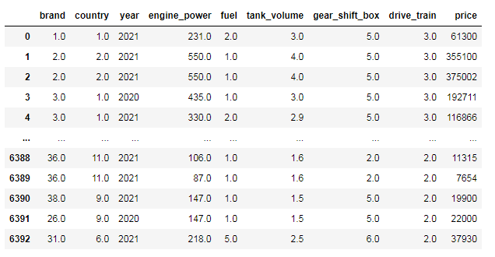
Preparing the model
Next, 2 methods of encoding data by car brand and country of production were performed:
1) encoding categorical features by the LabelEncoder() method that assign a unique number to each category and replace the feature value with the corresponding number:

Slide 21
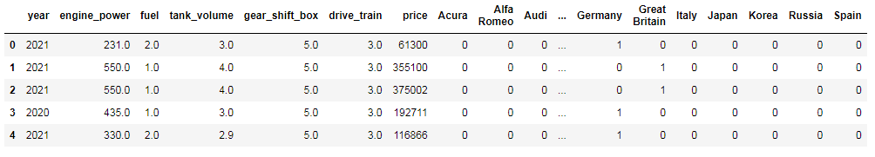
2) the get_dummies method (turning categorical features into new ones that answer the question whether the car belongs to a certain brand and country or not. With this approach as many new columns appear for each categorical feature as there are possible categories. One of the columns will be filled with 1 and the rest - with 0):
In the new table with 8 columns, it became 73.

Slide 22
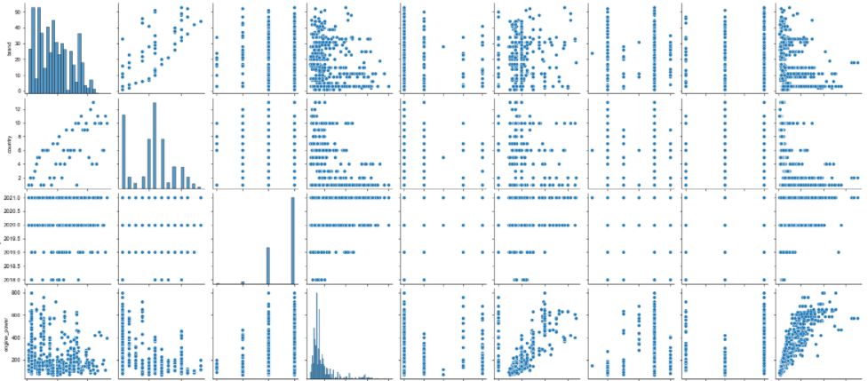
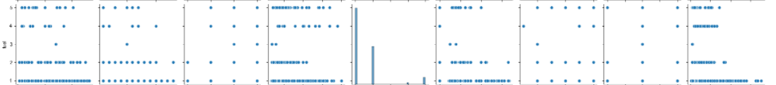
A pairplot according to 1 option

Slide 23
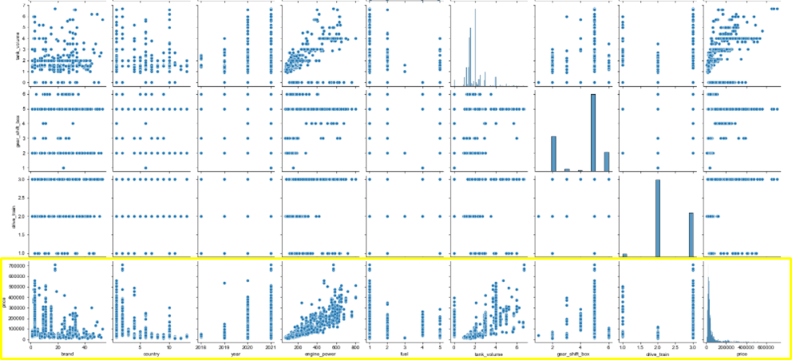
We are only interested in the last line with graphs of price dependence on other parameters

Slide 24
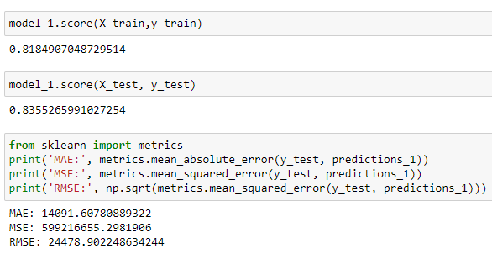
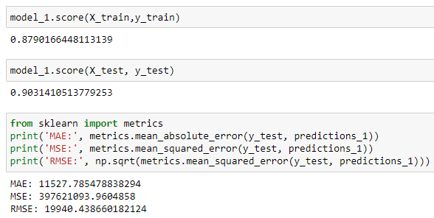
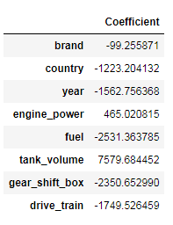
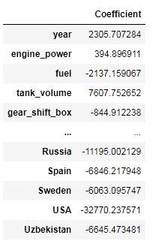
Modeling Linear Regression
1 option (LabelEncoder)
2 option (get_dummies)

Slide 25
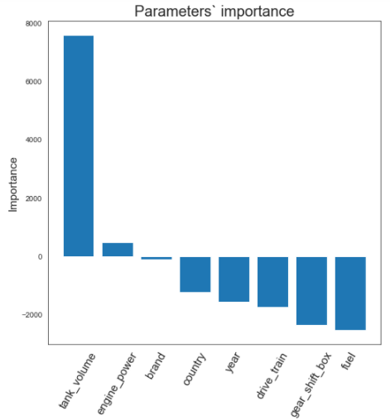
Linear Regression
1 option (LabelEncoder)

Slide 26
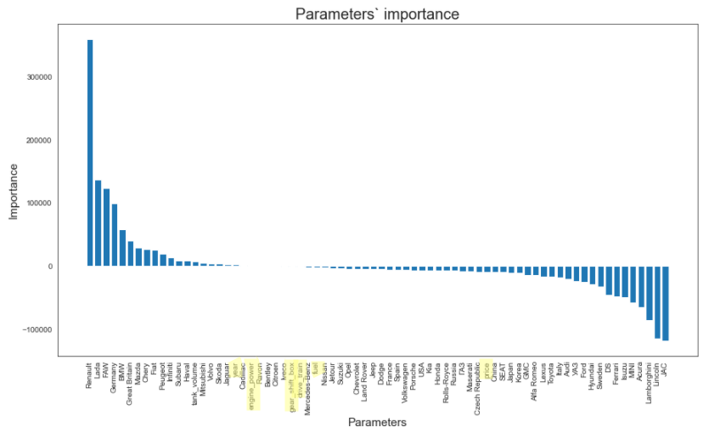
Linear Regression
2 option (get_dummies)

Slide 27
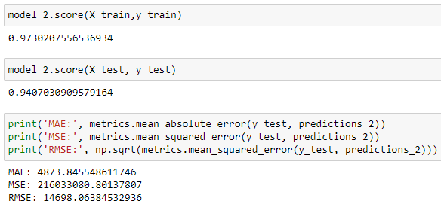
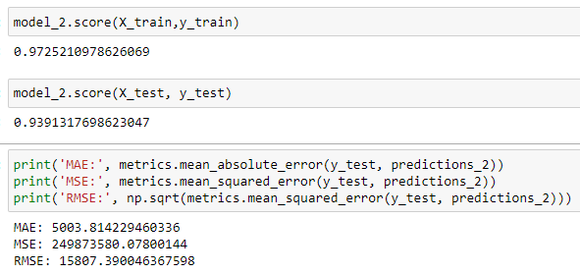
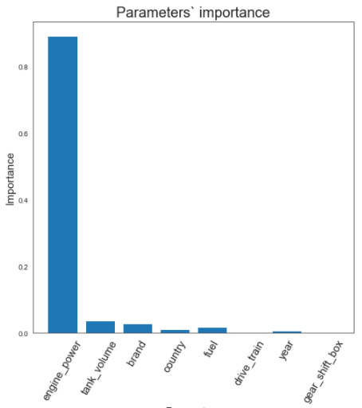
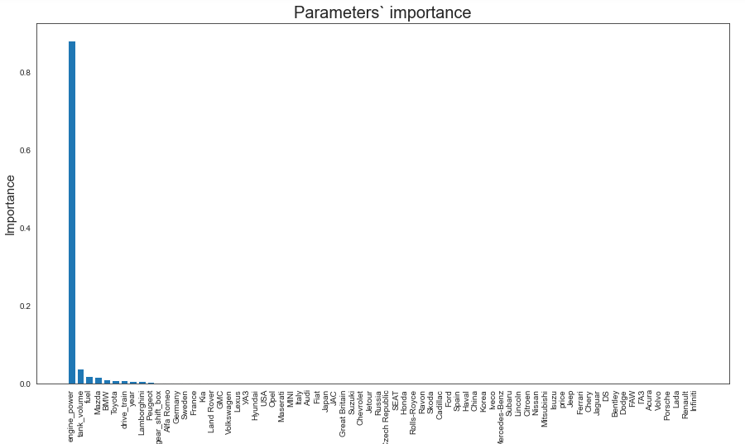
Decision Tree
1 option (LabelEncoder)
2 option (get_dummies)

Slide 28
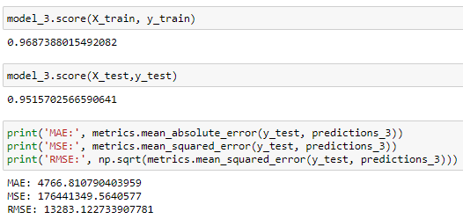
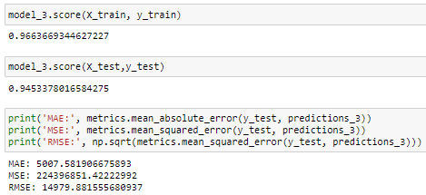
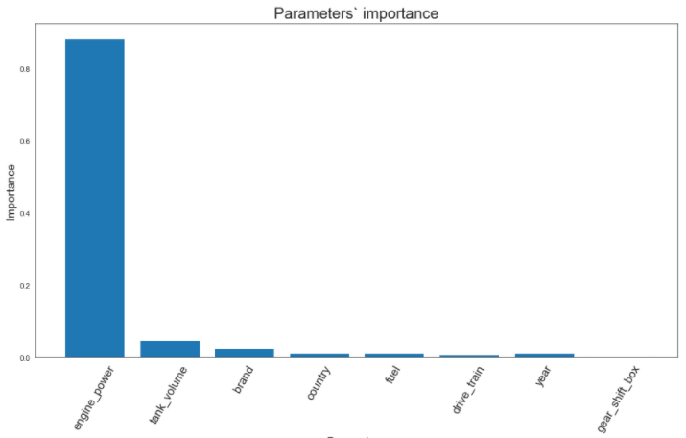

Random Forest
1 option (LabelEncoder)
2 option (get_dummies)

Slide 29

After going through the following algorithms, Decision Tree Regressor showed the highest accuracy. The other high-accurate algorithms are XGBRegressor, BaggingRegressor, and GradientBoostingRegressor.

Slide 30




XGB Boost
1 option (LabelEncoder)
2 option (get_dummies)

Slide 31


Bagging Regressor
1 option (LabelEncoder)
2 option (get_dummies)

Slide 32




Gradient Boosting Regressor
1 option (LabelEncoder)
2 option (get_dummies)

Slide 33


Ensemble Voting Regressor
1 option (LabelEncoder)
2 option (get_dummies)

Slide 34



Algorithms comparison
1 option (LabelEncoder)
2 option (get_dummies)
Decision Tree has the highest accuracy – 0.9730. Linear Regression has the lowest accuracy – only 0.8355.
Ensemble Voting Regressor has the highest accuracy – 0,9739. Linear Regression has the lowest accuracy – 0,9031.
All in all, the first option with LabelEncoder is more appropriate and shows higher accuracy than the second one.

Slide 35

Price prediction
On the website Auto.ria.com, I chose a car priced at $71,211:

Slide 36


Comparison of the predicted price by different algorithms
1 option (LabelEncoder)
2 option (get_dummies)
The closest forecast to the real price is by DecisionTreeRegressor algorithm – $72,780
The closest forecast to the real price is by BaggingRegressor – $73,722
In general, the price prediction is better in the first option – the forecast is closer to the real price on the website.

Slide 37

Cross Validation 2 option (get_dummies)
Evaluation of the effectiveness of each algorithm is performed using cross-validation. The output message contains the following information: the name of the algorithm as an abbreviation, the average score of 10-fold cross-validation on the training data (metric ‘r2’), the standard deviation in parentheses, and the coefficient of determination r2 on the test data.

Slide 38

Boxplot of each algorithm’s span

