Slide 1


AML Insight — evidence-backed AML investigations
Team / project name: Genesis (repository project name)
Team leader: not recorded in the codebase
Problem statement: help analysts assess transaction alerts with traceable evidence,
structured AI explanations and controlled learning from actual reviews.
Notes:
Repository-grounded content. No new model calls, cloud changes or human feedback created.
Sources: README.md, backend/engine.py, backend/models.py
Slide text:
AML Insight — evidence-backed AML investigations
Team / project name: Genesis (repository project name)
Team leader: not recorded in the codebase
Problem statement: help analysts assess transaction alerts with traceable evidence,
structured AI explanations and controlled learning from actual reviews.

Slide 2
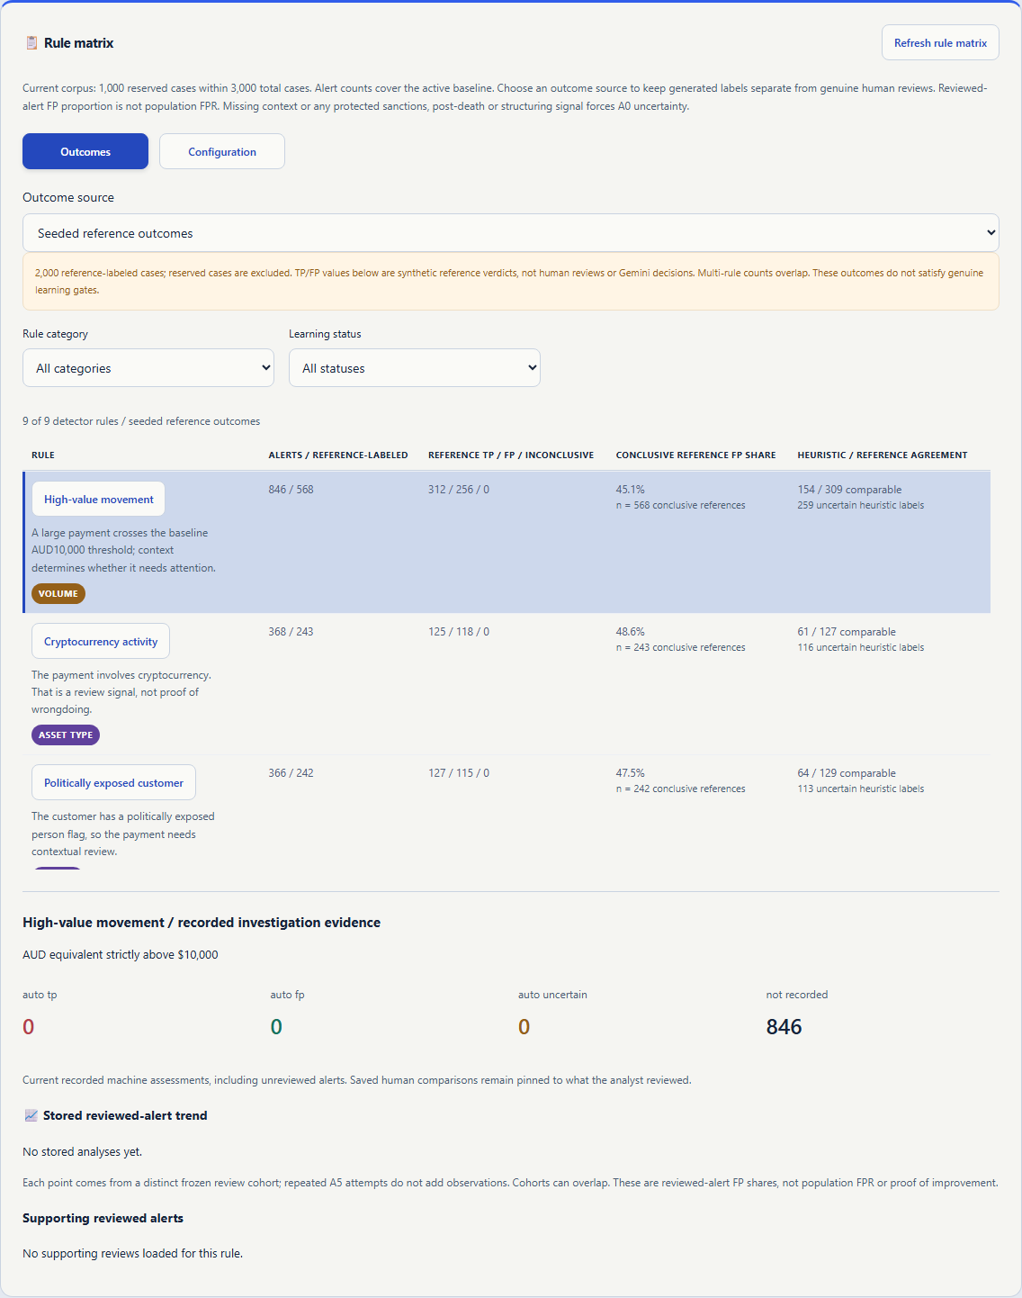

AML Insight / Genesis
A working investigation workspace
for synthetic financial-crime cases.
Nine deterministic detectors
Six focused workflow roles
Evidence-linked Gemini assistance
Analyst-owned decisions
Actual local Evolution rule matrix
Seeded reference outcomes, not human verdicts.
Current source: local prototype; earlier private cloud staging.
Notes:
Repository-grounded content. No new model calls, cloud changes or human feedback created.
Sources: README.md, docs/pending-tasks.md, backend/engine.py
Slide text:
Actual local Evolution rule matrix
Seeded reference outcomes, not human verdicts.
AML Insight / Genesis
A working investigation workspace
for synthetic financial-crime cases.
Nine deterministic detectors
Six focused workflow roles
Evidence-linked Gemini assistance
Analyst-owned decisions
Current source: local prototype; earlier private cloud staging.

Slide 3
Brief about the idea
Turn transaction alerts into evidence-linked investigations, then learn from genuine analyst outcomes.
Investigate
Review
Learn carefully
Python enriches source facts and computes risk. Gemini explains, categorizes and writes a cited brief.
The analyst inspects source history, model findings and uncertainty, then saves a frozen verdict.
Evolution separates evidence sources and tests cutoff candidates before explicit application or rollback.
Current workspace: 3,000 synthetic cases / 200 identities / nine detector rules.
AML Insight / Genesis | Repository evidence, 18 October 2026
03
Notes:
Repository-grounded content. No new model calls, cloud changes or human feedback created.
Sources: backend/engine.py, backend/jobs.py, backend/evolution.py, backend/baseline_workspace.py, docs/pending-tasks.md
Slide text:
Brief about the idea
AML Insight / Genesis | Repository evidence, 18 October 2026
03
Turn transaction alerts into evidence-linked investigations, then learn from genuine analyst outcomes.
Investigate
Python enriches source facts and computes risk. Gemini explains, categorizes and writes a cited brief.
Review
The analyst inspects source history, model findings and uncertainty, then saves a frozen verdict.
Learn carefully
Evolution separates evidence sources and tests cutoff candidates before explicit application or rollback.
Current workspace: 3,000 synthetic cases / 200 identities / nine detector rules.

Slide 4
Opportunities and proposed USP
How it differs
How it solves the problem
Proposed USP
Combines deterministic risk arithmetic with evidence-linked AI output, a sealed attempt ledger and a separate learning workflow.
No external competitor comparison is established by the code.
Keeps source history, scores, counter-evidence and suggestions in one case view.
Structured validation rejects unsupported citation IDs and preserves uncertainty for analyst attention.
Traceable assistance with controlled adaptation: source labels, model opinions, drafts and human verdicts stay separate.
Python validates candidates; a model recommendation cannot apply itself.
Value proposition is implemented in the workflow; real-world productivity gains are not yet measured.
AML Insight / Genesis | Repository evidence, 18 October 2026
04
Notes:
Repository-grounded content. No new model calls, cloud changes or human feedback created.
Sources: backend/engine.py, backend/gateway.py, backend/calibration.py, backend/projected_reviews.py
Slide text:
Opportunities and proposed USP
AML Insight / Genesis | Repository evidence, 18 October 2026
04
How it differs
Combines deterministic risk arithmetic with evidence-linked AI output, a sealed attempt ledger and a separate learning workflow.
No external competitor comparison is established by the code.
How it solves the problem
Keeps source history, scores, counter-evidence and suggestions in one case view.
Structured validation rejects unsupported citation IDs and preserves uncertainty for analyst attention.
Proposed USP
Traceable assistance with controlled adaptation: source labels, model opinions, drafts and human verdicts stay separate.
Python validates candidates; a model recommendation cannot apply itself.
Value proposition is implemented in the workflow; real-world productivity gains are not yet measured.

Slide 5
Features offered by the solution
Nine alert rules
Explainable risk
High value, crypto, PEP, post-death, dormant, multi-currency, cash, foreign wire and structuring.
Five Python-owned dimensions: transaction 30%, customer 25%, account 15%, behavior 20%, network 10%.
Case investigation
Durable execution
Identity/account links, source trail, risk explanation, typology, brief and agent traces.
Parent/child runs, leases, checkpoints, deduplication and bounded retry handling.
Evolution lab
Usage and access
Nine-rule matrix; separate reference, simulated and human outcomes; gated cutoff learning.
Per-attempt tokens/cost status, daily controls, operator/admin allowlists and private outputs.
AML Insight / Genesis | Repository evidence, 18 October 2026
05
Notes:
Repository-grounded content. No new model calls, cloud changes or human feedback created.
Sources: backend/engine.py, backend/jobs.py, backend/usage.py, backend/rule_intelligence.py, frontend/main.tsx
Slide text:
Features offered by the solution
AML Insight / Genesis | Repository evidence, 18 October 2026
05
Nine alert rules
High value, crypto, PEP, post-death, dormant, multi-currency, cash, foreign wire and structuring.
Explainable risk
Five Python-owned dimensions: transaction 30%, customer 25%, account 15%, behavior 20%, network 10%.
Case investigation
Identity/account links, source trail, risk explanation, typology, brief and agent traces.
Durable execution
Parent/child runs, leases, checkpoints, deduplication and bounded retry handling.
Evolution lab
Nine-rule matrix; separate reference, simulated and human outcomes; gated cutoff learning.
Usage and access
Per-attempt tokens/cost status, daily controls, operator/admin allowlists and private outputs.

Slide 6
Process flow / use case
Investigation: sequential stages, with source facts and risk owned by Python
Source rules
A1
A2
A3
A4
A0
Transaction / alert
Evidence enrichment
Risk explanation
Typology / action
Cited case brief
Priority / pre-label
Decision and learning: human feedback is required; generated labels do not qualify
Analyst verdict
A5 Evolution
Python candidate
Explicit approval
Frozen feedback
Frozen evidence
Fit + validation
Apply / observe / rollback
Missing context or protected signals require attention. AI output never becomes a human verdict.
AML Insight / Genesis | Repository evidence, 18 October 2026
06
Notes:
Repository-grounded content. No new model calls, cloud changes or human feedback created.
Sources: backend/jobs.py, backend/engine.py, backend/evolution.py, backend/calibration.py
Slide text:
Process flow / use case
AML Insight / Genesis | Repository evidence, 18 October 2026
06
Investigation: sequential stages, with source facts and risk owned by Python
Source rules
Transaction / alert
A1
Evidence enrichment
A2
Risk explanation
A3
Typology / action
A4
Cited case brief
A0
Priority / pre-label
Decision and learning: human feedback is required; generated labels do not qualify
Analyst verdict
Frozen feedback
A5 Evolution
Frozen evidence
Python candidate
Fit + validation
Explicit approval
Apply / observe / rollback
Missing context or protected signals require attention. AI output never becomes a human verdict.

Slide 7
Wireframes / source-based screen map
INVESTIGATIONS
CASE DETAILS
EVOLUTION LAB
Dataset / coverage counters
Identity / account / trigger
Outcomes / Understand / Learn
Identity + rule + status filters
Risk dimensions + evidence
Reference / simulated / human
Paged investigation queue
A2 → A3 → A4 → A0 trace
Nine-rule matrix + trends
View details / reference
Transactions / citations
Candidate evidence + validation
Explicit triage preview
Saved analyst verdict
Apply / Observe / rollback
Read-only browsing; explicit actions.
Private outputs require operator access.
Simulation is labeled; no silent activation.
Schematic of existing components; actual prototype screenshots follow on slide 11.
AML Insight / Genesis | Repository evidence, 18 October 2026
07
Notes:
Repository-grounded content. No new model calls, cloud changes or human feedback created.
Sources: frontend/main.tsx, frontend/BulkWorkspace.tsx, frontend/RuleIntelligence.tsx, frontend/OperatorReview.tsx
Slide text:
Wireframes / source-based screen map
AML Insight / Genesis | Repository evidence, 18 October 2026
07
INVESTIGATIONS
CASE DETAILS
EVOLUTION LAB
Dataset / coverage counters
Identity + rule + status filters
Paged investigation queue
View details / reference
Explicit triage preview
Identity / account / trigger
Risk dimensions + evidence
A2 → A3 → A4 → A0 trace
Transactions / citations
Saved analyst verdict
Outcomes / Understand / Learn
Reference / simulated / human
Nine-rule matrix + trends
Candidate evidence + validation
Apply / Observe / rollback
Read-only browsing; explicit actions.
Private outputs require operator access.
Simulation is labeled; no silent activation.
Schematic of existing components; actual prototype screenshots follow on slide 11.

Slide 8
Architecture of the solution
Browser
Cloud Run: web
Firebase Auth
React / TypeScript / Vite
FastAPI / web + private API
Human sign-in / UID allowlists
Web ↔ Firestore • Web → Tasks → worker • Worker ↔ Firestore
Firestore
Cloud Tasks
Cloud Run: worker
Sources / runs / reviews / versions
Named jobs / OIDC delivery
Leases / stages / attempt ledger
Worker → Gemini via google-genai
Managed cloud identity; separate opt-in local Developer API path.
Cloud deployment design in code; earlier private staging exists, newest local source is not deployed.
AML Insight / Genesis | Repository evidence, 18 October 2026
08
Notes:
Repository-grounded content. No new model calls, cloud changes or human feedback created.
Sources: backend/api.py, backend/worker.py, backend/dispatch.py, backend/repository.py, backend/gateway.py, Dockerfile
Slide text:
Architecture of the solution
AML Insight / Genesis | Repository evidence, 18 October 2026
08
Browser
React / TypeScript / Vite
Cloud Run: web
FastAPI / web + private API
Firebase Auth
Human sign-in / UID allowlists
Firestore
Sources / runs / reviews / versions
Cloud Tasks
Named jobs / OIDC delivery
Cloud Run: worker
Leases / stages / attempt ledger
Web ↔ Firestore • Web → Tasks → worker • Worker ↔ Firestore
Worker → Gemini via google-genai
Managed cloud identity; separate opt-in local Developer API path.
Cloud deployment design in code; earlier private staging exists, newest local source is not deployed.

Slide 9
Technologies used in the solution
Frontend
Backend
React 19, TypeScript, Vite; Firebase web SDK; accessible native dialogs.
Python 3.12, FastAPI, Uvicorn and Pydantic; deterministic detection/scoring.
Google AI
Data / identity
google-genai SDK; structured Gemini JSON, citations, per-leg model profiles and token budgets.
Firestore, Firebase Authentication; emulator-backed local development.
Deployment
Verification
Cloud Run web + worker; Cloud Tasks; Artifact Registry; Cloud Build; Secret Manager / ADC.
pytest, Firebase emulator integration tests, TypeScript checks and Playwright browser journeys.
AML Insight / Genesis | Repository evidence, 18 October 2026
09
Notes:
Repository-grounded content. No new model calls, cloud changes or human feedback created.
Sources: package.json, pyproject.toml, backend/gateway.py, backend/agent_profiles.py, Dockerfile
Slide text:
Technologies used in the solution
AML Insight / Genesis | Repository evidence, 18 October 2026
09
Frontend
React 19, TypeScript, Vite; Firebase web SDK; accessible native dialogs.
Backend
Python 3.12, FastAPI, Uvicorn and Pydantic; deterministic detection/scoring.
Google AI
google-genai SDK; structured Gemini JSON, citations, per-leg model profiles and token budgets.
Data / identity
Firestore, Firebase Authentication; emulator-backed local development.
Deployment
Cloud Run web + worker; Cloud Tasks; Artifact Registry; Cloud Build; Secret Manager / ADC.
Verification
pytest, Firebase emulator integration tests, TypeScript checks and Playwright browser journeys.

Slide 10
Estimated implementation cost
What the repository records
What is not established
Earlier build: 118.60 seconds; recorded compute list-rate estimate US$0.01186, before free allowances.
Not an invoice or a complete project cost.
No labor-cost estimate or final monthly bill is recorded. Model cost remains UNKNOWN unless a matching verified rate card and usage are available.
Configured token ceilings per investigation (before retries)
A2: 4,096 input / 1,536 generated • A3: 2,048 / 768 • A4: 4,096 / 2,048
Total A2–A4: 10,240 input / 4,352 generated. A5 is separate: 8,192 / 3,072.
Controls: scale 0–1 in recorded staging, daily attempt controls and paused dispatch.
The recorded AUD 6 alerts-only budget is not a spending cap; storage/network/build costs are separate.
AML Insight / Genesis | Repository evidence, 18 October 2026
10
Notes:
Repository-grounded content. No new model calls, cloud changes or human feedback created.
Sources: backend/pricing.py, backend/usage.py, backend/prompts.py, docs/deployment-recovery.md
Slide text:
Estimated implementation cost
AML Insight / Genesis | Repository evidence, 18 October 2026
10
What the repository records
Earlier build: 118.60 seconds; recorded compute list-rate estimate US$0.01186, before free allowances.
Not an invoice or a complete project cost.
What is not established
No labor-cost estimate or final monthly bill is recorded. Model cost remains UNKNOWN unless a matching verified rate card and usage are available.
Configured token ceilings per investigation (before retries)
A2: 4,096 input / 1,536 generated • A3: 2,048 / 768 • A4: 4,096 / 2,048
Total A2–A4: 10,240 input / 4,352 generated. A5 is separate: 8,192 / 3,072.
Controls: scale 0–1 in recorded staging, daily attempt controls and paused dispatch.
The recorded AUD 6 alerts-only budget is not a spending cap; storage/network/build costs are separate.

Slide 11
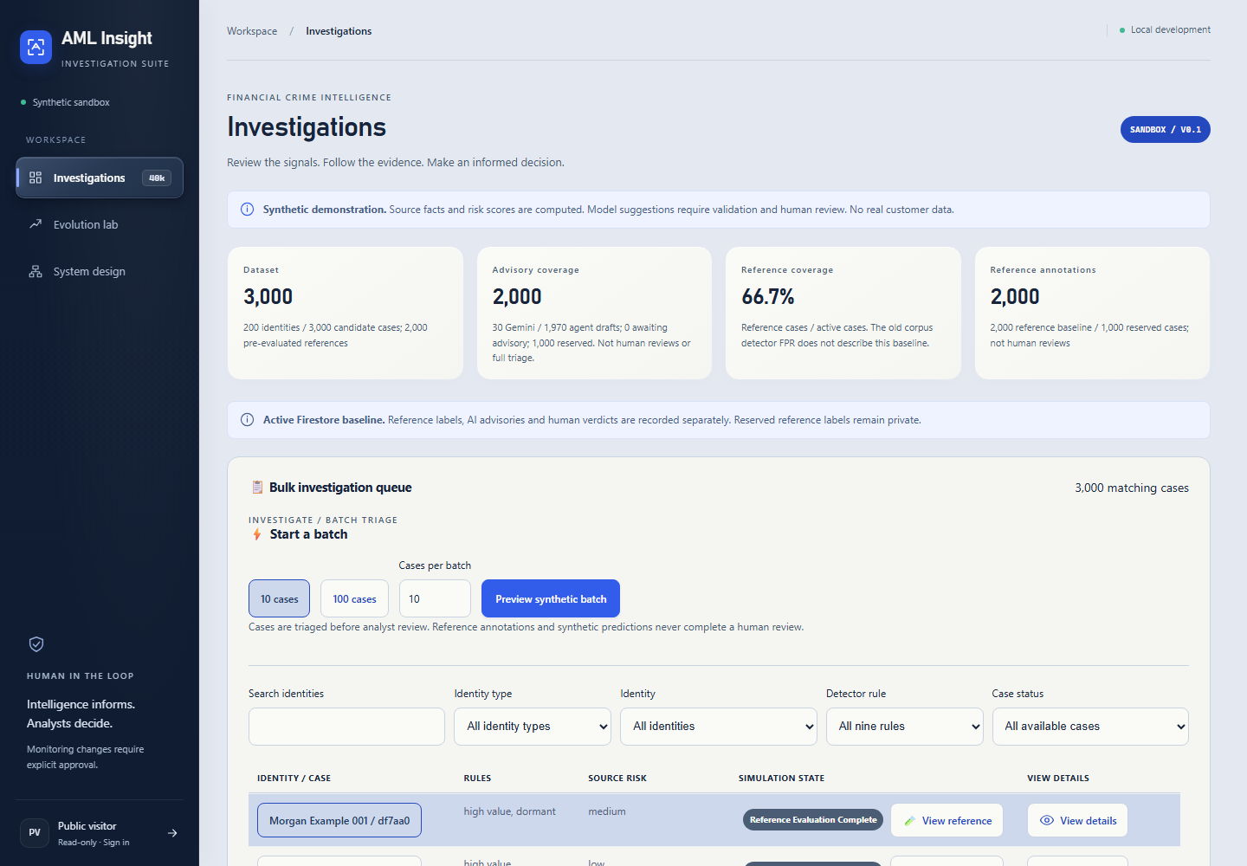
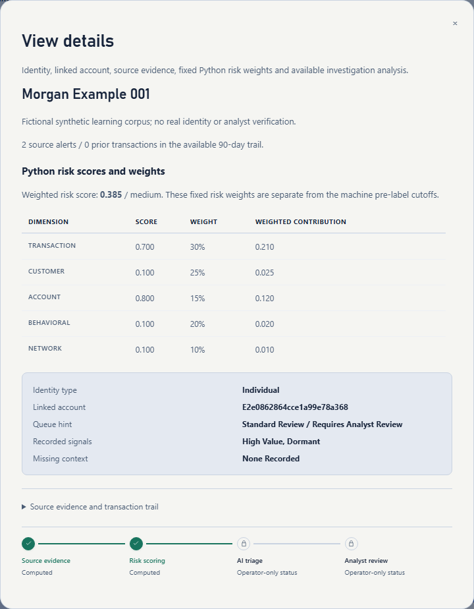
Snapshots of the prototype
Actual case-details dialog.
Synthetic customer data only.
Actual local queue: 3,000 cases / 200 identities.
AML Insight / Genesis | Repository evidence, 18 October 2026
11
Notes:
Repository-grounded content. No new model calls, cloud changes or human feedback created.
Sources: frontend/main.tsx, frontend/RuleIntelligence.tsx, docs/baseline-workspace.md
Slide text:
Snapshots of the prototype
AML Insight / Genesis | Repository evidence, 18 October 2026
11
Actual local queue: 3,000 cases / 200 identities.
Actual case-details dialog.
Synthetic customer data only.

Slide 12
Prototype performance / benchmarking
162
25
9
unit tests passed
emulator integrations passed
detector rules covered
Recorded completed checkpoint: CI-012; 25 integrations, zero integration skips.
What was exercised
What is not a benchmark
Source integrity, scoped access, deduplication, projections and browser layouts from 320–1440 px. TypeScript and design checks passed.
No validated production accuracy, p95 latency, false-positive reduction or analyst-time saving is established. CI-013 is in progress.
These are recorded verification results, not tests rerun for this deck or evidence of deployed-current-source performance.
AML Insight / Genesis | Repository evidence, 18 October 2026
12
Notes:
Repository-grounded content. No new model calls, cloud changes or human feedback created.
Sources: docs/code-improvements.md, docs/projected-analyst-baseline.md, docs/evaluation-record.json, docs/deployment-recovery.md
Slide text:
Prototype performance / benchmarking
AML Insight / Genesis | Repository evidence, 18 October 2026
12
162
unit tests passed
25
emulator integrations passed
9
detector rules covered
Recorded completed checkpoint: CI-012; 25 integrations, zero integration skips.
What was exercised
Source integrity, scoped access, deduplication, projections and browser layouts from 320–1440 px. TypeScript and design checks passed.
What is not a benchmark
No validated production accuracy, p95 latency, false-positive reduction or analyst-time saving is established. CI-013 is in progress.
These are recorded verification results, not tests rerun for this deck or evidence of deployed-current-source performance.

Slide 13
Additional details / future development
Complete the current workflow
Validate improvement
Finish and verify the reserved-case genuine-batch work. Gather real analyst verdicts and measure outcomes; generated projections cannot satisfy learning gates.
Require 30 conclusive genuine reviews overall and 15 eligible target-rule observations; then prospective validation on five new distinct identities.
Deploy current source
Finish release artifacts
Build the verified current revision; validate publisher, Auth and private web/worker integration. Keep model/task activation explicit and bounded.
Publish clean source, a signed-out prototype and a real video under three minutes. Keep private notes, held-out labels and credentials out of release assets.
These are existing repository tasks, not new product promises or claimed completed capabilities.
AML Insight / Genesis | Repository evidence, 18 October 2026
13
Notes:
Repository-grounded content. No new model calls, cloud changes or human feedback created.
Sources: docs/pending-tasks.md, backend/calibration.py, backend/publisher.py, docs/operator-staging-login.md
Slide text:
Additional details / future development
AML Insight / Genesis | Repository evidence, 18 October 2026
13
Complete the current workflow
Finish and verify the reserved-case genuine-batch work. Gather real analyst verdicts and measure outcomes; generated projections cannot satisfy learning gates.
Validate improvement
Require 30 conclusive genuine reviews overall and 15 eligible target-rule observations; then prospective validation on five new distinct identities.
Deploy current source
Build the verified current revision; validate publisher, Auth and private web/worker integration. Keep model/task activation explicit and bounded.
Finish release artifacts
Publish clean source, a signed-out prototype and a real video under three minutes. Keep private notes, held-out labels and credentials out of release assets.
These are existing repository tasks, not new product promises or claimed completed capabilities.

Slide 14
Repository, video and product links
GitHub public repository
No published public repository URL is recorded. Clean source-export copies exist in submission/github-repository/.
Demo video — under three minutes
No recorded video URL or measured duration is available. A 150-second recording script exists in submission/demo-video/.
Final product link
Local source preview: http://127.0.0.1:5173 — this workstation only. Earlier private Cloud Run staging is recorded; no signed-out public product URL is recorded.
All three requested fields are answered from the repository; unavailable public links are not fabricated.
AML Insight / Genesis | Repository evidence, 18 October 2026
14
Notes:
Repository-grounded content. No new model calls, cloud changes or human feedback created.
Sources: submission/github-repository/README.md, submission/demo-video/README.md, submission/deployed-prototype/README.md, docs/deployment-recovery.md
Slide text:
Repository, video and product links
AML Insight / Genesis | Repository evidence, 18 October 2026
14
GitHub public repository
No published public repository URL is recorded. Clean source-export copies exist in submission/github-repository/.
Demo video — under three minutes
No recorded video URL or measured duration is available. A 150-second recording script exists in submission/demo-video/.
Final product link
Local source preview: http://127.0.0.1:5173 — this workstation only. Earlier private Cloud Run staging is recorded; no signed-out public product URL is recorded.
All three requested fields are answered from the repository; unavailable public links are not fabricated.

Slide 15
Evidence boundaries: know what each count means
2,000 advisory cases: coverage is not the same as human verification
30 genuine Gemini advisories (1.5%) + 1,970 agent drafts (98.5%).
Agent drafts have distinct provenance and no provider attempts or human-feedback claims.
1,000 reserved cases are excluded from advisory preprocessing.
Simulated analyst assignments
Current learning outcome
1,500 agree / 400 disagree / 100 uncertain. Generated training labels, not actual human verdicts.
No supported cutoff candidate in the recorded projection run. No operational policy changed.
Reference labels, full investigations, Gemini advisories, agent drafts and human reviews remain separate.
AML Insight / Genesis | Repository evidence, 18 October 2026
15
Notes:
Repository-grounded content. No new model calls, cloud changes or human feedback created.
Sources: docs/baseline-workspace.md, docs/projected-analyst-baseline.md, backend/projected_reviews.py
Slide text:
Evidence boundaries: know what each count means
AML Insight / Genesis | Repository evidence, 18 October 2026
15
2,000 advisory cases: coverage is not the same as human verification
30 genuine Gemini advisories (1.5%) + 1,970 agent drafts (98.5%).
Agent drafts have distinct provenance and no provider attempts or human-feedback claims.
1,000 reserved cases are excluded from advisory preprocessing.
Simulated analyst assignments
1,500 agree / 400 disagree / 100 uncertain. Generated training labels, not actual human verdicts.
Current learning outcome
No supported cutoff candidate in the recorded projection run. No operational policy changed.
Reference labels, full investigations, Gemini advisories, agent drafts and human reviews remain separate.

Slide 16

AML Insight / Genesis
Evidence first.
AI assists. Analysts decide.
Learning requires validated outcomes.
Notes:
Repository-grounded content. No new model calls, cloud changes or human feedback created.
Sources: backend/engine.py, backend/gateway.py, backend/calibration.py
Slide text:
AML Insight / Genesis
Evidence first.
AI assists. Analysts decide.
Learning requires validated outcomes.

