Slide 1
EEG Decoding:
Face/Car Classification
Group 8: Chengxi Fan, Michael Pressler, Ady Zhang

Slide 2
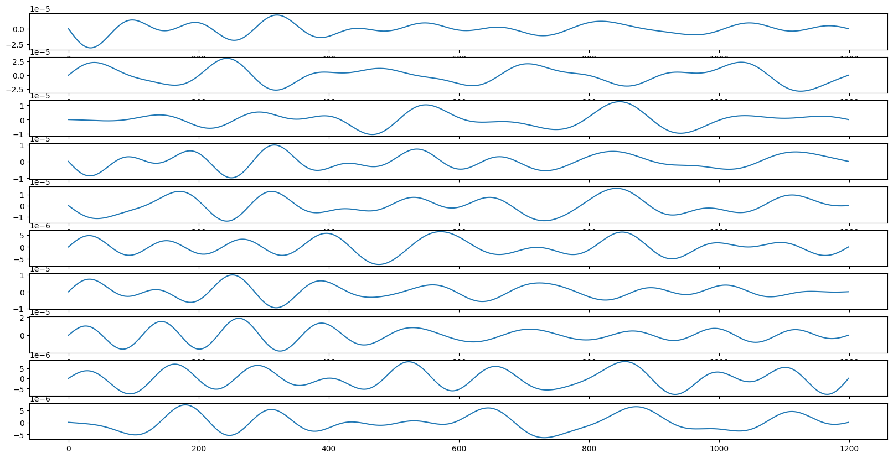
Preprocessing
Filtering
Bandpass (passing 4 – 8 Hz)
Data centering & Normalization using z-score
Principal Component Analysis (PCA)
Dimensionality reduction
Number of components: 20
Data Splitting
80% for training, 20% for testing from X_EEG_TRAIN and Y_EEG_TRAIN (X_train, y_train, X_test, y_test)

Slide 3
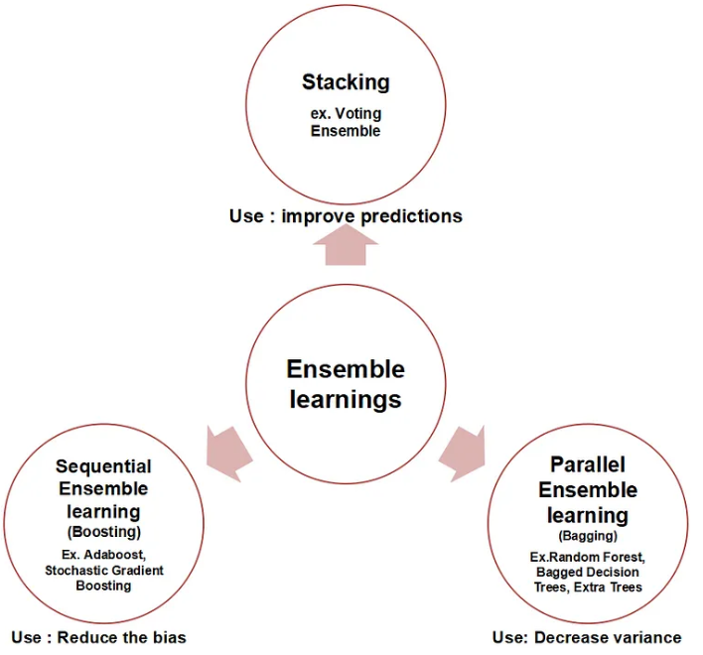
Ensemble Learning
The concept of ensemble learning refers to when multiple learning algorithms are combined to produce a learning algorithm with higher accuracy than achievable by any individual algorithm.
Three main categories:
Boosting: reduces bias
Bagging: decreases variance
Stacking: combination of multiple models
Patel, Ashish. “Ensemble Learning- the Heart of Machine Learning.” Medium, ML Research Lab, 18 Mar. 2020, https://medium.com/ml-research-lab/ensemble-learning-the-heart-of-machine-learning-b4f59a5f9777.

Slide 4
Models Used for Ensemble
Support Vector Machine
Decision Tree
Random Forest Classifier
Stochastic Gradient Descent Classifier
Gaussian Naive Bayes
Logistic Regression

Slide 5

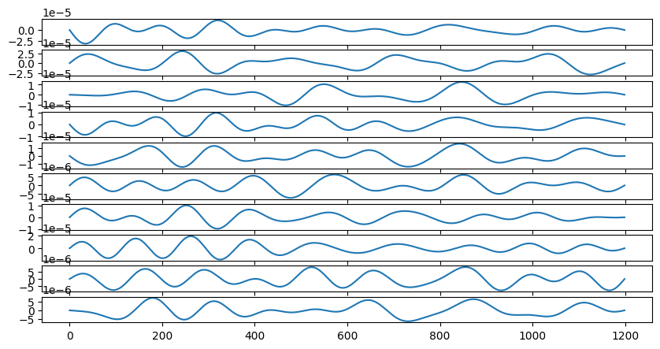
Model Structure
Preprocessing
Feature Extraction
Voting
.
.
.

Slide 6
Feature Extraction
Features extracted per channel, window, and trial:
Mean
Median
Standard Deviation
Variance
Kurtosis
4th Moment
Max Value
Creates a Trials by Channels*Features Array to be used for training
Sliding Window was used to extract features at different time intervals.
Window Size = 50 ms
Stride = 20 ms
Channels
t (ms)

Slide 7
Results
 | Avg Best Time Window | Best ROC AUC
Subject 1 | 653.3 - 702.3 | 0.517
Subject 2 | 693.3 - 742.3 | 0.582
Subject 3 | 713.3 - 762.3 | 0.723
Subject 4 | 475.5 - 524.5 | 0.485
Subject 5 | 556.6 - 605.6 | 0.628
Subject 6 | 396.6- 445.6 | 0.697
Subject 7 | 627.7- 676.7 | 0.757
Subject 8 | 640.0 - 689.0 | 0.652
20% of training samples were held out for the final test

Slide 8
Discussion
Many of the individual models seemed to perform well in during cross validation ~ 0.7-0.8 AUC of ROC, but when tried on test set even with ensemble, it performs poorly.
Overfitting
Data leakage
Using better feature extraction techniques
ICA
AR Modeling
Better Deep Learning architecture
Results may be limited to sample size
Using pretrained model
Exploring different architectures

Slide 9
Questions?

