Slide 1
Migration from jBPM to Activiti
Frederik Heremans
Software Engineer, Activiti Team, Alfresco

Slide 2

Introduction
Frederik Heremans
Software Engineer at Alfresco
  Activiti core developer
  Open-source enthusiast
  Former J2EE and ECM consultant
  Based in Belgium

Slide 3
Agenda
  What is Activiti?
  BPMN 2.0
  Activiti and JBPM compared
  Migrating your workflow
    Process definition
    Your code
  Designer Demo
  Q&A

Slide 4
What is Activiti?
  100% Open source BPM
  100% Java
  Lightweight
  Embeddable
  Customizable
  Excellent testability

Slide 5

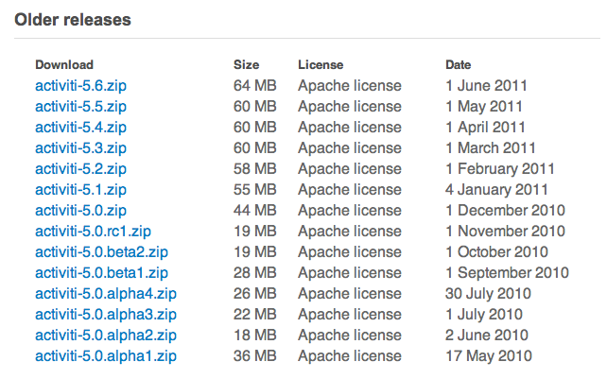
What is Activiti?
  Not only an Alfresco effort
  Active community
  Release fast, release often

Slide 6
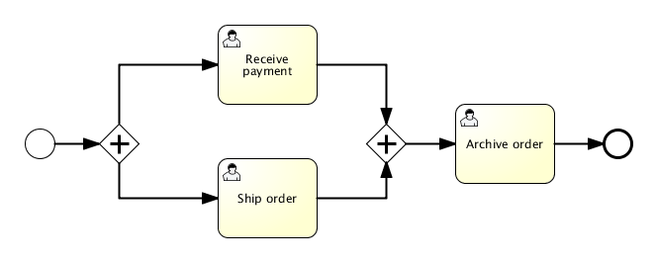

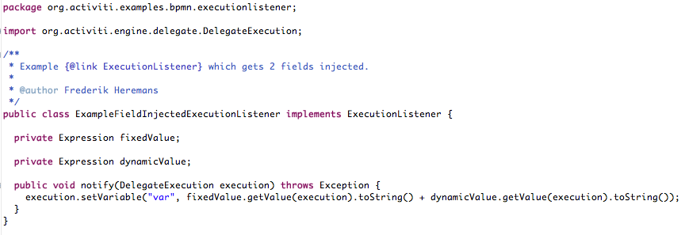
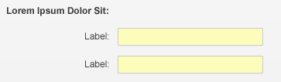
What is Activiti?
Process
API
→ runtimeService.startProcessInstance…
Java
Forms

Slide 7
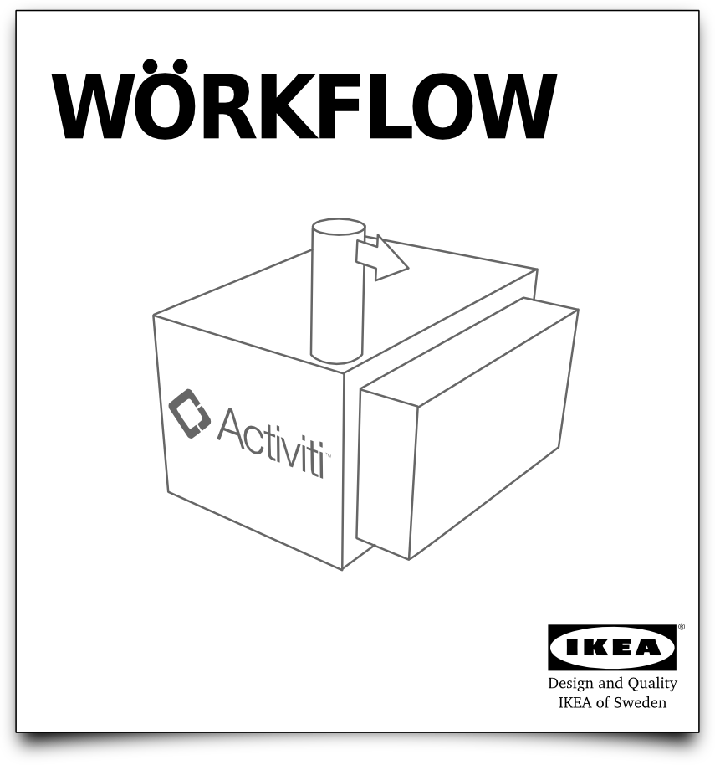
More than just a simple library…

Slide 8
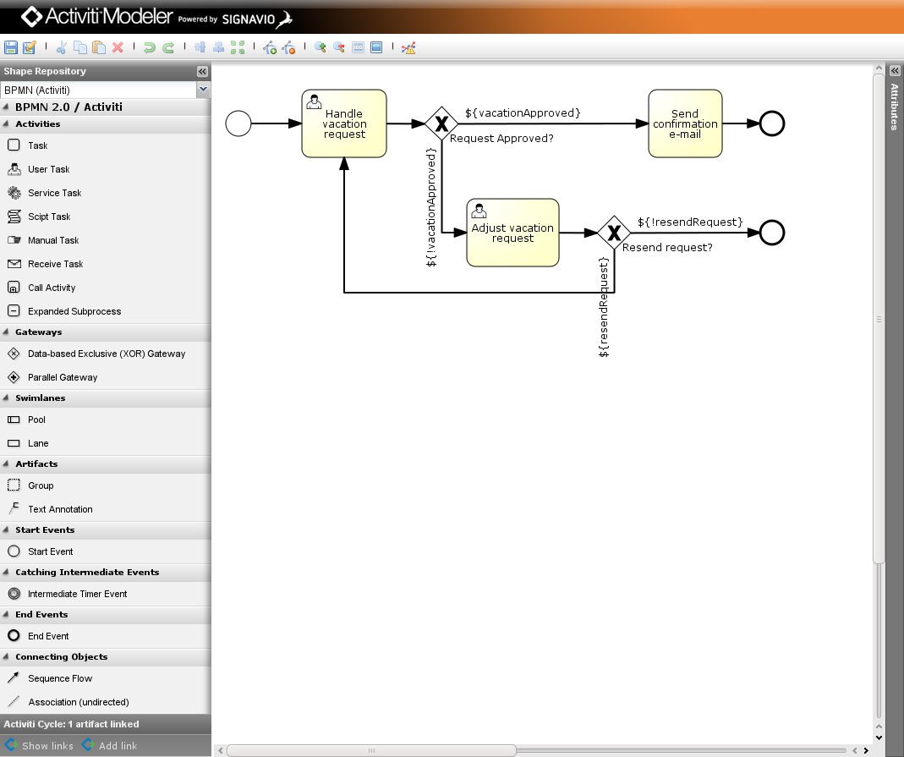
Activiti Modeler (Browser)

Slide 9
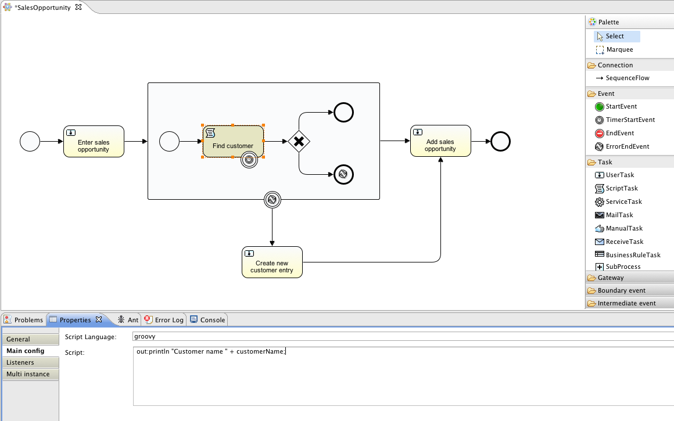
Activiti Designer (Eclipse)

Slide 10
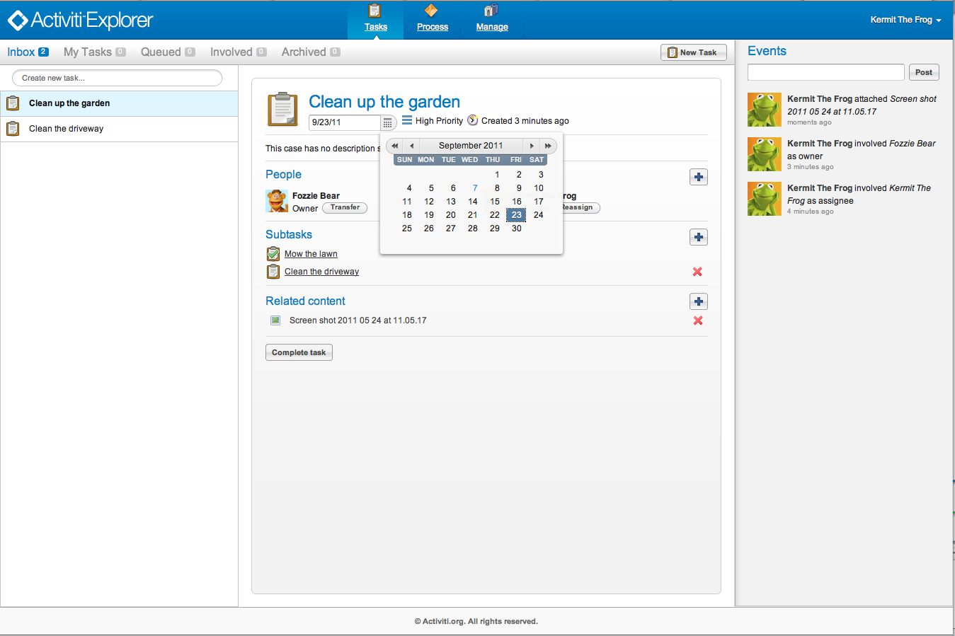
Activiti Explorer

Slide 11
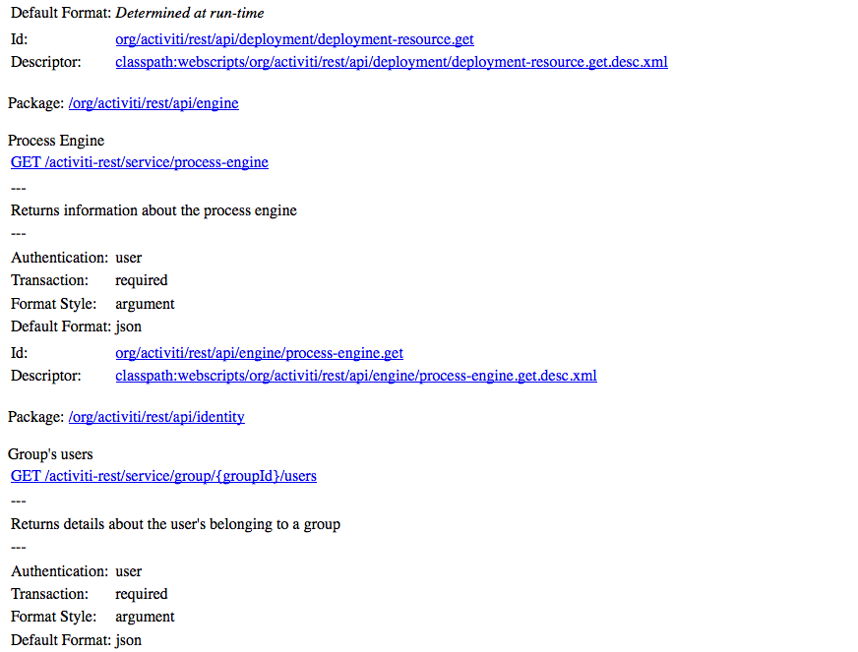

Activiti REST API

Slide 12
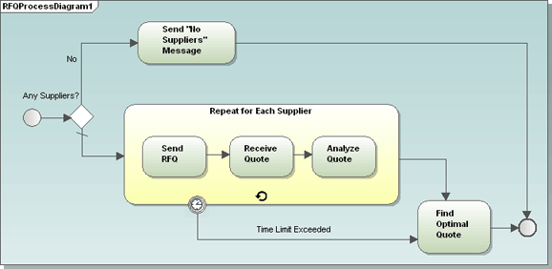
BPMN 2.0
OMG standard
  Shapes
  Execution semantics
  File format
First pure play BPM standard
  With general endorsement

Slide 13
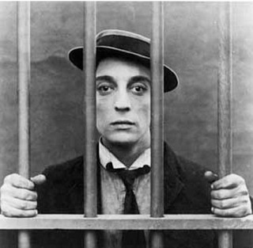
What does that mean?
  Huge pool of skilled analysts
  Any BPMN 2.0 Compliant editor
    MS Visio, Oracle, IBM, Aris, …
  Executable on the Activiti engine

Slide 14
Activiti and JBPM compared
  Apache licensed
  Started from scratch, new architecture
  Clean (fluent) API
  History separated from runtime data
  Hibernate replaced by myBatis
  BPMN 2.0 offers more constructs than JPDL

Slide 15
Migrating your workflows
No automatic database-upgrade possible
  Due to big difference in architecture
  Not necessary in Alfresco, both engines can be running alongside during transition period
What to migrate?
  Convert process definition
  Convert (or reuse) task-definitions
  Convert custom coding

Slide 16
Migrating your workflows
No automatic database-upgrade possible
  Due to big difference in architecture
  Not necessary in Alfresco, both engines can be running alongside during transition period
What to migrate?
  Convert process definition
  Convert (or reuse) task-definitions
  Convert custom coding

Slide 17
Modeling an Activiti process
Using the Activiti designer
  Eclipse plug-in (uses Graphiti)
  Built-in extensions & templates for Alfresco
Editing XML by hand
  Activiti offers some extensions for making BPMN less verbose
Modeling BPMN 2.0 in the Web-base modeler
  Pure BPMN modeler, no custom activiti/alfresco features

Slide 18
Common constructs
JBPM Start-state = Activiti start event
  No notion of start-task in BPMN 2.0
<start-state name="start">
<task name="wf:submitAdhocTask" swimlane="initiator"/>
<transition name="" to="adhoc"/>
</start-state>
<!-- Activiti -->
<startEvent id="start” activiti:formKey="wf:submitAdhocTask" />
<sequenceFlow id='flow1’ sourceRef='start’ targetRef='adhocTask' />

Slide 19

Common constructs
User tasks
<task-node name="completed">
<task name="wf:completedAdhocTask" swimlane="initiator"/>
<transition name="" to="end"/>
</task-node>
<!-- Activiti -->
<userTask id="adhocTask" name="Adhoc Task” activiti:formKey="wf:adhocTask">
<humanPerformer>
<resourceAssignmentExpression>
<formalExpression>
${bpm_assignee.properties.userName}
</formalExpression>
</resourceAssignmentExpression>
</humanPerformer>
</userTask>
<sequenceFlow id='flow2’ sourceRef='adhocTask’ targetRef='verifyTaskDone' />

Slide 20
Common constructs
User tasks
<task-node name="completed">
<task name="wf:completedAdhocTask" swimlane="initiator"/>
<transition name="" to="end"/>
</task-node>
<!-- Activiti -->
<userTask id="adhocTask" name="Adhoc Task”
activiti:assignee="${bpm_assignee.properties.userName}”
activiti:formKey="wf:adhocTask” />
<sequenceFlow id='flow2’ sourceRef='adhocTask’ targetRef='verifyTaskDone' />

Slide 21
Assignment
Swimlanes not supported in Activiti, use one of:
  Assignee (human performer)
  Candidate users (potential owner)
  Candidate groups (potential owner)
Use of expressions is possible
  Assignment based on process-variables

Slide 22
Common constructs
Variables
  Process and Task-local variables
  Some correspond to task-properties (QName)
  Supports same variable types
  Task-variables aren’t flushed to the process (by default)
  Can be used in expressions and alfresco scripts

Slide 23
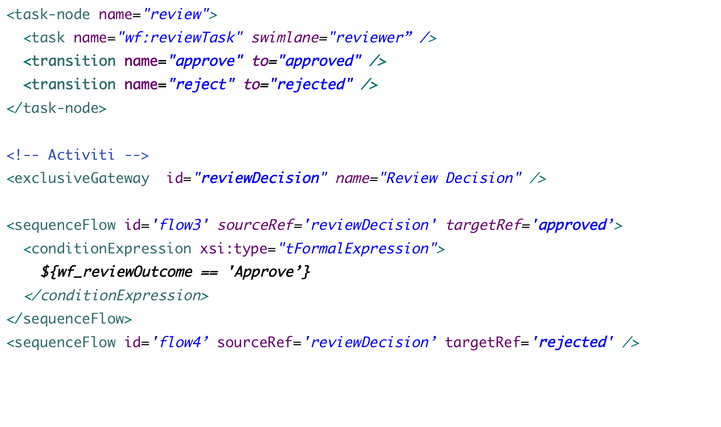
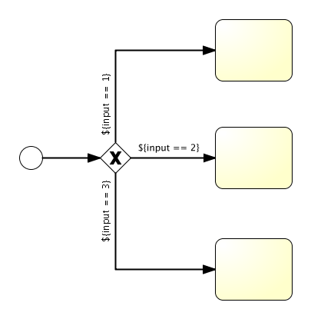
Multiple transitions - Gateway

Slide 24
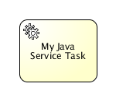
Executing your code
Service-task instead of action
  Executing Java code as part of the process
  Field injection possible, using process context
  Java Class, evaluate expression or use Spring-bean
  Provided class to execute script against Alfresco

Slide 25
Executing your code
Execution Listener
  Available events
    Process start
    Process end
    Transition taken (sequenceflow)
  ExecutionListener provided which executes a Script
Task Listener
  Available events
    Task assigned
    Task created
    Task completed
  TaskListener provided which executes a Script

Slide 26
Tips
  Look at the process-definitions shipped with Alfresco
    Property handling
    Timers
    Scripting
    Gateways and outcomes
  Activiti userguide
    Contains a lot of examples
    All supported BPMN 2.0 constructs explained
  No need to read the full BPMN 2.0 spec (unless you have a lot of time on your hands…)
  Come to the “Workflow Deep Dive” talk to learn more!

Slide 27
Eclipse designer demo

Slide 28
Thank you for your attention!
Any questions?

