Slide 1
SOA, BPM, BPEL, jBPM

Slide 2
Outline
Service oriented architecture
Enterprise application integration
Point-to-point integration
Enterprise Service Bus
BPM
BPEL
jBPM

Slide 3
Service Oriented Architecture
Service Oriented Architecture (SOA) is an architectural style that guides all aspects of creating and using business processes, packaged as services
Functionality is decomposed into small, distinct units (services), which can be distributed over a network and can be combined together and reused to create business applications

Slide 4
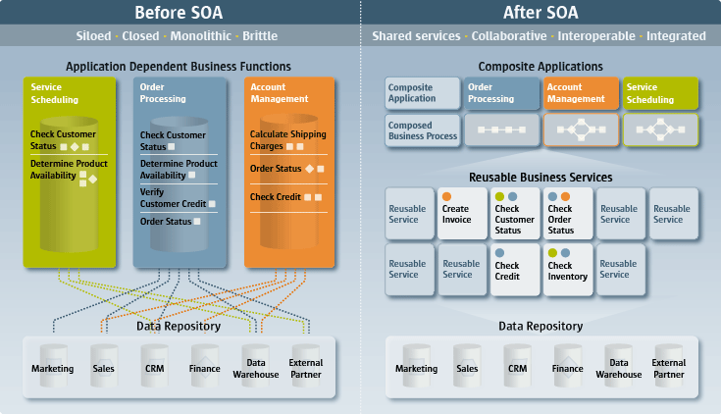
SOA Benefits
http://www.sun.com/products/soa/benefits.jsp

Slide 5
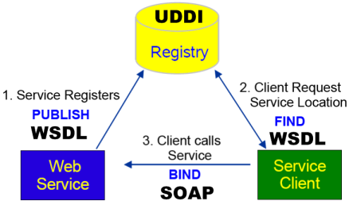
Web Services
Web services can be used to implement a service oriented architecture
Web Service characteristics:
  Application-to-application communication
  XML-based
  Platform and language
  independent
  SOAP → protocol
  WSDL → interface
  UDDI → registry

Slide 6
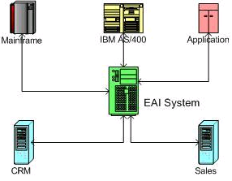
Enterprise Application Integration
EAI combines separate applications into a co-operating federation of applications
https://www.soainstitute.org/articles/article/article/eai-bpm-and-soa/

Slide 7
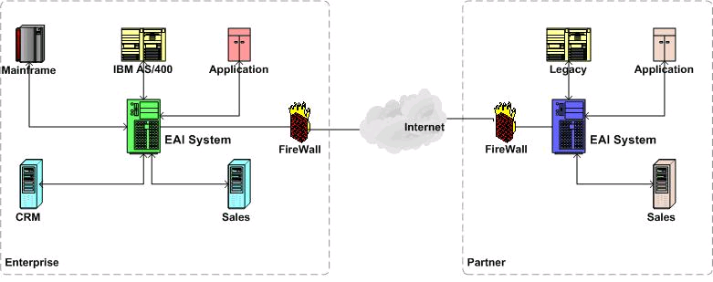
Business-to-business integration
System-to-system communications among business partners
https://www.soainstitute.org/articles/article/article/eai-bpm-and-soa/

Slide 8
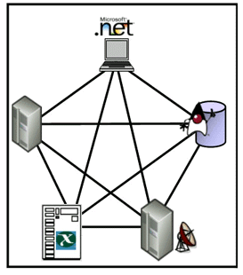
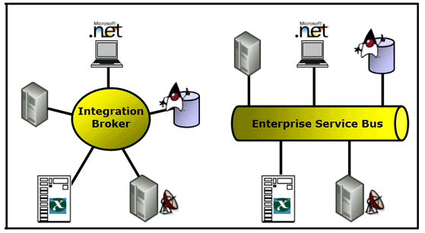
Integration architectures
Two logical integration architectures for integrating applications:
  Direct point-to-point connections
  Middleware-based integration

Slide 9
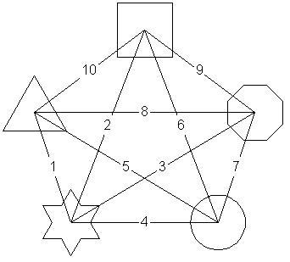
Point-to-point integration
Easy to understand and quick to implement when there are just a few systems to integrate
Disadvantages
  Tightly coupled, changes in one application may break the applications integrated with it
  Number of integration points
  require support, connections
  grow across an organization

Slide 10
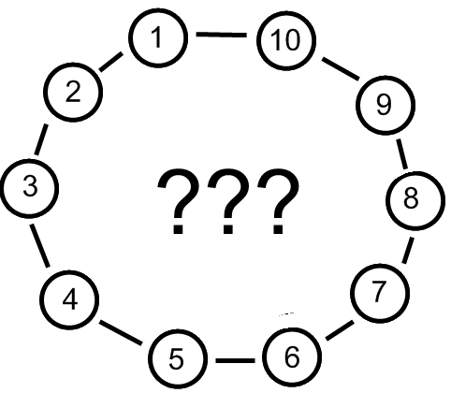
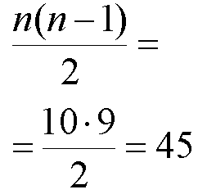
Uzdevums
Cik daudz savienojumi ir jāizveido 10 sistēmu integrācijas gadījumā???

Slide 11
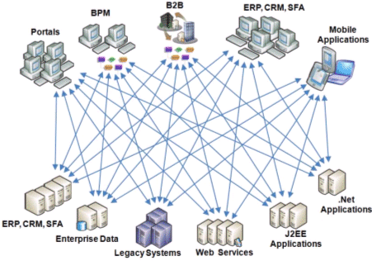
The result of P2P integrations
http://msdn2.microsoft.com/en-us/library/bb220799.aspx

Slide 12
Middleware-based integration
Middleware infrastructure products provide foundational services for complex architectures via an event-driven and standards-based messaging engine

Slide 13
Enterprise Service Bus
Based on asynchronous messaging
Application communicate via the bus, which acts as a message broker between applications
Typically Web services based, but not necessarily (WSDL interfaces)
Primary advantage - it reduces the number of point-to-point connections
  The process of adapting a system to changes in one of its components becomes easier

Slide 14
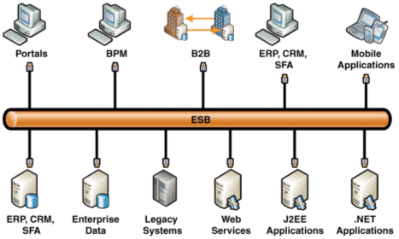
ESB Architecture
http://msdn2.microsoft.com/en-us/library/bb220799.aspx

Slide 15
ESB Definition
An ESB is a standards-based, service-oriented backbone capable of connecting hundreds of application endpoints.
ESBs combine messaging, Web Services, XML, data transformation and management to reliably connect and coordinate application interaction.
The ESB deployment model is an integrated network of collaborating service nodes, deployed in service containers.
http://www.fiorano.com/whitepapers/ESB_Best_Practices.htm

Slide 16
ESB Functions
Invocation
  Synchronous and asynchronous transport protocols, service mapping (locating and binding)
Routing
  Addressability, static/deterministic routing, content-based routing, policy-based routing
Mediation
  Adapters, protocol transformation, service mapping
Messaging
  Message processing, message transformation and message enhancement

Slide 17
ESB Functions
Process Choreography
  Implementation of complex business processes
Service Orchestration
  Coordination of multiple implementation services exposed as a single, aggregate service
Complex Event Processing
  Event interpretation, correlation, pattern matching
Other Quality of Service
  Security, reliable delivery, transaction management
Management
  Monitoring, audit, logging

Slide 18
ESB - Standards based integration
Communication and data routing (JMS)
Data protocols (XML)
Transformation (XSLT)
Connectivity (JCA)
WebServices
Security
Business Process Management (BPM)
Pre-built Business Components
Business Process Modelling (BPEL)
B2B – trading partner management

Slide 19
Business Process Management
A business process is a set of coordinated tasks and activities, conducted by both people and equipment, that will lead to accomplishing a specific goal
Business process management (BPM) is a systematic approach to improving an organization's business processes

Slide 20
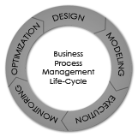
Business Process Management
BPM is a structured approach that models an enterprise's human and machine tasks and the interactions between them as processes
Evolving from document management,
workflow and enterprise application
integration (EAI), a BPM system
can monitor and analyze tasks

Slide 21



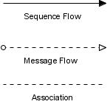
BPM Notation
A standardized graphical notation for drawing business processes in a workflow
Flow objects:
  Event
  Activity
  Gateway
Connecting objects

Slide 22
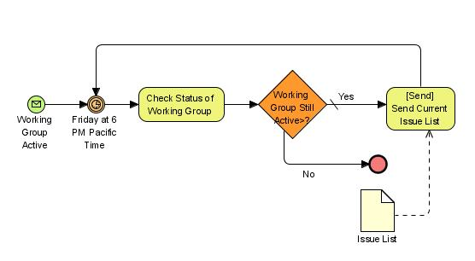
Example: Business process 1
http://en.wikipedia.org/wiki/BPMN

Slide 23
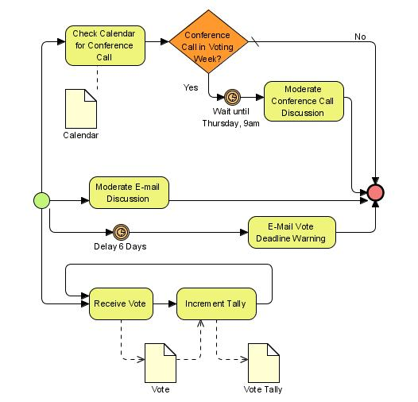
Example: Business process 2
http://en.wikipedia.org/wiki/BPMN

Slide 24
BPEL
Business Process Execution Language (or BPEL, pronounced 'bipple', 'bepple' or 'bee-pell'),
is a business process modelling language that is executable
BPEL is a language for specifying business process behavior based on Web Services
BPEL is serialized in XML and aims to enable programming in the large

Slide 25
Two Programming Levels
Programming in the large generally refers to the high-level state transition interactions of a process
Programming in the small deals with short-lived programmatic behaviour, often executed as a single transaction and involving access to local logic and resources such as files, databases, etc

Slide 26
BPEL presentations
OASIS BPEL Web page
http://www.oasis-open.org/committees/wsbpel/
Technical overview part 1
Technical overview part 2
Technical overview part 3

Slide 27
BPELJ
BPELJ is a combination of BPEL and the Java allowing the two languages to be used together to build business process applications
BPEL → programming in the large → the logic of business processes
It is assumed that BPEL will be combined with other languages which are used to implement business functions (programming in the small)
→ Java

Slide 28
BPELJ
BPELJ enables Java and BPEL to cooperate by allowing sections of Java code, called Java snippets, to be included in BPEL process definitions
BPELJ Web page:
http://www.ibm.com/developerworks/library/specification/ws-bpelj/

Slide 29
jBPM
JBoss jBPM is a framework that delivers workflow, business process management (BPM), and process orchestration
Enables enterprises to create and automate business processes that coordinate between people, applications, and services
Provides the tools and process execution engine to integrate services deployed in a SOA and automate workflows

Slide 30
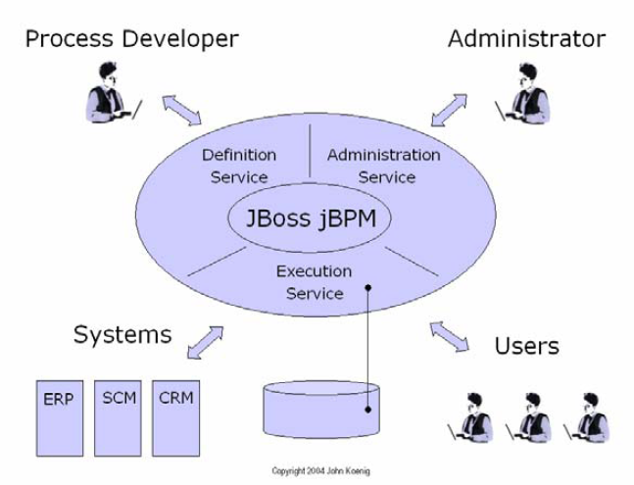
jBPM vision for BPM

Slide 31
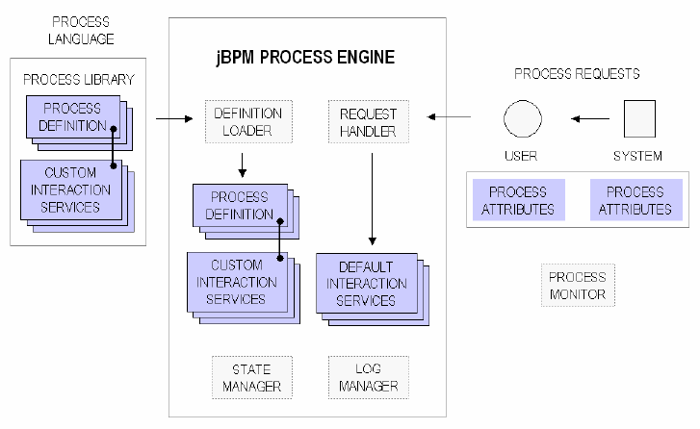
jBPM components
The core workflow and BPM functionality is packaged as a simple java library

Slide 32
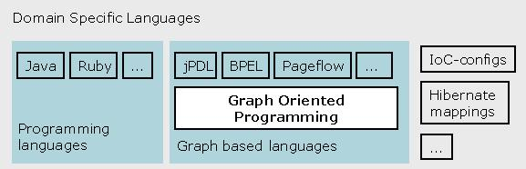
jBPM process language - jPDL
jPDL is a graph based process language that is build on top of common jBPM framework

Slide 33
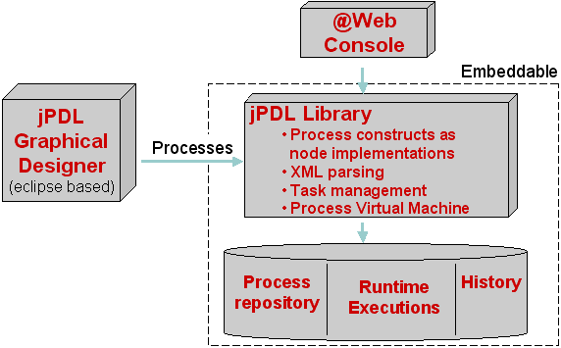
Overview of the jPDL components
http://docs.jboss.com/jbpm/v3.2/userguide/html/introduction.html

Slide 34
BPEL support
jBPM design and pluggable architecture makes it possible to support different languages that can be shown as a graph and represent some sort of execution
jBPM provides BPEL support:
  JBoss jBPM BPEL Extension, version 1.1.Beta3
  Download
    http://prdownloads.sourceforge.net/jbpm/jbpm-bpel-1.1.Beta3.zip?download
  Documentation
    http://docs.jboss.com/jbpm/bpel/

Slide 35
References
ESB Best Practices Presentation http://www.fiorano.com/whitepapers/ESB_Best_Practices.htm
jBPM Documentation Library http://labs.jboss.com/jbossjbpm/docs/index.html
jBPM Presentations http://wiki.jboss.org/wiki/Wiki.jsp?page=JbpmPresentations

