Slide 1
Reinforcement Learning

Slide 2
Introduction
Element of reinforcement learning
Reinforcement Learning Problem
Problem solving methods for RL

Slide 3
Introduction
Machine learning: Definition
  Machine learning is a scientific discipline that is concerned with the design and development of algorithms that allow computers to learn based on data, such as from sensor data or databases.
  A major focus of machine learning research is to
  automatically learn to recognize complex patterns and
  make intelligent decisions based on data .

Slide 4
Machine learning Type:
With respect to the feedback type to learner:
  Supervised learning : Task Driven (Classification)‏
  Unsupervised learning : Data Driven (Clustering)‏
  Reinforcement learning —
    Close to human learning.
    Algorithm learns a policy of how to act in a given environment.
    Every action has some impact in the environment, and the environment provides rewards that guides the learning algorithm.

Slide 5
Supervised Learning Vs Reinforcement Learning
Supervised Learning
Step: 1
  Teacher: Does picture 1 show a car or a flower?
  Learner: A flower.
  Teacher: No, it’s a car.
Step: 2
  Teacher: Does picture 2 show a car or a flower?
  Learner: A car.
  Teacher: Yes, it’s a car.
Step: 3 ....

Slide 6
Supervised Learning Vs Reinforcement Learning (Cont...)‏
Reinforcement Learning
Step: 1
  World: You are in state 9. Choose action A or C.
  Learner: Action A.
  World: Your reward is 100.
Step: 2
  World: You are in state 32. Choose action B or E.
  Learner: Action B.
  World: Your reward is 50.
Step: 3 ....

Slide 7
Introduction (Cont..)‏
Meaning of Reinforcement: Occurrence of an event, in the proper relation to a response, that tends to increase the probability that the response will occur again in the same situation.
Reinforcement learning is the problem faced by an agent that learns behavior through trial-and-error interactions with a dynamic environment.
  Reinforcement Learning is learning how to act in order to maximize a numerical reward.

Slide 8
Introduction (Cont..)‏
Reinforcement learning is not a type of neural network, nor is it an alternative to neural networks. Rather, it is an orthogonal approach for Learning Machine.
Reinforcement learning emphasizes learning feedback that evaluates the learner's performance without providing standards of correctness in the form of behavioral targets.
Example: Bicycle learning

Slide 9
Element of reinforcement learning
Agent
Policy
State
Reward
Action
Environment
  Agent: Intelligent programs
  Environment: External condition
  Policy:
    Defines the agent’s behavior at a given time
    A mapping from states to actions
    Lookup tables or simple function

Slide 10
Element of reinforcement learning
Reward function :
  Defines the goal in an RL problem
  Policy is altered to achieve this goal
Value function:
  Reward function indicates what is good in an immediate sense while a value function specifies what is good in the long run.
  Value of a state is the total amount of reward an agent can expect to accumulate over the future, starting form that state.
Model of the environment :
  Predict mimic behavior of environment,
  Used for planning & if Know current state and action then predict the resultant next state and next reward.

Slide 11
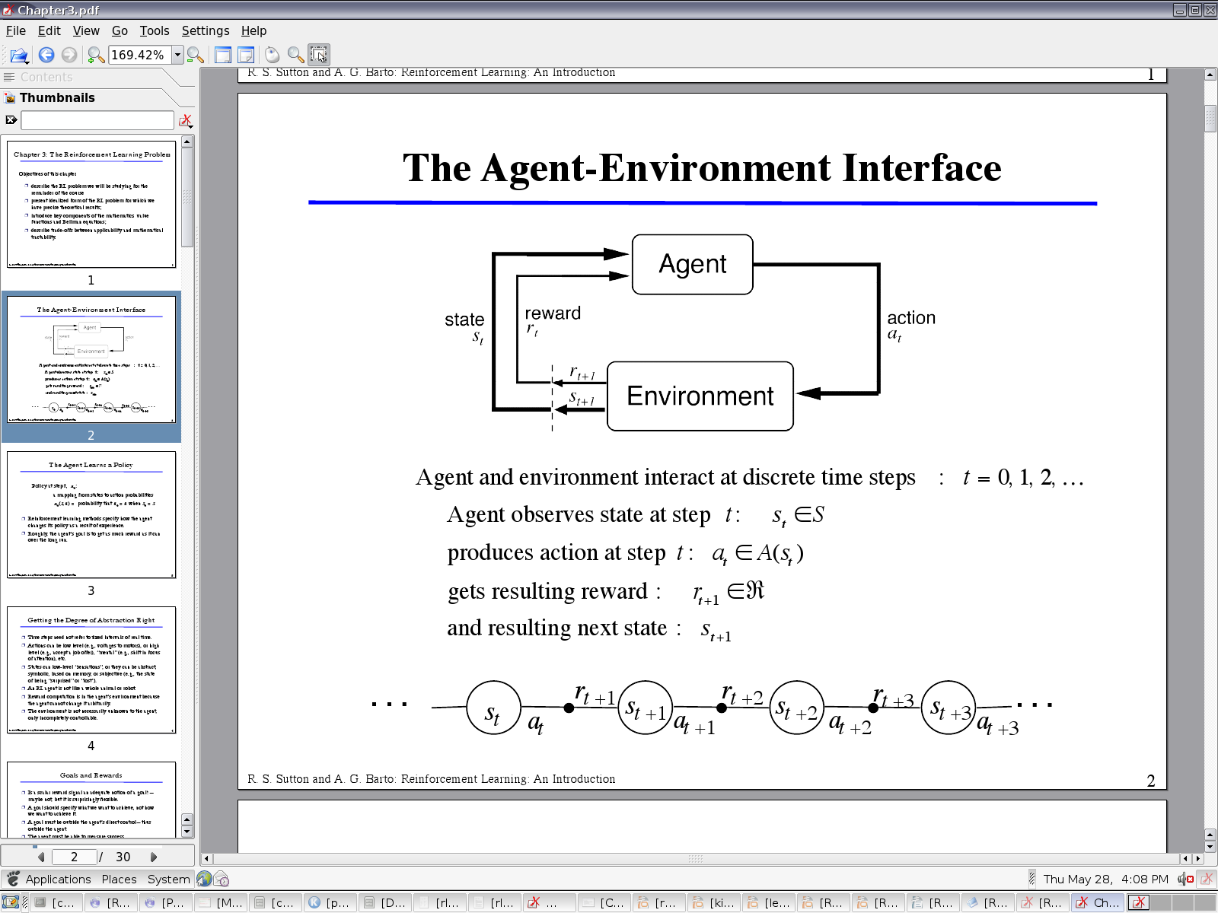
Agent- Environment Interface

Slide 12
Steps for Reinforcement Learning
  The agent observes an input state
  An action is determined by a decision making function (policy)
  The action is performed
  The agent receives a scalar reward or reinforcement from the environment
  Information about the reward given for that state / action pair is recorded

Slide 13
Silent Features of Reinforcement Learning :
Set of problems rather than a set of techniques
Without specifying how the task is to be achieved.
“RL as a tool” point of view:
  RL is training by rewards and punishments.
  Train tool for the computer learning.
The learning agent’s point of view:
  RL is learning from trial and error with the world.
  Eg. how much reward I much get if I get this.

Slide 14
Reinforcement Learning (Cont..)‏
Reinforcement Learning uses Evaluative Feedback
Purely Evaluative Feedback
  Indicates how good the action taken is.
  Not tell if it is the best or the worst action possible.
  Basis of methods for function optimization.
Purely Instructive Feedback
  Indicates the correct action to take, independently of the action actually taken.
  Eg: Supervised Learning
Associative and Non Associative:

Slide 15
Associative & Non Associative Tasks
Associative :
  Situation Dependent
  Mapping from situation to the actions that are best in that situation
Non Associative:
  Situation independent
  No need for associating different action with different situations.
  Learner either tries to find a single best action when the task is stationary, or tries to track the best action as it changes over time when the task is non stationary.

Slide 16
Reinforcement Learning (Cont..)‏
Exploration and exploitation
  Greedy action: Action chosen with greatest estimated value.
  Greedy action: a case of Exploitation.
  Non greedy action: a case of Exploration, as it enables us to improve estimate the non-greedy action's value.
N-armed bandit Problem:
  We have to choose from n different options or actions.
  We will choose the one with maximum reward.

Slide 17
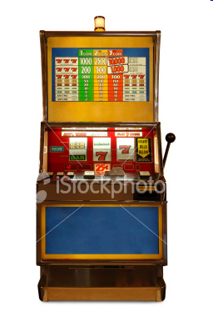
Bandits Problem
One-Bandit “arms”
Pull arms sequentially so as to maximize the total expected reward
It is non associative and evaluative

Slide 18
Action Selection Policies
Greediest action - action with the highest estimated reward.
Ɛ -greedy
  Most of the time the greediest action is chosen
  Every once in a while with a small probability Ɛ, an action is selected at random. The action is selected uniformly, independent of the action-value estimates.
Ɛ -soft - The best action is selected with probability (1 –Ɛ) and the rest of the time a random action is chosen uniformly.

Slide 19
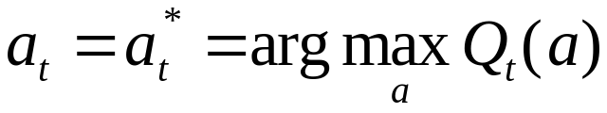
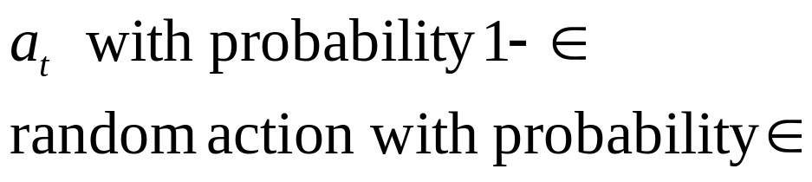

Ɛ-Greedy Action Selection Method :
Let the a* is the greedy action at time t and Q_{t}(a) is the value of action a at time.
Greedy Action Selection:
Ɛ –greedy
{

Slide 20
Action Selection Policies (Cont…)‏
Softmax –
  Drawback of Ɛ -greedy & Ɛ -soft: Select random actions uniformly.
  Softmax remedies this by:
    Assigning a weight with each actions, according to their action-value estimate.
    A random action is selected with regards to the weight associated with each action
    The worst actions are unlikely to be chosen.
    This is a good approach to take where the worst actions are very unfavorable.

Slide 21

Softmax Action Selection( Cont…)‏
Problem with Ɛ-greedy: Neglects action values
Softmax idea: grade action probs. by estimated values.
Gibbs, or Boltzmann action selection, or exponential weights:
  τ is the “computational temperature”
At τ → 0 the Softmax action selection method become
the same as greedy action selection.

Slide 22



Incremental Implementation
Sample average:
Incremental computation:
Common update rule form:
NewEstimate = OldEstimate + StepSize[Target – OldEstimate]
The expression [ Target - Old Estimate] is an error in the estimate.
It is reduce by taking a step toward the target.
In proceeding the (t+1)st reward for action a the step-size parameter will be 1\(t+1).

Slide 23


Some terms in Reinforcement Learning
The Agent Learns a Policy:
  Policy at step t, : a mapping from states to action probabilities will be:
  Agents changes their policy with Experience.
  Objective: get as much reward as possible over a long run.
Goals and Rewards
  A goal should specify what we want to achieve, not how we want to achieve it.

Slide 24
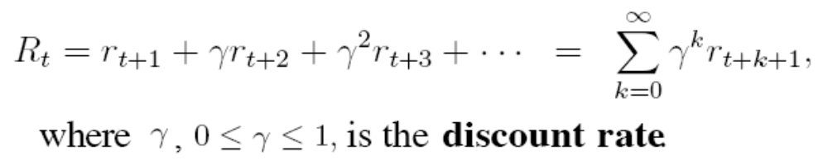
Some terms in RL (Cont…)‏
Returns
  Rewards in long term
  Episodes: Subsequence of interaction between agent-environment e.g., plays of a game, trips through a maze.
Discount return
  The geometrically discounted model of return:
  Used to:
    To determine the present value of the future rewards
    Give more weight to earlier rewards

Slide 25
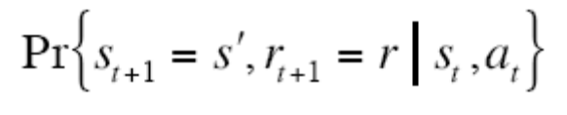
The Markov Property
Environment's response at (t+1) depends only on State (s) & Action (a) at t,
Markov Decision Processes
  Finite MDP
    Transition Probabilities:
    Expected Reward
Transition Graph: Summarize dynamics of finite MDP.

Slide 26
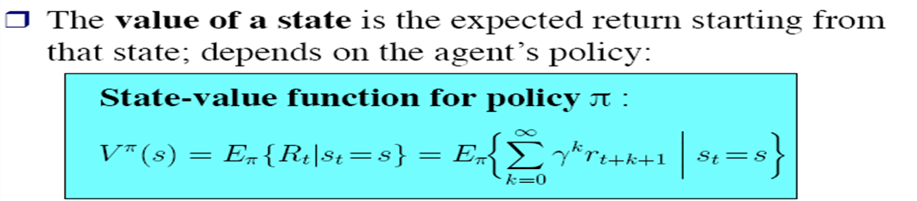
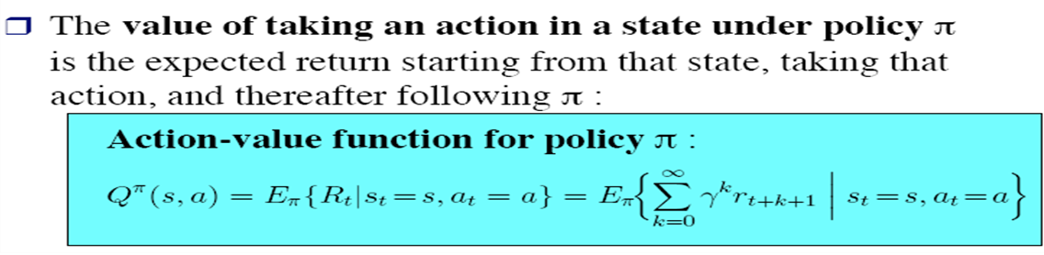
Value function
States-action pairs function that estimate how good it is for the agent to be in a given state
Type of value function
  State-Value function
  Action-Value function

Slide 27
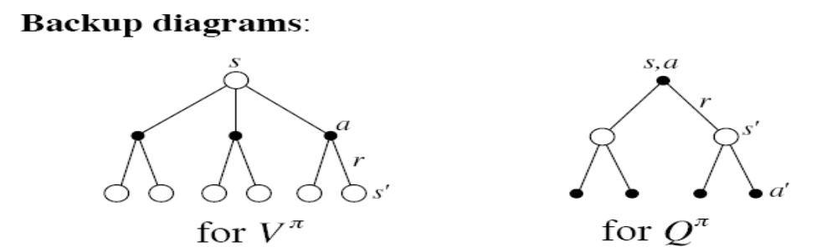


Backup Diagrams
Basis of the update or backup operations
backup diagrams to provide graphical summaries of the algorithms. (State value & Action value function)
Bellman Equation for a Policy Π

Slide 28
Model-free and Model-based Learning
Model-based learning
  Learn from the model instead of interacting with the world
  Can visit arbitrary parts of the model
  Also called indirect methods
  E.g. Dynamic Programming
Model-free learning
  Sample Reward and transition function by interacting with the world
  Also called direct methods

Slide 29
Problem Solving Methods for RL
Dynamic programming
Monte Carlo methods
Temporal-difference learning.

Slide 30
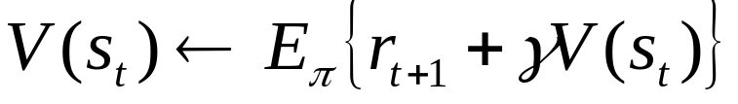
1.Dynamic programming
Classical solution method
Require a complete and accurate model of the environment.
Popular method for Dynamic programming
  Policy Evaluation : Iterative computation of the value function for a given policy (prediction Problem)‏
  Policy Improvement: Computation of improved policy for a given value function.

Slide 31

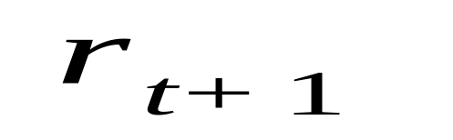
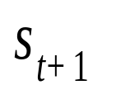
Dynamic Programming
T
T
T
T
T
T
T
T
T
T
T
T
T

Slide 32
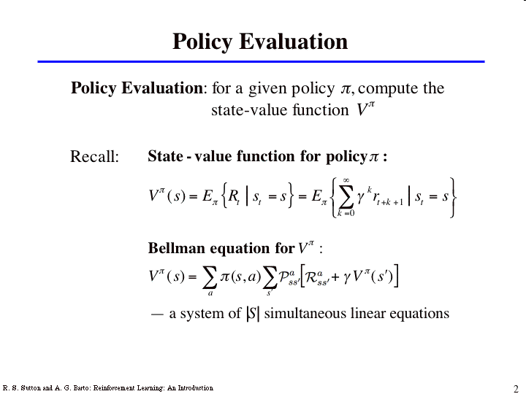

Slide 33
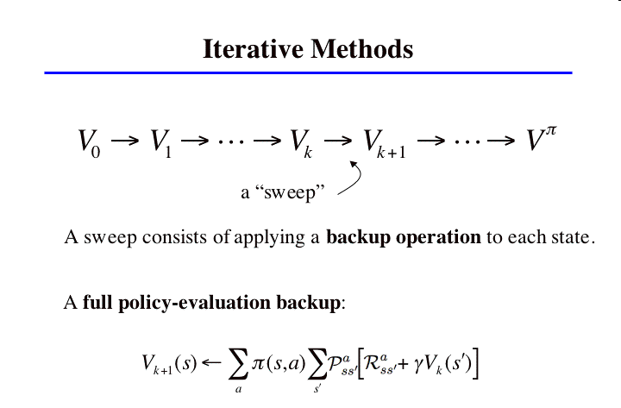

Slide 34
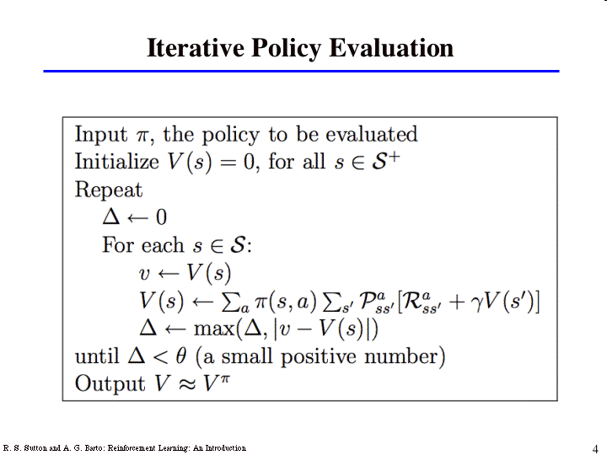
NewEstimate = OldEstimate + StepSize[Target – OldEstimate]
NewEstimate = OldEstimate + StepSize[Target – OldEstimate]

Slide 35
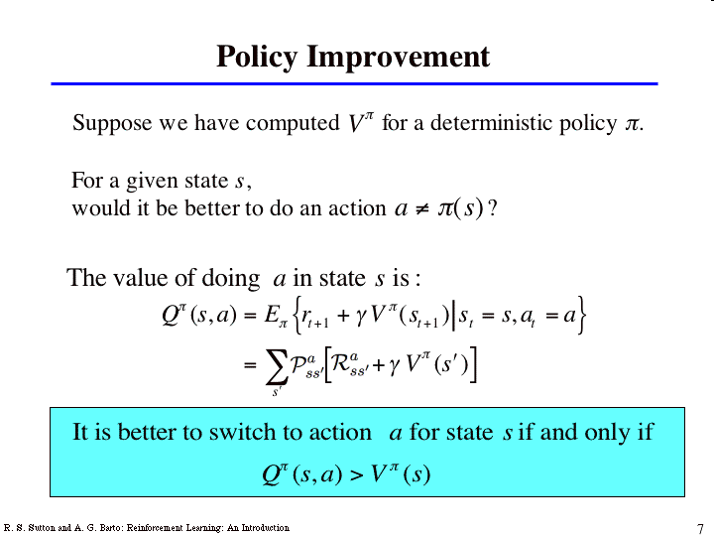
Computation of improved policy for a given value function

Slide 36
Policy Evaluation and Policy improvement together leads
    Policy Iteration
    Value Iteration:

Slide 37
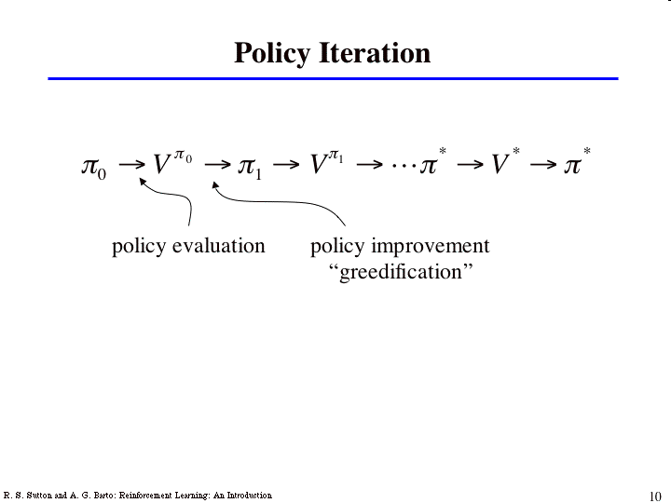
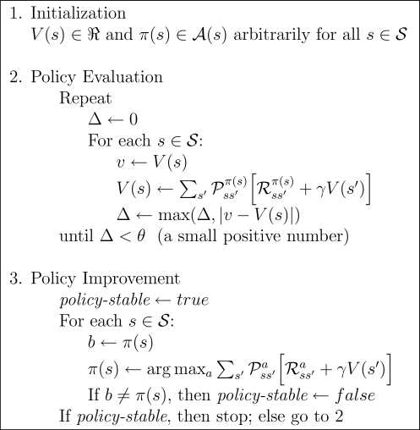
Policy Iteration : Alternates policy evaluation and policy improvement steps

Slide 38
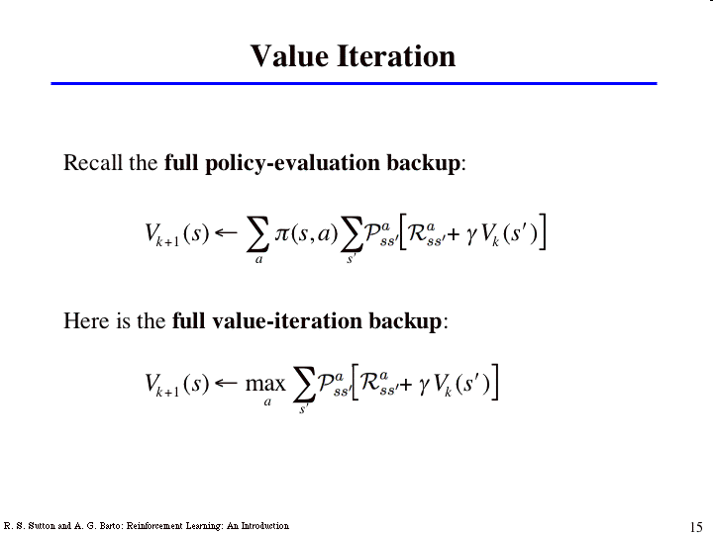
Combines evaluation and improvement in one update

Slide 39
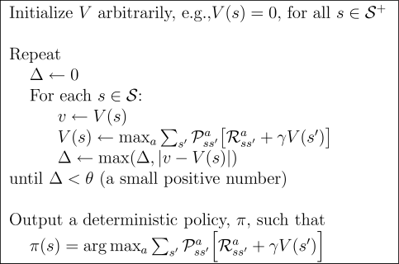
Value Iteration:
Combines evaluation and improvement in one update

Slide 40
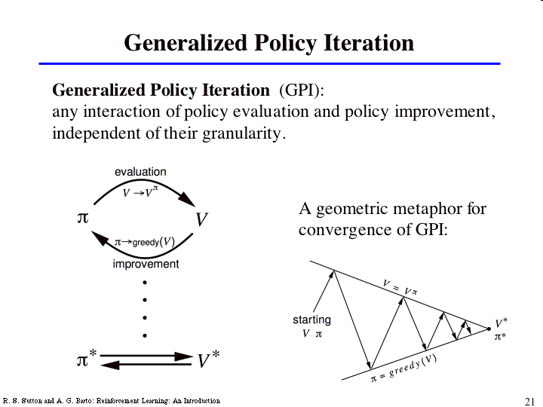
Generalized Policy Iteration (GPI)‏
Consist of two iteration process,
Policy Evaluation :Making the value function consistent with the current policy
Policy Improvement: Making the policy greedy with respect to the current value function ‏

Slide 41
2. Monte Carlo Methods
Features of Monte Carlo Methods
  No need of Complete knowledge of environment
  Based on averaging sample returns observed after visit to that state.
  Experience is divided into Episodes
  Only after completing an episode, value estimates and policies are changed.
  Don't require a model
  Not suited for step-by-step incremental computation

Slide 42
MC and DP Methods
Compute same value function
Same step as in DP
  Policy evaluation
  Computation of VΠ and QΠ for a fixed arbitrary policy (Π).
  Policy Improvement
  Generalized Policy Iteration

Slide 43
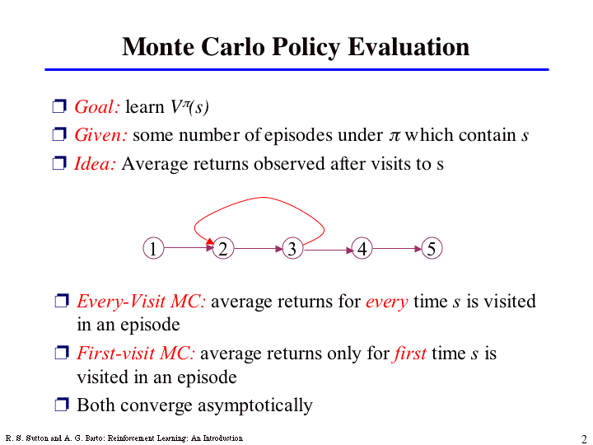
To find value of a State
Estimate by experience, average the returns observed after visit to that state.
More the return, more is the average converge to expected value

Slide 44
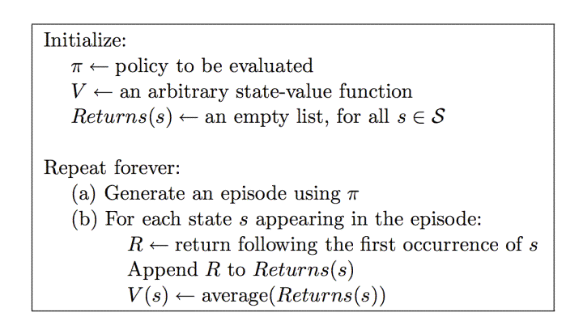
First-visit Monte Carlo Policy evaluation

Slide 45
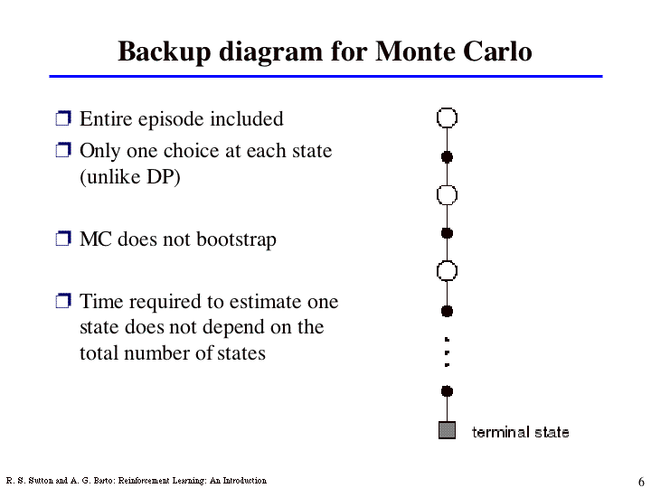
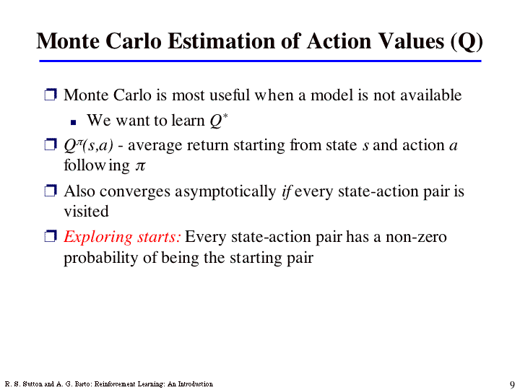

Slide 46
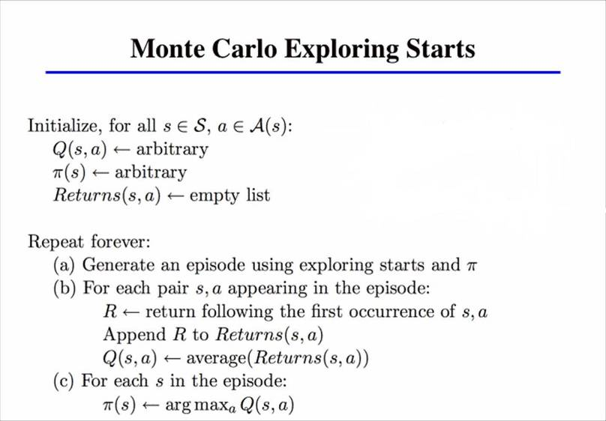
In MCES, all returns for each state-action pair are accumulated and averaged, irrespective of what Policy was in force when they were observed

Slide 47
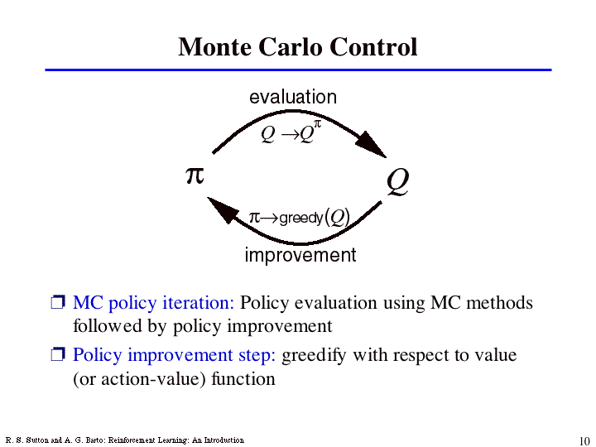

Slide 48
Monte Carlo Method (Cont…)‏
All actions should be selected infinitely for optimization
MC exploring starts can not converge to any suboptimal policy.
Agents have 2 approaches
  On-policy
  Off-policy

Slide 49
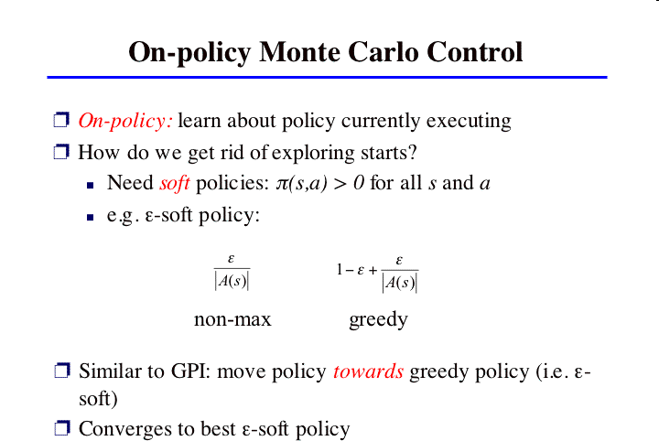

Slide 50
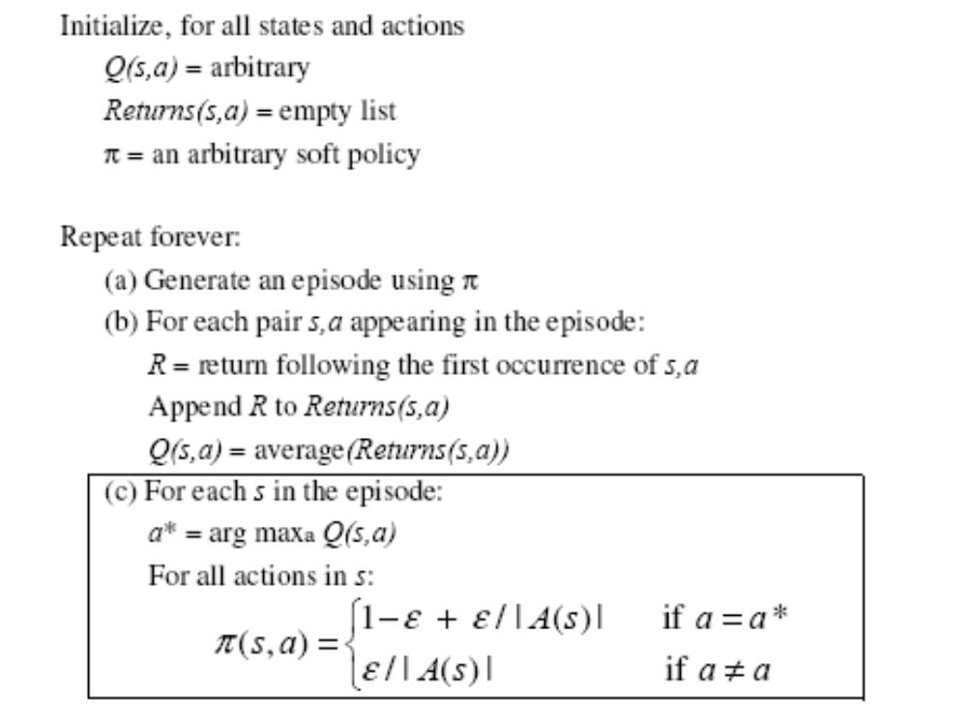
On-policy MC algorithm

Slide 51
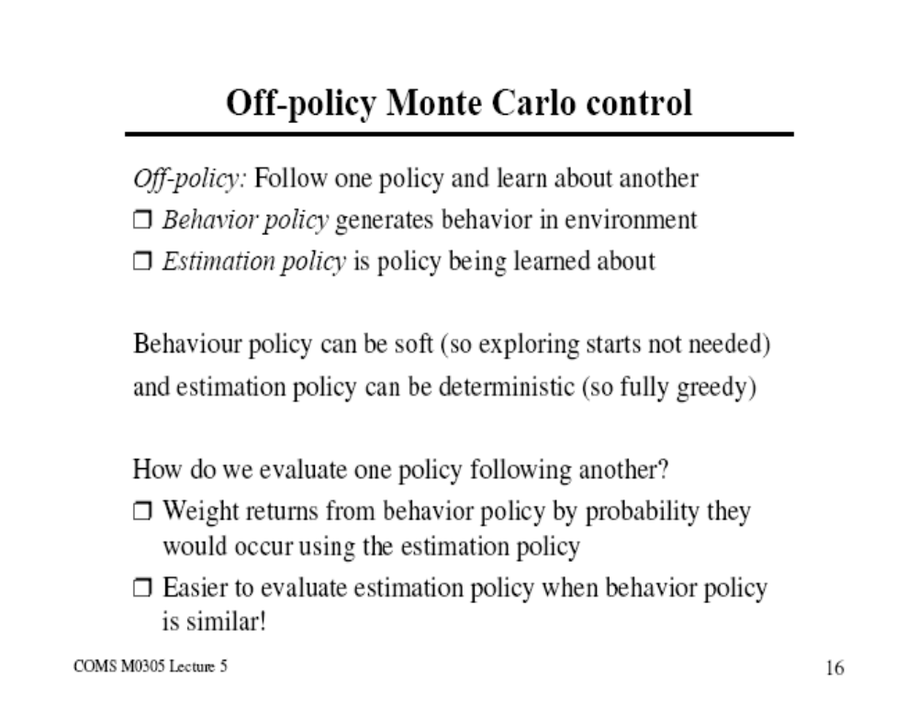
Off Policy MC algorithm

Slide 52
Monte Carlo and Dynamic Programming
MC has several advantage over DP:
  Can learn from interaction with environment
  No need of full models
  No need to learn about ALL states
  No bootstrapping

Slide 53
3. Temporal Difference (TD) methods
Learn from experience, like MC
  Can learn directly from interaction with environment
  No need for full models
Estimate values based on estimated values of next states, like DP
Bootstrapping (like DP)‏
Issue to watch for: maintaining sufficient exploration

Slide 54

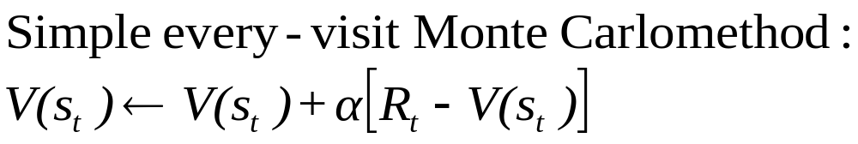
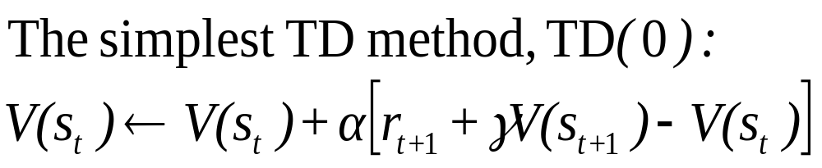
TD Prediction
Policy Evaluation (the prediction problem):
for a given policy π, compute the state-value function
target: the actual return after time t
target: an estimate of the return

Slide 55
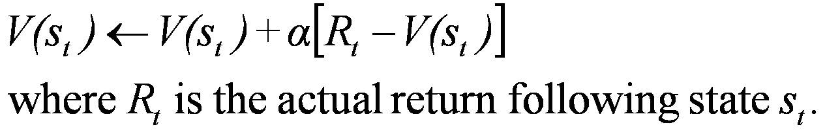
Simple Monte Carlo
T
T
T
T
T
T
T
T
T
T
T
T
T
T
T
T
T
T
T
T

Slide 56
Simplest TD Method
T
T
T
T
T
T
T
T
T
T
T
T
T
T
T
T
T
T
T
T

Slide 57
Dynamic Programming
T
T
T
T
T
T
T
T
T
T
T
T
T

Slide 58
TD methods bootstrap and sample
Bootstrapping: update involves an estimate
  MC does not bootstrap
  DP bootstraps
  TD bootstraps
Sampling: update does not involve an expected value
  MC samples
  DP does not sample
  TD samples

Slide 59
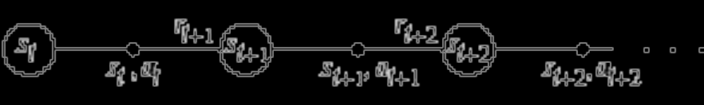
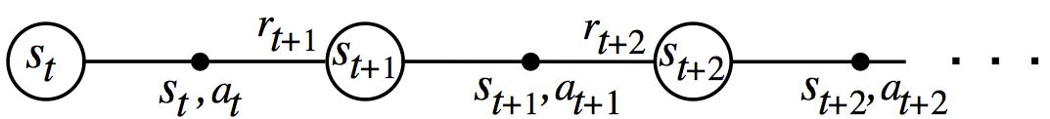
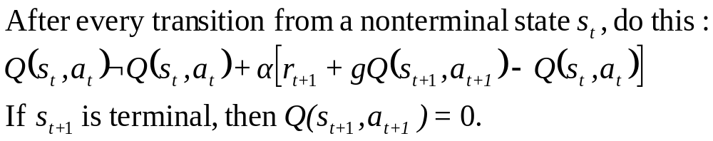
Learning An Action-Value Function

Slide 60
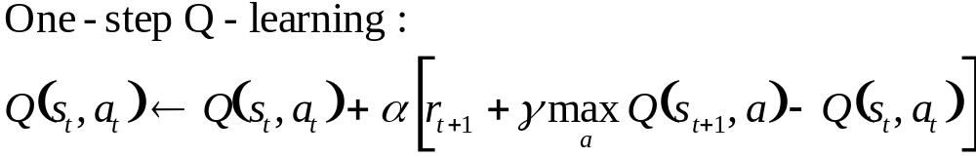
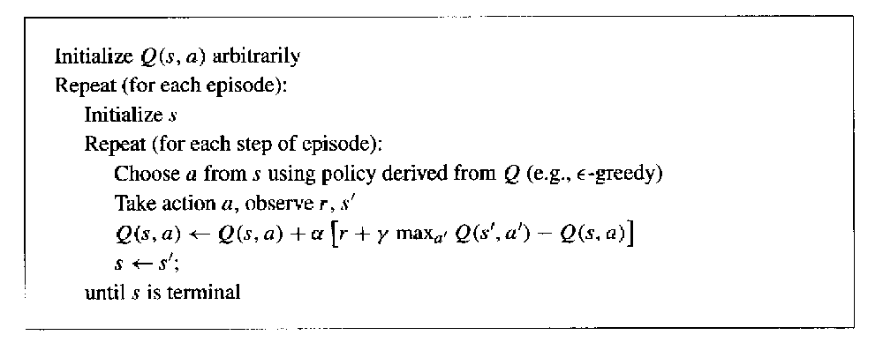
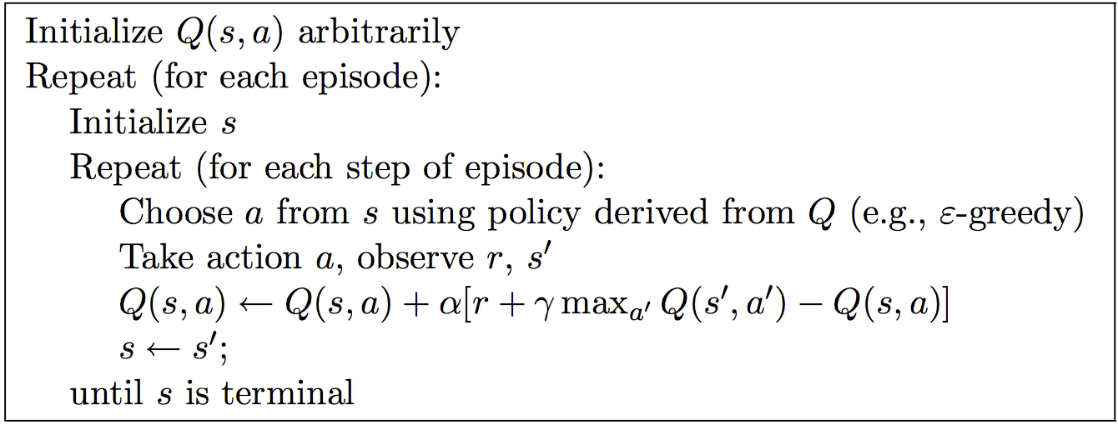
Q-Learning: Off-Policy TD Control

Slide 61
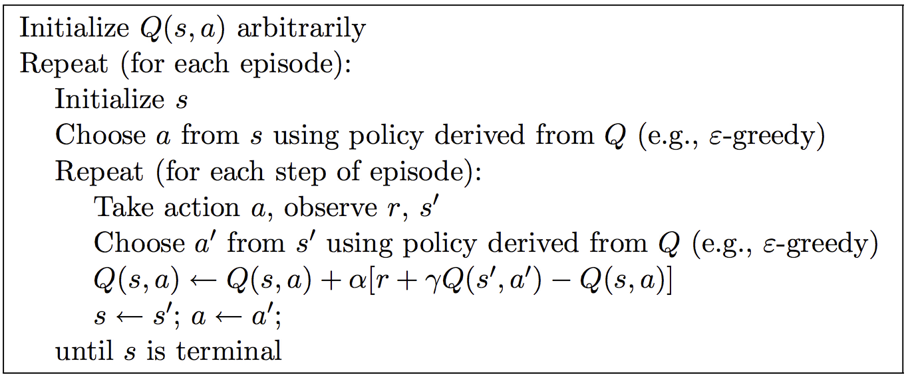
Sarsa: On-Policy TD Control
S A R S A: State Action Reward State Action
Turn this into a control method by always updating the policy to be greedy with respect to the current estimate:

Slide 62
Advantages of TD Learning
TD methods do not require a model of the environment, only experience
TD, but not MC, methods can be fully incremental
  You can learn before knowing the final outcome
    Less memory
    Less peak computation
  You can learn without the final outcome
    From incomplete sequences
Both MC and TD converge

Slide 63
References: RL
Univ. of Alberta
    http://www.cs.ualberta.ca/~sutton/book/ebook/node1.html
    Sutton and barto,”Reinforcement Learning an introduction.”
Univ. of South Wales
    http://www.cse.unsw.edu.au/~cs9417ml/RL1/tdlearning.html

Slide 64
Thank You

