Slide 1
Introduction to Natural Language Processing

Slide 2
What is NLP ?
  ”Natural language processing (NLP) is a field of computer science, artificial intelligence (also called machine learning), and linguistics concerned with the interactions between computers and human (natural) languages. Specifically, the process of a computer extracting meaningful information from natural language input and/or producing natural language output ”
  - Wikipedia

Slide 3
Why NLP ?

Slide 4
Answering Questions
  ”What time is the next bus from the city after the 5:00 pm bus ?”
  ”I am a 3rd year CSE student, which classes do I have today ?”
  ”Which gene is associated with Diabetes ?”
  ”Who is Donald Knuth ?”

Slide 5
Information extraction
  Extraction of meaning from email :-
  We have decided to meet tomorrow at 10:00am in the lab.

Slide 6
Information extraction
  Extraction of meaning from email :-
  We have decided to meet tomorrow at 10:00am in the lab.
To do : meeting
Time : 10:00 am, 22/3/2012
Venue : Lab

Slide 7
Machine Translation
  मेरा नाम रजत है | => My name is Rajat.

Slide 8
Machine Translation
  मेरा नाम रजत है | => My name is Rajat.
  Grass is greener on the other side.

Slide 9
Machine Translation
  मेरा नाम रजत है | => My name is Rajat.
  Grass is greener on the other side. => दूर के ढोल सुहावने |
  Google’s Translation : घास दूसरी तरफ हरियाली है |

Slide 10
Other applications
  Text summarization
    Extract keywords or key-phrases from a large piece of text.
    Creating an abstract of an entire article.
  Context analysis
    Social networking sites can ‘fairly’ understand the topic of discussion
    “ 4 of your friends posted about Indian Institute of Technology, Guwahati”.
  Sentiment analysis
    Help companies analyze large number of reviews on a product
    Help customers process the reviews provided on a product.

Slide 11
Tasks in NLP
Tokenization / Segmentation
Disambiguation
Stemming
Part of Speech (POS) tagging
Contextual Analysis
Sentiment Analysis

Slide 12
Segmentation
Segmenting text into words
  “The meeting has been scheduled for this Saturday.”
  “He has agreed to co-operate with me.”
  “Indian Airlines introduces another flight on the New Delhi–Mumbai route.”
  “We are leaving for the U.S.A. on 26th May.”
  “Vineet is playing the role of Duke of Athens in A Midsummer Night’s Dream in a theatre in New Delhi.”
  Named Entity Recognition

Slide 13
Stemming
Stemming is the process for reducing inflected (or sometimes derived) words to their stem, base or root form.
car, cars -> car
run, ran, running -> run
stemmer, stemming, stemmed -> stem

Slide 14
POS tagging
Part of speech (POS) recognition
  “ Today is a beautiful day. “
  Today is a beautiful day
  Noun Verb Article Adjective Noun

Slide 15
POS tagging
Part of speech (POS) recognition
  “ Today is a beautiful day. “
  Today is a beautiful day
  Noun Verb Article Adjective Noun
  “Interest rates interest economists for the interest of the nation.“
(word sense disambiguation)

Slide 16
Word Sense Disambiguation
Same word different meanings.
“He approached many banks for the loan.”
vs
“IIT Guwahati is on the banks of Bhramaputra.”
“Free lunch.” vs “Free speech.”

Slide 17
Contextual Analysis
“The teacher pointed out that ‘Mark is the smartest person on Earth’ has two proper nouns.”
“Violinist linked with JAL Crash Blossoms.”

Slide 18
Sentiment Analysis
Reviews about a restaurant :-
  “Best roast chicken in New Delhi.”
  “Service was very disappointing.”

Slide 19
Sentiment Analysis
Reviews about a restaurant :-
  “Best roast chicken in New Delhi.”
  “Service was very disappointing.”
Another set of reviews
  “iPhone 4S is over-hyped.”

Slide 20
Sentiment Analysis
Reviews about a restaurant :-
  “Best roast chicken in New Delhi.”
  “Service was very disappointing.”
Another set of reviews
  “iPhone 4S is over-hyped.”
  “The hype about iPhone 4S is justified.”

Slide 21
Ambiguous statements
(Crash blossoms)
Red Tape Holds Up New Bridges
Hospitals Are Sued by 7 Foot Doctors
Juvenile Court to Try Shooting Defendant
Fed raises interest rates.

Slide 22
Supervised vs. Unsupervised
Supervised
  Use of large training data to generalize patterns and rules
  Example: Hidden Markov Models
Unsupervised
  Don’t require training; use in-built rules or a general algorithm; can work straightaway on any unknown situations or problem
  The algorithm may be developed as a result of linguistic analysis
  Example: ‘Text Rank’ Algorithm for text summarization

Slide 23
General tasks and techniques in NLP
NLP uses machine learning as well as other AI systems in general. More specifically NLP Techniques fall mainly into 3 categories:
1. Symbolic
Deep analysis of linguistic phenomena
human verification of facts and rules
use of inferred data – knowledge generation
2. Statistical
  Mathematical models without much use of linguistic phenomena
  use of large corpora
  Use of only observable knowledge
3. Connectionist
Use of large corpora
allows inferencing from the examples

Slide 24
Part of Speech (POS) Tagging
Given a sentence automatically give the correct part of speech for each word.
Parts of Speech – not the limited set of Nouns, Verbs, Adjectives, Pronouns etc. but further subdivisions – Noun-Singular, Noun-Plural, Noun-Proper, Verb-Supporting – depends on implementation
Example:
given : I can can a can.
output : I_NNP can_VBS can_VB a_DT can_NP

Slide 25
Penn TreeBank Tagset
1. CC Coordinating conjunction 2. CD Cardinal number 3. DT Determiner 4. EX Existential there 5. FW Foreign word 6. IN Preposition or subordinating conjunction 7. JJ Adjective 8. JJR Adjective, comparative 8. JJS Adjective, superlative 9. LS List item marker 10. MD Modal 11. NN Noun, singular or mass 12. NNS Noun, plural 13. NP Proper noun, singular 14. NPS Proper noun, plural 15. PDT Predeterminer 16. POS Possessive ending 17. PP Personal pronoun 18. PP$ Possessive pronoun | 19. RB Adverb 20. RBR Adverb, comparative 21. RBS Adverb, superlative 22. RP Particle 23. SYM Symbol 24. TO to 25. UH Interjection 26. VB Verb, base form 27. VBD Verb, past tense 28. VBG Verb, gerund or present participle 29. VBN Verb, past participle 30. VBP Verb, non-3rd person singular present 31. VBZ Verb, 3rd person singular present 32. WDT Wh-determiner 33. WP Wh-pronoun 34. WP$ Possessive wh-pronoun 35. WRB Wh-adverb

Slide 26
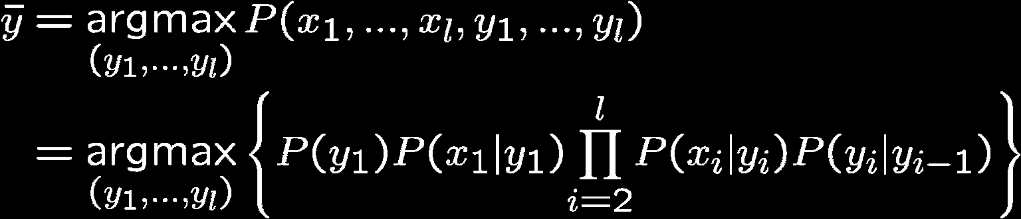
Hidden Markov Models
An HMM is defined by:
Set of states ‘S’
Set of output symbols ‘W’
Starting Probability Set (A) P(S = s_{i})
Emission Probability Set (E) P(W = w_{j} / S = s_{i})
Transition probability Set (T) P(S_{k} / S_{k-1} S_{k-2} S_{k-3} … S₁)
Now one can use the HMM to estimate the most likely sequence of states given the set of output symbols. (using Viterbi Algorithm)

Slide 27
PoS Tagging and First Order HMM
Our HMM Model of the PoS Tagging Problem
Set of states (S) = set of PoS tags
Set of output symbols (W) = set of words in our language
Initial probability (A) = P(S = s_{i}) = probability of the occurrence of the PoS Tag s_{i} in the corpus.
Emission Probability (E) = P(W = w_{i} / S = s_{i}) = probability of occurrence of the word w_{i} with the PoS Tag s_{i}.
Transition Probability (T) = P(S_{k} / S_{k-1} S_{k-2} .. S₁) = P(S_{k} = s_{i}/ S_{k-1} = s_{j}) = probability of the occurrence of the PoS Tag s_{i} next to the tag s_{j} in the corpus.

Slide 28
Text Summarization
Given a piece of text, automatically make a summary satisfying required constraints.
Examples of constraints:
  Summary should have all the information of the document
  Summary should have only correct information of the document.
  Summary should have information only from the document
  and so on, depending on the user’s needs!

Slide 29
Abstraction vs. extraction
"The Army Corps of Engineers, in their rush to protect New Orleans by the start of the 2006 hurricane season, installed defective flood-control pumps despite warnings from its own expert about the defects”
Extractive
"Army Corps of Engineers", "New Orleans", and "defective flood-control pumps“
Abstractive
"political negligence" , "inadequate protection from floods"

Slide 30
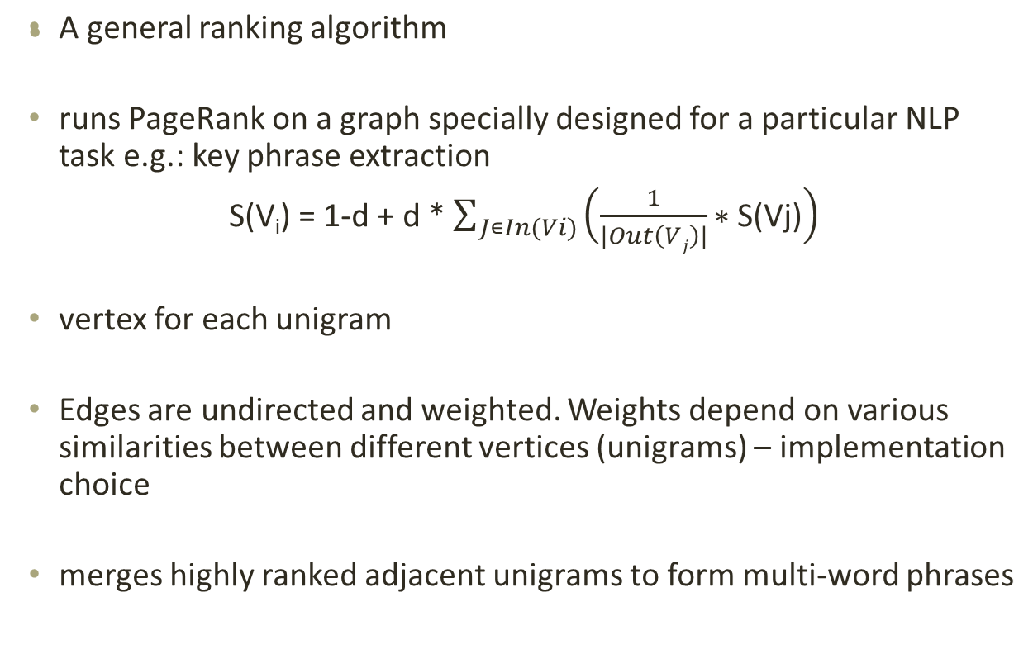
Text Rank – Key phrase Extraction

Slide 31
Thank You!

Slide 32
Resources
Links
acl.ldc.upenn.edu/acl2004/emnlp/pdf/Mihalcea.pdf
ilpubs.stanford.edu:8090/422/1/1999-66.pdf
en.wikipedia.org/wiki/Automatic_summarization
en.wikipedia.org/wiki/Viterbi_algorithm
http://ieeexplore.ieee.org/stamp/stamp.jsp?arnumber=01450960
http://nlp-class.org
Books:
Artificial Intelligence and Intelligence Systems, N.P. Padhy

