Slide 1

Unsupervised
Machine Learning

Slide 2
What is Machine Learning?
ML is a subfield of AI that involves the creation of Algorithms and statistical models, which enables computers to perform a specific task or to make a prediction by learning from data.
Subfield of AI.
Involves the creation of Algorithms and Models.
Enables computer to perform specific tasks/predictions
Key feature of ML is it’s ability to automatically learn and improve from the
experience.

Slide 3
Why we need ML?
Predictive Analytics: Forecasting future based on historical data.
Natural Language Processing: Understand human languages
Computer vision: Recognize objects in Images or Videos
Recommender Systems: Build personalized recommendations
Fraud detection: Detect fraudulent activities or anomalies

Slide 4
Types of ML
Supervised learning: Model is trained on a labeled dataset.
Unsupervised learning: Model is trained on a unlabeled dataset.
Reinforcement learning: Learns to make decisions based on feedbacks

Slide 5
Unsupervised ML- What?
A technique in which models are not supervised using training dataset
Models finds the patterns itself and insights from given dataset
Real-LIFE Example:
Humans

Slide 6
Unsupervised ML - Why?
❏ When 0 manual labour is desired in training.
❏ When it is difficult to find patterns.
❏ When there is a need to find the hidden pattern

Slide 7
Unsupervised ML - How?
Unsupervised ML
Clustering
Association

Slide 8
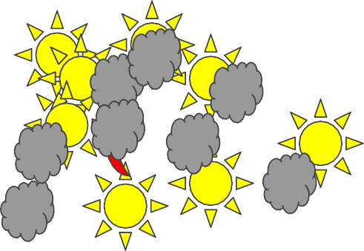
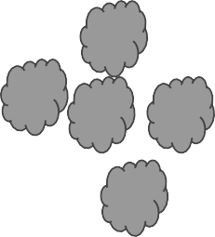
Clustering

Slide 9







Association

Slide 10
Popular Algorithms
★ K-means Clustering: K clusters and centroids
★ Hierarchical Clustering: Dendrogram shaped
★ Apriori Association Algorithm
★ Eclat Algorithm
★ F-P Growth Algorithm
★ Anomaly Detection Algorithm

Slide 11
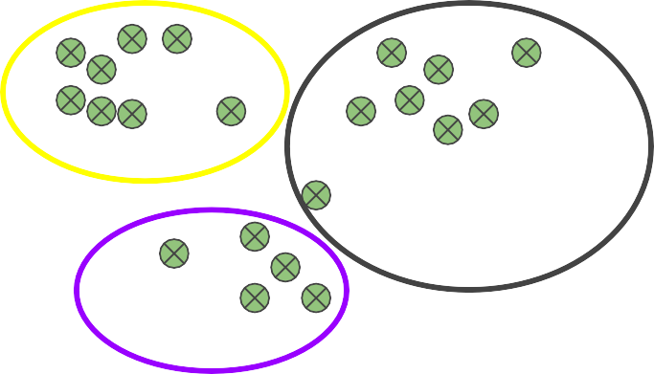
K-Means Algorithm(K=3)

Slide 12
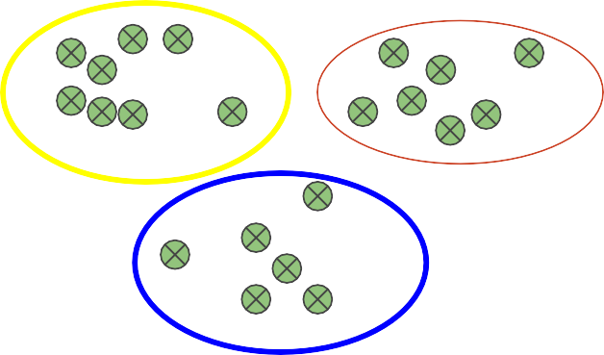
K-Means Algorithm(K=3)

Slide 13
Pros and cons of K-mean
Pros
Various Applications like Customer segmentation, image segmentation, etc.
Scalable (Suitable for large datasets)
Fast
Simple and easy to understand
Cons
Sensitive to initial choice of centroids
Prior knowledge of number of clusters Limited to linearly separable data Prone to converge into local optima

Slide 14
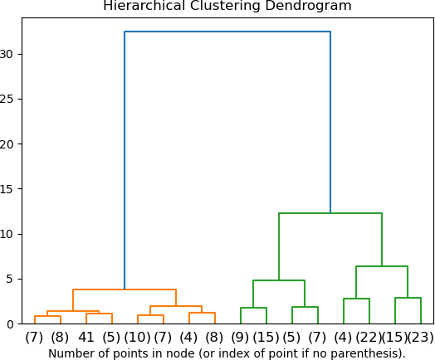
Hierarchical Clustering
Hierarchy of clusters in Dendrogram shaped
Agglomerative Approach: Bottom-up
i.e. each data set is a cluster
Divisive Approach: Top-down approach
i.e. whole data set is a single cluster.

Slide 15
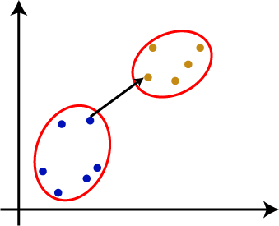
Hierarchical Clustering - Linkage methods
Single(Shortest)
Complete
Average
Centroid
Single Linkage

Slide 16
N Clusters
N-1
N-2
N-3
N-4
N-5

Slide 17
Pros and cons of Hierarchical Clustering
Pros
Easy to understand
Suitable for small datasets
Detection of overlapping clusters
Handles different types of distance measure and linkage
Cons
Computationally expensive(time complexity is O(n^3))
Different methods gives different results
Greedy Algorithm
Not suitable for large dataset and when clusters are not well separated

Slide 18
Apriori Association Algorithm
Uses Frequent item sets to generate association rules.
Designed to work on Databases containing transactions.
Determines the strength(Strong or weak) connection between two objects.
Iterative in nature.
Mainly used for market-basket analysis and drug-reaction analysis on patients.

Slide 19
Apriori Association Algorithm
Terminologies:
Antecedent A
Consequent B
Confidence: measure of how often B appear in a transaction that also contains the A
Confidence (A -> B) = Support (A ∪ B) / Support (A)

Slide 20
Apriori Association Algorithm
Confidence (A -> B) = Support (A ∪ B) / Support (A)
Support(X) = number of times X appeared in any transaction / total number of transactions.
∪ =
Union i.e., Transactions that have A and B together

Slide 21
Apriori Association Algorithm
Sales data of a shop
1000 overall Transactions.
200 transactions included the purchase of milk
150 transactions included the purchase of bread along with milk
Confidence(Milk->Bread) = Support (Milk
∪
Bread) / Support (Milk)
Confidence = (150/1000) / (200/1000)
Confidence = 0.15 / 0.2
Confidence = 0.75

Slide 22
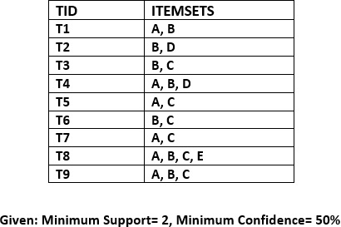
Frequent Itemset

Slide 23
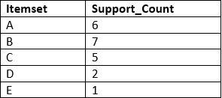
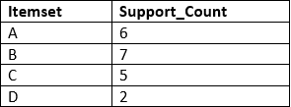
Frequent Itemset- Candidate 1 and Itemset 1

Slide 24
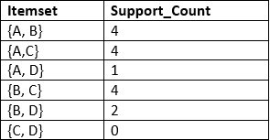
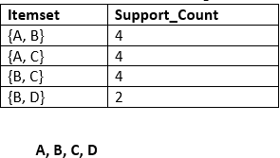
Frequent Itemset- Candidate 2 and Itemset 2

Slide 25
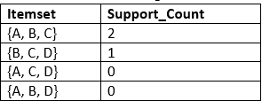
Frequent Itemset- Candidate 3 and Itemset 3
Itemset | Support count
{A, B, C} | 2

Slide 26
Confidence
Confidence((A∪B)->C) = Support ((A∪B)∪C)/Support (A∪B)

Slide 27
Pros and cons of Apriori Algorithm
Pros
Cons
Scalable
Computationally expensive for large dataset.
Simple
Only suitable for binary data
Widely used
Need high memory to store all the itemsets
generated in between

Slide 28
Unsupervised - Pros and cons
Pros
No need for labeled data
Discovers hidden patterns Useful in preprocessing of data
Cons
Challenging to know the performance of algorithm
Computationally expensive Difficult to interpret results

Slide 29
What’s next?
KNN Algorithm

Slide 30



CONTACT DETAILS
OUR
Livares Technologies Pvt Ltd 5th Floor, Yamuna Building Technopark Phase III Campus
Trivandrum, Kerala, India-695581
contact@livares.com
+91-471-2710003 | +91-471-
2710004
www.facebook.com/livaresofficial
@livaresofficial
Our helpline is always open to receive any inquiry or feedback.Please feel free to contact us
THANK YOU
Tech&Socio-Cultural Group
Livares Technologies Pvt Ltd
www.livares.com

