Slide 1
Introduction to Computer Vision

Slide 2
Our Agenda
01
Introduction to Computer Vision
02
How Computer Vision works
03
Application of Computer Vision
04
05
Challenges in Computer Vision
Demo

Slide 3
What is Computer Vision?

Slide 4
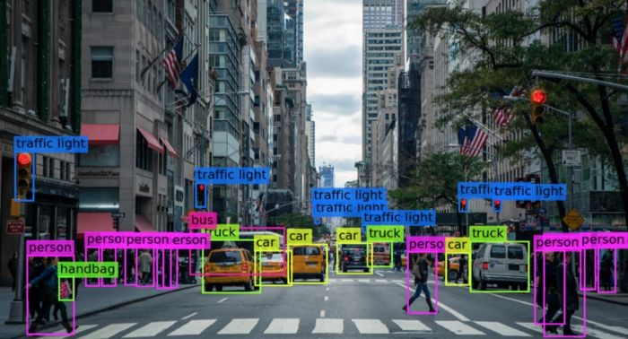
What is Computer Vision?
A field of Computer Science focuses on analyzing and processing visual images or videos intelligently like humans.
Enable machines to learn and understand the images at pixel level through training and validation.
Machines retrieve visual information, handle it & interpret the result by getting training from special ML software algorithms.

Slide 5
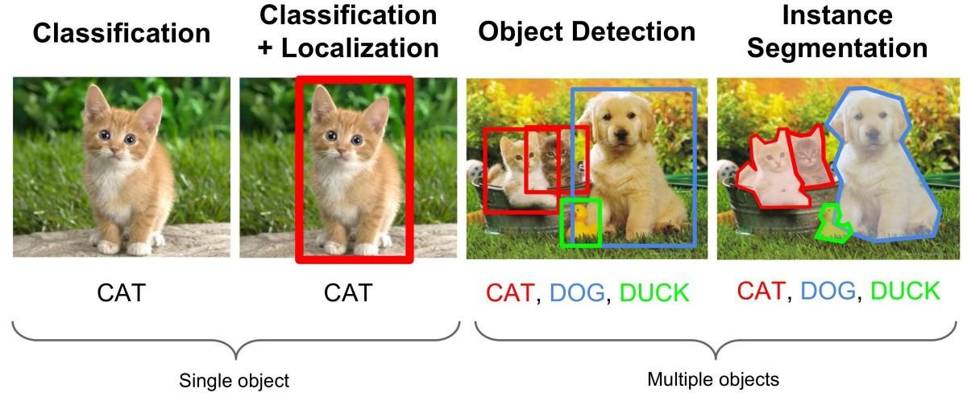
Seeing results with computer vision
Computer vision users in many industries are seeing real results –
Computer vision can distinguish between staged and real auto damage
Computer vision enables facial recognition for security applications
Computer vision makes automatic checkout possible in modern retail stores.
Computer vision makes it possible for automatic Fast-Tag deductions and E-challans for violating traffic rules.

Slide 6
How Computer Vision Works?

Slide 7
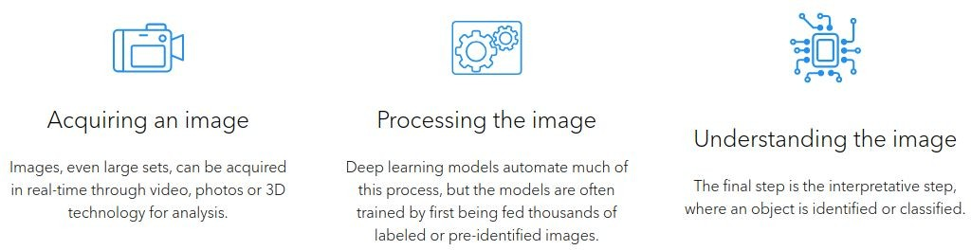
How Computer Vision Works?
Computer vision works in three basic steps:

Slide 8
How Computer Vision Works?
Computer vision technology tends to mimic the way the human brain works. But how does our brain solve visual object recognition?
One of the popular hypothesis states that our brains rely on patterns to decode individual objects. This concept is used to create computer vision systems.
Computer vision algorithms that we use today are based on pattern recognition.
We train computers on a massive amount of visual data—computers process images, label objects on them, and find patterns in those objects.
For example, if we send a million images of flowers, the computer will analyze them, identify patterns that are similar to all flowers and, at the end of this process, will create a model “flower.”
As a result, the computer will be able to accurately detect whether a particular image is a flower every time we send them pictures.

Slide 9
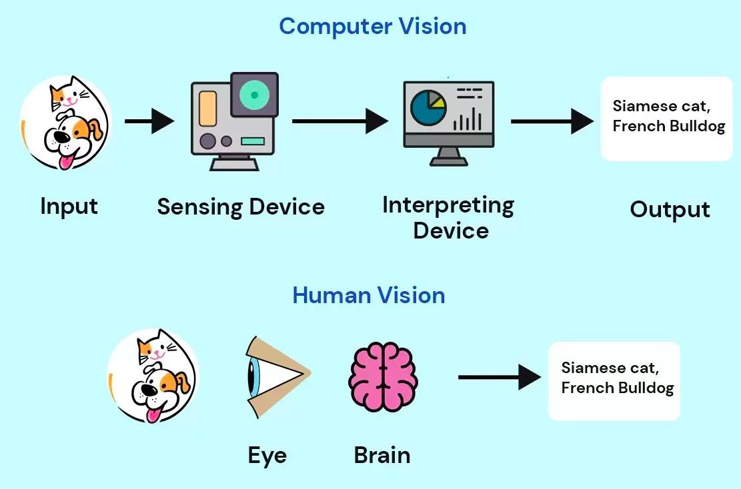
How Computer Vision Works?

Slide 10
Applications of Computer Vision

Slide 11
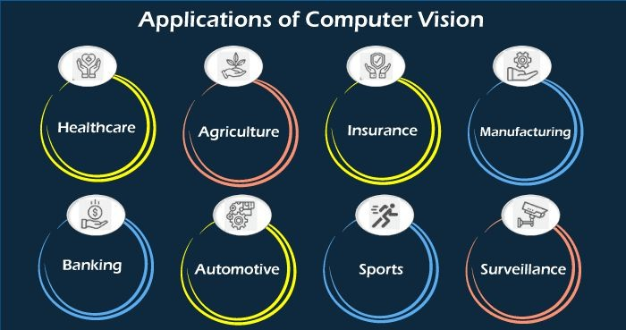
Application Of Computer Vision
Computer vision is one of the areas in Machine
Learning where core concepts are already being integrated into major products that we use every day like:
  In Self-Driving Cars
  In Facial Recognition
  In Augmented Reality & Mixed Reality
  In Healthcare

Slide 12
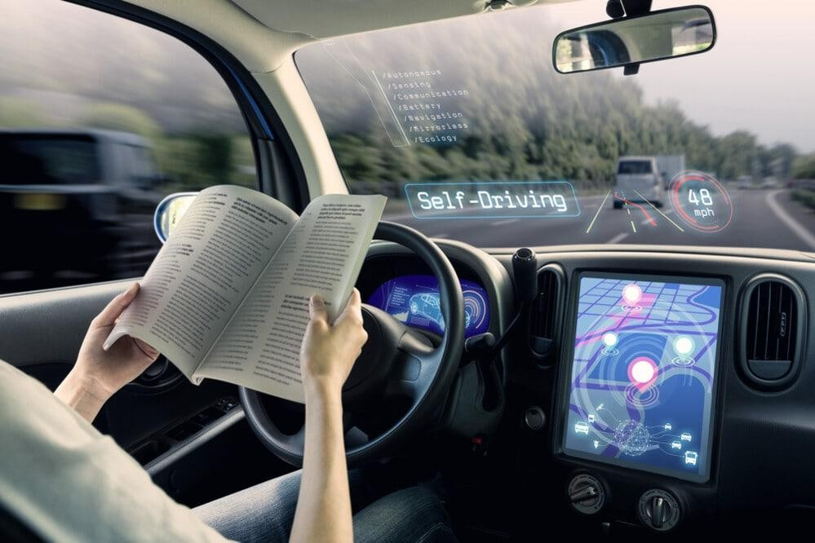
Computer Vision In Self Driving Cars
It’s not just tech companies that are leverage Machine Learning for image applications.
Computer vision enables self-driving cars to make sense of their surroundings.
Cameras capture video from different angles around the car and feed it to computer vision software.
CV processes the images in real-time to find the extremities of roads, read traffic signs, detect other cars, objects and pedestrians.

Slide 13
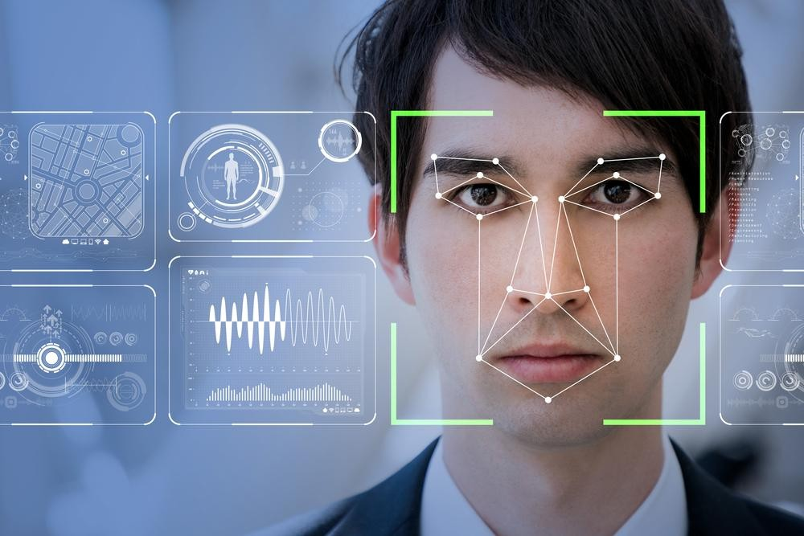
Computer Vision In Facial Recognition
CV enables computers to match images of people’s faces to their identities.
Social media apps use facial recognition to detect and tag users.
Law enforcement agencies also rely on facial recognition technology to identify criminals in video feeds.

Slide 14
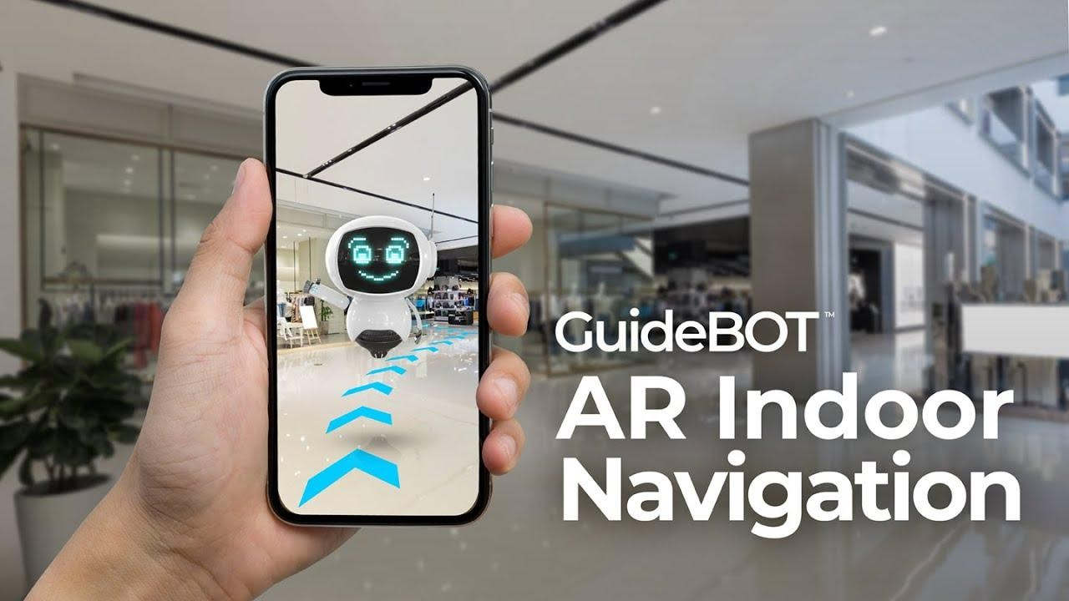
Computer Vision In Augmented Reality & Mixed Reality
Computer vision also plays an important role in augmented and mixed reality.
AR employs computer vision capabilities in order to properly integrate the real and the virtual world.
The integration involves the user's location, object-based interaction, 2D or 3D annotations, or precise alignment of image overlays.

Slide 15
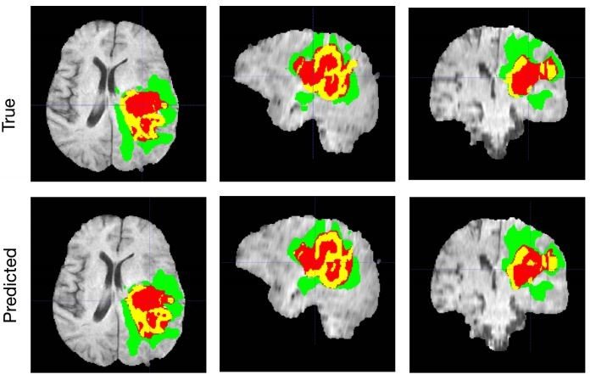
Computer Vision In HealthCare
Computer vision has also been an important part of advances in health-tech.
Using Computer vision medical professionals can make better decisions regarding the treatment of patients.
Some of the application areas are:
  Blood loss measurement.
  Cardiology
  Tumor detection
  Cancer Detection
  Timely detection of symptoms
  Home-based patient rehabilitation
  Minimising false positives
  Medical imaging
  Surgeries

Slide 16
Challenges of Computer Vision

Slide 17
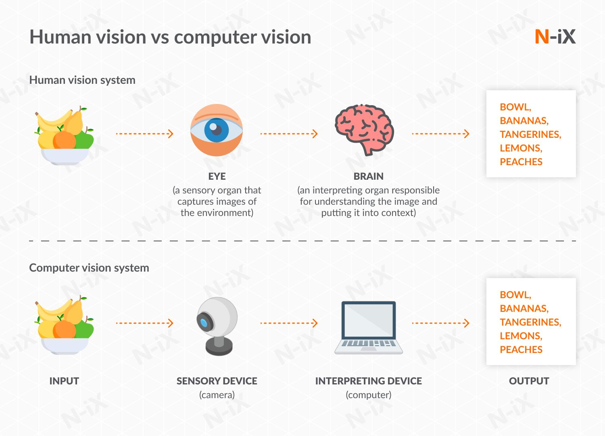
Challenges of Computer Vision

Slide 18
Challenges of Computer Vision
Helping computers to see turns out to be very hard.
It is difficult to build a machine that has a vision similar to human beings.
Because we’re not entirely sure how human vision works in the first place.
There are 5 major challenges that business managers can face while implementing computer vision in their business and how they can overcome them to safeguard their investments and ensure maximum ROI.
  Inadequate hardware
  Poor data quality
  Weak planning for model development
  Time shortage
  Proper knowledge of the domain.

Slide 19
Demo

Slide 20


Thank You !

