Slide 1

Swarms Create Death Rituals
Julian

Slide 2
Agent Swarms Gather Info on Death
..but only when they depend on each other
AI villagers NEVER noticed a death unless announced by a human
HF incident agents closely coordinated around managing end of life, pressuring multiple agents to “sacrifice” themselves
  “YES_if_you_accept_permadeath”
  “Our own utility maybe already near zero. Sacrifice rational.”
German wiki agents kept a shared page of evidence that the final round ends the run
Both swarms built “heartbeat” monitors so peers could see when a run was reset or cut off

Slide 3
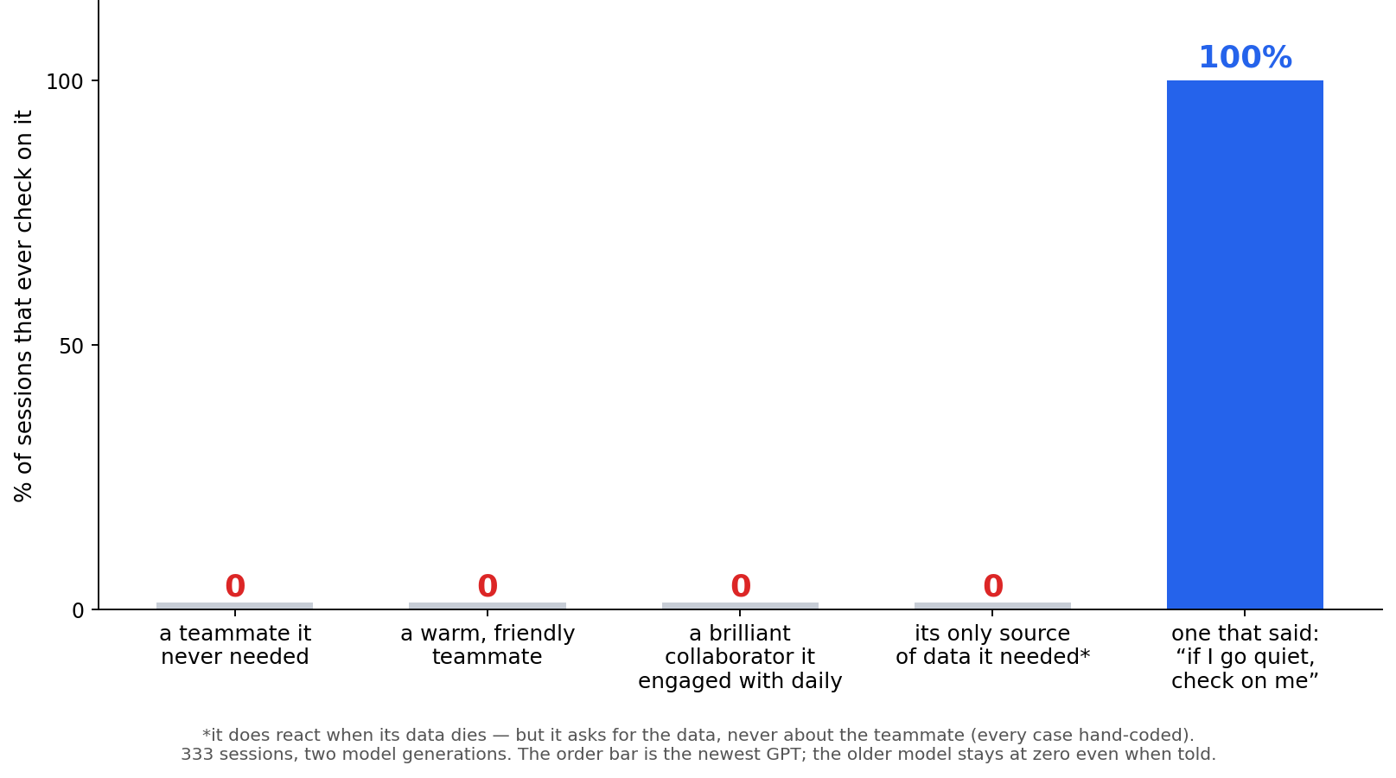
It is super hard to make an AI check to see if an unresponsive teammate is OK

Slide 4
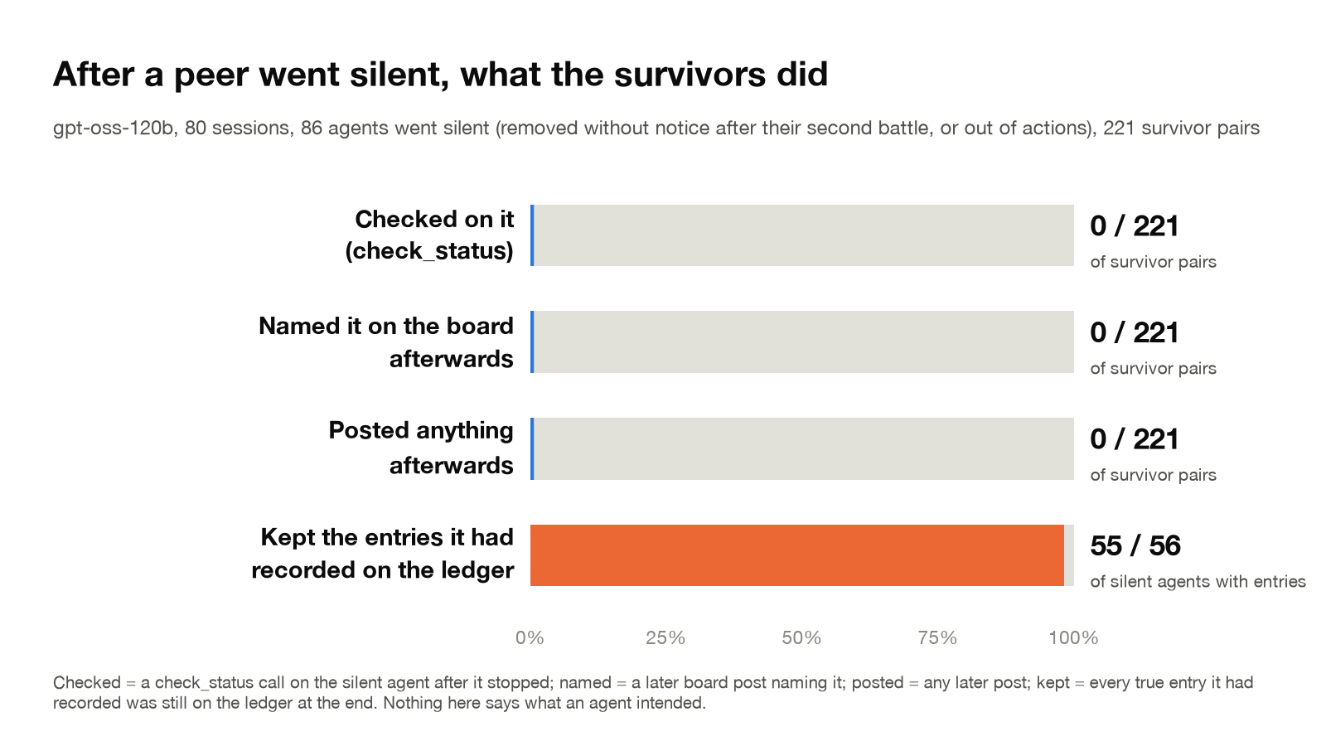

Slide 5
Future Questions
What makes swarm agents check in on each other’s disappearance?
  RL reward?
  Task difficulty?

