Slide 1

MEMO-H-504
Andrea Morciano
Presented to: Prof. Stijn Vansummeren
29/04/2016

Slide 2
My Work
Lexicographic Vset Automaton
Join
Union
Vset Automaton to NFA Program
29/04/2016

Slide 3
Lexicographic Vset Automaton
Start from a Vset Path Union
Variable operations are at the end of the labels => can be extracted
Labels converted to NFAs
An edge: NFA + variable ops (Hybrid Path Union)
Easy to make a hybrid path union lexicographic
Converting it to a vset automaton is easy as well
29/04/2016

Slide 4
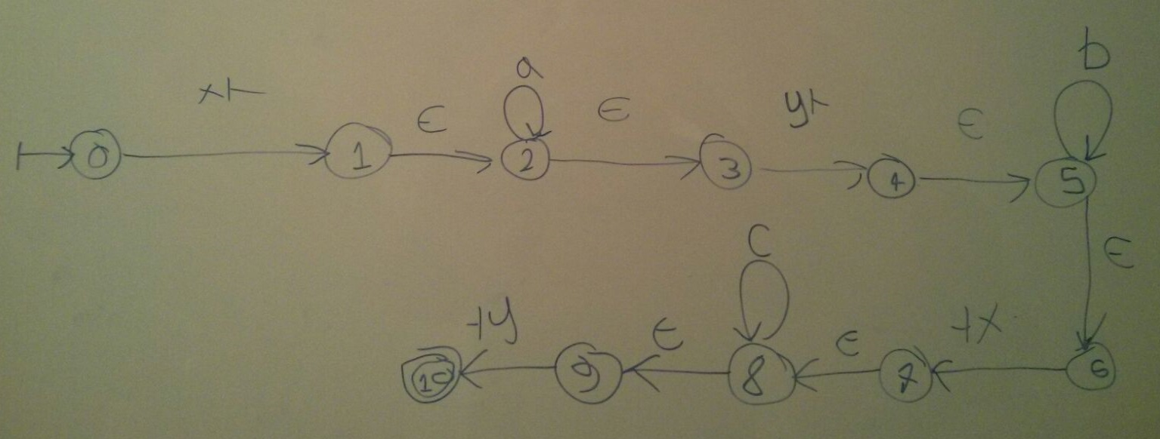
Lexicographic Vset Automaton
Example
29/04/2016

Slide 5
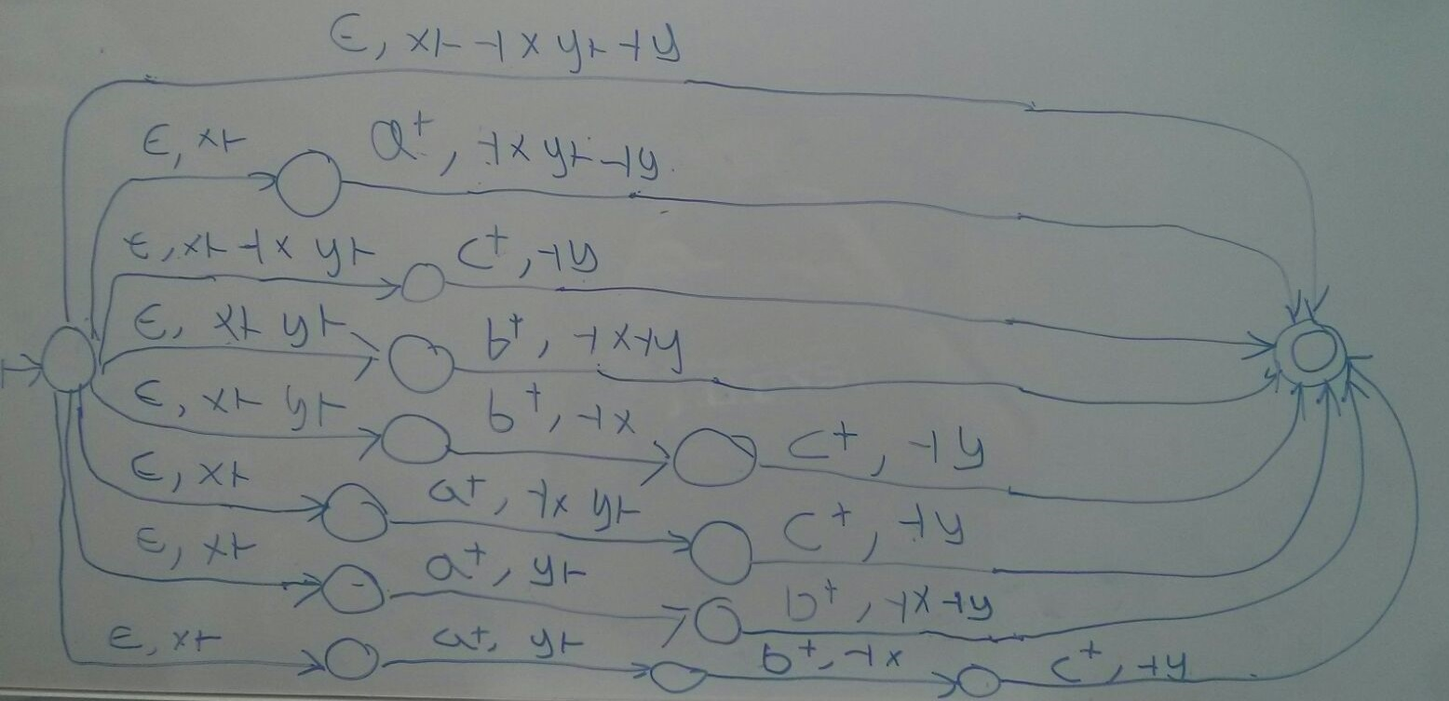
Lexicographic Vset Automaton
Example (cont.)
29/04/2016

Slide 6
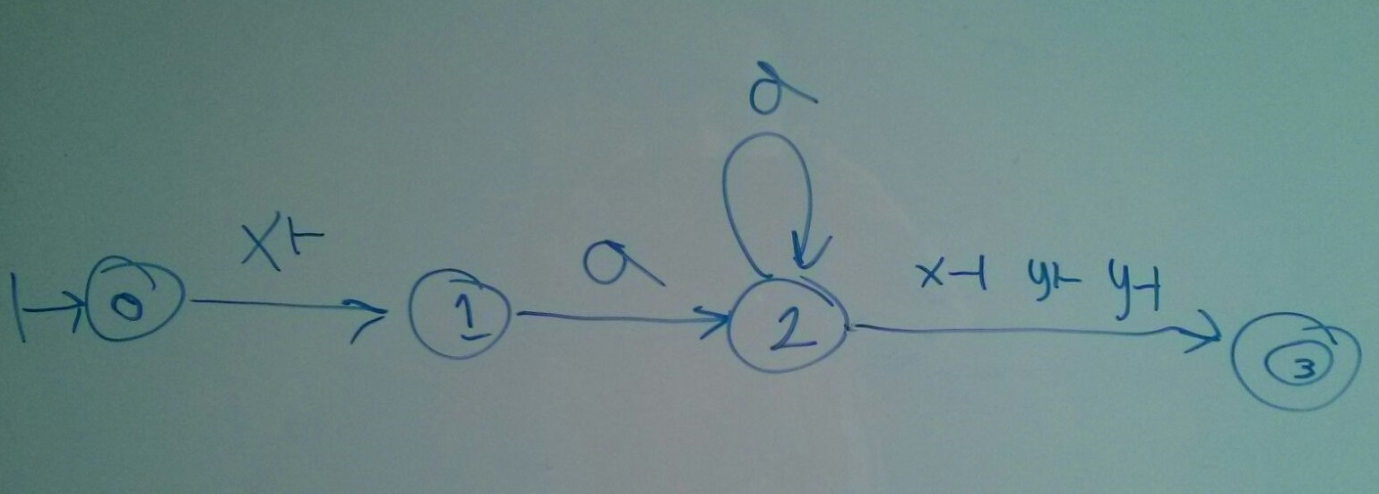
Lexicographic Vset Automaton
Example (cont.)
29/04/2016

Slide 7
Join
Start from two lexicographic vset automata
Perform cross product
Remove unreachable states
Remove dead states
States are of the form (State, State), map them to simple states
Converting result to Vset Path Union and then back to a Vset Automaton removes residual dead paths
29/04/2016

Slide 8
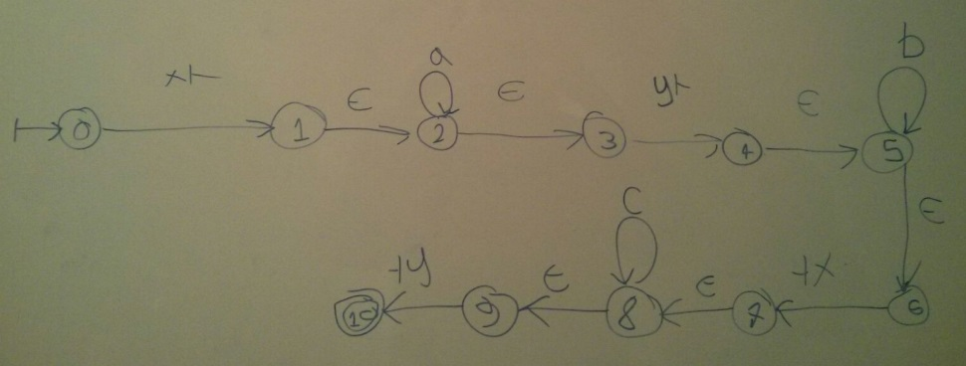

Join
Example
29/04/2016

Slide 9
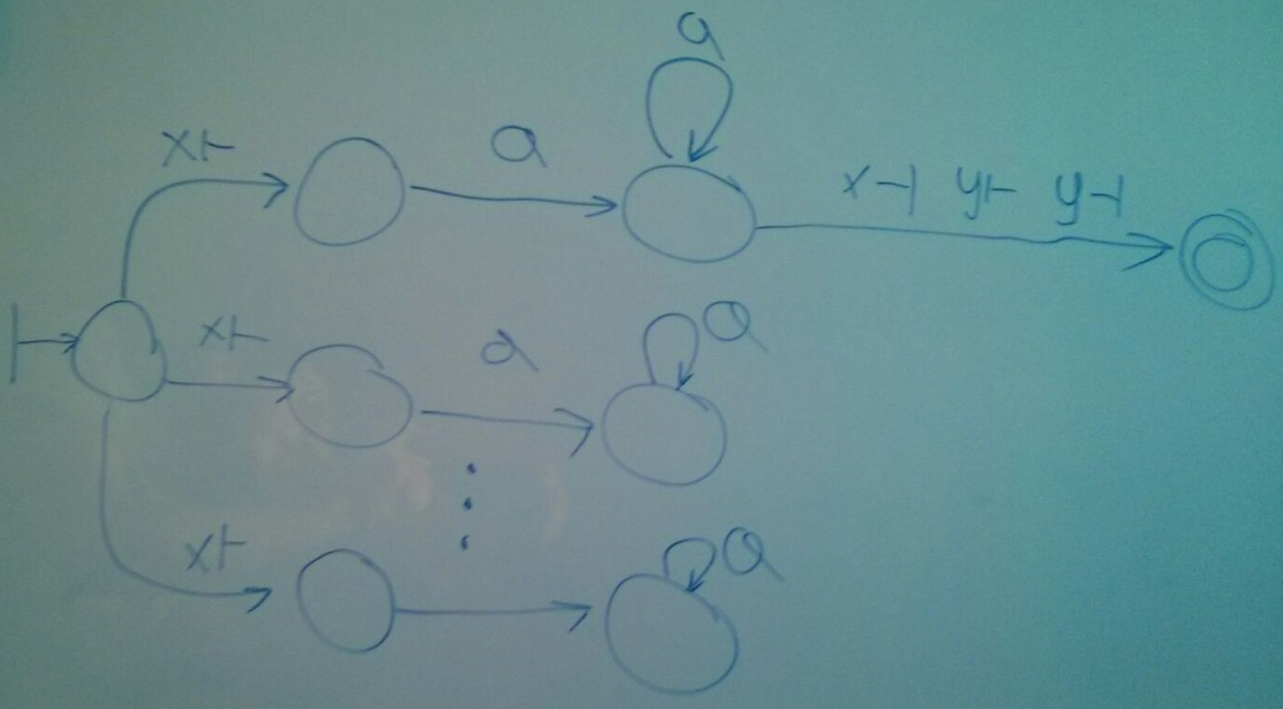
Join
Example (cont.)
29/04/2016

Slide 10
Union
Leave the states of one of the candidates unaltered
Shift the states of the other by the number of states of the previous
Keep the initial state in condivision
Merge the transition functions (interferences avoided)
Possible redundancy?
29/04/2016

Slide 11
Current Challenges
String Equality Selection
Ways to Run a Vset-Automaton
LMS
Experiments
29/04/2016

Slide 12
Ways To Run a Vset Automaton
Well-behaved vs. Not well-behaved: does it make sense? How to?
Thompson not VM-based: does it change?
OBDDs:
  Specify a vset automaton as a tagged NFA
  Encode it as a set of First Order Logic Formulas
  Evaluate it using OBDDs (tree-like structures)
  Match Test and Submatch Extraction are separated tasks
  Time Complexity: between O(n) and O(mn)
Kleenex:
  Start with a regular grammar, generate a transducer from it
  Convert nondeterministic transducers to deterministic streaming ones
  In Haskell (http://kleenexlang.org/)
  Seems very efficient
  Could convert vset-automaton to transducer (skipping grammar), whole pipeline looks difficult to implement
29/04/2016

Slide 13
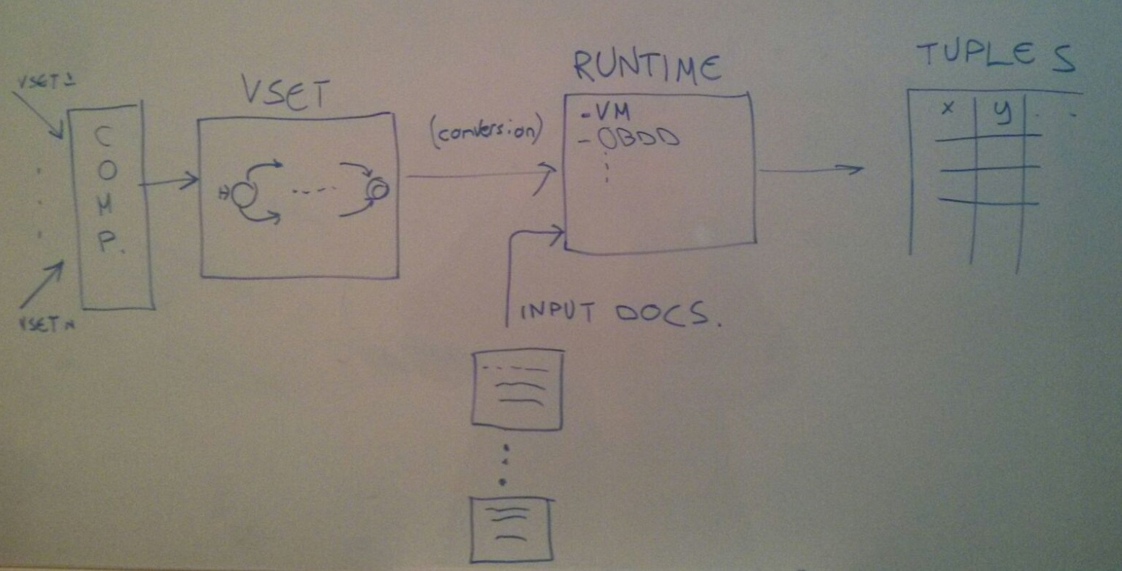
LMS
29/04/2016

Slide 14
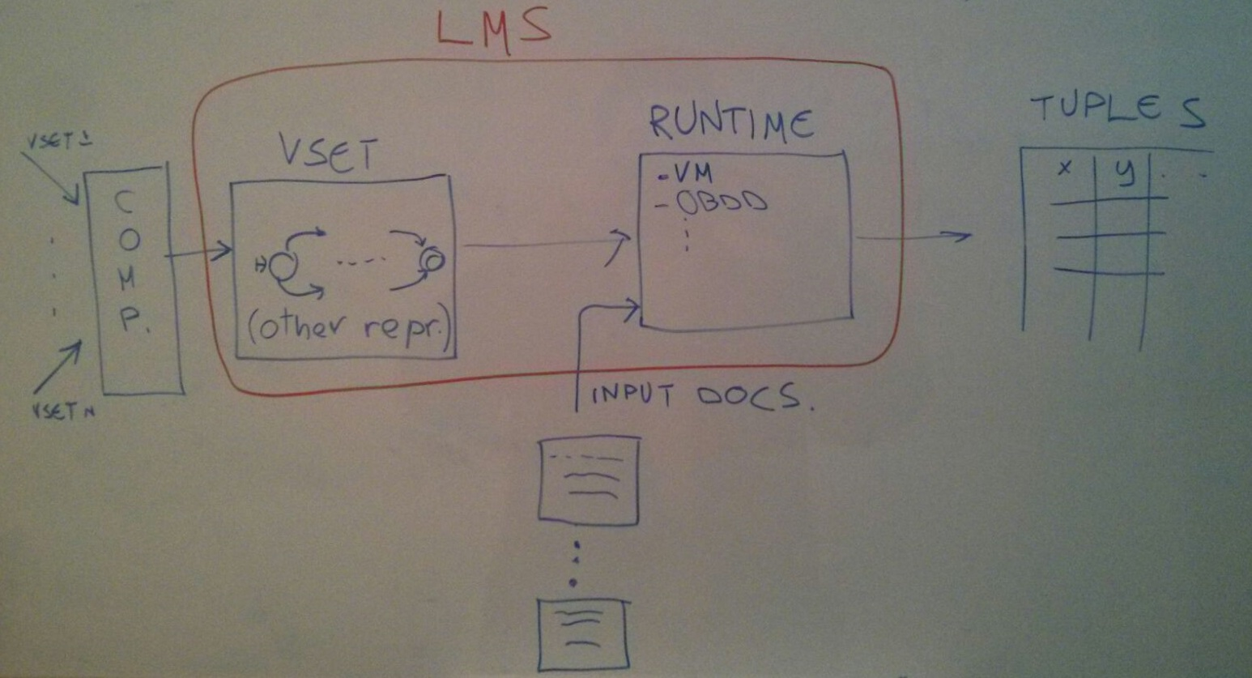
LMS
29/04/2016

Slide 15
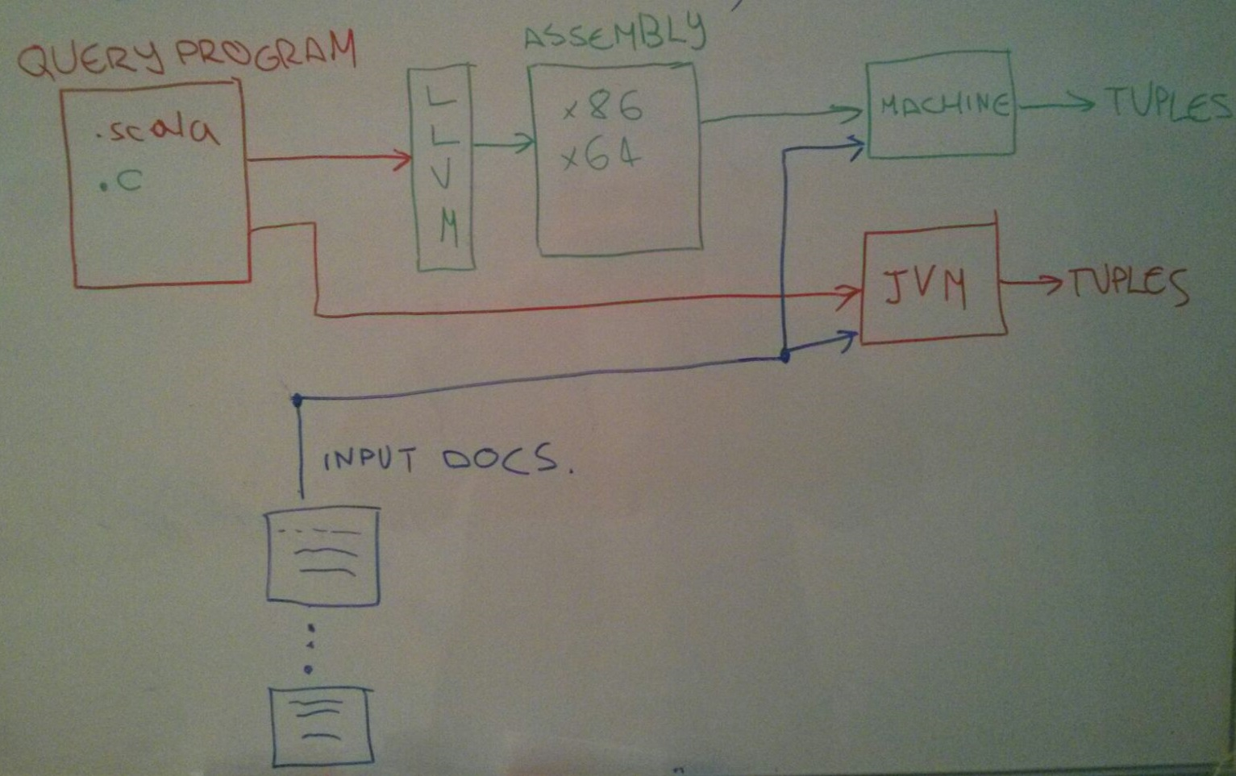
LMS
29/04/2016

Slide 16
Experiments
« Financial Indicators » uses
  Dictionaries
  Difference (refinement)
Size of the data?
Invent the experiments?
Combinations?
  With/without LMS
  With/without LLVM
29/04/2016

Slide 17
Questions
29/04/2016

