Slide 1

MEMO-H-504
Andrea Morciano
Presented to: Prof. Stijn Vansummeren
16/02/2016

Slide 2
My Discoveries
Information Extraction
SystemT
AQL
XLog
Document Spanners (Formal Model)
16/02/2016

Slide 3
Information Extraction (IE)
Extract structured information from an unstructured source in an automated fashion (e. g. set of docs, Web…)
Named entities
Relationships between entities
Diversity of applications: enterprise, scientific, personal information management, etc.
Challenges:
  Accuracy
  Running time
Major approaches:
  Rule Based (Cascading Grammars, Regexps);
  Stastistical (Machine Learning);
16/02/2016

Slide 4
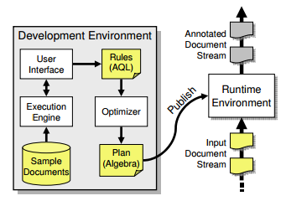
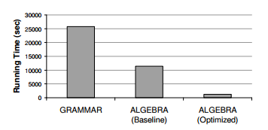
SystemT
System for rule-based IE
Developed at IBM to solve the traditional systems’ scaling problems
Express annotators with AQL
Features:
  Development Environment (supports iterative method)
  Optimizer
  Runtime environment:
    Uses annotators to process continuous streams of documents
    One document at a time (no interconnections)
Optimization allows enormous increase in performance and scalability
16/02/2016

Slide 5
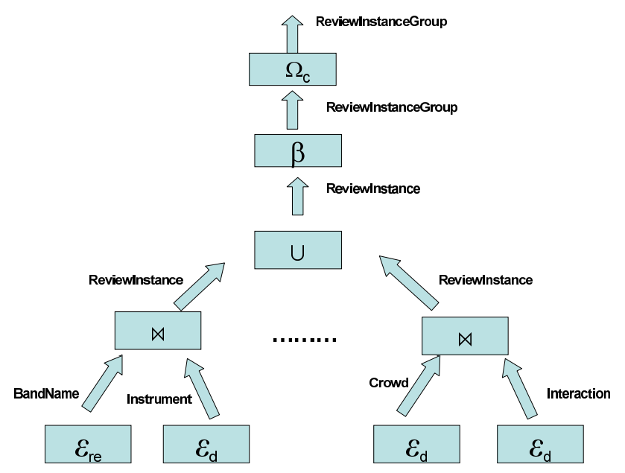
AQL
Declarative SLQ-like language for annotators
Map source strings to a series of spans
Span extraction operators:
  Regexp matcher
  Dictionary lookup
Allows expressing complex spanners by means of relational algebra
Relational operators:
  Selection
  Projection
  Join (Cartesian Product)
  Intersection
  Union
  …
Span aggregation operators
Span selection predicates
Discloses optimization techniques from DB world + new ones (based on text-specific features, e.g. Conditional Evaluation)
16/02/2016

Slide 6
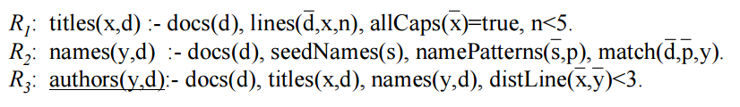
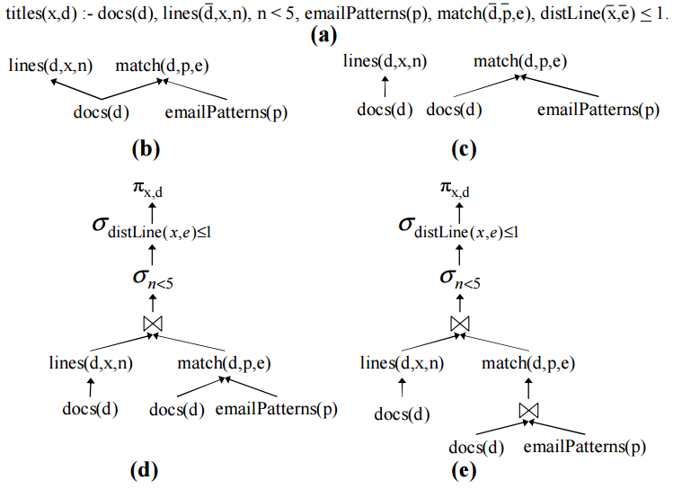
XLog
Modification of DataLog query language for IE
Types of predicates:
  Extensional (table provided by program)
  Intensional (table must be computed using rules)
Enriched with:
  Procedural predicates (built-in or user defined)
  IE predicates (span extraction predicates)
    Special case of p-predicates
Similar goals to SystemT + AQL (i.e. scalability, modularity, flexibility, …)
Enables opimizations as well:
  Pushing down text properties
  Scoping extraction
  Indexing patterns
16/02/2016

Slide 7
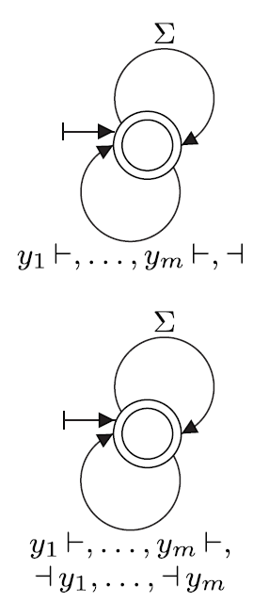
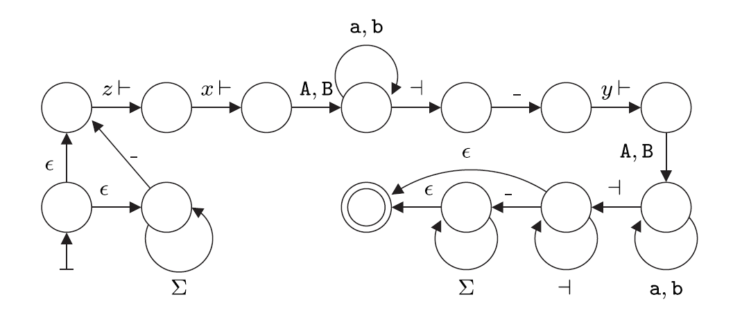
Document Spanners (Formal Model)
Model capturing the core features of AQL
Spanner: maps input string into a relation over spans of the string
Important spanners’ classes:
  Boolean
  Hierarchical
  Universal
Primitive spanner representations:
  Regex formulas
  Variable stack automata
  Variable set automata (called regular spanners)
Spanner algebra operators:
  Union
  Projection
  Natural Join
  String Selection
Core of AQL: Core spanners
  Regex formulas with algebra operators
  Can be expressed by vset-automata with string selection and projection
  Core-simplification Lemma
  Not closed under difference
16/02/2016

Slide 8
My Questions
16/02/2016

Slide 9
More practical info in the remaining material?
Should I go beyond the provided reading material?
Should I follow the steps in the thesis statement in order?
Format of the thesis? (LaTex?)
How to identify the chapters/sections? (Maybe the steps of the statement?)
Guidelines for the document? E.g. when/how to cite, avoiding unexpected plagiarism accusations, cover page, ‘I now show’ vs. ‘it is now shown’…
Should I start developing in parallel to writing the thesis?
Estimated time for producing the compiler?
Is it reasonable to take the operators descibed in your paper for the implementation?
Which data sets to use for benchmarks?
Can I have access to already developed annotators?
What to upload to the repository?
Comments on these slides?
16/02/2016

Slide 10
Your Questions
16/02/2016

