Slide 1

MEMO-H-504
Andrea Morciano
Presented to: Prof. Stijn Vansummeren
17/05/2016

Slide 2
My Work
Join (based on epsilon-closure)
Theory
LMS
17/05/2016

Slide 3
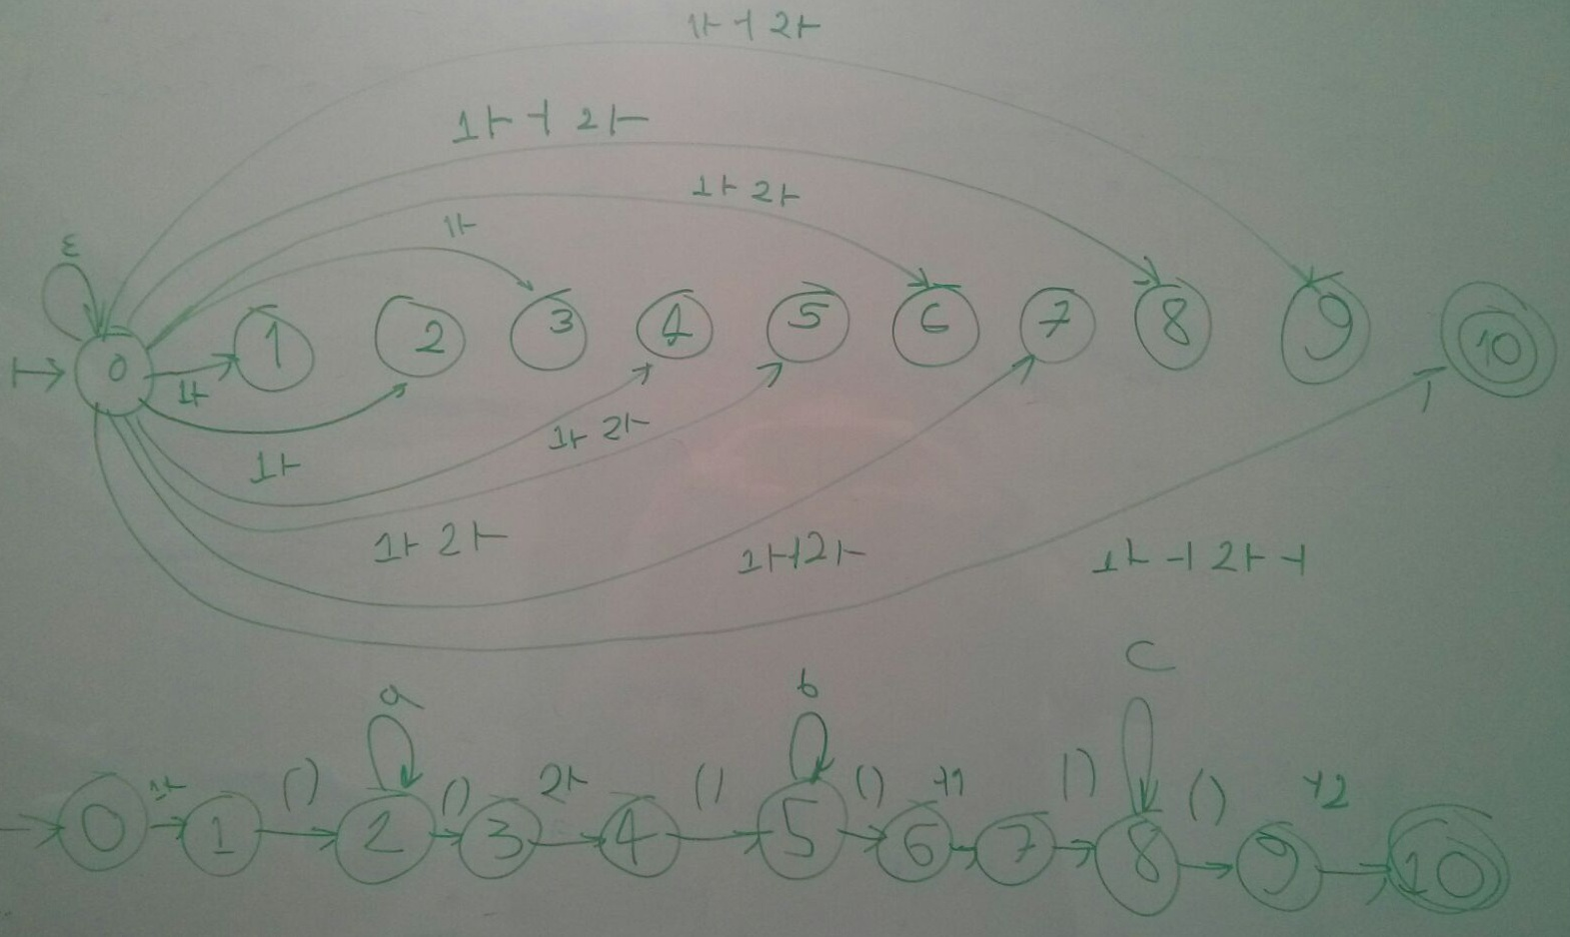
Join
Epsilon-closure
17/05/2016

Slide 4
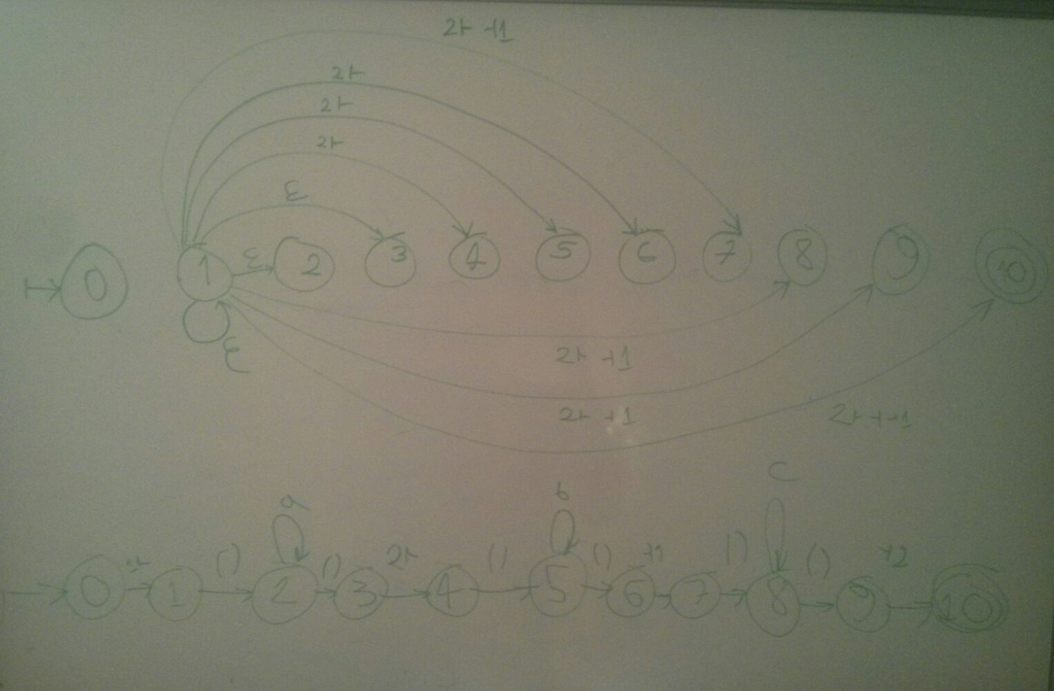
Join
Epsilon-closure (2)
17/05/2016

Slide 5
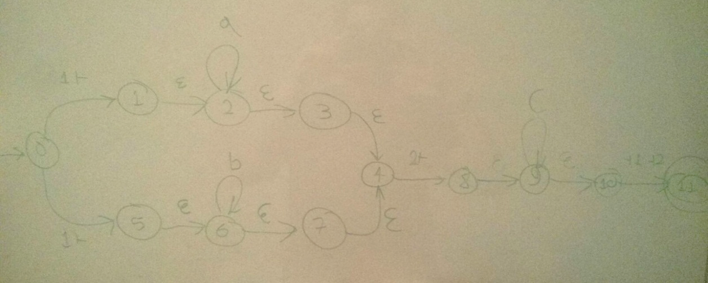
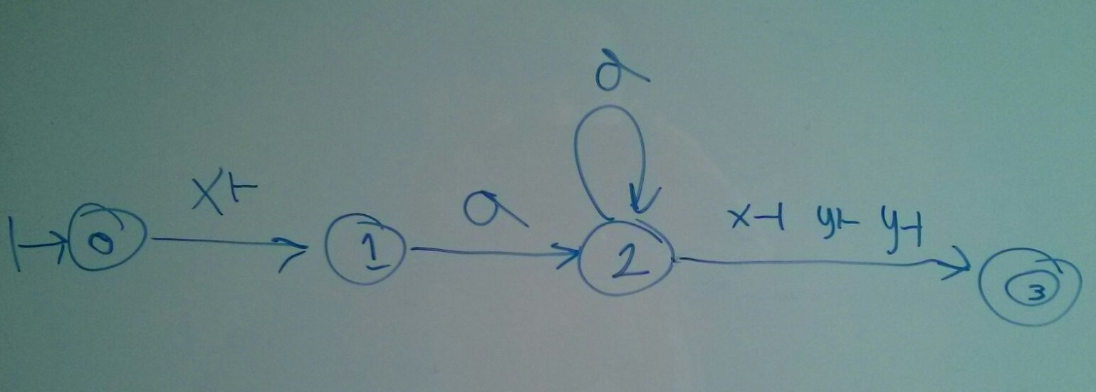
Join
Example
17/05/2016

Slide 6
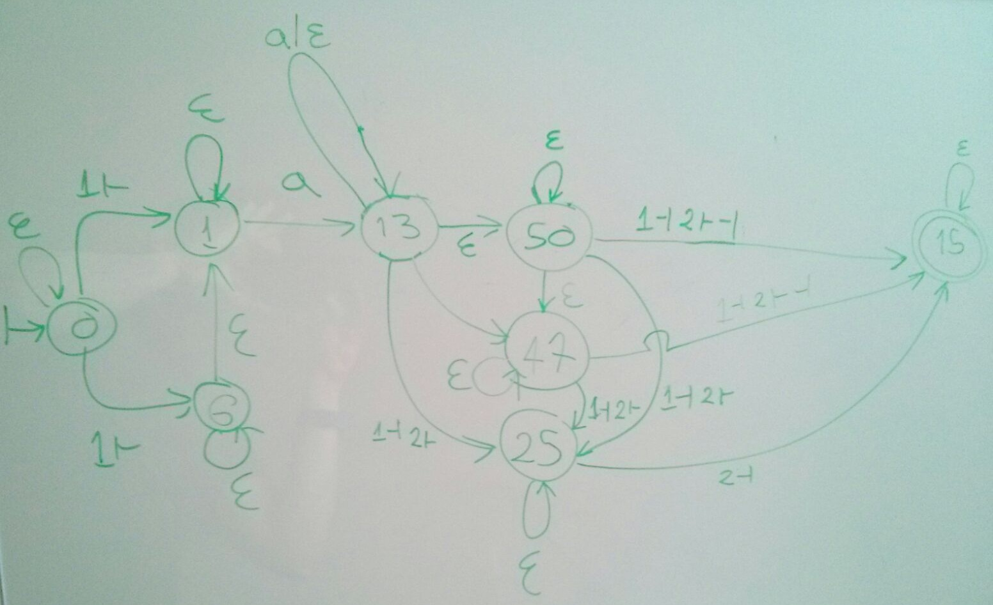
Join
Example (cont.)
Redundancy!
17/05/2016

Slide 7
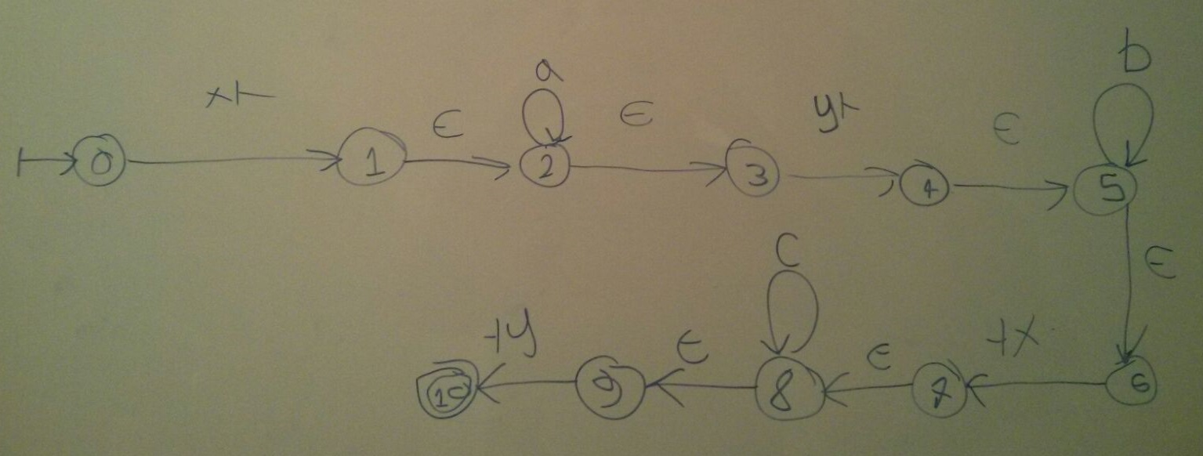
Join
EXPLOSION!
17/05/2016

Slide 8
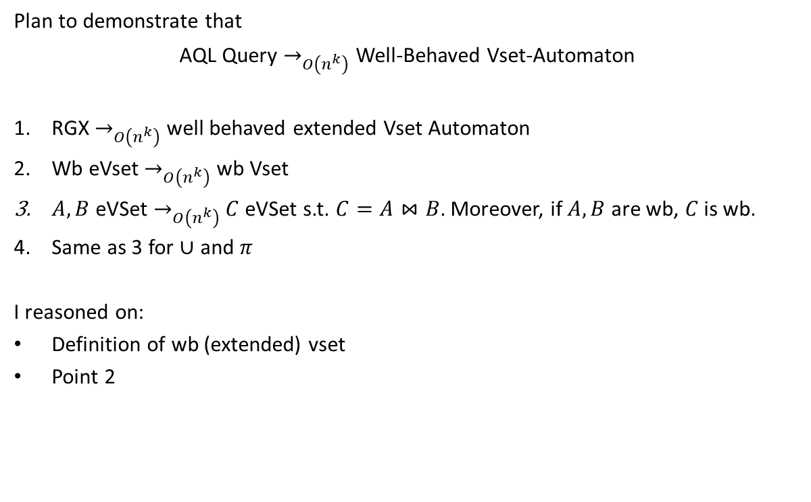
Theory
17/05/2016

Slide 9
LMS
Studied the documentation
Allows specifying custom DSLs and embedded compilers for them
Compilers implement domain specific optimizations
Execution = Staging Time + Runtime
Data objects with type wrapped in Rep[] => value not known at staging time
All other data objects are evaluated at staging time
Evaluate prog. => DS opt. => Code Graph (AMS) => LMS op.
17/05/2016

Slide 10
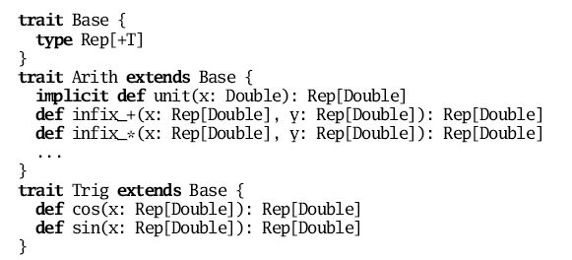
LMS
Example
17/05/2016

Slide 11
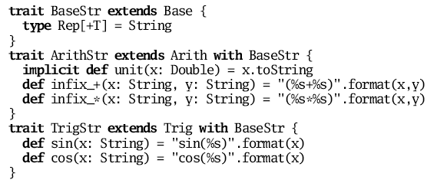
LMS
Example (2)
17/05/2016

Slide 12
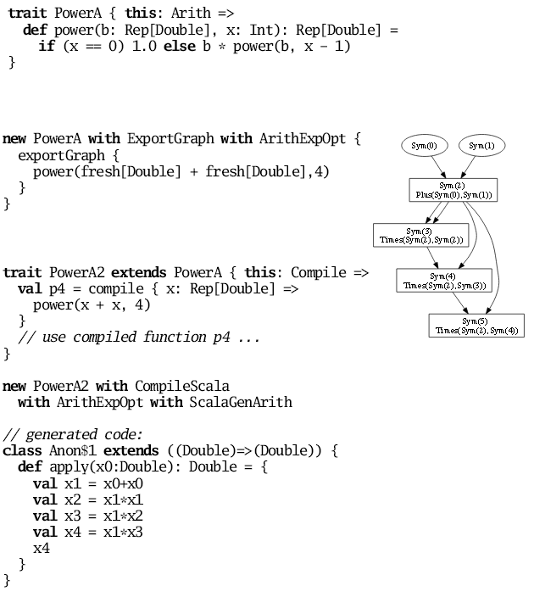
LMS
Example (3)
17/05/2016

Slide 13
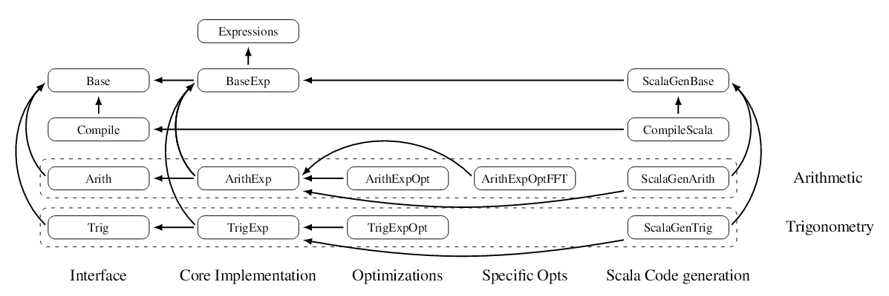
LMS
Example (4)
Reference: https://infoscience.epfl.ch/record/150347/files/gpce63-rompf.pdf
17/05/2016

Slide 14
Current Challenges
Debugging
Demonstrating
LMS
Experiments
17/05/2016

Slide 15
Questions
17/05/2016

