Slide 1

MEMO-H-504
Andrea Morciano
Presented to: Prof. Stijn Vansummeren
08/04/2016

Slide 2
My Work So Far
Introductory Chapters of the Paper
Virtual Machine to Match REs
Vset-Automaton to Vset Path Union
08/04/2016

Slide 3
Introductory Chapters of the Paper
Written using Lyx (https://www.lyx.org/)
They are:
  Introduction to IE: generic overview of the topic: techniques, applications, challenges, etc.
  Description of SystemT and AQL:
    SystemT’s concept, data model, execution model, etc.
    Brief description of AQL as SystemT’s query language
    Formal description of AQL’s core using document spanners
08/04/2016

Slide 4
Virtual Machine to Match REs
Taken from articles on RE2
Pike’s implementation
Takes an NFA program (example later) as input
Mantains a conceptual thread for each branch in the NFA’s computation tree
Threads are advanced in lockstep
Supports submatch extraction
08/04/2016

Slide 5
Virtual Machine to Match REs
Sample NFA program for (a+)(b)
0 SAVE 0
1 CHAR a
2 SPLIT 1, 3
3 SAVE 1
4 SAVE 2
5 CHAR b
6 SAVE 3
7 MATCH
08/04/2016

Slide 6
Vset-Automaton to Vset Path Union
Two steps:
  State elimination
  Individual paths collection
Initial automaton normalized to have:
  1 initial state with no incoming transitions
  1 final state with no outgoing transitions
Basis for join, projection implementation
08/04/2016

Slide 7
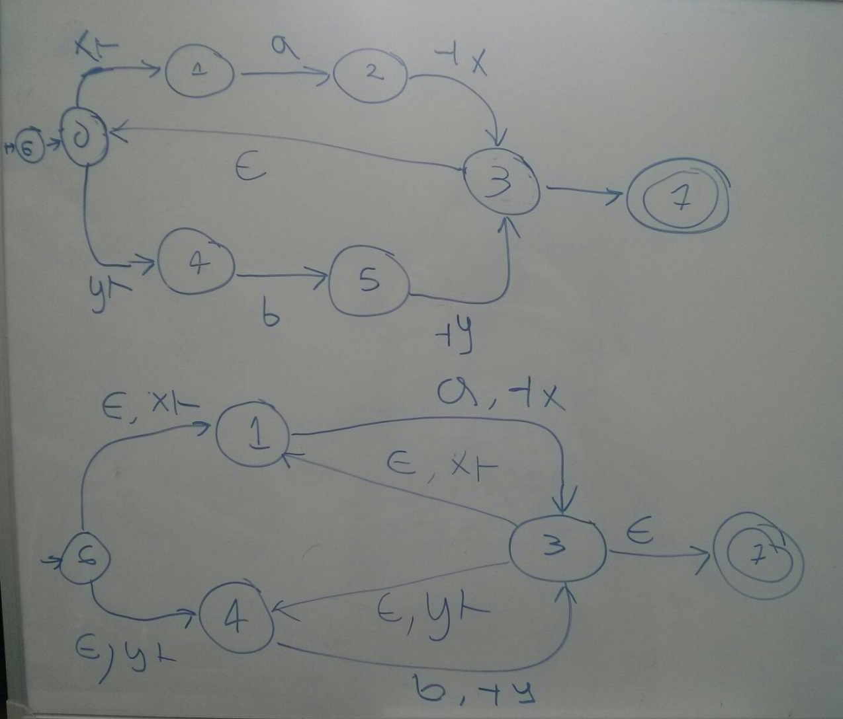
Vset-Automaton to Vset Path
08/04/2016

Slide 8
Current Challenges
Vset Path Union to Vset-Automaton
Computing Intersection of Automata
Translating Vset-Automaton to NFA program
08/04/2016

Slide 9
Vset Path Union to Vset-Automaton
Intersect the individual paths first?
Simply do the union of the paths?
Labels have regular expressions and not single tokens, how to parse them?
08/04/2016

Slide 10
Computing Intersection of Automata
Should I do it from scratch?
Libraries exist:
  FSAUtils (http://rindphi.github.io/FSAUtils/)
    Parses RE into NFA (useful for previous problem)
    Supports custom transitions labels (e.g. « x_in »)
    Verbose (requires total transition function, automata intersection tracks original states)
  dk.brics.automaton (http://www.brics.dk/automaton/)
    Parses RE into NFA
    Concise representations
    No support for custom labels
  Jautomata (http://jautomata.sourceforge.net/)
    Support for string labels
    Doesn’t parse RE into NFA
    I can’t compile it: Maven error
08/04/2016

Slide 11
Translating Vset-Automaton to NFA program
Is this the best way to go?
Alternative: Vset -> RE -> NFA program
My idea: traverse automaton’s graph, generating program’s instructions in the meantime
08/04/2016

Slide 12
My Questions
08/04/2016

Slide 13
What’s the tasks’ priority? Vset->NFA program, Automata intersection (->join/projection), AQL parsing, LLVM, LMS, alternative runtime implementations (OBDDs, transducers)
LMS references? Can I target C++/IR by default or manual adaptation required?
Will BigInsights be deployed on your machine? Should I try Jaql either way?
Your opinion on when to present the thesis?
08/04/2016

Slide 14
Your Questions
08/04/2016

