Slide 1

MEMO-H-504
Andrea Morciano
Presented to: Prof. Stijn Vansummeren
23/06/2016

Slide 2
My Work
Classical Implementation
Compiler/Interpreter
Benchmark
Frontend
23/06/2016

Slide 3
Classical Implementation
Initial relations spanned by core spanners
Algebraic operations performed directly on the relations
Lazy evaluation of the initial relations possible
Generalized Join:
  Based on boolean predicates
  Input relations must not have tuples in common
  Predicates: ‘Follows’, ‘IsWithin’
  Implementation: nested loop join
Natural join:
  Implementation: hash join
  Probably not very useful
23/06/2016

Slide 4
Compiler/Interpreter
AQL specifications can be given to the system to be:
  COMPILED: monolithic spanner derived
  INTERPRETED: classical implementation applied
Spanners can be provided to be executed
23/06/2016

Slide 5
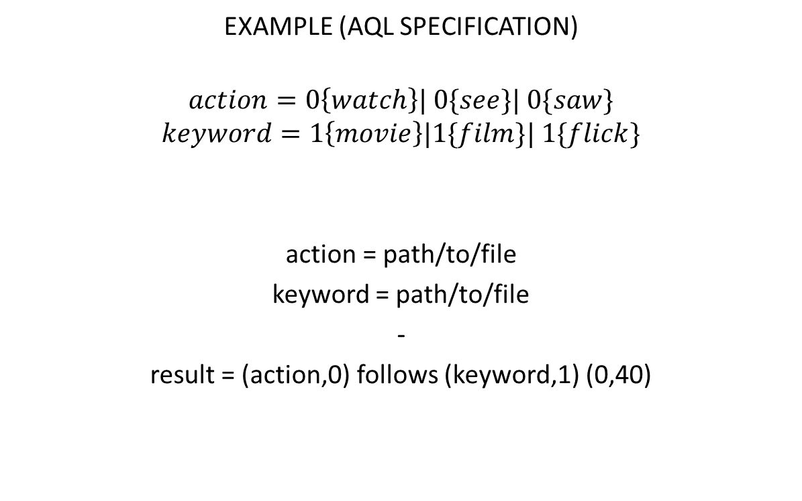
Compiler/Interpreter (2)
23/06/2016

Slide 6
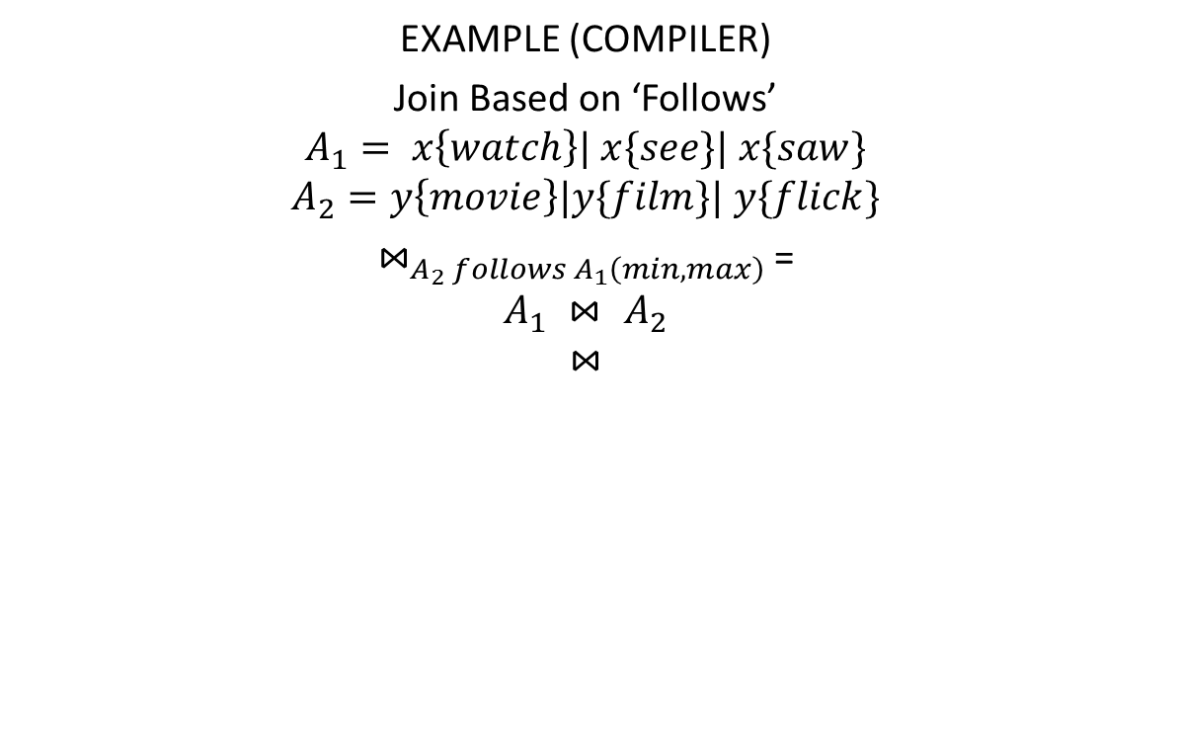
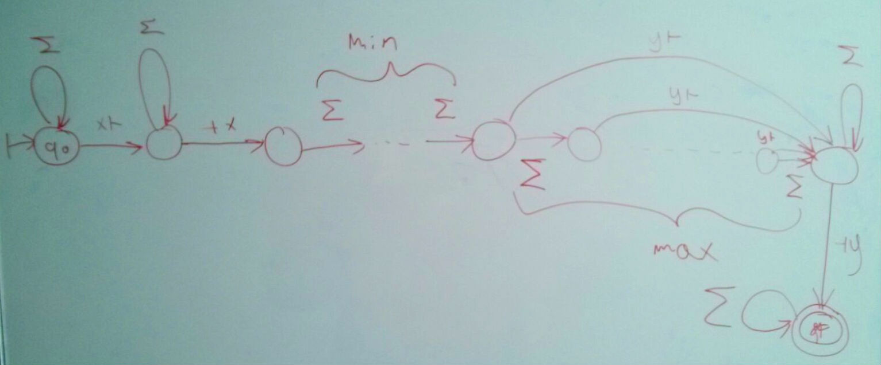
Compiler/Interpreter (3)
23/06/2016

Slide 7
Benchmark
Idea: finding movie reviews in a corpus of blog entries
Corpus: http://u.cs.biu.ac.il/~koppel/BlogCorpus.htm
Query plan inspired from [1]
Compare compiled approach with interpreted
23/06/2016

Slide 8

































Benchmark (2)
23/06/2016

Slide 9
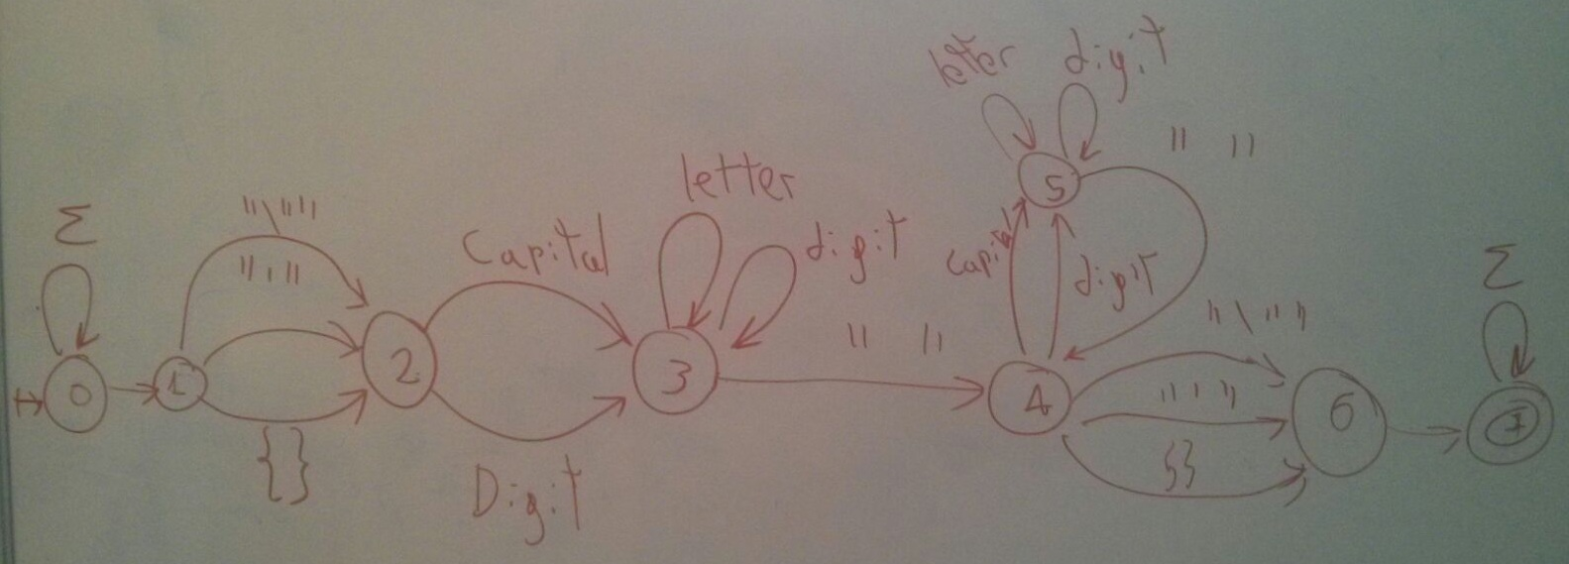
Benchmark (3)
EXAMPLE
‘title’ spanner
23/06/2016

Slide 10
Questions
23/06/2016

Slide 11
Paper abstract in French?
Explanatory article?
Where to print the document? Which format?
23/06/2016

Slide 12
References
[1] Reiss, F.; Raghavan, S.; Krishnamurthy, R.; Zhu, H. & Vaithyanathan, S. (2008), An Algebraic Approach to Rule-Based Information Extraction., in 'Proceedings of the 24th IEEE International Conference on Data Engineering' , IEEE, , pp. 933-942 .
23/06/2016

