Slide 1
Question answering system from reviews
Sirinian Aram Emmanouil
Department of Computer Science & Engineering
University of Ioannina
Panayiotis Tsaparas

Slide 2
INTRODUCTION

Slide 3
Motivation
Sheer amount of information in online tips and reviews makes it difficult for the platform users to digest them and find the most needed answers to their questions.
Human response in Community based question-answering (QA) system usually take lot of time.

Slide 4
Goal
A question-answering system that automatically answers questions using online tips and reviews.
Try different algorithms using word embeddings

Slide 5
PRELIMINARIES

Slide 6

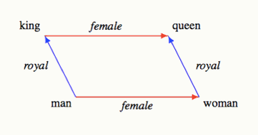
Preliminaries
Word Embeddings
form of word representation
word vectors in an n-dimensional space
two similar words are represented by almost similar vectors that are very closely placed in a vector space
word analogies can often be solved with vector arithmetic

Slide 7
Preliminaries
BiDAF
BiDAF is a QA model
For several weeks topped the leaderboard of the Stanford Question and Answering Dataset (SQuAD)
Closed-domained, extractive and can answer only factoid questions
Needs to consult an accompanying text that contains the information needed to answer the questions
Returns a text’s substring

Slide 8
Q&A SYSTEM

Slide 9

Q&A System
Corpus
We use the Yelp Open Dataset. This dataset contains:
8.021.122 reviews
1.320.761 tips
209.393 businesses
For answering questions we use either Tips or Reviews.

Slide 10
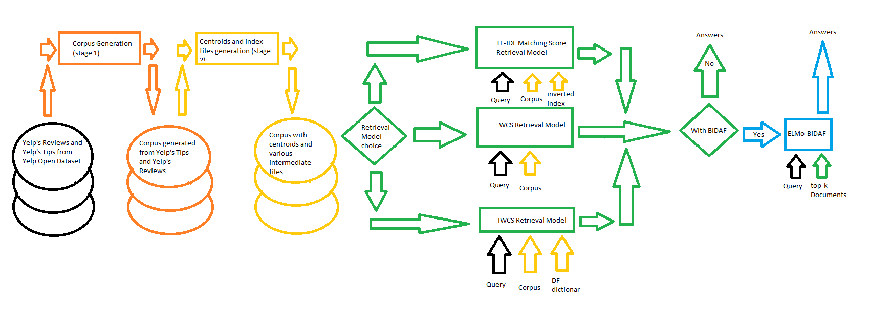
Q&A System
Retrieval models
Word Vector Centroid Similarity (WCS)
IDF Re-weighted Word Vector Centroid Similarity (IWCS)
TF-IDF Matching Score (used as baseline)

Slide 11
Q&A System
Word Vector Centroid Similarity (WCS)
And
IDF Re-weighted Word Vector Centroid Similarity (IWCS)
Load Documents from Corpus based on the chosen business
Compute question’s vector centroid representation
Compute Documents’ vector centroid representations
Compute all the cosine similarities between question’s and Documents’ vector centroid representations
Sort all Documents based on their cosine similarities
Return the k-top Documents with the highest cosine similarities

Slide 12
Q&A System
Word Vector Centroid Similarity (WCS)
Vector centroid computation
For each word in text get it’s word vector
Sum all word vectors to a single vector
Compute the vector centroid by dividing the sum with the number of text’s words

Slide 13
Q&A System
IDF Re-weighted Word Vector Centroid Similarity (IWCS)
Vector centroid computation
For each word in text get it’s word vector
For each word in text compute it’s TF-IDF weight
For each word in text multiply it’s TF-IDF weight with it’s word vector
Compute the vector centroid by summing all new vector

Slide 14
Q&A System
TF-IDF Matching Score
For each Document that contains a word from the question. Compute its score by adding the TF-IDF values of the words that are in the question.
Sort all Documents based on their score
Return the k-top Documents with the highest scores

Slide 15
Q&A System
Answer’s generation
Break every Yelp’s Tip and Yelp’s Review into sentences and use them as our Corpus.
Use an already well known Q&A model just for this task named BiDAF
We also have the option to rearrange the extracted by BiDAF answers by computing their cosine similarity with the question.

Slide 16
Algorithms
Short form | Description
TF-IDF+Without_BiDAF | The Corpus consists of sentences (from Tips or Reviews) and we use the TF-IDF Matching Score retrieval model.
TF-IDF+With_BiDAF | The Corpus consists of full-length documents (Tips or Reviews) and we use the TF-IDF Matching Score retrieval model. The results are fed to the BiDAF. Returns back BiDAF results sorted by the previously computed similarities.
WCS+Without_BiDAF | The Corpus consists of sentences (from Tips or Reviews) and we use the WCS retrieval model.
WCS+With_BiDAF | The Corpus consists of full-length documents (Tips or Reviews) and we use the WCS retrieval model. The results are fed to the BiDAF. Returns back BiDAF results sorted by the previously computed similarities.
IWCS+Without_BiDAF | The Corpus consists of sentences (from Tips or Reviews) and we use the IWCS retrieval model.
IWCS+With_BiDAF | The Corpus consists of full-length documents (Tips or Reviews) and we use the IWCS retrieval model. The results are fed to the BiDAF. Returns back BiDAF results sorted by the previously computed similarities.

Slide 17

Preparatory stages
Corpus generation (stage 1)
Centroids and index files generation (stage 2)

Slide 18
Q&A System
Corpus generation (stage 1)
When using the BiDAF model: Yelp’s Tips and Yelp’s Reviews.
In the other case : Yelp’s Tips and Yelp’s Reviews broken to sentences.
In all cases we remove too short documents and when we do not use the BiDAF model we remove too long documents as well.

Slide 19
Q&A System
Centroids and index files generation (stage 2)
For the TF-IDF Matching Score retrieval model:
Inverted indexes with TF-IDF values
For the Word Vector Centroid Similarity WCS retrieval model:
Corpus with Word Vector Centroids (WC)
For the IDF Re-weighted Word Vector Centroid Similarity (IWCS) retrieval model:
Corpus with IDF Re-weighted Word Vector Centroids (IWC).
Inverted indexes with TF-IDF values
Dictionaries with all Documents’ words and their DF values

Slide 20
System’s flow

Slide 21
EXPERIMENTAL EVALUATION

Slide 22

Experimental Evaluation
In order to evaluate our algorithms we collected questions from Yelp’s community Q&A.
995 questions
2.947 answers
67 businesses

Slide 23
Experimental Evaluation
Obtaining Ground Truth
Evaluation based on Yelp’s answers
Steps
Compute a vector representation for each answer generated from our algorithms
Compute a vector representation for each answer collected from Yelp
Group answers collected from Yelp by (question, business)
Compute a centroid vector representation for each group out of grouped answers collected from Yelp
Compute the cosine similarity between the collected answers and the generated get a good approximation of their similarity
rel(answer) = cos(answer, Yelp community’s answer)

Slide 24
Experimental Evaluation
Obtaining Ground Truth
Evaluation based on Yelp’s answers
We haven’t used all of the collected questions from Yelp
862 questions
51.432 total answers generated (~4310 from each algorithm)
57 businesses

Slide 25
Experimental Evaluation
Obtaining Ground Truth
Evaluation based on manual labeling
Steps
Chose a subset of questions
Rate in scale of [1-5] the generated from our algorithms answers with questions from the chosen subset

Slide 26
Experimental Evaluation
Obtaining Ground Truth
Evaluation based on manual labeling
We haven’t used all of the collected questions from Yelp
45 questions
2.638 total answers generated (~225 from each algorithm)
18 businesses

Slide 27
Experimental Evaluation
Rating | Criterion
1 | If it is a useless information
2 | If it answers to the question of a similar topic but not to the actual question
3 | If it answers to the question but provides some extra information that is off-topic or useless. If the answer is incomplete and more information is necessary in order to understand it or feel sure about the meaning of the answer
4 | If it answers the question laconically. Lacking any additional information that could potentially be useful in some way
5 | If it answers to the question and provides additionally information or an example that is on topic

Slide 28
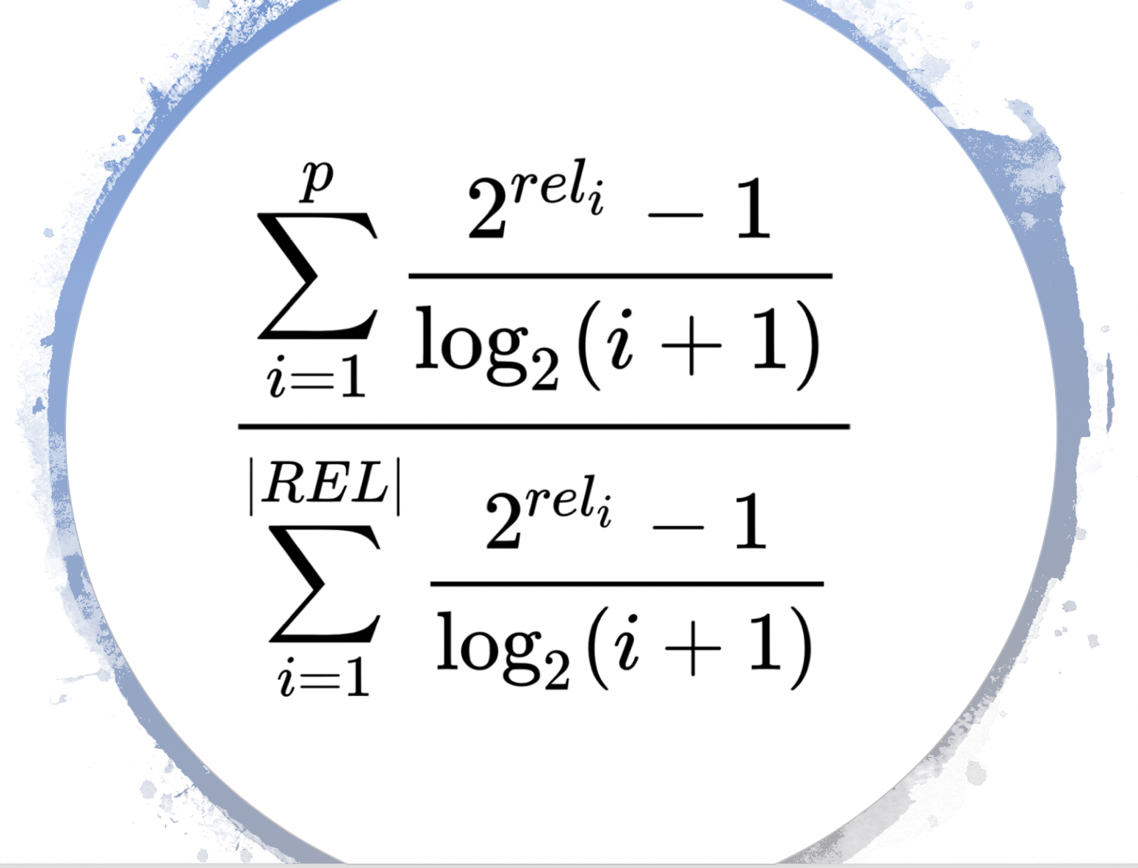
Experimental Evaluation
Evaluation Metrics
NDCG
Rank-aware evaluation metric
For all the results
Award a result by its relevance
Punish a result by its rank
Add all the result scores

Slide 29
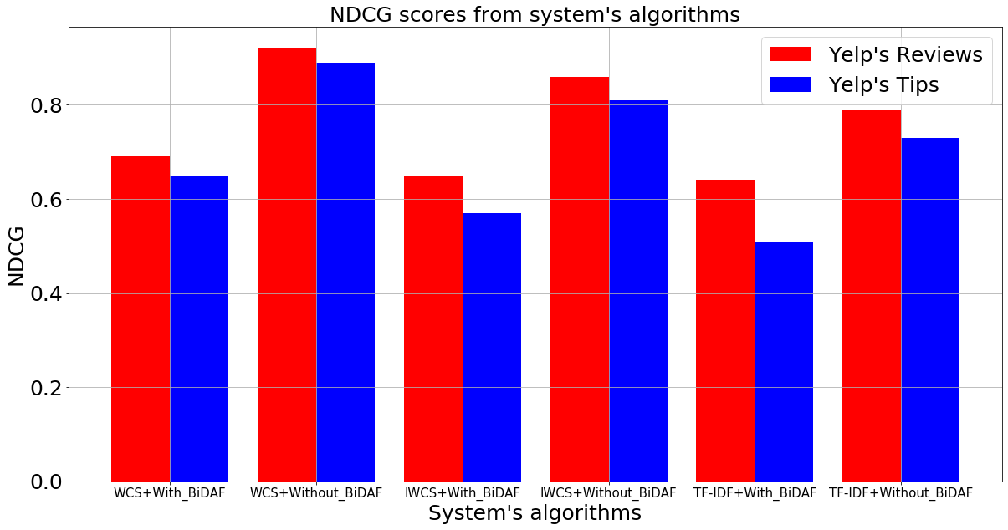
Experimental Evaluation
Evaluation based on Yelp’s answers
Yelp’s Reviews improve performance
BiDAF worsen performance
Best retrieval model: WCS
Second best retrieval model: IWCS
Worst retrieval model: TF-IDF Matching Score

Slide 30
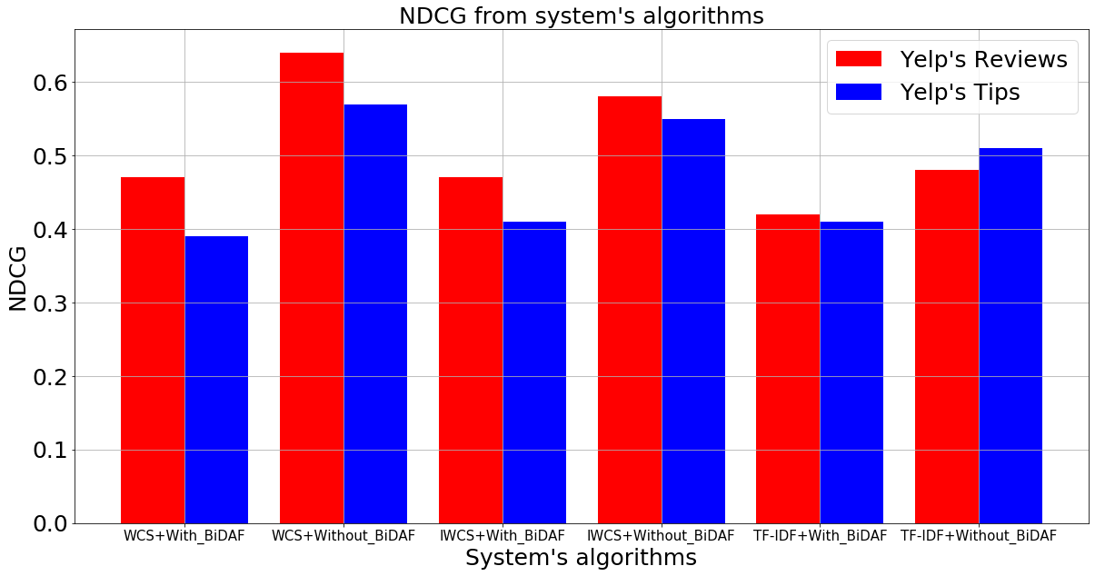
Experimental Evaluation
Evaluation based on manual labeling
Yelp’s Reviews improve performance (in most of the cases)
BiDAF worsen performance
Best retrieval model: WCS
Second best retrieval model: IWCS
Worst retrieval model: TF-IDF Matching Score

Slide 31
Conclusion
Best algorithm:
WCS+Without_BiDAF
Best results when we use for our Corpus:
Yelp’s Reviews
Using BiDAF:
worsen performance
Retrieval models that use word vectors have proved with these result that they can after all understand human language and therefore be able to answer communities’ queries much better than models that rely to TF-IDF.

Slide 32
?
QUESTIONS

Slide 33
THANK YOU!
Question answering system from reviews
Sirinian Aram Emmanouil
Department of Computer Science & Engineering
University of Ioannina
Panayiotis Tsaparas

Slide 34
Examples of WCS+Without_BiDAF with Reviews
Question | Business | Answer | Rating
Do they have lobster? | Bacchanal Buffet | Do you want shrimp and seafood? | 1
Do they have lobster? | Bacchanal Buffet | Too overpriced ($60 per person and didn't even have lobster but they had lobsters on display) for what they have if you like crab legs then it's for you. | 5
Do they have lobster? | Bacchanal Buffet | They didn't have the good stuff like lobster or king crab. | 5
Do they have lobster? | Bacchanal Buffet | You can bring a fork with you too so when you first make your way through the hot seafood items, you can snack on the halibut, salmon, crab croquette, lobster corn chowder. | 5
Do they have lobster? | Bacchanal Buffet | Don't you hate it when you go for crab legs and they are out, well not at Bacchanal. | 2

Slide 35
Examples of WCS+With_BiDAF with Reviews
Question | Business | Answer | Rating
Do they have lobster? | Bacchanal Buffet | Do you want shrimp and seafood? | 1
Do they have lobster? | Bacchanal Buffet | didn't even have lobster | 4
Do they have lobster? | Bacchanal Buffet | They didn't have the good stuff like lobster or king crab. | 5
Do they have lobster? | Bacchanal Buffet | Don't have breakfast. | 1
Do they have lobster? | Bacchanal Buffet | Do you love seafood? | 1

Slide 36
Examples of IWCS+Without_BiDAF with Reviews
Question | Business | Answer | Rating
Do they have lobster? | Bacchanal Buffet | D. There was no lobster. | 4
Do they have lobster? | Bacchanal Buffet | The lobster benedict didn't have lobster meat incorporated, just a lobster sauce on top of the benedict. | 4
Do they have lobster? | Bacchanal Buffet | Where was lobster, and the crab croquettes? | 1
Do they have lobster? | Bacchanal Buffet | All corn and no lobster in lobster chowder. | 4
Do they have lobster? | Bacchanal Buffet | Was hoping to try lobster bisque, but only found lobster corn chowder that did not have any lobster to be found. | 5

Slide 37
Examples of IWCS+With_BiDAF with Reviews
Question | Business | Answer | Rating
Do they have lobster? | Bacchanal Buffet | ? | 1
Do they have lobster? | Bacchanal Buffet | no lobster. | 4
Do they have lobster? | Bacchanal Buffet | D. There was no lobster. | 4
Do they have lobster? | Bacchanal Buffet | didn't have lobster meat incorporated | 4
Do they have lobster? | Bacchanal Buffet | Where | 1

Slide 38
Examples of TF-IDF+Without_BiDAF with Reviews
Question | Business | Answer | Rating
Do they have lobster? | Bacchanal Buffet | D. There was no lobster. | 4
Do they have lobster? | Bacchanal Buffet | NO LOBSTER I WAS TOLD. | 4
Do they have lobster? | Bacchanal Buffet | TIP: There's NO lobster! | 4
Do they have lobster? | Bacchanal Buffet | All corn and no lobster in lobster chowder. | 4
Do they have lobster? | Bacchanal Buffet | ), clams and where was the lobster? | 1

Slide 39
Examples of TF-IDF+With_BiDAF with Reviews
Question | Business | Answer | Rating
Do they have lobster? | Bacchanal Buffet | ? | 1
Do they have lobster? | Bacchanal Buffet | D. There was no lobster. | 4
Do they have lobster? | Bacchanal Buffet | no lobster. | 4
Do they have lobster? | Bacchanal Buffet | But no lobsters. | 4
Do they have lobster? | Bacchanal Buffet | Rio | 1

Slide 40
Examples of WCS+Without_BiDAF with Tips
Question | Business | Answer | Rating
Do they have the Bone Marrow here during brunch? | Wicked Spoon | Bone marrow is the only fabulous thing but no matter how many marrows you slurp, this place is still wickedly awful for brunch, lunch, and dinner. | 5
Do they have the Bone Marrow here during brunch? | Wicked Spoon | Don't come here for dinner! | 1
Do they have the Bone Marrow here during brunch? | Wicked Spoon | Try their bone marrow and roast duck.. they have good desserts too.. | 5
Do they have the Bone Marrow here during brunch? | Wicked Spoon | Do not come here for the sushi :( | 1
Do they have the Bone Marrow here during brunch? | Wicked Spoon | All you can eat bone marrow? | 1

Slide 41
Examples of WCS+With_BiDAF with Tips
Question | Business | Answer | Rating
Do they have the Bone Marrow here during brunch? | Wicked Spoon | no matter | 1
Do they have the Bone Marrow here during brunch? | Wicked Spoon | Try their bone marrow and roast duck.. they have good desserts too.. | 5
Do they have the Bone Marrow here during brunch? | Wicked Spoon | Do not come here for the sushi :( | 1
Do they have the Bone Marrow here during brunch? | Wicked Spoon | Usually go to Hash House a Go Go for brunch | 1
Do they have the Bone Marrow here during brunch? | Wicked Spoon | I even tried the bone marrow | 4

Slide 42
Examples of IWCS+Without_BiDAF with Tips
Question | Business | Answer | Rating
Do they have the Bone Marrow here during brunch? | Wicked Spoon | no bone marrow for brunch :( | 4
Do they have the Bone Marrow here during brunch? | Wicked Spoon | Bone marrow was served after 1130 am. | 4
Do they have the Bone Marrow here during brunch? | Wicked Spoon | Amazing dinner buffet... With BONE MARROW! | 4
Do they have the Bone Marrow here during brunch? | Wicked Spoon | They have bone marrow now!! | 4
Do they have the Bone Marrow here during brunch? | Wicked Spoon | There's no more bone marrow!!! | 4

Slide 43
Examples of IWCS+With_BiDAF with Tips
Question | Business | Answer | Rating
Do they have the Bone Marrow here during brunch? | Wicked Spoon | Yayuhhhh | 4
Do they have the Bone Marrow here during brunch? | Wicked Spoon | :( | 1
Do they have the Bone Marrow here during brunch? | Wicked Spoon | Amazing dinner buffet... With BONE MARROW! | 4
Do they have the Bone Marrow here during brunch? | Wicked Spoon | There's no more bone marrow!!!! | 4
Do they have the Bone Marrow here during brunch? | Wicked Spoon | They have bone marrow now | 4

Slide 44
Examples of TF-IDF+Without_BiDAF with Tips
Question | Business | Answer | Rating
Do they have the Bone Marrow here during brunch? | Wicked Spoon | They have bone marrow now!! | 4
Do they have the Bone Marrow here during brunch? | Wicked Spoon | There's no more bone marrow!!! | 4
Do they have the Bone Marrow here during brunch? | Wicked Spoon | no bone marrow for brunch :( | 4
Do they have the Bone Marrow here during brunch? | Wicked Spoon | All you can eat bone marrow? | 1
Do they have the Bone Marrow here during brunch? | Wicked Spoon | The bone marrow is awesome. | 4

Slide 45
Examples of TF-IDF+With_BiDAF with Tips
Question | Business | Answer | Rating
Do they have the Bone Marrow here during brunch? | Wicked Spoon | There's no more bone marrow!!!! | 4
Do they have the Bone Marrow here during brunch? | Wicked Spoon | They have bone marrow now | 4
Do they have the Bone Marrow here during brunch? | Wicked Spoon | :( | 1
Do they have the Bone Marrow here during brunch? | Wicked Spoon | Yayuhhhh | 4
Do they have the Bone Marrow here during brunch? | Wicked Spoon | Unlimited bone marrow! | 5

