Slide 1
Countermeasure

Slide 2
Challenges for Attacker
Find the address of inserted source code
Find the return address
Assuming the code is executable
Overflow is not noticed
Memory is linear
Stack and buffer grow in opposite direction
Strcpy no ’\0’
…
Attacker’s code
Return address
…
buffer
…

Slide 3
Defenses
Canary
Library Wrapper
Shadow Stack
W⊕X Pages

Slide 4
Canary
After the Overflow (Compiler and OS level)
- sometimes called Stack Guards or Cookies
- embed “canaries” before return address
terminator (0x00, 0x0a, 0x0d)
random
- verify their integrity PRIOR to Function RETURN
…
Attacker’s code
Return address
Canary
…
buffer
…

Slide 5
Store Canary
Foo()
{
…
…
exit(0);
}
int canary = rand();
int mySecret;
mySecret = canary;
if (mySecret != canary) { alert();}
Craft canary?

Slide 6
Store Canary
Foo()
{
…
…
exit(0);
}
int *canary = malloc(sizeof(int));
int mySecret;
*canary = rand();
mySecret = *canary;
if (mySecret != *canary) { alert();}
Craft the address of canary?

Slide 7
Store Canary
Foo()
{
…
…
exit(0);
}
static int canary = rand();
int mySecret;
mySecret = canary;
if (mySecret != canary) { alert();}
Craft the address of canary?

Slide 8
Solved?
Not really
What about format string attacks?
…
Attacker’s code
Return address
Canary
…
&format string
…
Point to the source code
Write the return address directly
without touch canary

Slide 9
Library Wrappers (libsafe)
Replace know vulnerable function calls with ‘safe’ versions
‘Safe’ versions ensure nothing is written past the current stack frame
If we cannot get past the stack frame, we cannot exploit anything?

Slide 10
Problems
We can still corrupt local variables
We can still do a heap overflow

Slide 11
Shadow Stack
Keeps extra copy of return address in separate memory space
Only allows a return if address matches up
…
Return address
…
buffer
…
…
Return address
…
…
Shadow stack

Slide 12
Problems
Not protection for other data
Local variables
Function pointers in heap

Slide 13
W⊕X / DEP
Mark all writeable memory locations as non-executable
Example: Microsoft’s DEP (Data Execution Prevention)
This blocks all code injection exploits
Hardware support
AMD “NX” bit, Intel “XD” bit (in post-2004 CPUs)
Makes memory page non-executable
Widely deployed
Windows (since XP SP2), Linux (via PaX patches), OpenBSD, OS X (since 10.5)

Slide 14
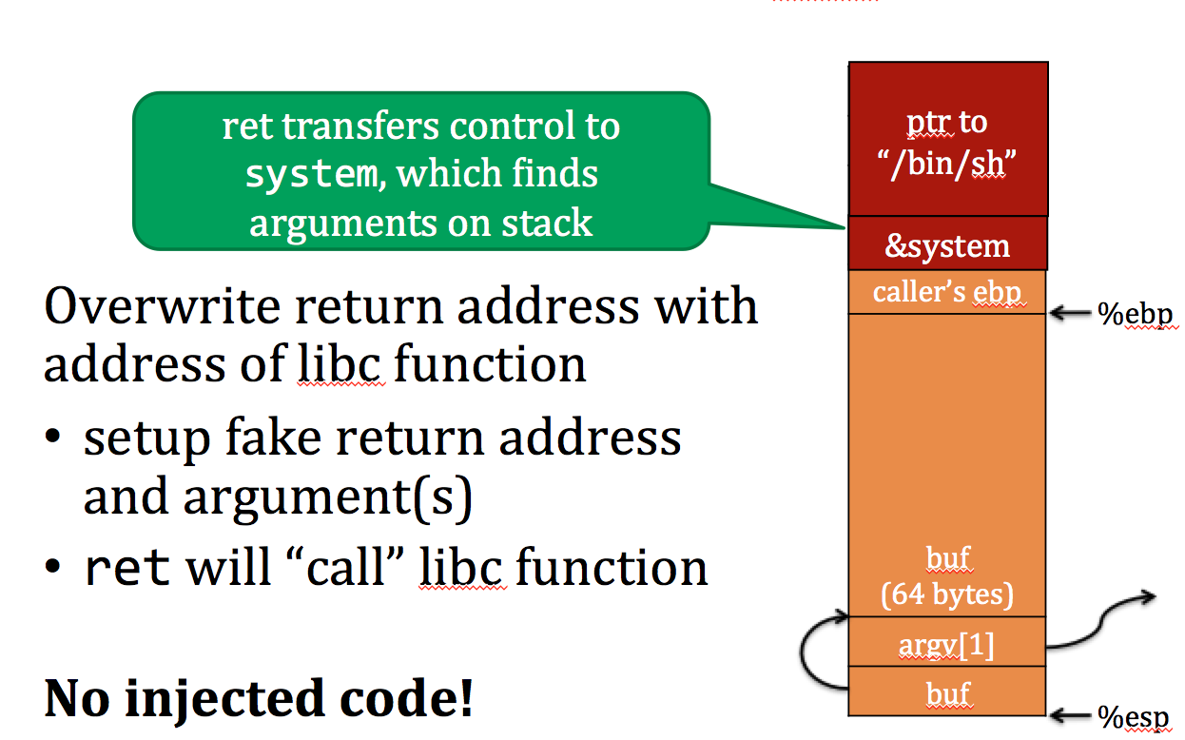
Problems
We can do return-to-libc

Slide 15
Defense Summary
No defense protects against all memory exploits
We need a defense-in-breadth approach

Slide 16
Countermeasures
Instruction Set Randomization
Address Space Randomization

Slide 17
Instruction Set Randomization
Observation: attackers need to know the instruction set
Idea: Obfuscate the instruction set

Slide 18
How to obfuscate
Encode the machine code of an executable
Decode instructions before sending to processor

Slide 19
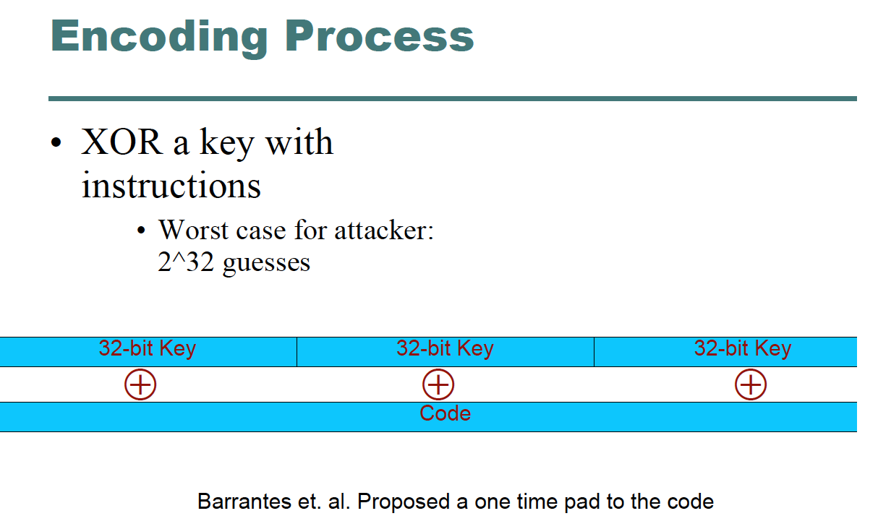

Slide 20
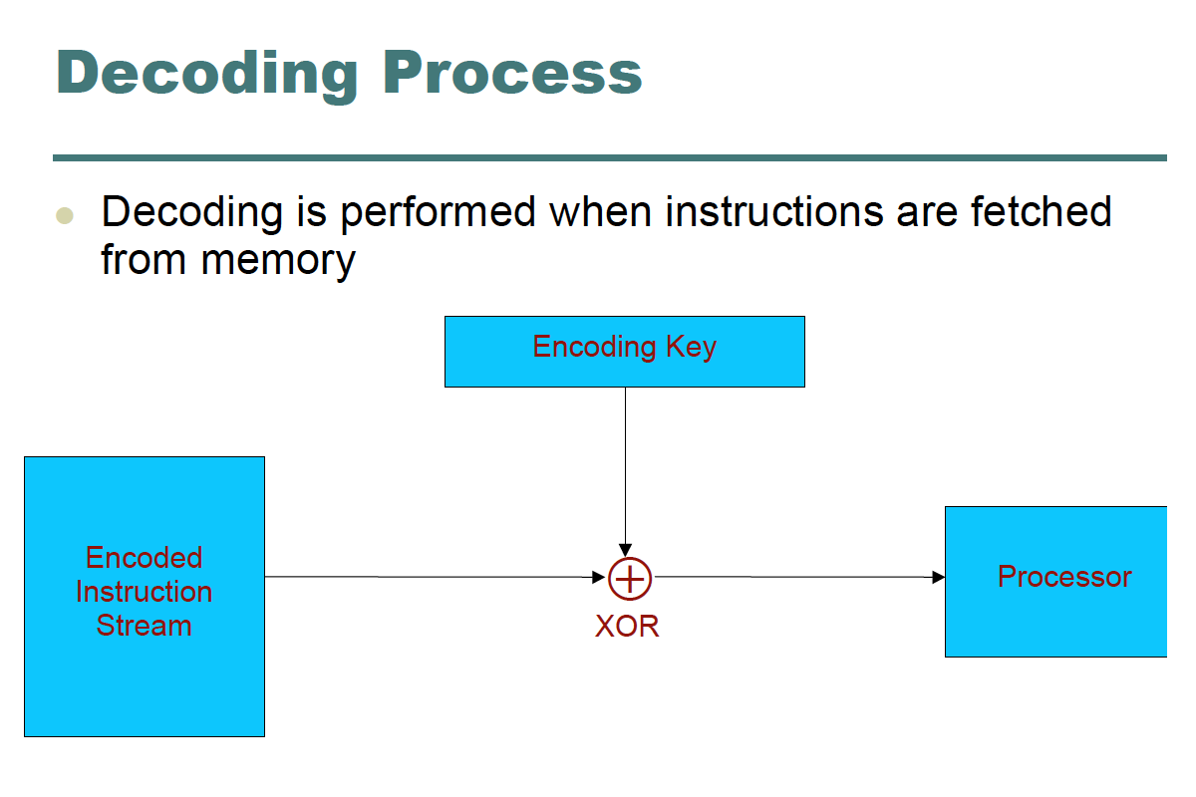

Slide 21
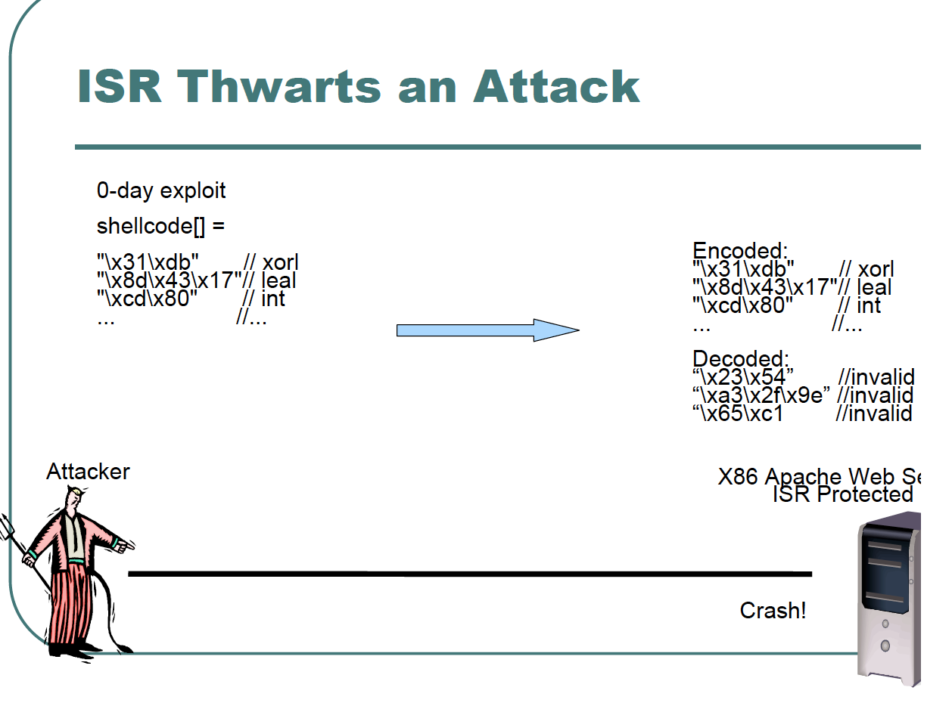

Slide 22
ISR Summary
Can be implemented in hardware or emulator
Performance may suffer
Completely eliminates executing injected code
No prevention to return-to-libc
No injected code

Slide 23
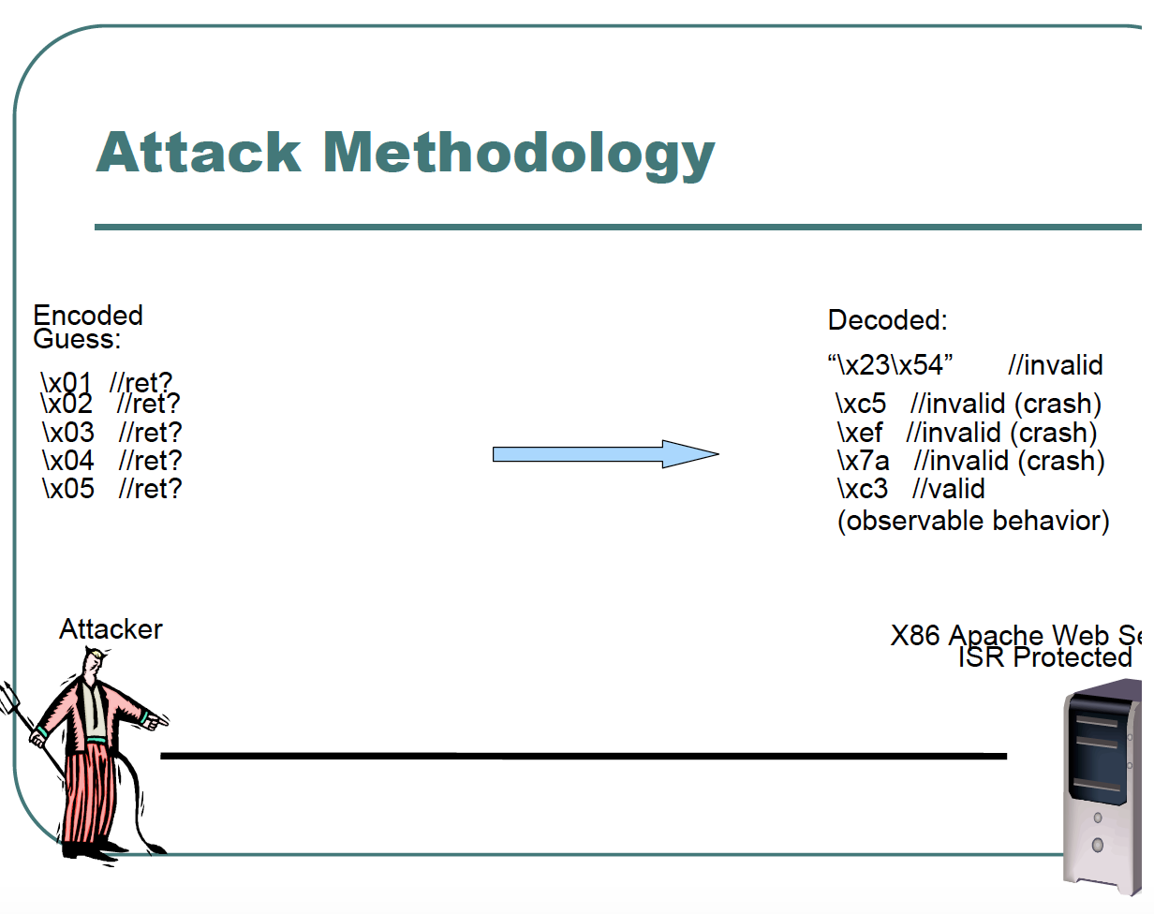
Distinguish between correct and incorrect guesses

Slide 24
ISR Attacks
Return attack
Jump attack
Extended attack
Notes:
Distinguish between correct and incorrect guesses

Slide 25
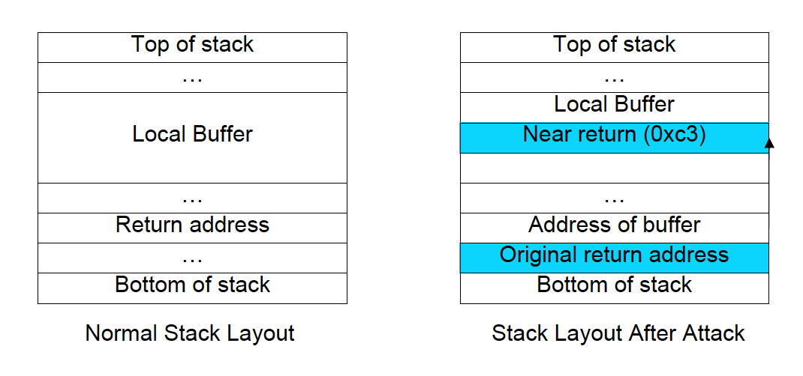
Return Attack
Inject a 1-byte near return instruction
Incorrect guess causes a crash
Correct guess causes observable behavior
For example, some output will be returned

Slide 26
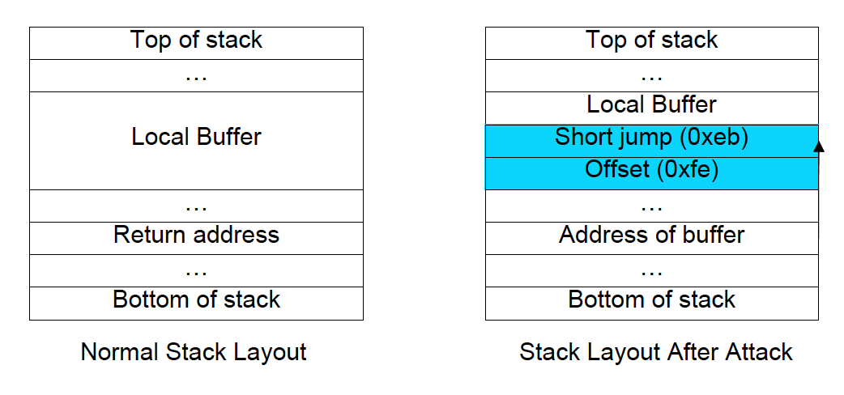
Jump Attack
Inject a 2-byte short jump instruction
Correct guess causes an infinite loop
Incorrect guess causes crash
Notes:
0xfe:-2

Slide 27
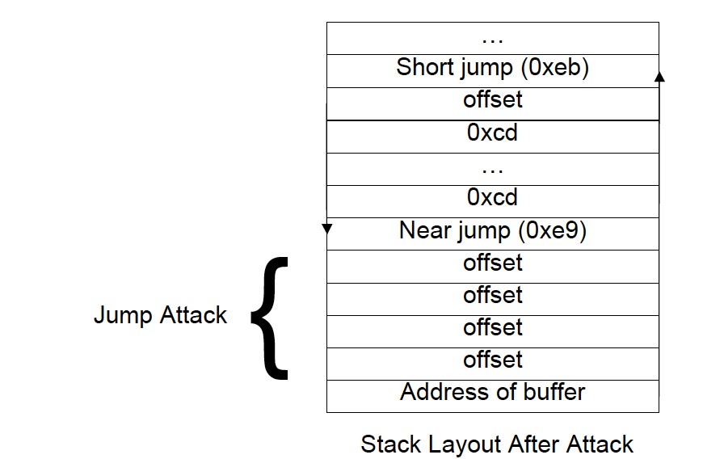
Extended Attack
Near jmp jumps to original return address

Slide 28
Address Space Randomization
Observation: Attacker needs to know certain addresses in memory
Idea: Obfuscate memory addresses
Randomizes: stack, heap, libraries

Slide 29
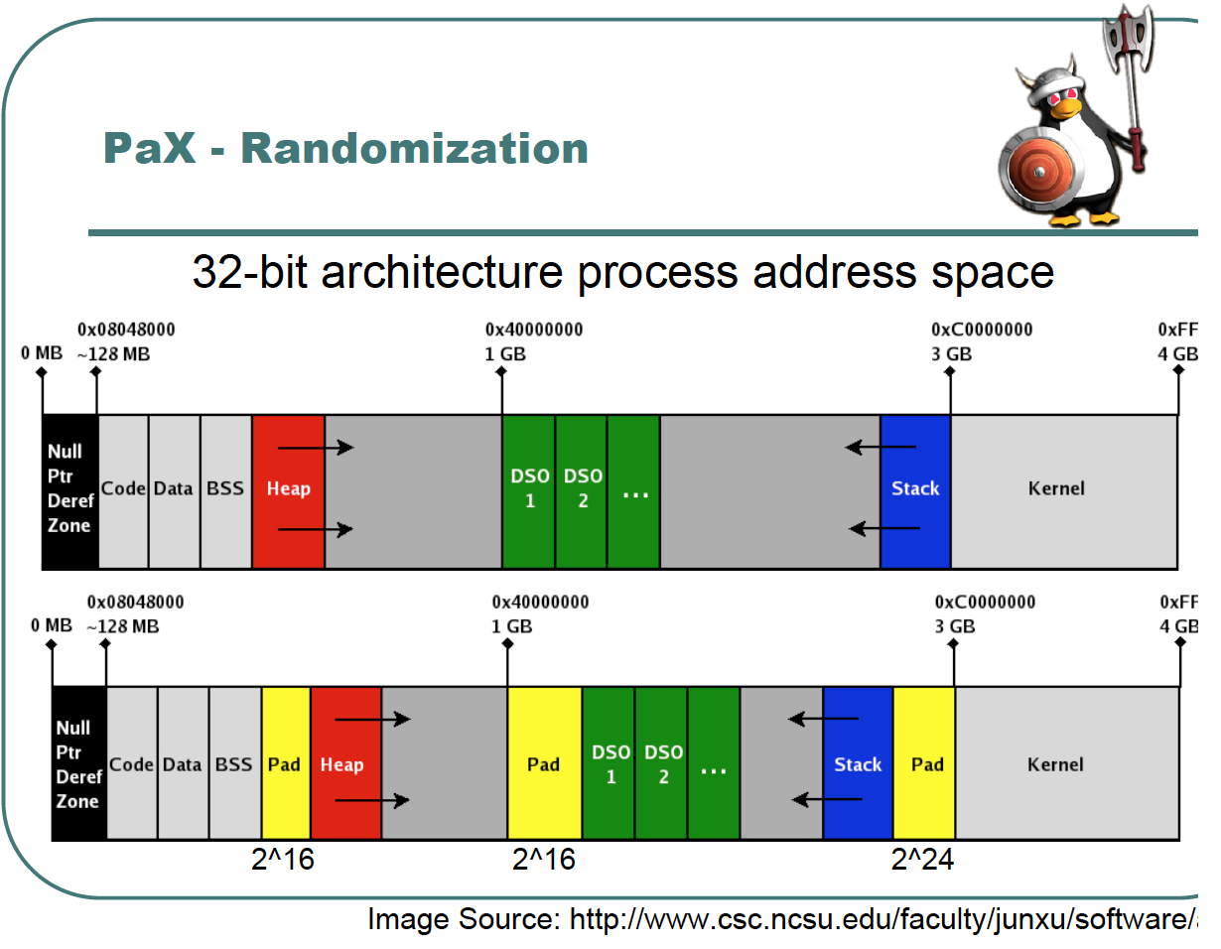

Slide 30
The Exploit - Guessing Addresses
Send probes using return-to-libc attack
Unsuccessful guess crashes
Successful guess produces observable behavior
TIME: usleep()

Slide 31
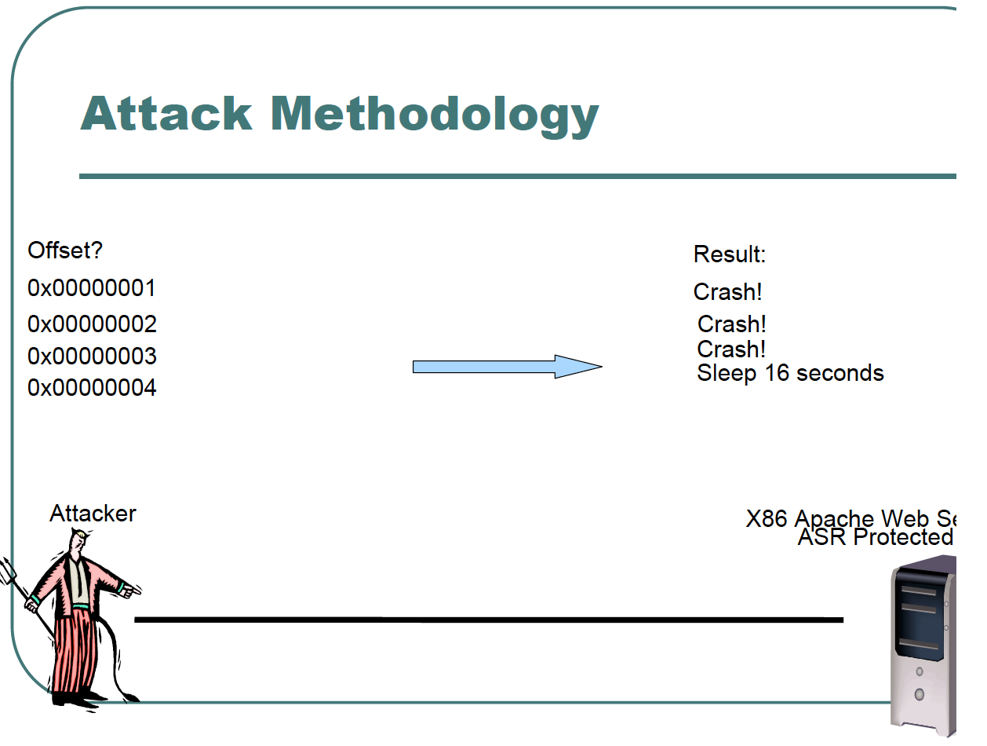

Slide 32
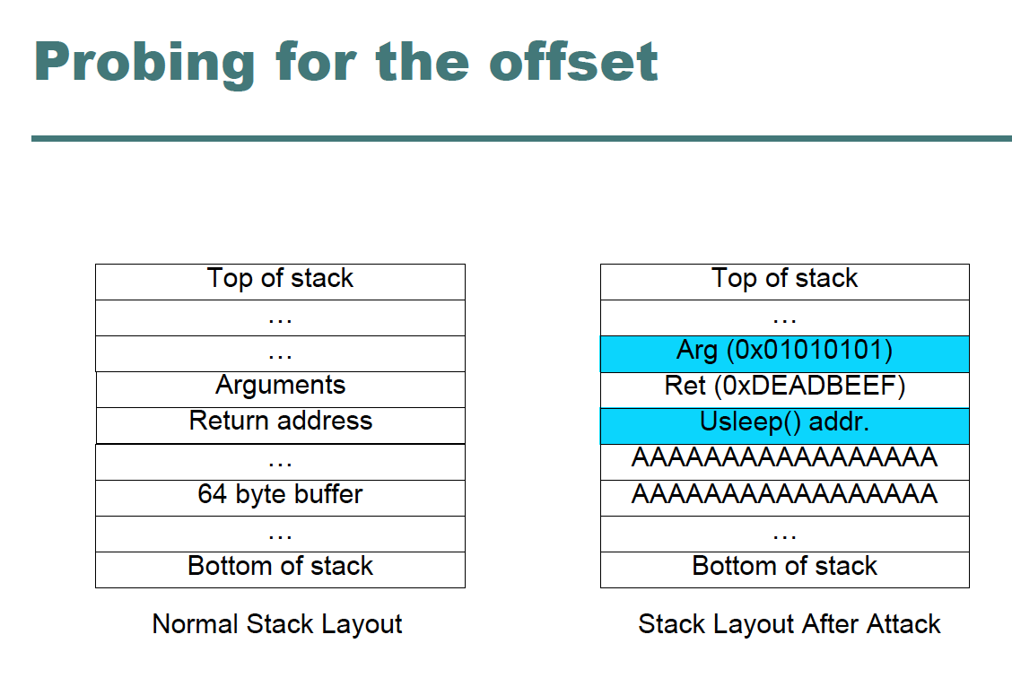

Slide 33
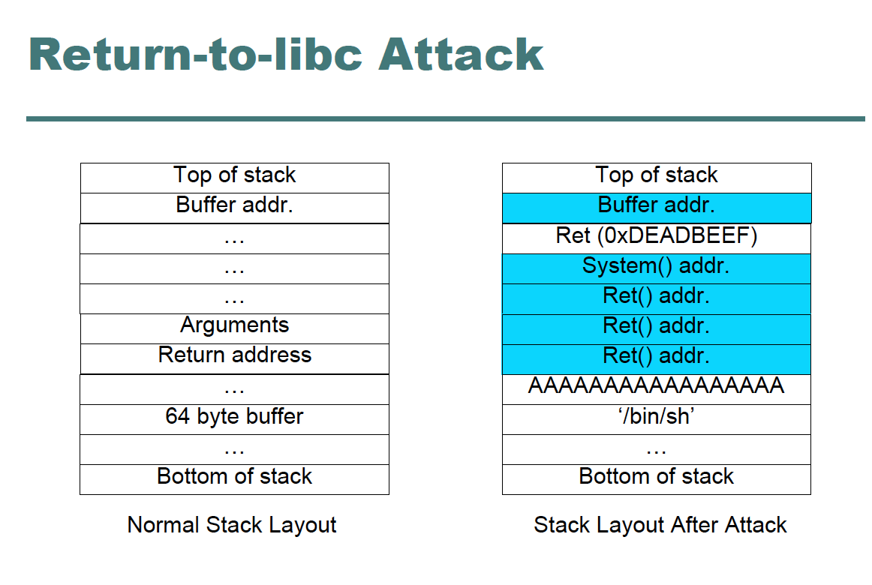

Slide 34
A better approach to ASR?
64-bit architecture
Can increase randomness from 2^16 to 2^40
Randomization Frequency
Granularity
Permute stack variables
Permute code & library functions
Permute static data
Combine with other approaches

