Slide 1
Format String

Slide 2
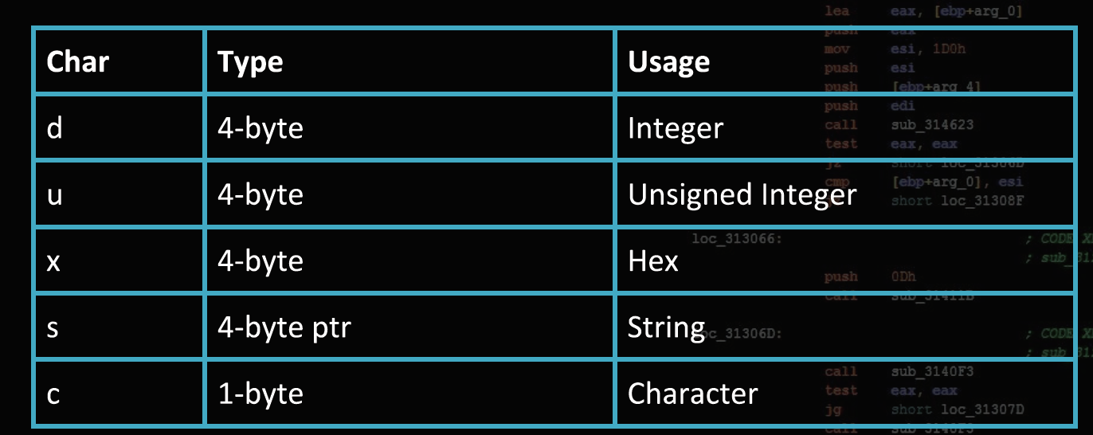
What is Format String
String with conversion specifiers
Common formats

Slide 3
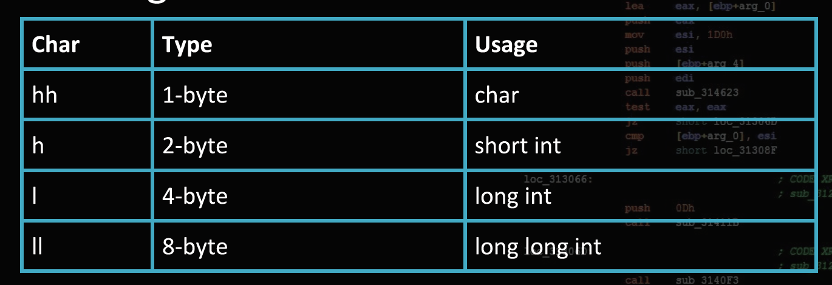
The length modifier
Example: “%hd”

Slide 4
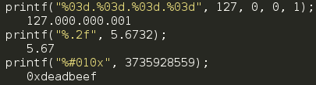
Example
Formatting output
Counting bytes written

Slide 5
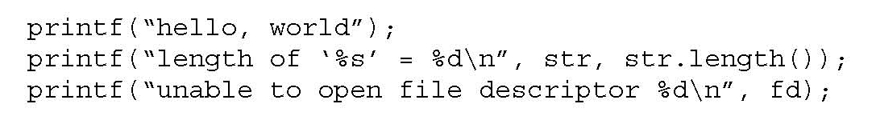
Variable Arguments in C
Format specification encoded by
special %-encoded characters
%d,%i,%o,%u,%x,%X – integer argument
%s – string argument
%p – pointer argument (void *)
Several others

Slide 6
Format Strings in C
Proper use of printf format string:
… int foo=1234;
printf(“foo = %d in decimal, %X in hex”,foo,foo); …
This will print
foo = 1234 in decimal, 4D2 in hex
Sloppy use of printf format string:
… char buf[13]=“Hello, world!”;
printf(buf);
// should’ve used printf(“%s”, buf); …
If buffer contains a format symbol starting with %, location
pointed to by printf’s internal stack pointer will be interpreted
as an argument of printf. This can be exploited to move
printf’s internal stack pointer!

Slide 7
Writing Stack with Format Strings
%n format symbol tells printf to write the number of characters that have been printed
… printf(“Overflow this!%n”,&myVar); …
Argument of printf is interpeted as destination address
This writes 14 into myVar
What if printf does not have an argument?
… char buf[16]=“Overflow this!%n”;
printf(buf); …
Stack location pointed to by printf’s internal stack pointer will be interpreted as the address into which the number of characters will be written!

Slide 8
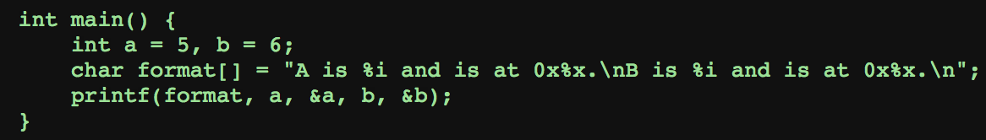
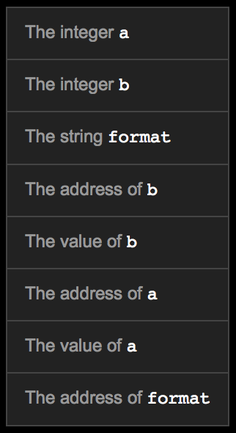
Stack Look
4 bytes
printf function executing:
The first argument is a string pointer, starting to read string
Read a “%i” pop off a value and print it
Read a “%x” pop out an address and print it
4 bytes
52 bytes

Slide 9
What will happen if replace printf(format, a, &a, b, &b) with printf(format)?
Stack will be the same but NO the value of a, the address of a, the value of b, and the address of b
when the printf function accessed the first %i, it would retrieve the next four bytes on the stack (part of the string format) and print those as an integer

Slide 10
Data Access
Format string functions are safe when they are used correctly.
Format string vulnerabilities arise when programmer accidently allows the user to control the input string
Read from stdin

Slide 11
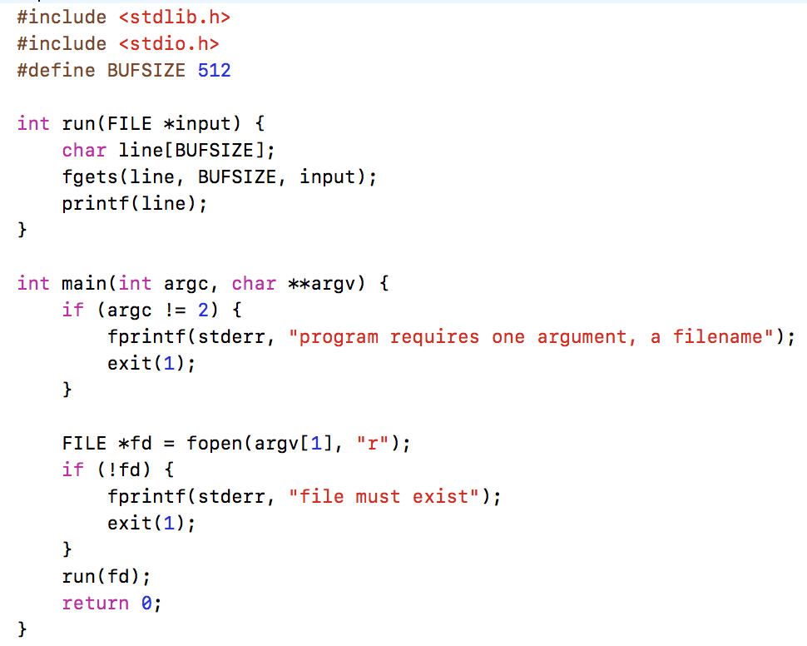
Notes:
This example would be safe if the printf line was: printf("%s", line);

Slide 12
Harmless Input

Slide 13
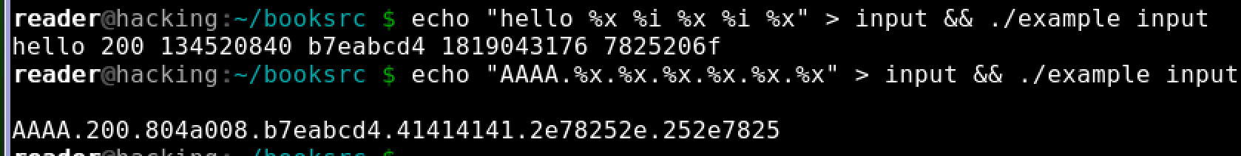
Manipulated Input
internal function call looks something like this:
_printf(string, format_arg1, format_arg2, 200, addr, addr, 0, addr)

Slide 14
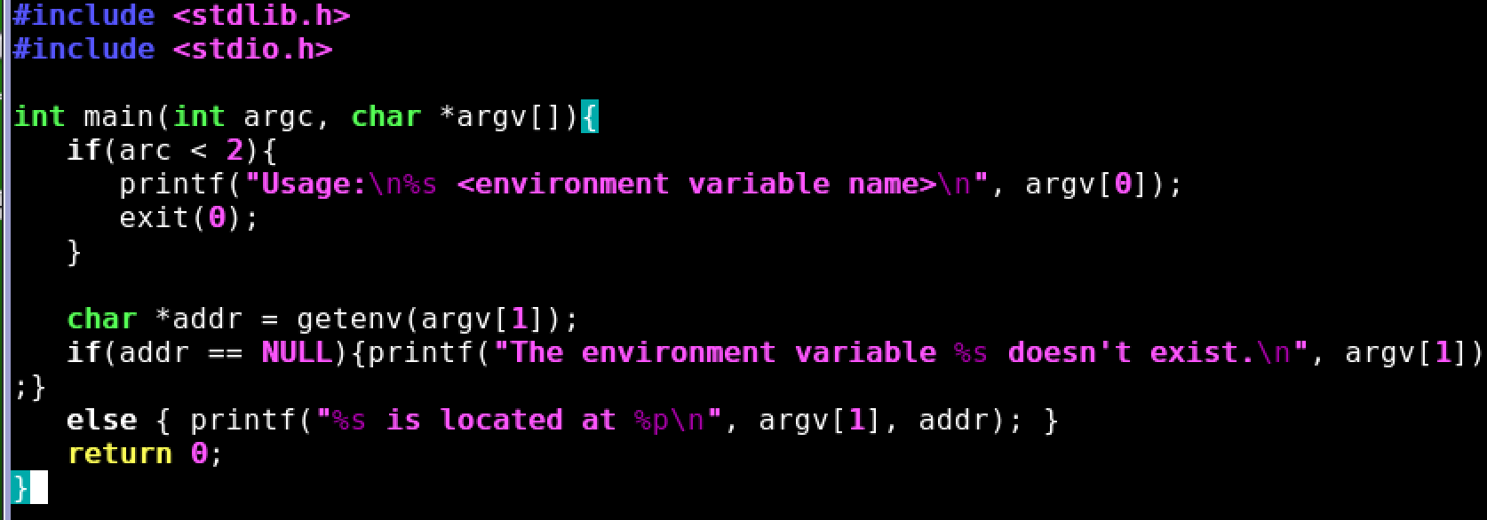
Get Environment

Slide 15
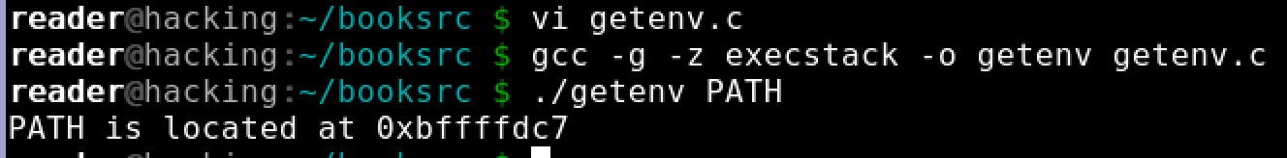
Normal Input

Slide 16
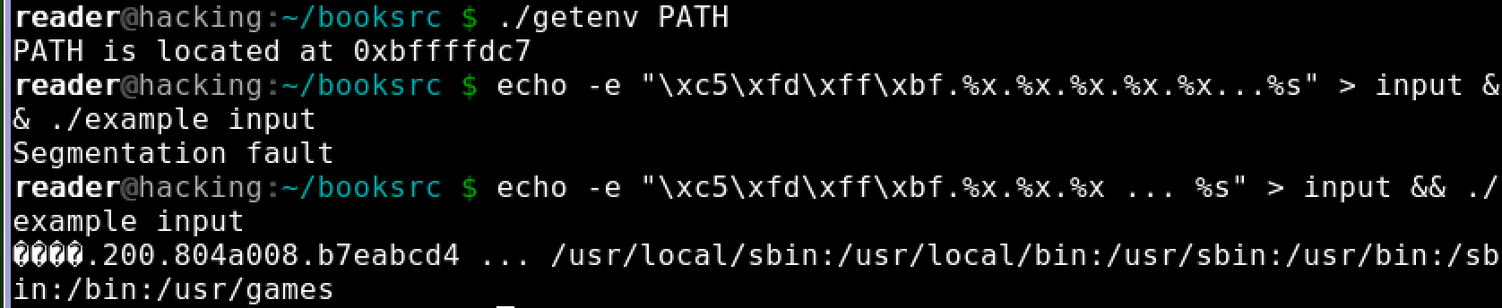
Manipulated Input
The buffer line
Some address
The value 200
The address of line

Slide 17
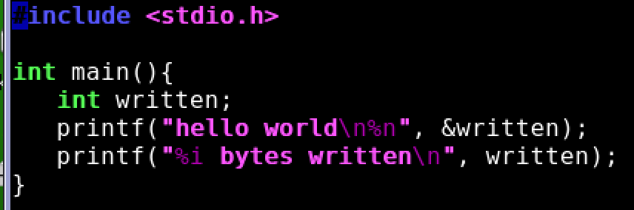
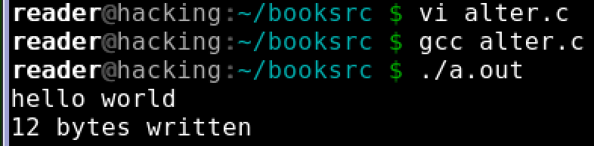
Write to Memory

Slide 18
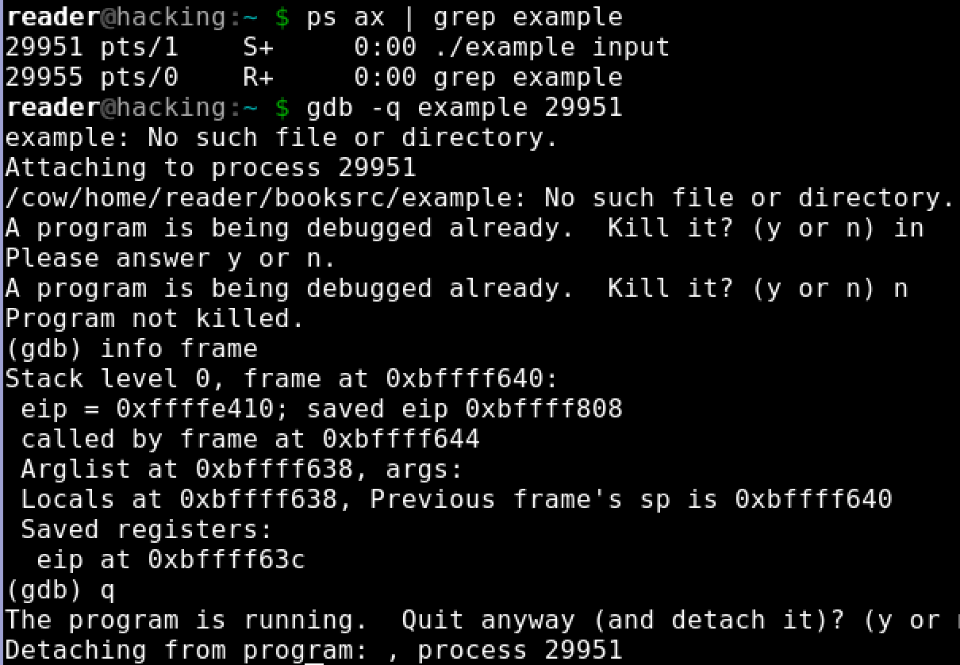
Write to Return Addr

Slide 19
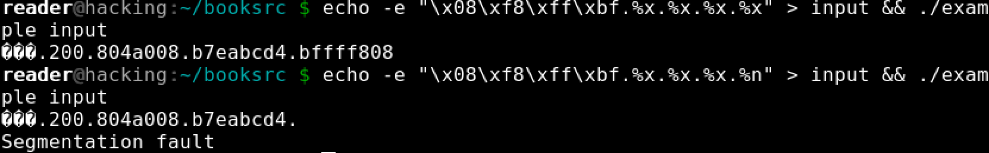
Write to Return Addr

Slide 20
Using %n to Mung Return Address
This portion contains
enough % symbols
to advance printf’s
internal stack pointer
Buffer with attacker-supplied
input string
“… attackString%n”, attack code
&RET
RET
Number of characters in
attackString must be
equal to … what?
Overwrite location under printf’s stack
pointer with RET address; then
printf(buffer) will write the number of
characters in attackString into RET
Return
execution to
this address
C has a concise way of printing multiple symbols: %Mx will print exactly M bytes (taking them from the stack). If attackString contains enough “%Mx” so that its total length is equal to the most significant byte of the address of the attack code, this byte will be written into &RET.
Repeat three times (four “%n” in total) to write into &RET+1, &RET+2, &RET+3, replacing RET with the address of attack code.

Slide 21
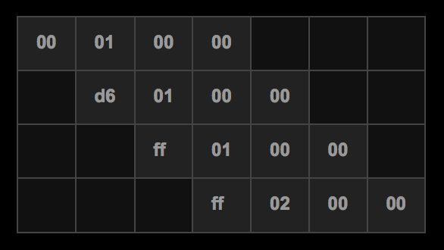
Write Exact Value
%n writes to a memory location the number of bytes that have been created so far by the printf function
It not practical to create a string that's 0xffffd600 bytes long and then have the %n
%n writes 0xffffd600 byte by byte
First byte 0x00: write 256 (0x100) long string
%n write one byte higher than the last, write 0xd6 by a 0x1d6 long string
Write 0xff to extend string to 0x1ff
Write second 0xff to extend string to 0x2ff

Slide 22
Formula for Format String
The address to write in reverse hex
Four bytes (anything will do, we use junk)
The address to write +1 in reverse hex
Four bytes (anything will do, we use junk)
The address to write +2 in reverse hex
Four bytes (anything will do, we use junk)
The address to write +3 in reverse hex
One less than the number of %8x's so the printf function is using arguments from the start of the input string
Pairs of %#x, %n's to write to the addresses

Slide 23
shellcode = ""
shellcode += "\xeb\x1c\x5b\x31\xc0\x88\x43\x07\x89\x5b\x08\x89\x43"
shellcode += "\x0c\x89\xc2\x8d\x4b\x08\xb0\x0b\xcd\x80\x31\xdb\x89"
shellcode += "\xd8\x40\xcd\x80\xe8\xdf\xff\xff\xff/bin/sh"
addr_overwrite = ""
addr_overwrite += "\x9c\xd5\xff\xffjunk"
addr_overwrite += "\x9d\xd5\xff\xffjunk"
addr_overwrite += "\x9e\xd5\xff\xffjunk"
addr_overwrite += "\x9f\xd5\xff\xff"
addr_overwrite += "%8x%8x%8x%8x"
addr_overwrite += "%196x%n"
addr_overwrite += "%214x%n"
addr_overwrite += "%41x%n"
addr_overwrite += "%256x%n"
puts addr_overwrite + "\x90" * 200 + shellcode

Slide 24
Buffer Overflow: Causes and Cures
Typical memory exploit involves code injection
Put malicious code at a predictable location in memory, usually masquerading as data
Trick vulnerable program into passing control to it
Overwrite saved EIP, function callback pointer, etc.
Idea: prevent execution of untrusted code
Make stack and other data areas non-executable
Note: messes up useful functionality (e.g., ActionScript)
Digitally sign all code
Ensure that all control transfers are into a trusted, approved code image

Slide 25
W⊕X / DEP
Mark all writeable memory locations as non-executable
Example: Microsoft’s DEP (Data Execution Prevention)
This blocks all code injection exploits
Hardware support
AMD “NX” bit, Intel “XD” bit (in post-2004 CPUs)
Makes memory page non-executable
Widely deployed
Windows (since XP SP2), Linux (via PaX patches), OpenBSD, OS X (since 10.5)

