Slide 1
Piecing It All Together: Healthcare Disparities Among People with Historically Excluded Identities

Slide 2
Introduction to Healthcare Disparities

Slide 3
Healthcare Disparities Definition
Healthy People 2020 defines a health disparity as, “a particular type of health difference that is closely linked with social, economic, and/or environmental disadvantage” and notes that disparities, “adversely affect groups of people who have systematically experienced greater obstacles to health based on their racial or ethnic group; religion; socioeconomic status; gender; age; mental health; cognitive, sensory, or physical disability; sexual orientation or gender identity; geographic location; or other characteristics historically linked to discrimination or exclusion.”
****There are systems and structures in place causing these disparities****

Slide 4
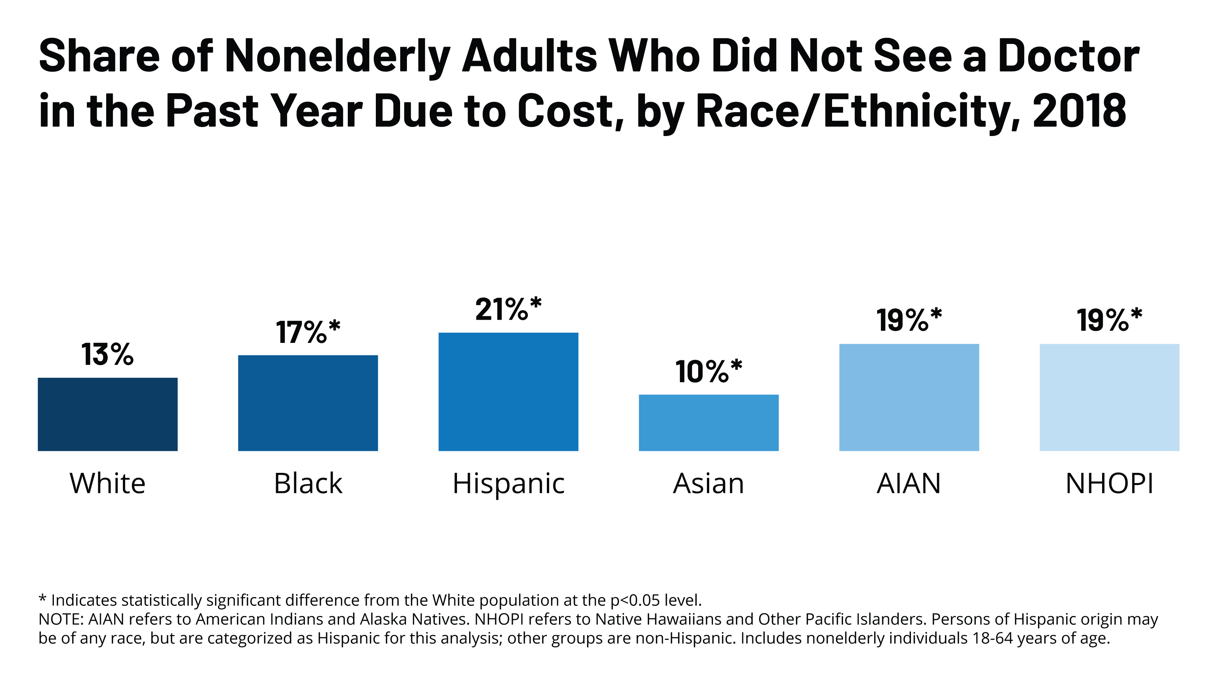
Racial and Ethnic Disparities in Health Care, Updated 2010
Disproportionately, Black, Hispanic, American Indian/Alaskan Native, and Native Hawaiian/Pacific Islander racial groups were unable to see a doctor due to cost when compared to White and Asian counterparts
What is systematically occurring in the healthcare system or society that is causing high medical costs?

Slide 5
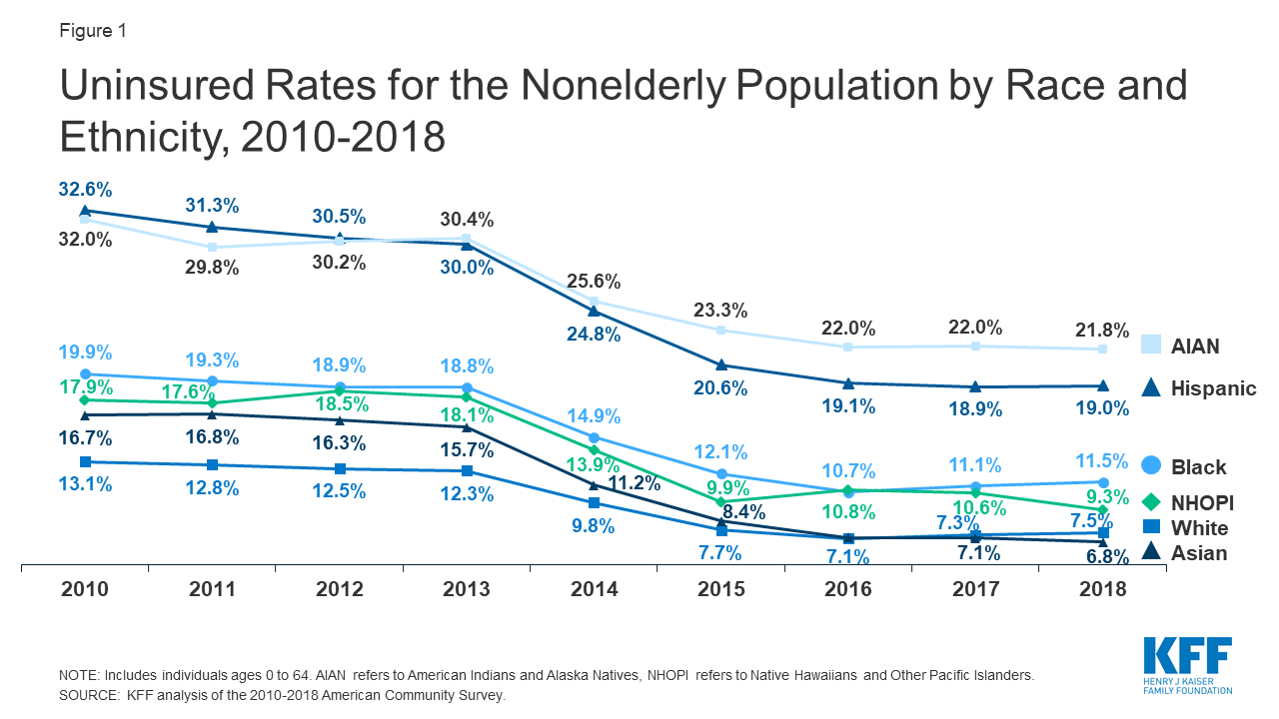
Racial and Ethnic Disparities in Health Care, Updated 2010
Marginalized groups have less access to health care than their white counterparts due to the lack of insurance coverage. (2010)
Systematically what are the barriers to healthcare access?
Notes:
In 2010, about 13% of white Americans were uninsured. But 33% of Hispanics and AIAM, which stands for American Indian and Alaska Natives, were and 20% of black Americans uninsured at that same time.
Now this is one area where we see improvements. Between 2010 and 2018, those numbers have decreased substantially for each of those groups. For most groups, those numbers have been cut in half, giving many more people access to health care.
Now these are all examples that I found in just a few minutes of searching. There are so many more, so there is no lack of proof that this is a common pattern and not an anomaly. While this graph shows that things are taking a turn in the right direction, we still have a lot of work to do.

Slide 6
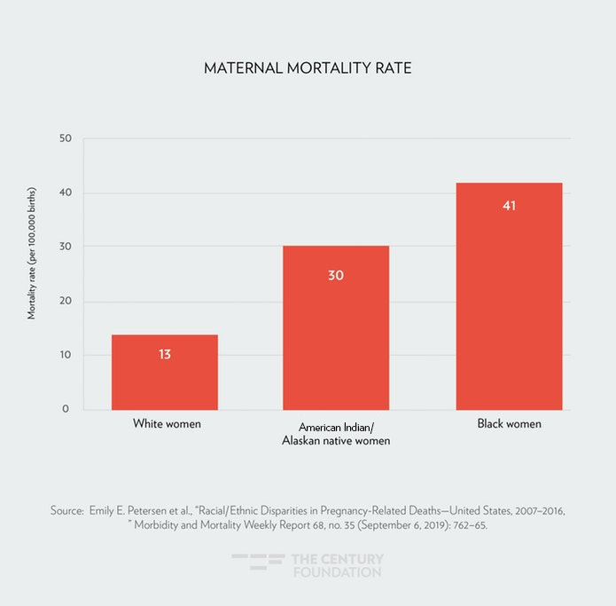
Racial and Ethnic Disparities in Health Care, Updated 2010
Black women, American Indians, and Alaskan Native women are more likely to die of a pregnancy related death than white women
Systematically, what are the differences in the quality of healthcare these women are receiving?
Notes:
Another example can be seen in the maternal mortality rate through pregnancy related deaths.

Slide 7
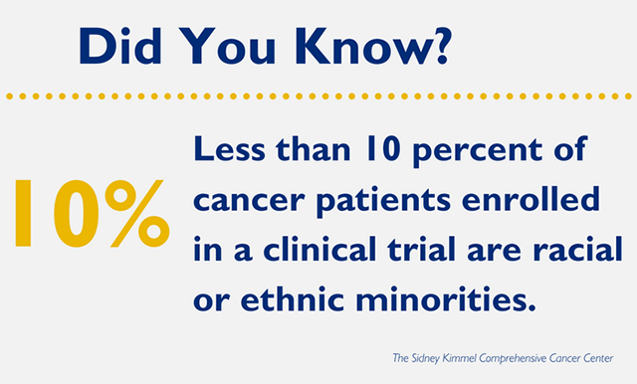
Racial and Ethnic Disparities in Health Care, Updated 2010
What might the effects of this statistic be on treatments?
Systemically, how might the healthcare system make policies to change this statistic?
Notes:
These limitations run deep. It isn’t just the immediate access to healthcare that is effected. It is the quality of healthcare from those groups as well.
And some of these limitations start at the experimentation phase. For example, less than 10% of cancer patients enrolled in a clinical trial are racial or ethnic minorities.
While all humans share 99.9% of their DNA, which means that only 0.1% of our DNA differs from person to person, sometimes that 0,1% can matter when it comes to healthcare. We are now moving into a field of personalized healthcare, where we make cancer treatments that are designed for a specific human being. But many treatments and studies are completed to determine the effectiveness and safety of possible treatments. And testing those properties on a subset of the population isn’t good. Sometimes those small differences in DNA matter. And by running all of our trials on while Americans, we are doing a disservice to the rest of the community. Running a clinical trial on 100,000 white men and women, and then approving that drug for all of America can lead to differences in the quality of care provided.
Now these are all examples that I found in just a few minutes of searching. There are so many more, so there is no lack of proof that this is a common pattern and not an anomaly.

Slide 8
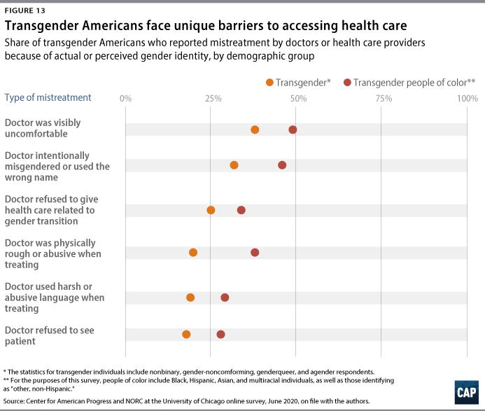
LGBTQ+ Disparities in Health Care, Updated 2020
Transgender Americans experience barriers to healthcare access such as intentional discrimination to refusal care and abuse, even more so as a transgender person of color
Notes:
Another example can be seen in the maternal mortality rate through pregnancy related deaths.

Slide 9
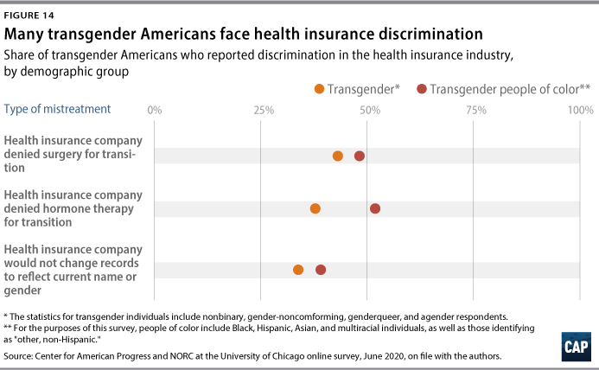
LGBTQ+ Disparities in Health Care, Updated 2020
Some of the discrimination in the healthcare system is due to insurance refusal to support transgender Americans, particularly those of color.
How can the healthcare system change its policies to support transgender Americans?
Notes:
Another example can be seen in the maternal mortality rate through pregnancy related deaths.

Slide 10
Healthcare Disparities Definition
The Centers for Disease Control and Prevention (CDC) identifies health disparities as, “preventable differences in the burden of disease, injury, violence, or opportunities to achieve optimal health that are experienced by socially disadvantaged populations.”
***These disparities can be fixed and are preventable, there are solutions that must be enacted to reduce the disparities***

Slide 11
Pre-class Work: Articles and Concept Mapping

Slide 12
Pre-Class Work: Article Reading
In groups you will be assigned a primary research article to read. As you read, consider the following questions:
What are the sources/causes of the healthcare disparities?
What are the effects/impacts of the healthcare disparities?
What are the strategies to reduce the healthcare disparities?

Slide 13
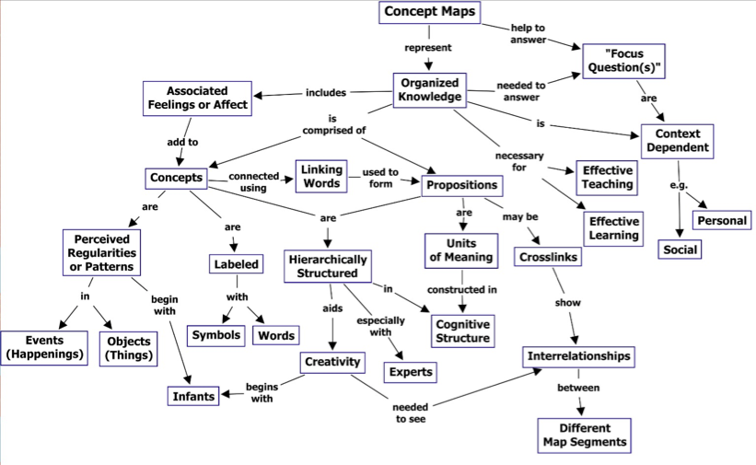
Pre-Class Work: Concept Map
Once you are finished reading and reflecting, you will make a concept map. A concept map includes:
Concepts: Any major topics/findings/information from your article in circles or boxes
Relationships: Concepts should be connected to one another with lines that are labeled with the relationship.
Interconnected concepts

Slide 14
Group Concept Maps

Slide 15

Group Concept Maps
In your article groups you will synthesize your individual concept maps
Each member must contribute at least one concept or relationship --> Share 'in a circle'

Slide 16
Concept Map
Each group will share a concept or relationship from their article
Will be added to our class concept map

Slide 17
Whole Class Discussion

Slide 18
Conclusions
The healthcare system and professionals must equitably serve all people.
Healthcare disparities are caused by the systematic discrimination of marginalized identities and social/economic inequities such as racism, economic instability, and lack of access (physically to locations and healthcare insurance).
The effects of these disparities have disproportionate effects on those with intersecting marginalized identities (transgender people of color) and can result in lower quality of life, reduced life span, and death.
Possible solutions include further research into the disparities cause and effect, centering equity in all healthcare initiatives, trainings, and policies, increasing cultural competence, expanding healthcare access, and explicitly working to have representation of marginalized groups in decision-making.

Slide 19
Assessment

