Slide 1
GWU Data Analytics Bootcamp Project #1 Trends: Brewery, Winery & Distillery
Team:
Anna Bower | Seth Drewry | Bobby Jaikaran | Janice Lee

Slide 2
The Project Team
Team Members | Project Title
Anna Bower
Seth Drewry
Bobby Jaikaran | Financial Systems Admin: compiled Google Places API data for sample of each type of establishment.
Janice Lee | Account Manager: researched and gathered data on wineries and distilleries in the US

Slide 3
Project Scope/Overview
A summary of our efforts for Project 1

Slide 4
Project Overview
Analysis of nationwide distilleries, breweries, and wineries
Data was correlated to Census information
Mission to find relationships between demographics to number of each establishment
number of establishment by state
population by state for establishments
correlation between industries for establishments

Slide 5
Results
Observations of Analysis

Slide 6
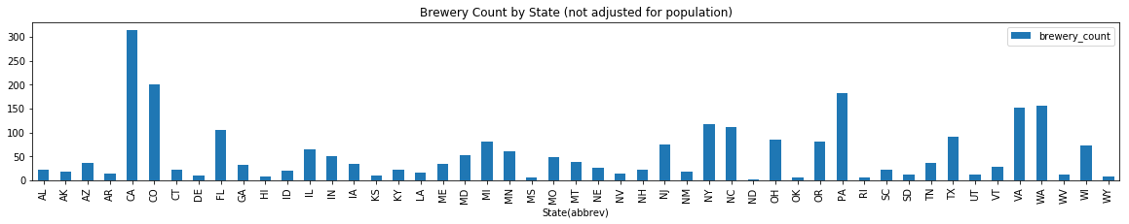
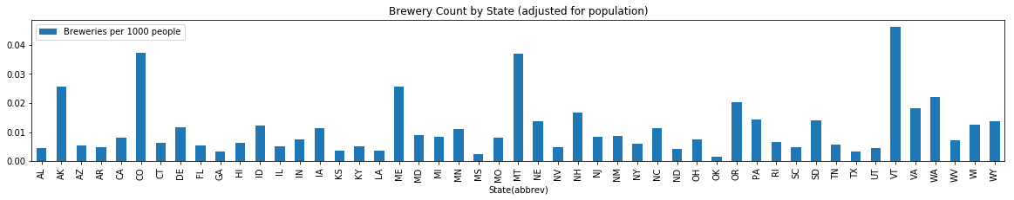
Observations
Brewery Count by State

Slide 7
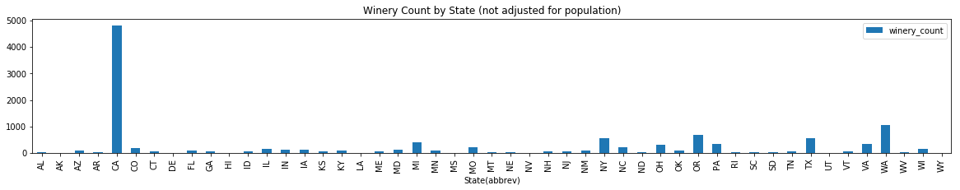
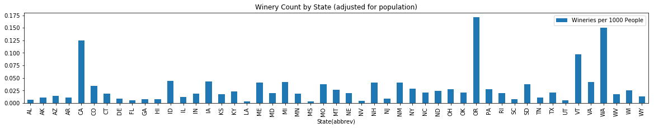
Observations
Winery Count by State

Slide 8
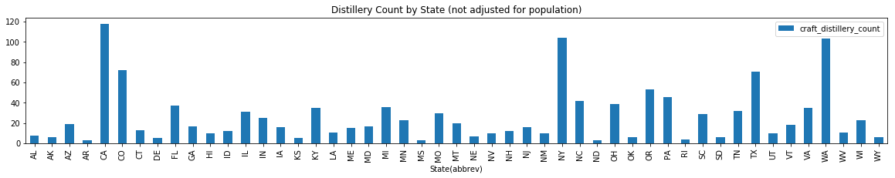
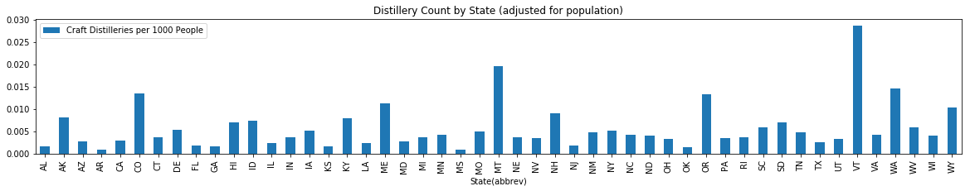
Observations
Distillery Count by State

Slide 9
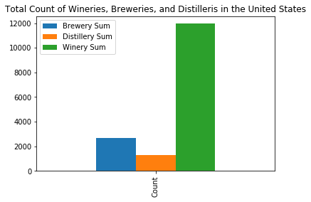
Observations

Slide 11
Challenges and Resolutions
Challenges
Performing Google API calls and hitting daily rate limit
Inconsistency with naming convention when merging data frames
Different types of data files provided from sources
Obtaining and preserving the accurate numeric data type
Naming conventions for States and US Territories (full name vs. abbreviations)
Aligning on the definition of terms
Resolutions
Utilized data.gov and obtained csv files for wineries and distilleries by states
Searched for common identifiers and renamed it for consistency when merging data frames
Converted data set to one type of file for consistency

Slide 12
Data Sources
Data Sources
https://beermapping.com/?lat=38.90010&lon=-77.04790&z=13
https://www.census.gov/data.html
https://www.data.gov

