Slide 1
Quantum Computing
Something we should start to think about?
A simple overview from a bioinformatics point of view

Slide 2
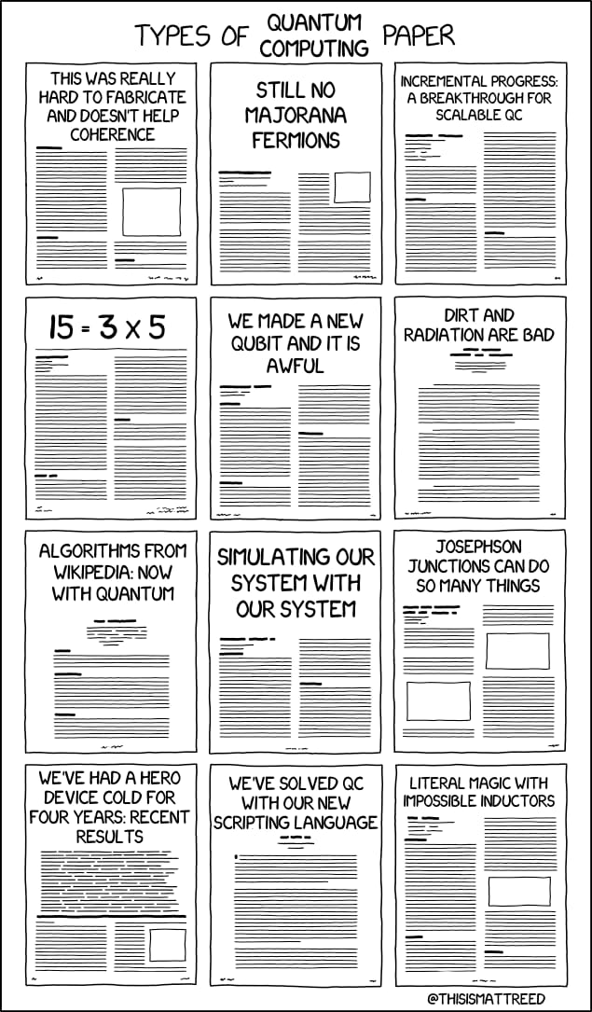
Warning!
https://www.reddit.com/r/xkcd/comments/n33728/quantum_computing_papers/

Slide 3
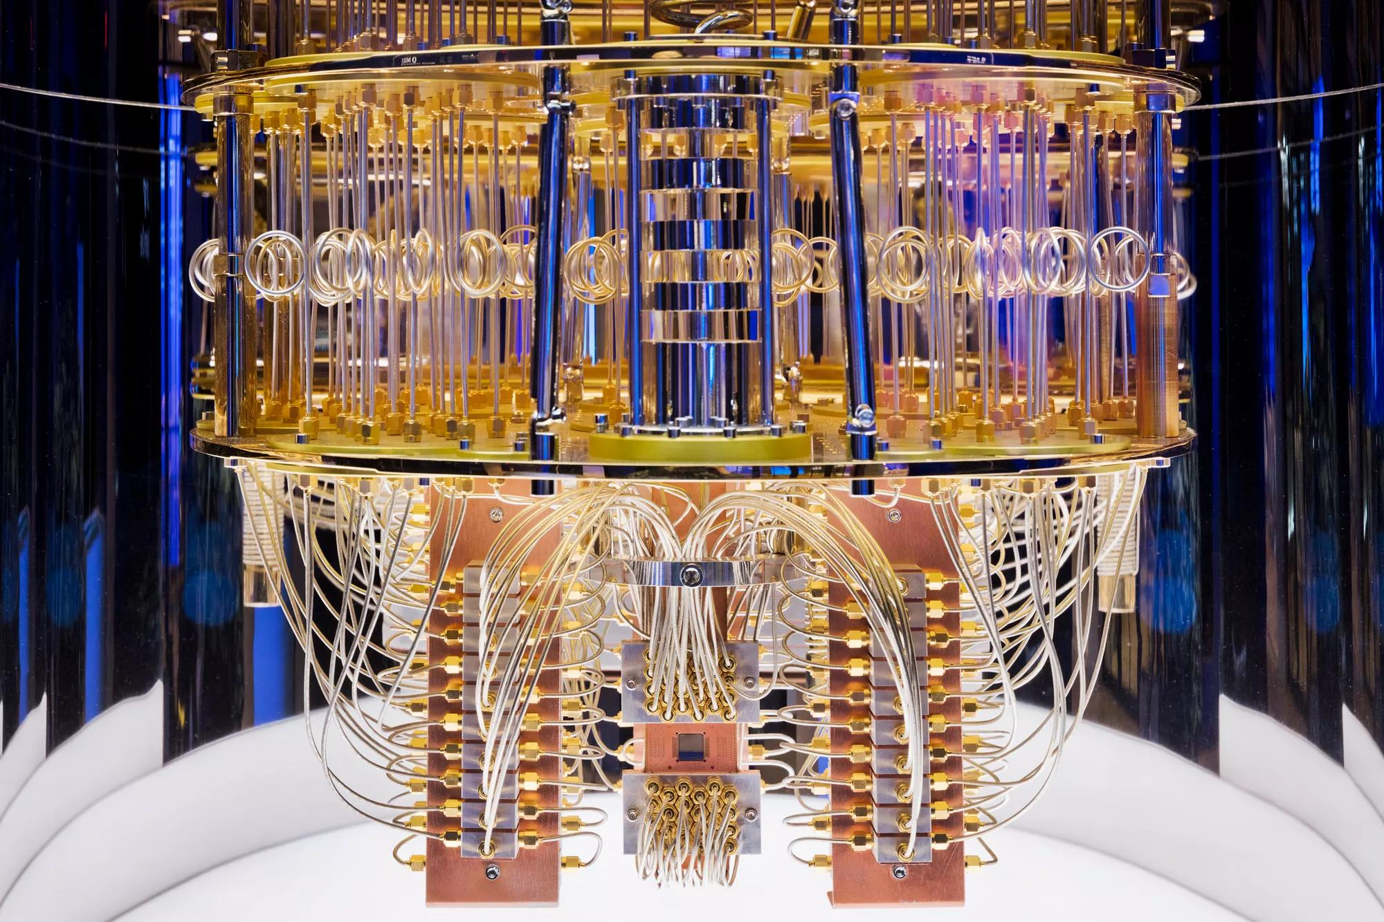
Outline
History & Background
Introduction
Qubit
Superposition
Entanglement
Quantum Advantage
Quantum Machine Learning
Cleveland Clinic

Slide 4
What is a Quantum Computer
A quantum computer is a computer that exploits superposed and entangled states
Uses Qubits instead of traditional bits
These can exist in many states at the same time – Superposition
They can be linked, affecting each other – Entanglement
Wrong answers are canceled out, amplifying the correct answer - Interference
Based on quantum mechanics
Proposed by Richard Feynman in 1982
Several types of different hardware implementations

Slide 5
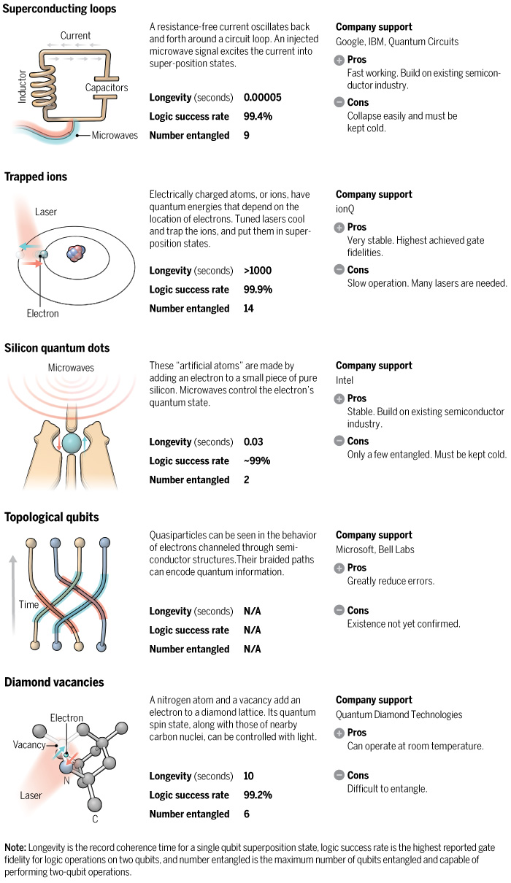
https://www.science.org/content/article/scientists-are-close-building-quantum-computer-can-beat-conventional-one (2016)

Slide 6
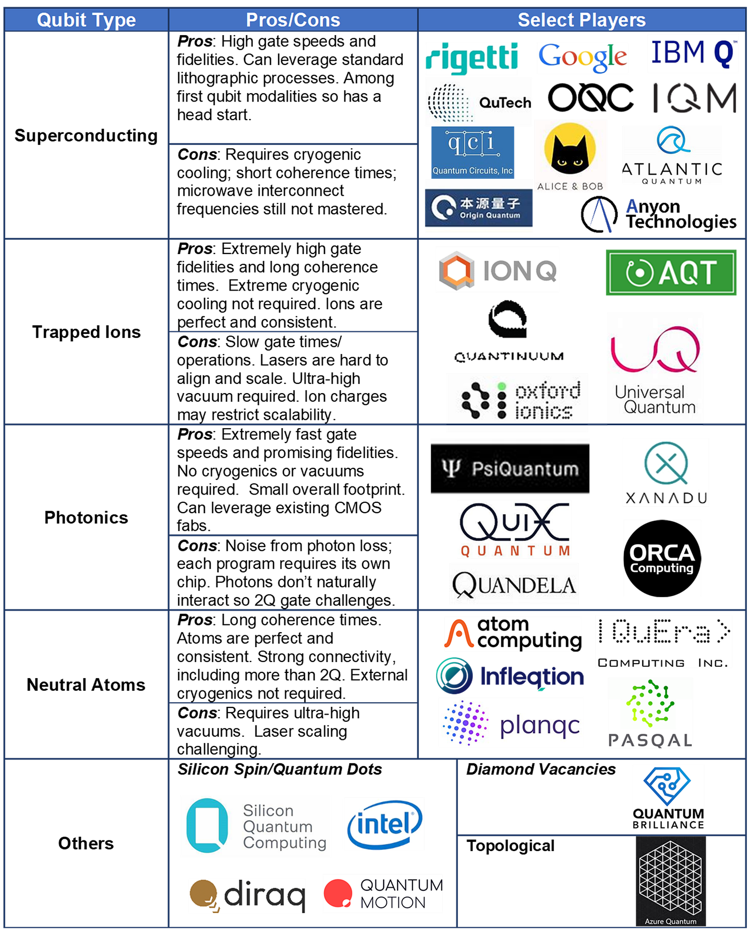
Quantum Computing Modalities
A Qubit Primer Re-Revisited in December 2024
Russ Fein
Dec 13, 2024

Slide 7

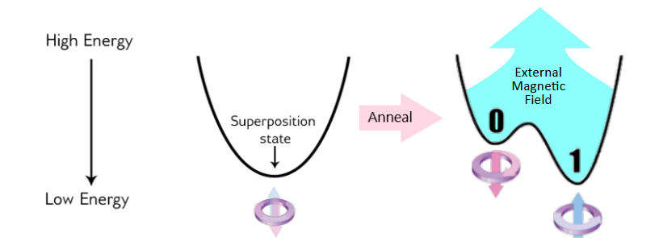
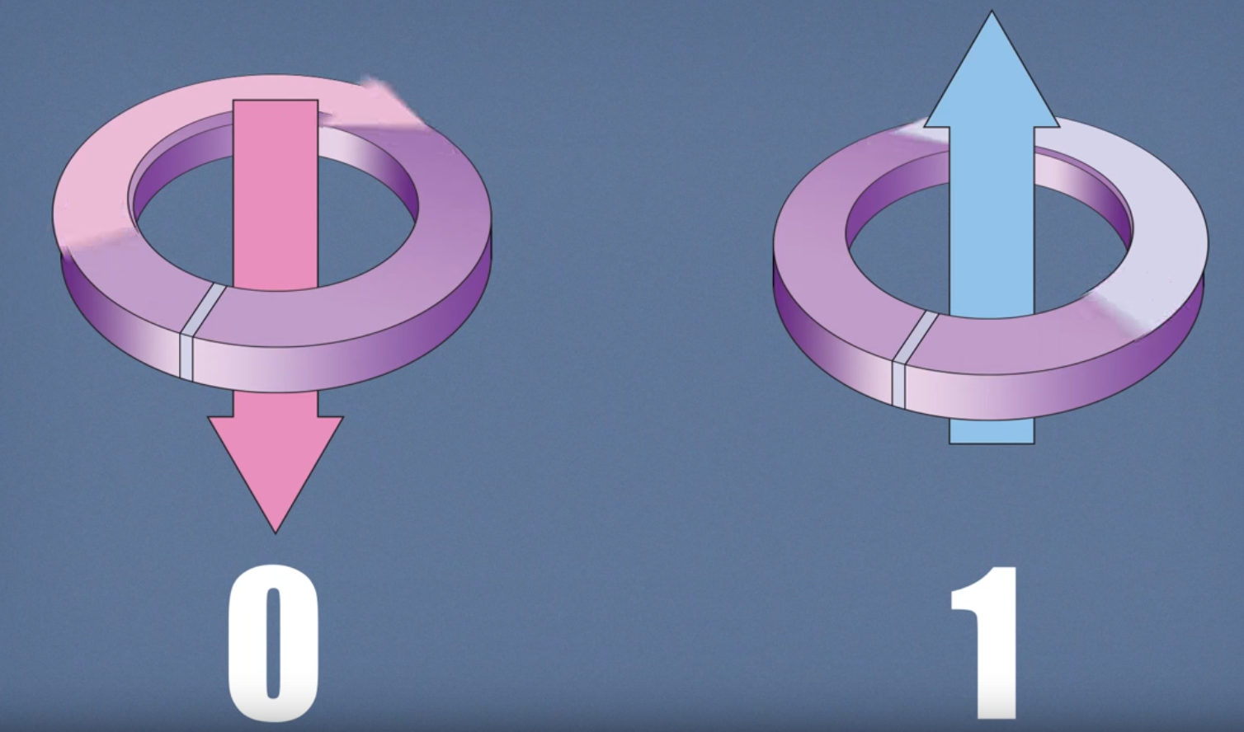
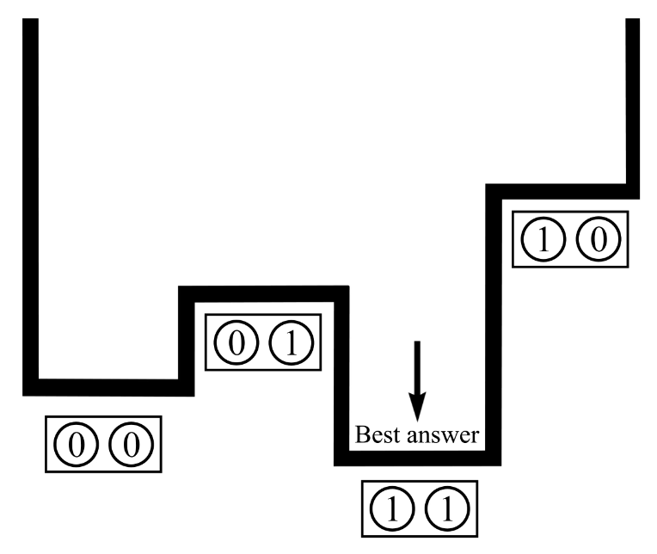
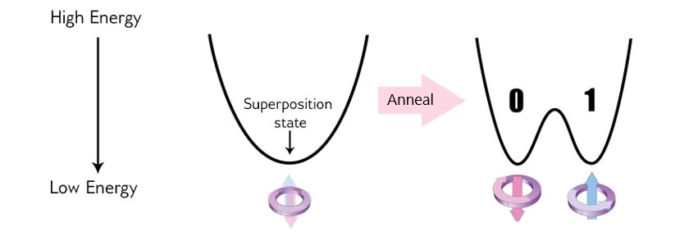
https://docs.dwavequantum.com/en/latest/quantum_research/quantum_annealing_intro.html

Slide 8
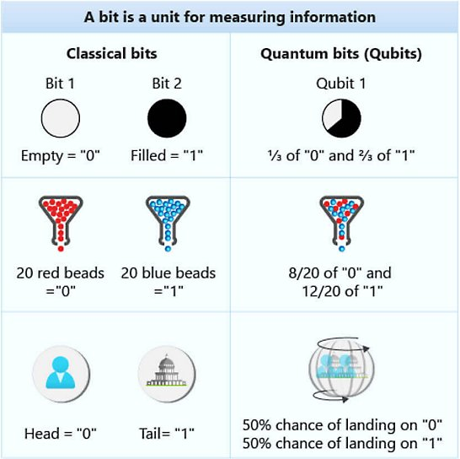
What is a Qubit?
Qubit vs bit
Qubits are represented by a superposition of multiple possible states
A qubit uses the quantum mechanical phenomena of superposition to achieve a linear combination of two states. A classical binary bit can only represent a single binary value, such as 0 or 1, meaning that it can only be in one of two possible states. A qubit, however, can represent a 0, a 1, or any proportion of 0 and 1 in superposition of both states, with a certain probability of being a 0 and a certain probability of being a 1.
Superposition gives quantum computers superior computing power
Superposition allows quantum algorithms to process information in a fraction of the time it would take even the fastest classical systems to solve certain problems.
The amount of information a qubit system can represent grows exponentially. Information that 500 qubits can easily represent would not be possible with even more than 2^500 classical bits.
It would take a classical computer millions of years to find the prime factors of a 2,048-bit number. Qubits could perform the calculation in just minutes.
https://azure.microsoft.com/en-us/resources/cloud-computing-dictionary/what-is-a-qubit

Slide 9
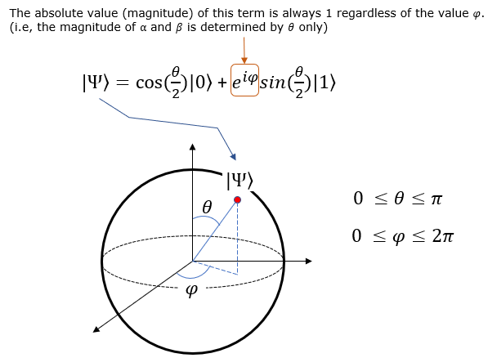
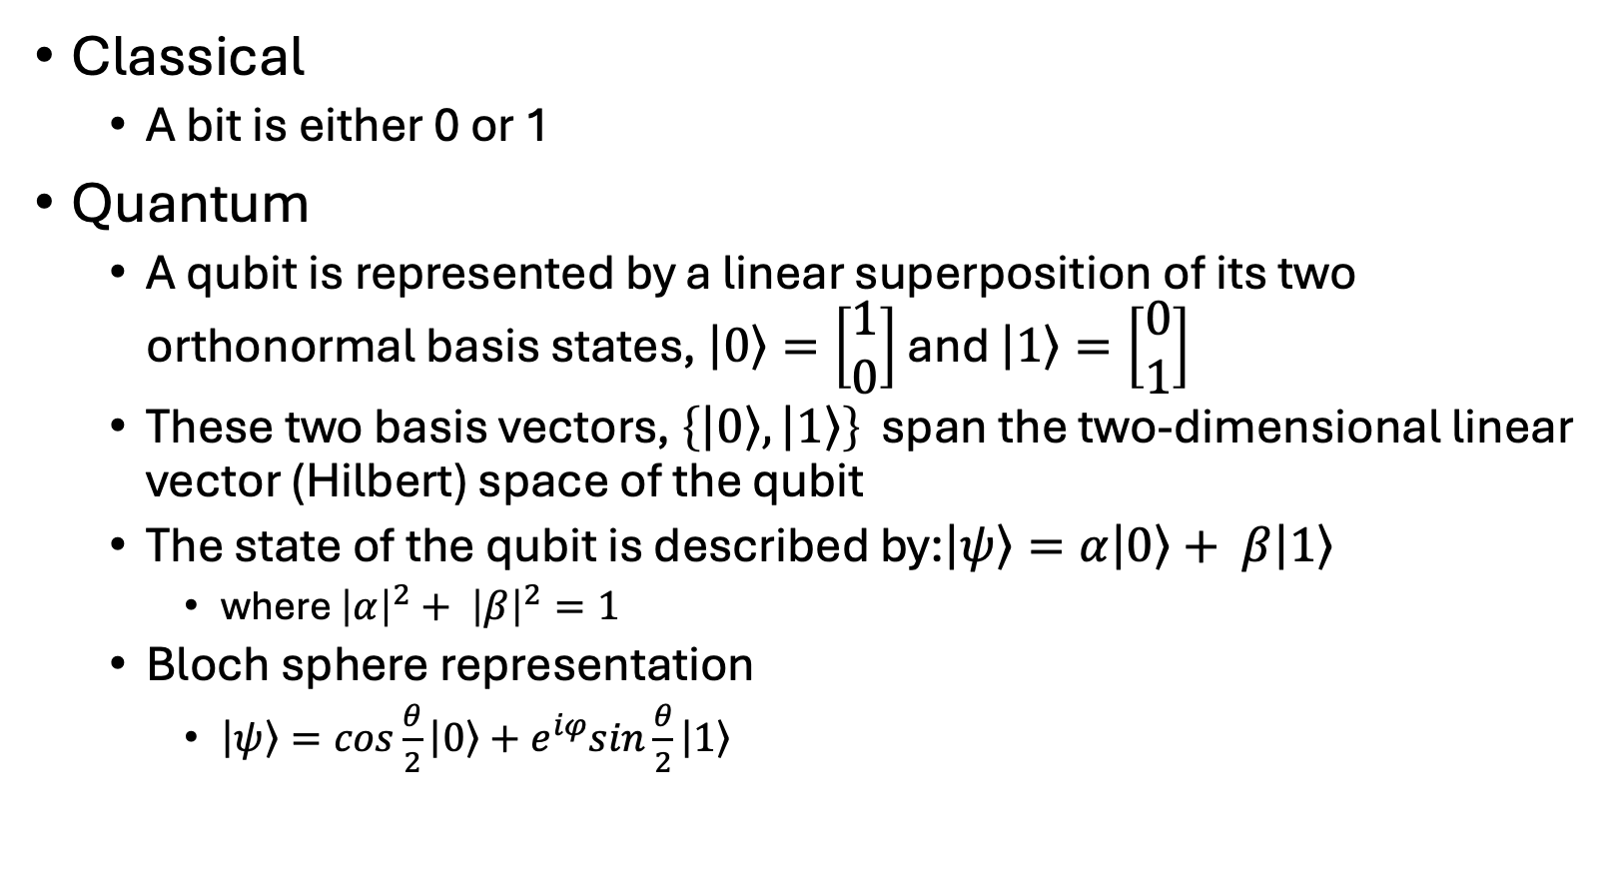
Classical
A bit is either 0 or 1
Quantum
A qubit is represented by a linear superposition of its two orthonormal basis states, $\left|\left.0\right\rangle \right.=\left[\begin{matrix}1 \\ 0\end{matrix}\right]$ and $\left|\left.1\right\rangle \right.=\left[\begin{matrix}0 \\ 1\end{matrix}\right]$
These two basis vectors, $\left\{\left|\left.0\right\rangle \right.,\left|\left.1\right\rangle \right.\right\}$ span the two-dimensional linear vector (Hilbert) space of the qubit
The state of the qubit is described by:$\left|\left.ψ\right\rangle \right.=α\left|\left.0\right\rangle \right.+ β\left|\left.1\right\rangle \right.$
where ${\left|α\right|}^{2}+ {\left|β\right|}^{2}=1$
Bloch sphere representation
$\left|\left.ψ\right\rangle \right.=cos\frac{θ}{2}\left|\left.0\right\rangle \right.+e^{iφ}sin\frac{θ}{2}\left|\left.1\right\rangle \right.$
https://www.sharetechnote.com/html/QC/QuantumComputing_BlochSphere.html

Slide 10

Entanglement
Quantum entanglement is a phenomenon where two or more quantum particles become linked in such a way that the state of one particle instantly determines the state of the other, no matter how far apart they are. In simple terms, it's like having two perfectly synchronized dice: if you roll one and get a six, the other—no matter where it is in the universe—will also show six at the exact same moment.
https://www.spinquanta.com/news-detail/understanding-quantum-entanglement-the-ultimate-expert-guide

Slide 11
Entanglement in quantum computing
Parallelism and Information Sharing: Entanglement allows qubits to represent and process multiple values simultaneously, increasing computational parallelism.
Quantum Speedup: Many quantum algorithms (such as Shor's algorithm and Grover's algorithm) rely on entangled states to outperform their classical counterparts.
Quantum Error Correction: Entangled qubits are used to detect and correct errors in quantum systems, maintaining coherence over longer periods.
Quantum Gate Operations: Multi-qubit quantum gates like the CNOT gate depend on entanglement to manipulate data across qubits.
https://www.spinquanta.com/news-detail/entanglement-in-quantum-computing

Slide 12
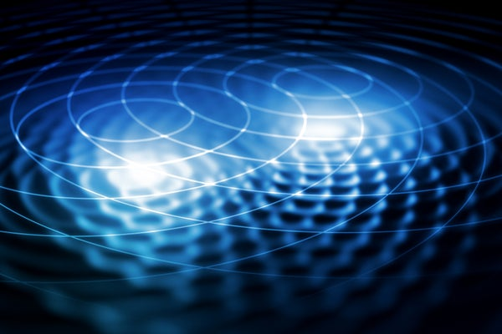
Quantum Interference
Quantum interference is a phenomenon in quantum mechanics that arises from the wave-like nature of quantum particles such as electrons or photons. When a particle is in a superposition of multiple states, these states can interfere with each other leading to constructive or destructive interference
Interference is the basis of many quantum algorithms and can lead to significant speedups in computation
Quantum Fourier transform (QFT),uses superpositions of different states, and quantum interference between them, to compute the Fourier transform of a quantum state. The interference between different paths in the QFT can be used to enhance the probability of measuring the correct solution and suppress the probability of measuring incorrect solutions, leading to a speedup in the computation.
https://quantum.microsoft.com/en-us/insights/education/concepts/interference

Slide 13
Quantum Errors – Quantum Computing largest challenge
Qubits superposition makes them extremely sensitive to environmental interference
Bit flips, phase flips, or both, depolarizing and amplitude damping
Quantum Error Correction (QEC)
Surface Code: Uses a 2D-lattice of qubits
Shor’s Code: Employs nine physical qubits to encode one logical qubit and can correct any single-qubit error.
Steane Code: A seven-qubit CSS (Calderbank-Shor-Steane) code correcting single-qubit errors using fewer resources than Shor’s code
Recent advances by IBM [1,2] and others
Fault tolerant Quantum computers by 2030
Bravyi, S., Cross, A.W., Gambetta, J.M. et al. High-threshold and low-overhead fault-tolerant quantum memory. Nature 627, 778–782 (2024).
Yoder, Theodore J., Eddie Schoute, Patrick Rall, et al. “Tour de Gross: A Modular Quantum Computer Based on Bivariate Bicycle Codes.” arXiv:2506.03094. Preprint, arXiv, June 3, 2025.

Slide 14
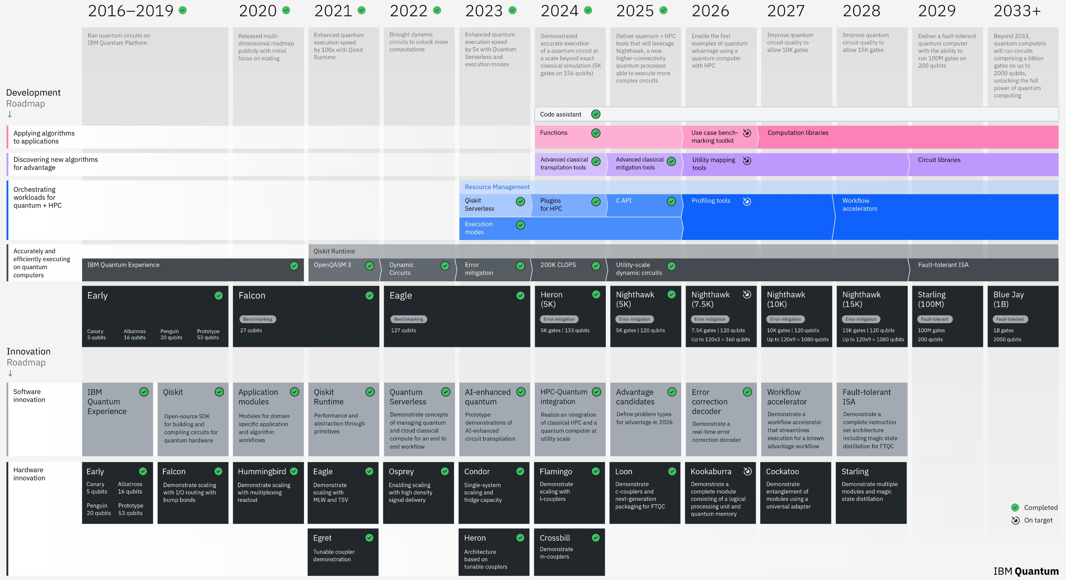

Slide 15
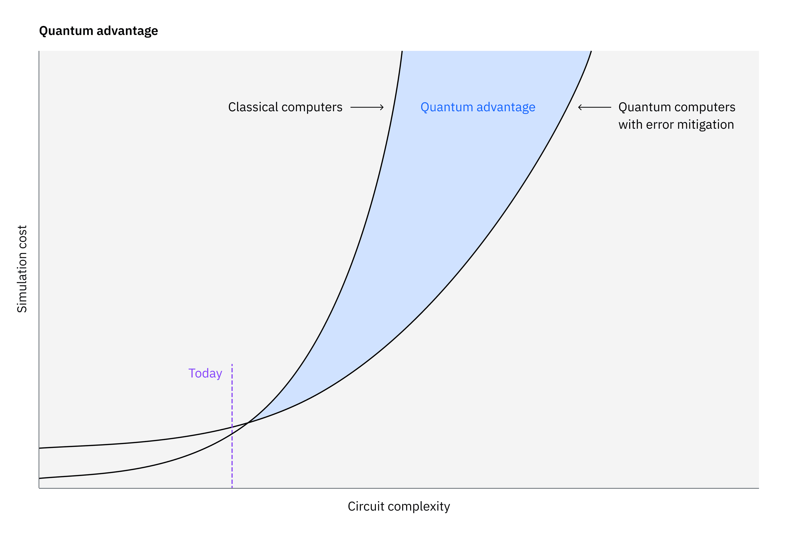
Quantum Advantage
A quantum computer can run a computation more accurately, cheaply, or efficiently than a classical computer
Effort to develop an accurate measurement [1]
The correctness of the quantum computer's output can be rigorously validated
Performed with a quantum separation that demonstrates superior efficiency, cost-effectiveness, or accuracy over what is attainable with classical computation alone
Examples of quantum advantage
Microsoft in 2019 [2]
D-Wave in 2025 [3]
https://www.ibm.com/quantum/blog/quantum-advantage-era
Lanes, Olivia, Mourad Beji, Antonio D. Corcoles, et al. “A Framework for Quantum Advantage.” arXiv:2506.20658. Preprint, arXiv, July 14, 2025.
Arute, Frank, Kunal Arya, Ryan Babbush, et al. “Quantum Supremacy Using a Programmable Superconducting Processor.” Nature 574, no. 7779 (2019): 505–10.
King, Andrew D., Alberto Nocera, Marek M. Rams, et al. “Beyond-Classical Computation in Quantum Simulation.” Science 388, no. 6743 (2025): 199–204.

Slide 16
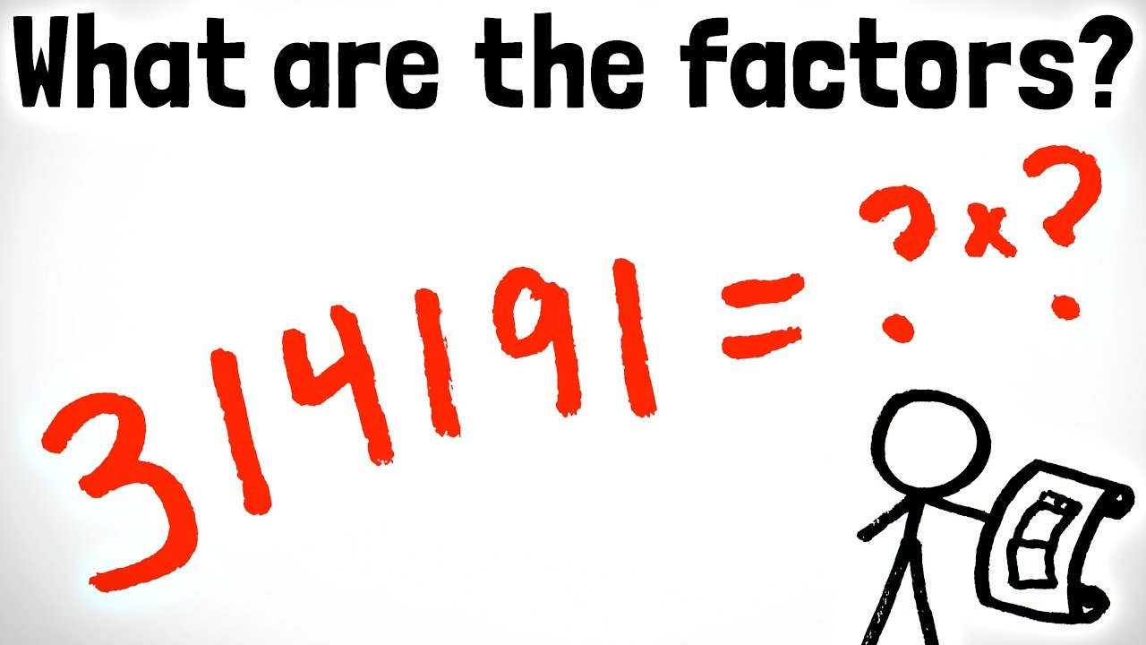
Ok, so what can we do with Quantum Computers?
Shor’s algorithm[1]
Finds prime factors to large numbers (15 = 3 x 5)
Uses quantum mechanics, such as, superposition and quantum Fourier transforms
Exponential speedup
Grover's algorithm[2]
Search algorithm
Quadratic speedup
Shor, P.W. (1994). "Algorithms for quantum computation: Discrete logarithms and factoring". Proceedings 35th Annual Symposium on Foundations of Computer Science. pp. 124–134.
Grover, Lov K. (1996-07-01). "A fast quantum mechanical algorithm for database search". Proceedings of the twenty-eighth annual ACM symposium on Theory of computing - STOC '96. Philadelphia, Pennsylvania, USA: Association for Computing Machinery. pp. 212–219. arXiv:quant-ph/9605043.

Slide 17
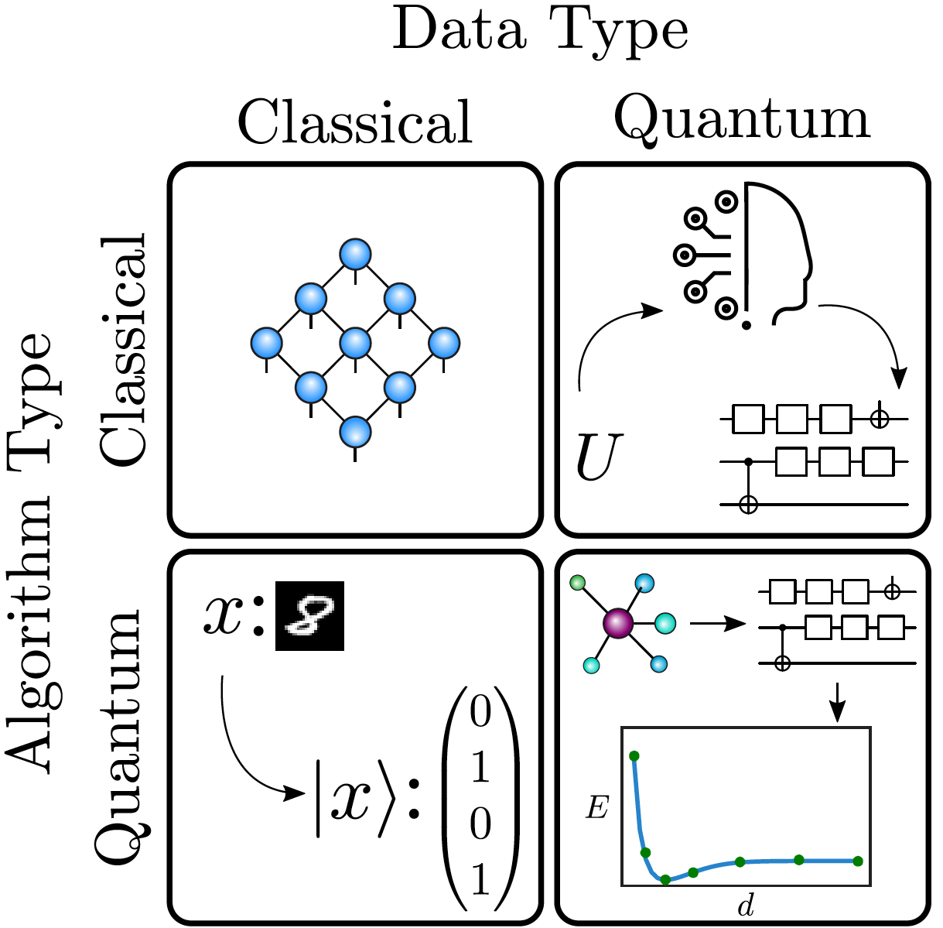
Quantum Machine Learning (QML)
1
2
Quantum machine learning is usually considered for four main tasks. These include tasks where the data is either classical or quantum, and where the algorithm is either classical or quantum.
Tensor networks are quantum-inspired classical methods that can analyze classical data.
Unitary time-evolution data U from a quantum system can be classically compiled into a quantum circuit.
Handwritten digits can be mapped to quantum states for classiﬁcation on a quantum computer.
Molecular ground state data can be classiﬁed directly on a quantum computer. The ﬁgure shows ground state energy E dependence on the distance d between the atoms.
3
4
Cerezo, M., Guillaume Verdon, Hsin-Yuan Huang, Lukasz Cincio, and Patrick J. Coles. “Challenges and Opportunities in Quantum Machine Learning.” Nature Computational Science 2, no. 9 (2022): 567–76.

Slide 18
Classical ML
QML
Dataset D
Machine Learning
Prediction
Dataset D
Machine Learning
Prediction
Encoding
Encoding

Slide 19
Encoding data
Encoding classical information into quantum systems that can be manipulated by a quantum computer, which can be regarded as the classical-to-quantum mapping [1]
Basis encoding is a basic method for processing classical data that can be represented in binary form. In this process, N qubits are required to represent a binary vector of length N
Amplitude encoding is a technique that maps classical data into the amplitudes of a quantum state. Amplitude encoding is highly efficient because it allows an exponentially large vector of length 2N to be represented using only N qubits
Angle encoding embeds classical data into a quantum state through rotation angles. A key advantage of angle encoding is its ability to introduce nonlinearity. By mapping classical data into the parameters of quantum rotation gates, angle encoding leverages trigonometric functions to naturally capture nonlinear relationships.
There are also other types of encoding [2]
Du, Yuxuan, Xinbiao Wang, Naixu Guo, et al. “Quantum Machine Learning: A Hands-on Tutorial for Machine Learning Practitioners and Researchers.” arXiv:2502.01146. Preprint, arXiv, February 3, 2025
Pande, Mandaar B. “A Comprehensive Review of Data Encoding Techniques for Quantum Machine Learning Problems.” 2024 Second International Conference on Emerging Trends in Information Technology and Engineering (ICETITE), February 2024, 1–7.

Slide 20
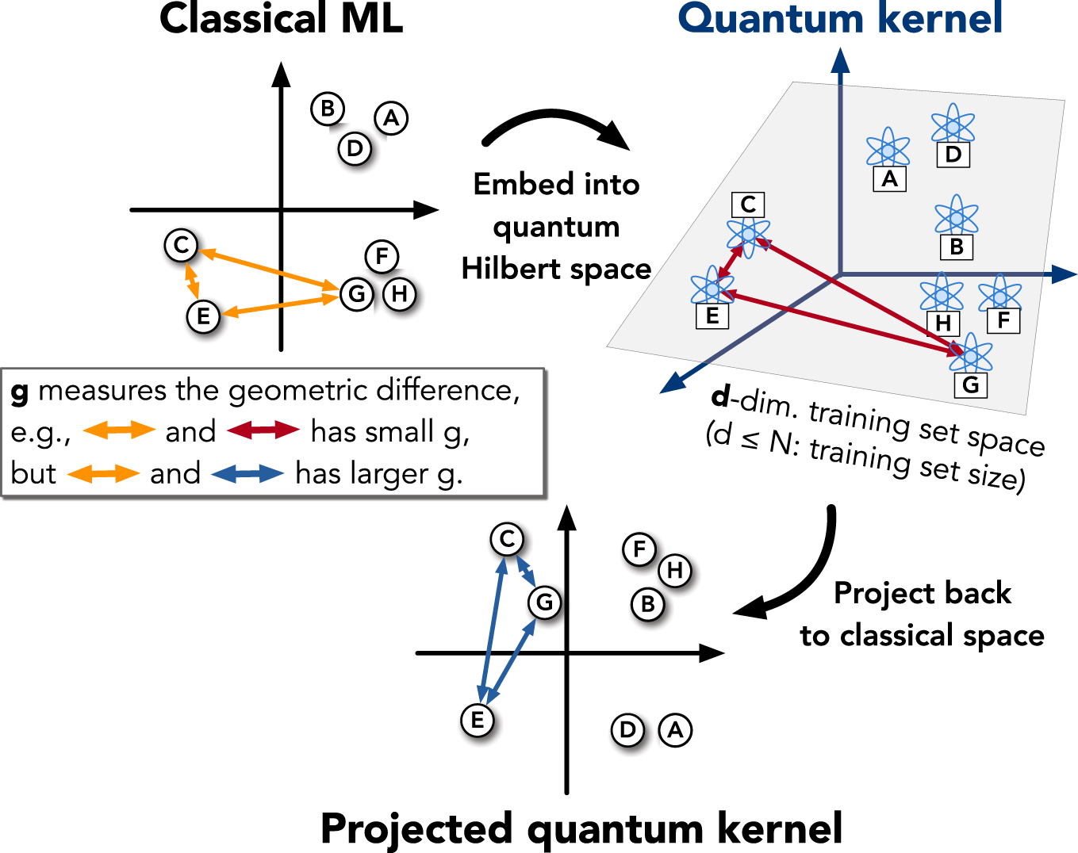
Huang, Hsin-Yuan, Michael Broughton, Masoud Mohseni, et al. “Power of Data in Quantum Machine Learning.” Nature Communications 12, no. 1 (2021): 2631. https://doi.org/10.1038/s41467-021-22539-9.

Slide 21
Benefits with QML
Several reviews of the benefits with QML[1-3]
Offers polynomial and exponential speed-ups
Assumes amplitude base encoding
Ongoing research in the area [4-5]
Benchmarking is a challenge
Basically, all ML algorithms are available in QML
Quantum Principal Component Analysis (QPCA) [6]
Quantum Support Vector Machines (QSVM):[7,8]
Quantum K-Nearest Neighbors (QKNN)
Quantum Neural Networks (QNNs)
Quantum Kernel Methods
And others…
Biamonte, Jacob, Peter Wittek, Nicola Pancotti, Patrick Rebentrost, Nathan Wiebe, and Seth Lloyd. “Quantum Machine Learning.” Nature 549, no. 7671 (2017): 195–202.
Huang, Hsin-Yuan, Michael Broughton, Masoud Mohseni, et al. “Power of Data in Quantum Machine Learning.” Nature Communications 12, no. 1 (2021): 2631.
Cerezo, M., Guillaume Verdon, Hsin-Yuan Huang, Lukasz Cincio, and Patrick J. Coles. “Challenges and Opportunities in Quantum Machine Learning.” Nature Computational Science 2, no. 9 (2022): 567–76.
Liu, Yunchao, Srinivasan Arunachalam, and Kristan Temme. “A Rigorous and Robust Quantum Speed-up in Supervised Machine Learning.” Nature Physics 17, no. 9 (2021): 1013–17.
Bowles, Joseph, Shahnawaz Ahmed, and Maria Schuld. “Better than Classical? The Subtle Art of Benchmarking Quantum Machine Learning Models.” arXiv:2403.07059. Preprint, arXiv, March 14, 2024.
Lloyd, Seth, Masoud Mohseni, and Patrick Rebentrost. “Quantum Principal Component Analysis.” Nature Physics 10, no. 9 (2014): 631–33.
Rebentrost, Patrick. “Quantum Support Vector Machine for Big Data Classification.” Physical Review Letters 113, no. 13 (2014).
Havlíček, Vojtěch, Antonio D. Córcoles, Kristan Temme, et al. “Supervised Learning with Quantum-Enhanced Feature Spaces.” Nature 567, no. 7747 (2019): 209–12.

Slide 22
How can I run QML?
QML oriented SDKs
Qiskit (IBM): IBM's comprehensive open-source SDK provides a vast ecosystem and extensive learning resources
PennyLane (Xanadu): QML SDK designed for hybrid quantum-classical computations. It is framework-agnostic, integrating with popular tools like TensorFlow, PyTorch, and NumPy, and allows users to run algorithms on various quantum backends, including those from IBM, Google, and Rigetti
Quantum computing frameworks
Cirq (Google): Designed with a focus on writing and optimizing circuits for current (NISQ) devices. Its integration capabilities with TensorFlow Quantum make it a core tool for Google's QML research efforts
Amazon Braket SDK (Amazon): Provides a unified interface to access different quantum hardware providers (e.g., IonQ, Rigetti). It supports hybrid algorithms and integrates well within the broader AWS cloud environment for ML workflows
Microsoft Azure Quantum Development Kit (QDK): The QDK features the Q# programming language and integrates with classical languages like Python and C#. It provides hybrid computation support within the Azure cloud, making it suitable for developing enterprise-scale QML solutions
https://www.dasca.org/world-of-data-science/article/top-open-source-tools-in-quantum-computing-for-data-scientists

Slide 23
Quantum Computing Cloud Services
IBM Quantum: A pioneer offering access to the world's largest fleet of superconducting quantum computers, including the 1,121-qubit Condor processor. It uses the Qiskit framework and provides tiers ranging from a free "Open Plan" to an enterprise "Premium Plan" ($48–$96 per minute of runtime).
Amazon Braket: A fully managed AWS service that acts as a hub for multiple hardware types, including gate-model systems from IonQ, Rigetti, and Oxford Quantum Circuits, plus neutral-atom processors from QuEra. It features pre-configured Jupyter notebooks and integrated S3 storage for results.
Microsoft Azure Quantum: Focuses on hybrid workflows, allowing users to combine classical Azure resources (like GPUs) with quantum co-processors from partners like Quantinuum and IonQ. It natively supports the Q# programming language and the Quantum Development Kit.
D-Wave Leap: Specialized in quantum annealing, which is optimized for industrial-scale optimization problems (e.g., logistics, scheduling) rather than general-purpose gate-model computing. Its Advantage2 system can handle up to two million variables.
Google Quantum AI: Provides access to its Sycamore and Willow chips primarily for approved researchers. It uses the Cirq framework and specializes in high-fidelity operations and quantum error correction research.

Slide 24
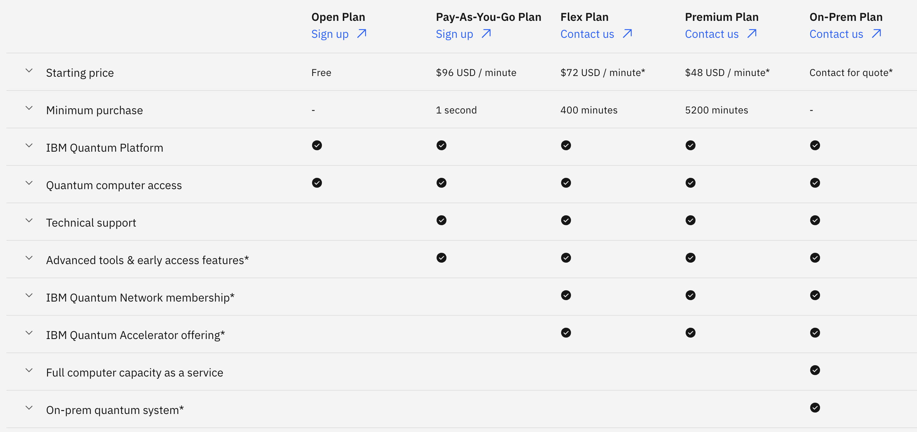
Taken from https://www.ibm.com/quantum/products 2026-01-18

Slide 25
Quantum Computing in Bioinformatics
Many publications of the use of QC and QML in bioiformatics
Many falls under the slide two category
Unclear results when it comes to the benefits
Recent reviews
Maurizio et al. Advocates for a balanced perspective on quantum computing in genomics, guiding future research toward targeted applications and robust validation
Bose et al. Roadmap article, we discuss the advancements and challenges in spatiotemporal single-cell analysis, explore the possibility of quantum computing to address the challenges and present a case study on how quantum computing may be integrated into cell-based therapeutics
Maurizio, Aurora, and Guglielmo Mazzola. “Quantum Computing for Genomics: Conceptual Challenges and Practical Perspectives.” PRX Life 3, no. 4 (2025)
Bose, Aritra, Kahn Rhrissorrakrai, Filippo Utro, and Laxmi Parida. “Advancing Single-Cell Omics and Cell-Based Therapeutics with Quantum Computing.” Nature Reviews Molecular Cell Biology, January 2, 2026

Slide 26
Summary – My thoughts
Really cool technology
Its actually using quantum mechanics
Real quantum computers exists
Not sure of usefulness for a simple bioinformatics scientist
Today
Pros
May be a good idea for a grant
Cons
Unclear of the real quantum advantage
Access to quantum hardware
2030
Probably very different

