Slide 1
File and file Redirection Module 2 slides 55-58

Slide 2
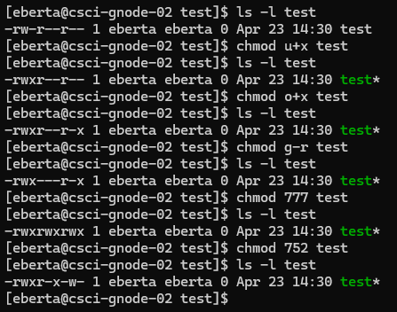
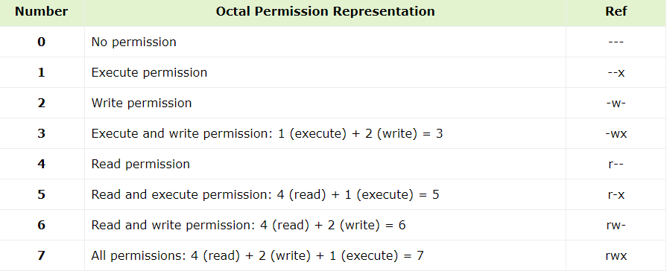
PermissionS:
-rwxr-xr--
First index: ‘-’ or ‘d’ if file or directory
2-4: owner permissions(u)
5-7: group permissions(g)
8-10: everyone else’s permissions(o)
+(adds permission), -(removes permission), =(sets permission)
Chmod(permission), chown(owner)
umask 022(specifies denied permission)
Group and other can’t write
777 & ~022 → 755

Slide 3
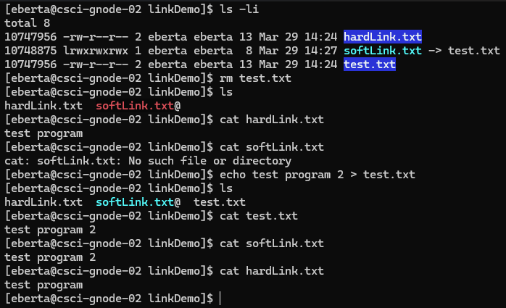
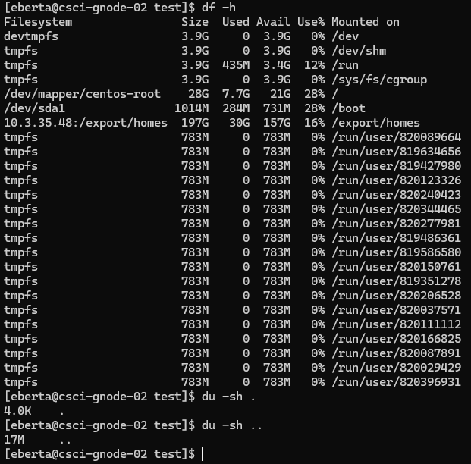
Operations:
ls:
-1 –a –d –F –l –i –r –t –S
one line, all, directories, indicator(/*), inode, reverse, by time, by file space
rm –f (recursively deletes)
ln(hard link), ln –s(soft link)
cp –i, mv –i (interactive-confirmation)
stat(file system status)
unlink(delete file)
df -h(disk space for file systems)
du(file space usage for directory)

Slide 4
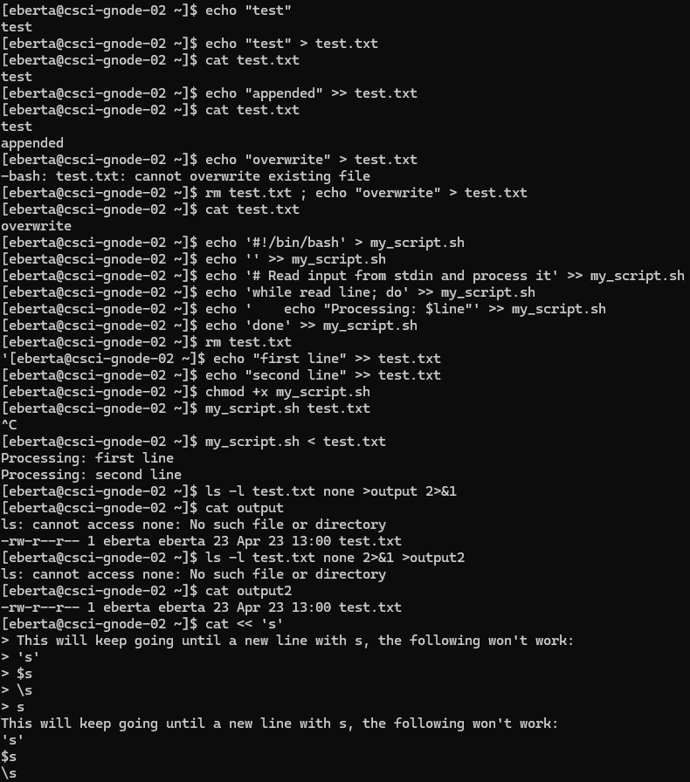
Redirection:
> Direct output
>> Append output
< Read input
cat – concatenate files and print to stdout
>output 2>&1 redirect stdout to output file and then redirect stderr to stdout
2>&1 >ouput redirect stderr to stdout and then redirect stdout to ouput file

Slide 5
Questions?

