Slide 1

THCHS Covid Data Audit
March - July 2020
Data analysis by: Angela Ebirim

Slide 2

Patients Referred To THIDH
Total number of patients referred to Tower Hamlets Integrated Discharge Hub (THIDH) between March - November 2020:
2387
Total number of Tower Hamlets patients referred to Tower Hamlets Integrated Discharge Hub (THIDH) during the same period :
1375
(over 50% of all referrals to THIDH)
Data analysis by: Angela Ebirim

Slide 3
Breakdown Of Covid Status For Tower Hamlets
Responsible Borough (where patient resides) | Covid status | Number of patients | Percentage
Tower Hamlets | Positive | 71* | 5.17%
Tower Hamlets | Negative | 696 | 50.65%
Tower Hamlets | Other | 608 | 44.18%
* represents the total number of Tower Hamlets patients, referred to THIDH between March - November 2020, who were Covid19 +ve (inclusive of all treatment options - therapy, equipment, district nursing etc). The resulting percentage is the number of Tower Hamlets Covid19 +ve patients divided by the total number of Tower Hamlets patients referred, during the same period, to THIDH i.e. 71/1375 * 100
Data analysis by: Angela Ebirim

Slide 4
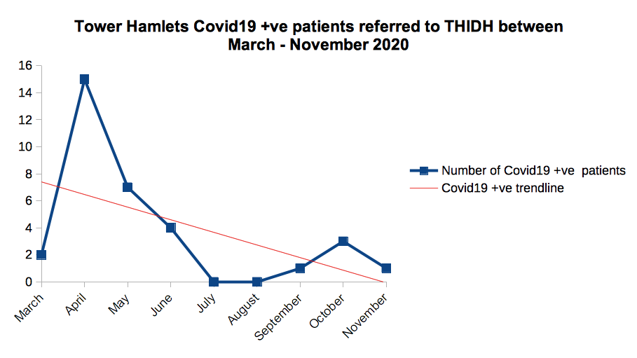
Data analysis by: Angela Ebirim

Slide 5
Covid Audit Dataset
gender | age | ethnicity | last_seen_in 12 months | ltc*_1 | ltc*_2
Female | 33 | Black | No | No
Male | 46 | Asian | No | Other
Male | 46 | White | No | No
Male | 49 | Asian | No | Hypertension | Diabetes
Male | 51 | Other ethnic group | No | No reply
Male | 54 | White | No | Diabetes | Other
Audit dataset dimensions: 29 anonymized Tower Hamlets Covid19 +ve patients with 61 characteristics including age, gender, ethnicity etc, referred to the THIDH between March - July 2020, and in receipt of therapeutic input
*ltc, abbreviation for long term condition
Data analysis by: Angela Ebirim

Slide 6
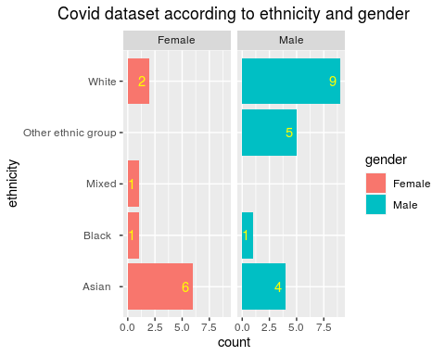
Breakdown Of Dataset: Gender And Ethnicity
38% White
17% Other ethnic group
3% Mixed
7% Black
34% Asian
34% Female
66% Male
.
Data analysis by: Angela Ebirim

Slide 7
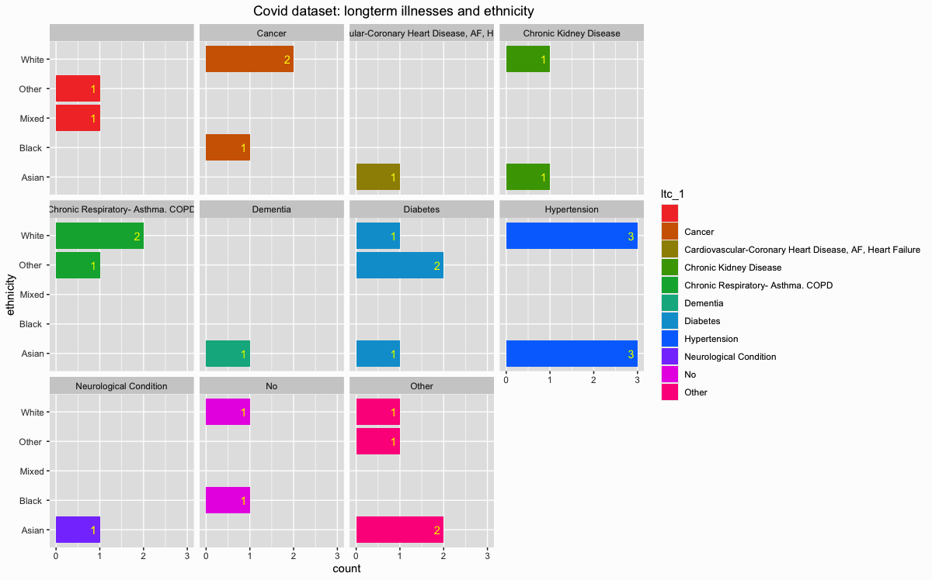
Breakdown Of Dataset: Long Term Conditions And Ethnicity
Hypertension is the condition suffered by the most patients (21%)
White and Asian ethnicities most affected
Data analysis by: Angela Ebirim

Slide 8
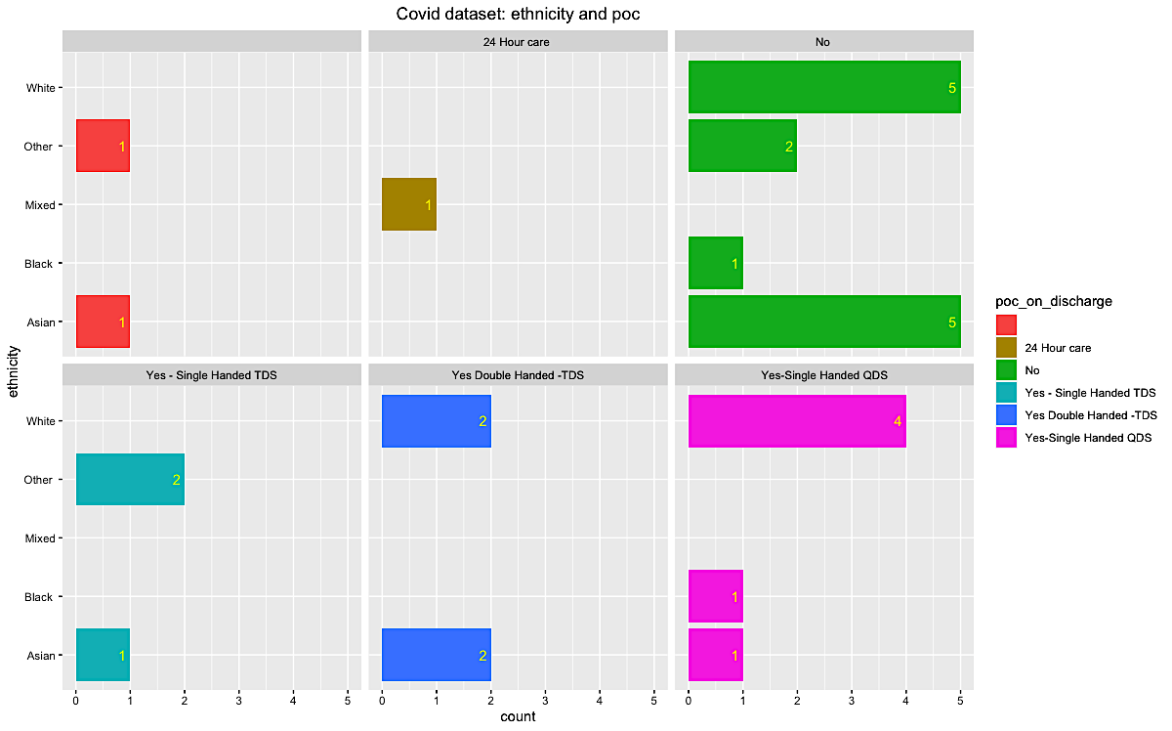
Breakdown Of Dataset: Ethnicity And Package Of Care
45% had no POC
21% had single handed QDS
3% had 24 hour care
14% had double handed TDS
10% had single handed TDS
Data analysis by: Angela Ebirim

Slide 9
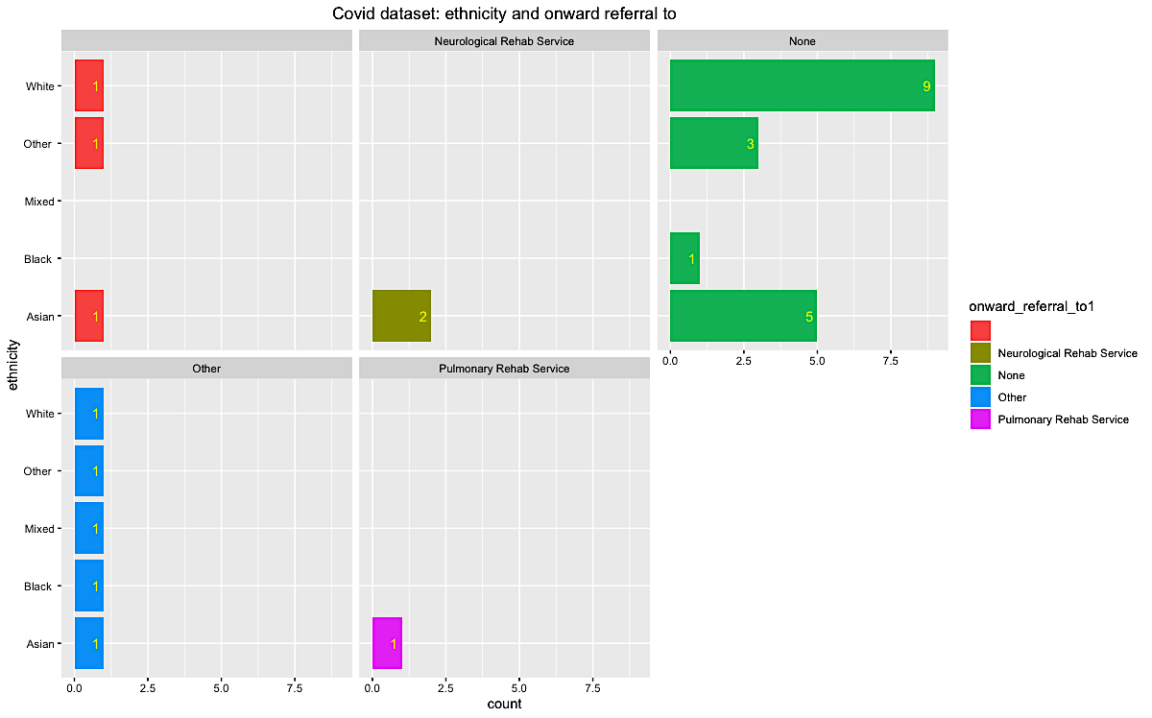
Breakdown Of Dataset: Ethnicity And Service Patient Referred To
62% of patients were not referred onward to another service
Data analysis by: Angela Ebirim

Slide 10
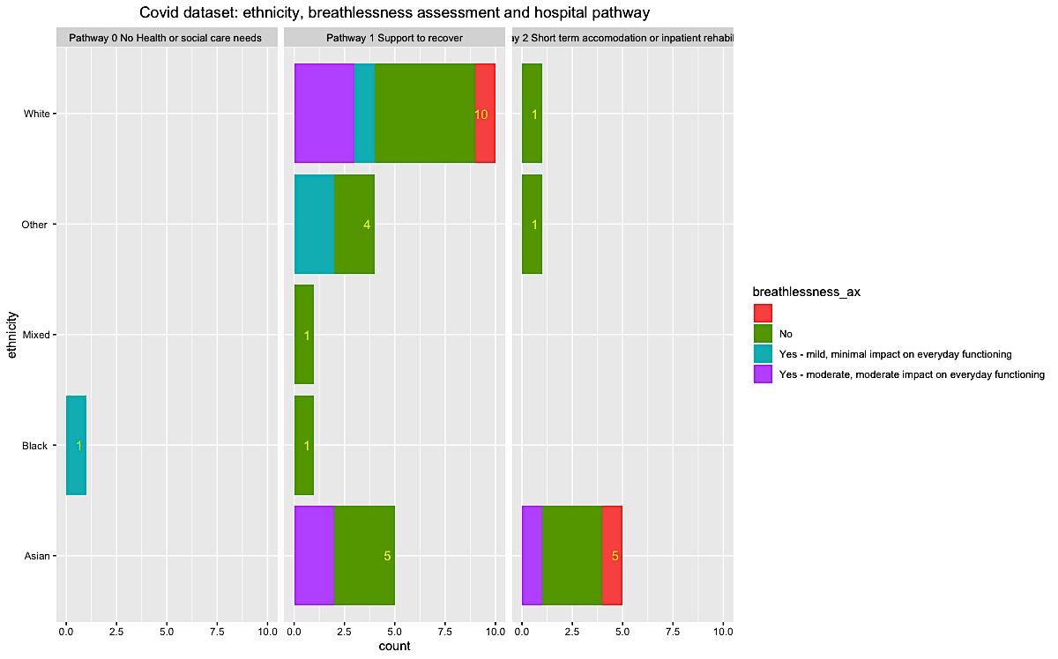
Breakdown Of Dataset: Ethnicity, Breathlessness And Hospital Pathway
59% of patients do not have a breathlessness assessment
The most frequently used hospital pathway is pathway 1
Data analysis by: Angela Ebirim

Slide 11
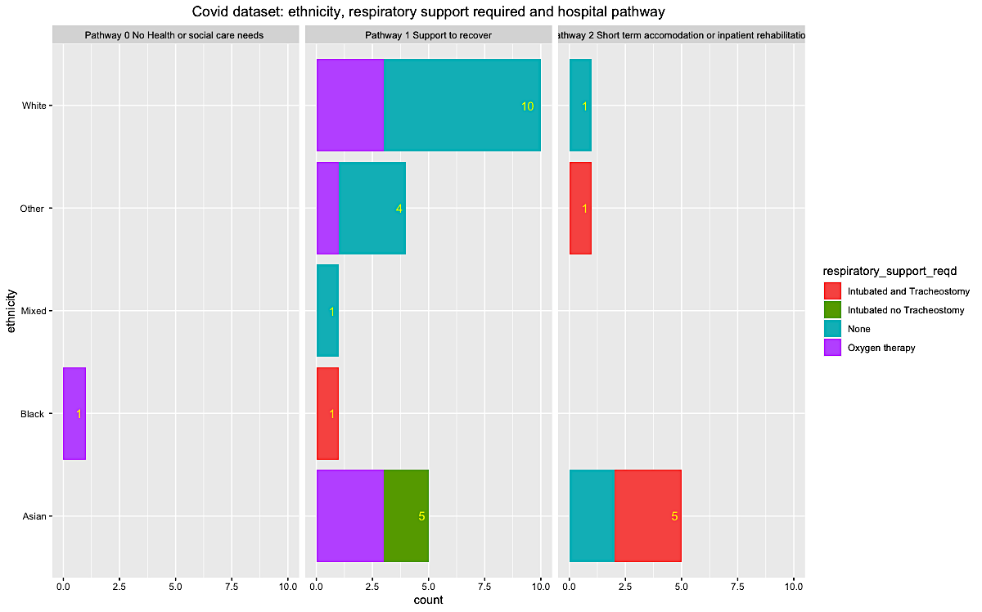
Breakdown Of Dataset: Ethnicity, Respiratory Support And Hospital Pathway
49% of patients needed no respiratory support
28% of patients needed oxygen therapy
24% of patients are intubated
The most frequently used hospital pathway is pathway 1
Data analysis by: Angela Ebirim

Slide 12
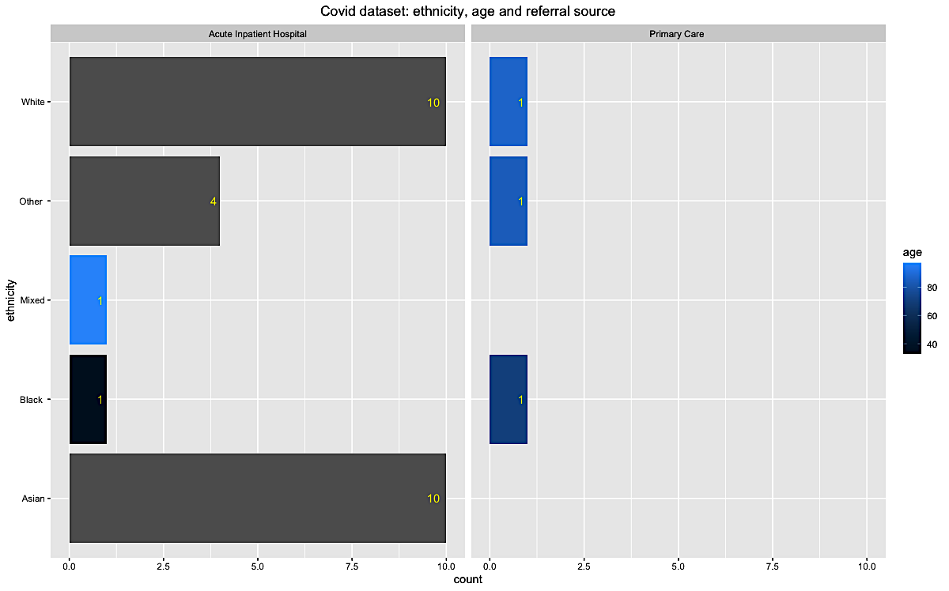
Breakdown Of Dataset: Ethnicity, Age And Referral Source
Younger patients (< 60 years old) were referred from an acute inpatient hospital
Older patients
(> 60 years old) were referred from primary care
Data analysis by: Angela Ebirim

Slide 13
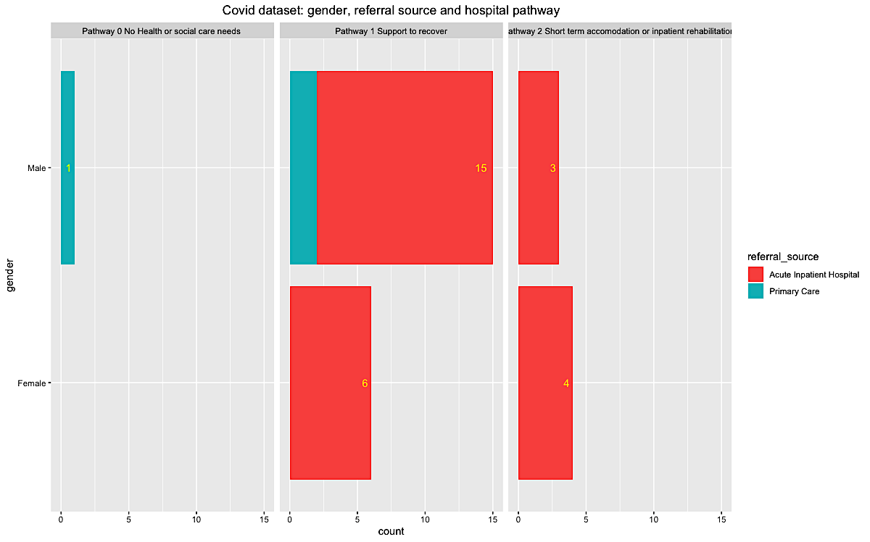
Breakdown Of Dataset: Gender, Referral Source And Hospital Pathway
90% of patients were referred from an acute inpatients hospital
The most frequently used hospital pathway is pathway 1
Data analysis by: Angela Ebirim

Slide 14
Insights Summary
Some insights taken from analysis of audit dataset …
90% of patients were referred from an inpatients ward
62% of patients were not referred onward to another service
Most common long term condition experienced was hypertension
most frequently used hospital pathway is pathway 1 across all genders and ethnicities
59% of patients did not have breathlessness on discharge
45% of patients had no POC on discharge
49% of patients needed no respiratory support
Data analysis by: Angela Ebirim

Slide 15
THCHS Covid Data Audit
March - July 2020
Data analysis by: Angela Ebirim

