Slide 1
Augmented Incident response (AIR)
Amit Manthanwar, Joseph Xavior Patterson, RD Childers, Amir Siddiqui, David Turner, Jason Kang, Harold Jackson

Slide 2
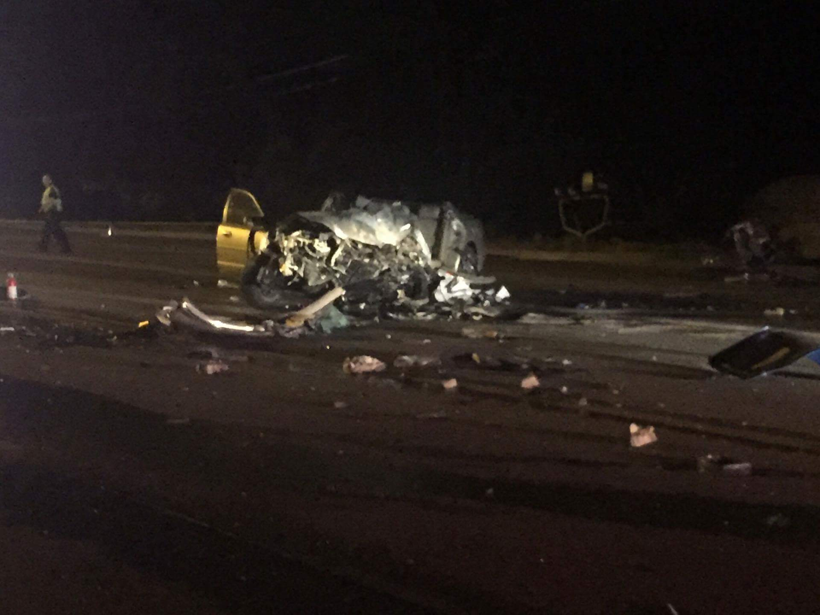
The Story

Slide 3
The Story

Slide 4
The Story

Slide 5
Problem Statement
Synergize existing emergency services and resources with the willingness of human beings to help one another. Incentivize community members to be prepared to assist their fellow citizens and first responders.

Slide 6
The Solution: AiR

Slide 7
The Solution: AiR
"I collect, receive and organize the facts and evidence and where they originated."
Notes:
- Scrape images
Pull data from databases to visualize
Maps
Past Data

Slide 8
The Solution: AiR
"I am the interface I present the right information to the right stakeholder in the most natural and intuitive way. I augment reality with lifesaving instructions. I present the environment in virtual reality."
Notes:
Stitch together images
AR visualization for command center and responders
Plan resources
i.e. number of jaws of life
Plan Locations
News, Fire Trucks, etc.

Slide 9
The Solution: AiR
Map Link here
Notes:
Demo

Slide 10
The Solution: AiR
" I am the concerned and prepared citizen armed with the application's and willingness that will make the difference."
Notes:
Feed data back to citizenry with instructions to help
Take more photos
Road Flares
CPR
Certifications
Incentives

Slide 11
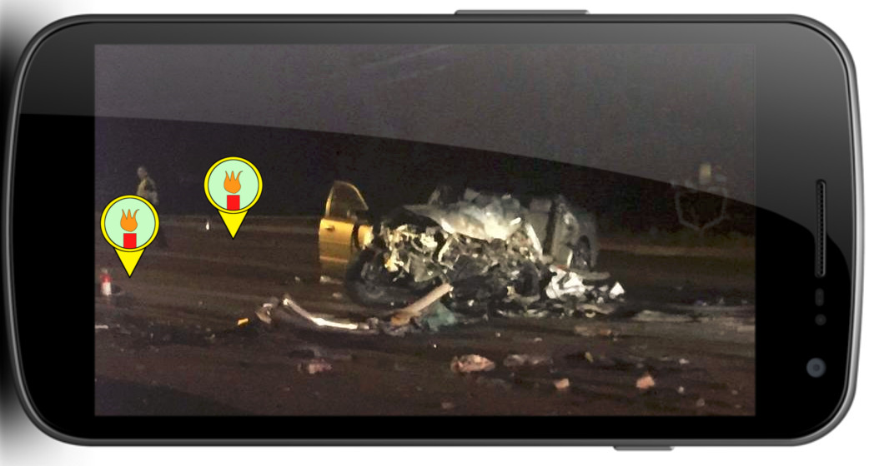
The Solution: AiR

Slide 12
The Solution: AiR
"I analyze the facts and evidence of the active incident to include location and parties involved, simultaneously I analyze historical data from the incident location as well as from similar incidents. I analyse to understand the past. Inform the present crisis and to predict and prevent future incidents."
Notes:
Analytics
Predictions of accident frequency
Resource optimization

Slide 13
The Solution: AiR
"I am the trained professional first responder. I have dedicated my life fully in service to my community. I skillfully use the information and tools I have mastered to access and make decisions with my team when seconds count."
Notes:
- First responder now has info needed to know what he is getting into

Slide 14
Conclusion
Provide emergency responders with improved knowledge about the scene they are about to arrive on.
Movement to include community

Slide 15
Resources
Github:
https://github.com/codecofee19/AiR

