Slide 1
what is an Arduino
Arduino is an open-source platform used for building electronics projects. Arduino consists of both a physical programmable circuit board (often referred to as a microcontroller) and a piece of software, or IDE (Integrated Development Environment) that runs on your computer, used to write and upload computer code to the physical board.
Additionally, the Arduino IDE uses a simplified version of C++, making it easier to learn to program.

Slide 2
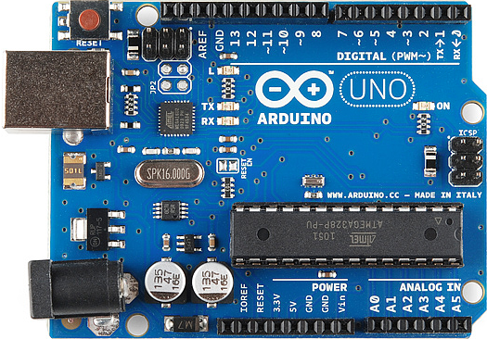
Lets See How It Looks

Slide 3

Bluetooth Interactive Apps – How TO Make Them
MIT App Inventor is an intuitive, visual programming environment that allows everyone – even children – to build fully functional apps for smartphones and tablets. Those new to MIT App Inventor can have a simple first app up and running in less than 30 minutes.

Slide 4
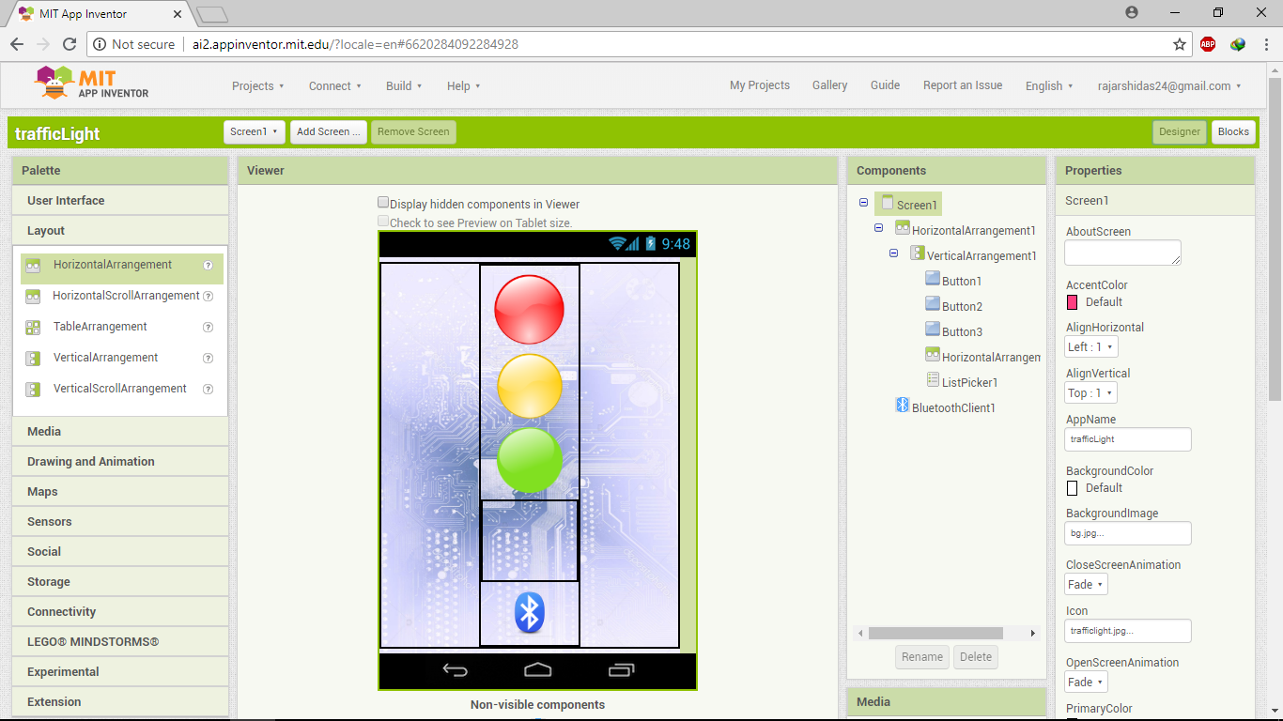

Slide 5
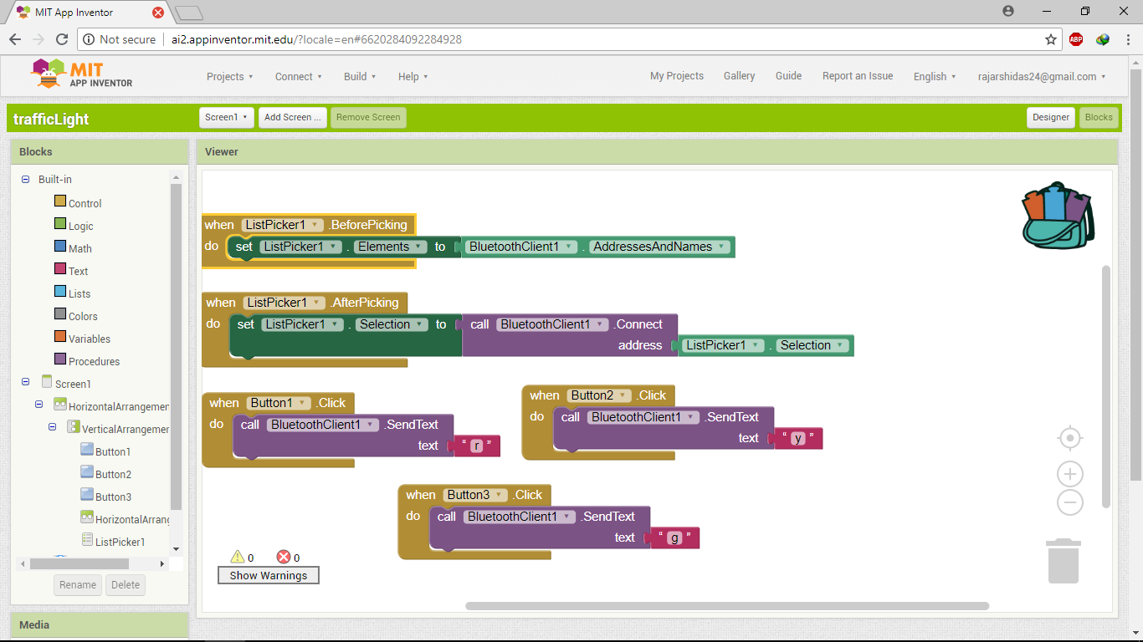

Slide 6
Sensors
The ease with which an Arduino can obtain sensor values is one of the features that makes it so useful. Sensors are devices that convert a physical quantity, such as light intensity or temperature, into an electrical quantity.
Some Examples of Sensors :-
Temperature and Humidity sensor module.
Ultrasonic Sensors.
Infrared emission sensor module.
Smoke Detector

Slide 7

Arduino IDE
The Arduino Integrated Development Environment - or Arduino Software (IDE) - contains a text editor for writing code, a message area, a text console, a toolbar with buttons for common functions and a series of menus. It connects to the Arduino hardware to upload programs and communicate with them.

Slide 8
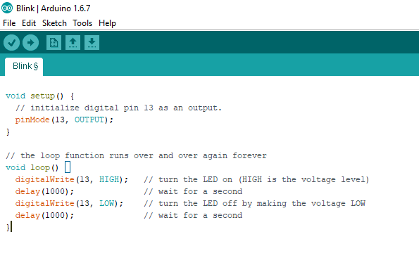
Lets Blink

