Slide 1


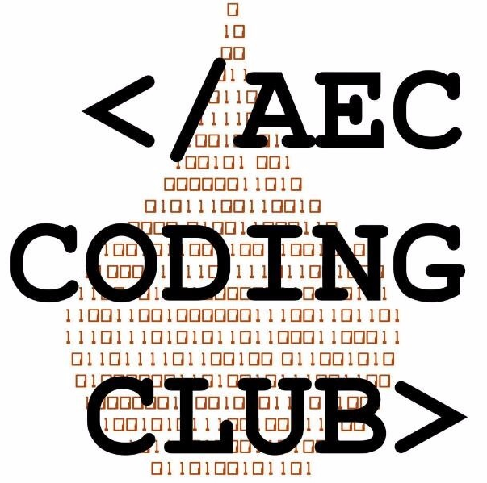
Web development or simply web dev (the lazier, the shorter)
Basically, these-
Introduction to html5
Introduction to CSS
CALM DOWN EVERYONE!! CHILL!! I JUST SAID ONLY INTRODUCTION!! DON’T FREAK OUT!!
MY NAME IS HRISHIKESH, BTW, IF YOU CARE. YOU CAN CALL ME JACK TOO.
¯\_(ツ)_/¯

Slide 2
WEB DEVELOPMENT
It is basically a term used to define the way or the process to develop and website, or an webpage for an internet or an intranet. It can be either designing the simplest webpage, or designing a sophisticated and complex web based internet applications. Some of the web dev languages are-
HTML5, CSS, JavaScript, PHP(Facebook is its son), jQuery, XHTML(Stricter than HTML5), STML(Ever did “ok google”?), SQL etc.

Slide 3

What is HTML5?
HTML5 is the newest version of HTML.
It incorporates all features from earlier versions of HTML, including the stricter XHTML.
It adds a diverse set of new tools for the web developer to use.
The extension for saving a file in html format is .html
Sooo??

Slide 4
History of HTML
1991
HTML first published
1995
HTML 2.0
After HTML 4.01 was released, focus shifted to XHTML and its stricter standards.
1997
HTML 3.2
1999
HTML 4.01
2000
XHTML 1.0
HTML5 is much more tolerant and can handle markup from all the prior versions.
2002 -2009
XHTML 2.0
HTML5
Though HTML5 was published officially in 2012, it has been in development since 2004.
2012

Slide 5
New Elements in HTML5
<article>
<aside>
<audio>
<canvas>
<datalist>
<figure>
<figcaption>
<footer>
<header>
<hgroup>
<mark>
<nav>
<progress>
<section>
<source>
<svg>
<time>
<video>

Slide 6
Other New Features in HTML5
Built-in audio and video support (without plugins)
Enhanced form controls and attributes
The Canvas (a way to draw directly on a web page)
Drag and Drop functionality

Slide 7
Basics
Every tag starts with < and ends with > example- <head>
Almost element command has an ending command. The ending command is same as the beginning command, but with a / in front of it. For example, the command <head> has the ending command </head>
All the html files are stored with the extension .html in webpages or websites.

Slide 8
The head Section
The basic HTML5 webpage contains a head element that contains a title element that will get displayed in the Tab of the browser.
INPUT-
<head>
<title>First HTML5</title>
</head>
OUTPUT-

Slide 9
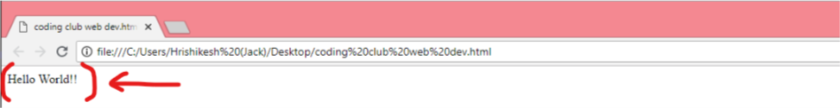
THE BODY SECTION
The body command starts with <body> and closes with </body>. It is used to write the body, that is, the main content of the webpage. It may contain text, images, hyperlinks, forms etc. to make a paragraph in a body, the command <p> is used, and </p> is used to end a paragraph.
INPUT-
<html>
<body>
<p>Hello World!!</p>
</body>
</html>
OUTPUT-

Slide 10
COMBINING BOTH HEAD AND BODY TO MAKE A BASIC WEBPAGE
Putting the prior sections together, and now adding the <body> section and closing tags inside a common html tag, we have our first complete web page in HTML5:
INPUT-
<html>
<head>
<title>First HTML5</title>
</head>
<body>
<p>Hello World</p>
</body>
</html>

Slide 11
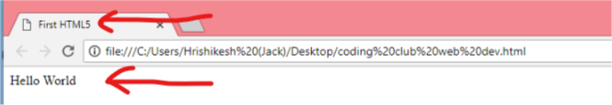
OUTPUT-
Even though we used HTML5, the page looks exactly the same in a web browser as it would in XHTML. Without looking at the source code, web visitors will not know which version of HTML the page was created with.

Slide 12
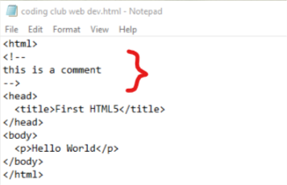
MAKING A COMMENT IN HTML5
To turn a command into a comment or to make it inactive, or to write down a comment that shall not disturb the program, <!-- (text) --> is used.

Slide 13
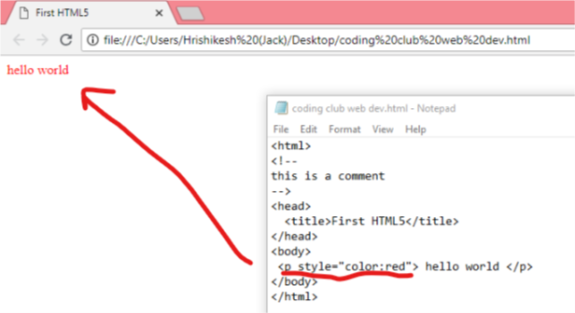
ADDING A COLOUR TO THE TEXT
To add a colour to a text line, the style=“color:colour name” tag command is used inside the heading or paragraph tag related to the particular text line.

Slide 14
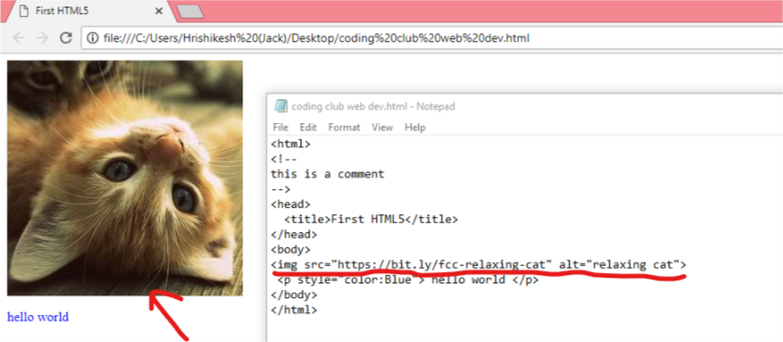
ADDING AN IMAGE TO THE WEBPAGE
To add an image to the webpage, the img src command is used. It is in the format –
<img src=“link of image.jpg” alt=“name of pic”>

Slide 15
Adding a hyperlink to an webpage And breaking a line
Hyperlink is basically a link connecting a hypertext document (an webpage, word document, image etc.) to another location, activated by clicking on a highlighted word or image. (strong uses in click baits :P)
The tag for a hyperlink is-
<a href=“link”>link text</a>
To break a line in a paragraph or in the body, or to start a new line, the tag <br> is used. It is a singled tag, that is, it doesn’t have a closing tag. It is used at the end of previous line.

Slide 16
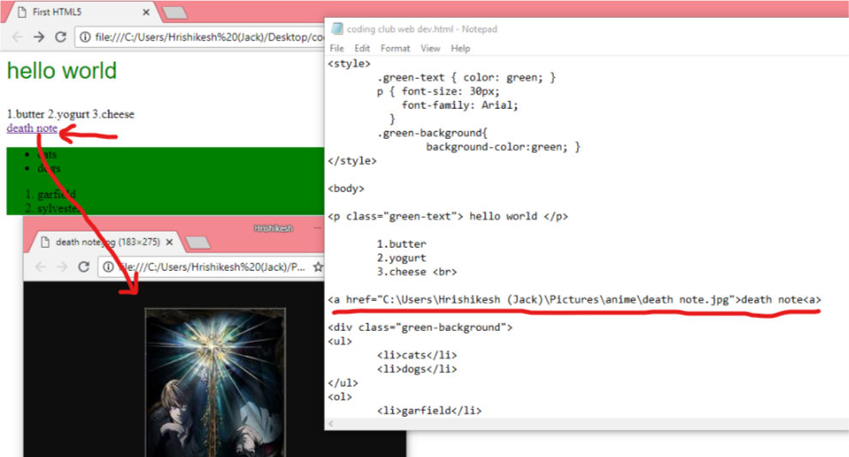
OUTPUT-
ON CLICKING THE LINK AND OPENING IN NEW WINDOW

Slide 17
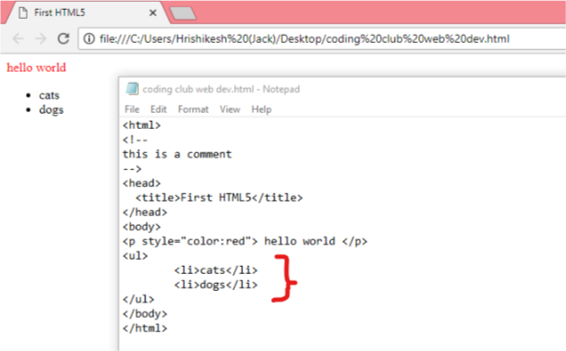
unordered list
To make an unordered list, we use the ul command. Under this, we use li command for every bullet points of the list. In unordered list, only bullets are added. For example-

Slide 18
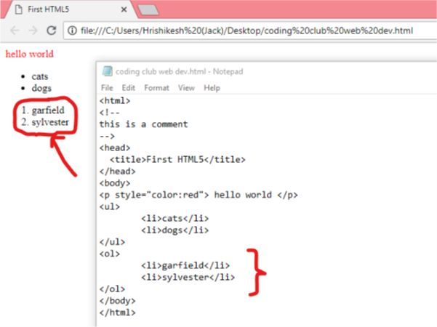
Ordered list
To make an ordered list, we use the ol command. Under this, we use li command for every bullet points of the list. In ordered list, numbers are used to denote points. For example-

Slide 19
THE DIVISION ELEMENT (<DIV>)
The division element is one of the most useful element in HTML5.
Is actually a collection of objects in HTML5 & puts various objects under the same group.
Can be used if a common command is to be executed to different elements of HTML5 together.
The tag used for the division element is <div> and the closing tag is </div>

Slide 20

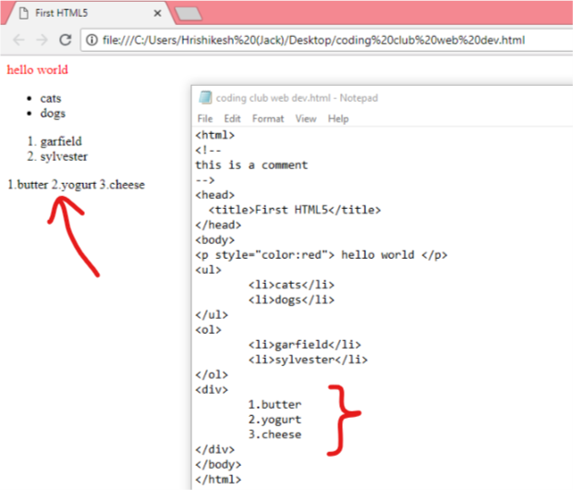

Using the division element in html5
The division or the div element is used in places where collective changes of various elements are required and are nested together.
Ok Done!!

Slide 21

CASCADING STYLE SHEETS (CSS)
Cascading Style Sheets (CSS) tell the browser how to display the text and other content that you write in HTML. Note that CSS is case-sensitive so be careful with your capitalization. CSS has been adopted by all major browsers and allows you to control:
colour
fonts
positioning
spacing
sizing
decorations
transitions
What!!?? There is more??

Slide 22
Basic CSS: Change the Color of Text
At the top of our code, we create a style block like this:
<style> (opening tag of style element)
(style commands)
</style> (closing tag of style element)
Inside that style block, we can create a CSS selector for all h2 elements. For example, if we want p elements to be red, we would add a style rule that looks like this:
<style>
p {color: red;}
</style>

Slide 23
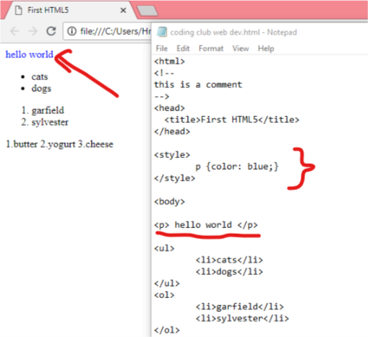
OUTPUT-

Slide 24
Basic CSS: Use a CSS Class to Style an Element
Classes are reusable styles that can be added to HTML elements. Here's an example CSS class declaration:
<style>
.blue-text { color: blue; }
</style>
We can see that we've created a CSS class called blue-text within the <style> tag. We can apply a class to an HTML element like this:
<p class="blue-text">hello world</p>

Slide 25
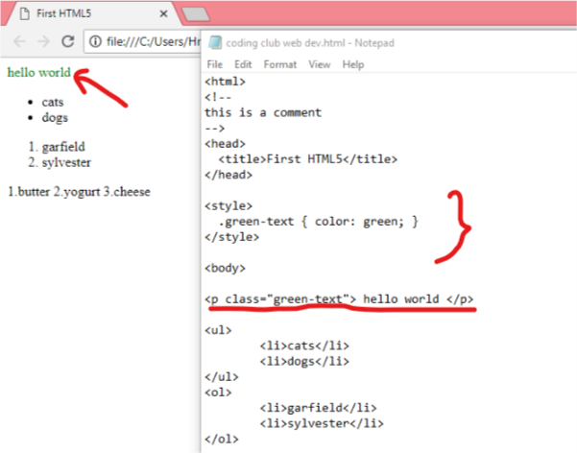
OUTPUT-

Slide 26
Basic CSS: font size and font type
Font size is controlled by the font-size CSS property, like this:
p {
font-size: 30px;
}
You can set which font an element should use, by using the font-family property. For example, if you wanted to set your h2 element's font to sans-serif, you would use the following CSS:
p {
font-family: sans-serif;
}
Remember, all of these must be inside the style element!!

Slide 27
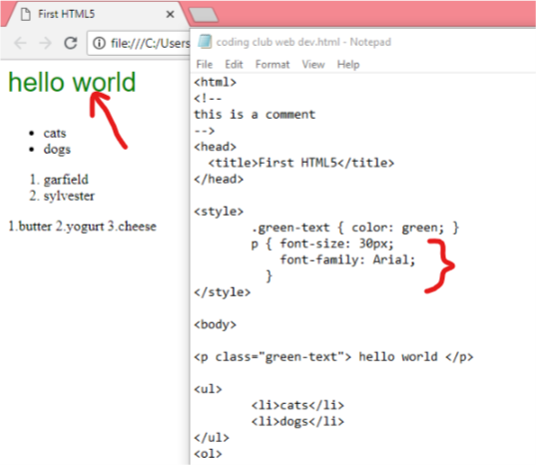
OUTPUT-

Slide 28
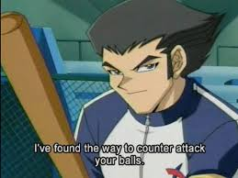
Basic CSS: giving background colour to a division element
Remember the division element of HTML5?? Now it’s back!!
DIVISION ELEMENT
CSS
GUYS!! I AM BACK!!
We already know that the division element is used to change the attributes of various elements collectively. Changing background colour is one of them. We’ll now see how to do it. Basically, to change the background colour of any element, the background-colour command is used inside the style element.

Slide 29
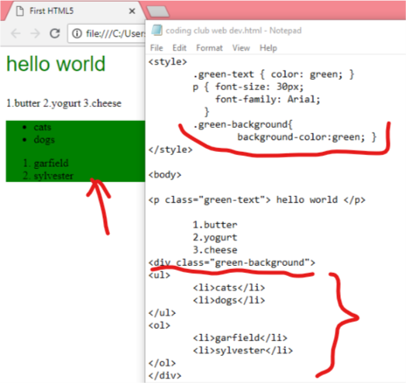

Slide 30
Benefits of CSS in Web Development
Improves Website Presentation
The standout advantage of CSS is the added design flexibility and interactivity it brings to web development.
Makes Updates Easier and Smoother
CSS works by creating rules. Eliminating the repetitive coding style of HTML makes development work faster and less monotonous. Errors are also reduced considerably.
Helps Web Pages Load Faster
Improved website loading is an underrated yet important benefit of CSS. Browsers download the CSS rules once and cache them for loading all the pages of a website. It makes browsing the website faster and enhances the overall user experience.

Slide 31

Thanks a lot for bearing with me
Hope you learnt something today. Do try out the things shown today. It’ll be a great experience for you!!
YES, WE MADE IT TILL HERE!! THANKS A LOT, ALL OF YOU, FOR YOUR CONTRIBUTION IN MAKING THIS POSSIBLE!! GOODBYE!! SEE YOU SOON!!

