Slide 1
Who gets the Blues?
Do suicide rates vary with age?
Nationally vs. World-wide?
Does access to mental health treatment or government spending affect suicide rates?

Slide 2
Do suicide rates vary with age? Nationally vs. World-wide? What we read in news… accurate impressions?
Does access to mental health
treatment or government spending
correlate with suicide statistics?
Is data accessible, can we visualize?

Slide 3


Slide 4
CDC's WISQARS™ is an interactive, online database that provides fatal and nonfatal injury, violent death, and cost of injury data from a variety of trusted sources.
US Department of Health and Human Services,
Centers for Disease Control and Prevention (CDC)
National Center for Injury Prevention and Control,
Web-based Injury Statistics Query and Reporting System
last updated Januaray 18, 2019; accessed at https://webappa.cdc.gov/sasweb/ncipc/leadcause.html

Slide 5
CDC – WONDER
US Department of Health and Human Services,
Centers for Disease Control and Prevention,
CDC Wide-ranging ONline Data for Epidemiologic Research
last reviewed December 18, 2018, accessed at https://wonder.cdc.gov/controller/datarequest/D76;jsessionid=E5FCE4EAF6848EBA89A050D538B446A0

Slide 6




Slide 7
Similar data values retrieved from Treatment Episode Data Set (TEDS) (by ICD-9 code) and National Committee on Vital and Health Statistics indicating derived from same reporting.
U.S. Department of Health and Human Services
Substance Abuse & Mental Health Services Administration
Locator Map
accessed at https://findtreatment.samhsa.gov/locator

Slide 8
United Nations Development Program: Human development index (HDI). World Bank: World development indicators: GDP (current US$) by country:1985 to 2016. World Health Organization: Suicide prevention. Suicide in the twenty-first century [dataset]. Compilation data file accessed at Kaggle.Com
Master.csv

Slide 9

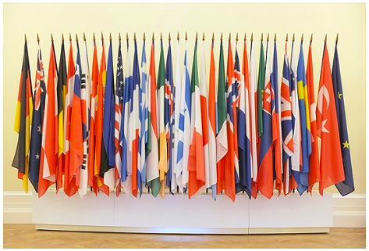
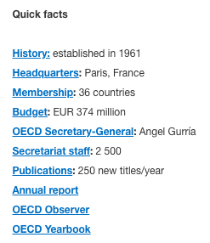
“like” World Health Organization

Slide 10
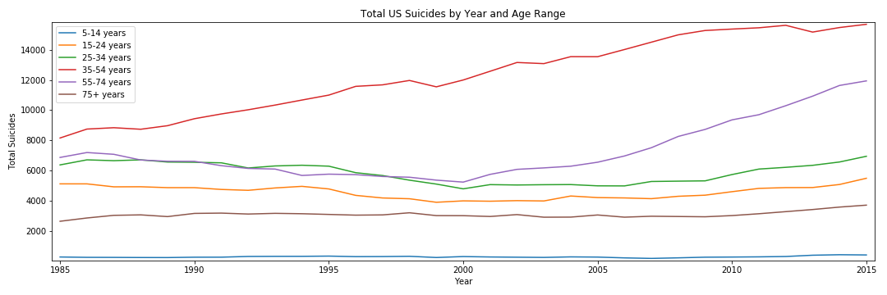
Total US Suicides By Year and Age Range, 1985 - 2015

Slide 11
Total US Suicides By Year and Age Range, 1985 - 2015
Orig. impression: prevention focuses on teens/20s.
BUT highest, and climbing, is 35-54y/o
Followed by 55-74y/o, climbing since 2000
Ages under 35 and over 75y/o unchanging, low.

Slide 12
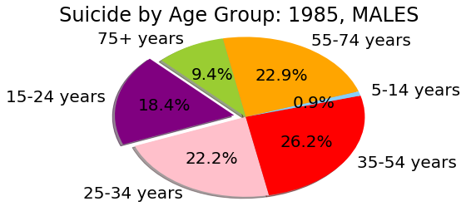
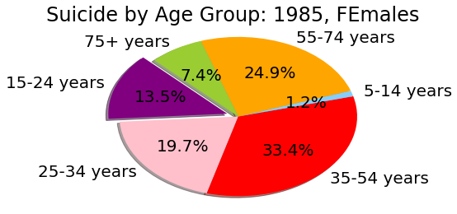
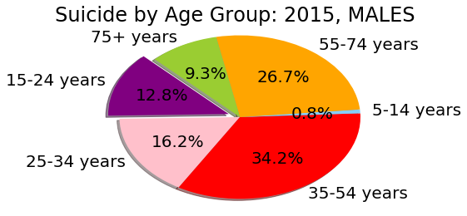
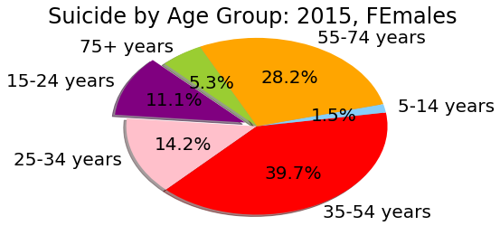
US Suicides by Age, Gender:1985 & 2015

Slide 13
US Suicides by Age, Gender:1985 & 2015
Orig. impression: young males, teens/20s.
Looks like efforts were effective.
Now MIDDLE age groups have most suicides.
Males over 75y/o more likely than women.

Slide 14
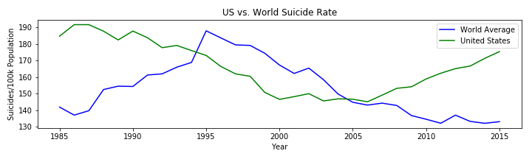
US vs. World Suicide Rates, 1985-2015

Slide 15
US vs. World Suicide Rates, 1985-2015
Orig. impression: US more suicides. Well, Japan...
US dropping since 1995, climbing 2005 on
World rising ’TIL 1995, dropping since then.
Sort of an inverse relationship… more questions!

Slide 16
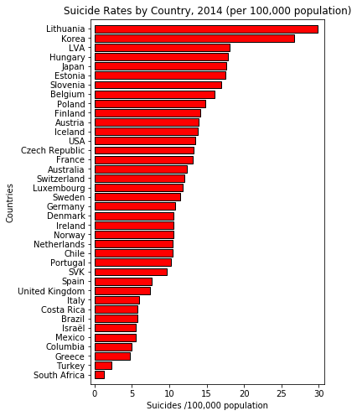
World Suicide Rates, 2014, by country (EURO)

Slide 17
World Suicide Rates, 2014, by country (EURO)
Orig. impression: US more suicides. Well, Japan...
US upper 1/3rd, out of 38 Euro-centric countries
[Prev] was 101 countries, wider range of GDPs; Implication: Eurocentric countries higher than Non.
Japan up there, but not highest.
Lowest rates: is it culture? Not reporting?

Slide 18
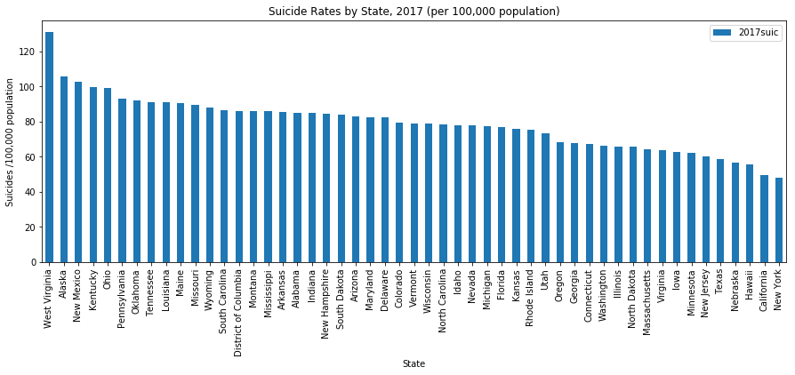
US suicide rates, by State, 2017

Slide 19
US suicide rates, by State, 2017
Smooth distribution, gradual trend across states
NY, CA, Hawaii, TX lowest --
WV, Alaska, New Mexico, Kentucky highest
Economic? Geographic? Access?

Slide 20
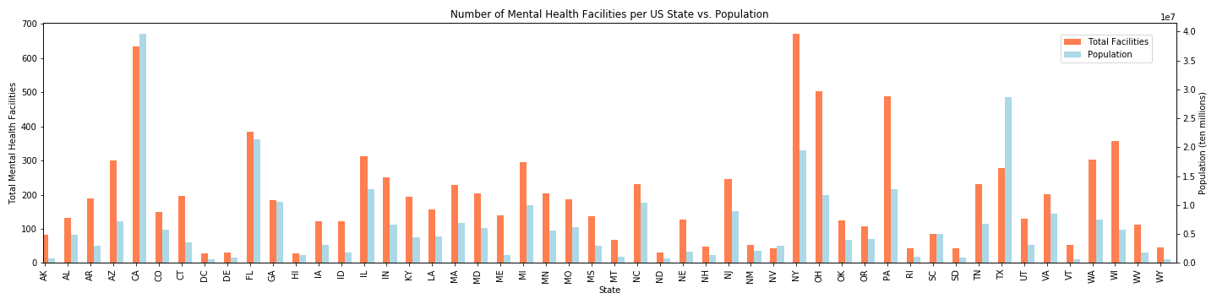
#US Mental Health Facilities / state, vs. Population

Slide 21
#US Mental Health Facilities / state, vs. Population
Surprise, lotsa variation.
NY has LOTsa facilities and LOW Pop.
CA has LOTsa facilities, and HIGH Pop.
Generally, low pop with low facilities, BUT the ONLY state FEW facilities and HIGH Pop: Texas.
Add’l ques: overlay suicide rates,

Slide 22
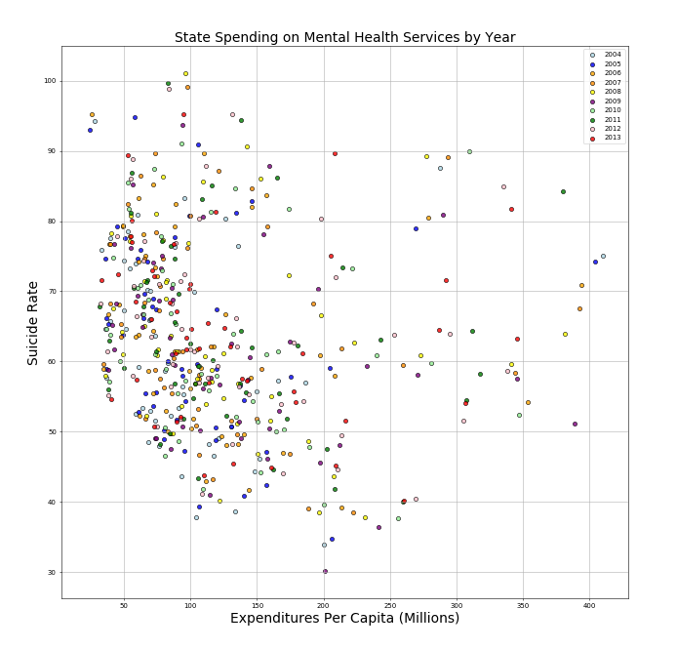
Spending on Mental Health in US states, 2004-2013

Slide 23
Spending on Mental Health in US states, 2004-2013
Low costs in most states, with wide variation SR. Outliers high cost with similar wide variation SF.
NO association of better result for more spent. In a scatter plot, Lower Left corner desirable, or linear distribution UpperLeft to LowerRight.
Range $25mil and $400mil overall; Suicide rates 40-90/100,000 population

Slide 24
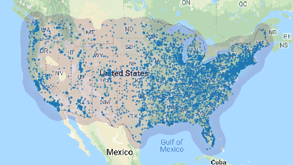
Density MAP of facilities, LatLong (9800 fac.s)

Slide 25
Density MAP of facilities, LatLong (9800 fac.s)
Denser facilities/ better access correlates w Pop.
Denser facilities/ better access in Urban areas.
Alaska and Hawaii low access…
No surprises.

Slide 26
Discussion, Questions

Slide 27
Impressions challenged, Shift of focus, more data
What influences suicide rates? Money? Access?
Codification of data recording changed in 1999. Does that help explain the US climb?
Comparable US vs. world? Restrict to US, compare state to state (enough variation!)

Slide 28
BUT WHAT ABOUT: Age distributions of populations? How can we compare occurrence rates between states? Miami has more elderly, AL/CO/CA are much younger...
CDC data already “age-adjusted” –– a technique for “removing” the effects of age from crude rates, to allow meaningful comparisons across populations despite
different distributions of the variable being examined...
…by applying corrective weighting factors (multipliers)
derived from comparison with a standardized population.

Slide 29
Suicide – How to help: Trust your instincts, reach out. Talk to them, LISTEN Ask questions, don’t judge. Get them help, even /esp. if they resist. Don’t leave them alone Don’t swear to secrecy.

Slide 30
Suicide trivia: Reason not got help? 28% “didn’t know where.”²⁰¹⁷ 3 times as many males & caucasions ^{2015: 37k M: 12k F} US spends 18% of GDP ($19trillion) on healthcare. incl. $200billion on mental health, grows 4-6%/yr 25 attempts for every suicide: attempts INCRs risk, but surviving an attempt DECRs risk (1/10) Years-of-life lost > all except heart dz, cancer.

