Slide 1
Lesson 1: Introduction to Advanced Machine Learning

Slide 2
Today's Agenda
Class Introduction
Class policy and expectations
How to succeed in this course
Assignments, quizzes and milestones
Participation and grading
Grading expectations and supplementary material
Introduction to Advanced Machine Learning
Challenges in Machine Learning and how to overcome them

Slide 3
Learning Objectives
By the end of this lesson, you should be able to
Implement two strategies for multiclass classification (lab).
Apply implementation to data set .
Apply insights gained from exploring a real-world case to thinking about how to address real-world problems, starting with a machine learning problem, then applying techniques.

Slide 4
Course Overview
Lesson 01: Introduction to Advanced Machine Learning
Lesson 02: Decision Tree
Lesson 03: Random Forest & Gradient Boosted Trees
Lesson 04: Support Vector Machine
Lesson 05: Stacking and Blending
Lesson 06: Unsupervised Learning
Lesson 07: Natural Language Processing
Lesson 08: Recommendation Systems
Lesson 09: Forecasting
Lesson 10: Building Machine Learning Applications

Slide 5
Student Introduction
Name and current role
Why enrolled in data science certificate
Course and program expectations

Slide 6
Course Format
On average, we spend about 40% on lecture and 60% on hands-on
Let's have frequent discussions during the session and share diverse perspectives
Let's take frequent short breaks to fit online format

Slide 7
How to succeed in this course
Pay attention during class and ask questions
Run notebooks alongside but don't let it distract you too much
Learn from peers by participating in discussion boards and by sharing your code after assignment due dates
Do your best not to fall behind, because lessons build on each other
Basic to intermediate Python programming concepts should be second nature by now

Slide 8
Assignments, quizzes and milestones
Assignments are due by 11:59 PM one week after lecture
I will make no exceptions about assignment due dates
Questions about the assignments should be posted on the discussion board on Canvas, where instructional team will answer them (or students if they wish)

Slide 9
How to submit a great assignment
Your code should run from start to finish, so once you finish the assignment, restart the notebook and run again to make sure nothing breaks
Each step in the assignment should include (1) one code cell with a few comments in the code to point out key parts, and (2) a Markdown cell explaining your reasoning and (3) a Markdown cell explaining your conclusions
Someone who doesn't know Python could still be able to read through and understand the analysis
When faced with ambiguity, you are free to make assumptions as long as you (1) clearly state your assumptions and (2) it is a reasonable assumption

Slide 10
let's take a tour through Canvas

Slide 11
Grading expectations
Please use the discussion boards for questions on assignment
DO NOT post your assignment code in discussion boards
When necessary, it's generally OK to make an assumption about the assignment reqs - as long as you state your assumption
More important to be on time than perfect:
Meet the requirements with working code
Write good comments for your code
Write good explanations showing your line of thinking

Slide 12
Participation and grading
activity | what you need to do | grade
Class and discussion board participation | be active in discussion boards | 15%
Quizzes |  | 10%
Weekly Lab Assignments | submit by 11:59 PM the week after | 75%

Slide 13
Coding Environment
We will be using browser-based Jupyter notebooks as our python environment
Basics of Jupyter notebooks:
  Code cells and Markdown cells
  Running and re-running code cells - order matters!

Slide 14
Break time

Slide 15
What Is Machine Learning?
An algorithm is a self-contained set of rules or instructions used to solve problems
Machine learning is the field of study that gives computers the ability to learn without being explicitly programmed, by using data to learn
The problems ML algorithms try to solve are usually
  prediction: supervised learning
  finding structure in data: unsupervised learning
  Mimicking human behavior: reinforcement learning (not covered)

Slide 16
Machine learning algorithm
A machine learning algorithm walks into a bar.
The bartender asks, "What'll you have?"
The algorithm says, "What's everyone else having?

Slide 17
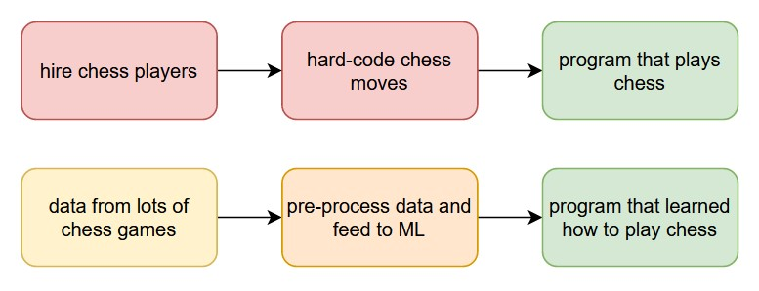
Rule-based Vs Machine Learning?

Slide 18
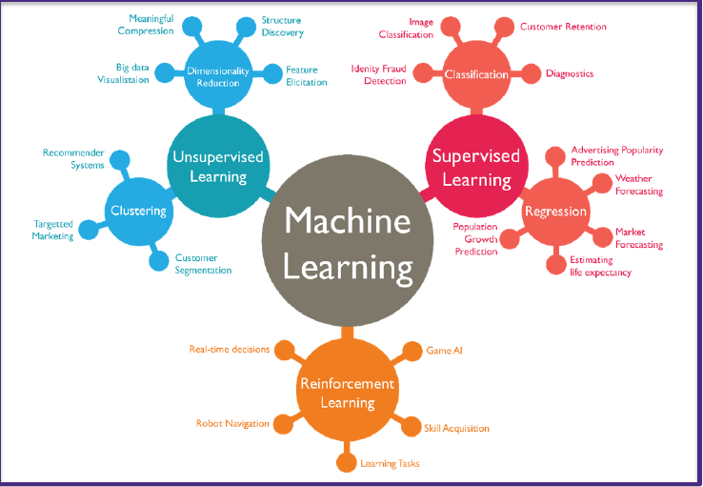
Types of Machine Learning Algorithms
https://blogs.oracle.com/ai/types-of-machine-learning-and-top-10-algorithms-everyone-should-know

Slide 19
Supervised Learning
Also called predictive modeling or inference
Look at some current examples (labeled data) and find a model that can predict future examples (unlabeled data)
The target variable or label is what we want to predict
  Regression algorithms are used with a numeric target
  Classification algorithms are used with a categorical target
By comparing predictions with the actual labels, we can evaluate our model's accuracy (hence the term supervised)

Slide 20
Unsupervised Learning
Also called data-mining / pattern recognition / structure discovery
Look at unlabeled data and find general patterns
More subjective and difficult to evaluate and interpret, and hence it is far less common than supervised learning
Clustering is the most common example
  K-means clustering
  Variable clustering / dimensionality reduction
  Word clouds (kind of)

Slide 21
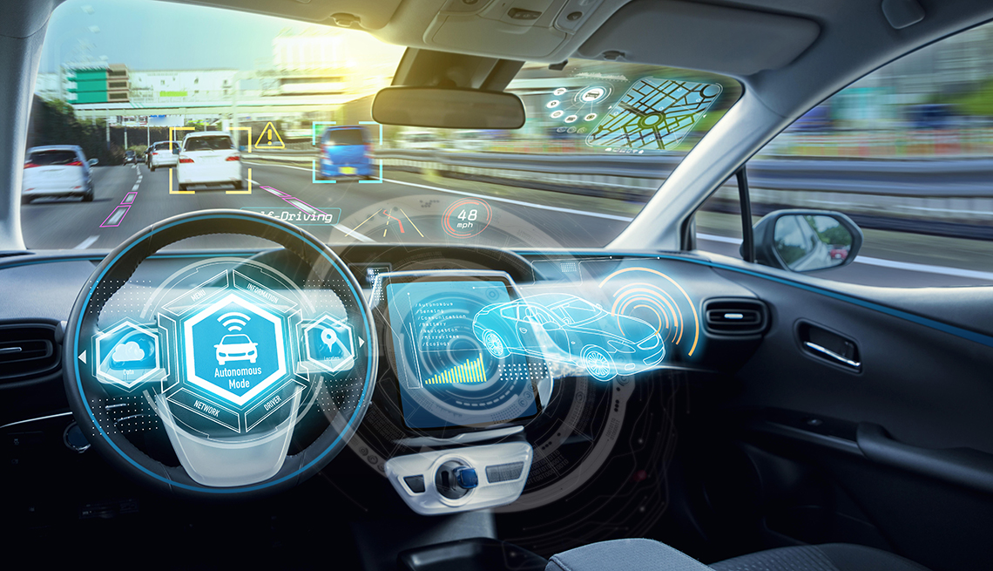
Reinforcement Learning
Learn to take actions in an environment to maximize expected future rewards

Slide 22
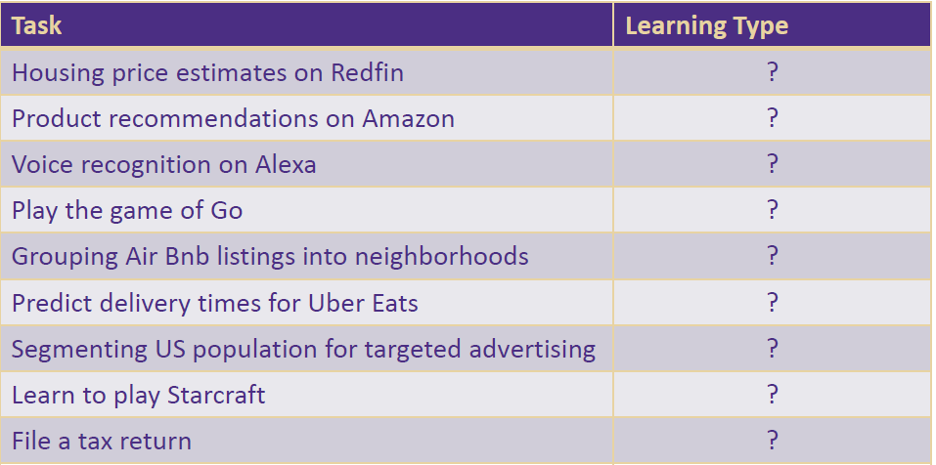
Discussion

Slide 23
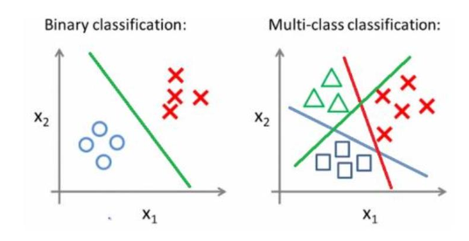
Multi-Class Classification
Multi-class classification generalizes the problem where classifier
is expected to distinguish between more than two classes
Hand-written digits (0, 1, …, 9)
Image classification (cat, dog, human etc.)
Classifying different species of flowers

Slide 24
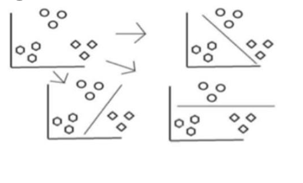
Multi-Class Classification – One vs. All
One vs. All is a way to handle multi-class classification
Training
  Fit a binary classifier per class, with the samples of that class as positive samples and all other samples as negative
  Base classifiers produce a real-valued confidence score for its decision, instead of just a class label
Prediction
  Apply all trained classifiers to the new unseen data point and select the class with highest score

Slide 25
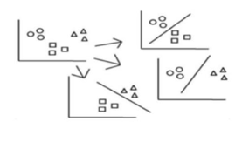
Multi-Class Classification – One vs. All
A second strategy is One vs. One
Training
  Fit a binary classifier for every pair of classes. Therefore, if there are N classes, we need N*(N-1)/2 classifiers
Prediction
  A voting scheme is applied
  All N*(N-1)/2 classifiers are applied to an unseen sample and the class that gets the highest number of votes is selected

Slide 26
Underfitting vs. Overfitting
Fitting means learning when we call the .fit() method
If a model performs poorly on the training data, then it almost certainly will perform poorly on the test data as well: we say the model is underfitting (not learning enough)
If a model performs well on the training data, but poorly on the test data: we say the model is overfitting (it's learning the signal but also "learning" the noise in the training data, and hence fails to generalize)
A good model is one that neither underfits nor overfits

Slide 27
Overfitting and Complexity
More simple models tend to underfit, because they are more likely to oversimplify (not pick up enough signal)
  Analogy: models can be prejudiced too, we call it bias
Complex models tend to overfit, because they are so eager to pick up any signal that they also grab noise disguised as signal
  Analogy: people who read too much into something
The trick is to find the happy medium
Everything should be made as simple as possible, but not simpler. -Albert Einstein
(also look up Occam's Razor)

Slide 28
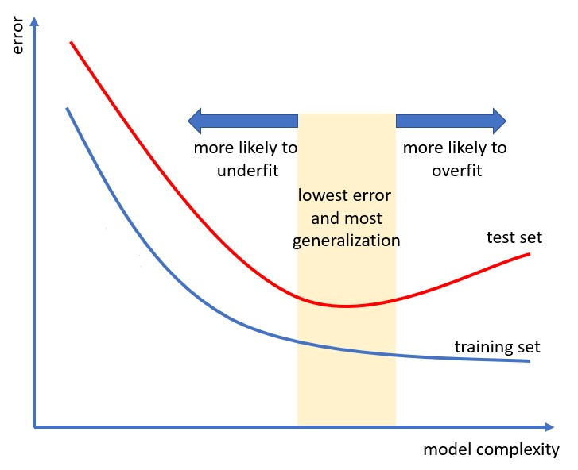

Slide 29
What Are Hyper-Parameters?
Almost all algorithm have ways they can be "tuned" through different hyper-parameter choices
Some hyper-parameters are very generic, e.g. learning rate
Most hyper-parameters are algorithm-specific, such as
  For tree-based algorithms: tree depth, min leaf size
ML algorithms cannot directly learn optimal hyper-parameter values during training
If we don't specify them, they usually default to "reasonable" values

Slide 30
Model Selection and Validation
So how do we know what hyper-parameter values to pick?
  Mostly through trial and error, also called model selection
If we want to tune our hyper-parameters, we also need validation data in addition to training and testing
Train many models, each with different hyper-parameters, and evaluate their performance on the validation data
The model that performs best on the validation data wins
Check how the winner model performs on the test data

Slide 31
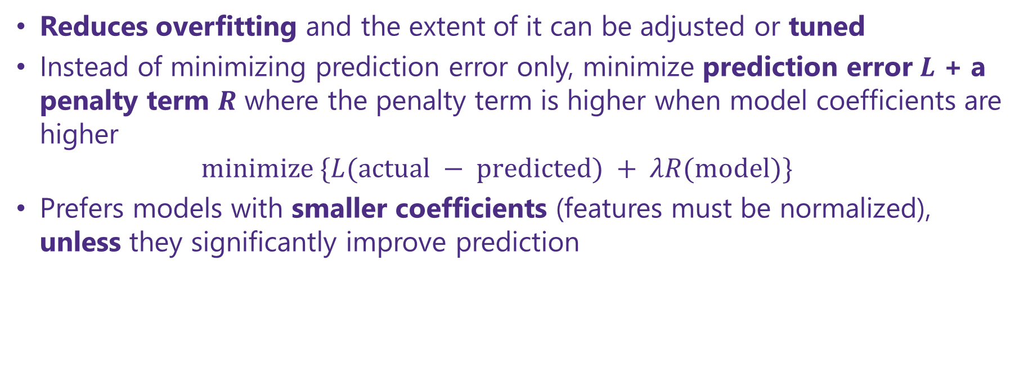
Regularization
Reduces overfitting and the extent of it can be adjusted or tuned
Instead of minimizing prediction error only, minimize prediction error $L$ + a penalty term $R$ where the penalty term is higher when model coefficients are higher
$minimize \{L(actual − predicted) + λR(model)\}$
Prefers models with smaller coefficients (features must be normalized), unless they significantly improve prediction

Slide 32
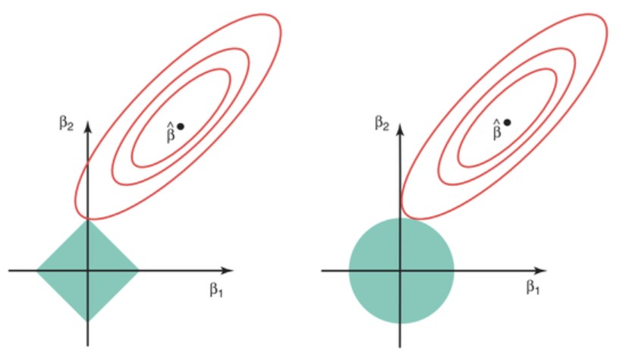

L1 vs L2 Norm Regularization
$L1 :R=λ(\left|β_{1}\right|+ \left|β_{2}\right|)$ has sharp edges
$L2 :R=λ(\left|β_{1}^{2}\right|+ \left|β_{2}^{2}\right|)$ has round edges
$L1$ can drop features
Image source: Elements of Statistical Learning

Slide 33
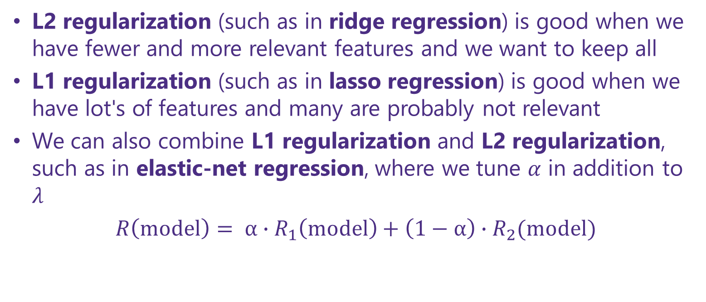
Types of Regularization
L2 regularization (such as in ridge regression) is good when we have fewer and more relevant features and we want to keep all
L1 regularization (such as in lasso regression) is good when we have lot's of features and many are probably not relevant
We can also combine L1 regularization and L2 regularization, such as in elastic-net regression, where we tune $α$ in addition to $λ$
$R\left(model\right)= α∙R_{1}\left(model\right)+\left(1−α\right)∙R_{2}(model)$

Slide 34
Test Data vs. Validation Data
So why not combine test data and validation data?
Because the test data is used once with the final model to get an unbiased estimate of performance (prediction error)
The validation data is used many times so we can compare the performance of models trained with different sets of hyper-parameters, a.k.a. hyper-parameter tuning
If we also use the test data to tune hyper-parameters, we are over-using it and its estimate of performance will not be so unbiased anymore

Slide 35
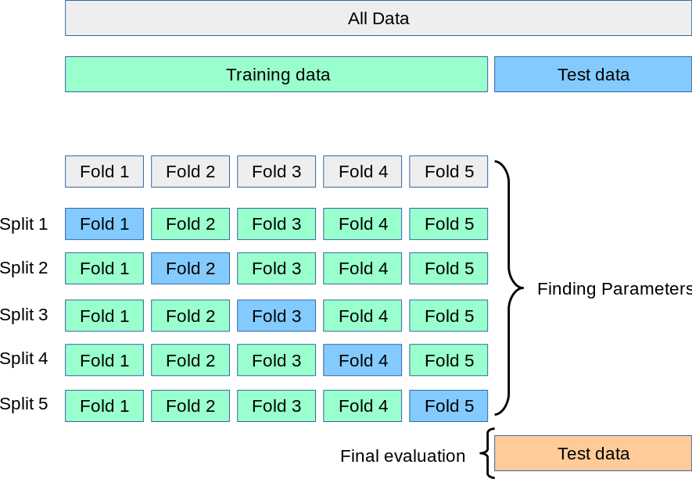
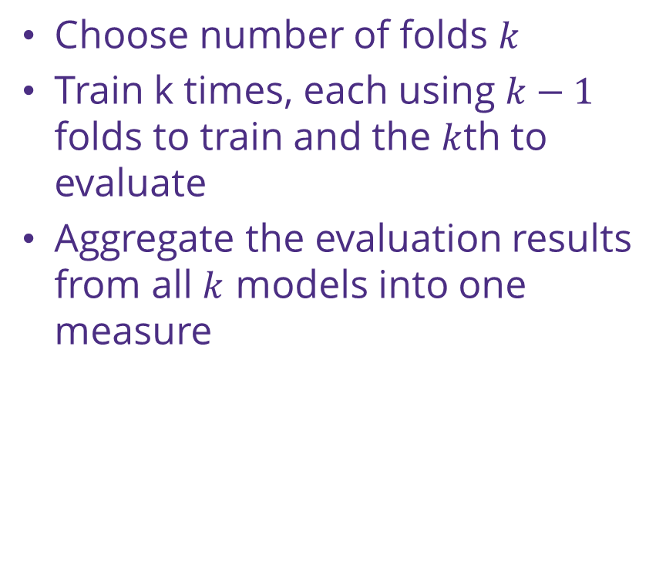
Cross Validation
Choose number of folds $k$
Train k times, each using $k−1$ folds to train and the $k$th to evaluate
Aggregate the evaluation results from all $k$ models into one measure
Image source: sciit-learn.org

Slide 36
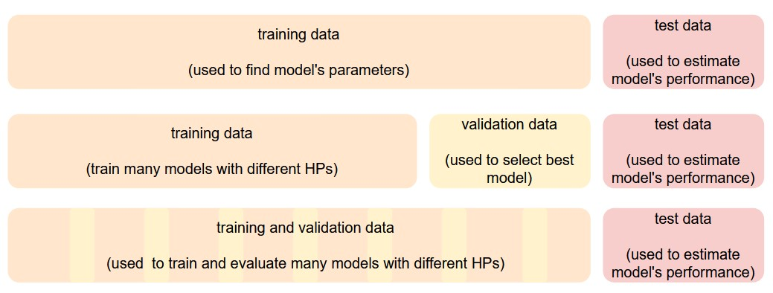

Slide 37
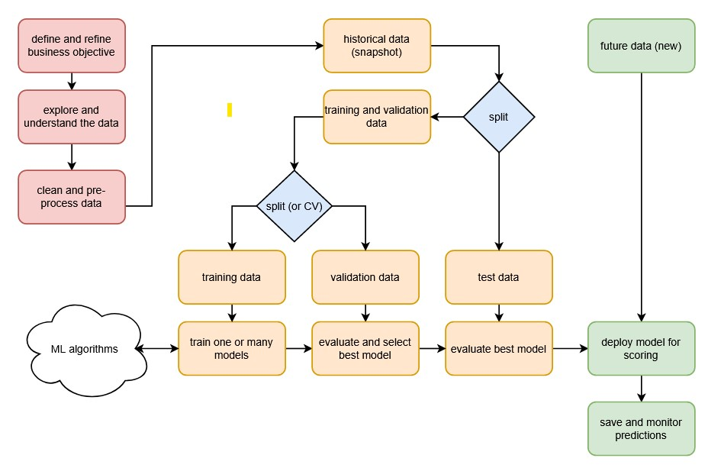

Slide 38
The Confusion Matrix
It's really not that confusing!
 | predicted positive | predicted negative
actually positve | true positive TP | false negative FN
actually negative | false positive FP | true negative TN
For TP/FP/TN/FN
The second letter indicates what the prediction was
The first letter indicates if the prediction was right or not

Slide 39
Discussion
We saw there a binary classification model can make two kinds of errors: FP and FN
For the following scenarios, say what kind of error is more costly (use common sense)
  Credit card fraud detection: someone impersonates you to use your credit card
  Medical diagnosis: finding out who has a disease
  Information retrieval: finding relevant web pages based on a search query

Slide 40
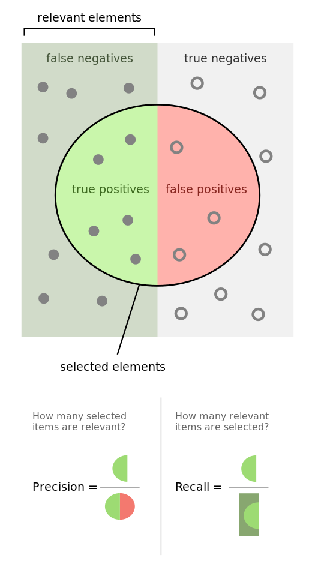
Precision and Recall
Precision is the percentage of positive predictions that were actually positive
Recall is the percentage of positive cases that we correctly predicted as such
Image source: Wikipedia

Slide 41
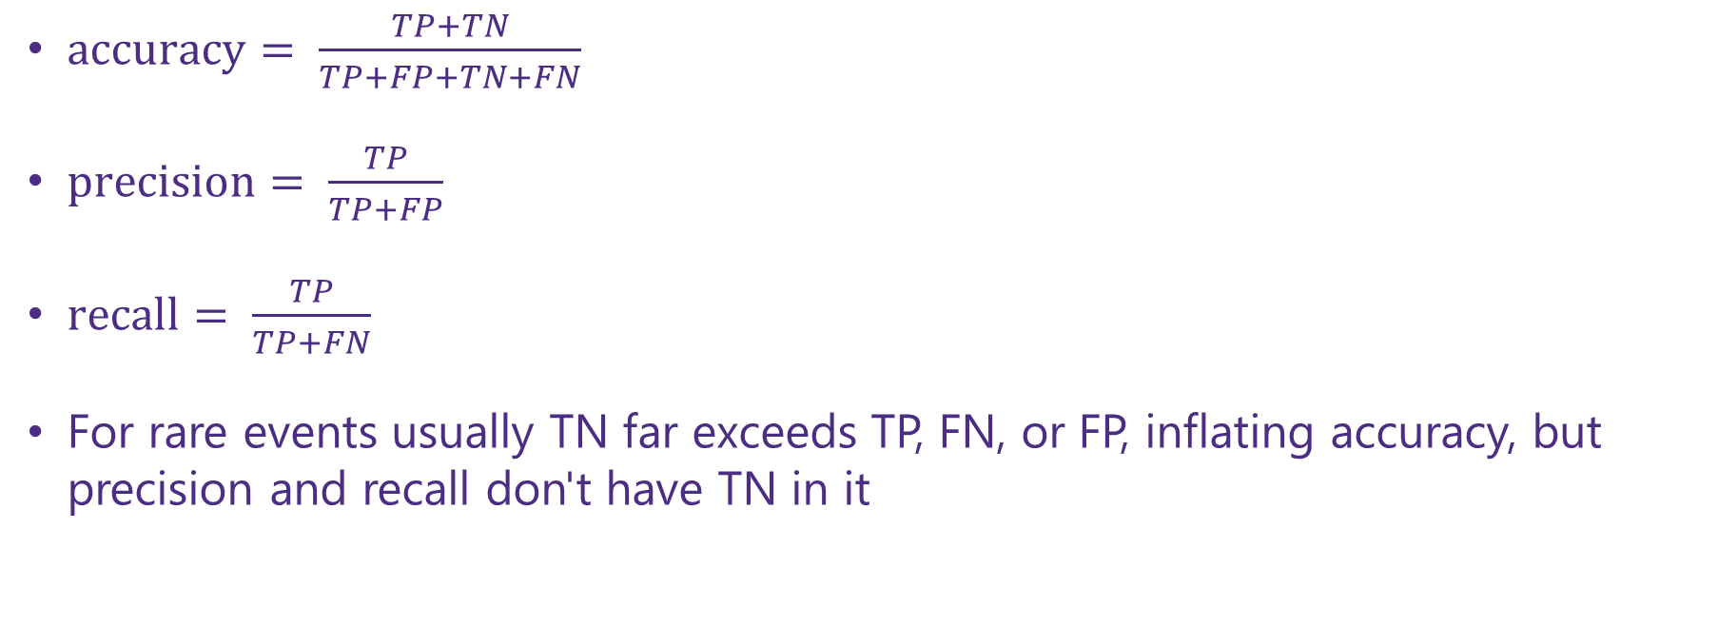
Accuracy, Precision and Recall
$accuracy= \frac{TP+TN}{TP+FP+TN+FN}$
$precision= \frac{TP}{TP+FP}$
$recall= \frac{TP}{TP+FN}$
For rare events usually TN far exceeds TP, FN, or FP, inflating accuracy, but precision and recall don't have TN in it

Slide 42
Discussion
Here's an analogy that shows why we should evaluate a classification model's accuracy using both precision and recall:
When you stand witness in a court of law, you are asked to tell the truth:
  The whole truth: no lie of omission
  Nothing but the truth: no lies
Relate the above two statements to precision and recall

Slide 43
Notebook time

Slide 44
The end

