Slide 1
Lesson 8: Recommendation Systems

Slide 2
Today's Agenda
What is a recommendation system?
Content filtering
Collaborative filtering
Matrix factorization
Hybrid system
Evaluation the performance of recommendation systems

Slide 3
Learning Objectives
Explain how content filtering works for recommendation.
Explain the theory behind collaborative filtering.
Use matrix factorization to estimate ratings (collaborative filtering).
Explain how collaborative filtering and content filtering can be combined to make recommendations.
Evaluate the performance of collaborative filtering algorithms.

Slide 4
Introduction
Purpose: Find and recommend items that a user is most likely to be interested in
Recommendation systems help people make decisions, be exposed to new content that they may be interested in but may not be aware of their existence
Recommendation is based on implicit or explicit preferences of
Individuals
Groups
Population

Slide 5
Examples of Recommendation Engines
Products recommendation: Amazon, ebay
Movie recommendation: Netflix
Music recommendation: Amazon music, Apple music
Social connection recommendations: Facebook, LinkedIn, Instagram
Recommendation is not limited to products

Slide 6
Why do we need Recommendation Systems?
Information Overload: There is too much information out there, one can easily be overwhelmed by choices. Recommendation systems help reduce the search space and cognitive overload
Item Discovery: Provide guidance/assistance for item/concept discovery
Social Analogies
I like this book, you might also like this book since we have similar tastes
Don’t go to watch that movie, you will hate it
Since I liked this song, you will love these other songs

Slide 7


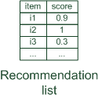

Paradigms of recommendation systems
Personalized recommendations

Slide 8

Paradigms of recommendation systems
Collaborative: Use community/peer/friends data to make recommendation

Slide 9

Paradigms of recommendation systems
Content-based: Recommend based on things I have liked/seen in the past

Slide 10


Paradigms of recommendation systems
Knowledge-based: Recommend based on my information needs/requirements

Slide 11
Paradigms of recommendation systems
Hybrid Paradigms: Combination of different paradigms

Slide 12
Main Types of Recommendation systems
 | Pros | Cons
Collaborative | No hard-coded knowledge Serendipity of results Learns “natural” segments | Requires rating feedback cold start for new users and new items
Content-based | No community needed item-item comparison possible | Content descriptions necessary, cold start for new users, no surprises
Knowledge-based | Deterministic recommendations no cold-start | Knowledge engineering effort to bootstrap static short-term trends undetectable

Slide 13
Collaborative Recommendation Systems

Slide 14
Collaborative Filtering (CF)
Main Idea
Implicit or Explicit ratings information given by the user
People who had similar interests in the past, will have similar interests in the future or for unknown things
Use the "wisdom of the crowd”
Application
Widely used and deployed in industry
Well-understood and thoroughly studied empirically
Wide applicability in multiple domains

Slide 15
User-based NN collaborative filtering
Nearest Neighbor Collaborative Filtering
Given a user (Alice) and an item i not yet seen by Alice
The goal is to estimate Alice's rating for this item:
find a set of users who liked the same items as Alice in the past and who have rated item i
the average of their ratings to predict, if Alice will like item i
Do this for all items Alice has not seen and recommend the best-rated
 | Item1 | Item2 | Item3 | Item4 | Item5
Alice | 5 | 3 | 4 | 4 | ?
User1 | 3 | 1 | 2 | 3 | 3
User2 | 4 | 3 | 4 | 3 | 5
User3 | 3 | 3 | 1 | 5 | 4
User4 | 1 | 5 | 5 | 2 | 1

Slide 16
User-based NN collaborative filtering
Foundational Questions
How do we measure similarity?
How many neighbors should we consider?
How do we generate a prediction from the neighbors' ratings?
 | Item1 | Item2 | Item3 | Item4 | Item5
Alice | 5 | 3 | 4 | 4 | ?
User1 | 3 | 1 | 2 | 3 | 3
User2 | 4 | 3 | 4 | 3 | 5
User3 | 3 | 3 | 1 | 5 | 4
User4 | 1 | 5 | 5 | 2 | 1

Slide 17


Measuring user similarity
A popular similarity measure in user-based CF: Pearson correlation
a, b : users
r_{a,p} : rating of user a for item p
P : set of items, rated both by a and b
Possible similarity values between -1 and 1; = user's average ratings
$\overline{r_{a}}$, $\overline{r_{b}}$
 | Item1 | Item2 | Item3 | Item4 | Item5
Alice | 5 | 3 | 4 | 4 | ?
User1 | 3 | 1 | 2 | 3 | 3
User2 | 4 | 3 | 4 | 3 | 5
User3 | 3 | 3 | 1 | 5 | 4
User4 | 1 | 5 | 5 | 2 | 1
sim = 0.85
sim = 0.70
sim = - 0.79

Slide 18
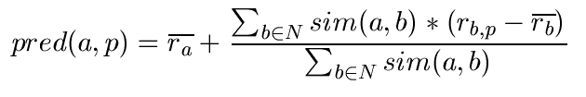
Recommendation Predictions
Prediction function:
Calculate, whether the neighbors' ratings for the unseen item i are higher or lower than their average
Combine the rating differences – use the similarity as a weight
Add/subtract the neighbors' bias from the active user's average and use this as a prediction

Slide 19
Improving Predictions
Not all neighbor ratings might be equally "valuable"
Agreement on commonly liked items is not so informative as agreement on controversial items
Possible solution: Give more weight to items that have a higher variance
Value of number of co-rated items
Use "significance weighting", e.g., by linearly reducing the weight when the number of co-rated items is low
Case Amplification
Give more weight to "very similar" neighbors, i.e., where the similarity value is close to 1.
Neighborhood selection
Use similarity threshold or fixed number of neighbors

Slide 20
Memory-based vs. Model-based approaches
Memory-based Approaches (nearest-neighbor or user-based collaborative filtering)
The rating matrix is directly used to find neighbors / make predictions
Does not scale for most real-world scenarios (Clever techniques to overcome these limitations)
Large scale systems have tens of millions of customers and millions of items
Collaborative Filtering is an example
Model-based approaches (classification, clustering, and rule-based approach)
Based on an offline pre-processing or "model-learning" phase
At run-time, only the learned model is used to make predictions
Models are updated / re-trained periodically
Large variety of techniques used
Model-building and updating can be computationally expensive

Slide 21
Item-based collaborative filtering
Main idea:
Use the similarity between items (and not users) to make predictions
Example:
Look for items that are similar to Item 5
Take Alice's ratings for these items to predict the rating for Item 5
 | Item1 | Item2 | Item3 | Item4 | Item5
Alice | 5 | 3 | 4 | 4 | ?
User1 | 3 | 1 | 2 | 3 | 3
User2 | 4 | 3 | 4 | 3 | 5
User3 | 3 | 3 | 1 | 5 | 4
User4 | 1 | 5 | 5 | 2 | 1

Slide 22


The cosine similarity measure
Produces better results in item-to-item filtering
Ratings are seen as vector in n-dimensional space
Similarity is calculated based on the angle between the vectors
Adjusted cosine similarity
take average user ratings into account, transform the original ratings
U: set of users who have rated both items a and b

Slide 23
Scalability item-based filtering
Item-based filtering does not solve the scalability problem itself
Pre-processing approach by Amazon (2003)
Calculate all pair-wise item similarities in advance
The neighborhood to be used at run-time is typically rather small, because only items are taken into account which the user has rated
Item similarities are supposed to be more stable than user similarities
Memory requirements
Up to N² pair-wise similarities to be memorized (N = number of items) in theory
In practice, this is significantly lower (items with no co-ratings)
Further reductions possible
Minimum threshold for co-ratings (items, which are rated at least by n users)
Limit the size of the neighborhood (might affect recommendation accuracy)

Slide 24
Ratings in Item-Based Filtering
Pure CF-based systems only rely on the rating matrix
Explicit ratings
Most commonly used (1 to 5, 1 to 7 Likert response scales)
Challenge
Users not always willing to rate many items; sparse rating matrices
How to stimulate users to rate more items?
Implicit ratings
Clicks, page views, time spent on some page
Can be used in addition to explicit ones; question of correctness of interpretation

Slide 25
Data sparsity problems
Cold start problem
How to recommend new items? What to recommend to new users?
Straightforward approaches
Ask/force users to rate a set of items
Data Driven Methods e.g., content-based, demographic or simply non-personalized
Alternatives
Use better algorithms (beyond nearest-neighbor approaches)
Example:
In nearest-neighbor approaches, the set of sufficiently similar neighbors might be to small to make good predictions
Assume "transitivity" of neighborhoods

Slide 26
Example algorithms for sparse datasets
Recursive CF
Assume there is a very close neighbor n of user u who has not rated the target item i yet.
Idea:
Apply CF-method recursively and predict a rating for item i for the neighbor
Use this predicted rating instead of the rating of a more distant direct neighbor
 | Item1 | Item2 | Item3 | Item4 | Item5
Alice | 5 | 3 | 4 | 4 | ?
User1 | 3 | 1 | 2 | 3 | ?
User2 | 4 | 3 | 4 | 3 | 5
User3 | 3 | 3 | 1 | 5 | 4
User4 | 1 | 5 | 5 | 2 | 1
sim = 0.85
Predict rating for
User1

Slide 27
More model-based approaches
Matrix factorization techniques, statistics
singular value decomposition, principal component analysis
Association rule mining
Use Association rules to find common co-occurring items for recommendation
Probabilistic models
Clustering models, Bayesian networks, probabilistic Latent Semantic Analysis

Slide 28
Vector Space Models
Basic idea: Trade more complex offline model building for faster online prediction generation
Singular Value Decomposition for dimensionality reduction of rating matrices
Captures important factors/aspects and their weights in the data
factors can be genre, actors, as well as factors not easily described in human language
Assumption that k dimensions capture the signals and filter out noise (K = 20 to 100)
Constant time to make recommendations
Approach also popular in IR (Latent Semantic Indexing), data compression, etc.

Slide 29


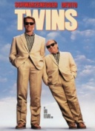


Matrix factorization
SVD:
U_{k} | Dim1 | Dim2
Alice | 0.47 | -0.30
Bob | -0.44 | 0.23
Mary | 0.70 | -0.06
Sue | 0.31 | 0.93
V_{k}^{T}
Dim1 | -0.44 | -0.57 | 0.06 | 0.38 | 0.57
Dim2 | 0.58 | -0.66 | 0.26 | 0.18 | -0.36
 | Dim1 | Dim2
Dim1 | 5.63 | 0
Dim2 | 0 | 3.23
Prediction:
= 3 + 0.84 = 3.84

Slide 30
Power of Matrix Factorization
Stimulated by work on Netflix competition
Prize of $1,000,000 for accuracy improvement of 10% RMSE compared to Netflix's own Cinematch system
Netflix dataset (~100M ratings, ~480K users , ~18K movies)
Last ratings/user withheld (set K)
Root mean squared error metric optimized to 0.8567

Slide 31
Collaborative Filtering Issues
Pros:
well-understood, works well in some domains, no knowledge engineering required
Cons:
requires user community, sparsity problems, no integration of other knowledge sources, no explanation of results
What is the best CF method?
In which situation and which domain? Inconsistent findings; always the same domains and data sets; differences between methods are often very small (1/100)
How to evaluate the prediction quality?
MAE / RMSE: What does an MAE of 0.7 actually mean?
Serendipity: Not yet fully understood

Slide 32
Content-Based Recommendations

Slide 33
Content-based recommendation
Collaborative filtering does NOT require any information about the items:
However, it might be reasonable to exploit such information
E.g. recommend fantasy novels to people who liked fantasy novels in the past
What do we need:
Some information about the available items such as the genre ("content")
Some sort of user profile describing what the user likes (the preferences)
The task:
Learn user preferences
Locate/recommend items that are "similar" to the user preferences

Slide 34
Paradigms of recommendation systems
Content-based: "Show me more of the same what I've liked"

Slide 35
What is Content?
The genre is actually not part of the content of a book
Most CB-recommendation methods originate from Information Retrieval (IR) field:
The item descriptions are usually automatically extracted (important words)
Goal is to find and rank interesting text documents (news articles, web pages)
Here:
Classical IR-based methods based on keywords
No expert recommendation knowledge involved
User profile (preferences) are rather learned than explicitly elicited

Slide 36
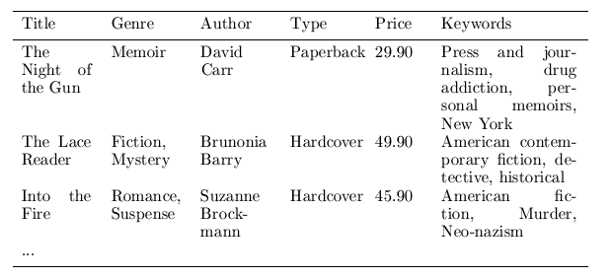
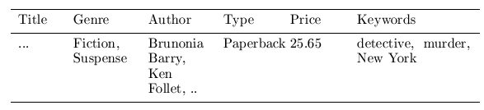

Content representation and item similarities
Compute the similarity of an unseen item with the user profile based on the keyword overlap (e.g. using the Dice coefficient)
sim(b_{i}, b_{j}) = $\frac{2 ∗|keywords\left(bi\right)∩keywords\left(bj\right)|}{\left|keywords\left(bi\right)\right|+|keywords\left(bj\right)|}$
Notes:
Intersection

Slide 37
Term-Frequency - Inverse Document Frequency (TF-IDF)
Simple keyword representation has its problems
In particular when automatically extracted because
Not every word has similar importance
Longer documents have a higher chance to have an overlap with the user profile
Standard measure: TF-IDF
Encodes text documents as weighted term vector
TF: Measures, how often a term appears (density in a document)
Assuming that important terms appear more often
Normalization has to be done in order to take document length into account
IDF: Aims to reduce the weight of terms that appear in all documents

Slide 38
Improvements
Side note: Conditional independence of events does in fact not hold
“New”/ “York“ and “Hong” / “Kong"
Still, good accuracy can be achieved
Boolean representation simplistic
Keyword counts lost
More elaborate probabilistic methods
E.g. estimate probability of term v occurring in a document of class C by relative frequency of v in all documents of the class
Classification algorithms can also be used

Slide 39
Limitations of content-based recommendation methods
Keywords alone may not be sufficient to judge quality/relevance of a document or web page
Up-to-dateness, usability, aesthetics, writing style
Content may also be limited / too short
Content may not be automatically extractable (multimedia)
Ramp-up phase required
Some training data is still required
Use other sources to learn the user preferences
Overspecialization
Algorithms tend to propose "more of the same"
E.g. too similar news items

Slide 40
Network-Based Recommendations

Slide 41
Recommendation in Social Networks
People explicitly state who their friends are
Birds of a feature flock together
Make recommendations based on similarity with friends
Friends with similar tastes should be given preferences over other people that one does not know but who have similar tastes

Slide 42
Inferring Trust
The Goal: Select two individuals - the source (node A) and sink (node C) - and recommend to the source how much to trust the sink.
t_{AC}
A
B
C
t_{AB}
t_{BC}

Slide 43
Sink
Source

Slide 44
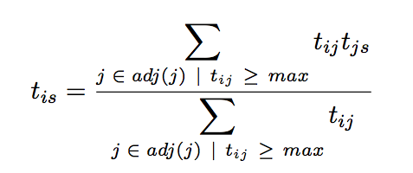
TidalTrust Algorithm
If the source does not know the sink, the source asks all of its friends how much to trust the sink, and computes a trust value by a weighted average
Neighbors repeat the process if they do not have a direct rating for the sink

Slide 45
Knowledge-Based Recommendation Systems

Slide 46


Why do we need knowledge-based recommendation?
Products with low number of available ratings
Time span plays an important role
Five-year-old ratings for computers
User lifestyle or family situation changes
End users can specify their requirements explicitly
“The color of the car should be brown"

Slide 47
Knowledge-based recommendation
Knowledge-based: "Tell me what fits based on my needs"

Slide 48
Knowledge-based recommendation
Explicit domain knowledge
Sales knowledge elicitation from domain experts
System mimics the behavior of experienced sales assistant
Best-practice sales interactions
Can guarantee “correct” recommendations (determinism) with respect to expert knowledge but not necessarily the end user!
Conversational interaction strategy
Opposed to one-shot interaction
Elicitation of user requirements
Transfer of product knowledge (“educating users”)

Slide 49
Constraint-based recommendation I
A knowledge-based RS formulated as constraint satisfaction problem
where
X_{I}, X_{U}: Variables describing items and user model with domain D (e.g. lower focal length, purpose)
KB: Knowledge base comprising constraints and domain restrictions (e.g. IF purpose=“on travel” THEN lower focal length < 28mm)
SRS: Specific requirements of a user (e.g. purpose = “on travel”)
I: Product catalog (e.g. (id=1 ˄ lfl = 28mm) ˅ (id=2 ˄ lfl= 35mm) ˅ …)
Solution: Assignment tuple assigning values to all variables X_{I} is satisfiable

Slide 50
Item ranking
Multi-Attribute Utility Theory (MAUT)
Each item is evaluated according to a predefined set of dimensions that provide an aggregated view on the basic item properties
E.g. quality and economy are dimensions in the domain of digital cameras
id | value | quality | economy
price | ≤250 >250 | 5 10 | 10 5
mpix | ≤8 >8 | 4 10 | 10 6
opt-zoom | ≤9 >9 | 6 10 | 9 6

Slide 51
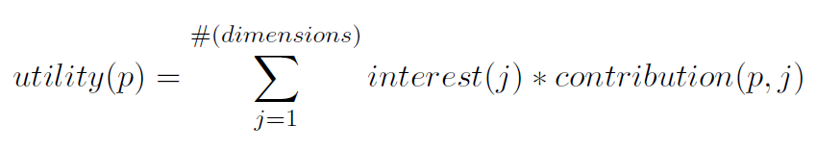
Customer-specific item utilities with MAUT
Customer interests:
Item utilities:
customer | quality | economy
Cu₁ | 80% | 20%
Cu₂ | 40% | 60%
*
quality | economy | utility: cu₁ | utility: cu₂
P1 Σ(5,4,6,6,3,7,10) = 41 | Σ (10,10,9,10,10,10,6) = 65 | 45.8 [8] | 55.4 [6]
P2 Σ(5,4,6,6,10,10,8) = 49 | Σ (10,10,9,10,7,8,10) = 64 | 52.0 [7] | 58.0 [1]
P3 Σ(5,4,10,6,10,10,8) = 53 | Σ (10,10,6,10,7,8,10) = 61 | 54.6 [5] | 57.8 [2]
... | ... | ... | ...
**
*
**

Slide 52
Constraint-based recommendation II
BUT: What if no solution exists?
not satisfiable → debugging of knowledge base
not satisfiable but
correct → debugging of user requirements
Application of model-based diagnosis for debugging user requirements
Diagnoses: is satisfiable
Repairs: is satisfiable
Conflict sets: not satisfiable

Slide 53
Ask user
Computation of minimal revisions of requirements
Do you want to relax your brand preference?
Accept Panasonic instead of Canon brand
What are other requirements?
Maximize features or cost?

Slide 54
Constraint-based recommendation III
More variants of recommendation task
Customers maybe not know what they are seeking
Find "diverse" sets of items
Notion of similarity/dissimilarity
Idea that users navigate a product space
We do not want to recommend too many things for the user to handle; there might be cognitive limitations.
Bundling of recommendations
Find item bundles that match together according to some knowledge
E.g. travel packages, skin care treatments or financial portfolios
RS for different item categories, CSP restricts configuring of bundles

Slide 55
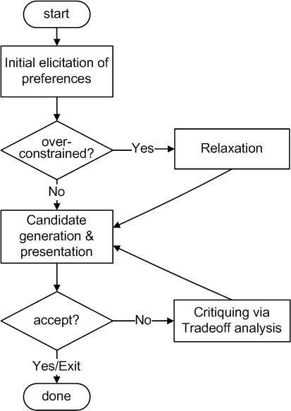
Conversational strategies
Process consisting of multiple conversational moves
Resembles natural sales interactions
Not all user requirements known beforehand
Customers are rarely satisfied with the initial recommendations
Different styles of preference elicitation:
Free text query interface
Asking technical/generic properties
Images / inspiration
Proposing and Critiquing

Slide 56
Limitations of KB Recommendations
Cost of knowledge acquisition
From domain experts
From users
Remedy: exploit web resources
Accuracy of preference models
Very fine granular preference models require many interaction cycles with the user or sufficient detailed data about the user
Remedy: use collaborative filtering, estimates the preference of a user
However: preference models may be instable
E.g. asymmetric dominance effects and decoy items

Slide 57
Evaluating Recommendation Systems

Slide 58


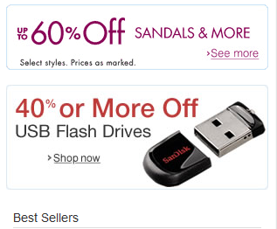
What is a good recommendation?
The definition of what constitutes a good recommendation is context dependent
Total sales numbers
Promotion of certain items
Click-through-rates
Interactivity on platform
Customer return rates
Customer satisfaction and loyalty

Slide 59
Purpose and success criteria
What guiding criteria should be used?
Depends on domain and purpose
No holistic evaluation scenario exists
Retrieval perspective
Reduce search costs
Provide "correct" proposals
Assumption: Users know in advance what they want
Recommendation perspective
Serendipity – identify items from the Long Tail
Users did not know about existence
Notes:
Could a RS be a persuasive technology? In fact depending on the application area RS are deployed to:

Slide 60
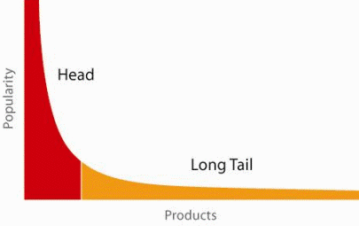
When does a RS do its job well?
"Recommend widely unknown items that users might actually like!"
20% of items accumulate 74% of all positive ratings
Recommend items from the long tail

Slide 61
Purpose and success criteria (2)
Prediction perspective
Predict to what degree users like an item
Most popular evaluation scenario in research
Interaction perspective
Give users a "good feeling"
Educate users about the product domain
Convince/persuade users - explain
Finally, conversion perspective
Commercial situations
Increase "hit", "clickthrough", "lookers to bookers" rates
Optimize sales margins and profit

Slide 62
Metrics: Rank Score – position matters
For a user:
Actually good
Item 237
Item 899
Recommended (predicted as good)
Item 345
Item 237
Item 187
hit
Rank Score extends recall and precision to take the positions of correct items in a ranked list into account
Particularly important in recommendation systems as lower ranked items may be overlooked by users
Learning-to-rank: Optimize models for such measures (e.g., AUC)

Slide 63

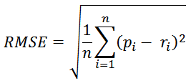
Accuracy measures
Datasets with items rated by users
MovieLens datasets 100K-10M ratings
Netflix 100M ratings
Historic user ratings constitute ground truth
Metrics measure error rate
Mean Absolute Error (MAE) computes the deviation between predicted ratings and actual ratings
Root Mean Square Error (RMSE) is similar to MAE, but places more emphasis on larger deviation

Slide 64
Offline experimentation example
Netflix competition
Web-based movie rental
Prize of $1,000,000 for accuracy improvement (RMSE) of 10% compared to Netflix's own Cinematch system.
Historical dataset
~480K users rated ~18K movies on a scale of 1 to 5 (~100M ratings)
Last 9 ratings/user withheld
Probe set – for teams for evaluation
Quiz set – evaluates teams’ submissions for leaderboard
Test set – used by Netflix to determine winner
Today
Rating prediction only seen as an additional input into the recommendation process

Slide 65
An imperfect world
Offline evaluation is the cheapest variant
Still, gives us valuable insights
Allows one to compare results
Dangers and trends:
Domination of accuracy measures
Focus on small set of domains (40% on movies in CS)
Alternative measures:
Diversity, Coverage, Novelty, Familiarity, Serendipity, Popularity, Concentration effects (Long tail)

Slide 66
Psychological Factors
Phenomenon/Effect | Description
Decoy effects | Additional irrelevant (inferior) items in an item set significantly influence the selection behavior
Primacy/recency effects | Items at the beginning and the end of a list are analyzed significantly more often/deeply than items in the middle of a list
Framing effects | The way in which different decision alternatives are presented influences the final decision taken
Priming | If specific decision properties are made more available in memory, this influences a consumer's item evaluations (background priming)
Defaults | Preset options bias the decision process

Slide 67
Decoy: asymmetric dominance effect
Product A dominates D in both dimensions (price and download limit)
Product B dominates alternative D in only one dimension (price)
The additional inclusion of D into the choice set could trigger an increase of the selection probability of A
Product | A | B | D
price per month | 30 | 20 | 50
download limit | 10GB | 6GB | 9GB

Slide 68
Personality
Different personality properties pose specific requirements on the design of recommender user interfaces
Some personality traits are more susceptible to heuristic simplifications
Provide various interfaces

Slide 69
Personality traits
Theory | Description
Internal vs. external Locus of control (LOC) | Externally influenced users need more guidance; internally controlled users want to actively and selectively search for additional information
Need for closure | Describes the individual pursuit of making a decision as soon as possible
Maximizer vs. satisficer | Maximizers try to find an optimal solution; satisficers search for solutions that fulfill their basic requirements

Slide 70
Dark Side of Recommendation Systems
Recommendation is not just about products but about things of interest in general
If the objective of the recommendation is to maximize clicks then other factors like social impacts of the click will be ignored (e.g., recommendation of fake news articles based on your likes or history)
Thus recommendations can create an echo chamber

Slide 71
Conclusion
A wide variety of techniques are used in recommendation systems
Recommendation systems reduce cognitive overload, make object discovery easier, etc.
Three major paradigms of recommendation systems:
Collaborative
Content-Based
Knowledge-Based
The hybrid approach is a combination of the three approaches

