Slide 1
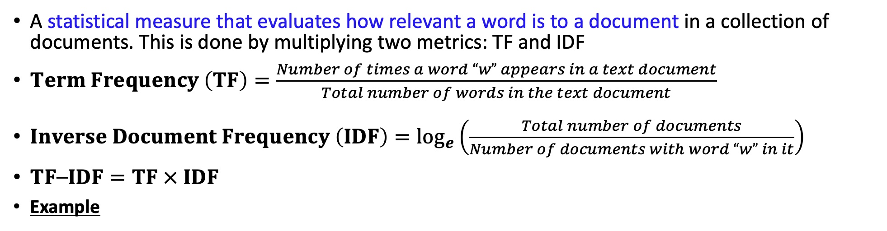
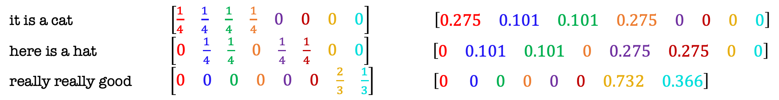
Term Frequency-Inverse Document Frequency (TF-IDF)
A statistical measure that evaluates how relevant a word is to a document in a collection of documents. This is done by multiplying two metrics: TF and IDF
$Term Frequency \left(TF\right)=\frac{Number of times a word “w” appears in a text document}{Total number of words in the text document}$
$Inverse Document Frequency \left(IDF\right)=\log_{e}\left(\frac{Total number of documents}{Number of documents with word “w” in it}\right)$
$TF⎯IDF=TF × IDF$
Example
Vocabulary:
it, is, a, cat, here, hat, really, good
Texts
TF values
Features extracted from TF-IDF Model
it is a cat .$\left[\begin{matrix}\frac{1}{4} & \frac{1}{4} & \frac{1}{4} & \frac{1}{4} & 0 & 0 & 0 & 0\end{matrix}\right] \left[\begin{matrix}0.275 & 0.101 & 0.101 & 0.275 & 0 & 0 & 0 & 0\end{matrix}\right]$
here is a hat . $\left[\begin{matrix}0 & \frac{1}{4} & \frac{1}{4} & 0 & \frac{1}{4} & \frac{1}{4} & 0 & 0\end{matrix}\right]$ $\left[\begin{matrix}0 & 0.101 & 0.101 & 0 & 0.275 & 0.275 & 0 & 0\end{matrix}\right]$
really really good $\left[\begin{matrix}0 & 0 & 0 & 0 & 0 & 0 & \frac{2}{3} & \frac{1}{3}\end{matrix}\right]$ $\left[\begin{matrix}0 & 0 & 0 & 0 & 0 & 0 & 0.732 & 0.366\end{matrix}\right]$
IDF values
$$\left[\begin{matrix}ln\left(\frac{3}{1}\right) & ln\left(\frac{3}{2}\right) & ln\left(\frac{3}{2}\right) & ln\left(\frac{3}{1}\right) & ln\left(\frac{3}{1}\right) & ln\left(\frac{3}{1}\right) & ln\left(\frac{3}{1}\right) & ln\left(\frac{3}{1}\right)\end{matrix}\right]$$

Slide 2
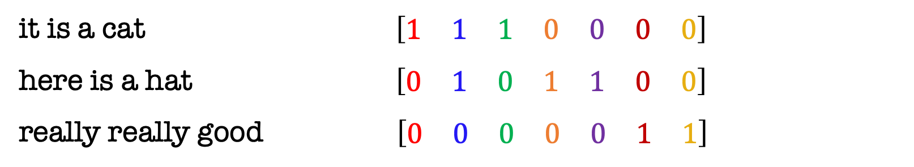
N-grams
A technique in which we consider sets of N consecutive words and use them to calculate the statistical measures (e.g., BoW frequencies, TF-IDF values)
Why N-grams? For example, in English, the 1-gram “good” conveys something different than the 2-gram “not good” or “very good”
Example: Bag of Words using 2-gram
2-gram vocabulary
Text 1
it is a cat
here is a hat
really really good
Extract distinct 2-gram words
Text 2
it is, is a, a cat, here is, a hat, really really, really good
Text 3
Texts
Features extracted from 2-gram BoW Model
it is a cat $\left[\begin{matrix}1 & 1 & 1 & 0 & 0 & 0 & 0\end{matrix}\right]$
here is a hat $\left[\begin{matrix}0 & 1 & 0 & 1 & 1 & 0 & 0\end{matrix}\right]$
really really good . $\left[\begin{matrix}0 & 0 & 0 & 0 & 0 & 1 & 1\end{matrix}\right]$

Slide 3
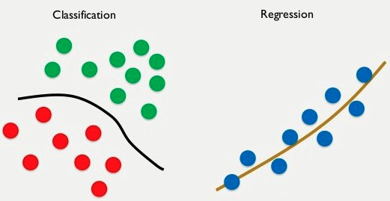

Regression
An instant of supervised learning where the labels of the training data are real-valued. i.e., $𝒴∈ℝ$
Regression can be viewed as curve fitting

Slide 4
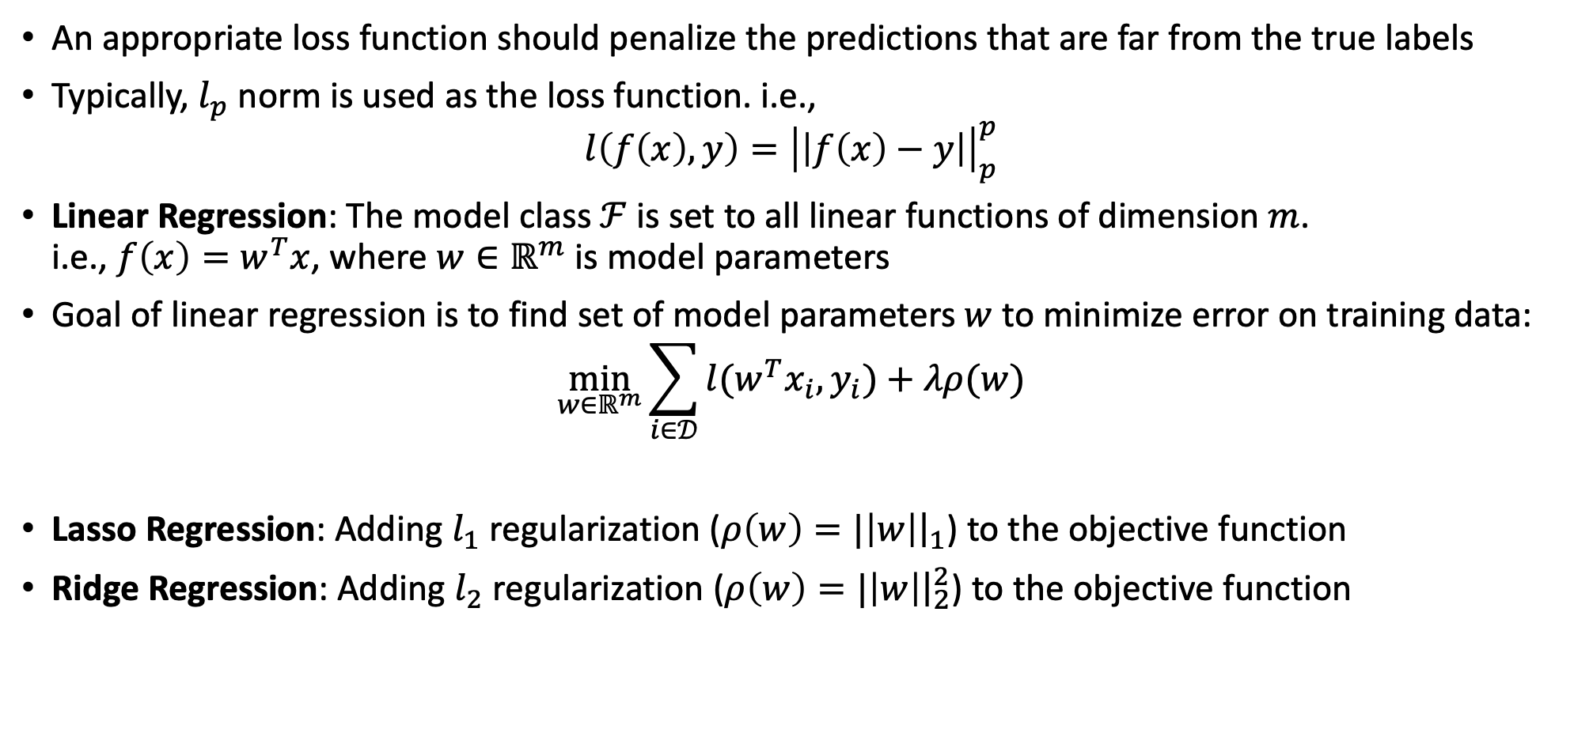
Regression Model
An appropriate loss function should penalize the predictions that are far from the true labels
Typically, $l_{p}$ norm is used as the loss function. i.e.,
$$l\left(f\left(x\right),y\right)={\left|\left|f\left(x\right)−y\right|\right|}_{p}^{p}$$
Linear Regression: The model class $ℱ$ is set to all linear functions of dimension $m$. i.e., $f\left(x\right)=w^{T}x$, where $w∈ℝ^{m}$ is model parameters
Goal of linear regression is to find set of model parameters $w$ to minimize error on training data:
$$\min_{w∈ℝ^{m}}{\sum_{i∈𝒟}{l(w^{T}x_{i}, y_{i})}+λρ(w)}$$
Lasso Regression: Adding $l_{1}$ regularization ($ρ\left(w\right)=|\left|w\right|{\left.​\right|}_{1}$) to the objective function
Ridge Regression: Adding $l_{2}$ regularization ($ρ\left(w\right)=|\left|w\right|{\left.​\right|}_{2}^{2}$) to the objective function

Slide 5
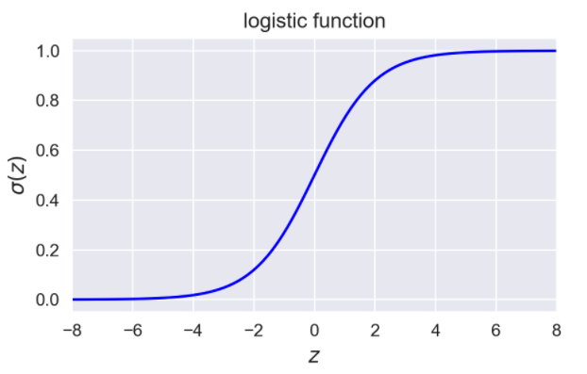
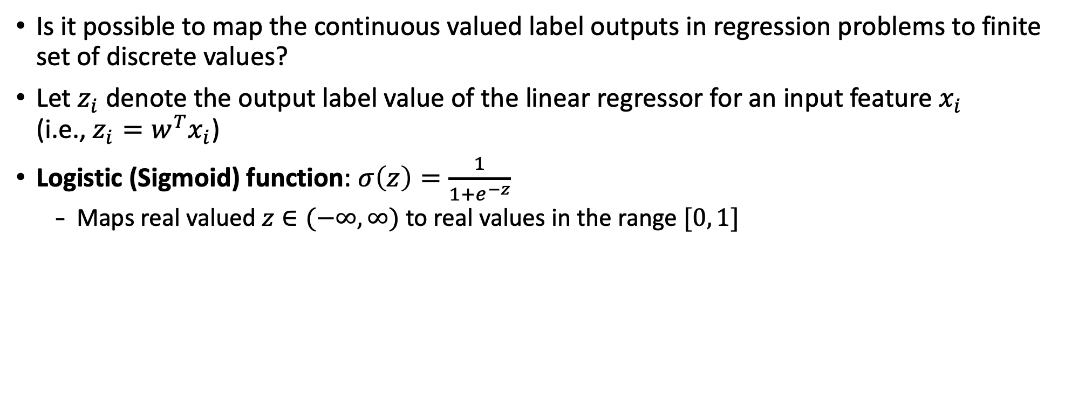
Logistic Regression
Is it possible to map the continuous valued label outputs in regression problems to finite set of discrete values?
Let $z_{i}$ denote the output label value of the linear regressor for an input feature $x_{i}$ (i.e., $z_{i}=w^{T}x_{i}$)
Logistic (Sigmoid) function: $σ\left(z\right)=\frac{1}{1+e^{−z}}$
Maps real valued $z∈(−∞, ∞)$ to real values in the range $[0, 1]$

