Slide 1
Exploration of Data is Critical
EDA should take place before more rigorous statistical analysis. 1st part of larger process
First line of defense against bad data, use to check assumptions about data.
Maybe lead to new insights, new questions or feed into process of building predictive models

Slide 2
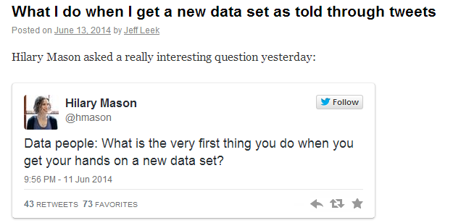
What do with a new dataset? – Jeef Leek
Blog: http://simplystatistics.org/

Slide 3
What do with a new dataset? – Jeff Leek
Step 0: Figure out what I'm trying to do with the data
  “Look, Stop, Think…”,
  Check-in with person generating data
Step 1: Learn about the elephant
  figure out what the data set "looks" like: head(), tail, sapply(df, class)
  look for NA,
  check for personally identifiable information
  colnames(), summary(), str() etc

Slide 4
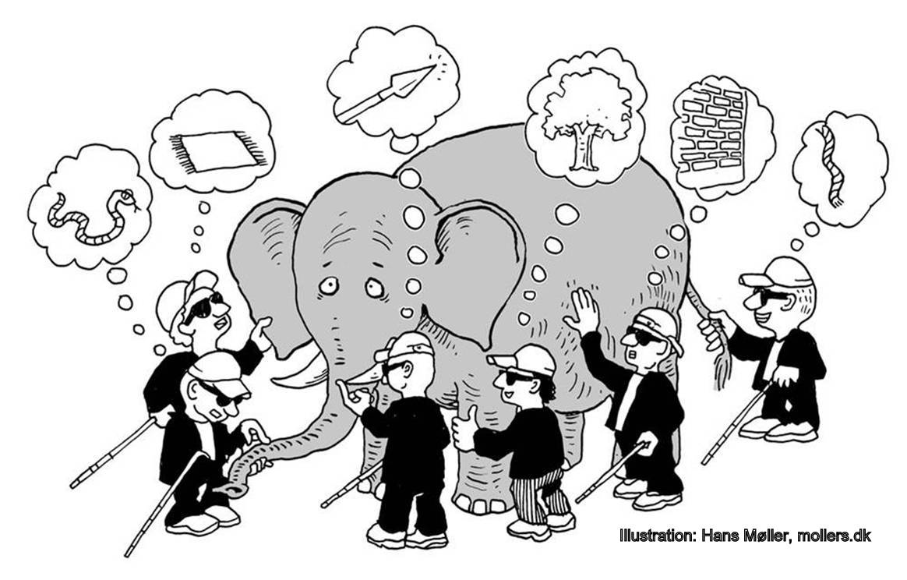

m

Slide 5
What do with a new dataset? – Jeff Leek
Step 0: Figure out what I'm trying to do with the data
Step 1: Learn about the elephant
Step 2: Clean/organize
  Fix data, NA,
  swear a lot
Step 3: Plot. That. Stuff
  look at variables one by one like
    Histograms,
    scatterplots,
    density plots,
    jittered 1d plots
  If data are multivariate ,get a feel for high dimensional structure
    dimension reduction : principal components,
    hierarchical clustering analysis

Slide 6
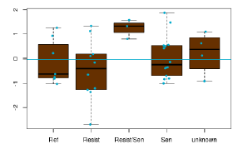
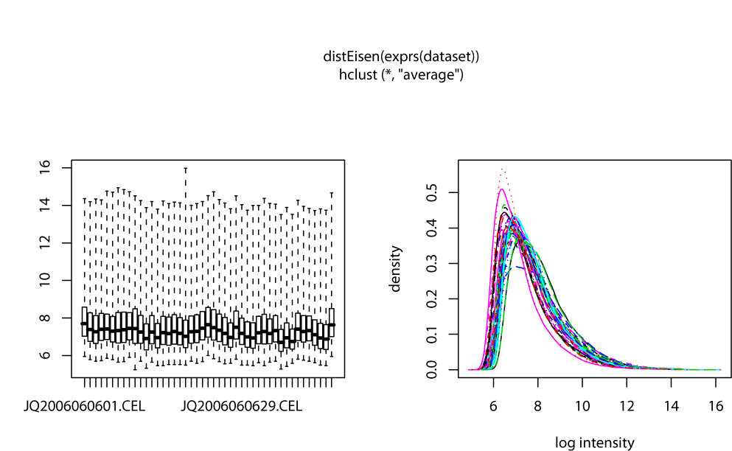
Visualize variables one by one
Histograms, density plots
Boxplots
Scatterplots
MA plots (variance v mean)
Pairs
Correlations, Corrplot

Slide 7
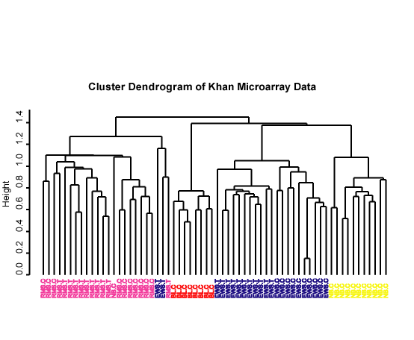
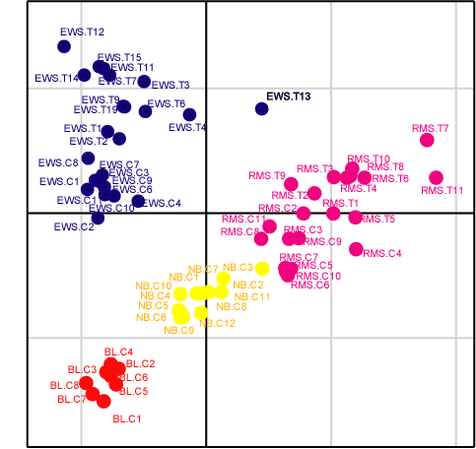
Get a feel for high dimensional structure of multivariate data
Clustering
  Hierarchical
  Flat (k-means)
Matrix Factorization/ Dimension Reduction
  Principal Component analysis, Correspondence analysis
  etc

Slide 8
What do with a new dataset? – Jeff Leek
Step 0: Figure out what I'm trying to do with the data
Step 1: Learn about the elephant
Step 2: Clean/organize
Step 3: Plot. That. Stuff
Step 4: Get a quick answer to the question from Step 1
  quick and dirty answer to the question;
  simple predictive model or a really basic regression model.
  Check back with person generating data.

Slide 9
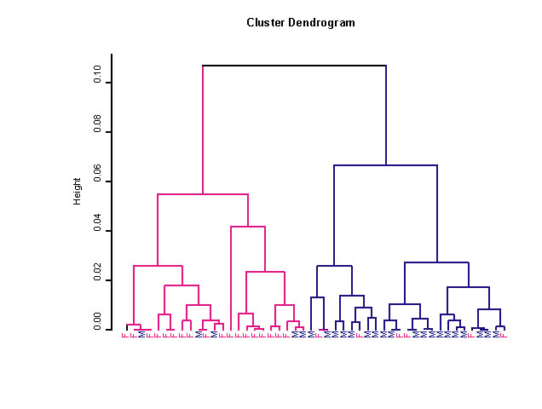

Limitations of hierarchical clustering
Samples compared in a pair wise manner
Hierarchy forced on data
Sometimes difficult to visualise if large data
Overlapping clustering or time/dose gradients ?

Slide 10
Matrix Factorization
Also refers to as
  Latent variable analysis, Dimension reduction, Ordination
Aim:
Find axes onto which data can be project so as to explain as much of the variance in the data as possible

Slide 11
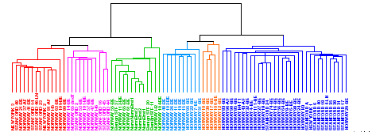
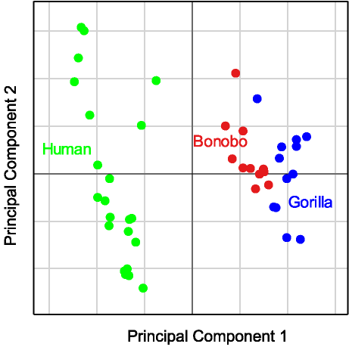
Complementary methods
  Cluster analysis generally investigates pairwise distances/similarities among objects looking for fine relationships
  Ordination in reduced space considers the variance of the whole dataset thus highlighting general gradients/patterns
        (Legendre and Legendre, 1998)

Slide 12
Dimension Reduction (Ordination)
z
New Axis 1
New Axis 2
New Axis 3
y
Principal Components
pick out the directions
in the data that capture
the greatest variability
x

Slide 13
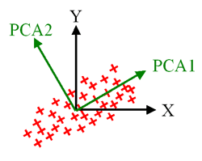
Representing data in a reduced space
_{New Axis 2}
_{New Axis 1}
The first new axes will be projected through the data so as to explain the greatest proportion of the variance in the data.
The second new axis will be orthogonal, and will explain the next largest amount of variance

Slide 14
Interpreting an Ordination
Each axes represent a different “trend” or set of profiles
The further from the origin
Greater loading/contribution
(ie higher expression)
Same direction from the origin

Slide 15
Principal Axes
Project new axes through data which capture variance. Each represents a different trend in the data.
Orthogonal (decorrelated)
Typically ranked: First axes most important
Principal axis, Principal component, latent variable or eigenvector

Slide 16

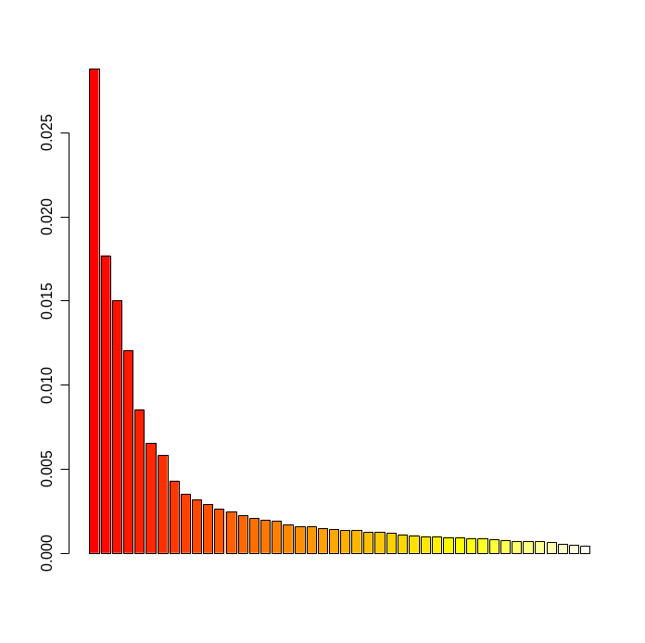
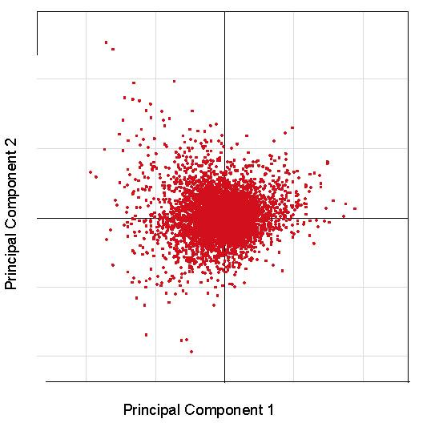
Typical Analysis
Plot of eigenvalues, select number.
X
Ordination
Array Projection
Gene Projection
Plot PC1 v PC2
etc

Slide 17
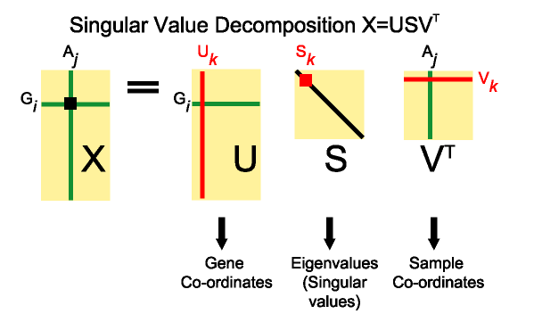
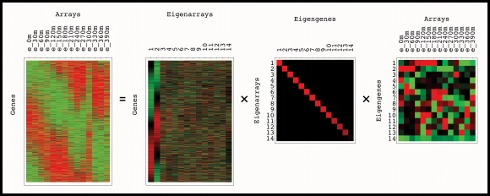
_{Image from}
http://genome-www.stanford.edu/SVD/

Slide 18
Eigenvalues
Describe the amount of variance (information) in eigenvectors
Ranked. First eigenvalue is the largest.
Generally only examine 1st few components
  scree plot

Slide 19

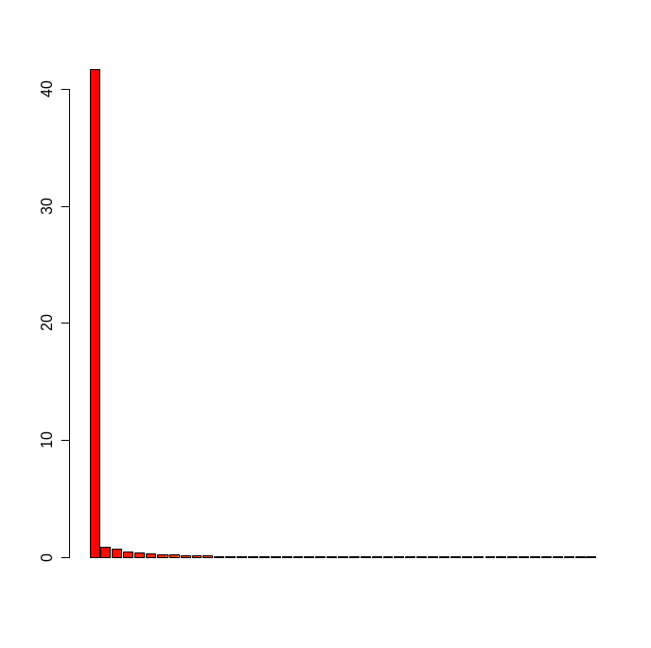
Choosing number of
Eigenvalues: Scree Plot
Maximum number of Eigenvalues/Eigenvectors = min(nrow, ncol) -1

Slide 20
Ordination Methods
Most common :
  Principal component analysis (PCA)‏
  Correspondence analysis (COA or CA)‏
  Nonmetric multidimensional scaling (NMDS, MDS)‏
  Principal co-ordinate analysis (PCoA)‏

Slide 21
Relationship
PCA, COA, etc can be computed using Singular value decomposition (SVD)
SVD applied to microarray data (Alter et al., 2000)
Wall et al., 2003 described both SVD, PCA (good paper)

Slide 22
Principal Component Analysis (PCA)‏
Probably most popular ordination method
Eigenanalysis of a covariance matrix (most common) or correlation matrix
Dates back to Pearson (1901)‏
Applied to quantitative data.
First applied to microarray data by Raychadhuri et al., 2000.
PCA: prcomp(stats), princomp(stats) dudi.pca (ade4).

Slide 23
PCA: Initial data transformation
_{Column mean centred}
_{(covariance PCA)‏}
_{J samples}
_{Matrix}
_{X}
_{J samples}
_{Matrix}
_{N}
_{Matrix S}
_{n}
_{ij}
_{x}
_{I}
_{n}
_{I}
_{ij}
_{genes}
_{i.}
_{genes}
_{n}
_{.j}
_{n}
..
_{x}
₌
_{n}
₋
_{m}
_{ij}
_{ij}
_{j}
Where mj is the mean of column J

Slide 24
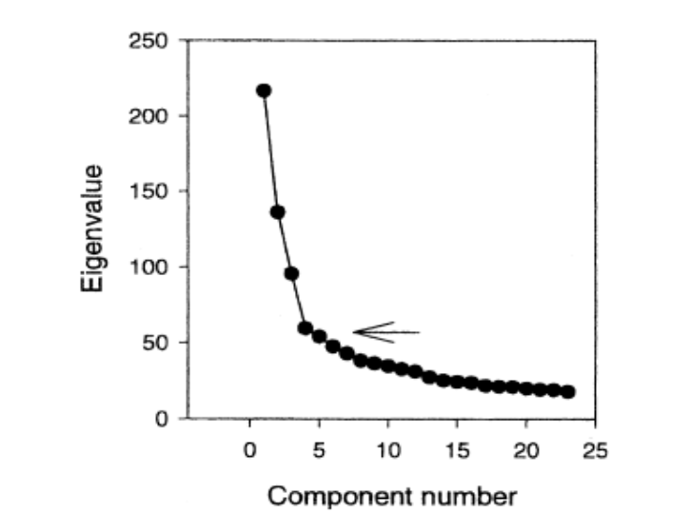
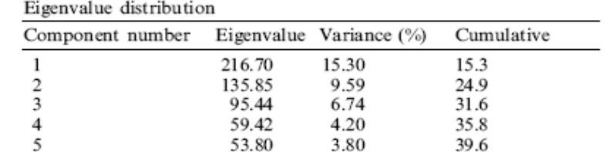
PCA of the NCI 60 cell lines
Crescenzi and Giuliani, 2001
Gene expression profiles of 60 cancer cell lines representing diverse cancers
Performed PCA
Found 5 PC’s to contain most of the variance. Of which first 3 most interesting

Slide 25
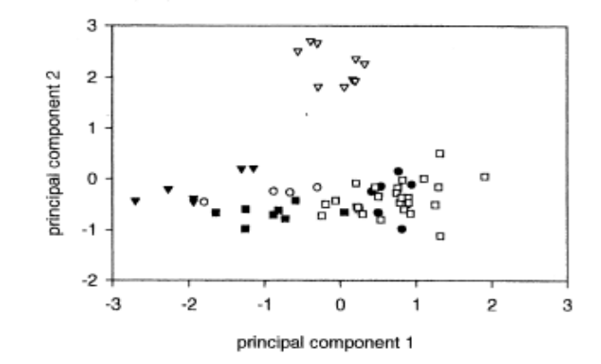
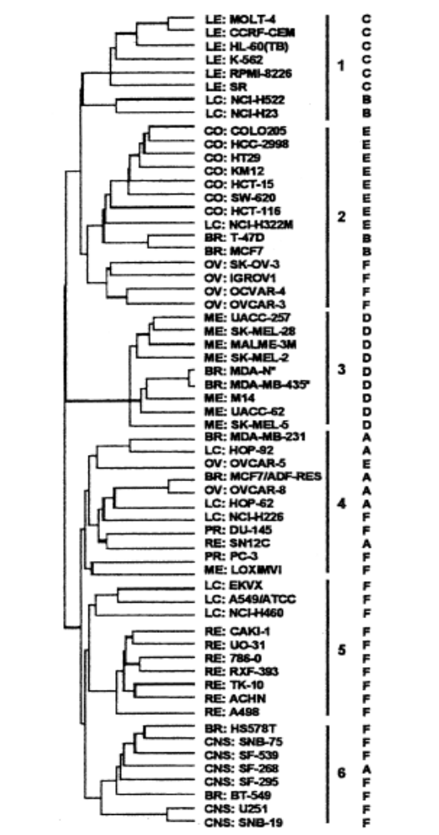
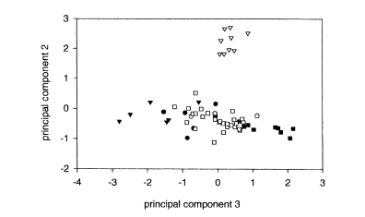
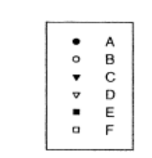
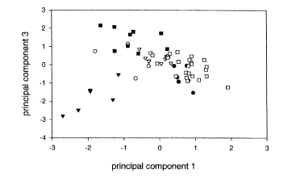

Slide 26
Considerations when applying PCA
Distance – Euclidean
Robust, but designed for analysis of multi-normal distributed data
  if very skewed data, the first few axes will only separate a few objects with extreme values instead of displaying main axes of variation
Generally for microarray analysis: Row centre.
  Eliminate size effect. Low abundance genes can be detected
Problems which Correspondence analysis handles better
  If lots zero
  Unimodal or non-linear trends. Get distortion or artifact in plot, in which the second axis is an arched function of the first axis. Called horseshoe effect in PCA.

Slide 27


Slide 28
Correspondence Analysis
COA (or CA) is an eigenanalysis of a Chi-square distance matrix.
Measures the “strength” of association between an up-regulated gene and an array sample.
Developed by numerous authors, also known as reciprocal averaging/ordering, dual scaling etc.
Initially designed for analysis of 2-way contingency tables (frequency counts). Thus assumes matrix counts positive integers or zeros.

Slide 29
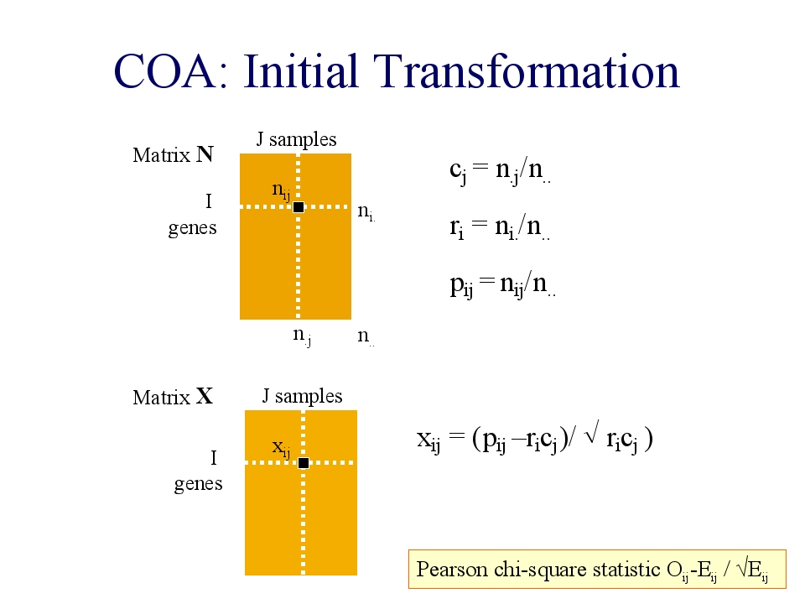

Slide 30
COA of the Yeast Cell-Cycle Data
Fellenberg et al., 2001
Dataset:
  Gene Expression of S. cerevisiae arrested during cell cycle by 4 methods
    alpha factor-, CDC15-, CDC28-based blocking and elutriation. (Spellman et al., 1998)‏
COA
Visualised using biplot of genes and arrays

Slide 31
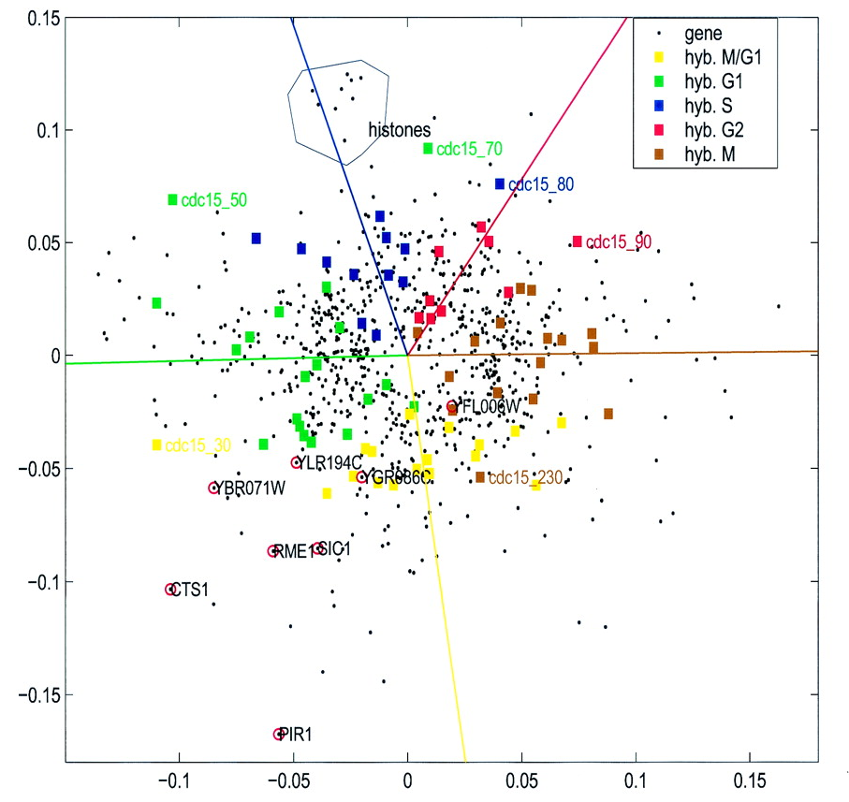
Correspondence Analysis
_{Biplot}
Arrays and genes with a strong association (correspondence) are projected in the same direction from the origin.
Fellenberg et al., (2001) PNAS 98(19):10781-10786
Notes:
Ordination methods such as COA and PCA are useful exploratory tools, whereby samples
Multivariate analysis techniques such as
COA - Fellenberg et al. 2001
PCA Crescenzi & Giuliani, 2001 (FEBS letts –on Ross dataset)‏
MDS – Khan et al., 2001

Slide 32
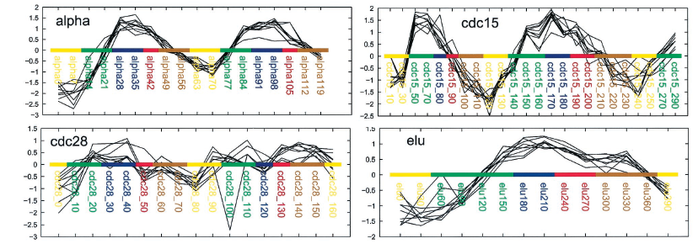
Gene Expression of 9 histone genes
See gene expression of histones ↑ during S phase

Slide 33
Consideration when applying COA
Data must be in same units (so they can be added)‏
Data must be non-negative or made position by translation (scalar addition)‏
In case of steep gradients (many zero) COA should produce better results than PCA
Data is dual (column and row) scaled.
Unimodal or non-linear trends may be represented as arch (2nd axis). Less serious than PCA’s horseshoe effect.

Slide 34
Among the other related methods
Independent Component Analysis
  generalization of PCA
  does not constrain the axes to be orthogonal
  attempts to place them in the directions of statistical dependencies in the data.
  Lee & Batzoglou 2003 and Saidi et al., 2004 show ICA outperformed PCA
Spectral map analysis
  related to COA (dual scaling of both rows + columns)‏
  not limited to contingency tables and cross-tabulations. possibility to use other weighting factors
  Wouters et al., 2003 showed SMA outperformed PCA, comparable to COA.

Slide 35
MDS
Multidimensional scaling
  metric and non-metric.
Input distance matrix
Classical MDS is identical to principal coordinates analysis (PCoA). R code cmdscale (stats), dudi.pco (ade4)‏
NMDS. Iterative. isoMDS (MASS), sammon (MASS).

Slide 36
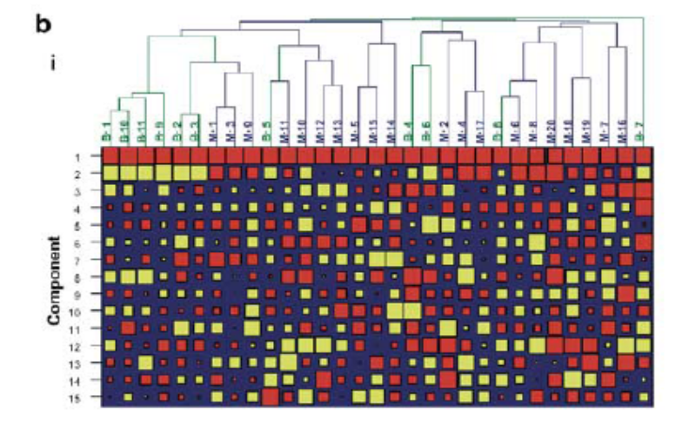
Independent Component Analysis Saudi et al., 2003
Axes/eigenvectors are not constrained to be orthogonal
May detect more subtle patterns in data
More complex interpretation of axes

Slide 37
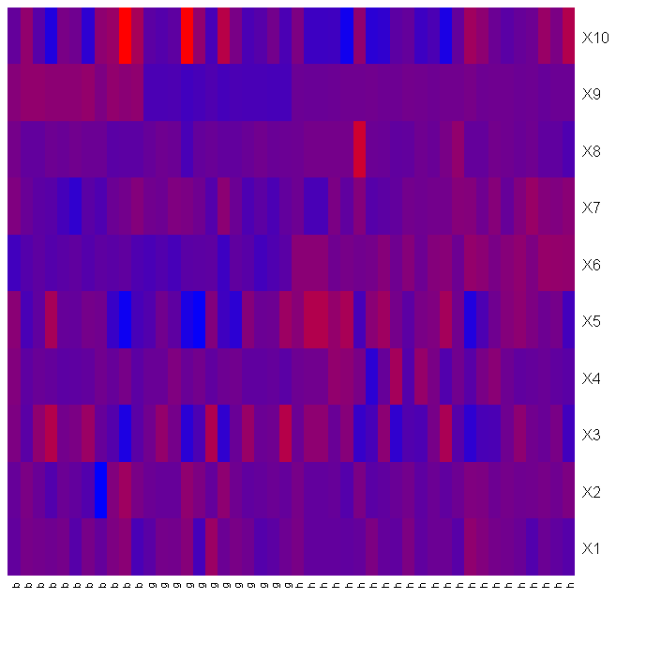
Fast ICA of Karaman Ape Data
_{d = 0.5}
_{d = 0.5}
_{Axis 1 and 2}
_{Axis 1 and 3}
_{d = 0.2}
_{d = 0.2}
_{Axis 1 and 6}
_{Axis 6 and 9}

Slide 38

Results from fastICA and COA
_{Bonobo}
_{Bonobo}
_{human}
_{human}
_{Gorilla}
_{Gorilla}
_{fastICA, Axis 6 and 9}
_{COA, Axis 1 and 3}

Slide 39
Summary: Exploration analysis using Ordination
SVD = straightforward dimension reduction
PCA = column mean centred +SVD
    Euclidean distance
COA = Chi-square +SVD
    produces nice biplot
Ordination be useful for visualising trends in data
Useful complementary methods to clustering

Slide 40
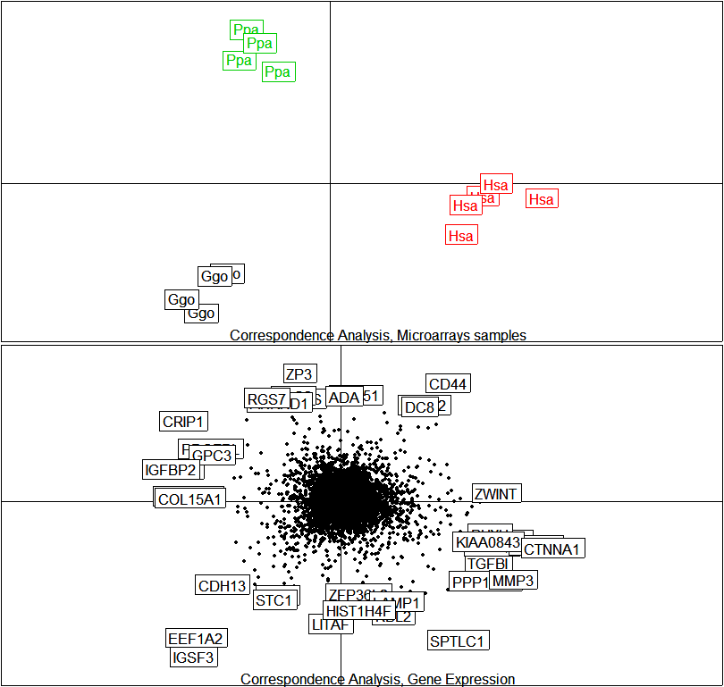
Ordination in R
Ordination (PCA, COA)‏
library(ade4)‏
dudi.pca()‏
dudi.coa()‏
library(made4)‏
ord(data, type=“pca”)‏
plot()‏
plotarrays()‏
plotgenes()‏
_{Link to example 3d html file}

Slide 41
Books/Book Chapters:
Legendre, P., and Legendre, L. 1998. Numerical Ecology, 2nd English Edition. ed. Elsevier, Amsterdam.
Wall, M., Rechtsteiner, A., and Rocha, L. 2003. Singular value decomposition and principal component analysis. In A Practical Approach to Microarray Data Analysis. (eds. D.P. Berrar, W. Dubitzky, and M. Granzow), pp. 91-109. Kluwer, Norwell, MA.
Papers:
Pearson, K. 1901. On lines and planes of closest fit to systems of points in space. Philosophical Magazine 2: 559-572.
Hotelling, H., 1933. Analysis of a complex statistical variables into principal components. J. Educ. Psychol. 24, 417-441. Alter, O., Brown, P.O., and Botstein, D. 2000. Singular value decomposition for genome-wide expression data processing and modeling. Proc Natl Acad Sci U S A 97: 10101-10106.
Culhane, A.C., Perriere, G., Considine, E.C., Cotter, T.G., and Higgins, D.G. 2002. Between-group analysis of microarray data. Bioinformatics 18: 1600-1608.
Culhane, A.C., Perriere, G., and Higgins, D.G. 2003. Cross-platform comparison and visualisation of gene expression data using co-inertia analysis. BMC Bioinformatics 4: 59.
Fellenberg, K., Hauser, N.C., Brors, B., Neutzner, A., Hoheisel, J.D., and Vingron, M. 2001. Correspondence analysis applied to microarray data. Proc Natl Acad Sci U S A 98: 10781-10786.
Raychaudhuri, S., Stuart, J.M., and Altman, R.B. 2000. Principal components analysis to summarize microarray experiments: application to sporulation time series. Pac Symp Biocomput: 455-466.
Wouters, L., Gohlmann, H.W., Bijnens, L., Kass, S.U., Molenberghs, G., and Lewi, P.J. 2003. Graphical exploration of gene expression data: a comparative study of three multivariate methods. Biometrics 59: 1131-1139
Reviews
Quackenbush, J. 2001. Computational analysis of microarray data. Nat Rev Genet 2: 418-427.
Brazma A., and Culhane AC. (2005) Algorithms for gene expression analysis. In Encyclopedia of Genetics, Genomics, Proteomics and Bioinformatics. Dunn MJ., Jorde LB., Little PFR, Subramaniam S. (eds) John Wiley & Sons. London (download from http://www.hsph.harvard.edu/research/aedin-culhane/publications/)
Interesting Commentary
Terry Speed’s commentary on PCA download from http://bulletin.imstat.org/pdf/37/3

