Slide 1

By Austin and Adam

Slide 2
Overview
Brief on frontend
Brief on backend

Slide 3
Frontend Overview
Important Changes from Frontend Design
CSS -> Bootstrap
Navigation Component
Login/Register: Firebase Auth tie with Firestore User Database
Context Creation for useAuth

Slide 4
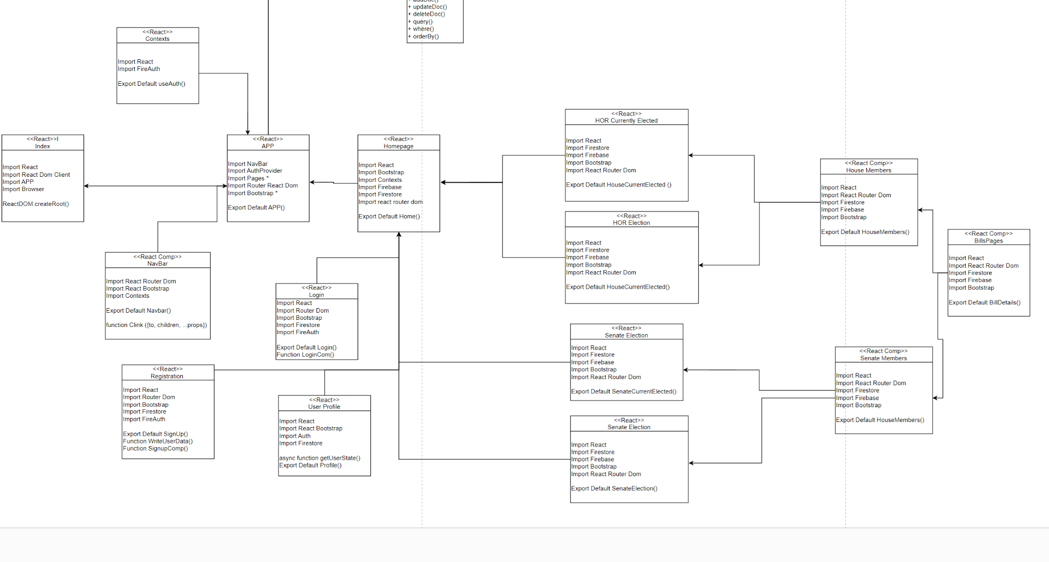

Slide 5
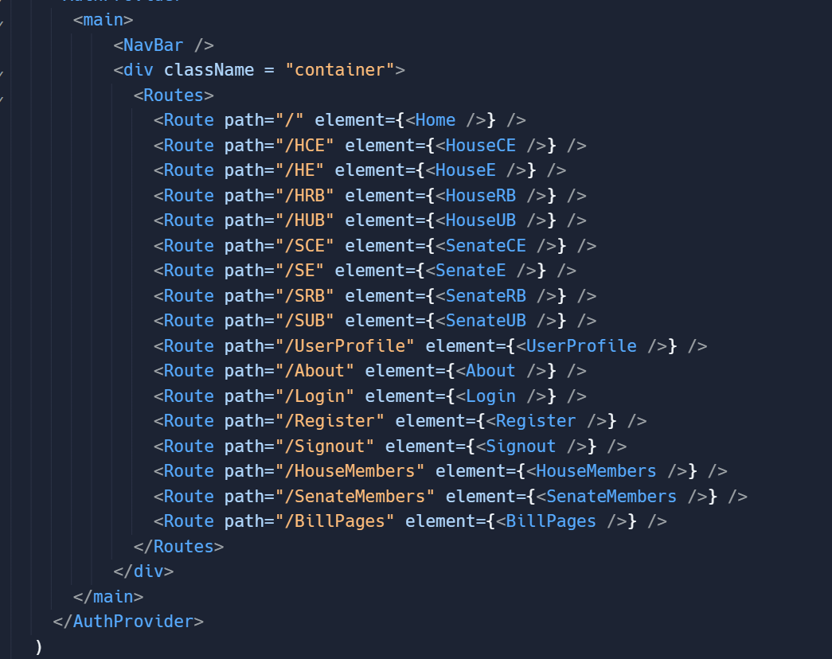
APP Code for Reference

Slide 6
Upcoming Frontend Developments and Issues
Improve user profile to delete accounts, and collect more user information
Finish Senate pages functionality
Implement recent news and personal statements
Touch up on the styling of the website.
Find a easier way to create bill summaries.
Add Ads to cover costs of running database.

Slide 7
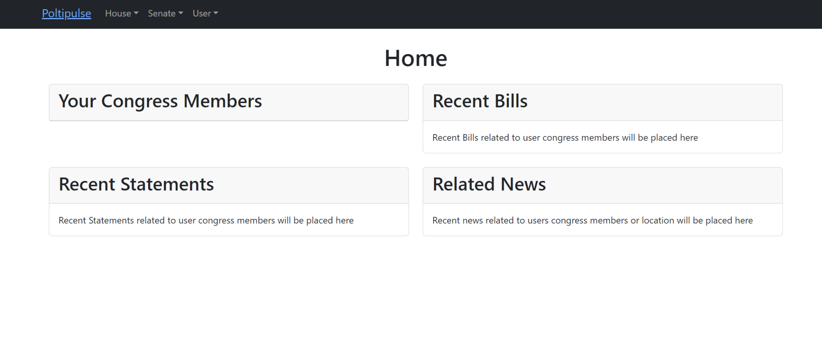

Slide 8
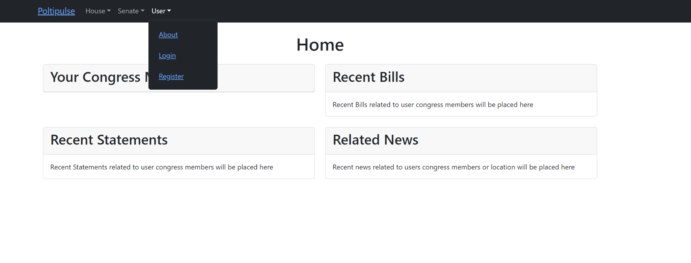

Slide 9
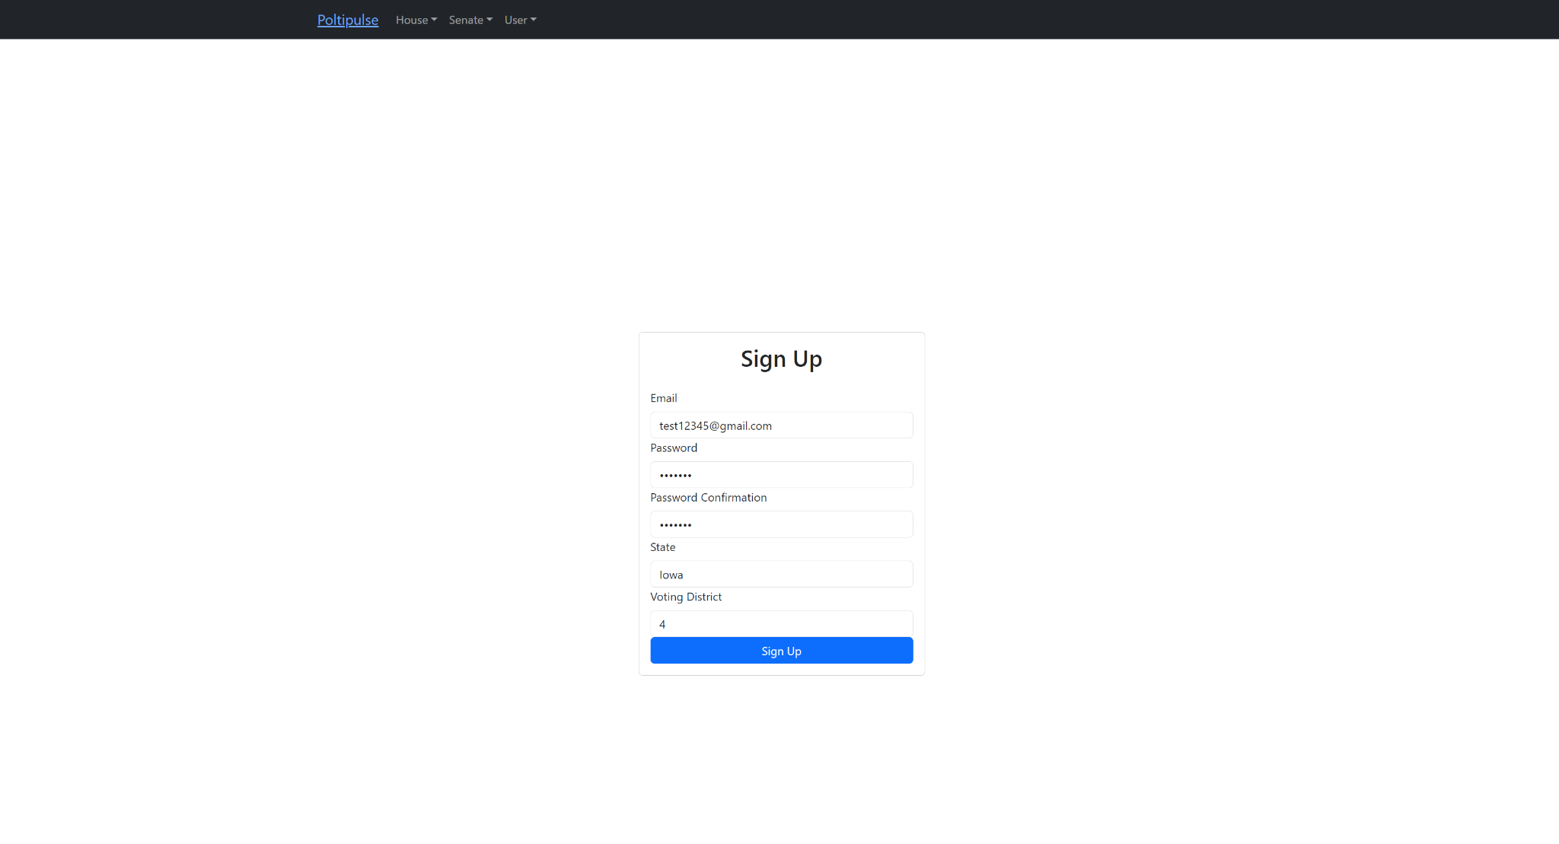

Slide 10
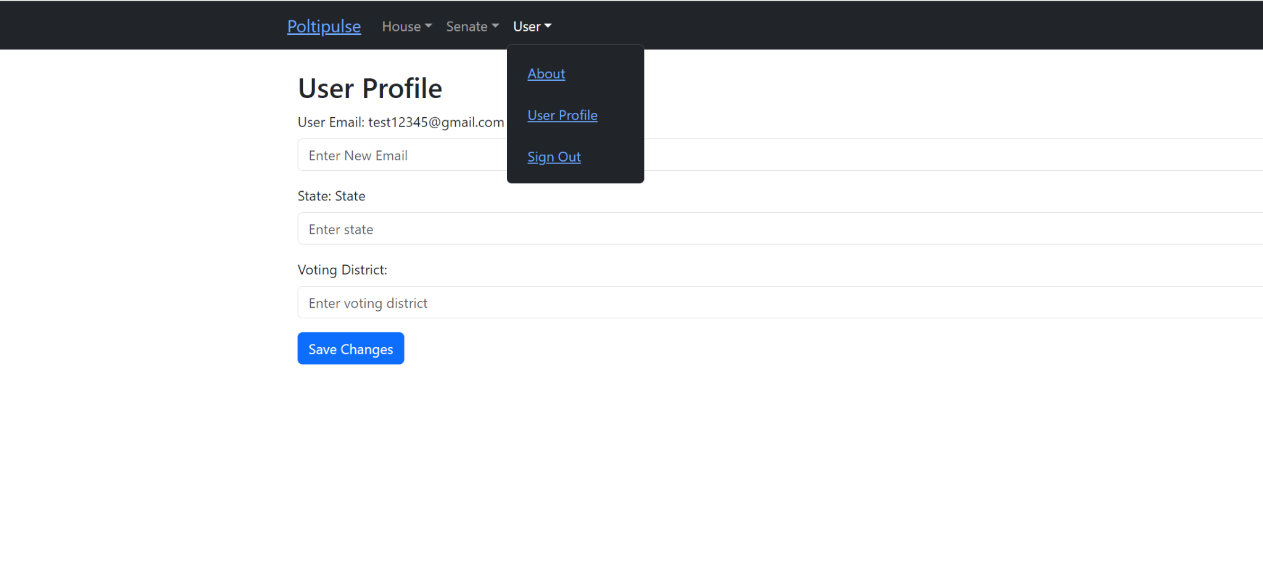

Slide 11
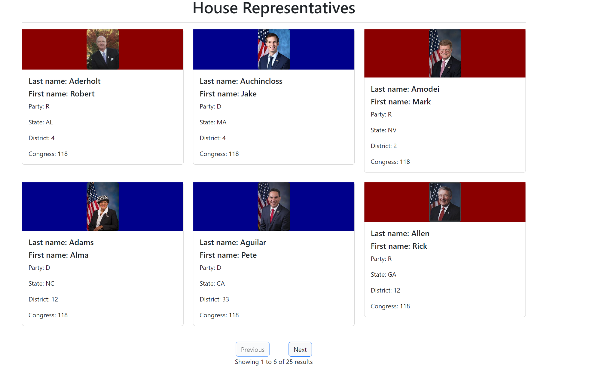

Slide 12
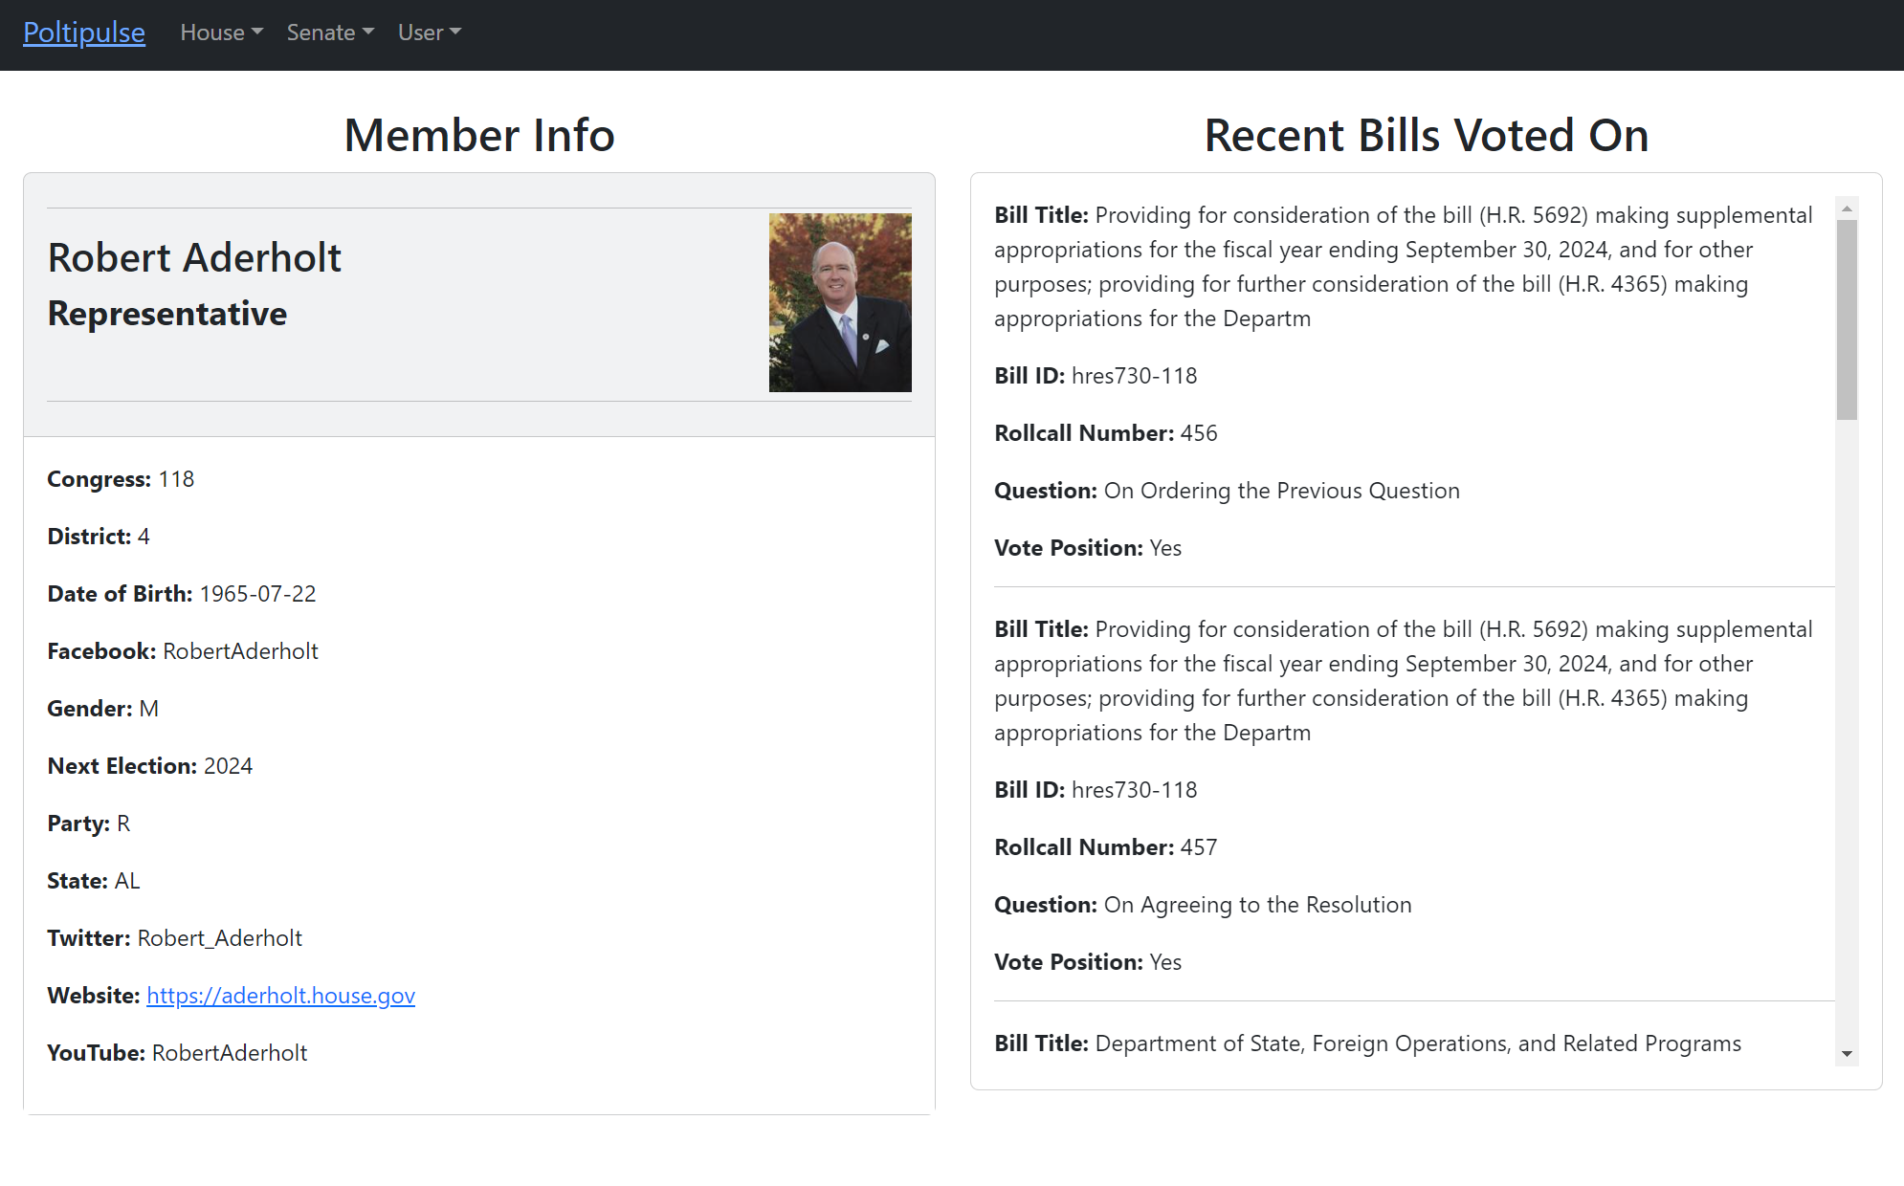

Slide 13
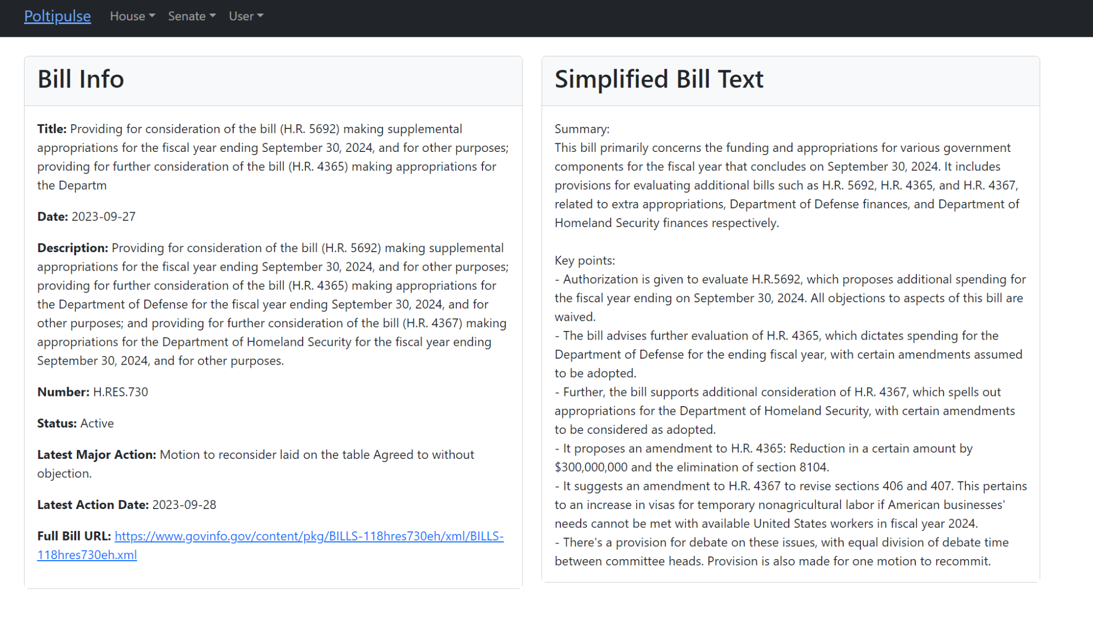

Slide 14
Backend Overview
Changes:
Modifications to the database and schema
Implementation of new APIs
Dropped Cloud Functions

Slide 15
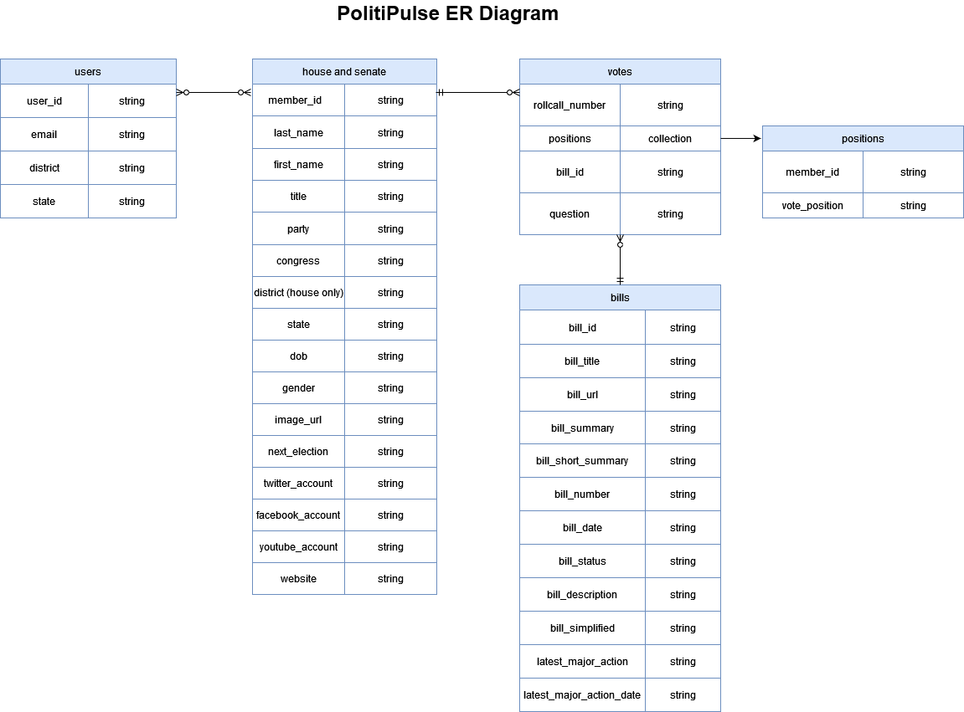
Database Schema Modifications

Slide 16
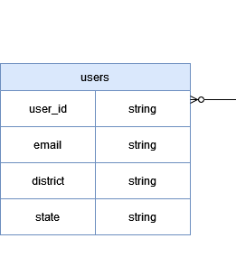
Database Schema Modifications
-xAxis
-yAxis
-alignment
+email

Slide 17
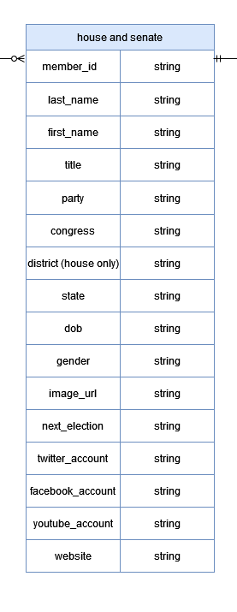
Database Schema Modifications
-name
-description
+last_name
+first_name
+dob
+gender
+social media
+image_url

Slide 18
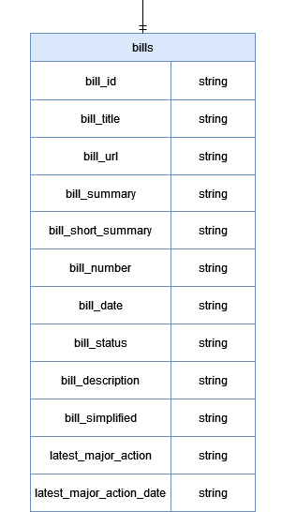
Database Schema Modifications
-full_bill
+bill_url
+bill_short_summary
+bill_simplified
+latest_major_action
+latest_major_action_date

Slide 19
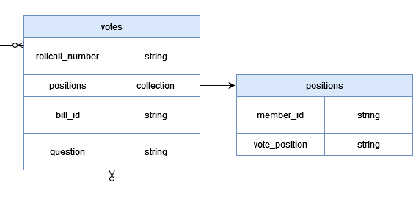
Database Schema Modifications

Slide 20
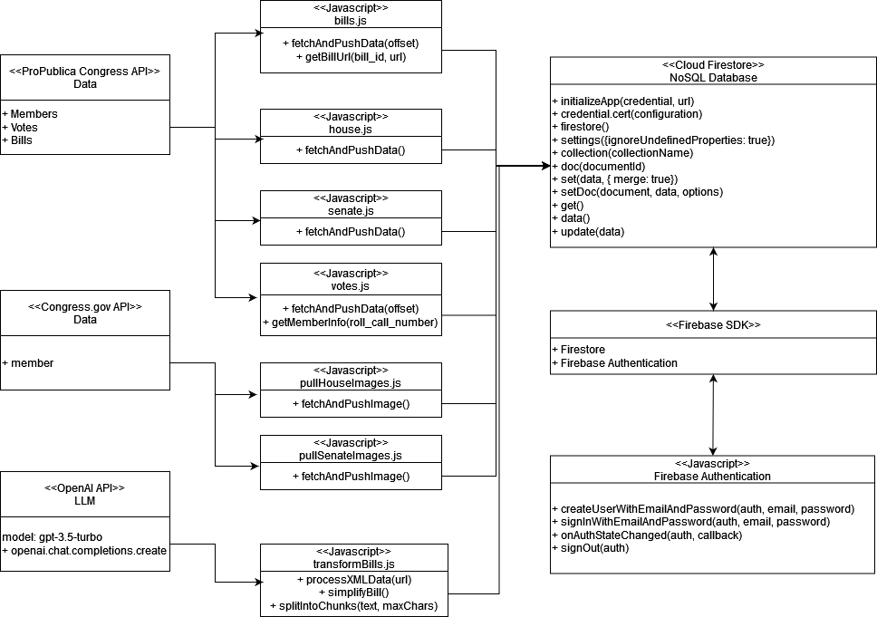
Updated Backend UML

Slide 21
backend progress and upcoming developments
Progress:
Collections generally complete
Integration with frontend
Upcoming:
Find API for recent news collection
Aggregate recent statements
Clean up ‘bills’ data

Slide 22
Unresolved Backend Issues
OpenAI token limit

Slide 23
Political Spectrum Component
Omitted Political Spectrum component

Slide 24
Conclusion
Questions?

