Slide 1

PolitiPulse
BY AUSTIN EDWARDS AND ADAM BOTENS

Slide 2
PolitiPulse: Enhancing Political Awareness
Why PolitiPulse?
  Simplify political data for public understanding.
  Enhance political awareness among voters

Slide 3
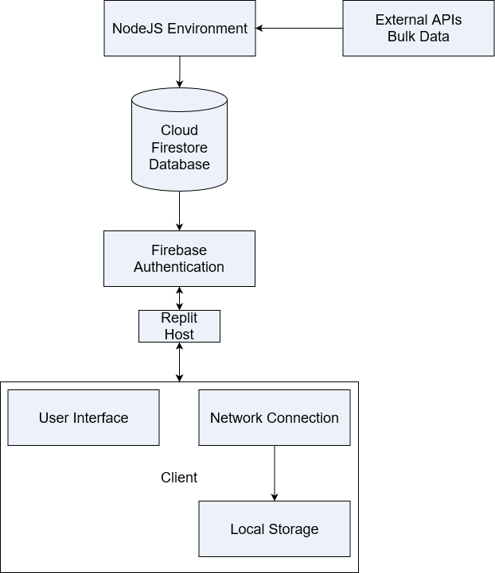
Building Blocks of PolitiPulse
Primary Technologies
  React
  Node.js
  Firestore
  Firebase Authentication
  Replit

Slide 4




Why These Technologies?
React
Component based architecture
NodeJS
Non-blocking I/O model
Firebase
NoSQL data and security features that integrate effortlessly
Replit
Real-time collaboration and ease of hosting and deploying.
Images are sourced through Wikipedia and are part of the public domain.

Slide 5

Front-end Technology
React-Router-Dom
  Seamless Navigation between web pages, restrict load times and database calls
Bootstrap
  Fast prototype Web Page styling
  Easy to implement javascript functionality within components.
  Auto uses Flexbox for responsive elements
Replit Dynamic Host
  CPU usage scales with active users and calls to the server instead of constant run time.

Slide 6
Back-end Technology
Axios for HTTP requests.
ProPublica API for congressional bills, votes, members, and statements.
Congress.gov for congress images.
Top Congress News Rapid API for political news.
OpenAI API for bill transformations.

Slide 7
Design and Implementation
Will start with building the database
Move on to user interface
Discuss authentication

Slide 8
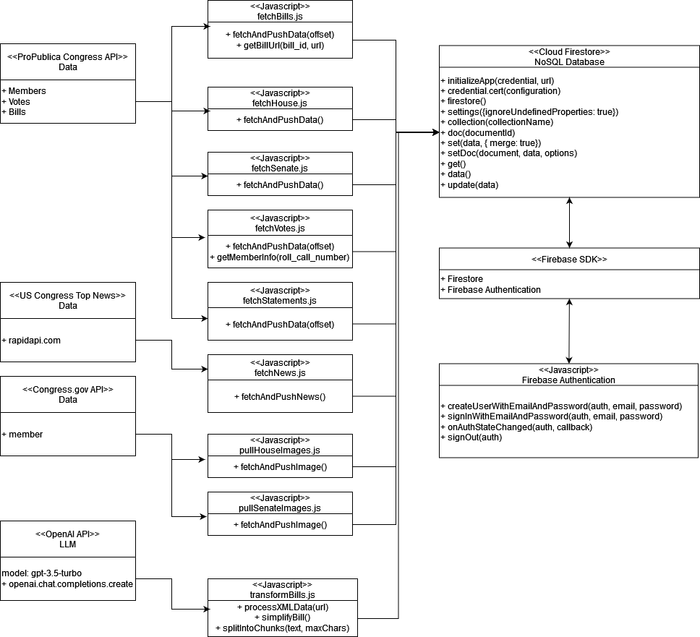
Back-end Design

Slide 9
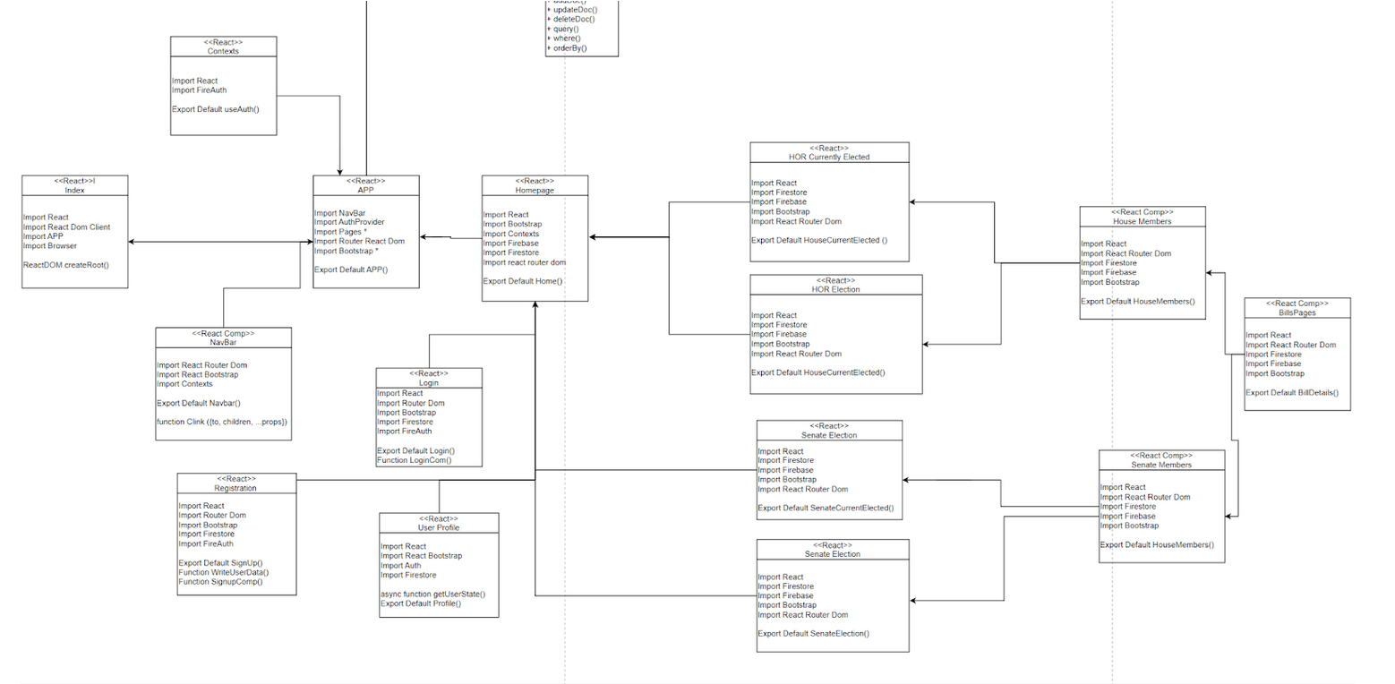
Front-end Design

Slide 10
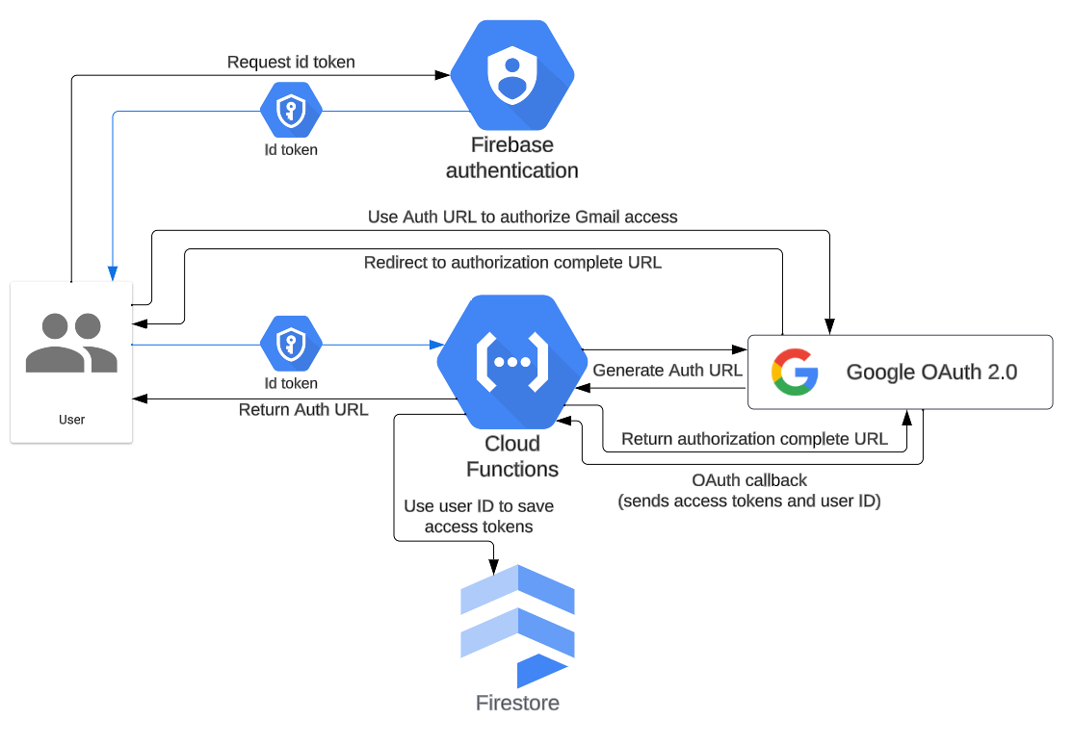
Authentication

Slide 11



Known Bugs
Fetching recent statements is buggy.
Bill transformations are limited to 4096 tokens (10000-24000) characters.
Altering user information.

Slide 12
Future Enhancements
Rename collections to take full advantage of Firestore.
Create a master script for running backend scripts.
Train an LLM to tackle the challenge of large bills.
Improvements to pagination.
Enhanced login and security.

Slide 13
Conclusion
QUESTIONS?

