Slide 1

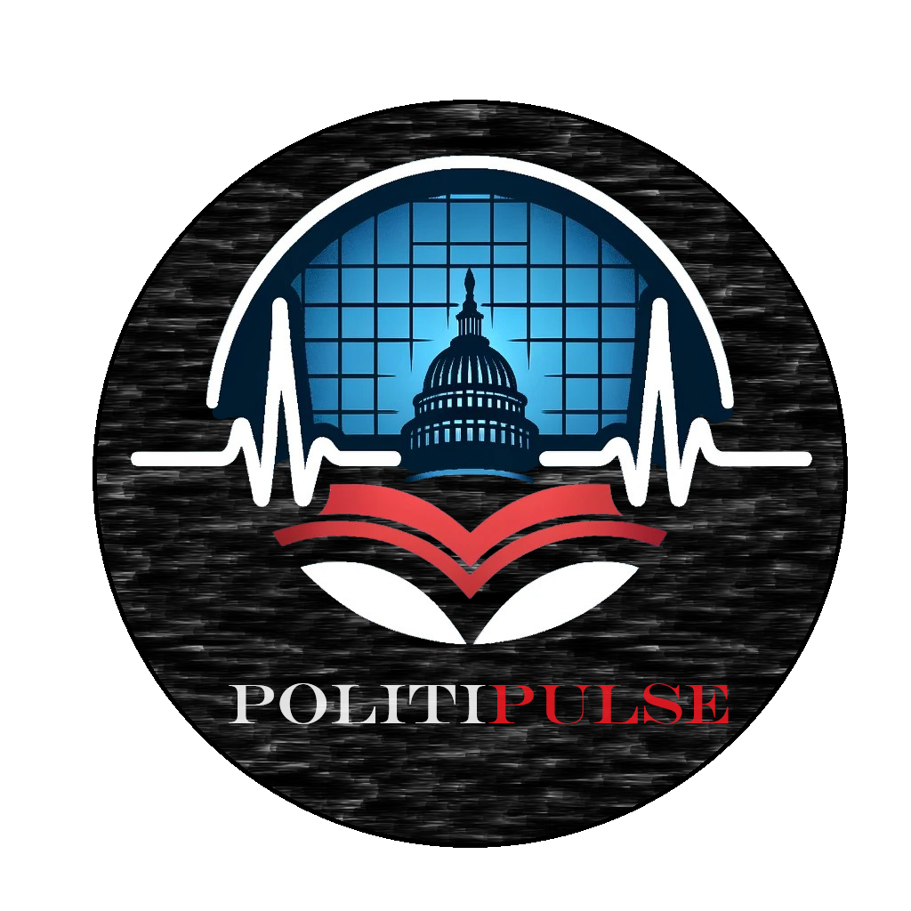
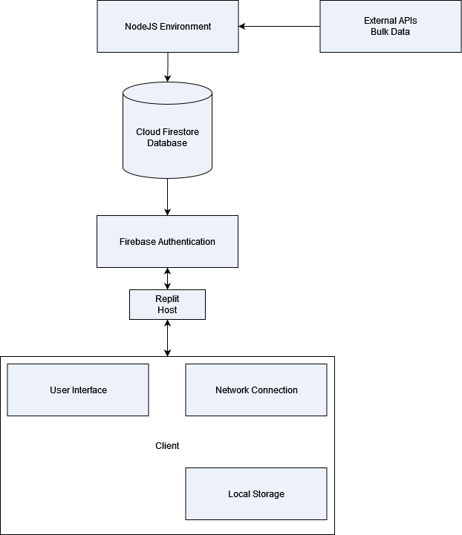

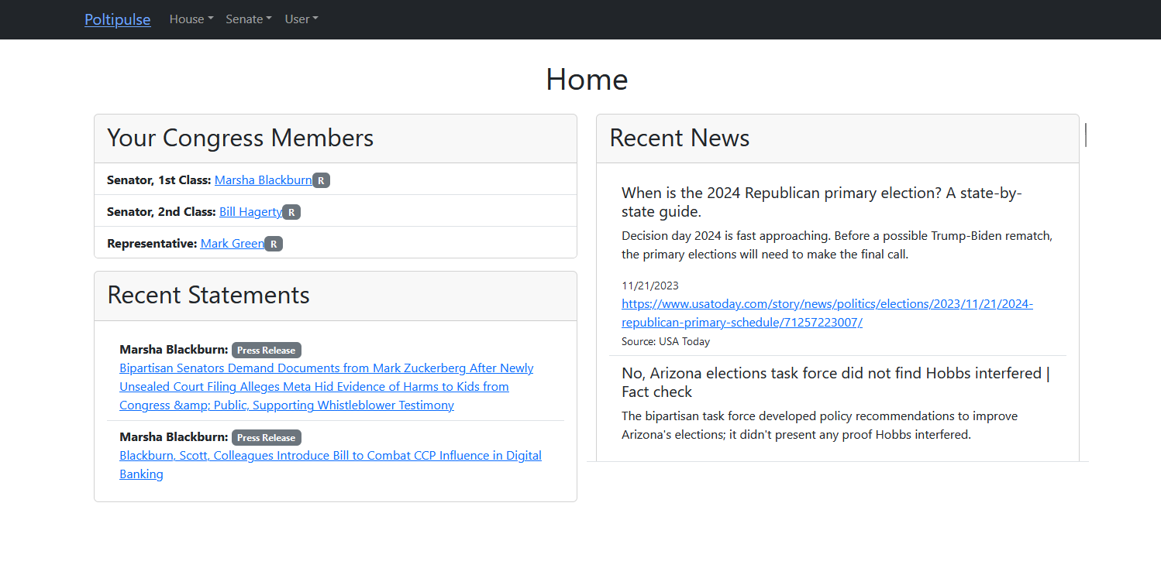
PolitiPulse
By Austin Edwards and Adam Botens
Dept. Of Computer Science and Information Technology
Abstract
Technology
PolitiPulse emerges as an online resource that enhances political awareness and engagement among voters. This innovative platform serves as a comprehensive hub for political information, mainly focusing on current and prospective members of Congress. It offers users easy access to information, including details about their elected representatives, pertinent news, legislative bills, and public statements. A standout feature of PolitiPulse is its pioneering 'Bill Transformer.' This unique tool is designed to demystify congressional bills by stripping away complex jargon, simplifying the language, and condensing the content. This transformation renders the bills more accessible and digestible for the average voter, fostering greater understanding and involvement in the political process. PolitiPulse, with its user-friendly interface and informative content, not only bridges the knowledge gap between citizens and their government but also empowers voters to make more informed decisions.
PoltiPulse leverages a robust technology stack to deliver an efficient, responsive, and secure user experience. The front-end interface is built using React, a popular JavaScript library known for its flexibility and efficiency in building interactive user interfaces. This choice ensures a dynamic and seamless interaction for users navigating PoltiPulse's features.
To manage our data, we employ a NoSQL database hosted on the Firebase Firestore service. Firestore offers scalable and flexible storage solutions for handling the diverse and voluminous political data integral to PoltiPulse. For user authentication, PoltiPulse incorporates Firebase Authentication, a reliable and secure authentication system that supports various sign-in methods while ensuring user data protection. Firebase authentication facilitates a straightforward and safe sign-in process, enhancing the user experience.
Lastly, React-Router-Dom is utilized for seamless navigation within the application. It enables the creation of a single-page application with navigation without the page refreshing, making the user's journey through the platform smooth and intuitive. This combination of technologies underpins PoltiPulse's commitment to providing a user-friendly, secure, and informative platform for political engagement and education.
Figure 1: A block diagram depicting the different components of the system.
Design
Future Work
PolitiPulse is designed as a web-based platform, combining an intuitive user interface with a robust back-end architecture to facilitate easy access to political information. Its front-end features a clean, responsive design, ensuring compatibility across various devices, while the back-end is built on a secure, scalable database management system integrated with APIs for real-time updates.
Key functionalities include a searchable directory of congress members, real-time news and bill updates, and the unique 'Bill Transformer' feature that simplifies and summarizes congressional bills. While the platform currently focuses on delivering detailed political information, future enhancements could include user-centric features such as search filters and alerts, as well as a strong emphasis on security and data privacy to ensure a safe and engaging user experience. This strategic direction aims to make PolitiPulse not just a repository of information but also a user-friendly and secure platform that resonates with a diverse voter base.
The ongoing development of PoltiPulse aims to introduce several key features to enhance user engagement and utility. A major planned enhancement is the integration of a search bar into the navigation bar. This feature will enable users to conveniently search for specific bills, allowing for more targeted and efficient access to legislative information. This functionality is essential for users who wish to explore particular topics or track the progress of specific bills. The team would also like to add more functionality to the home page utilizing queries to convey more relationships to the user, such as finding political news that might affect them based on their location or political party. Finally, the Bill Transformer is currently not 100% operational, and the team would like to correct that in the future.
Acknowledgments
We would like to thank Dr. Nicholson for his support of students in the College of Science, Technology, Engineering & Mathematics, and Dr. Leong Lee for his support of students in the Department of Computer Science and Information Technology.
Figure 3: An example of the Bill Transformer condensing a bill from 3354 characters to 773 characters, with the jargon removed.
Figure 2: The Home page user interface.

