Slide 1
Is Income the determining factor for loan approval? An Exploratory Data Analysis
530 DCS final Project
Avrohom Eckstein

Slide 2
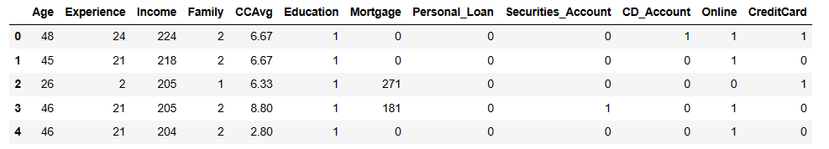
Dataset
I will be using this Loan dataset, pictured below, from Kaggle to investigate which factors lead to loan approvals.
Link: https://www.kaggle.com/datasets/vikramamin/bank-loan-approval-lr-dt-rf-and-auc

Slide 3
Variables

Slide 4
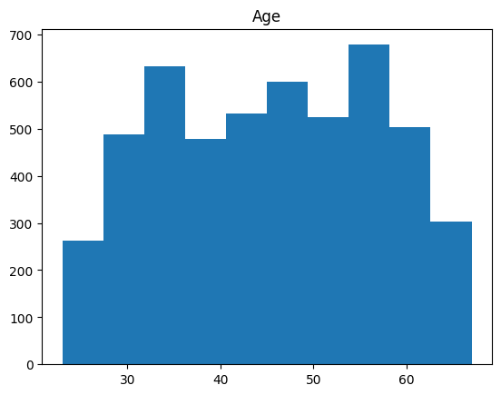

Slide 5
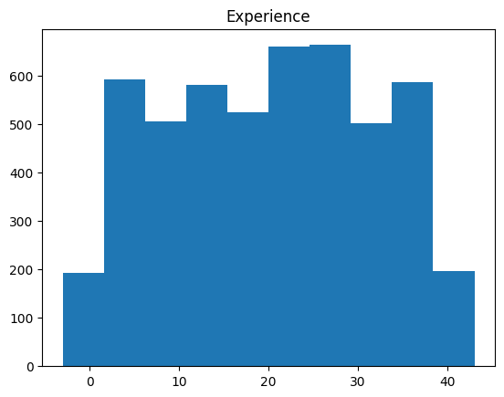

Slide 6
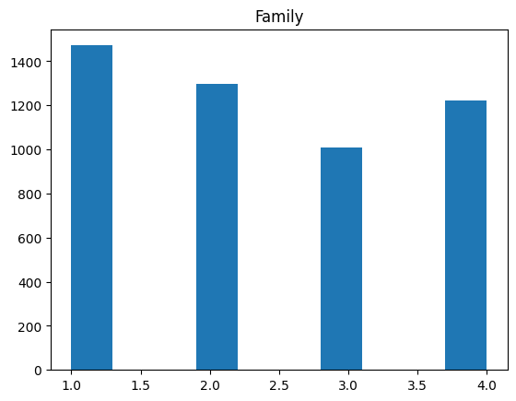

Slide 7
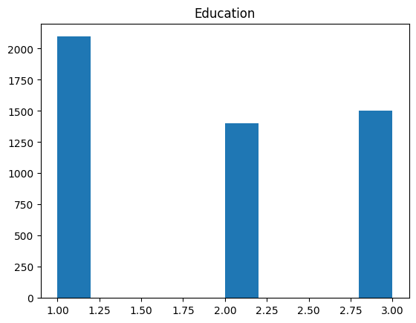

Slide 8
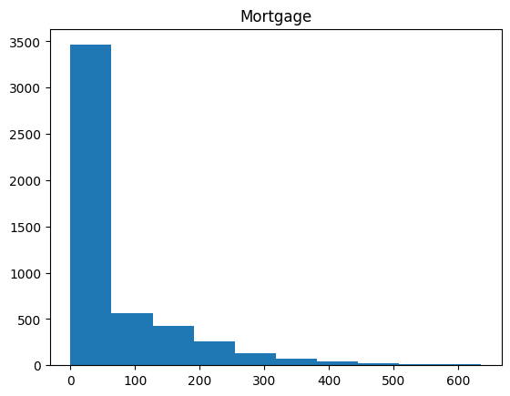

Slide 9
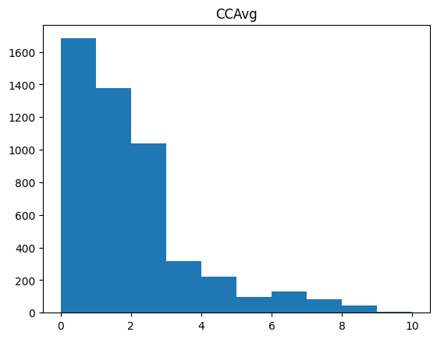

Slide 10
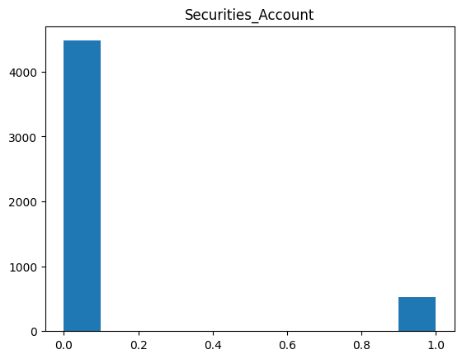

Slide 11
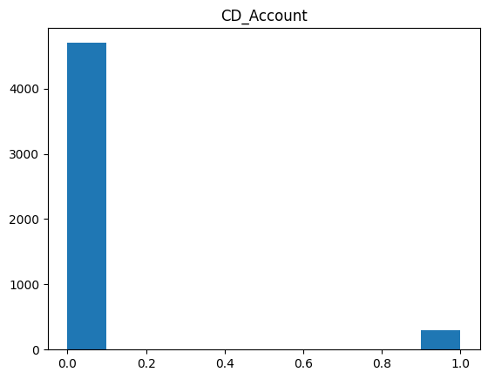

Slide 12
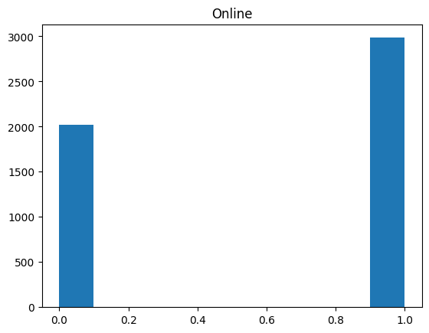

Slide 13
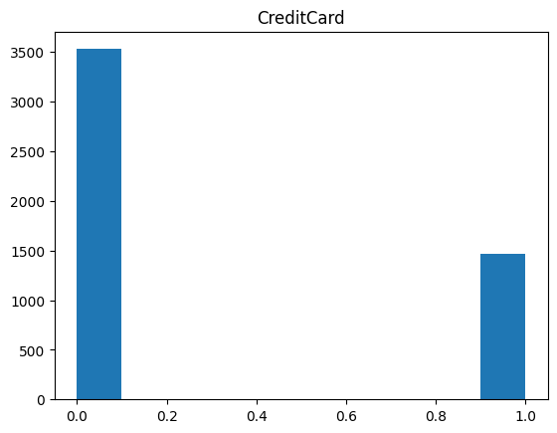

Slide 14
Approved Loans VS. Declined
For comparison, we will split our data between loan request that were accepted VS. Declined

Slide 15
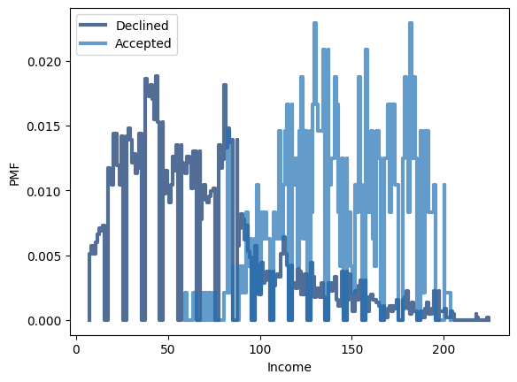
Approved Vs Declined Personal loans
We can see, looking at our pmf's, the lower income the more likely it is to get declined for a loan.

Slide 16
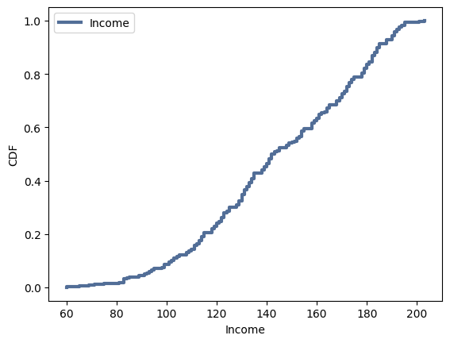
Computing a CDF
This figure shows us the cumulative probability of getting approved for a loan. As you can see the curve picks up at about 100K showing the income is a large factor in loan approval.

Slide 17
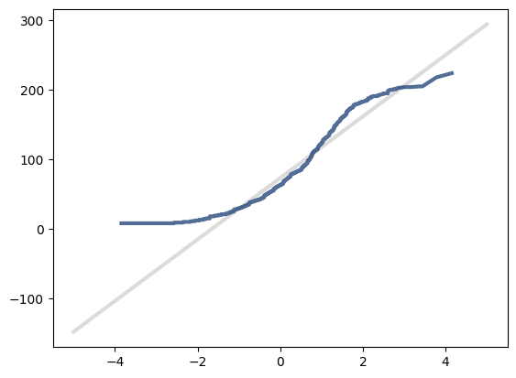
Analytical Distributions: The Normal Distribution
Looking at our graph, the data follows the pattern of the normal distribution pretty well. It does tail slightly at the extremes.

Slide 18
Scatterplots

Slide 19
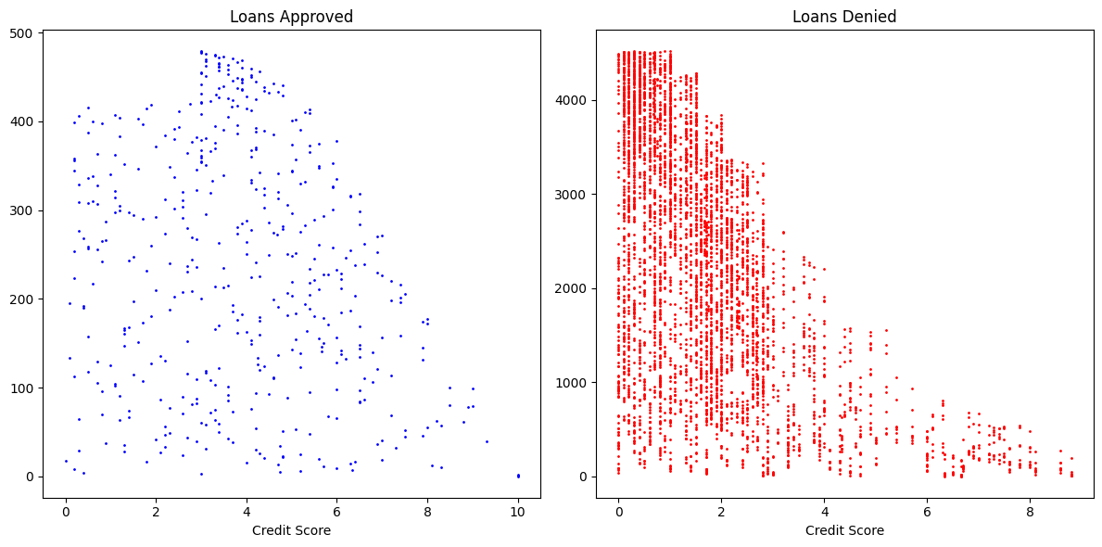
Loan Approval Vs. Income
The Pearson's correlation for Loan Approval and Income is 0.502. This means that there is a positive correlation between the two variables. As income increases, Approval rates also increases. The covariance between Loan Approval and Income is 6.81, meaning that the variables tend to vary together. We can see an upwards trend in our scatterplot, evidenced by the regression line. This relationship is best described with a linear shape.

Slide 20
Credit Score Vs. Income
The Pearson's correlation for Loan Approval and Credit rating is .36. This means that there is a Positive correlation between the two variables. As Credit rating increases , so does the prospect of loan approval. The covariance between Loan Approval and Credit rating is .18 , meaning that the variables have a very slight tendency to move in the same direction. We can see that trend in our scatterplot, evidenced by the density of the disapproval in the lower credit scores.

Slide 21
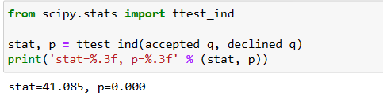
Hypothesis Testing
The p-value for our hypothesis test is very close to 0, meaning that the difference in Acceptance rate based of income is statistically significant.

Slide 22
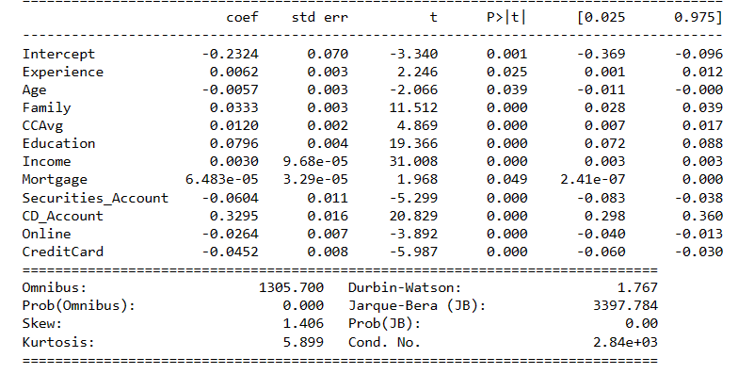
Fitting A Regression
Looking at the results of our regression, we can see that there is a p-value under p=0.05 for each of the measured variables . This means that Experience, Age, Family, credit score, Education, Income, Mortgage, Securities_Account , CD_Account, Online banking, and finally number of credit cards, all have a significant effect on a personal loan.

