Slide 1
Big Data & Data Science
Presented by Sun Aihua
October 24

Slide 2
Outline
Data, Big Data and Challenges
Data Science
Introduction
Why Data Science
Data Scientists
What do they do?
Knowledge Point in Data Science
What to learn.

Slide 3


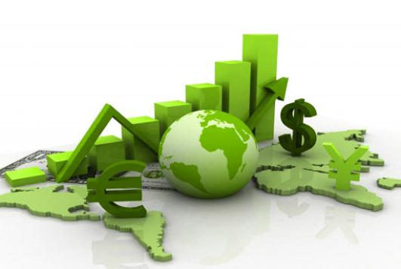

Data All Around
Lots of data is being collected and warehoused
Web data, e-commerce
Financial transactions, bank/credit transactions
Online trading and purchasing
Social Network

Slide 4
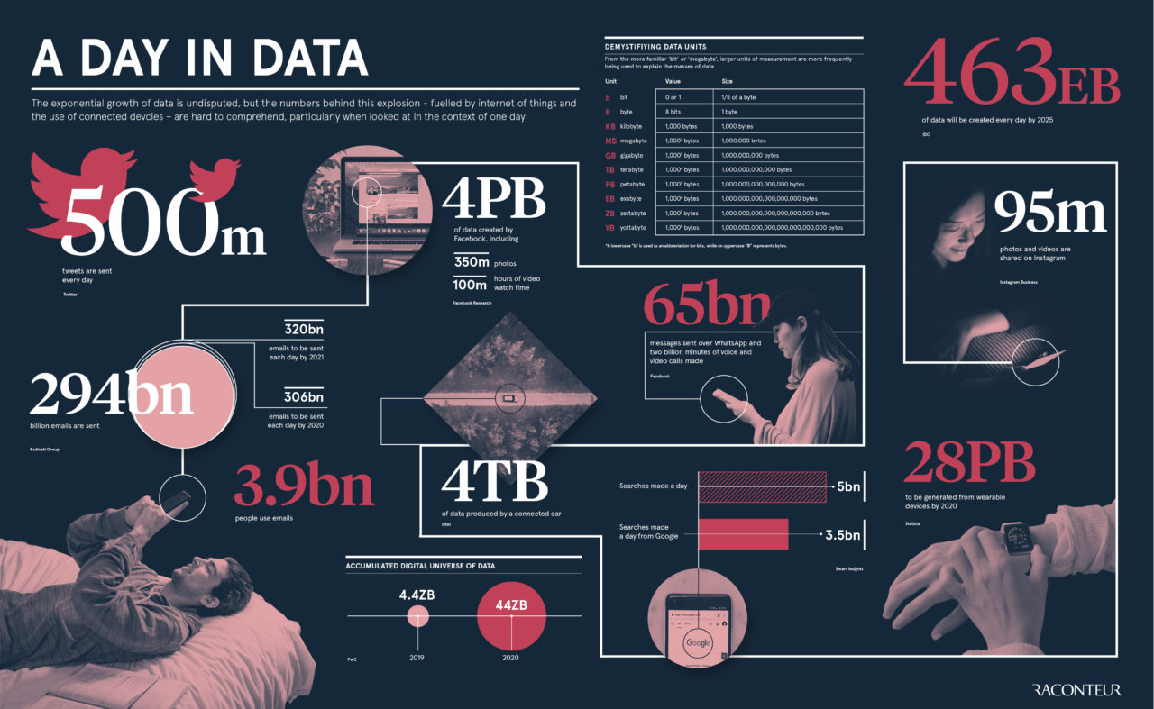
How Much Data Do We have?
463EB of data will be created every day by 2025
Facebook has 4 PB of daily logs(2022)

Slide 5
Big Data
Big Data is any data that is expensive to manage and hard to extract value from
Volume
The size of the data
Velocity
The latency of data processing relative to the growing demand for interactivity
Variety and Complexity
the diversity of sources, formats, quality, structures.

Slide 6
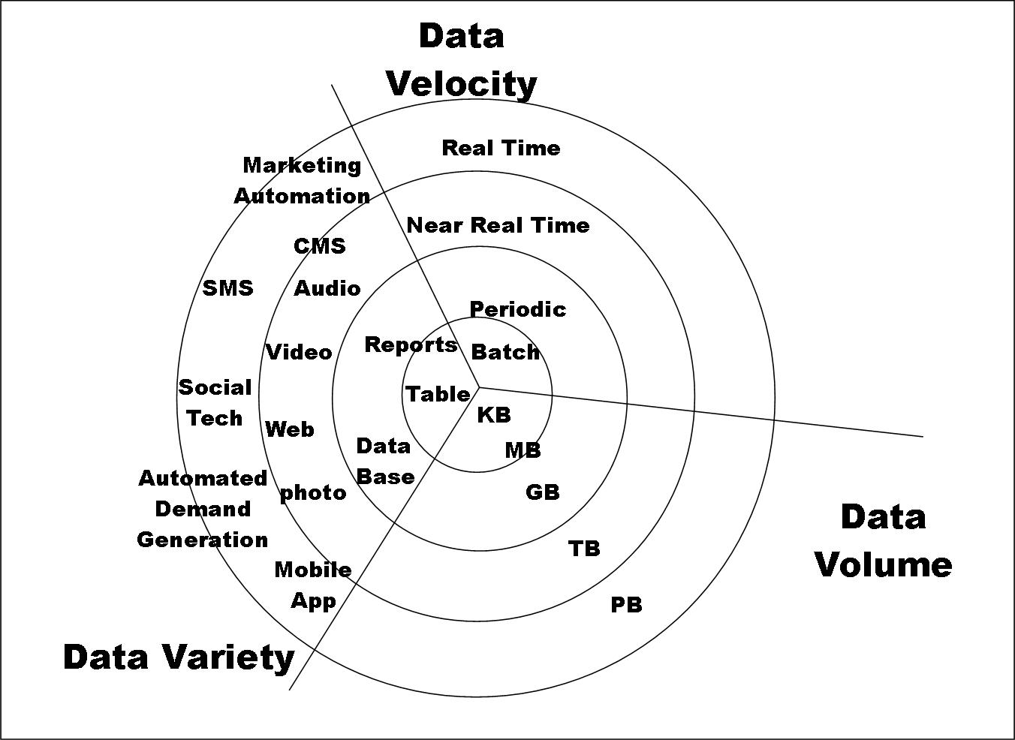
Big Data

Slide 7
Types of Data We Have
Relational Data (Tables/Transaction/Legacy Data)
Text Data (Web)
Semi-structured Data (XML)
Graph Data
Social Network, Semantic Web (RDF), …
Streaming Data
...

Slide 8
What To Do With These Data?
Aggregation and Statistics
Data warehousing and OLAP
(On Line Analytical Processing)
Indexing, Searching, and Querying
Keyword based search
Pattern matching (XML/RDF)
Knowledge discovery
Data Mining
Statistical Modeling

Slide 9
Data Science?
An area that manages, manipulates, extracts, and interprets knowledge from tremendous amount of data
Data science is a multidisciplinary field of study with goal to address the challenges in big data
Data science principles apply to all data – big and small

Slide 10
What is Data Science?
Theories and techniques from many fields and disciplines are used to investigate and analyze a large amount of data to help decision makers in many industries such as science, engineering, economics, politics, finance, and education
Computer Science
Pattern recognition, visualization, data warehousing, High performance computing, Databases, AI
Mathematics
Mathematical Modeling
Statistics
Statistical and Stochastic modeling, Probability.

Slide 11
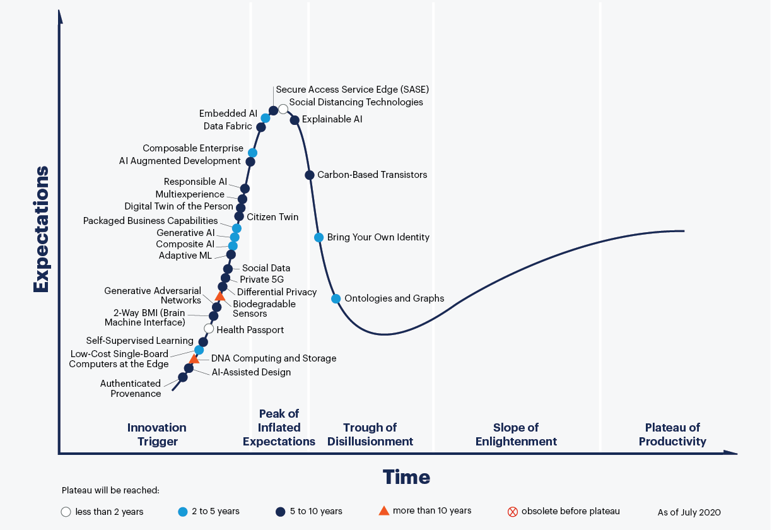
Why is it hot?
Gartner’s 2020 Hype Cycle

Slide 12
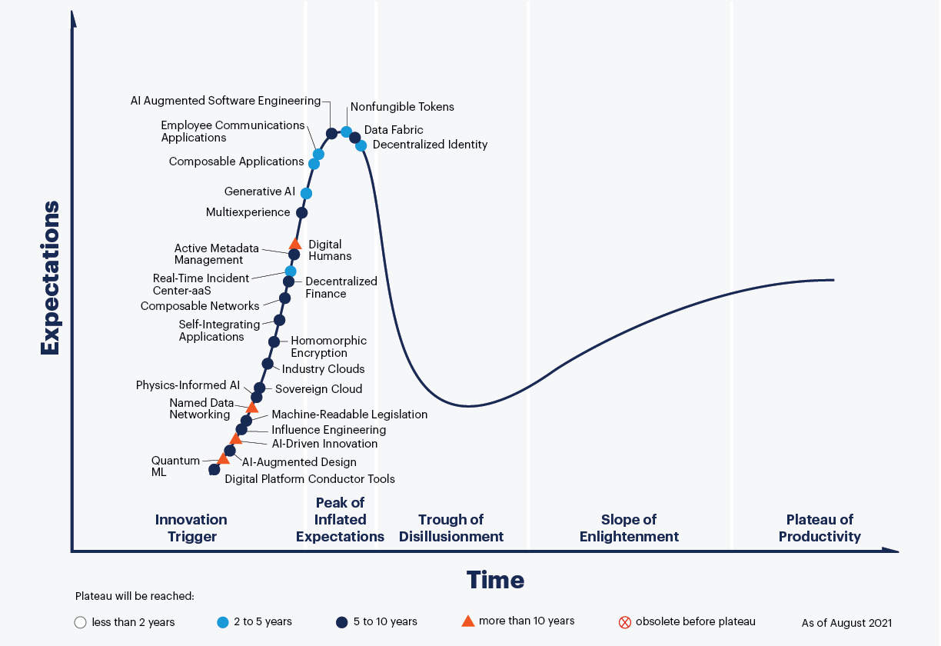
Why is it hot?
Gartner’s 2021 Hype Cycle

Slide 13
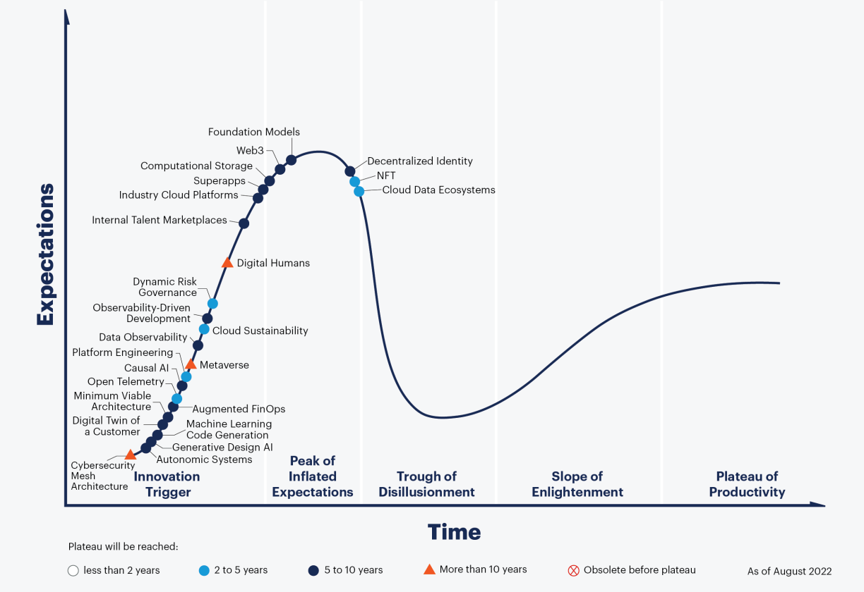
Why is it hot?
Gartner’s 2022 Hype Cycle

Slide 14
Why is it hot?
What we can see from Gartner’s 2022 Hype Cycle is that data science is being applied to many emerging technologies. Newer technologies require more powerful Big Data processing capabilities
With the booming development of AI, Data science as an input to AI, also needs to evolve to handle larger data sets

Slide 15
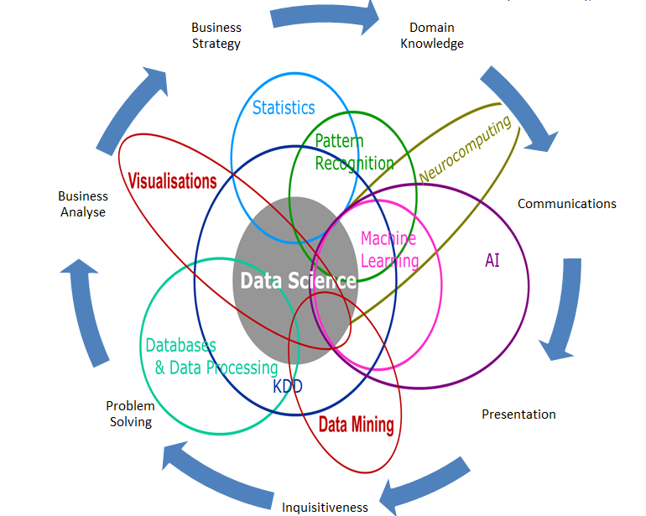
Data Science

Slide 16
Real Life Examples
Help Computer understand Code
GitHub Copilot uses the OpenAI Codex to suggest code and entire functions in real-time, right from your editor
Video is classified according to multimodal information
When you post a video on Tiktok, Tiktok will immediately push it to the corresponding user based on the automatic classification of multi-modal information

Slide 17

Data Scientists
Data Scientist
They design data modeling processes, create algorithms and predictive models to extract the data the business needs, and help analyze the data.

Slide 18





Concentration in Data Science
Mathematics and Applied Mathematics
Solid Programming Skills (R, Python, MATLAB and SQL)
Data Mining
Data Base Storage and Management
Machine Learning and discovery
Stay hungry, Stay foolish
Novice
Contributor
Expert
Master
Grandmaster

Slide 19
Reference
https://www.gartner.com/smarterwithgartner/5-trends-drive-the-gartner-hype-cycle-for-emerging-technologies-2020
https://www.gartner.com/smarterwithgartner/3-themes-surface-in-the-2021-hype-cycle-for-emerging-technologies
https://www.gartner.com/en/articles/what-s-new-in-the-2022-gartner-hype-cycle-for-emerging-technologies
https://www.raconteur.net/infographics/a-day-in-data/
https://github.com/features/copilot/
https://www.mygreatlearning.com/blog/difference-data-science-machine-learning-ai/
https://www.northeastern.edu/graduate/blog/what-does-a-data-scientist-do/
https://oralytics.com/2012/06/13/data-science-is-multidisciplinary/

Slide 20

Happy China Programmer’s Day!

