Slide 1
Football App
By Nuzhafiq and Shane

Slide 2
Info
This application uses mongodb and node. We use mongodb to store the players with the help of studio 3T. We use node.js to connect mongodb and ionic.

Slide 3
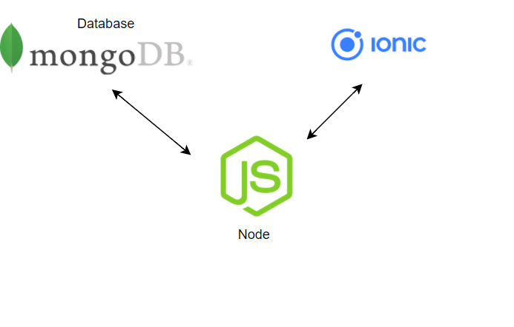
The 3 Tier Architecture

Slide 4
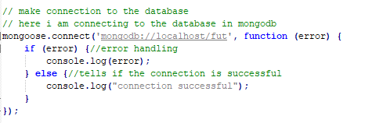
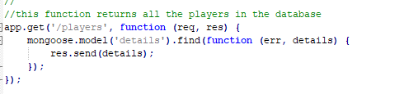
How we connect to mongodb

Slide 5
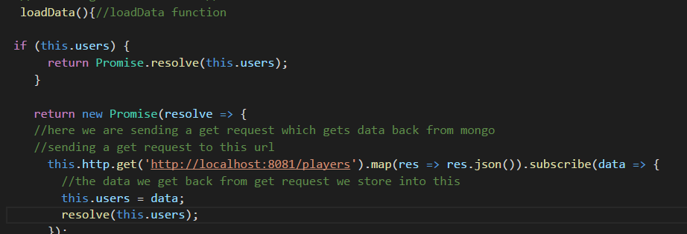
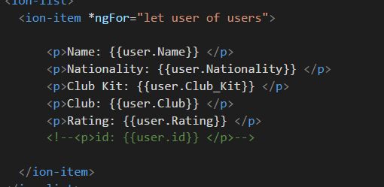
How we send a get request and how we display the values.

Slide 6
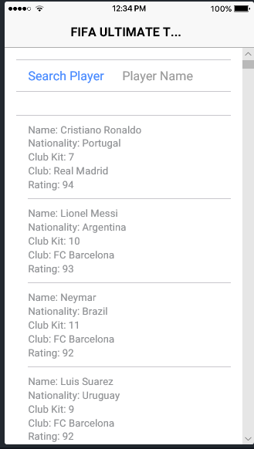
How it looks.

Slide 7
What we will do next.
We will add the search option. When user searches it will display that player.
We will add a login page

