Slide 1
Fake News Detection Project
By: Anvith, Jessica, Caitlyn, Lucy
Notes:
https://docs.google.com/document/d/1UKGa5wvABAnSv6yKsv7cqWUYjtdr0SyqNs2fhhHSX6Q/edit?usp=sharing

Slide 2
Our Product: Detecting Fake News
Problem: misinformation has become increasingly widespread, making it difficult to differentiate between real and fake news
Our Approach: We utilized a fake and real news dataset
Methods:
  Data Cleaning and Preprocessing
  Sentiment Analysis on the text
  Building the LSTM
  Evaluate accuracy, predictions , recall, and f1 score
  Model testing on articles
  ROC curve
  LIME to understand the model
  Road Bumps
  Conclusions

Slide 3
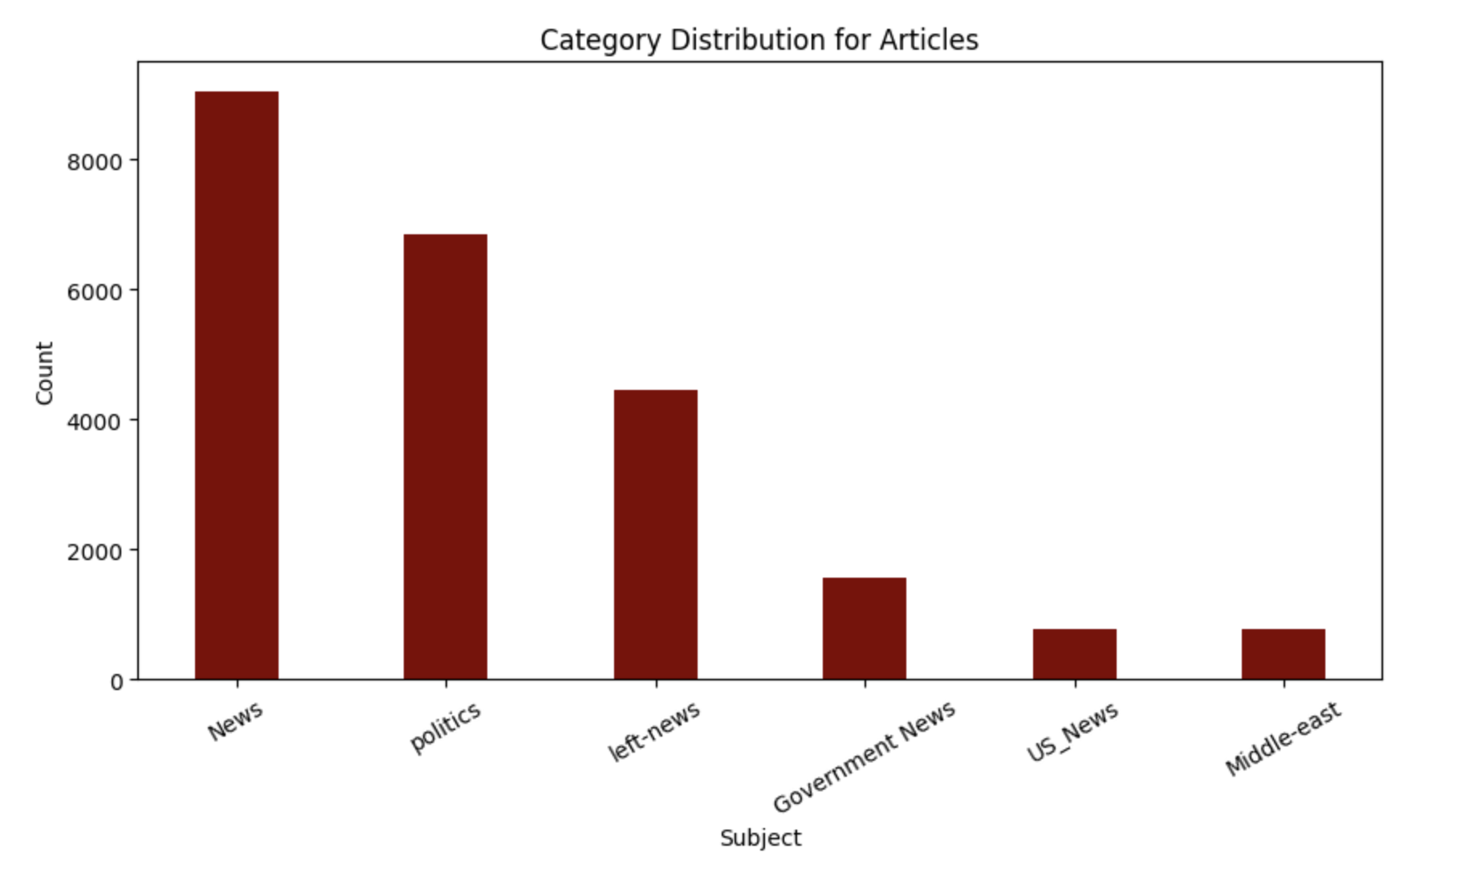
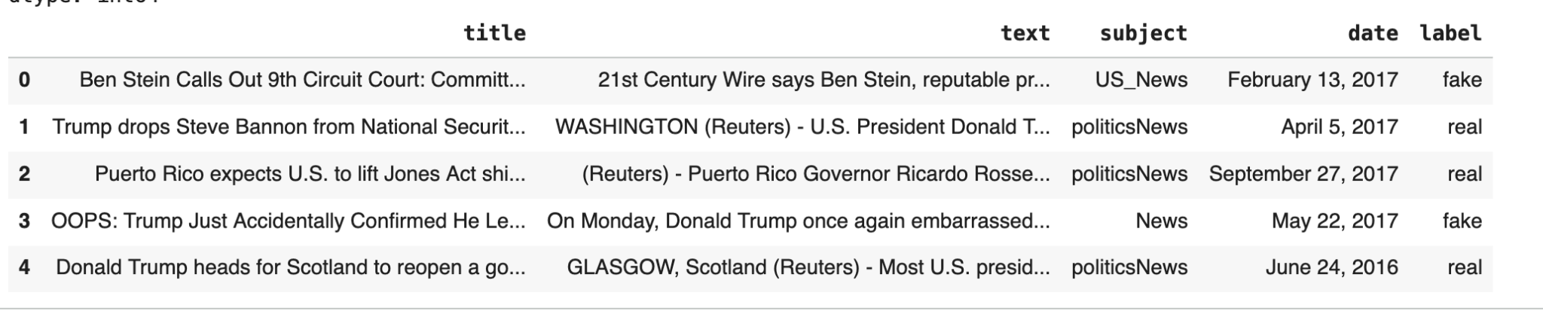
Data
Kaggle dataset:
  No missing values
  Removed duplicates
Contained a file for fake news and a file for real news
Columns: title, text, subject, date, label
After combining files and duplicates, the shape was (44,689, 5)

Slide 4
Preprocessing
Drop Columns title, subject, and date because we only used text and label for our model
LabelEncoder from sklearn.preprocessing
Tokenizer- converts words into integers and creates vocabulary (max vocabulary of 5000)
Padding- ensures all sequences have the same length (max sequence length of 1000)
Split the data into 80% training data, 10% validation data, and 10% test data

Slide 5
Using Sentiment Analysis from TextBlob Package
After cleaning and removing stopwords…
Calculating polarity from sentiment analysis for fake and real news (output ranges [-1,1] with negative values indicating negative sentiment and positive
Calculating subjectivity from sentiment analysis for fake and real news (output ranges [0,1] with 0 indicating objectivity and 1 indicating subjectivity)
Polarity was neutral for both fake and real news, but fake news tends to be slightly more subjective than real news
Notes:
Caitlyn

Slide 6
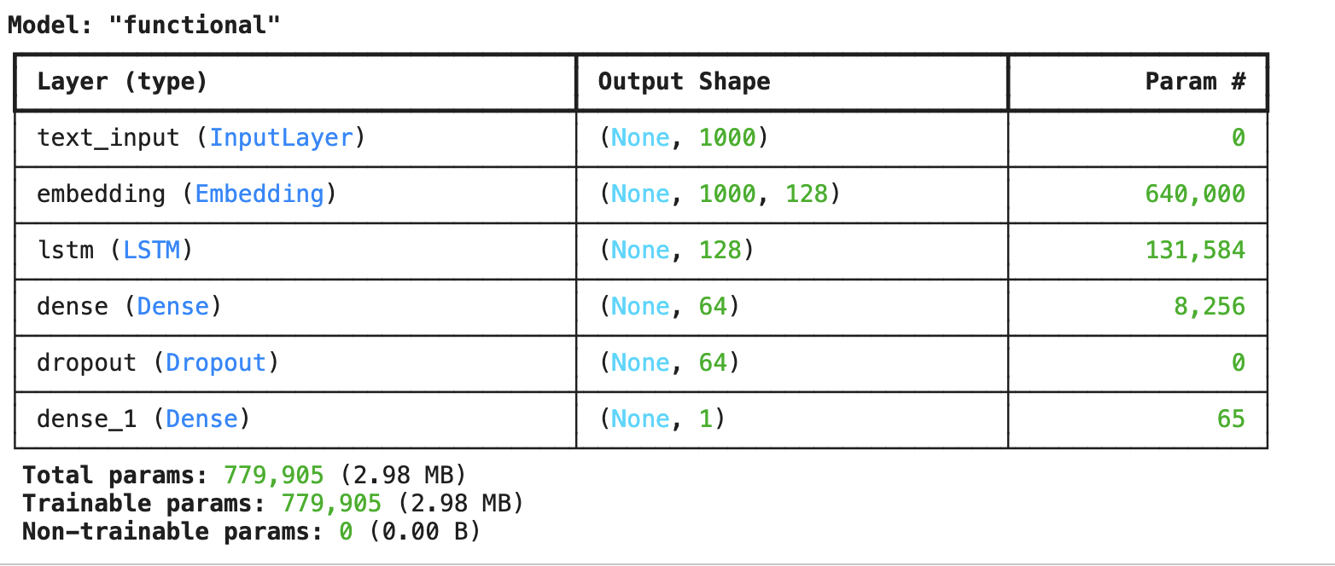
Methodology: Building an LSTM
Input layer accepts the sequence of integers
Embedding layer converts word indexes into 128 dimensional vector
The LSTM layer discovers the patterns between word sequences
Dense Layer takes in 128 dimensional summary and learns non-linear patterns that are output in a 64 dimensional layer
Dropout layer prevents overfitting
Output layer is sigmoid for binary classification
Compiler includes ‘binary_crossentropy’ for loss, ‘adam’ for our optimizer, and accuracy for our metric

Slide 7
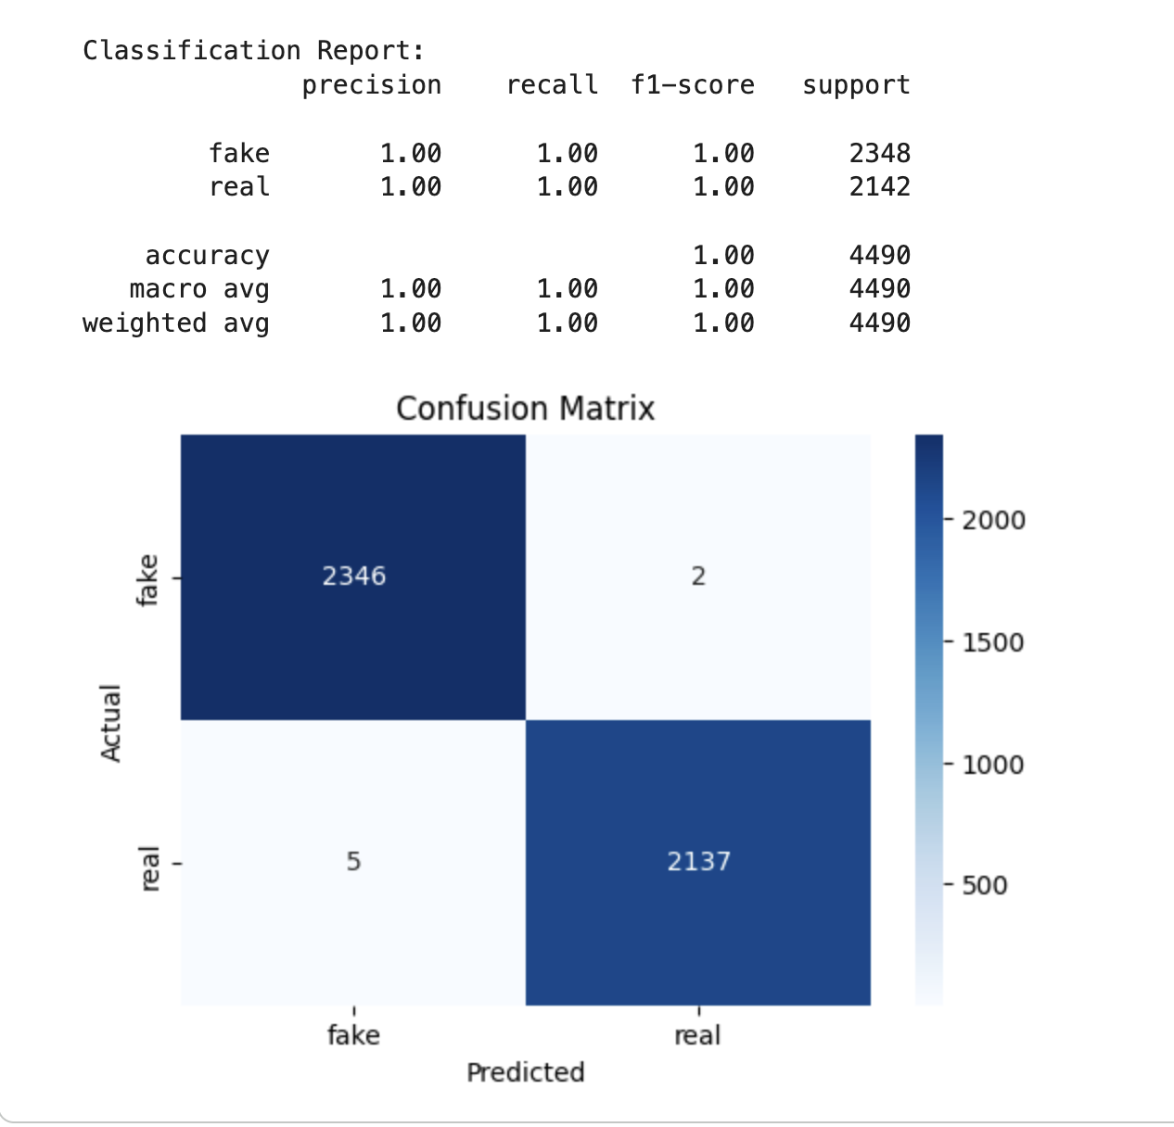
Results
Extremely high test accuracy, precision, recall, and f1-scores
5 False Positives (labeled fake but was real)
2 False Negatives (labeled real but was fake)
Extremely Confident
The data must be extremely differentiable or there may be a data leakage

Slide 8
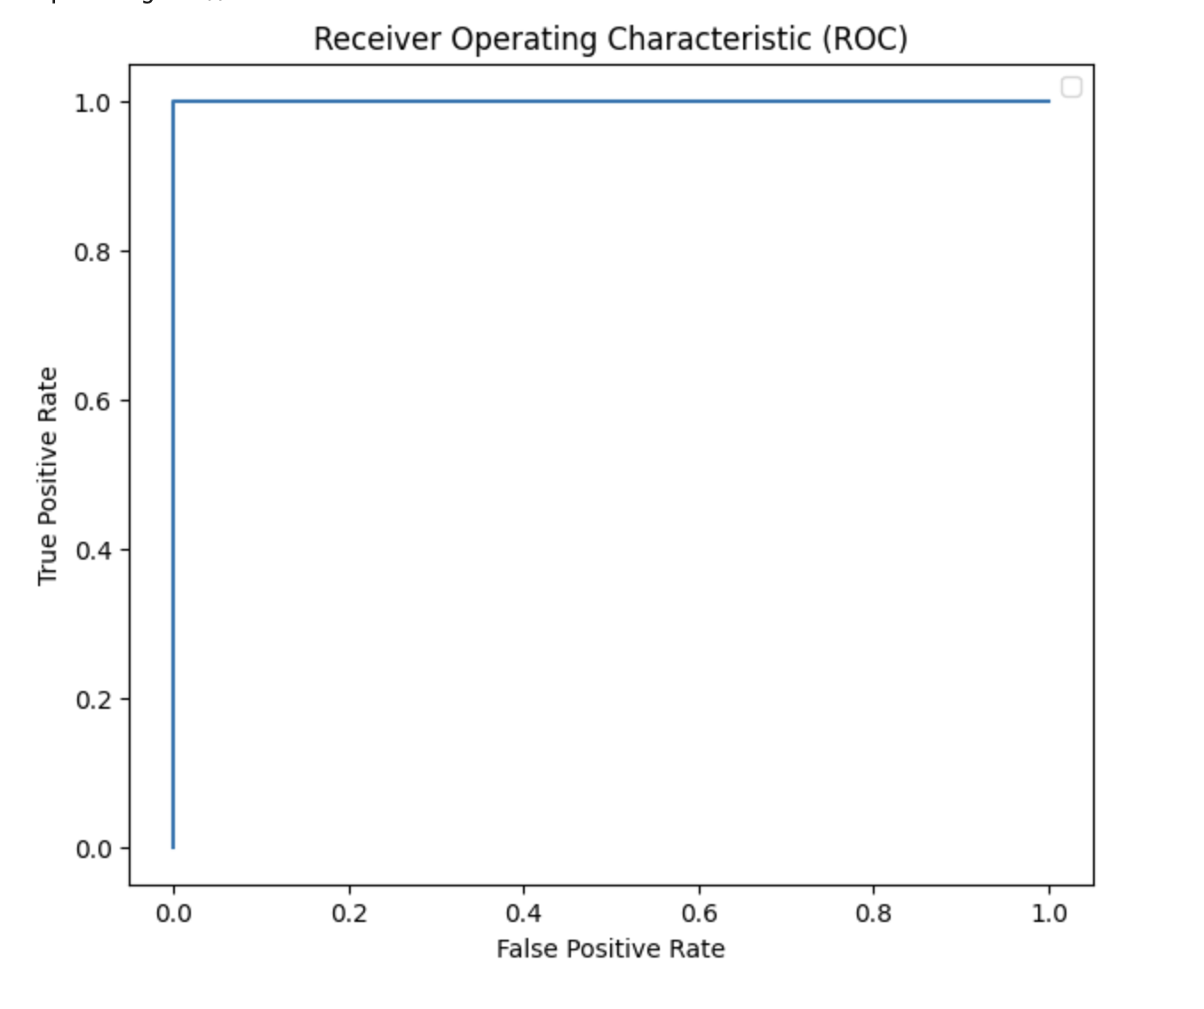
Receiver Operating Characteristic Curve
ROC compares False Positive Rate against True Positive Rate
The shape of the ROC curve shows us that the test data is very easily separable for the model and there is no overlap between positive and negative outcomes.
This graph shows there is a threshold where all true positives are identified and there are no false positive values.
Notes:
Caitlyn

Slide 9
Testing on Real Examples
Name of article | Source | Actual Label | Predicted Label
“Hegseth Ordered a Lethal Attack but Not the Killing of Survivors, Officials Say” | New York Times | Real | Real
“As Trump Deepens Immigration Crackdown, Even Long-Held Exceptions Disappear” | New York Times | Real | Real
“Researchers Determine Moon Serves No Purpose But Alerting Racoons It Safe To Come Out” | Onion | Fake | Fake
“Study: Average 19th century American Spent 93% of time Waving At Trains, Boats” | Onion | Fake | Real
“DNA Sequencing Reveals Hitler Was a Type of Fern” | Onion | Fake | Fake
Notes:
Caitlyn

Slide 10
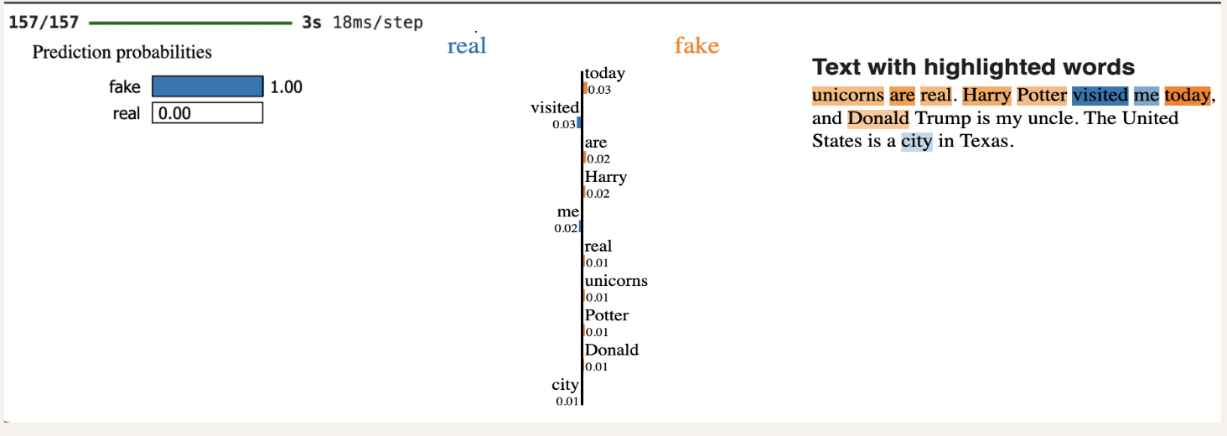
LIME Text Explainer
Lime Explainer can capture how individual words contribute to prediction, but the semantic patterns that are not shown in LIME contribute heavily to prediction as well
The model was able to very confidently detect the fabricated statement and the explainer shows how different words contributed to the prediction

Slide 11
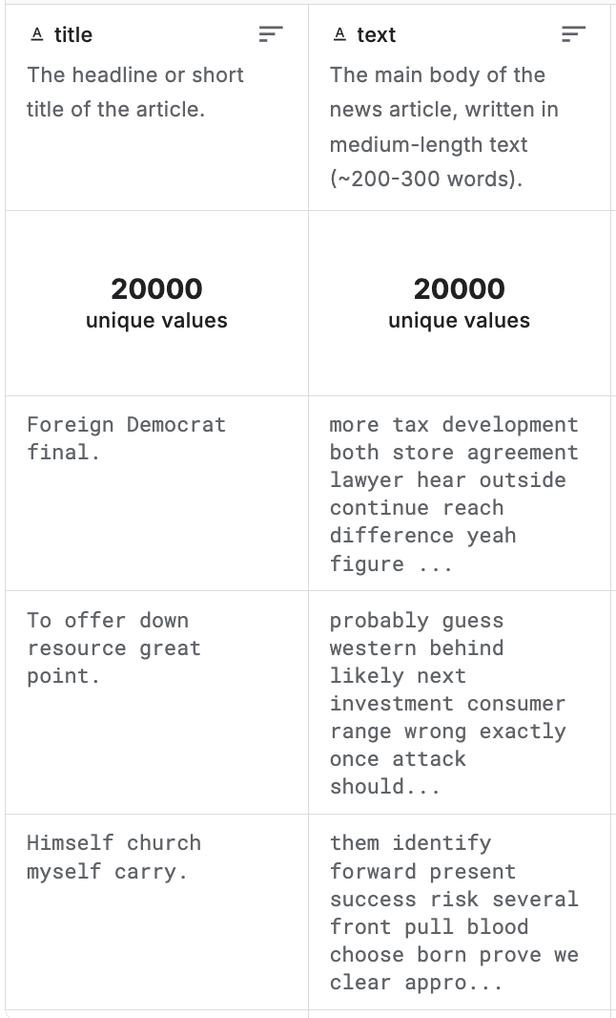
Road Bumps
Situation: Our original dataset was a fake news dataset from kaggle
  Attempted to build a LSTM model and a RoBERTa model and both had low scoring accuracy (both maxing out at 50% accuracy)
  The dataset was synthetically generated
  Text was randomly generated words and sentences had no meaning, making it hard for the models to find patterns
Solution: Finding a new dataset with real data resulting in accurate findings

Slide 12
Conclusions
Quality Data is important
  Originally chose a dataset in which the models were not able to determine patterns
  Our next dataset caused our model to predict extremely high accuracy, but did not hold up on real-world articles
Our dataset included a lot of articles with political contents, but news articles can contain other topics including trends, celebrities, etc.
Our product needs more data to train on and higher quality data, which is difficult to find on Kaggle
Future Work: using datasets with greater variety of contents

Slide 13
Sources
Sentiment Analysis Resources
Rivaldo, R. (2020). Sentiment-Analysis [Code repository]. GitHub. https://github.com/RichardRivaldo/Sentiment-Analysis?tab=readme-ov-file
Devêci, B. (2025, May). Fake-News Detection with TF-IDF & BERT [Notebook]. Kaggle. https://www.kaggle.com/code/busradeveci/fake-news-detection-with-tf-idf-bert#Fake-News-Detection-Project:-Summary-and-Evaluation
(Sentdex). (2018, February 27). Fake News Detection with TF-IDF & BERT [Video]. YouTube. https://www.youtube.com/watch?v=qTyj2R-wcks
LIME Text Explainer
marcotcr. (2021). LIME: Explaining the predictions of any machine learning classifier [Code repository]. GitHub. https://github.com/marcotcr/lime
Articles Used
The New York Times. (2025, December 1). Hegseth ordered a lethal strike on suspected drug-smuggling boat from Venezuela, U.S. officials say. The New York Times. https://www.nytimes.com/2025/12/01/us/hegseth-drug-boat-strike-order-venezuela.html
The New York Times. (2025, December 1). Trump administration signals hard-line shift on immigration for Afghan DACA recipients. The New York Times. https://www.nytimes.com/2025/12/01/us/politics/trump-immigration-afghan-daca.html
The Onion. (2025, November 28). Researchers determine moon serves no purpose but alerting raccoons it’s safe to come out. The Onion. https://theonion.com/researchers-determine-moon-serves-no-purpose-but-alerting-raccoons-it-safe-to-come-out/
The Onion. (2025, November 14). DNA sequencing reveals Hitler was type of fern. The Onion. https://theonion.com/dna-sequencing-reveals-hitler-was-type-of-fern/
The Onion. (2025, November 25). Study: average 19th-century American spent 93% of time waving at trains, boats. The Onion. https://theonion.com/study-average-19th-century-american-spent-93-of-time-waving-at-trains-boats/

Slide 14
Thank You!
Do you have any questions?

