Slide 1


SECTOR SPECIFIC PORTFOLIO OPTIMISATION
FinQuest Project
Finance Club, IIT Roorkee
In the Indian Stock Market
E: 23114065
Megh Bhavesh Shah
2nd Year, CSE

Slide 2

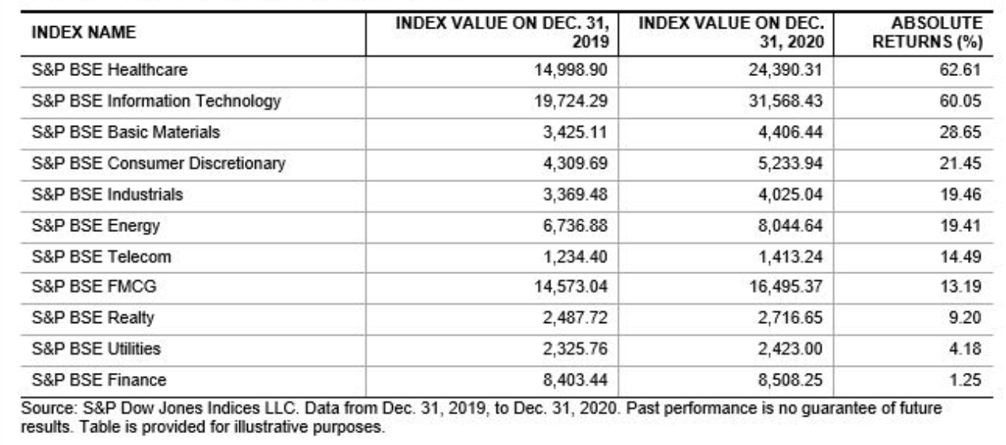
Project
Methodology
Investment Highlights
Project Overview
Project Deliverables
Conclusion
References
Risk Assessment
Project Overview
Sector-Specific Portfolio Optimization
The Indian Stock Market is heavily influenced by major industry sectors such as IT, Agriculture, FMCG, Pharmaceuticals, Energy, etc. This makes the Indian stock market diversified and therefore complex. Portfolio Optimization has been a challenging problem that has attracted the attention of many analysts. It is particularly difficult due to the volatile nature of the economy and industries.
Performance of various BSE Sectors during the period 2019-2020
Thus, a mix of stocks from every sector reduces the overall risk in the portfolio and enhances the chances of
having a larger return. With the help of the model of Mean Variance Optimization, we will find the portfolio
with stocks from various sectors that has the minimized risk for a given target return.

Slide 3
Project Overview
Project Deliverables
Project
Methodology
Conclusion
References
Risk Assessment
Project Deliverables
I have prepared and delivered the following things throughout my project:
Sectoral statistics including volatility, average returns, correlation matrices and beta
values of every stock within a sector
(b) Calculation of Sharpe and Sortino ratios of all stocks in a sector
(c) Monte Carlo Simulation of 10,000 portfolios within a sector to know which stocks are performing
the best
(d) Implementation of Mean-Variance Optimization Model to calculate the Efficient Frontier and the
optimized portfolio for a target return (=20%)
(e) Performance of the optimized portfolio on the 2023 stock market data and enhancement of
returns with dynamic rebalancing
(f) Comparison of the returns of the optimized portfolio with NIFTY 50 Benchmark Index

Slide 4
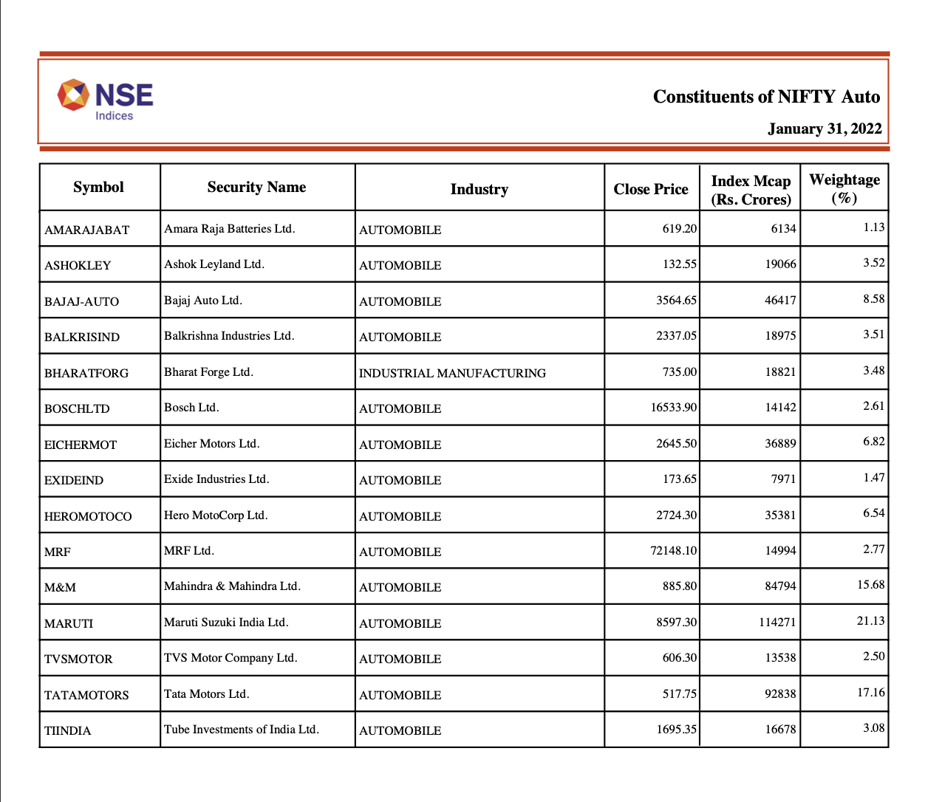
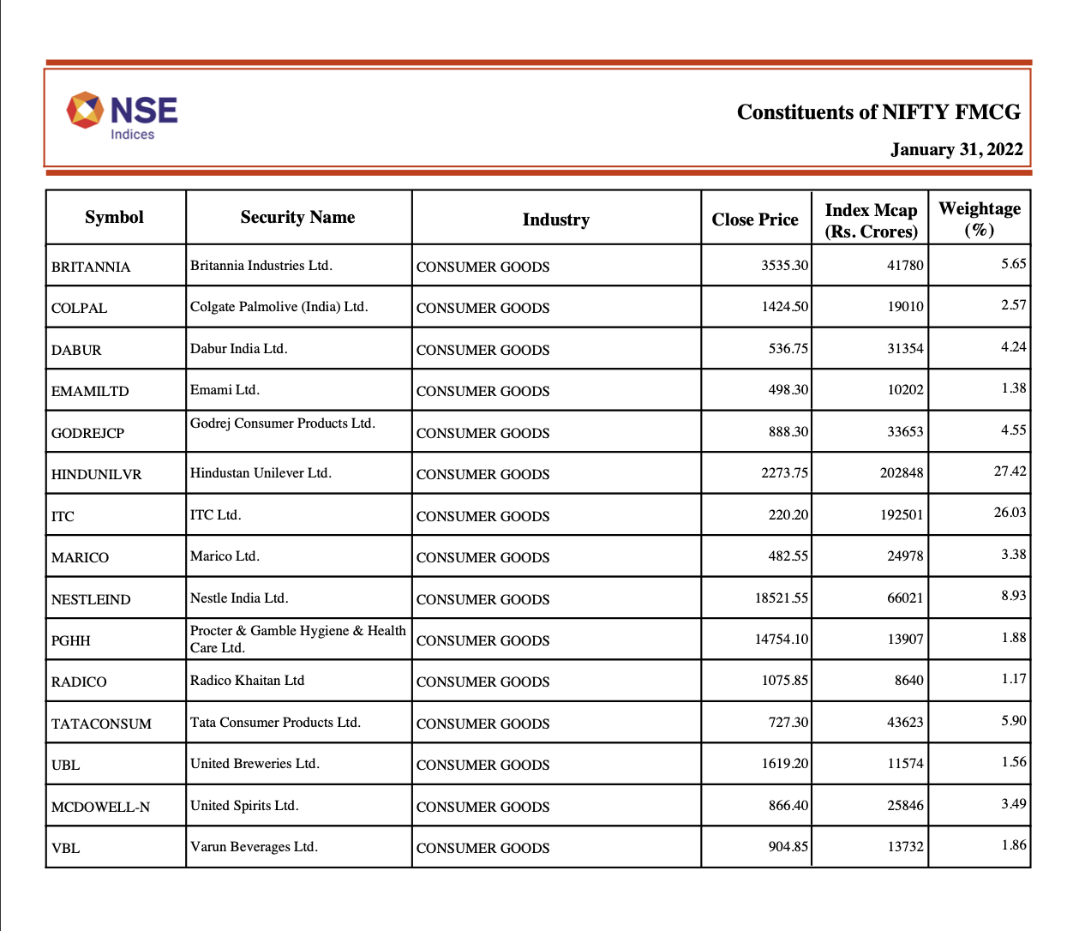
Project Overview
Project Deliverables
Project
Methodology
Conclusion
References
Risk Assessment
Project Methodology
Choosing the stocks
Among the various sectors in National Stock Exchange (NSE), Bombay, six sectors are chosen that
exhibit diversity in the Indian Stock Market:
Auto, Banking, Metal, Fast Moving Consumer Goods (FMCG), Pharmaceuticals, and Information
Technology (IT).
The NSE produces monthly reports identifying the stocks in each sector that have the most significant
impact on the respective sector.
Based on NSE’s report of Jan 2022, the eight most critical stocks from each of the six sectors are identified.
Most Critical Stocks in the sector of Auto and FMCG, as per NSE

Slide 5
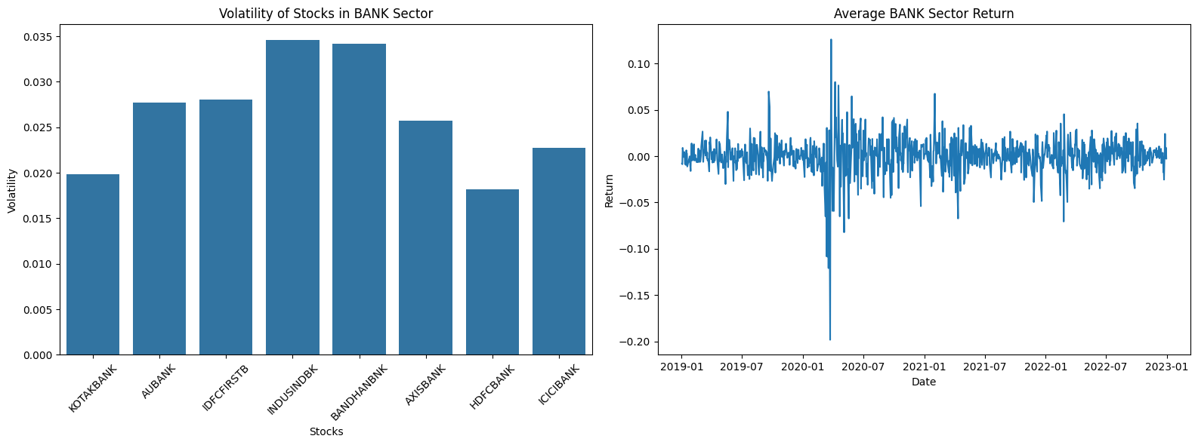
Project Overview
Project Deliverables
Project
Methodology
Conclusion
References
Project Methodology
2. Sector Analysis
Various statistics of the stock data are analysed. Daily log returns of each stock are calculated, using the
shift function. The log returns are also calculated for the sectoral indices for each sector, to analyse the sector
as a whole. The standard variation of the log returns are calculated to obtain the volatility within the
sector. Average returns are also calculated to review the performance of the sector.
Volatility of each stock and Average Return of the BANK sector

Slide 6
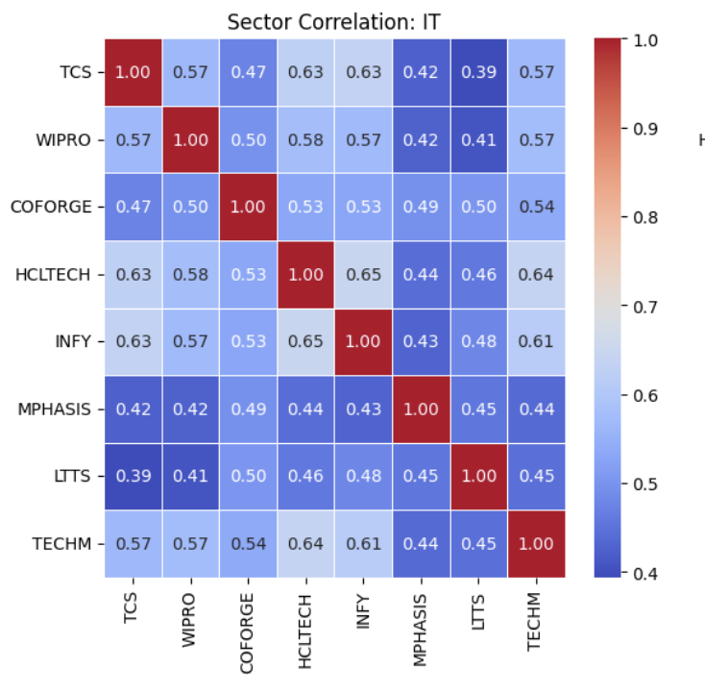
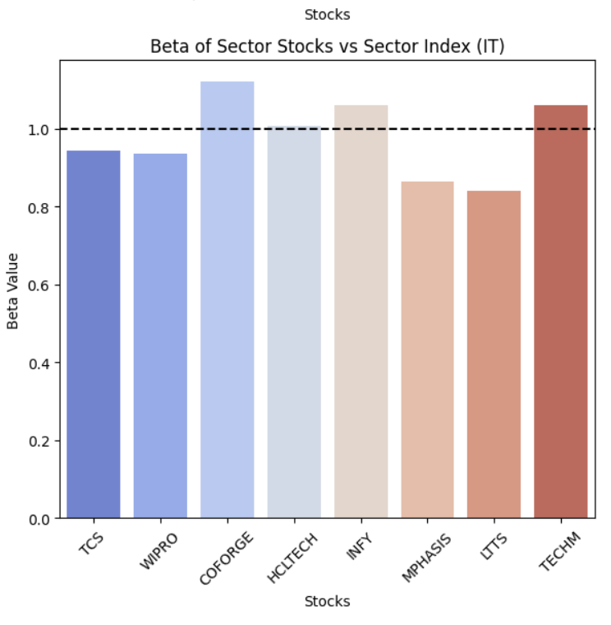
Project Overview
Project Deliverables
Project
Methodology
Conclusion
References
Project Methodology
2. Sector Analysis
Correlation matrix of the stock return data is calculated per sector, to analyse how strongly are the prices
of a certain stock depend upon any other stock in the sector. This helps identify, which stocks to be put
in the portfolio. The beta values for each stock is also calculated. It indicates how much the stock's price
tends to move relative to the market.
Heat Map showing the correlation within the stocks of IT Sector
Beta Values of the stocks in the IT Sector

Slide 7
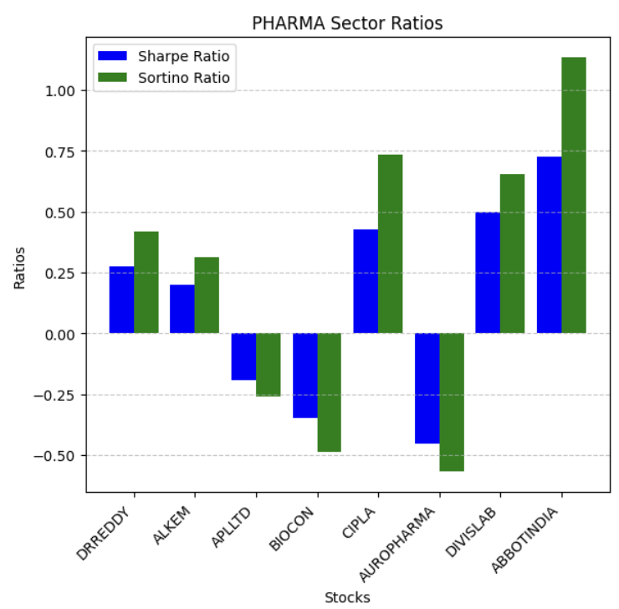
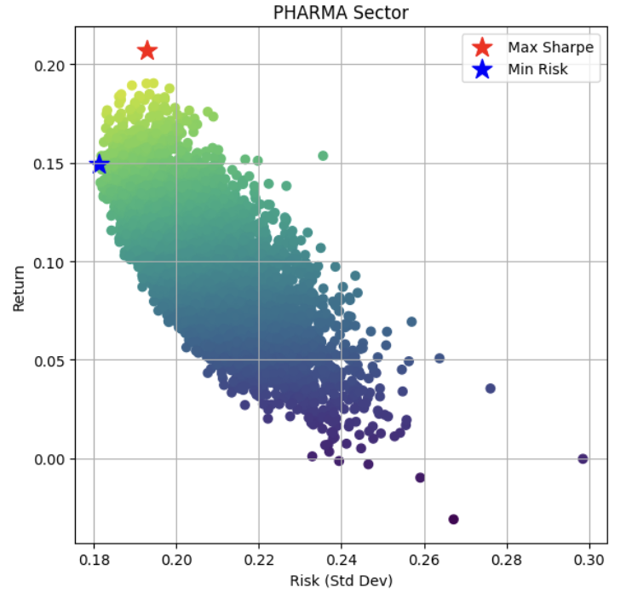
Project Overview
Project Deliverables
Project
Methodology
Conclusion
References
Project Methodology
3. Implementation of MVO Model
Sharpe and Sortino Ratios for each sector are calculated first. The risk free return rate is assumed to be 7%
for the same (Source: www.people.stern.nyu.edu) Monte Carlo Simulations (10000) for all the stocks in a
sector are also provided for review. The stocks shortlisted for the portfolio based on the insights
provided by these ratios and Monte Carlo Simulations are: 'BALKRISIND', 'BAJAJ-AUTO', 'ICICIBANK’,
'HDFCBANK', 'HINDUNILVR', 'INFY', 'HCLTECH', 'ADANIENT', 'APLAPOLLO', 'ABBOTINDIA'
Plots showing the Sharpe and Sortino Ratios and Monte Carlo Simulations for PHARMA sector

Slide 8
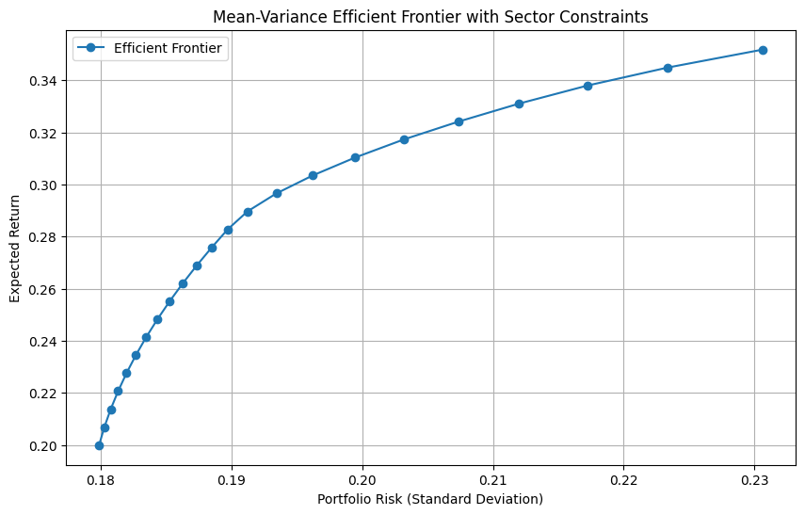
Project Overview
Project Deliverables
Project
Methodology
Conclusion
References
Project Methodology
3. Implementation of MVO Model
Now, the MVO model is implemented on the shortlisted stocks. Sector based constraints and base constraints
are specified. And, the optimization problem, to minimize the risk given the constraints is solved for
every target return. The efficient frontier is built using the optimal portfolio’s risk vs return analysis. The
optimal portfolio for 20% return is also shown as a pie-chart, which will be used for back-testing.
Efficient Frontier obtained by performing the MVO model analysis

Slide 9
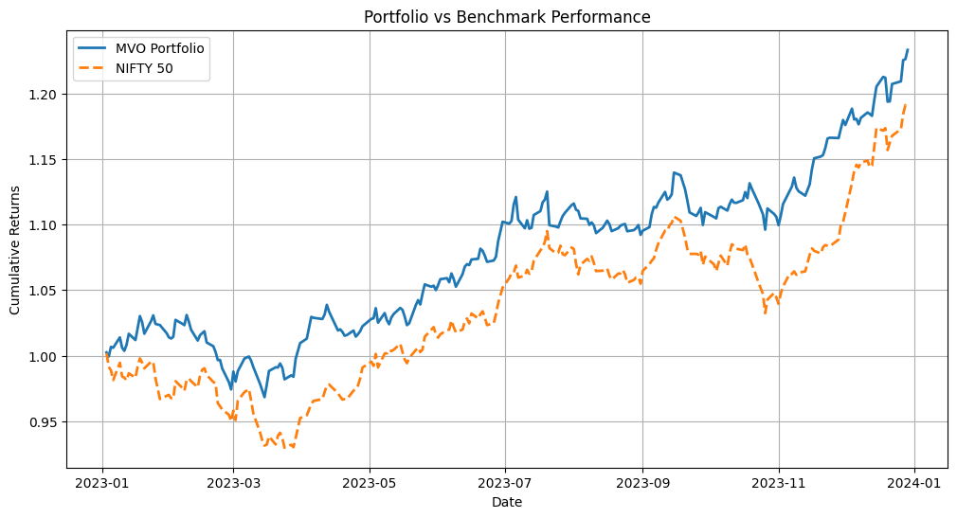
Project Overview
Project Deliverables
Project
Methodology
Conclusion
References
Project Methodology
4. Back-testing
The optimal portfolio (for 20% return) is performed in the stock market during the 2023 year. The annual
returns, volatility, Sharpe ratio and maximum drawdown is calculated for the year. And its performance
is compared with the NIFTY 50 Benchmark Performance. It turns out, our portfolio did significantly better
than the benchmark performance.
NIFTY Annual Return Rate: 19.14%
Our portfolio’s Return Rate: 23.69%

Slide 10
Project Overview
Project Deliverables
Project
Methodology
Conclusion
References
Project Methodology
4. Back-testing
The portfolio is also dynamically rebalanced half quarterly, quarterly, and monthly, to obtain better
returns. The process is run on a python file and results are shown using Dash and Plotly. When rebalanced
monthly, the portfolio gains maximum returns, (=26%) against the 19% return of NIFTY 50 Index.
Thus, the portfolio obtained from the Mean-Variance Optimization Model, satisfactorily gives returns in the
Year 2023.
Note: Please run the Jupyter notebooks in the order: Data_Preprocess.ipynb, Sector_Analysis.ipynb, MVO_
Model.ipynb, BackTesting.ipynb, monthwise_dashboard.py. Also, please ensure that all the folders of stock
data and csv files are in the same folder as those of the notebooks, while running them. Sorry for the mess :)

Slide 11
Project Overview
Project Deliverables
Project
Methodology
Conclusion
References
Conclusion
This project has presented an approach to portfolio optimization using the Mean-Variance Optimization
Model, using stocks that performed the best in their respective sectors. Six sectors are chosen and analysed,
and the stocks that were stable and gave maximum returns were shortlisted. The stock data from
January 1, 2019 to December 31, 2022 is used for the analysis. The optimal portfolio is prepared by
incorporating the sector constraints and minimising risk for given target returns. The data from
January 1, 2023 to December 31, 2023 is used for judging the performance of the optimal portfolio.
The study revealed that including stocks from different sectors made it diversified and hence, the risk was
reduced to an extent. Also, the Sharpe ratio and Sortino ratio prove to be excellent metrics to
nit pick the stocks to be included in the portfolio.
The further work includes incorporating sector related data, such as USD-INR rates, Crude Oil Prices, etc.
into account, and dynamically choose the stocks from the sectors which are positively affected from these
changes.

Slide 12
Project Overview
Project Deliverables
Project
Methodology
Conclusion
References
References
[1] Jaydip Sen and Abhishek Dutta, Design and Analysis of Optimized Portfolios for Selected Sectors of
the Indian Stock Market, 2022.
[2] Gupta, R. and Parikshit K. Basu, Portfolio optimisation in the Indian stock market - industry sector
analysis, 2022.
[3] NSE Website: http://www.nseindia.com
[4] Historical data on stocks and sectors between the dates January 1, 2019 to December 31, 2024,
from Yahoo Finance.
[5] Necessary Python modules like yfinance, pandas datareader and tools like Quandl, Dash and Plotly.
[6] Online AI models like ChatGPT

