Slide 1
Prepare Desserts

Slide 2
Prepare Desserts LO 1. Perform mise en place
Learning Objectives
Identify tools and equipment needed in preparing desserts
Recognize importance of dessert in a meal
Classify desserts according to types of ingredients used
Identify characteristics of desserts

Slide 3
1. Let’s Ignite your prior Knowledge!
Let’s start with identifying some tools!

Slide 4
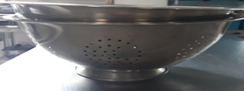
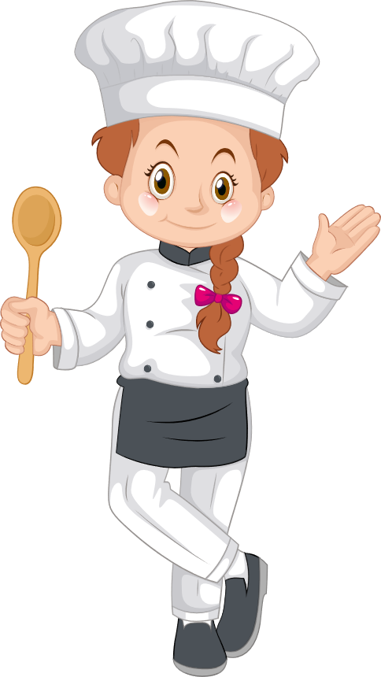
Correct! It’s a Colander!
Can you identify the tools?

Slide 5
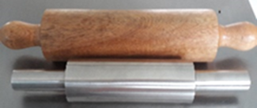
Correct! It’s a Rolling Pin!
Can you identify the tools?

Slide 6

Correct! It’s a Rotary egg beater
Can you identify the tools?

Slide 7

Correct! It’s a Spatula!
Can you identify the tools?

Slide 8
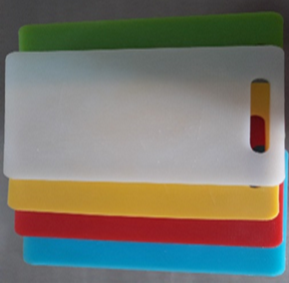
Can you identify the tools?
Correct! It’s a Cutting Boards!

Slide 9

Can you identify the tools?
Correct! It’s a Sifter!

Slide 10

Correct! It’s a Measuring glass
Can you identify the tools?

Slide 11

Correct! It’s a Weighing Scale
Can you identify the tools?

Slide 12
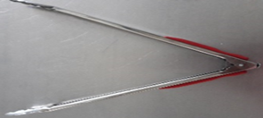
Can you identify the tools?
Correct! It’s a Food tong

Slide 13
1I. Input Information
Description here

Slide 14
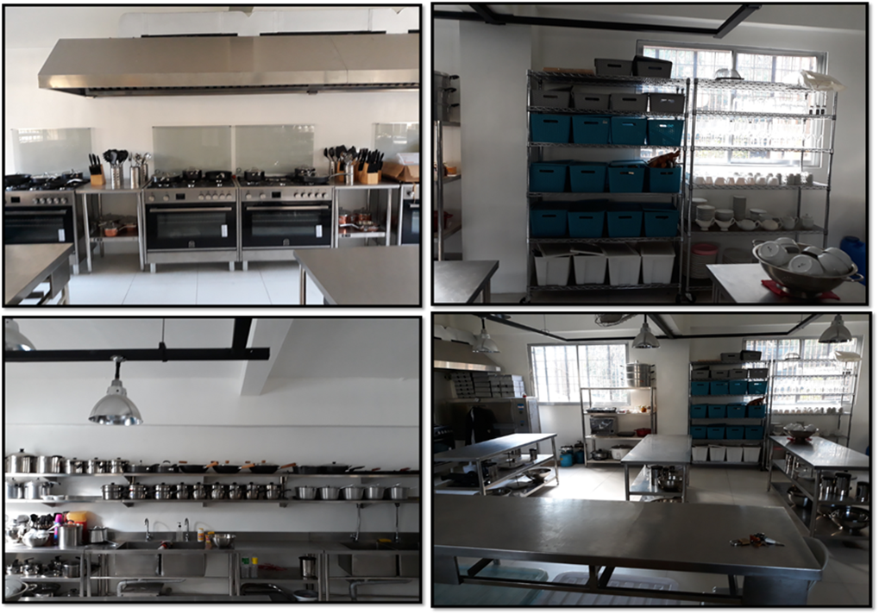
The success in preparing desserts depends on the availability of tools and utensils, and equipment used. Cooking is enjoyable if all tools, utensils and equipment are available, functioning and in good condition, it will make cooking easier and comfortable.

Slide 15
Kitchen Tools
Baking Wares
Made of glass or metals, they serve as containers for batter and dough and is available in various sizes and shapes

Slide 16
Kinds of Baking Wares
Muffin pan
has formed cups for baking muffins and cupcakes.
Bundt pan
is a round pan with scalloped sides used for baking elegant and special cakes

Slide 17
Kinds of Baking Wares
Jelly roll pan
for baking jelly rolls or roll cakes.
Loaf Pan
is used to bake loaf bread

Slide 18
Kitchen Tools
Colander
is used for draining liquids and rinsing fruits, vegetable and other ingredients.
Strainer
is used for draining liquids and for sifting flour

Slide 19
Kitchen Tools
Measuring cups
they are used to measure dry and liquid ingredients. It consist of two types namely

Slide 20
2 kinds of Measuring Cup
Graduated cup
with measurements (1, 3/4, 2/3, ½, 1/3, ¼, ) marked on each side used for dry ingredients such as flour, sugar powdered milk, etc..

Slide 21
2 kinds of Measuring Cup
Measuring glass
is made of transparent glass or plastic is used for measuring liquid ingredients.

Slide 22
Kitchen tools
Measuring spoons
consist of a set of spoons with different sizes for measuring small amount of ingredients

Slide 23
Kitchen tools
Weighing scale
consist of a set of spoons with different sizes for measuring small amount of ingredients

Slide 24
Kitchen tools
Mortar and Pestle
is used to pound or ground ingredients

Slide 25
Kitchen tools
Pastry bag & tips
used for decorating, plating or presenting dessert such as cakes, pastries torte etc.

Slide 26
Kitchen tools
Rolling pin
used to roll dough and fondant icing
Rubber scrapper
is used to remove bits of food on sides of the bowl

Slide 27
Kitchen tools
Rotary egg beater
is used in beating eggs
Food tong
used for various purposes. It is use to grab hot or larger food item

Slide 28
Kitchen tools
Spatula
comes in different sizes; it is used for various purposes such as removing excess ingredients when measuring and used for decorating cakes

Slide 29
Kitchen tools
Cutting board
it is used to protect the table when cutting, used a separate cutting board for meat and vegetable to prevent cross contamination. Cutting board have a different color for its purposes

Slide 30
Types of Cutting board
a. Red- for raw red meat;
b. Green – for fruits and vegetable;
c. Yellow- for poultries;
d. White- for bread;
e. Blue- for seafood; and
f. Brown- for cooked meat.

Slide 31
Kitchen tools
Knives is used for cutting foods
French knife – or commonly called as chief’s knife is used to chop, dice, or mince food.
Paring knife - used to feel off the skin of fruits and vegetables.
Boning knife- used to remove the bones of meat.

Slide 32
Kitchen tools
Kitchen slicer
is used to cut fruits and vegetable for equally proportion sized
Peeler is used to pare off skin of fruits and vegetable

Slide 33
Equipment

Slide 34
Equipment
Oven with top range – It is used for baking cakes, pastries and cooking desserts
Blender – is used blending, juicing and making puree.
Refrigerator - used for cooling and storing dessert
Stand mixer - used for mixing, whipping whisking batter.

Slide 35
Classification of Desserts and their Characteristics

Slide 36
The word dessert originates from an interesting French word, desservir, which actually means "to clear the table." After the dinner dishes are removed, the host brings out the dessert.

Slide 37
Importance of Desserts
Dessert is a sweet dish that is usually serve at the end of the meal.it gives you a feeling of fullness and signify a completion of the meal that create a sense of goodness. The following are the benefits of eating dessert:

Slide 38
Importance of Desserts
Desserts are packed with nutrients. There’s a reason why your body craves certain delicious desserts. Low carb diets often overlook the fact that carbohydrates are an essential nutrient for the body. While desserts may not be the healthiest form of carbohydrates, the right indulgences can fuel your body and mind.

Slide 39
Importance of Desserts
Mood Booster. Indulging in your favorite dessert alters your mind and body in positive ways. Take full advantage of this scientific process by allowing yourself to enjoy your favorite sweet treat without that extra side of guilt. You really are doing something good for your body.

Slide 40
Importance of Desserts
Eating dessert can actually improve your weight control. Cravings for sweets are one of the biggest causes of diet failure. When the average adult quits eating desserts all together, they may see improvement in their short term fitness goals. However, studies have shown that adults who indulge in dessert but eat an otherwise nutritious diet have a greater chance of producing long term success in weight loss. This is true because the body will respond to small amounts of desserts that satisfy cravings by satiating its own appetite for them.

Slide 41
Importance of Desserts
Desserts offer a convenient opportunity to incorporate more fruit into your diet. Fruit, as we all know by now, is an essential part of your daily intake of nutrients that keep you healthy, strong, and immune to certain diseases.

Slide 42
Classification of Desserts and their Characteristics
Hot Desserts
Desserts are served warm and hot. Following are example of hot dessert.

Slide 43
Baked Desserts
Sponge based dessert - these require ingredients similar with sponge cake (Flour eggs sugar and shortening). Fruits, nuts chocolate or vanilla is also part of ingredients of this desserts. Swiss roll is an example.

Slide 44
Fried Dessert
Pancakes and crepes
The pancake is a drop batter. It is a mixture of flour, sugar, baking powder oil, milk and oil, it is fried on both sides. Crepes it a very thin pancake made of rich batter without baking powder.

Slide 45
Fried Dessert
Fritters
It is stiff batter or dough filled with fresh or cooked fruits and deep fried. Example of fritters banana fritters and camote fritters.

Slide 46
Classification of Desserts and their Characteristics
Cold Desserts
Desserts are served chilled or frozen. Following are different kinds of cold desserts.

Slide 47
Gelatin based desserts
Gelatin is the main ingredient it dissolved into boiling water and then chilled.
Panna Cotta
Coffee Jelly
Jelly

Slide 48
Cold Desserts
Fruit based dessert – It is simplest dessert, most nutritious, easy to serve and prepared. Four seasons and fruit salad are example

Slide 49
Cold Desserts
Egg based milk/ cream a custard cream smooth and consistency with caramel sauce on top.
Ice Cream Based Dessert
This is normally made using an ice cream maker and kept frozen

Slide 50
Activity Sheet
Description here about the activity

Slide 51
Activity Sheet
A. Word Pool
Direction: Read statement and identify what is being describe. Choose your answer from the word pool.

Slide 52
Word Pool
It is used to cut fruits and vegetable for equally proportion sized.
Colander
Rubber scrapper
Pastry bag & tips
Oven
Kitchen slicer
Mortar and Pestle

Slide 53
Word Pool
It used for decorating, plating or presenting dessert such as cakes, pastries torte and others.
Colander
Rubber scrapper
Pastry bag & tips
Oven
Kitchen slicer
Mortar and Pestle

Slide 54
Word Pool
It is used for draining liquids and rinsing fruits, vegetable and other ingredients.
Colander
Rubber scrapper
Pastry bag & tips
Oven
Kitchen slicer
Mortar and Pestle

Slide 55
Word Pool
It is used for baking cakes, pastries and cooking desserts
Colander
Rubber scrapper
Pastry bag & tips
Oven
Kitchen slicer
Mortar and Pestle

Slide 56
Word Pool
It is used to remove bits of food on sides of the bowl.
Colander
Rubber scrapper
Pastry bag & tips
Oven
Kitchen slicer
Mortar and Pestle

Slide 57
Activity Sheet
B. Classification:
Direction: Classify the following example of desserts into hot or cold or cold dessert. Write hot dessert or cold dessert on the space provided before each number.

Slide 58
Classification
Butchi
Ice Cream
Brazo de Mercedez
Banana fritters
Bico
Sherbet
Fruit Salad
Leche flan
Chocolate mousse
Chocolate mousse

Slide 59
Authentic Assessment
Direction: Identify what is being described in each item. Write the letter of the correct answer on your answer sheet.

Slide 60
Authentic Assessment
What tool is used to shred and separate foods such as carrots and cheese?
a. Kitchen knife c. Paring knife
b. Grater d. Butchers knife

Slide 61
Authentic Assessment
Which of the following does NOT belong to the group?
a. Custard c. Pudding
b. Gelatin dessert d. Sandwich

Slide 62
Authentic Assessment
Which of the following does NOT belong to the group?
a. Custard c. Pudding
b. Gelatin dessert d. Sandwich

Slide 63
Authentic Assessment
Which of the following dessert can be served hot or cold?
a. Fruit cobblers c. Custard
b. Gelatin d. Ice cream

Slide 64
Authentic Assessment
Which of the following desserts is most nutritious appetizing and easy to prepare?
a. Fruit dessert c. Gelatin
b. Ice cream d. Pudding

Slide 65
References
Rondilla, Aida H. et al Cookery Vol. 1,Adriana Publishing Co. Inc. Aurora Blvd. QC
Retrieved 06/20/18 https://angellajohnson.com/events/ignite
Retrieved 06/20/18 http://thepeakperformancecenter.com/business/learning/business-training/learning-objectives/terminal-objectives/
Retrieved 06/20/18 https://www.google.com.ph/search?q=objective+in+cookery+animated&tbm=isch&tbs=rimg
Retrieved 06/20/18 https://www.google.com.ph/search?q=objective+in+cookery+animated&tbm=isch&tbs=rimg:CejoH5-Y4BznIjgtAC2wHpWrtnidbuk7Hh50Rv92b0yxgy_
Retrieved 06/20/18 http://laoblogger.com/cooking-class-clipart.html
Retrieved 06/10/18 https://www.vocabulary.com/dictionary/dessert
Retrieved 06/10/18 https://www.lifehack.org/articles/lifestyle/5-surprising-health-benefits-desserts.html
Retrieved 06/10/18 https://en.wikipedia.org/wiki/Dessert
Retrieved 6/11/18 https://www.pinterest.ph/pin/331647960032580498/
Retrieved 6/11/18 https://www.amazon.com/Mattel-Ratatouille-Little-Chef-Remy/dp/B000LRHWNA
Pictures by Ginalyn V. Manuel taken at Andres Bonifacio Integrated School

