Slide 1
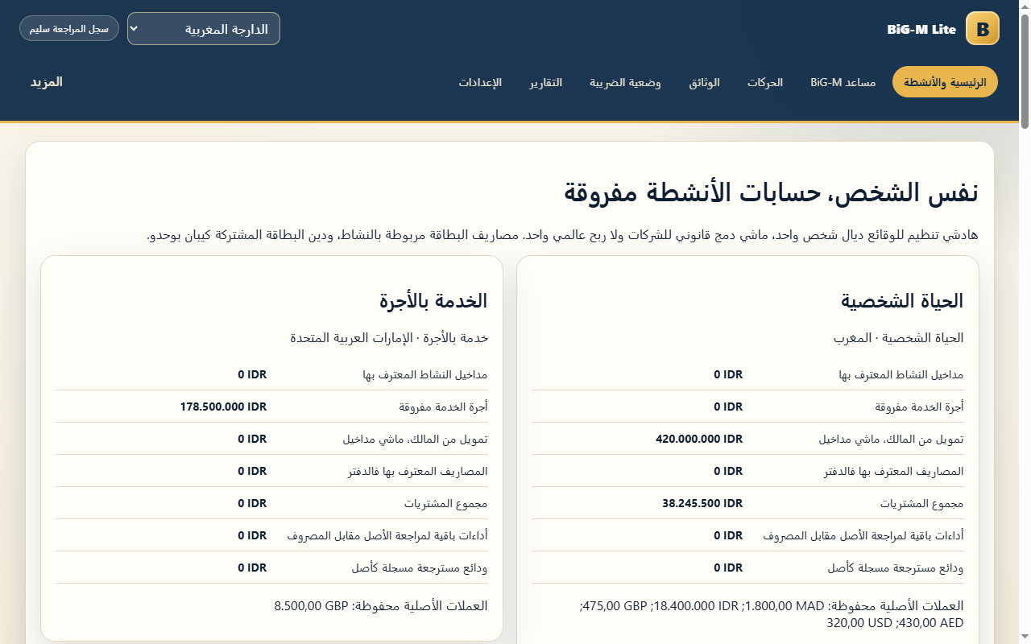
One person. Five economic roles.
BiG-M Lite
Darija conversation
GBP employment
Household and installments
Villa, cafe and gym
October 2025
Synthetic demonstration
1/6 BiG-M Lite Synthetic product demonstration
Notes:
Meet Youssef, a synthetic Moroccan expat. He speaks Darija, receives employment pay in pounds, manages household spending, owns a mixed-use villa, runs a cafe and invests in a gym. BiG-M Lite keeps those economic roles separate. The final demonstration consistently uses October twenty twenty-five. These are actual captured product screens with synthetic records, not real customer data.
Synthetic 2025 persona. Actual product captures from the final browser journey.

Slide 2
Muse interprets. Deterministic engines execute.
Muse Spark
Human review
Existing engines
Interpret context
Propose facts
Validate evidence
Confirm scope
Post journals
Calculate tax
CountryPack evidence and approved rules govern deterministic execution.
Muse selects grounded explanation facts. Recorded state supplies the numbers.
2/6 BiG-M Lite Synthetic product demonstration
Notes:
Muse Spark interprets conversations and documents and proposes structured candidates. BiG-M validates those candidates. A person reviews consequential facts, transactions and legal content. The existing accounting engine posts balanced journals, and one universal tax engine executes approved rules. Official evidence stays attached to the rule. Muse selects grounded facts to explain the result, while deterministic state supplies every amount.
One Accounting Engine and one Universal Tax Engine. Muse has no approval authority.

Slide 3
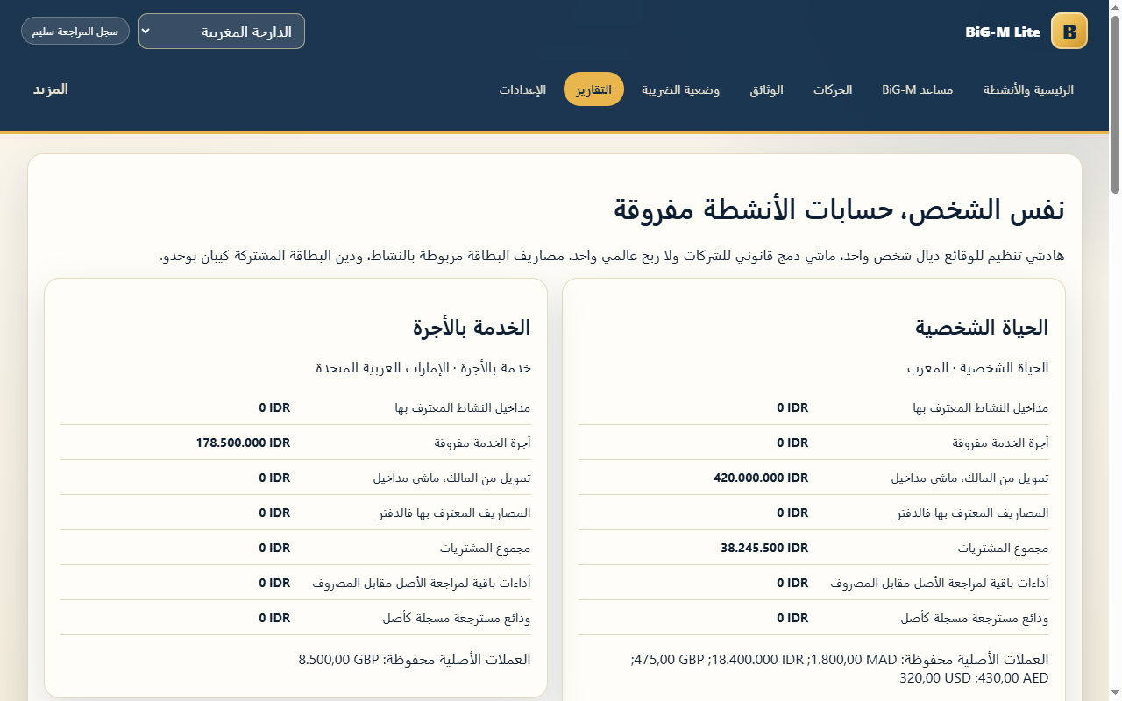
Financial evidence reaches one ledger.
Documents
Conversation
External statements
Reviewed candidates
One posting boundary
129 balanced journals
3/6 BiG-M Lite Synthetic product demonstration
Notes:
Conversation, documents and external imports converge on the same posting boundary. The journey includes foreign currencies, a shared credit card, household purchases and two installments. A card repayment reduces a liability instead of creating another expense. Salary, cafe turnover, villa costs and gym capital retain their own meaning. Duplicate imports and confirmations cannot create duplicate journals.
Original currency and reviewed fixture FX remain visible. Card repayment is liability settlement.

Slide 4
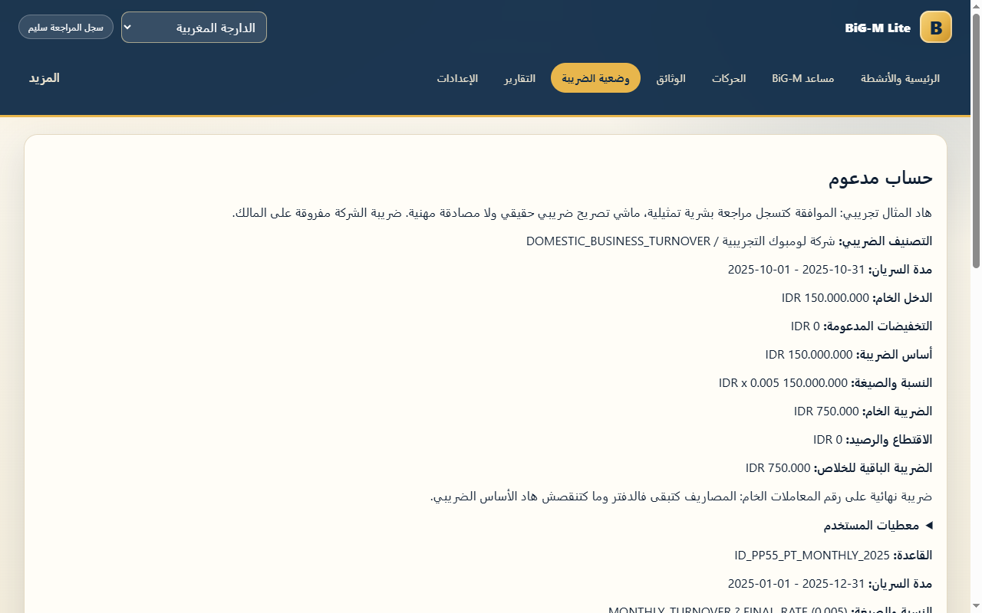
Rp750,000 with an evidence trail.
IDR 150,000,000
Monthly gross base
0.5%
PP 55/2022
IDR 750,000
Remaining payable
Zero withholding / credits
4/6 BiG-M Lite Synthetic product demonstration
Notes:
Here is the concrete supported result. The synthetic Indonesian company has one hundred fifty million rupiah in monthly gross turnover. The governed half-percent rate produces seven hundred fifty thousand rupiah in tax. Supported deductions against this final gross base are zero. Explicit fixture evidence confirms no withholding or advance tax. The user can inspect facts, the effective period, official quotations, formula and calculation trace.
Official sources: PP 55/2022 articles 56-62,74; UU7/2021 article 4(3)(c). Simulated human review.

Slide 5
Uncertainty stays with its own scope.
Supported company calculation
Review required
October 2025
Final gross-turnover tax
IDR 750,000 payable
Personal residence and salary
Mixed-use villa tax treatment
Treaty relief and credits
Villa costs remain recorded. No invented rental allocation or worldwide total.
5/6 BiG-M Lite Synthetic product demonstration
Notes:
The company result does not settle Youssef's worldwide personal taxes. Salary treatment, residence, treaties and mixed-use villa deductions still require evidence. Villa operating costs remain recorded, including staff, cleaning, management and maintenance, without inventing a rental allocation. The supported company amount remains visible while those other components stay under review. This separation makes uncertainty specific and useful.
Company tax is separate from personal worldwide tax. No invented deductions or allocation.

Slide 6
The result survives restart and replay.
129 balanced journals
1 live explanation
Fresh-process restart
Duplicate replay
Language invariance
Darija
Zero retries
Financial state unchanged
The 20-request residence pilot stays frozen and unresolved.
Facts, official evidence and arithmetic stay inspectable.
6/6 BiG-M Lite Synthetic product demonstration
Notes:
The full product journey records one hundred twenty-nine balanced journals and preserves state across a fresh process, replayed imports and language changes. One controlled live Muse request explains the calculated tax in Darija, with no retry and no financial-state change. The separate twenty-request residence pilot remains frozen and unresolved. BiG-M Lite shows the source of each supported number and states what it still cannot determine.
See MOROCCAN-EXPAT-E2E.md, deterministic-result.json and tax-live-explanation.json for evidence.

