Slide 1

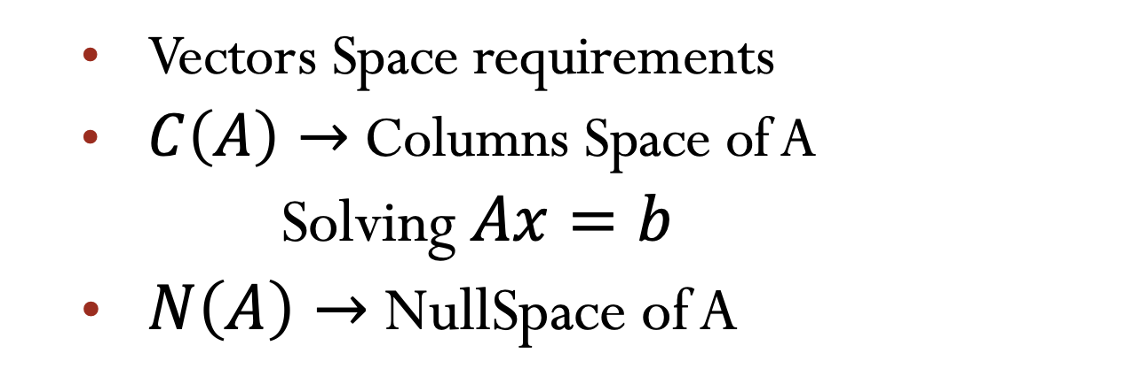
Lecture 06
Column space of A, NullSpace of A
  Vectors Space requirements
  $C\left(A\right)→$ Columns Space of A
  Solving $Ax=b$
  $N\left(A\right)→$NullSpace of A
Attribution-NonCommercial-ShareAlike 4.0 International (CC BY-NC-SA 4.0)

Slide 2
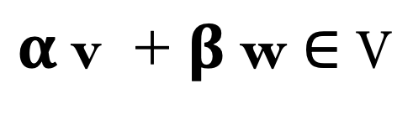

Vector Space requirements.
$$\text{v}\text{ ∈ }\text{ℝ}\text{ⁿ, }\text{w}\text{ ∈ }\text{ℝ}\text{ⁿ}, α\text{ ,}β\text{ ∈ }\text{ℝ}$$
$$α \text{v} \text{+ }β \text{w}\text{ ∈ }\text{V}$$
Subspace = closed under linear combinations

Slide 3
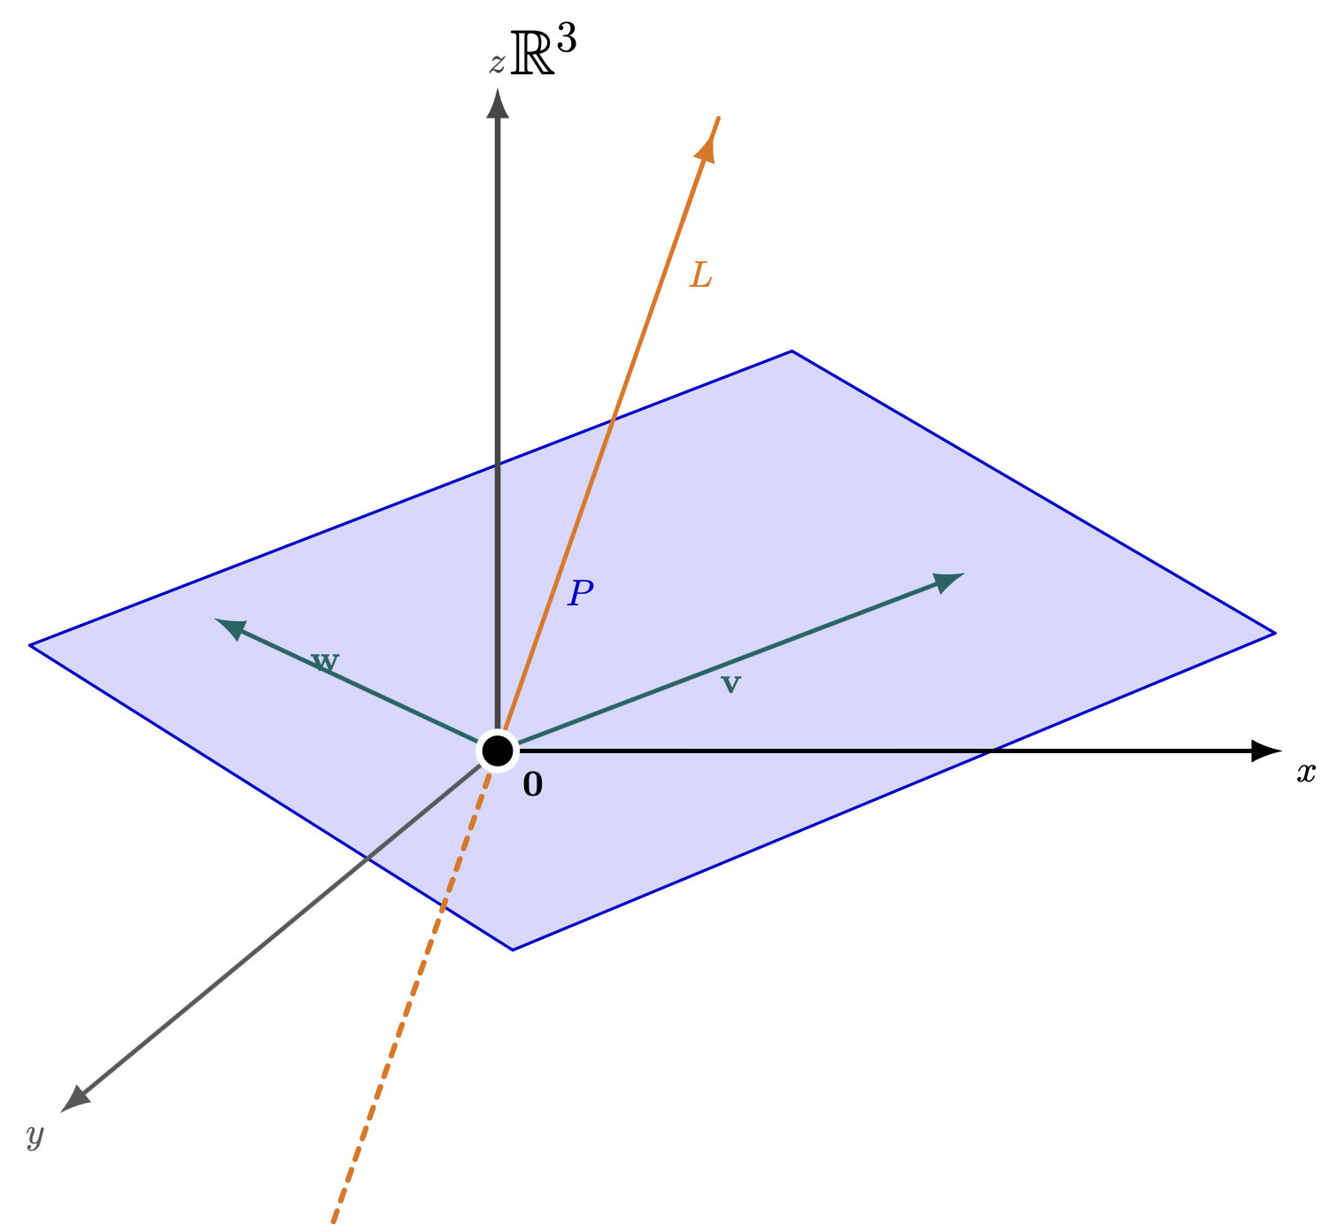
Subspaces in ℝ³
Plane through the origin
Line through the origin
Closed under:
• addition
• scalar multiplication
⇒ Subspaces of ℝ³
Closed under linear combinations

Slide 4
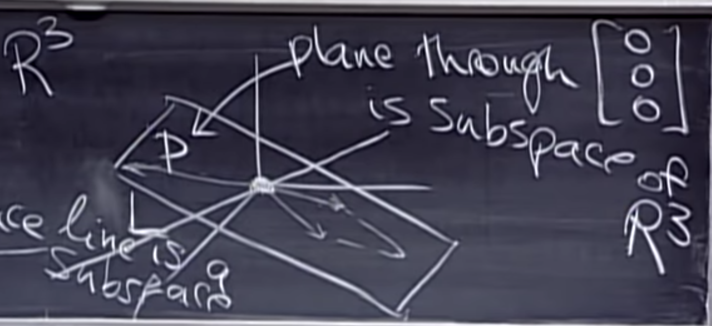


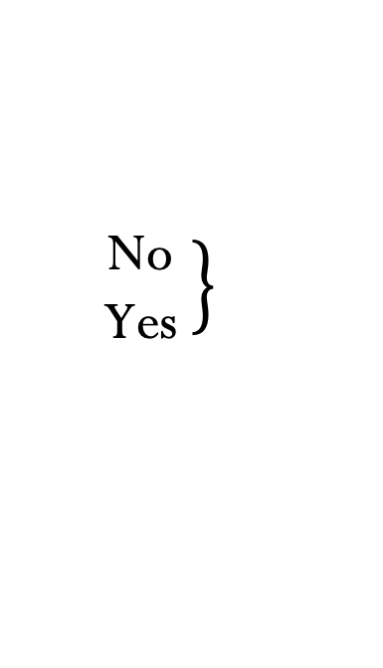


Examples.
P is a plane trough the (0,0,0).
L is a line trough the (0,0,0)
$P ∪L=$All vector in P or L or both.
$P ∩L$ = All vector in P and L.
$$P ∪L= is a subspace?$$
$$P ∩L=is a subspace?$$
$$\left.\begin{matrix}\text{No} \\ \text{Yes} \end{matrix}\right\}$$
Proof!
There are other set of vector like P and L.
Subspaces $S$ and $T$
Intersection is a subspace $S∩T$

Slide 5
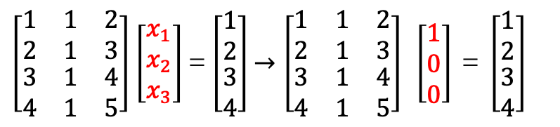
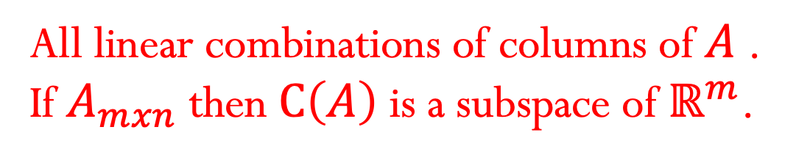
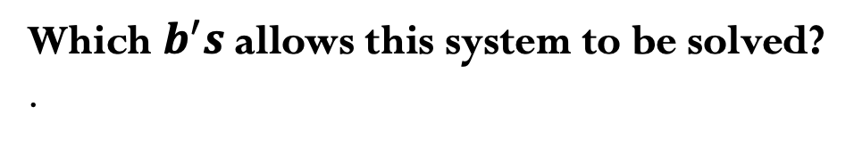

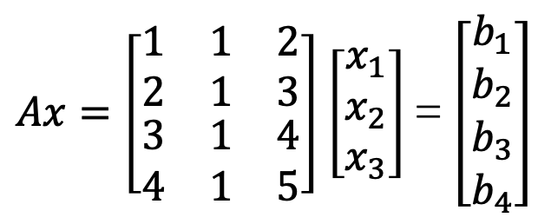
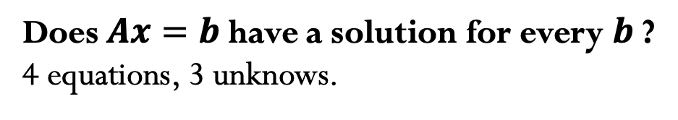
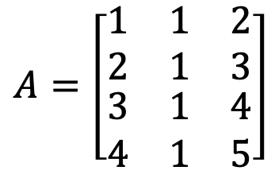

Column space of A $→C\left(A\right)$.
All linear combinations of columns of $A$.
If $A_{mxn}$ then $C\left(A\right)$ is a subspace of $ℝ^{m}$.
$$A=\left[\begin{matrix}\begin{matrix}1 & 1 & 2\end{matrix} \\ \begin{matrix}2 & 1 & 3\end{matrix} \\ \begin{matrix}\begin{matrix}3 & 1 & 4\end{matrix} \\ \begin{matrix}4 & 1 & 5\end{matrix}\end{matrix}\end{matrix}\right]$$
$Ax=\left[\begin{matrix}\begin{matrix}1 & 1 & 2\end{matrix} \\ \begin{matrix}2 & 1 & 3\end{matrix} \\ \begin{matrix}\begin{matrix}3 & 1 & 4\end{matrix} \\ \begin{matrix}4 & 1 & 5\end{matrix}\end{matrix}\end{matrix}\right]$ $\left[\begin{matrix}x_{1} \\ x_{2} \\ x_{3}\end{matrix}\right]$= $\left[\begin{matrix}b_{1} \\ b_{2} \\ \begin{matrix}b_{3} \\ b_{4}\end{matrix}\end{matrix}\right]$
Does $Ax=b$have a solution for every $b$?
4 equations, 3 unknows.
$C\left(A\right)$ is a subspace of $ℝ^{4}$
Which $b^{′}s$allows this system to be solved?
.
$\left[\begin{matrix}\begin{matrix}1 & 1 & 2\end{matrix} \\ \begin{matrix}2 & 1 & 3\end{matrix} \\ \begin{matrix}\begin{matrix}3 & 1 & 4\end{matrix} \\ \begin{matrix}4 & 1 & 5\end{matrix}\end{matrix}\end{matrix}\right]$ $\left[\begin{matrix}x_{1} \\ x_{2} \\ x_{3}\end{matrix}\right]$= $\left[\begin{matrix}1 \\ 2 \\ \begin{matrix}3 \\ 4\end{matrix}\end{matrix}\right]$ $→\left[\begin{matrix}\begin{matrix}1 & 1 & 2\end{matrix} \\ \begin{matrix}2 & 1 & 3\end{matrix} \\ \begin{matrix}\begin{matrix}3 & 1 & 4\end{matrix} \\ \begin{matrix}4 & 1 & 5\end{matrix}\end{matrix}\end{matrix}\right] \left[\begin{matrix}1 \\ 0 \\ 0\end{matrix}\right] \text{=} \left[\begin{matrix}1 \\ 2 \\ \begin{matrix}3 \\ 4\end{matrix}\end{matrix}\right]$
I can solve exactly then b is in the column space of A.

Slide 6
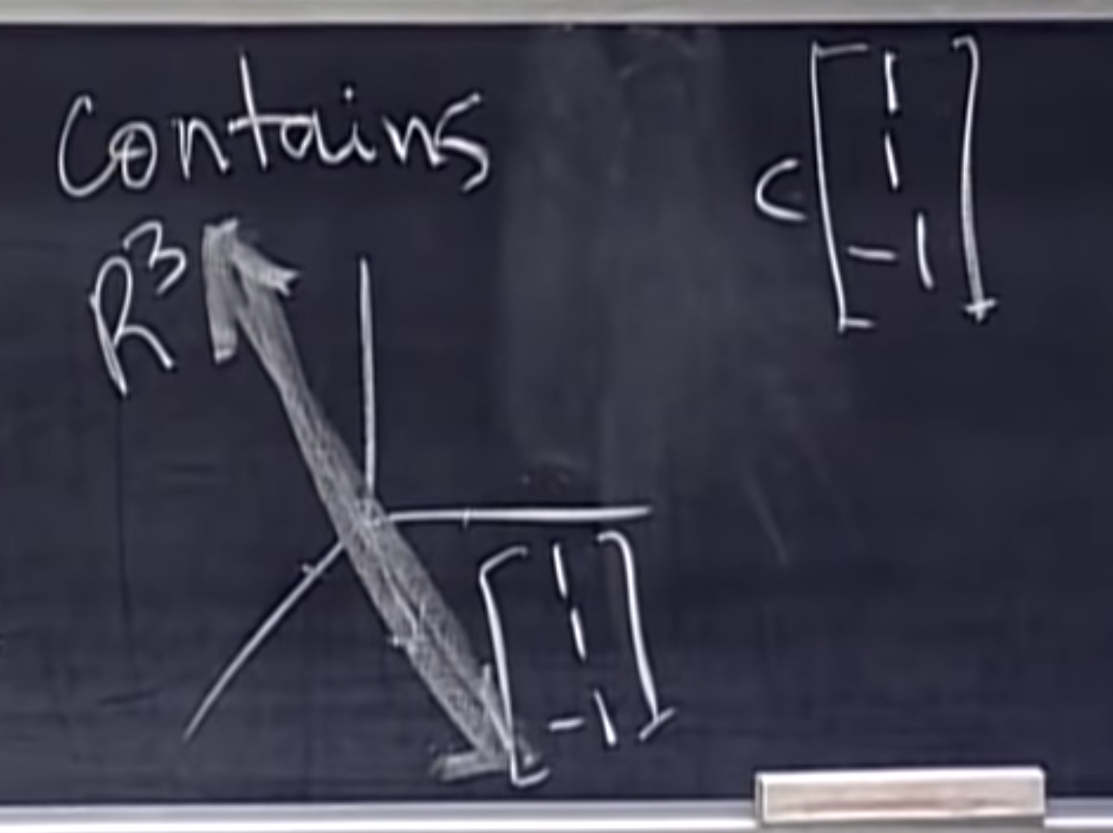
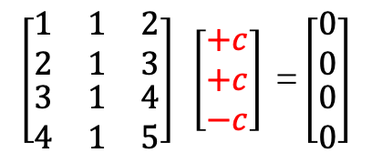
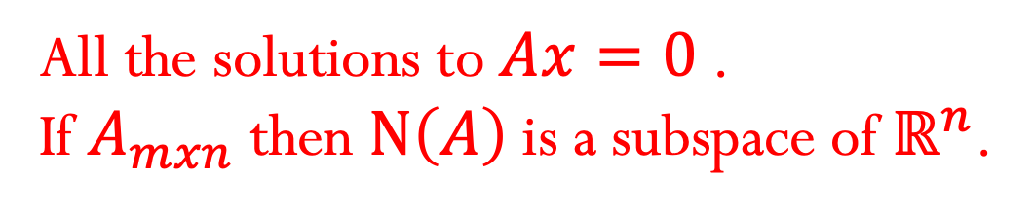
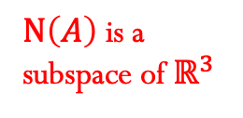

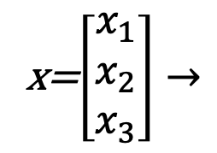
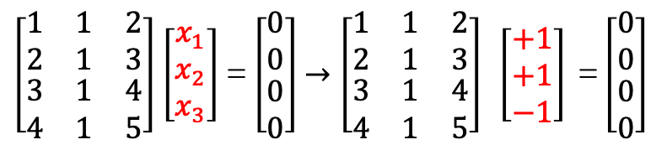
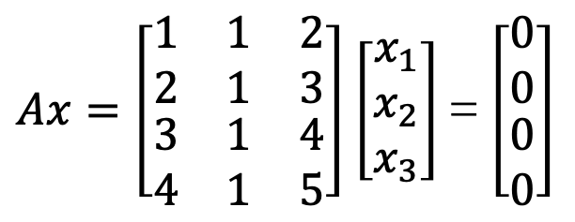
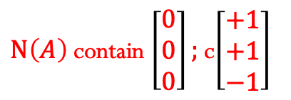
Nullspace of A $→N\left(A\right)$.
x=$\left[\begin{matrix}x_{1} \\ x_{2} \\ x_{3}\end{matrix}\right]→$
All the solutions to $Ax=0$.
If $A_{mxn}$ then $N\left(A\right)$ is a subspace of $ℝ^{n}$.
$N\left(A\right)$ is a subspace of $ℝ^{3}$
$Ax=\left[\begin{matrix}\begin{matrix}1 & 1 & 2\end{matrix} \\ \begin{matrix}2 & 1 & 3\end{matrix} \\ \begin{matrix}\begin{matrix}3 & 1 & 4\end{matrix} \\ \begin{matrix}4 & 1 & 5\end{matrix}\end{matrix}\end{matrix}\right]$ $\left[\begin{matrix}x_{1} \\ x_{2} \\ x_{3}\end{matrix}\right]$= $\left[\begin{matrix}0 \\ 0 \\ \begin{matrix}0 \\ 0\end{matrix}\end{matrix}\right]$
$N\left(A\right)$ contain $\left[\begin{matrix}0 \\ 0 \\ 0\end{matrix}\right];$ c$\left[\begin{matrix}+1 \\ +1 \\ −1\end{matrix}\right]$
$\left[\begin{matrix}\begin{matrix}1 & 1 & 2\end{matrix} \\ \begin{matrix}2 & 1 & 3\end{matrix} \\ \begin{matrix}\begin{matrix}3 & 1 & 4\end{matrix} \\ \begin{matrix}4 & 1 & 5\end{matrix}\end{matrix}\end{matrix}\right]$ $\left[\begin{matrix}x_{1} \\ x_{2} \\ x_{3}\end{matrix}\right]$= $\left[\begin{matrix}0 \\ 0 \\ \begin{matrix}0 \\ 0\end{matrix}\end{matrix}\right]$ $→\left[\begin{matrix}\begin{matrix}1 & 1 & 2\end{matrix} \\ \begin{matrix}2 & 1 & 3\end{matrix} \\ \begin{matrix}\begin{matrix}3 & 1 & 4\end{matrix} \\ \begin{matrix}4 & 1 & 5\end{matrix}\end{matrix}\end{matrix}\right] \left[\begin{matrix}+1 \\ +1 \\ −1\end{matrix}\right] \text{=}\left[\begin{matrix}0 \\ 0 \\ \begin{matrix}0 \\ 0\end{matrix}\end{matrix}\right]$
$$\left[\begin{matrix}\begin{matrix}1 & 1 & 2\end{matrix} \\ \begin{matrix}2 & 1 & 3\end{matrix} \\ \begin{matrix}\begin{matrix}3 & 1 & 4\end{matrix} \\ \begin{matrix}4 & 1 & 5\end{matrix}\end{matrix}\end{matrix}\right] \left[\begin{matrix}+c \\ +c \\ −c\end{matrix}\right] \text{=}\left[\begin{matrix}0 \\ 0 \\ \begin{matrix}0 \\ 0\end{matrix}\end{matrix}\right]$$

Slide 7
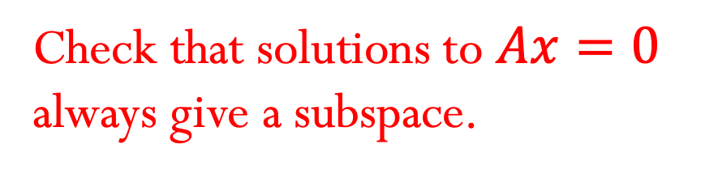
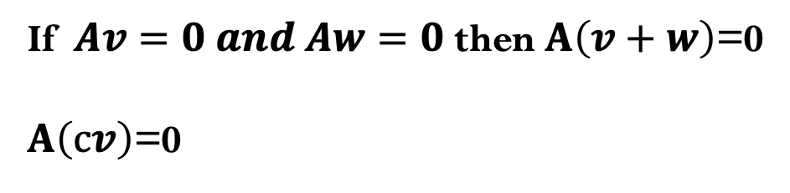
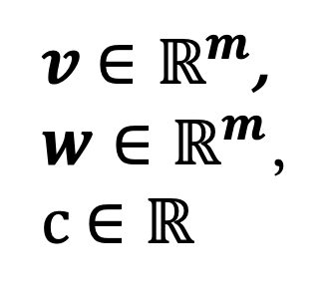
Nullspace of A $→N\left(A\right)$.
$v$ $∈ℝ^{m}$,
$w∈ℝ^{m}$,
c $∈ℝ$
Check that solutions to $Ax=0$
always give a subspace.
If $Av=0 and Aw=0$ then $A\left(v+w\right)$=0
$A\left(cv\right)$=0

Slide 8
Credits
Ariel Guerrero
Lic. Electrónica
ariel.guerrero@uc.edu.py
(+595) 981-425 040
Hernandarias – Paraguay
@2020
Attribution-NonCommercial-ShareAlike 4.0 International (CC BY-NC-SA 4.0)
GitHub
https://github.com/aegiloru/linearAlgebra
Lec 06 –MIT 18.06
https://www.youtube.com/watch?time_continue=12&v=8o5Cmfpeo6g
MIT 18.06
https://ocw.mit.edu/courses/mathematics/18-06-linear-algebra-spring-2010/
Prof. Gilbert Strang
http://www-math.mit.edu/~gs/

