Slide 1
Aegir Ecology vs Drupal Gardens
Aegir Project ecosystem vs Acquia's Drupal 7 hosted OpenSAAS

Slide 2
Nicholas Roberts
Views, opinions here my own
I stole all the screenshots, without permission
I do not work for Aegir, PageBuild, Acquia (or anyone)
Australian student in Bay Area, 10+ years in web
Just did OpenScholar and D6 project at Merritt College
R&D a site-network sustainabilty launch on Aegir in late-Summer
nicholas@themediasociety.org
Drupal d.o, g.d.o & aegir community: user niccolo

Slide 3
Aegir Ecology vs Drupal Gardens
Aegir Project
  Hostmaster
  Provision
  Drush
  Platforms
    Upload D6, D7, distro's etc
  Unix
Love
Service Providers
  Koumbit, Omega8cc
  PageBuild.net
Drupal Gardens
  Drupal 7
OpenSAAS
  No Lock-In
  Export site
  Upsell to Acquia Hosting
Proprietary, closed source hosting platform
Rackspace

Slide 4
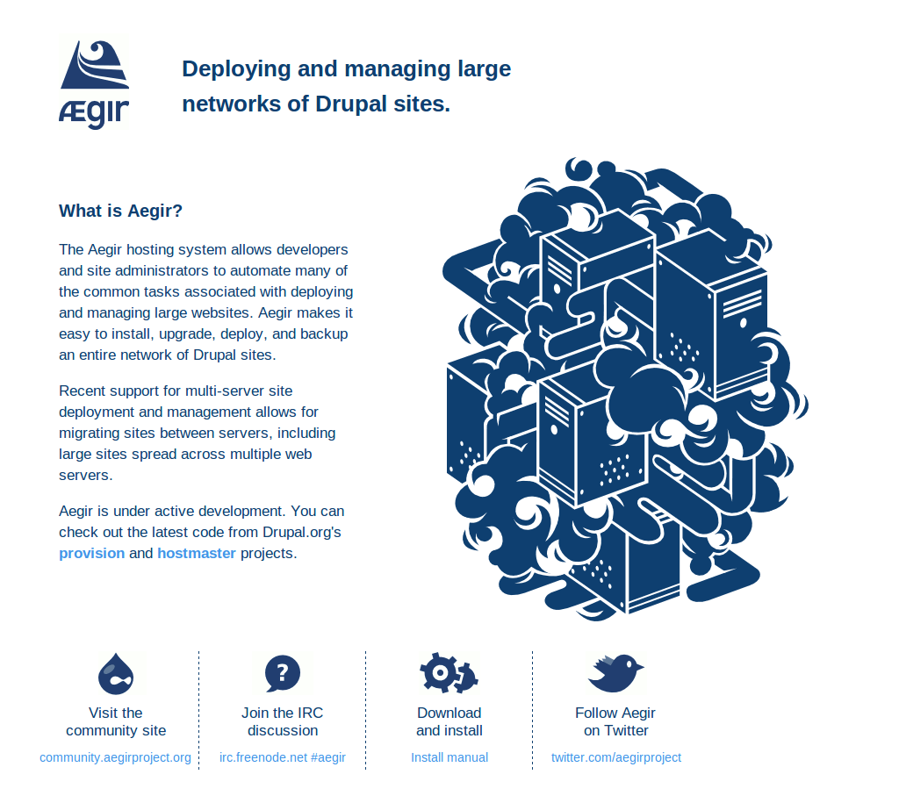
Aegir Project

Slide 5
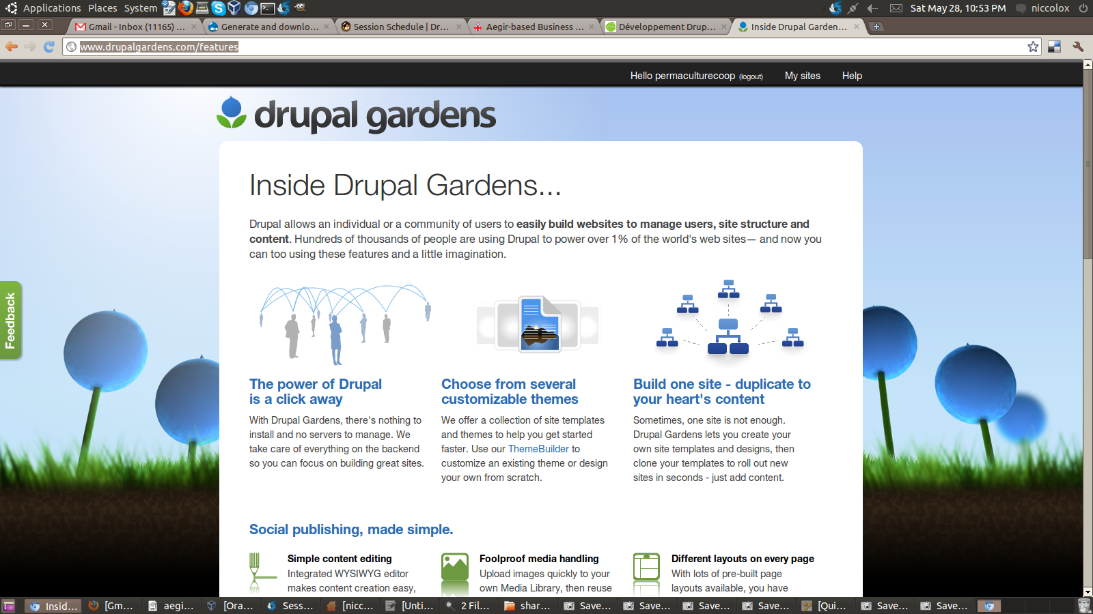
Drupal Gardens

Slide 6
Aegir

Slide 7
Aegir Project URI
Http://Www.AegirProject.org - home
Http://community.aegirproject.org - community & documentation
Provision
Hostmaster

Slide 8
Aegir Project Nutshell
Aegir is hostmaster + provision (+Drush)
Aegir is under active development. You can check out the latest code from Drupal.org's provision and hostmaster projects.
Aegir v 1.1 production release

Slide 9
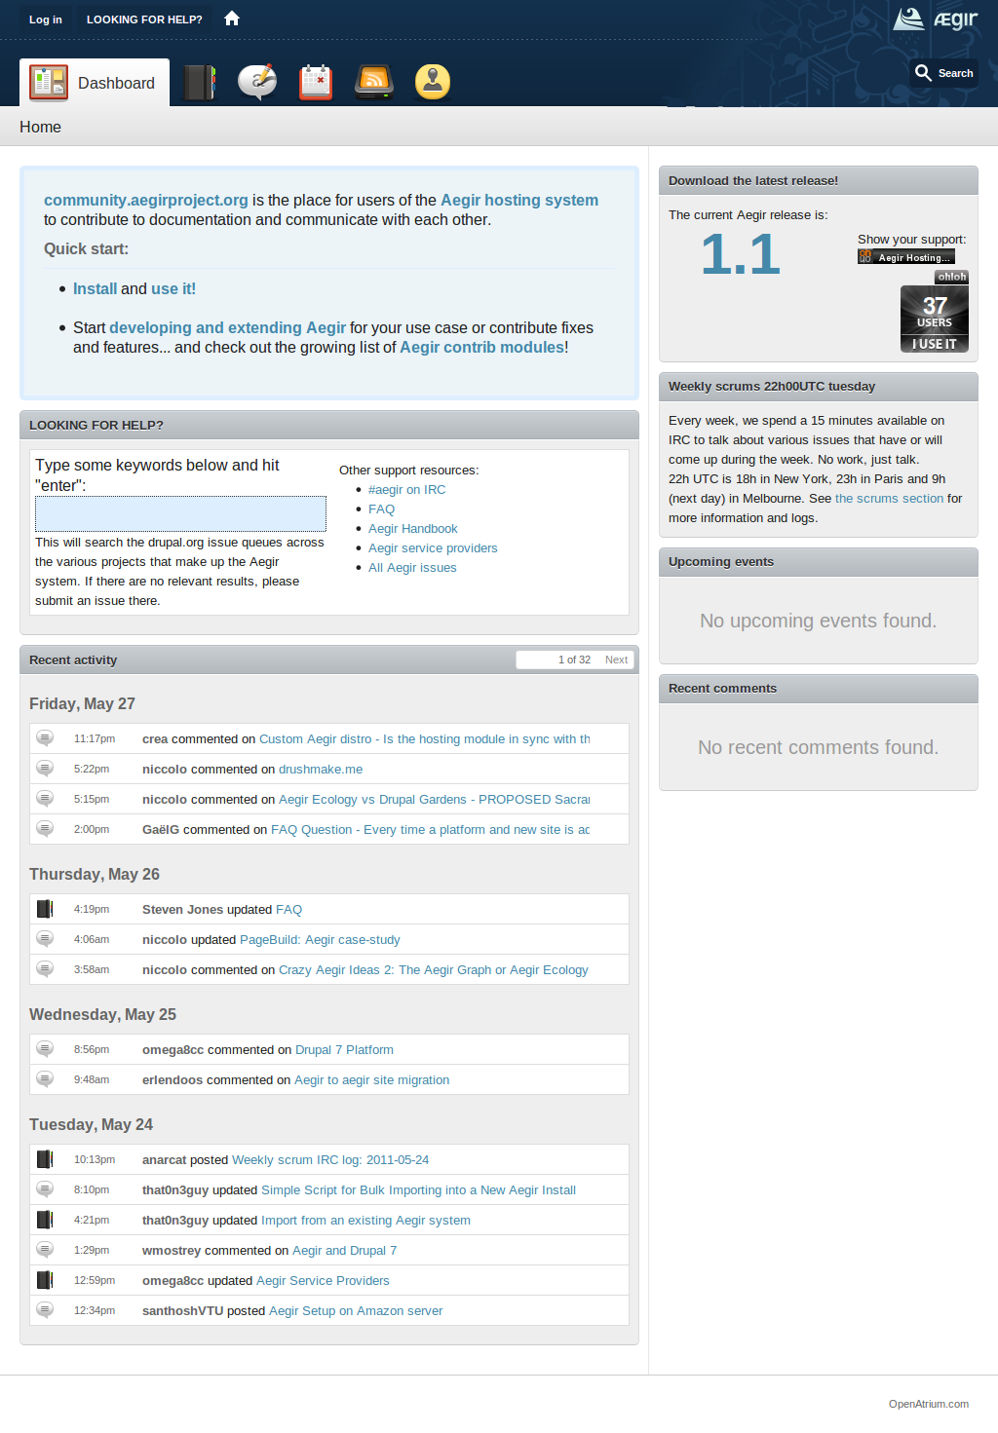
Aegir Community

Slide 10
Aegir Platforms
Common distro's
  Drupal 6.20 & 7.0
  Acquia 6 & 7
  OpenAtrium
  Drupal Commons
  OpenScholar
  OpenPublic
  ManagingNews
  COD
Other distro's
  OpenPublish
  NodeStream
  ProsePoint
  Voicebox
  UberDrupal
  OpenOutreach
  OpenAcademy

Slide 11
Aegir-based possibilities
Open, Free, Libre code-base already running 1000s of websites
SaaS – Software as a Service
PaaS – Platform as a Service
IaaS – Infrastructure as a Service

Slide 12
Aegir Installation
Production-ready v 1.1
.deb Debian packages apt-get install aegir *
Manual install ~15 minutes
Apache or Nginx
Ubuntu, Debian, CentOS (Linux/Unix)
http://community.aegirproject.org/installing
*requires add to Koumbit repositories

Slide 13
Aegir Issues
Future of Drupal distributions
Platforms vs products
Features vs Apps
Industry support for Aegir ecosystem

Slide 14
Aegir Contrib
Hostmaster (front-end)
Aegir Ubercart integration
Aegir feeds
Hosting queue
Hosting back-up
Hosting Platforms Roles
Hosting Upload
Services API Support
Provision (back-end)
Provision Boost
Provision ACL
Project Status
Provision CiviCRM
Themes
Eldir
Omega8cc install scripts
http://community.aegirproject.org/contrib-modules

Slide 15
Aegir Crazy Ideas
Aegir graph
Aegir model
Aegir site networks
Aegir platform maker
Aegir single sign-on
Aegir pattern language
Aegir Kit Specification for site networks
Aegir federation and nesting sites

Slide 16
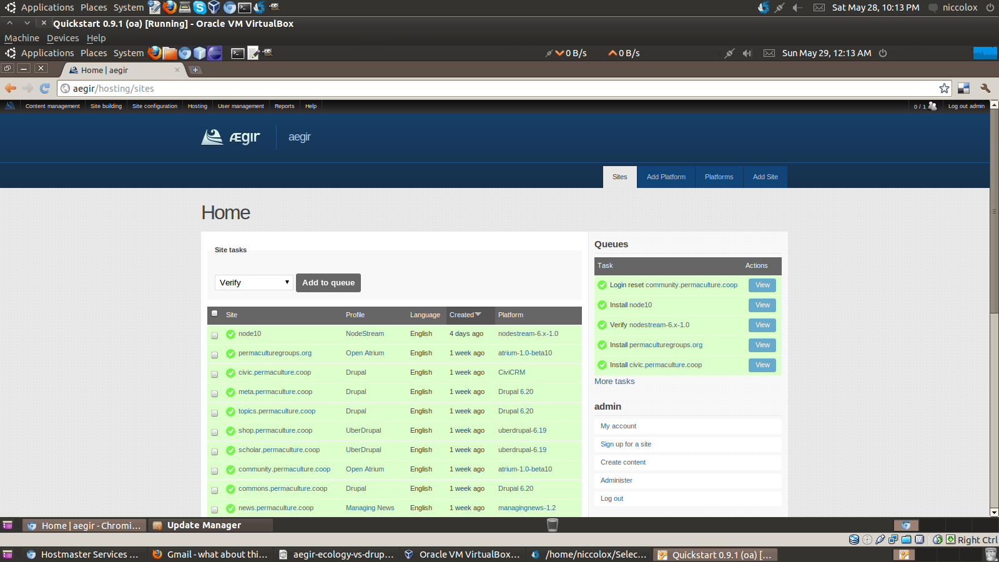
Aegir UI - Home

Slide 17
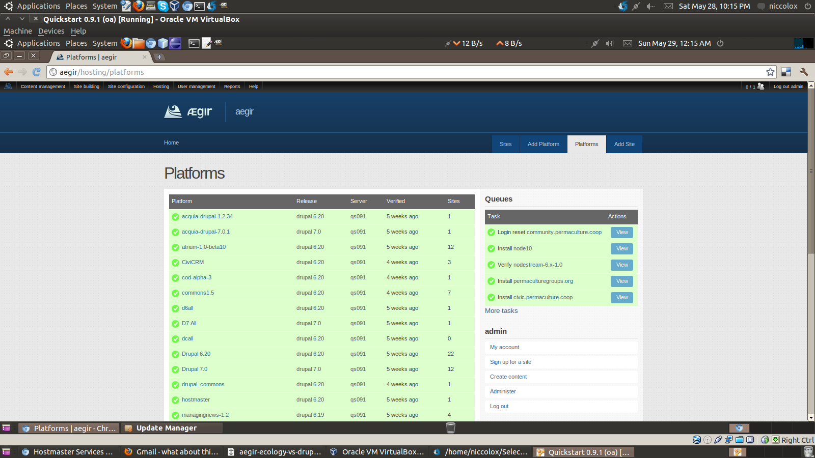
Aegir UI - Platforms

Slide 18
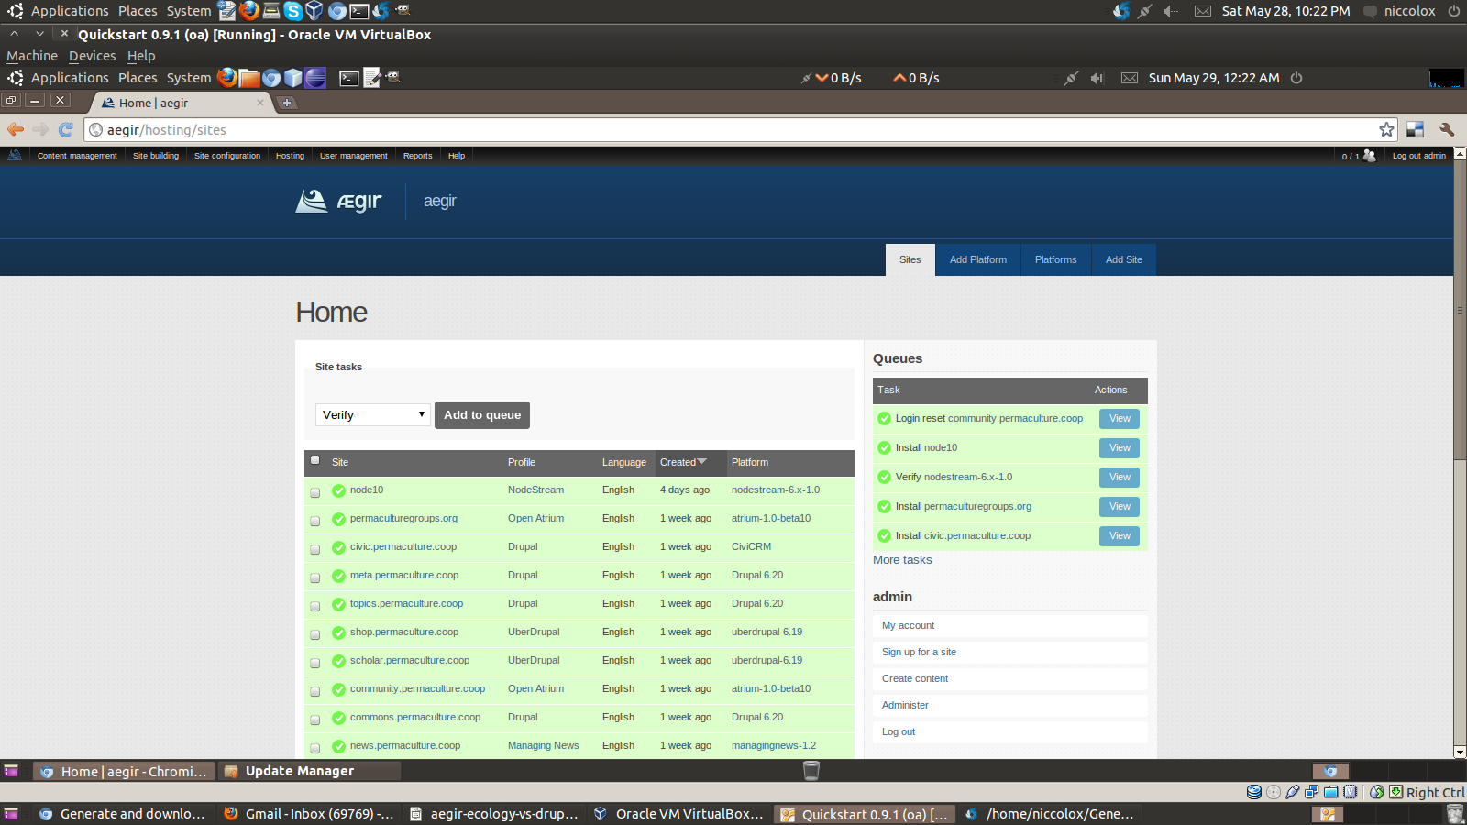
Aegir UI - Sites

Slide 19
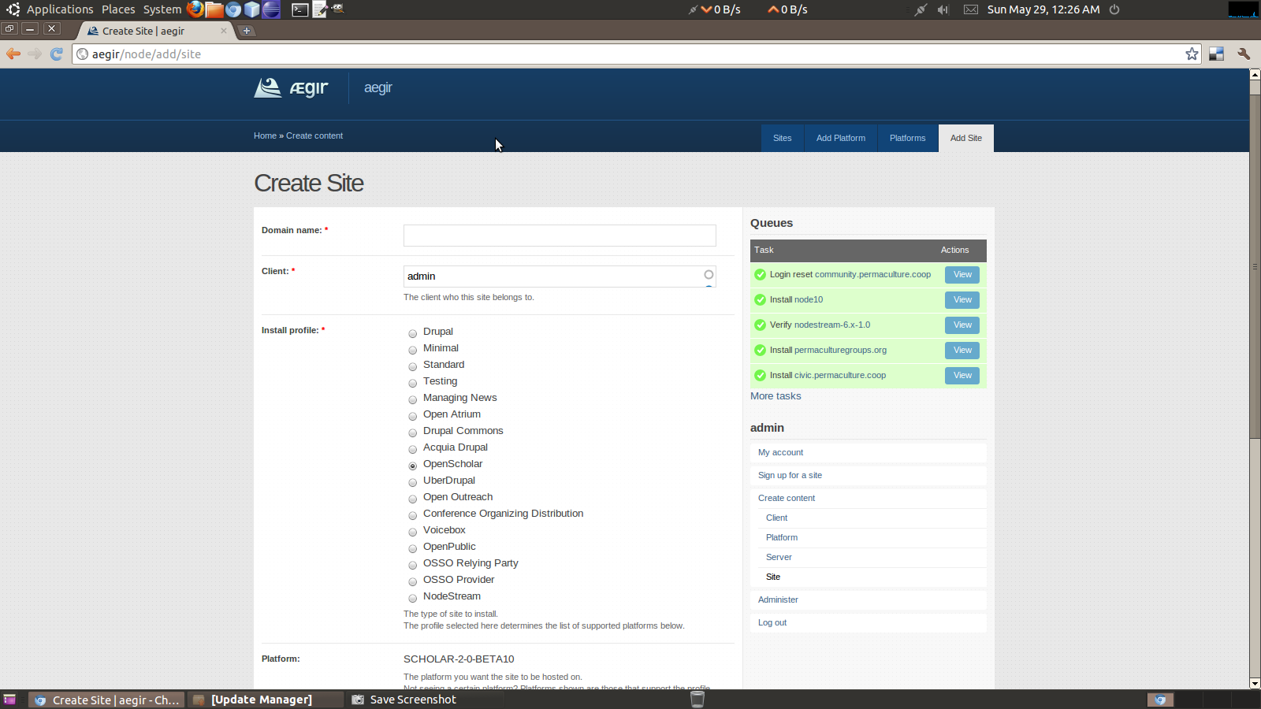
Aegir UI – Add Site

Slide 20
Aegir + ?
Aegir is only part of the story
You need a platform i.e. Drupal or OpenAtrium or Nodestream

Slide 21
PageBuild.net: Aegir-based
Aegir + Drupal 7
4000 sites
Software as a Service
Case-study http://drupal.org/node/993166

Slide 22

Aegir-based: PageBuild.net

Slide 23
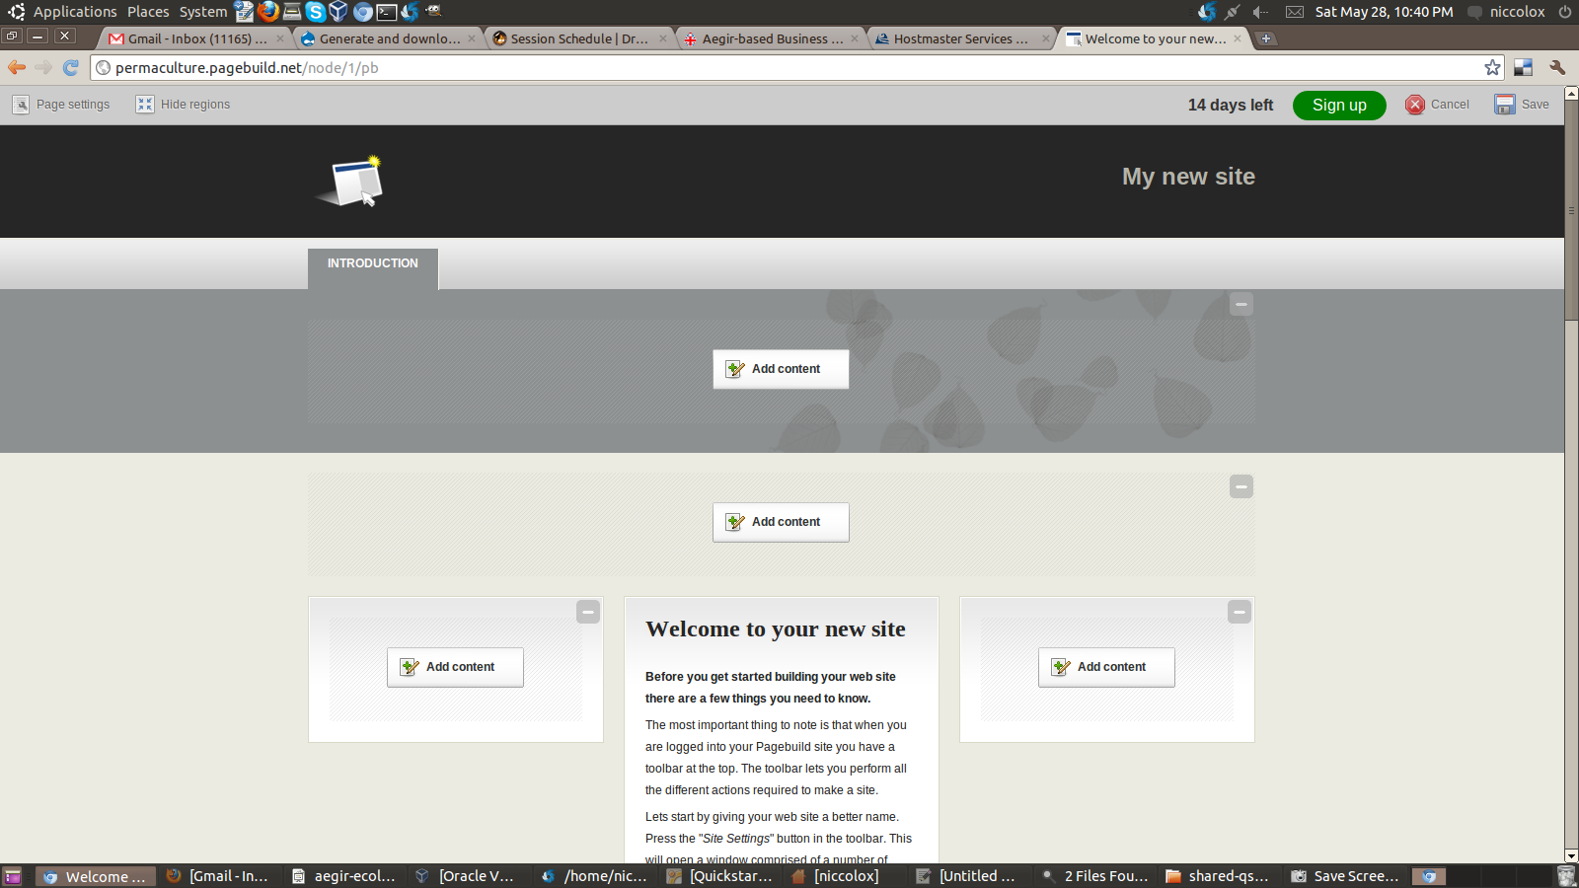
PageBuild: Edit / Show Regions

Slide 24
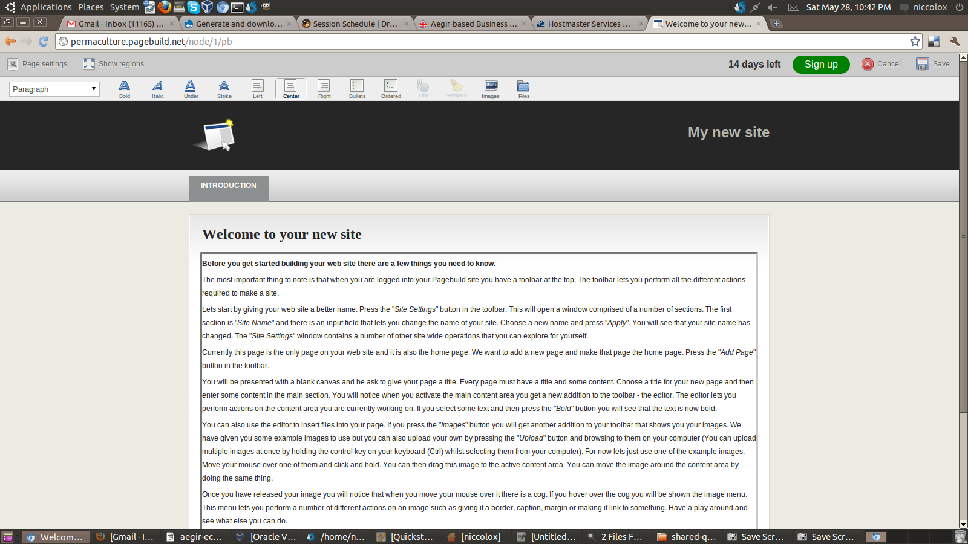
PageBuild: In-Place Edit

Slide 25
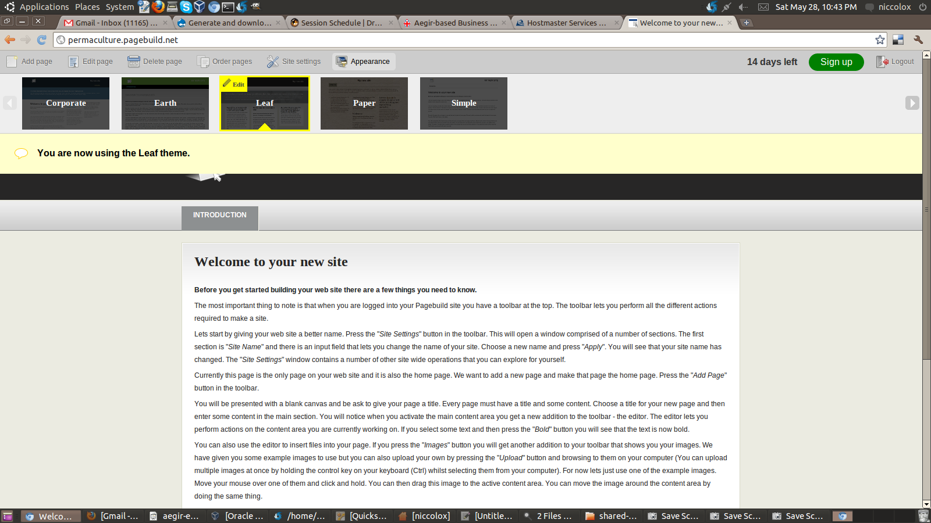
PageBuild: Appearance

Slide 26
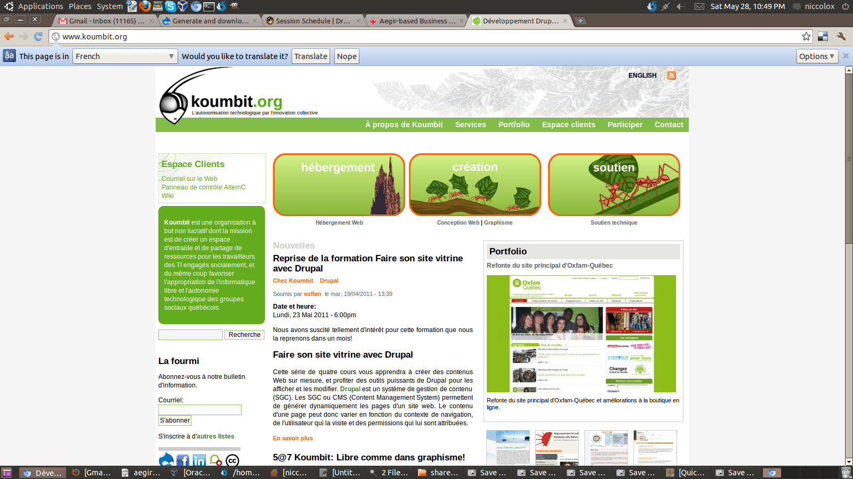
Aegir + Drupal Agency: Koumbit

Slide 27
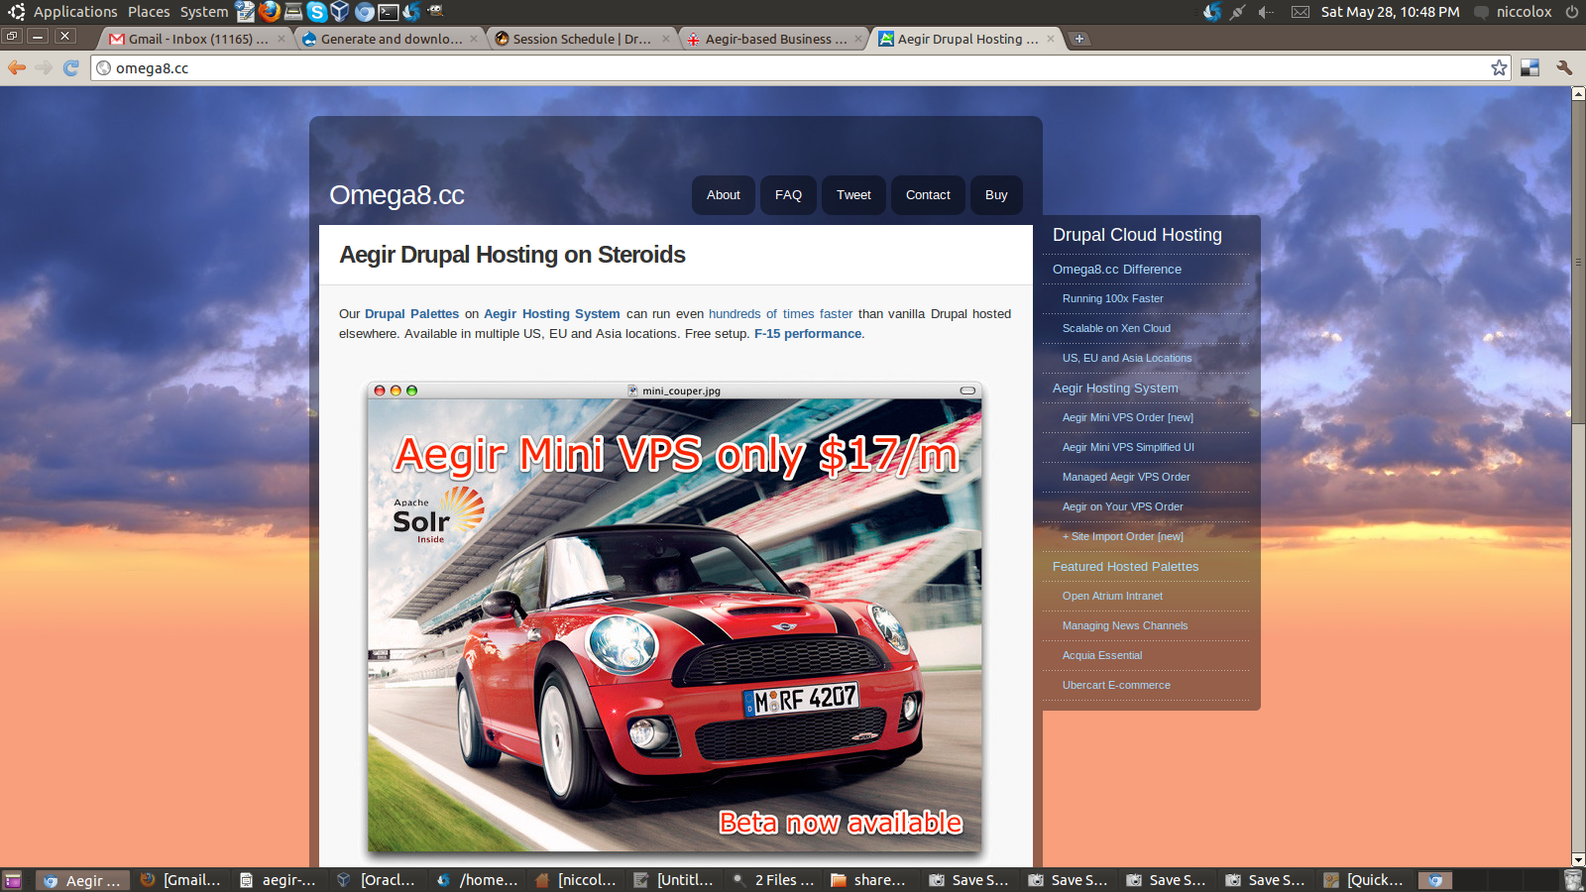
Aegir Hosters: Omega8cc

Slide 28
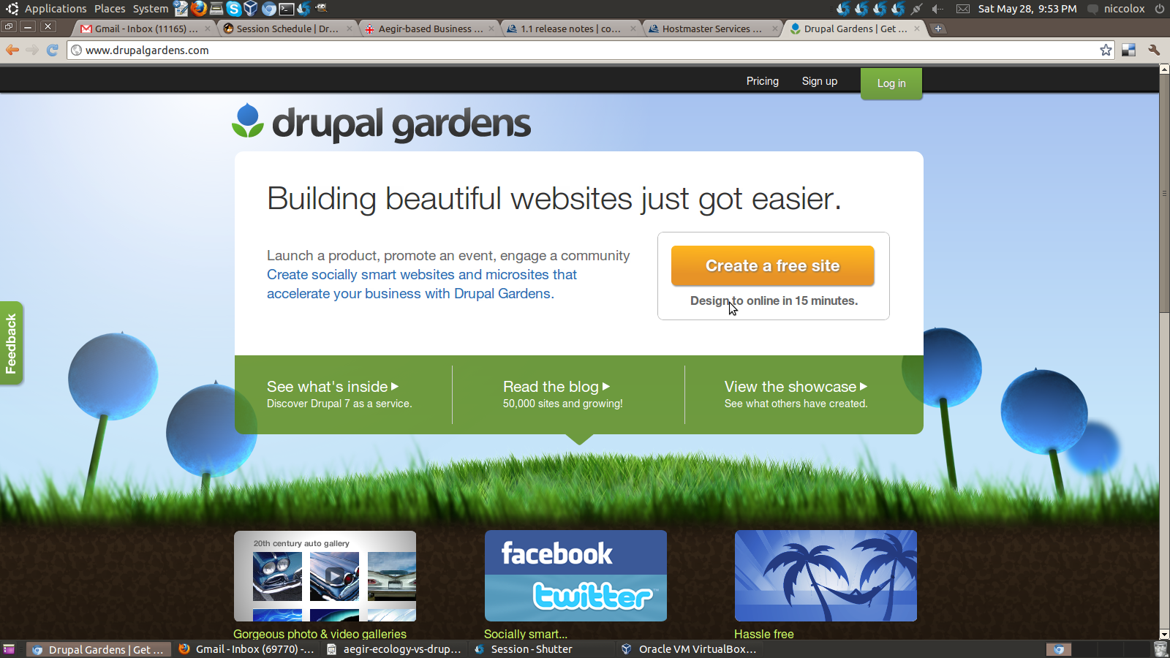
Drupal Gardens

Slide 29
Drupal Gardens
Www.DrupalGardens.com
Drupal 7 SAAS (software as service)

Slide 30
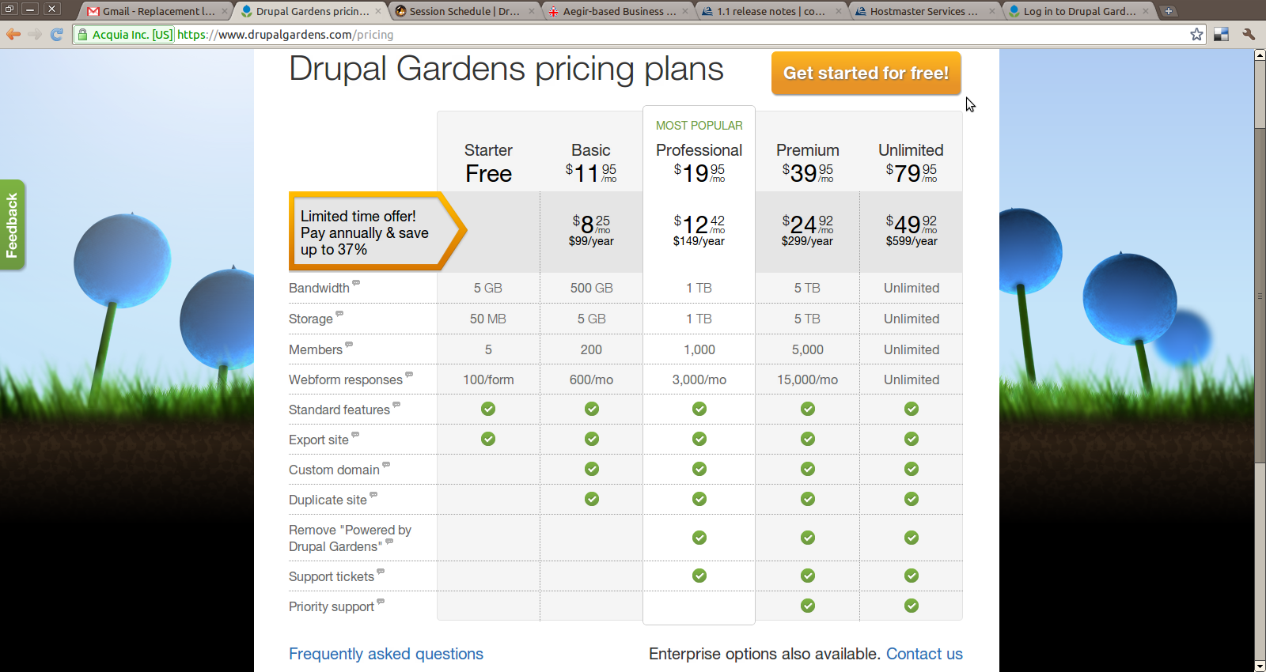
Drupal Gardens Pricing Plans
https://www.drupalgardens.com/pricing

Slide 31
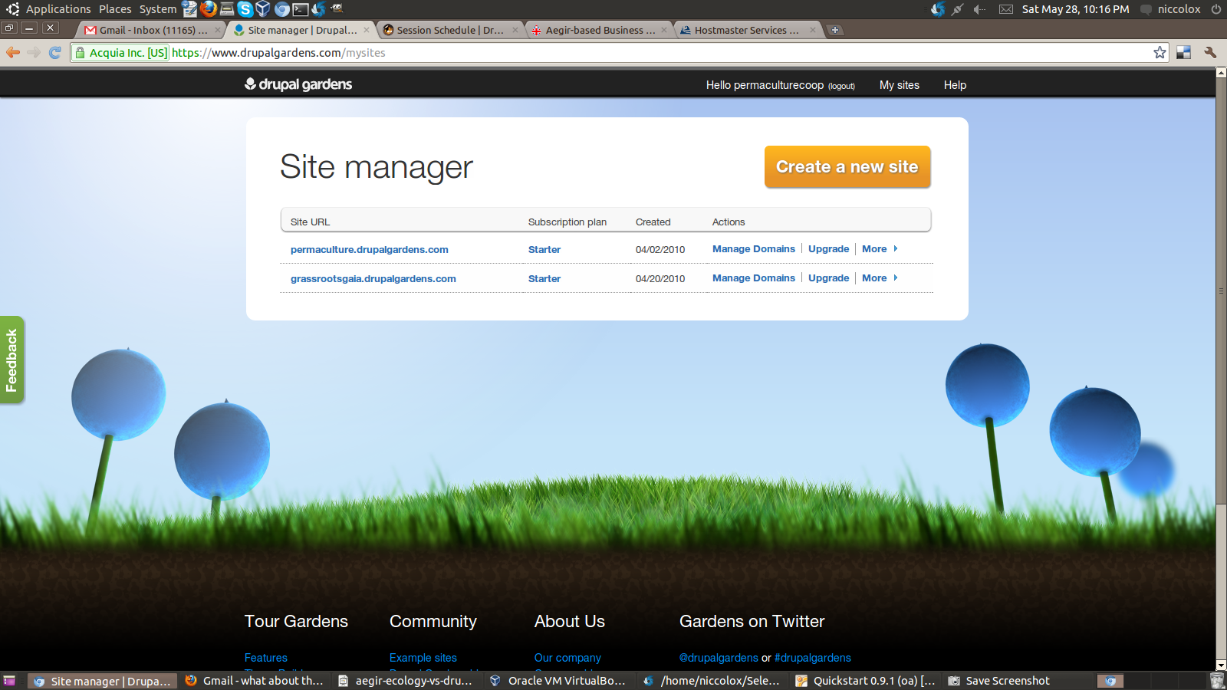
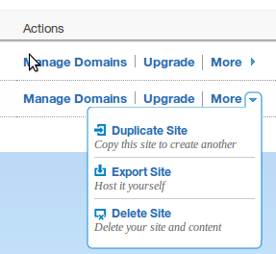
Drupal Gardens Site Manager

Slide 32
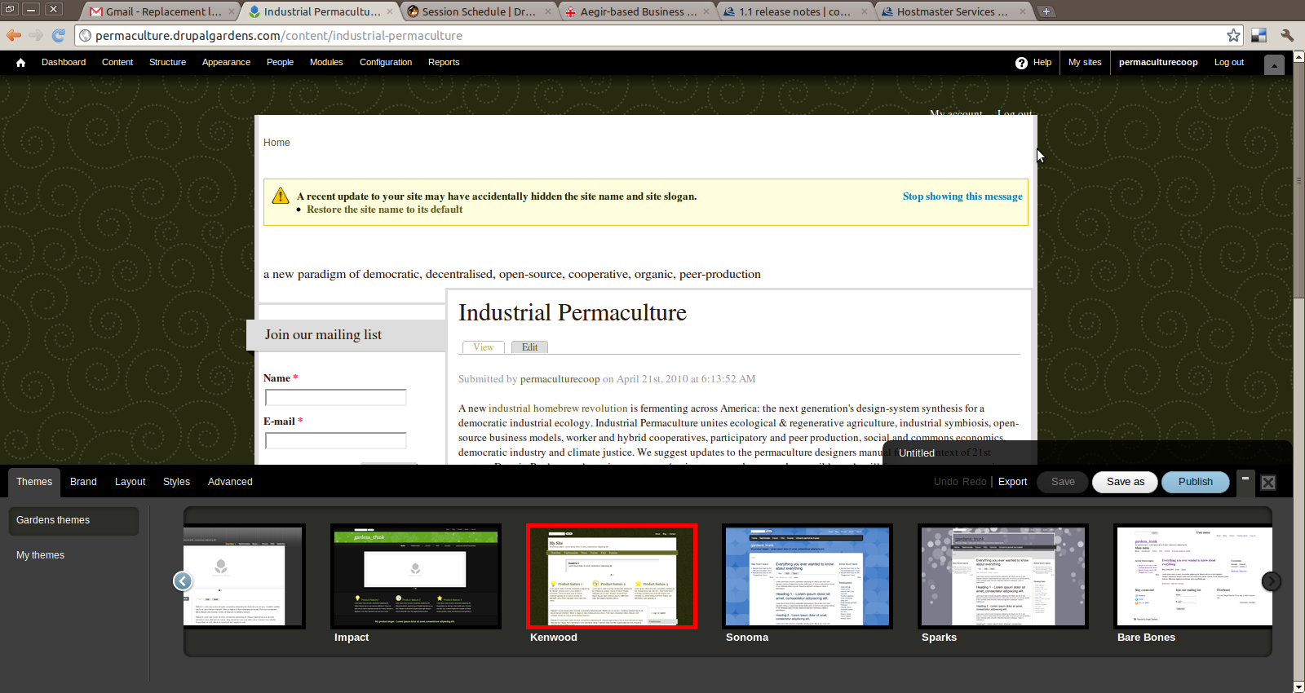
Drupal Gardens Theme Builder 1

Slide 33
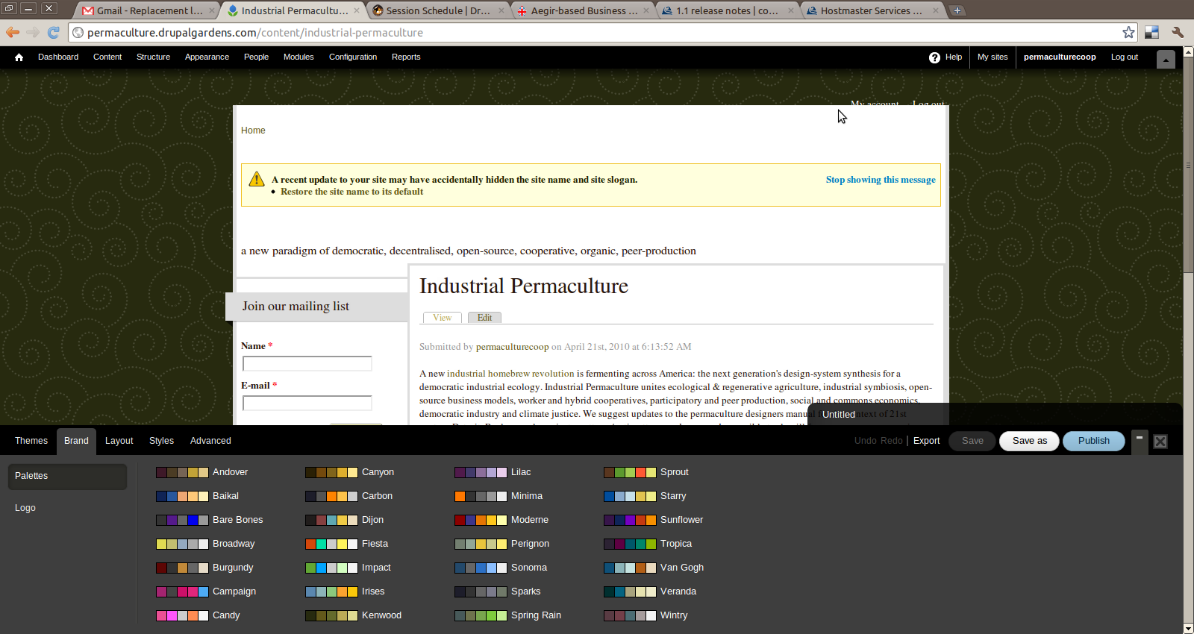
Drupal Gardens Theme Builder 2

Slide 34
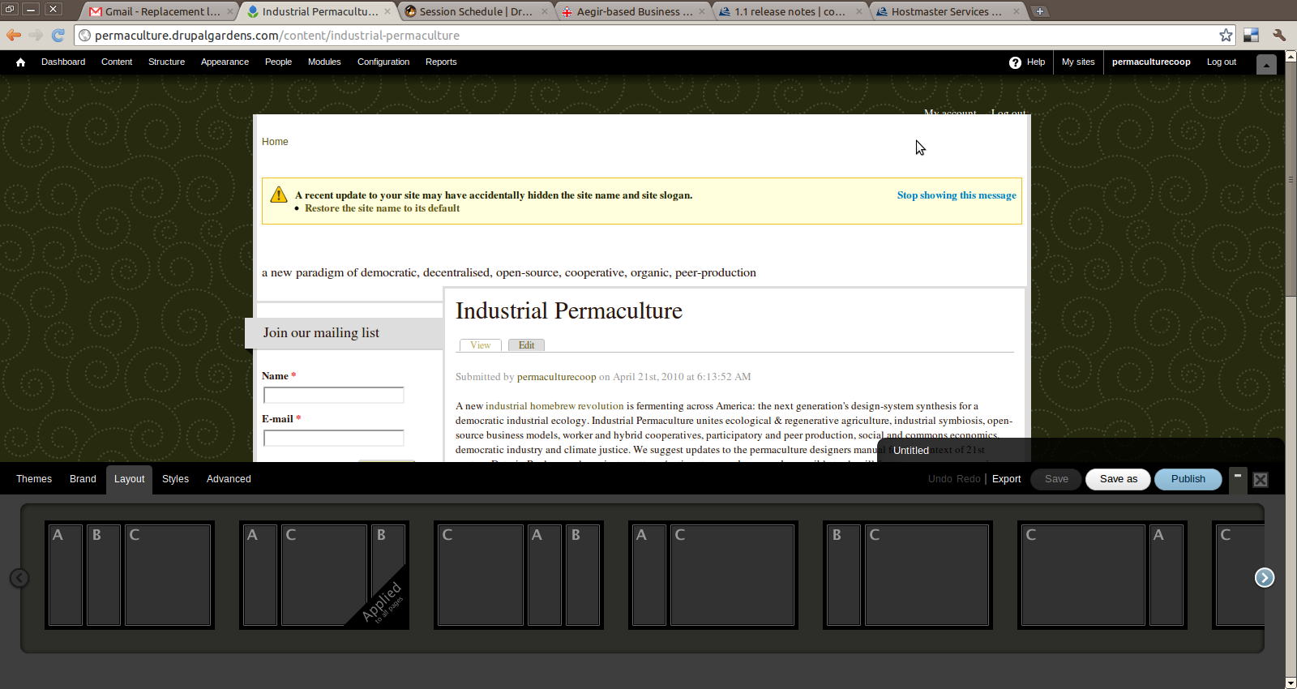
Drupal Gardens Theme Builder 3

Slide 35
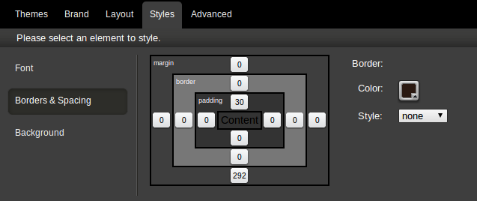

Drupal Gardens Theme Builder 4

Slide 36
Aegir Ecology vs Drupal Gardens
Aegir Project is fair trade, organic, shade grown, biodynamic, no animal testing
Aegir can be homebrew (self-hosted)
Aegir Project is community
Aegir creates your own Drupal Ecology i.e. PageBuild.net
Drupal Gardens is Rackspace + Acquia Team
Drupal Gardens is always there
Drupal Gardens is keystone

